Slide 1
Machine Learning and Kubernetes
Fedor Kitashov
Supervisor: Ricardo Rocha

Slide 2
Plan
Simulations using GANs
Why we need GPUs
Docker and Kubernetes

Slide 3
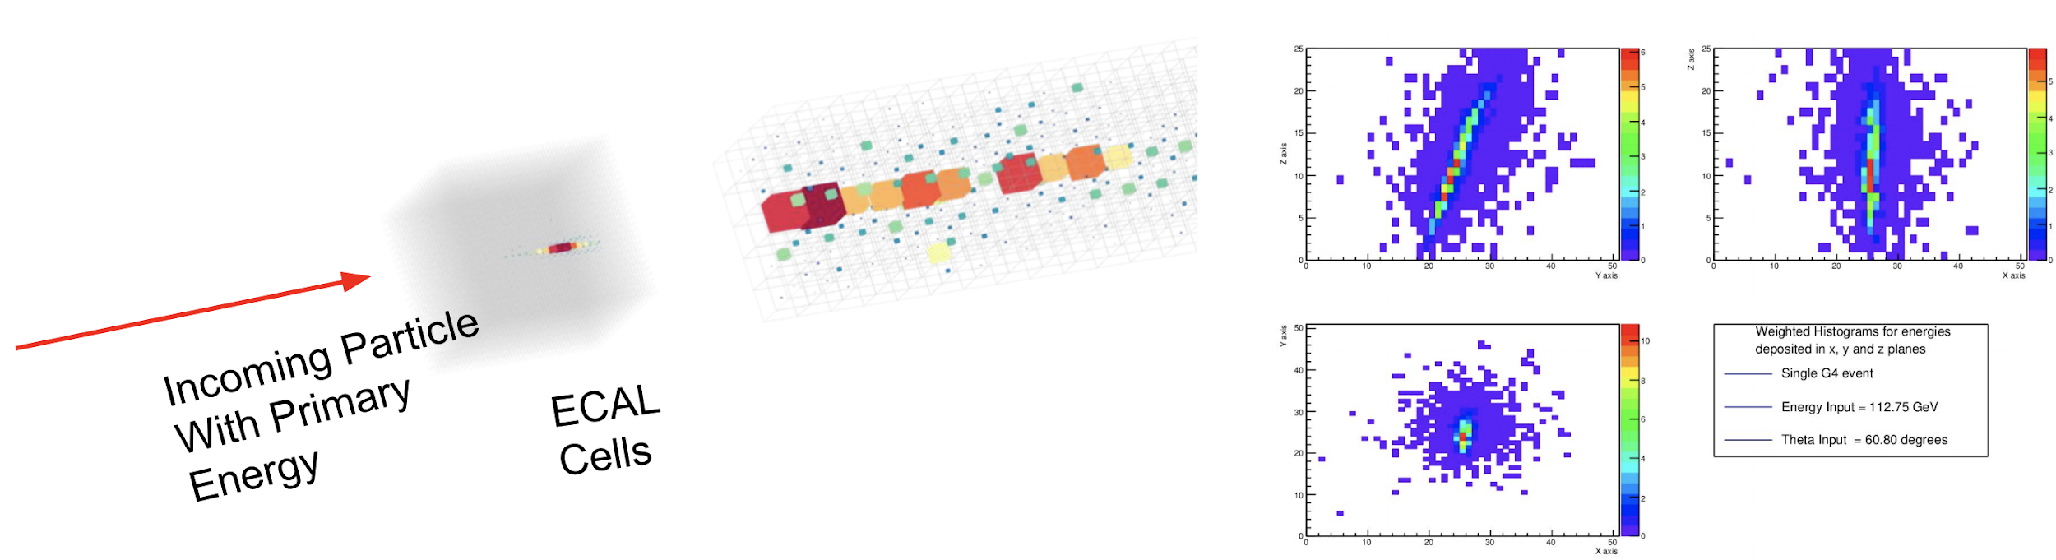
CLIC Calorimeter simulation

Slide 4
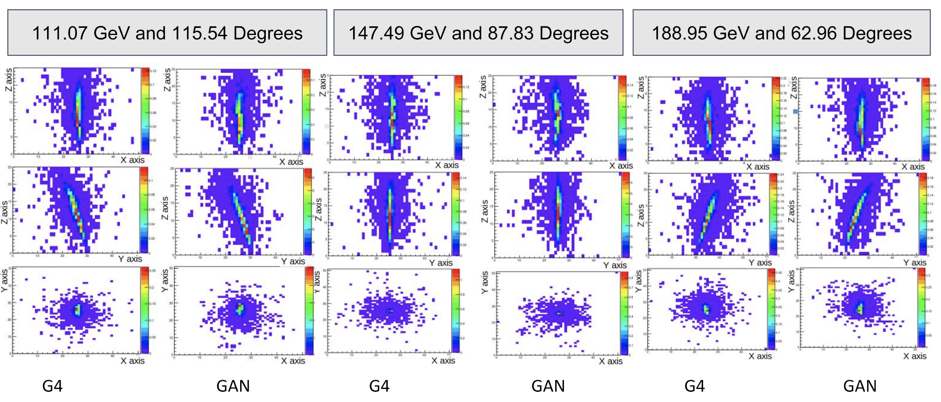
G4 vs 3D GAN

Slide 5
G4 vs 3D GAN

Slide 6
G4 vs 3D GAN

Slide 7
G4 vs 3D GAN

Slide 8
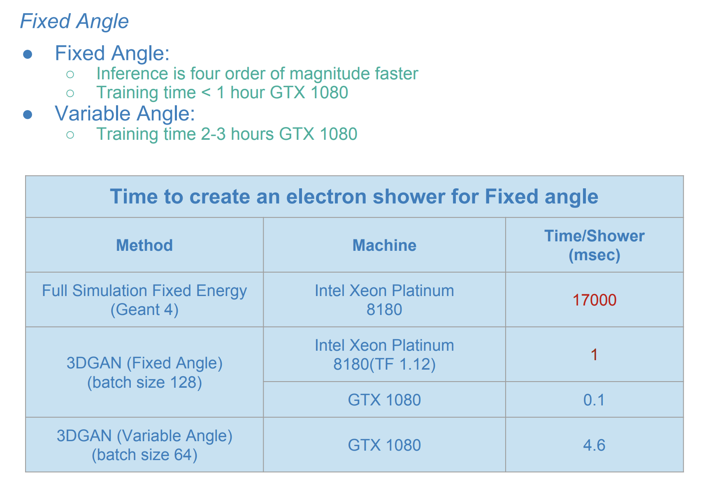
Timing

Slide 9
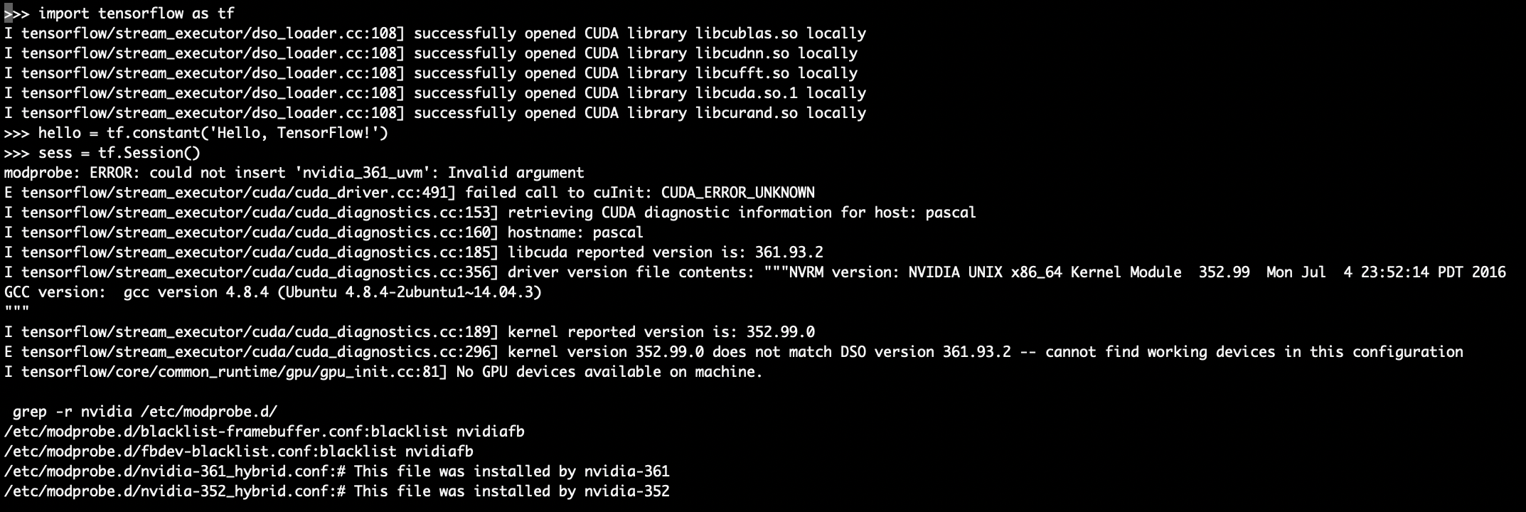
Dependencies are painful sometimes

Slide 10
What is Docker and why you need it

Slide 11
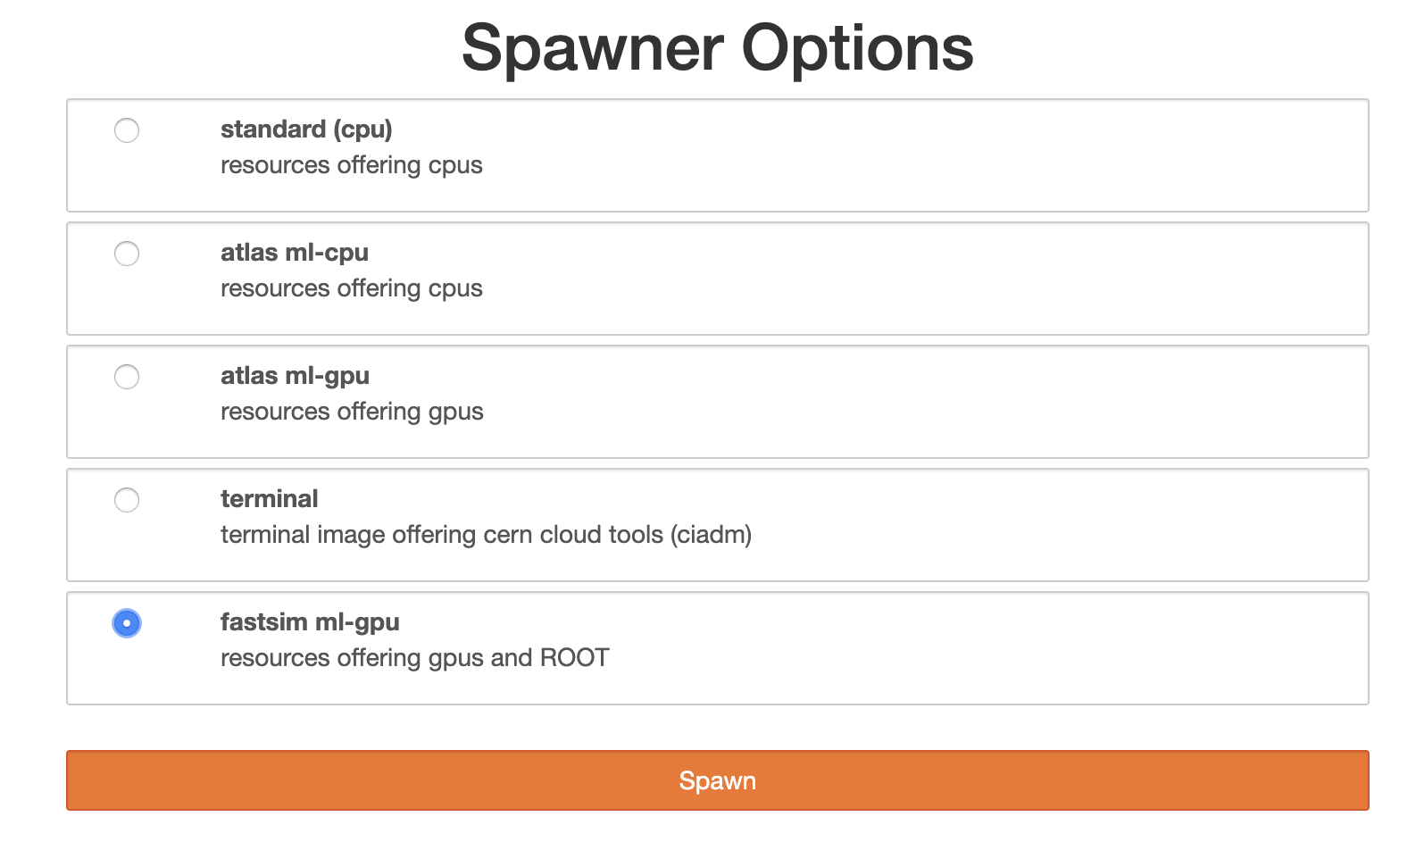
JupyterHub

Slide 12
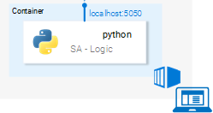
Dockerized application

Slide 13
Kubeflow
Main node

Slide 14
Contribution and Future Work
We created a reliable Docker image with ROOT and GPU-powered Tensorflow
We tested simulations on a single GPU
We are working towards using Kubeflow to make experiments more stable and scalable

Slide 15

Thank you!
fedor.kitashov@phystech.edu

