Slide 1

Potential improvements for the Gas Jet 2D mapping using the Moving Gauge
Robert Kieffer
rkieffer@cern.ch
BGC Meeting 21 June 2019

Slide 2
Overview
Actual situation
Precision of the multi-axis actuator positioning
Speed and acceleration of the stepper motor
Precision of the moving gauge and digitization
Reaching higher pressure in the jet.

Slide 3
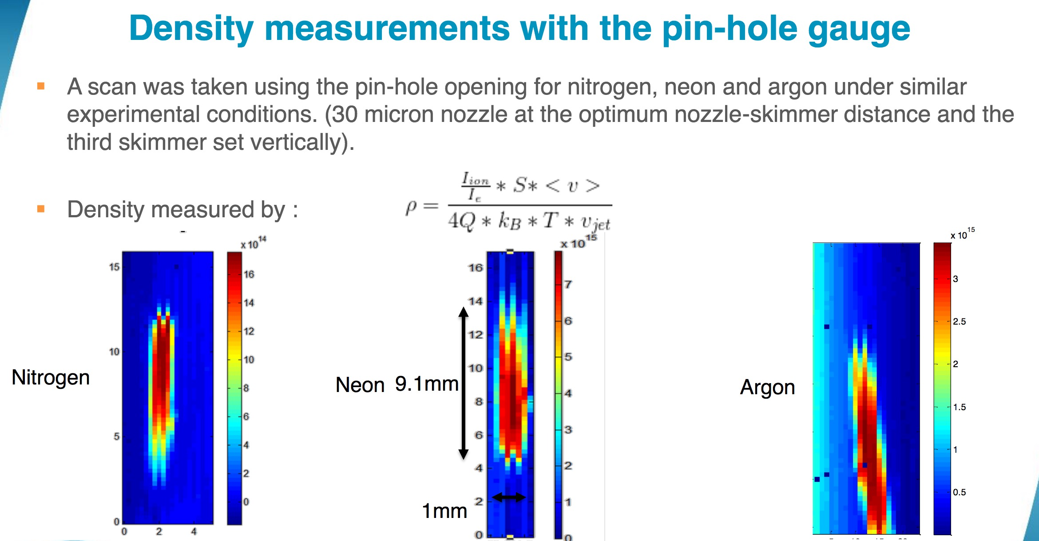
Data presented on the BGC workshop by Amir
Backlash or Gauge inertia effect ?
How to improve on this measurement technique?
Spatial position of the gauge / Resolution of Gauge

Slide 4
Multi-Axis Actuator bottleneck
I have been extensively using the exact same actuator to move a 50um ODR slit target with respect to a 1um electron beam in ATF2-KEK.
We quickly found a mechanical backlash on this actuator and decided to install magnetic encoders(1um precision) on it to overcome the problem.
Only with this add we where able to move the target repeatedly within micron accuracy.

Slide 5
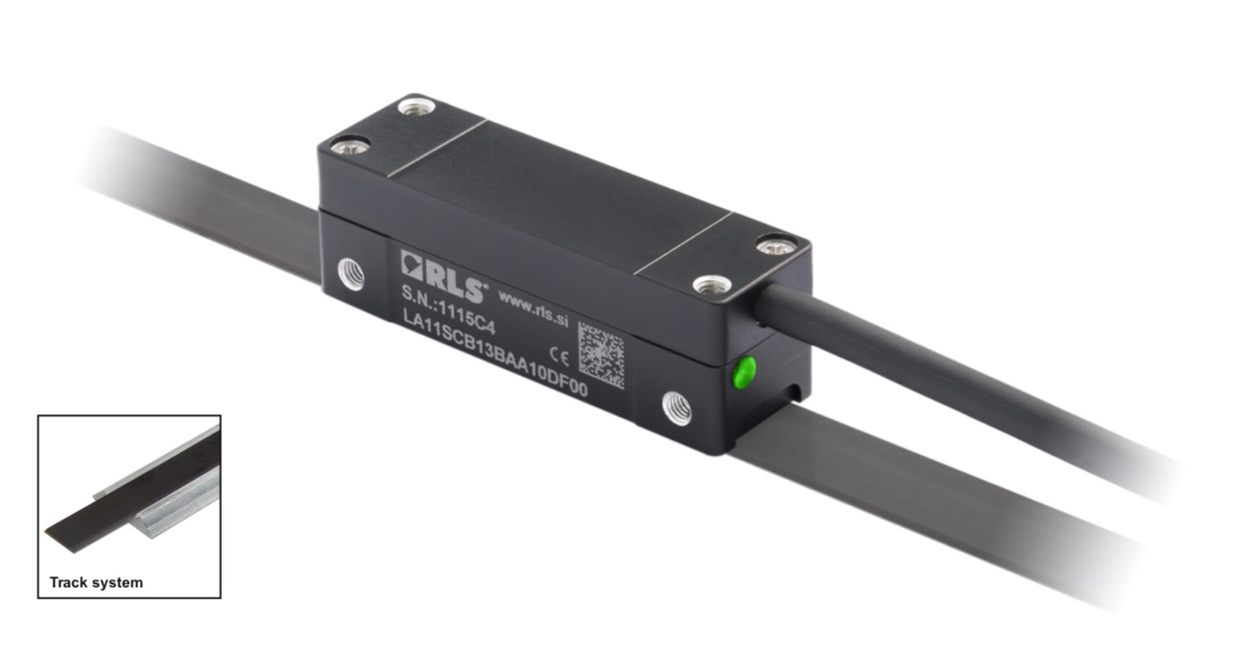
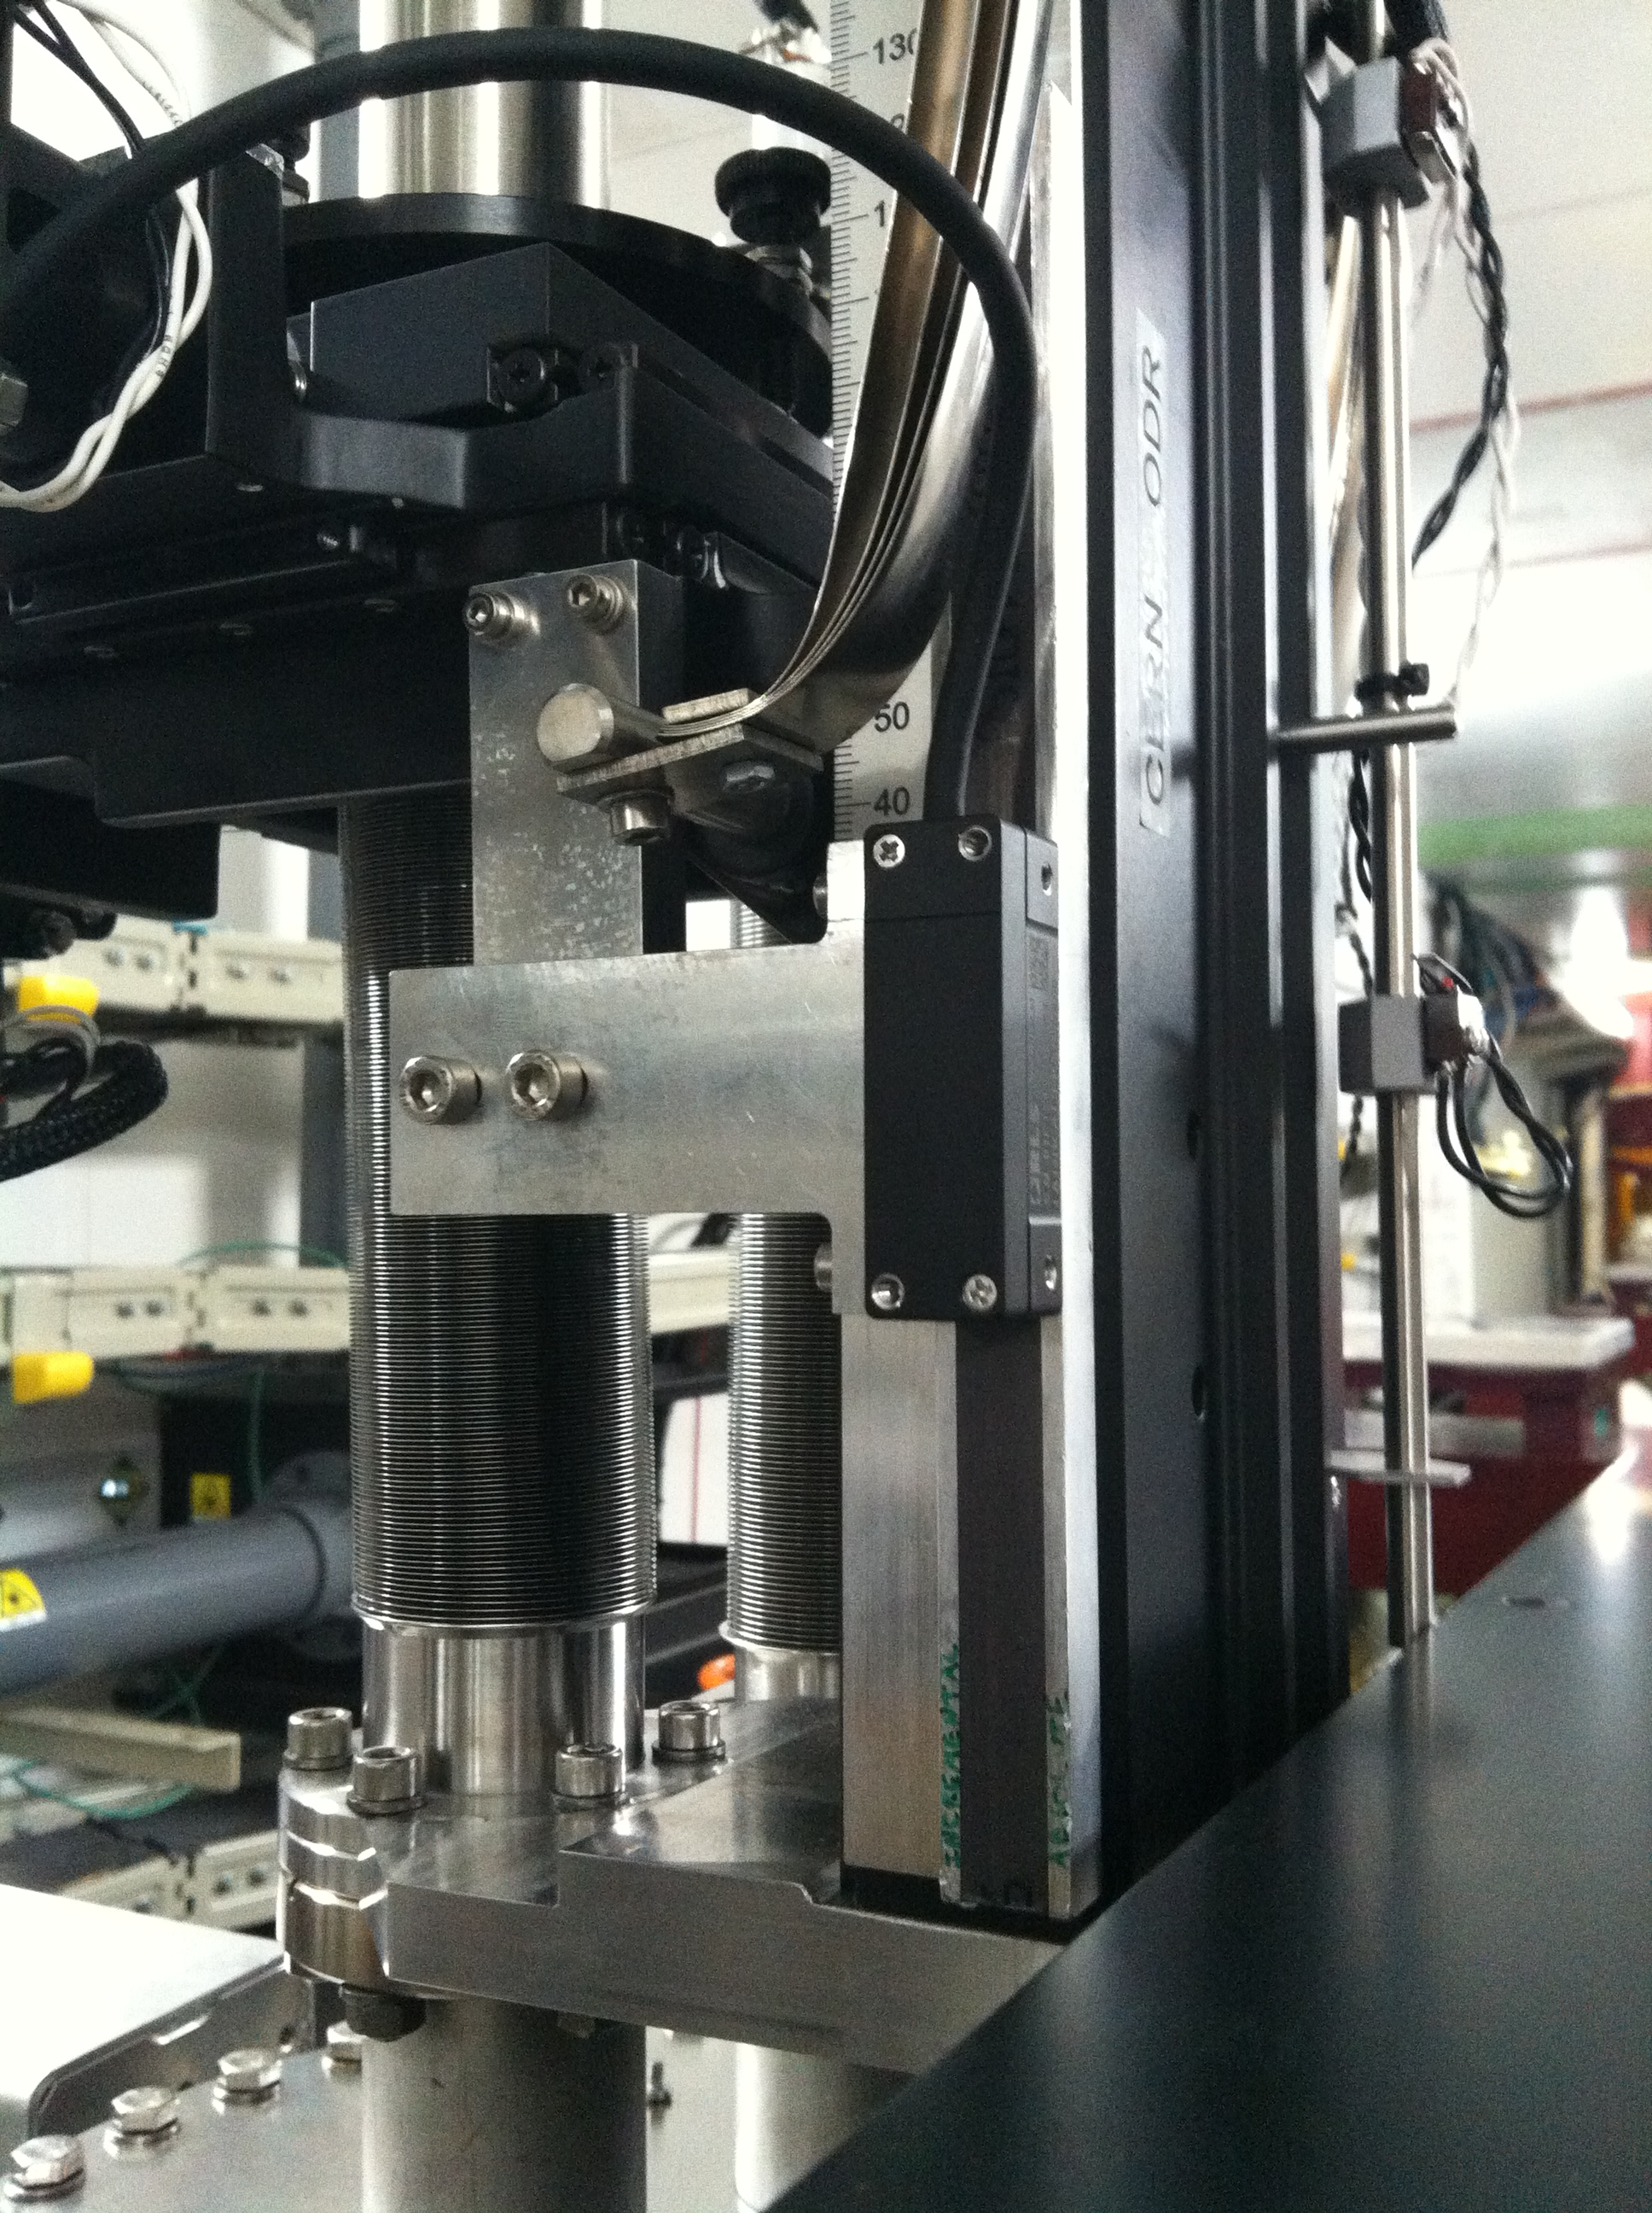
System as installed in ATF on the same mover
Encoder LA11 from Renishaw RLS
Full 1 axis kit with USB encoder costs 650 CHF
Mechanical Support
Magnetic encoder
Magnetic pole strip
For gas jet a 2D axis kit with USB encoder and mechanics : 2000 CHF

Slide 6
Manipulator movement
During the visit in the Cockcroft lab, the actuator have been moved quick to show us the gauge.
Looking by the view port I have noticed a pendulum behavior of the gauge over few millimeter that was few minutes after the move !
Amir told me that he only performs small steps moves to reduce pendulum oscillation during a 2D scan.
That’s helping but I think that a careful control of the stepper acceleration/deceleration would also help to reduce further this oscillation. (High speed small steps can be bad)
A better stiffness of the manipulator mechanics would also help to reduce this great source of uncertainty.

Slide 7
Gauge and digitization of the signal
Few questions from my side
What is the exact gauge model ?
Could the moving gauge volume be smaller?
Does it lead to more fluctuations at the expense of a faster scan capability?
Can we improve on the sensor itself and the system used for signal processing? (I have noticed old equipment with partially broken cable shielding)
If yes: can we gain in map precision if we use a more accurate digitizer for the gauge signal?

Slide 8
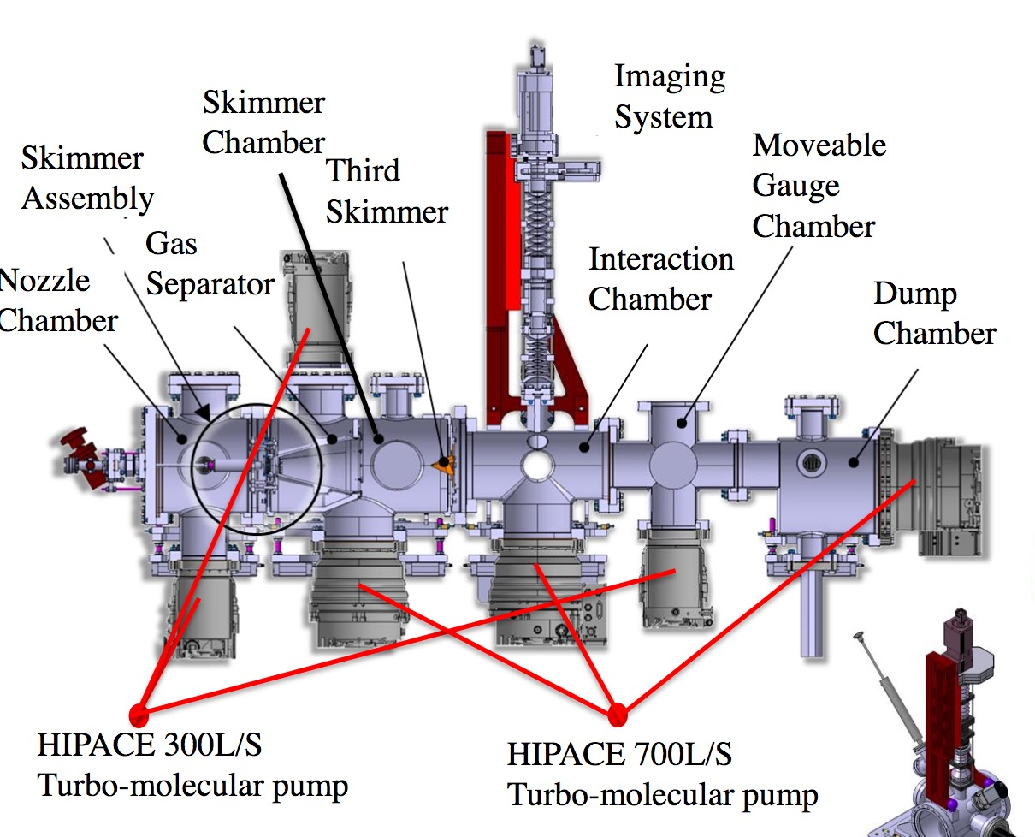
Can we reach higher pressure for the BGV gas jet
First check just after the second skimmer
The idea would be to move the Moveable Gauge Manipulator on the Skimmer Chamber as shown with the blue arrows.

Slide 9
Next actions for the BGV gas jet
The possibility of getting to higher pressure within the jet just after the second skimmer is something essential which could be tested on the actual setup (to be seen when).
A robust and precise measurement of the gas jet pressure profile is a key aspect for the BGV.
As a first step, I could help upgrading the scanning gauge system by purchasing adapted encoders, and using existing software that I developed to read these sensors.

