Slide 1
Offline Shift Training: the shuttle – monitoring and debugging
https://aloshi.cern.ch
19 February 2010
Chiara Zampolli, Jan Fiete Grosse-Oetringhaus

Slide 2
Outline
The Shuttle is the ALICE Online-Offline software framework dedicated to the extraction of conditions data – calibration and alignment – during data taking, running detector specific procedures called preprocessors
Outline:
Monitoring Web Page
How to read the Logs
The History
The Detectors Preprocessors Flow
How to handle Errors
The SHUTTLE Status
The OCDB
Contacts

Slide 3
The Shuttle General Schema
Run
Logbook
ECS
DIM
trigger
DAQ
FXS
FXS DB
SHUTTLE
Archive
DB
TRD
HMP
SPD
TPC
...
DCS
FXS
FXS DB
OCDB
Grid File Catalog
FXS
HLT
FXS DB
No alternative system to extract data (especially online calibration results) between data-taking and first reconstruction pass!

Slide 4
The Shuttle Data Flow – Schema per Detector
DAQ/DCS/HLT machines
DCS PVSS project
DA
DAQ/DCS/
HLT FXS
DCS database
SHUTTLE
Detector Preprocessor
OCDB
Reference
Data
via Shuttle
via Shuttle

Slide 5
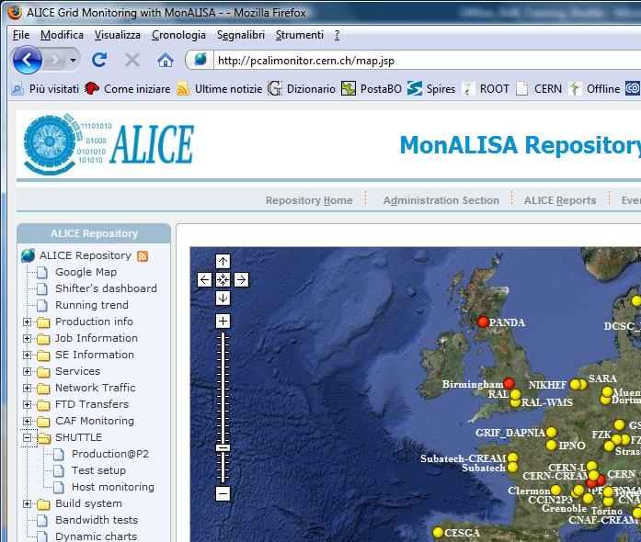
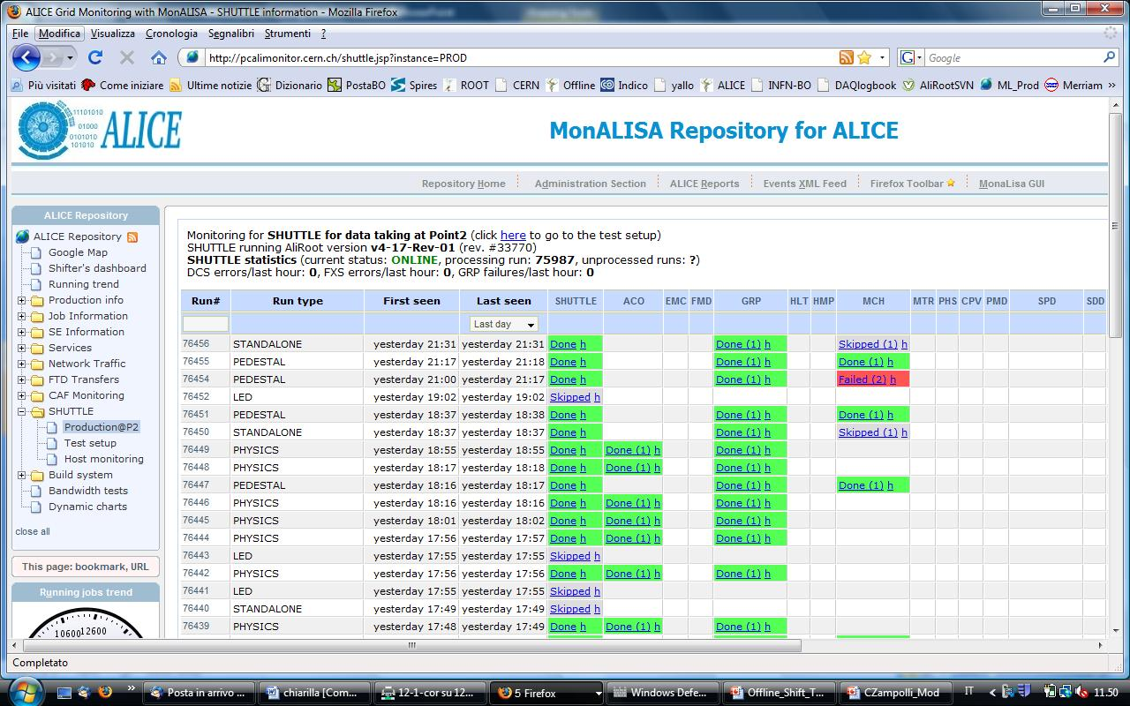
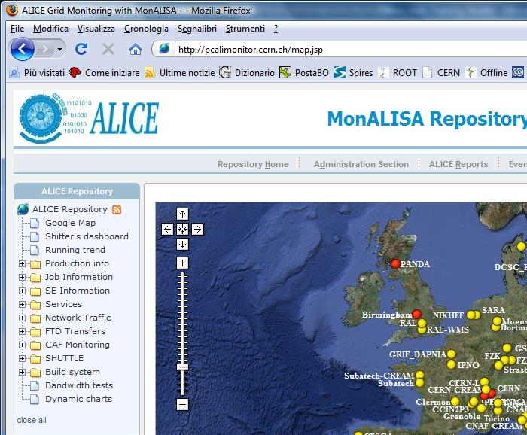
MonALISA Web Page
http://pcalimonitor.cern.ch/shuttle.jsp?instance=PROD
how to get there...
Start from the MonALISA web page
http://pcalimonitor.cern.ch/map.jsp
Open the SHUTTLE menu
Click on Production@P2 key word

Slide 6
MonALISA Web Page – an Overview
AliROOT version
DCS/FXS errors
GRP failures
Link to the test setup mon page
Monitoring for P2
SHUTTLE status

Slide 7
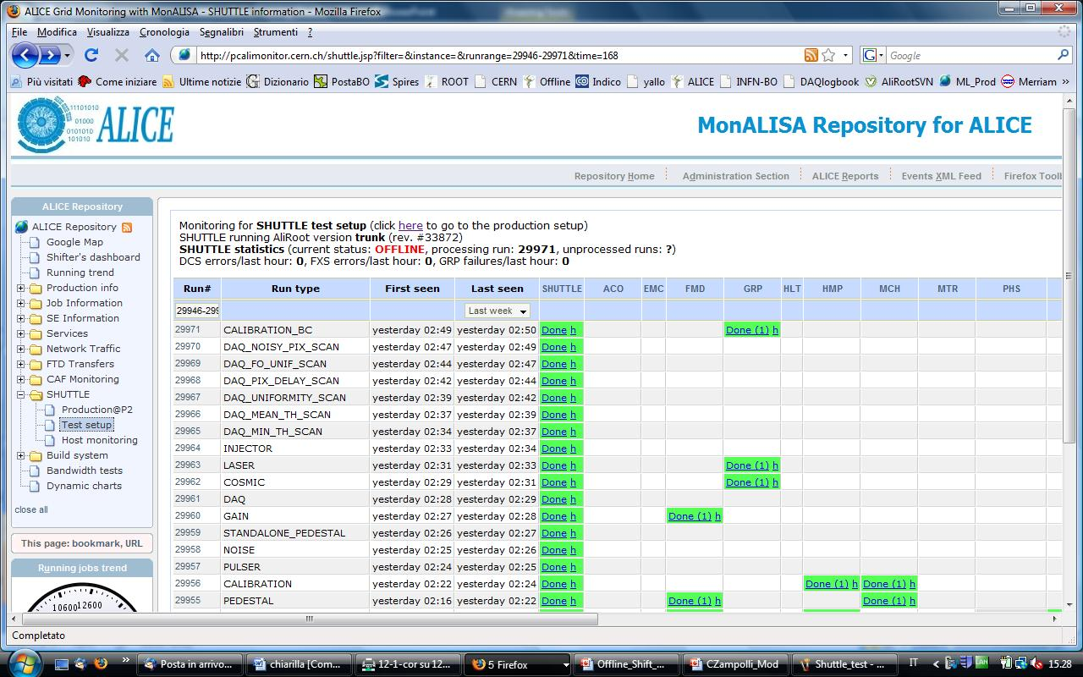
MonALISA Web Page – the Test Setup
Monitoring for the Test Setup

Slide 8
A Look to the Table
General information
SHUTTLE + Detector status
Access to the history
Status & access to the log
n. of retries

Slide 9
The SHUTTLE Log
Every information is associated to a timestamp which is expressed in UTC
  Geneva time is CEST → +1h in winter, +2h in summer
Contains information about the detectors participating in the run, and for which the corresponding preprocessor has been called
  E.g.: http://pcalishuttle02.cern.ch/logs_PROD/7/76448/SHUTTLE.log

Slide 10
The Detector Log
Every information is associated to a timestamp which is expressed in UTC
  Geneva time is CEST → +1h in winter, +2h in summer
Messages can come from either the detector, or the SHUTTLE
  E.g.: http://pcalishuttle02.cern.ch/logs_PROD/7/76451/MCH.log
  I-AliShuttle::Log: 2009-07-20 16:38:07 UTC (17478): MCH - run 76451 - ProcessCurrentDetector - The preprocessor requested to skip the retrieval of DCS values
  I-AliShuttle::Log: 2009-07-20 16:38:07 UTC (17478): SHUTTLE - run 76451 - UpdateShuttleStatus - MCH: Changing state from Started to PPStarted
In case of failure, the email address of the responsibles to which the notification has been sent can be found at the end of the log
Key words: DCS, FXS, GetFile, StoreOCDB

Slide 11
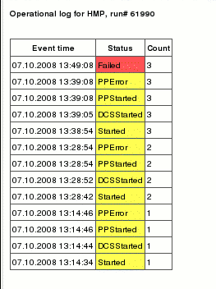
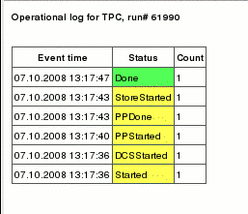
The History
time
time
Successful preprocessor: 1 retry
Failed preprocessor: 3 retries

Slide 12
Preprocessor Status Flow
Started
Failing to connect
To FXS
FXS Error
run type
not
requested
DCS error
DCS started
Failing retrieving
DCS DPs
Exceed of the
allowed mem
Preprocessor OutOfMemory
Preprocessor
Started
Exceed of the
allowed time
Preprocessor OutOfTime
Preprocessor
Done
Store Delayed
Waiting for
previous runs
Preprocessor
failure - retry
Preprocessor Error
Store Started
retry count
exceeded
Failing storing
data in OCDB
Store Error
Skipped
Done
Preprocessor
success
Failed

Slide 13
Possible ERRORs
When to intervene:
  GRP Errors
  DCS Errors
  FXS Errors
  Detector Errors (*)
When not to intervene:
  Store Errors
  Detector Errors (*)
  (*) Depending on the error, on the frequency...

Slide 14
Possible ERRORs – What to Do
GRP → “PPError”, “Failed”:
  Immediate action required → without the GRP, the run cannot be reconstructed!
  Search in the corresponding log the cause of the error in the last lines – e.g.: “GRP Preprocessor FAILS!!! (Trigger Configuration ERROR)” or “GRP Preprocessor FAILS!!! (DCS ERROR)”
  Contact the responsible for the corresponding system (Trigger or DCS, in the example)
  Inform the shift leader of the problem → no reconstruction will be possible for that run

Slide 15
Possible ERRORs – What to Do
DCS → “DCSError” (could happen for every detector):
  It means that the communication between the DCS AMANDA server (DP retrieval) and the Shuttle is broken
  Inform the DCS shifter, indicating the detector for which the problem is happening
FXS → “FXSError” (could happen for every detector):
  It means that the communication between one FXS (DAQ, DCS or HLT) and the Shuttle is broken
  Check in the log which system is involved (DAQ/DCS/HLT), finding the entry in the FXS for which the retrieval failed (search, e.g., for “GetFile” in the log)
  Inform the shifter of the online system involved (DAQ/DCS/HLT), indicating the detector for which it’s happening

Slide 16
Other Errors
“StoreError” (could happen for every detector):
  It means that some problems occured while storing the output files of the detector preprocessor
  Could be related to some instabilities of the GRID
  Inform the experts in case the error is persistent
“StoreDelayed” (could happen for every detector):
  This is NOT an error! (not in red)
  In case a previous run has still to be closed for this detector

Slide 17
Other Errors – II
“PPError”, “Failed”:
  An error occurred in the processing of the data by the corresponding detector preprocessor
  In general, no action has to be taken (if not in the case of GRP): the detector experts are automatically notified...
    See end of the corresponding log to see who was notified
  ...BUT! If the error is persistent, inform the detector shifter

Slide 18
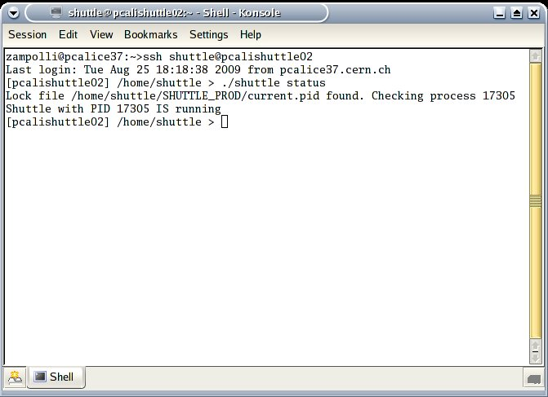
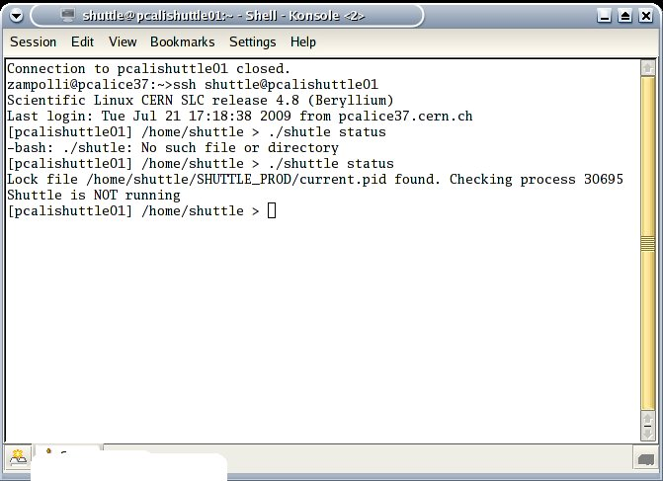
SHUTTLE Status
If, accoding to the MonALISA page, the Shuttle is OFFLINE, and ONLY in that case, login in the Shuttle machine (pcalishuttle02) from the offline console:
  [aldaqacr10] ssh shuttle@pcalishuttle02
  Check the SHUTTLE status:
  [pcalishuttle02] ./shuttle status
  If the SHUTTLE IS RUNNING, check whether MonALISA gets updated → if not, contact the MonALISA experts (Costin.Grigoras@cern.ch)
  If the SHUTTLE IS NOT RUNNING, type:
  [pcalishuttle02] ./shuttle restart

Slide 19
OCDB
The conditions data produced by the preprocessors while running within the SHUTTLE are put in the OCDB folder in AliEn:
    /alice/data/<current_year>/OCDB/*/*/*
    /alice/data/<current_year>/Reference/*/*/*

Slide 20
Important Remarks
The run types for which the detector preprocessors are run depend on the implementation of their preprocessor code
Only runs taken within the ECS framework (not from the DAQ Run Control of the detectors!!) can be processed by the Shuttle
The GRP preprocessor is run only for a subset of run types, http://aliceinfo.cern.ch/Offline/Activities/Shuttle/RunTypesForGRP.html
A successful preprocessor exits with code 1, a failing preprocessor exits with code > 1

Slide 21
Whom to Contact
For any SHUTTLE related issues not mentioned in the slides, please contact:
  Jan.Fiete.Grosse-Oetringhaus@cern.ch (165459) (*)
  Chiara.Zampolli@cern.ch (160906) (*)
  Raffaele.Grosso@cern.ch
  (*) based at CERN

Slide 22
Hands-on…

Slide 23
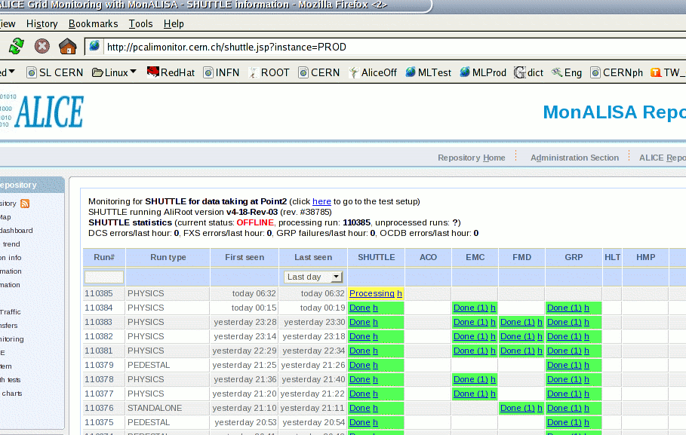
What is wrong here?
Shuttle OFFLINE
Check on the Shuttle machine
Inform the experts

Slide 24
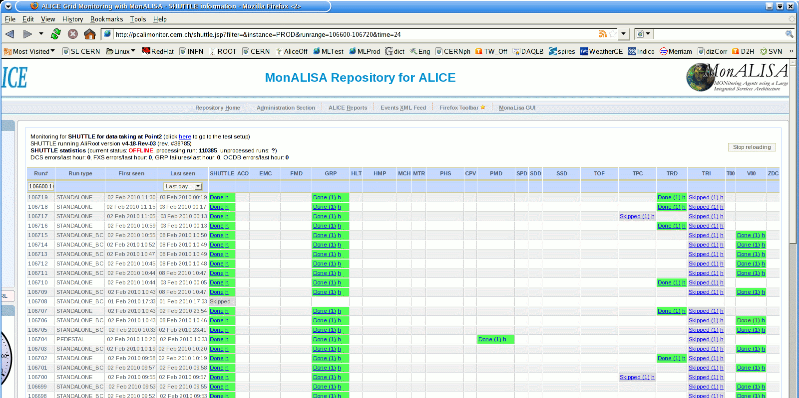
What is wrong here?
ONLINE
1
FXS Error
Go to the log
Inform the online system experts
FXS Error

Slide 25
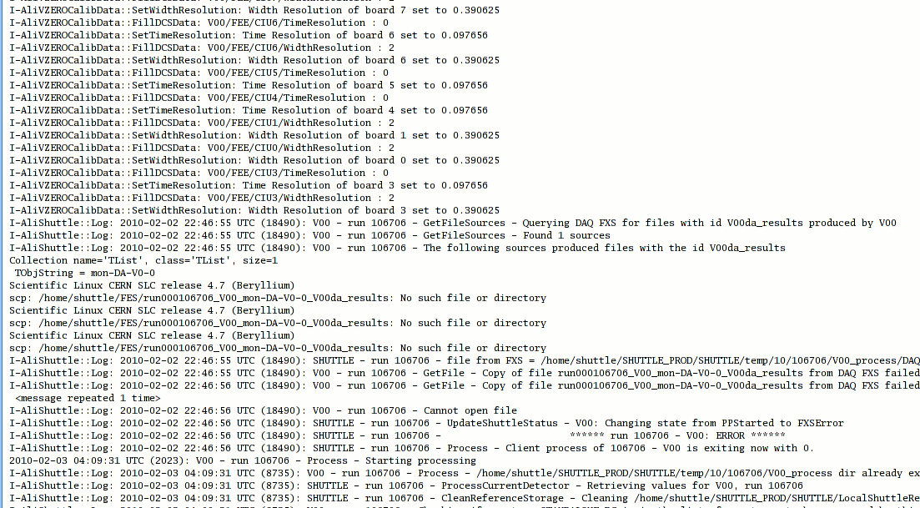
What do you see from the log?
DAQ FXS problem

Slide 26
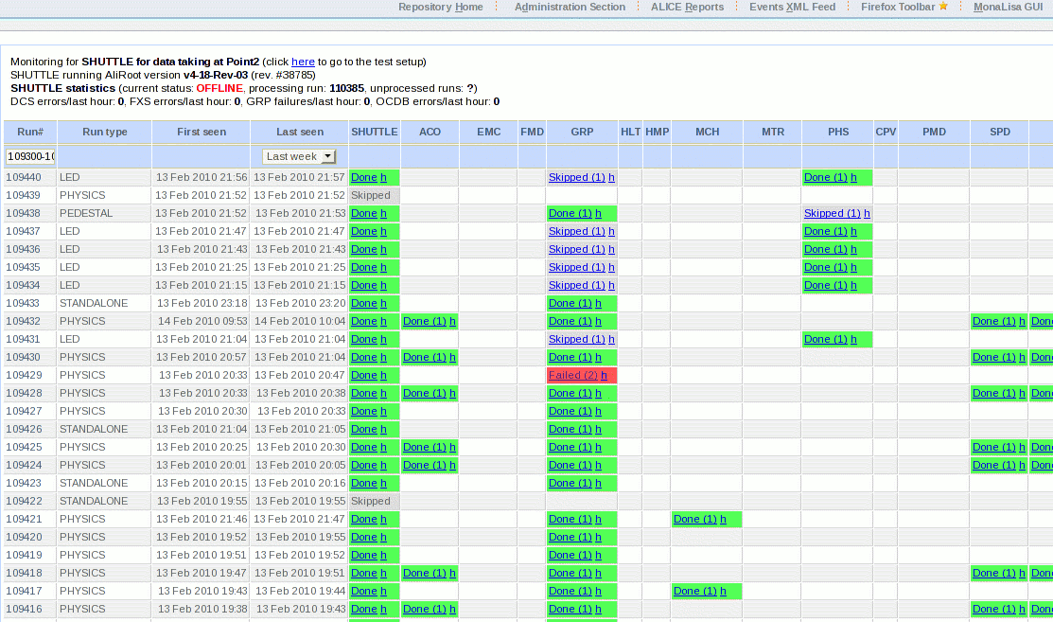
What is wrong here?
GRP Error
Check the log

Slide 27
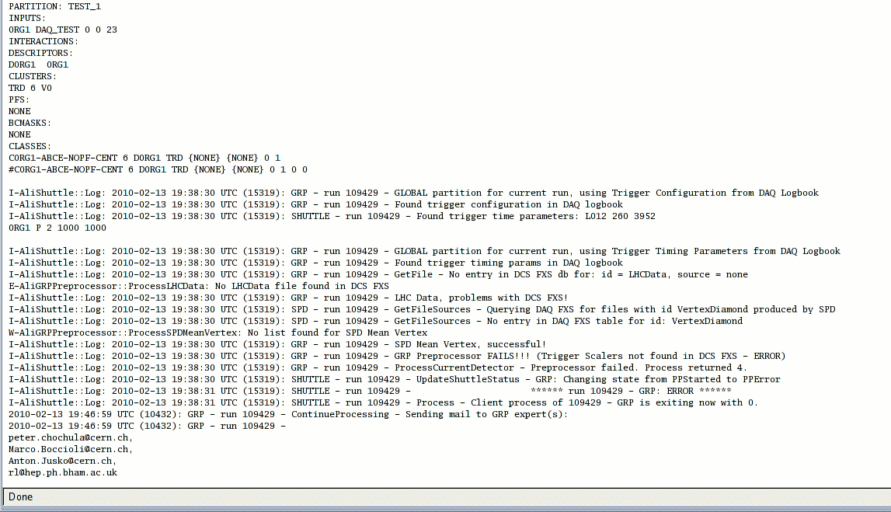
What do you see from the log?
DCS FXS problem
Trigger scalers missing
Inform Trigger and DCS

Slide 28
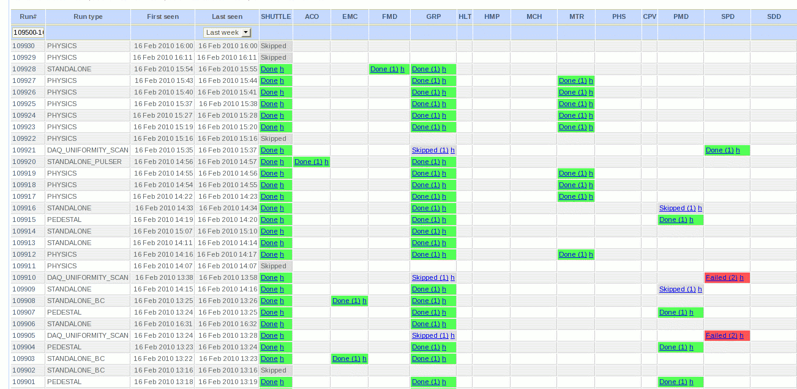
What is wrong here?
SPD Error
Go to the log

Slide 29
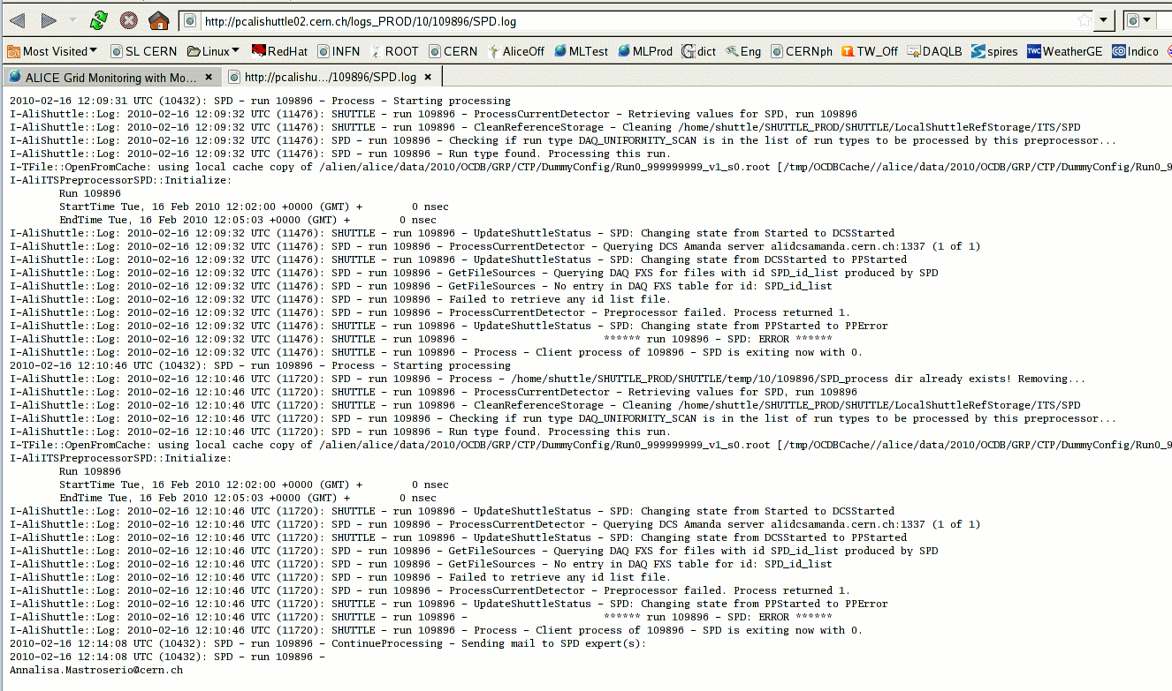
What do you see from the log?
problem with file from DAQ DA
Inform SPD expert (see bottom of the log)

Slide 30
Back-Ups

Slide 31
Sequence Diagram
End of Data Taking
End of Run
Start of Run
ECS
DAQ
DCS (FXS)
HLT
DCS (Arch. DB)
No interference with data taking!
Shuttle
Loop over all detectors (+ GRP and HLT)
Registration of conditions data files in AliEn
Interfaces with info providers
ACORDE
EMCAL
GRP
HLT
HMPID
FMD
ITS(*)
MUON (**)
PHOS
(***)
PMD
T0
TOF
TPC
TRD
V0
ZDC
Detector preprocessors
(*) ITS = SPD + SDD + SSD
(**) MUON = MCH + MTR
(***) PHOS = PHS + CPV

