Slide 1
sFGD electronics
28 June 2019

Slide 2
This meeting
Resources and planning review
FEB topics for discussion:
  Dimensions
  Connectivity
  FPGA choice
  FEB-FEB link
  Synchronisation
Ancillary boards design
  Backplane
  MCB
  Optical module
  Power module
Preparating for July meeting

Slide 3
December 2018 schedule (updated 28th June 2019)
Was drafted on assumption of positive outcomes from funding agencies in different countries known by Feb/Mar 2019!! BUT:
JP and CH: funding agency response is positive.
FR: funding agency response will be known in July 2019.
USA: funding agency response will be known end July 2019.
sFGD electronics schedule (still preliminary)
28th June

Slide 4
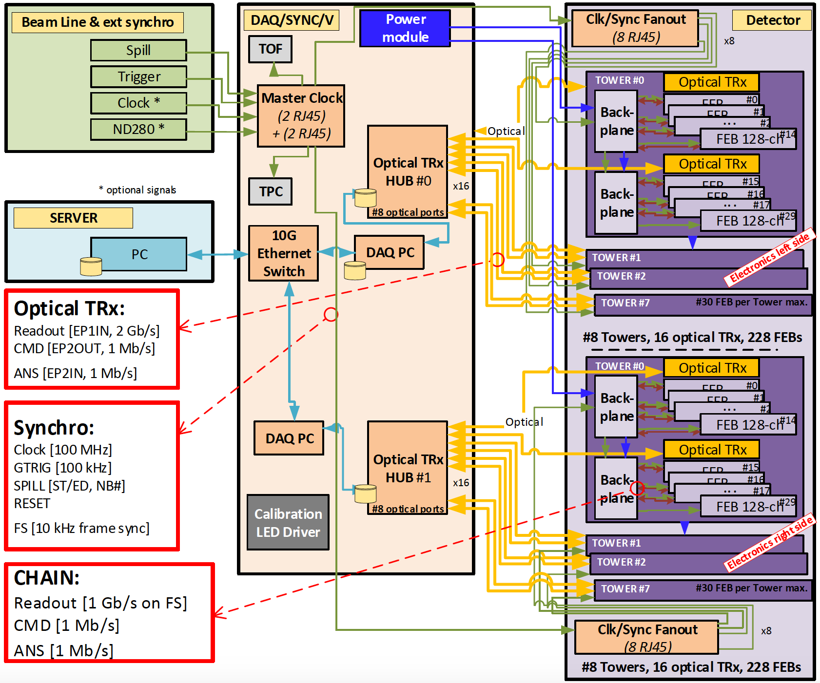
sFGD electronics readout scheme

Slide 5
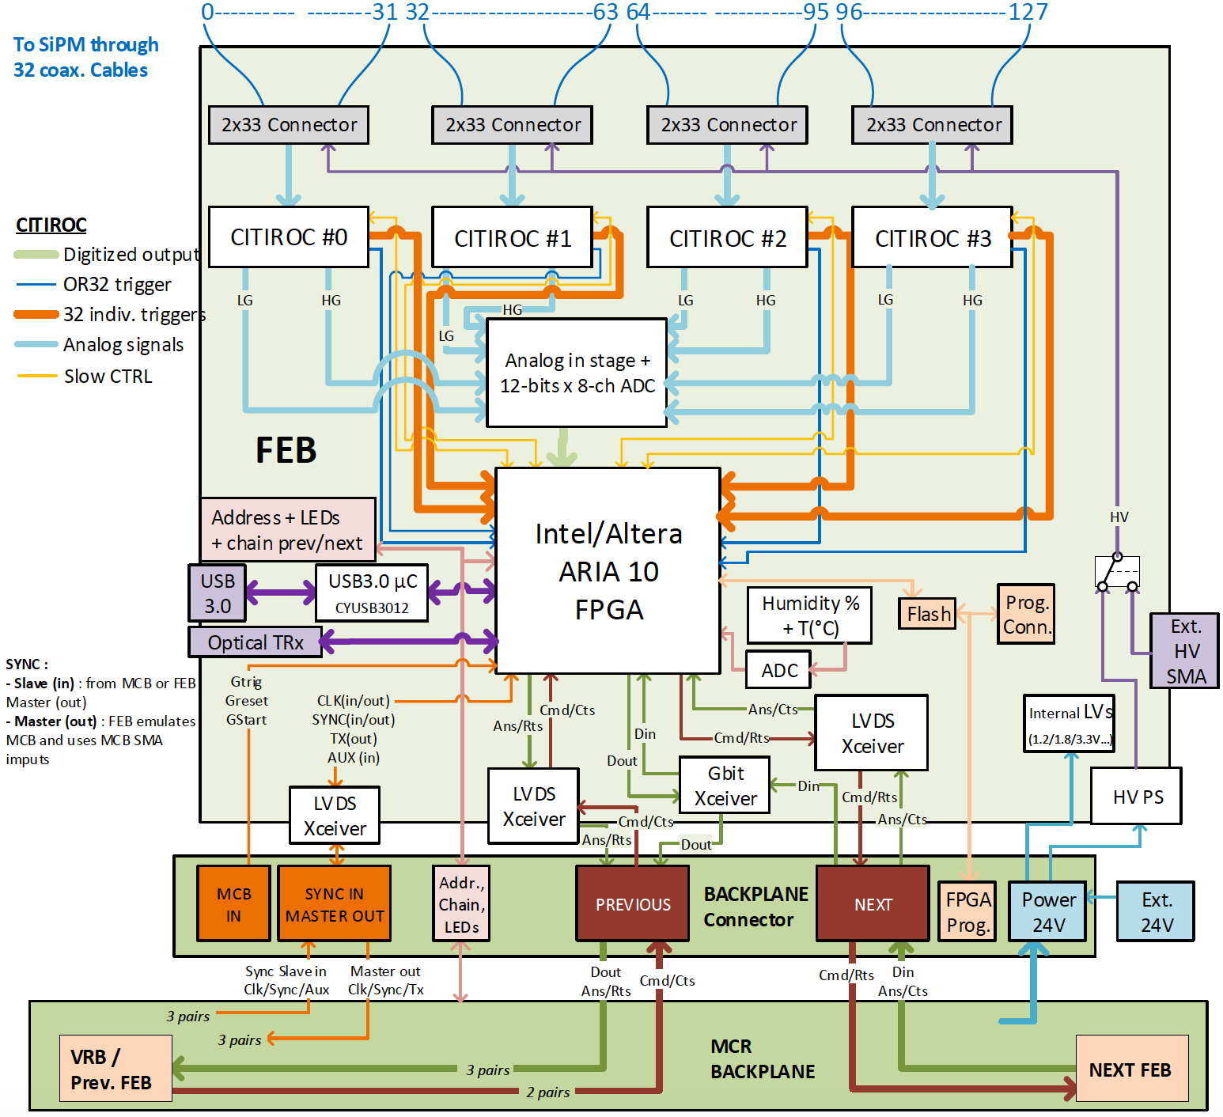
New FEB for T2K ND280 upgrade: SuperFGD detector
Meetings UniGe/CAEN [11th April, 3rd May, 20th June]:
  CAEN working on FERS-5200 board: a new readout architecture with CITIROCs and 64-ch boards connected via optical link to a data concentrator board (up to 4096ch/DCboard),
  Discussing possible synergies,
  Discussing requirements for T2K ND280 upgrade.
Studying Xilinx FPGA as alternative to Altera FPGA:
  More cost effective,
  Lower power consumption,
  Smaller PCB footprint (16 x 16 cm2),
  … but will require quite some hardware work to match up ADC and CITIROC.
Re-use as many of the “FPGA manufacturer”-independent firmware blocks as possible:
  Timing block,
  Analog block (ADC state machine),
  Readout and tagging block,
  Slow control block.
Communication block will be new:
  Few ideas TBC (PCI express, LVDS, Gigabit transceivers etc…)
Xilinx FPGA being studied

Slide 6
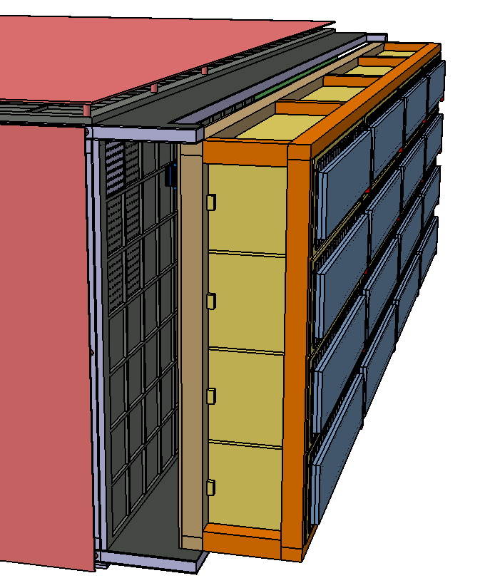
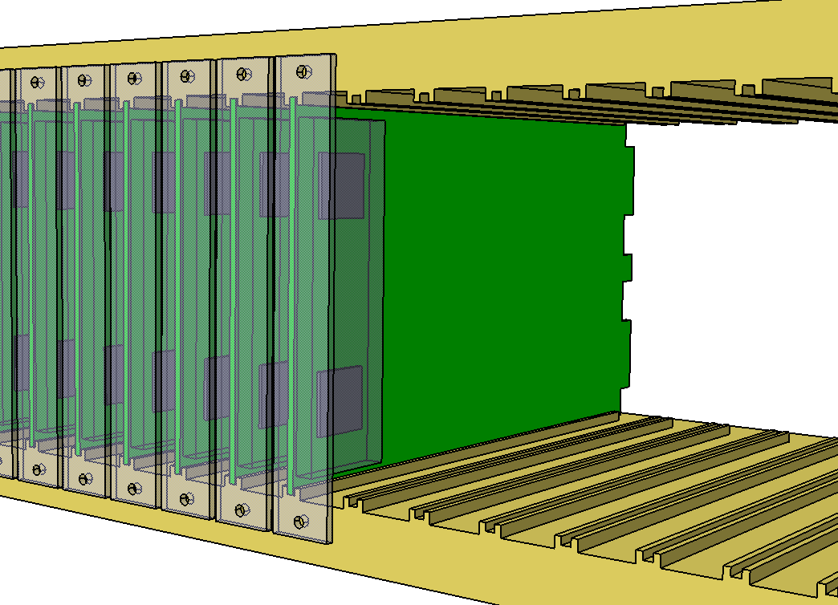
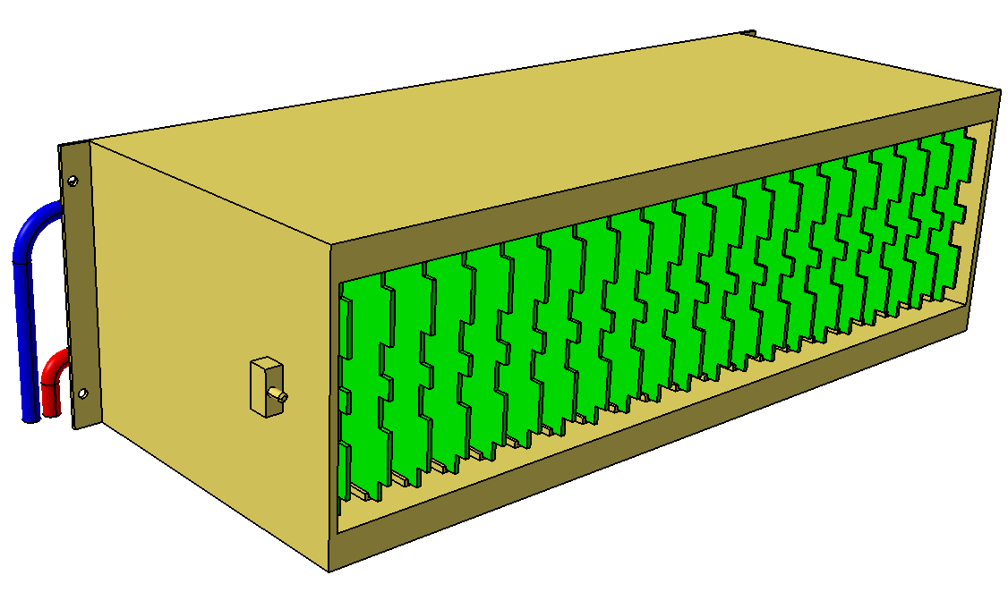
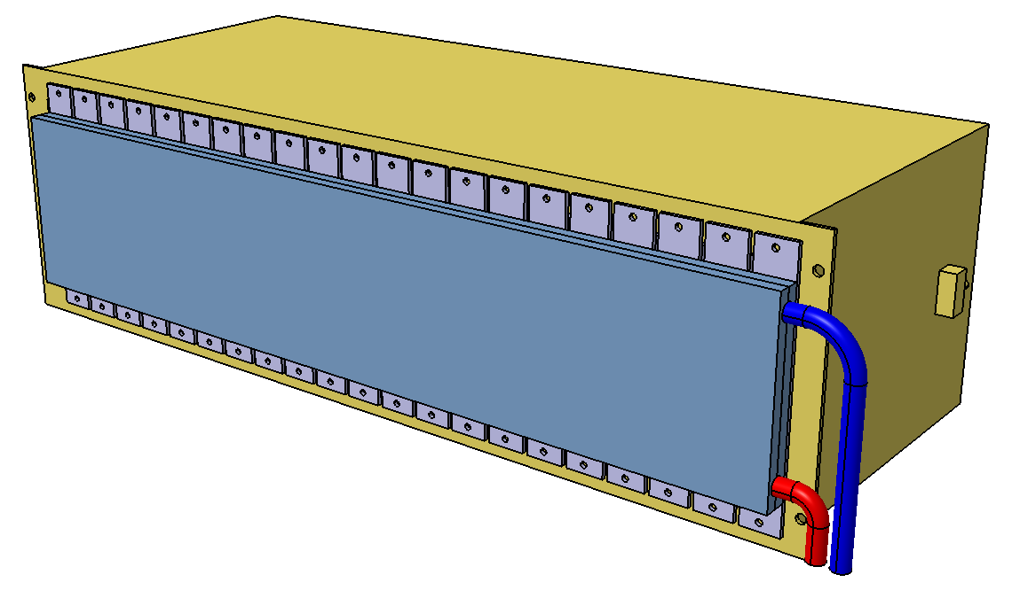
Mechanics for FEB
3U crates: 4 rows x 4 columns (shown here)
4U crates: 3 rows x 4 columns
84 HP = 426.72 mm
FEB pitch = 20.32 mm
21 slots per crate:
1 slot/crate for optical module
1 slot/crate for power module
19 slots/crate for FEBs
3U FEB dimensions
100 mm
165 mm
Conversion factors:
1 U = 1.75 in = 44.45 mm
1 HP = 1/5 in = 5.08 mm

Slide 7
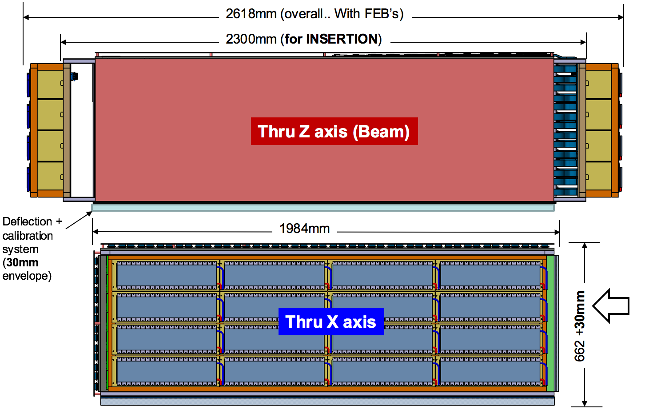
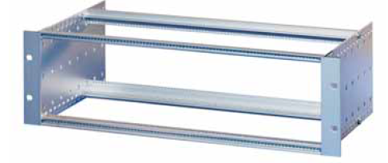
Electronics (FEB) envelope is:
~1900mm x ~200mm x ~600 mm
Crate slots | Occupied slots - FEB | 3U free slots | 4U free slots
Left side | 222 | 82 | 6
Right side | 219 | 85 | 9
sFGD electronics envelope
222 FEB (4 CITIROC/FEB)
219 FEB (4 CITIROC/FEB)
2 kW
2 kW
 | MPPC_PCBs | FEBs | Cable length
Left side (looking downstream) | 444 | 222
Top center left | 138 | 69 | TBD
Top edge left | 138 | 69 | TBD
Front left | 84 | 42 | TBD
Side left | 84 | 42 | TBD
Right side (looking downstream) | 437 | 219
Top center right | 138 | 69 | TBD
Top edge right | 138 | 69 | TBD
Front right | 84 | 42 | TBD
Side right | 77 | 39 | TBD
430 mm
3U
(133 mm)
175 mm
Standard kit “flexible” Schroff EuropacPRO

Slide 8
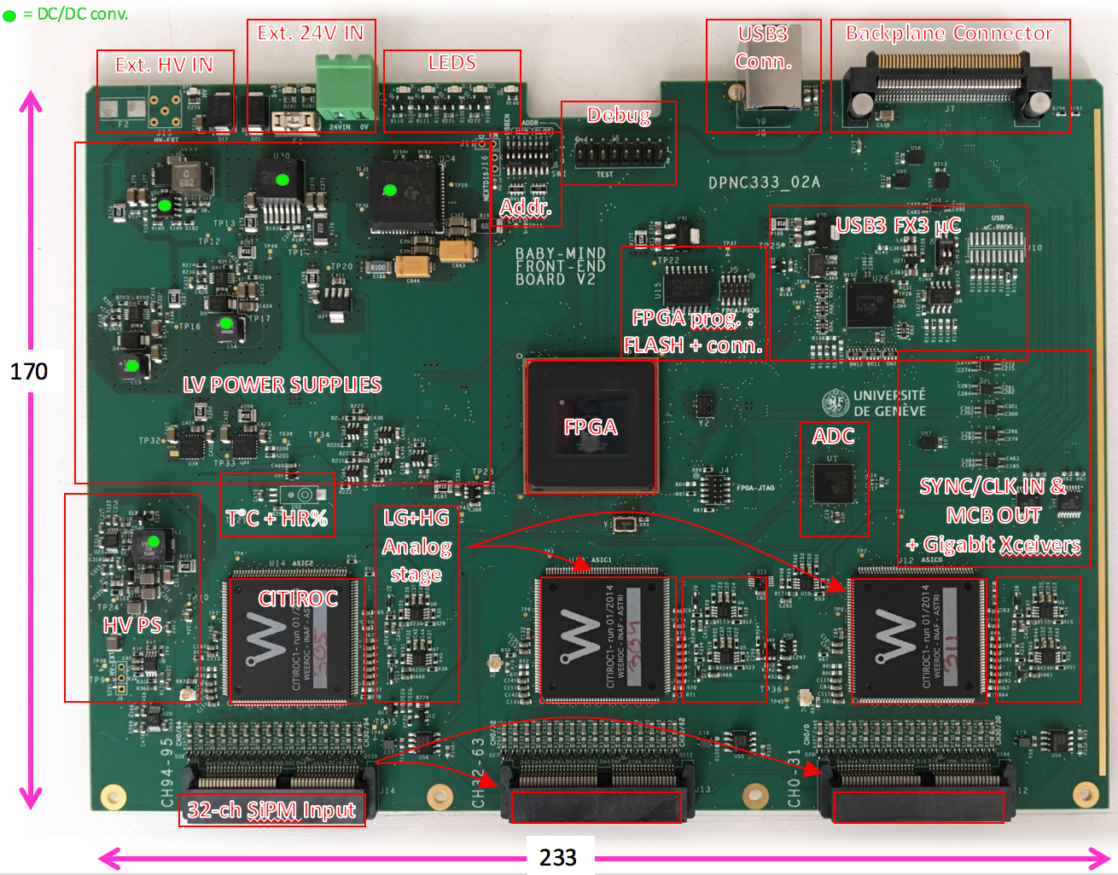
FEB layout
All connectors on one edge only!
sFGD FEB
Baby MIND FEB
3U
4U
170
100
144
What connectors on sFGD demo board
What connectors on sFGD production board
Connector dimensions??
e.g.: SAMTEC edge mount
ERM8-075-EM2 = 65 mm
(150 pins for 128 MPPC connections + 4 HV + GND)
ERM8-020-EM2 = 25 mm
(40 pins for LV distr. + SYNC 2pairs+ COM 2/3 pairs)

Slide 9
FPGA choice
Two candidates have been proposed, the Altera Aria X and the Xilinx Artix. No choice is being made at this stage. A comparative study will be made in order to inform the selection process. The selection will be made on the basis of technical performance and the experience of the people involved in the design and firmware tasks. Some of the criteria include footprint, power consumption, compatibility with the existing Baby MIND architecture, firmware implementation, newness and planned obsolescence of the product by manufacturer.

Slide 10
FEB-FEB link
The general idea is to make the system as robust as possible, whilst reusing as many of the existing Baby MIND architecture and/or commercially available products to minimise design effort. Because of access restrictions (the electronics will be enclosed by the magnet coils for most of the time), with maintenance periods of just a few weeks per year, an exact copy of the Baby MIND back-end daisy chaining architecture must be avoided. This is because if one FEB in the chain fails, all FEBs further down the chain will no longer be capable of communicating with the DAQ system, so there is a high risk of data loss.
The current baseline is to have a data concentrator card which would occupy one slot in each electronics crate. Each FEB is then connected directly to that card via a backplane bus, in a point-to-point scheme.
Data concentrator cards would then send data to a DAQ system via optical links and commercially available switches.
The maximum number of FEBs per crate alloweable in this scheme is to be evaluated, based on estimations/measurements of data throughput rates in different operation modes (data taking, calibration, cosmics etc...).

Slide 11
Power module
The distribution of power to the FEBs is a major design concern. It is estimated that several amps per rail would be required. Questions were raised such as how many rails are required, which components to use (LDOs, DC-DC converters), where to locate components.
One option is to design a specific power module, which would occupy another slot in each crate, and power the FEBs via another backplane bus.
The TPC team are also looking into studying DC/DC converters for the ND280 upgrade project.

Slide 12
Synchronisation
The plan is to adopt much of the synchronisation system developed for Baby MIND. A Master Clock Board would be developed, which would feed synchronisation signals to the data concentrator card(optical module), these signals would then be routed to the FEBs via the backplane bus.
In the current scheme, all Baby MIND FEBs are synchronised with a common 100 MHz clock either produced by the MCB, or received by the MCB from an external source and transmitted to the FEBs. Internally, a PLL on the FEBs produces the necessary clock frequencies (100 MHz and 400 MHz) from the MCB-distributed 100 MHz clock. This leads to an uncertainty in relative clock positive of order 70 ps for all FEBs due to the jitter on the 100 MHz clock signal.
One open question concerns the synchronisation of the beam trigger to the common clock. Currently this is known with the precision of the common clock, i.e. 10 ns. An improvement is possible by adding a TDC to the MCB. This may be required if we want to achieve better time precision with respect to other sub-detectors (e.g. FGD, ECAL).

Slide 13
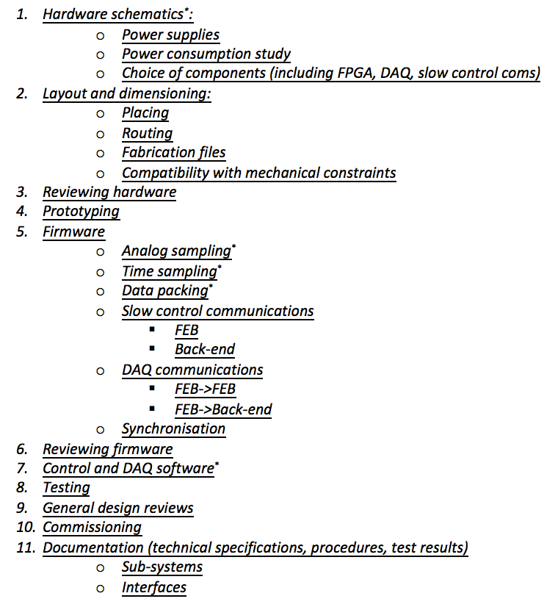
UniGe-LLR task sharing for FEB development
We reviewed the task list in Annex 1 of the collaboration agreement. These discussions are very preliminary, and further discussions must be held when resources at LLR are better defined, and the profile of the engineer to be recruited at UniGe is known.
The option of LLR mostly working on hardware tasks and UniGe mostly working on firmware tasks was discussed.

Slide 14
Preparing for July meeting
“Special” electronics meeting during T2K week in July
(23rd July 15h00 CEST)
Aim for:
  Choice of crate format 3U/4U,
  important for mechanical design, layout of FEB and backplane.
  Rough positioning of main components on FEB.
  Choice of FPGA.
  Basic backplane scheme.
  Basic synchronisation scheme.

