Slide 1
Beam Quality Tracking in the PS
Frank Tecker, for the PS Beam Commissioning WG

Slide 2
Contents
Pre-LS2 Beam Quality Measurements
Online displays
Occasional measurements
Offline
Post-LS2 Additions
BQM
Some additions

Slide 3
Online BQM
No dedicated logging server à la SPS
A few dedicated applications
Operation display
MTE Spill Inspector Vista
NToF Inspector
IRRAD display
Occasional dedicated measurements

Slide 4
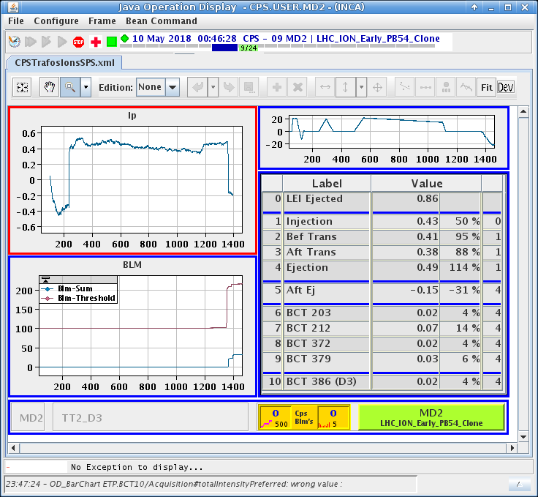
Operation display
For different cycles (protons, MTE, ions)
Intensity along cycle
Transmission
Losses
MTE: extraction

Slide 5
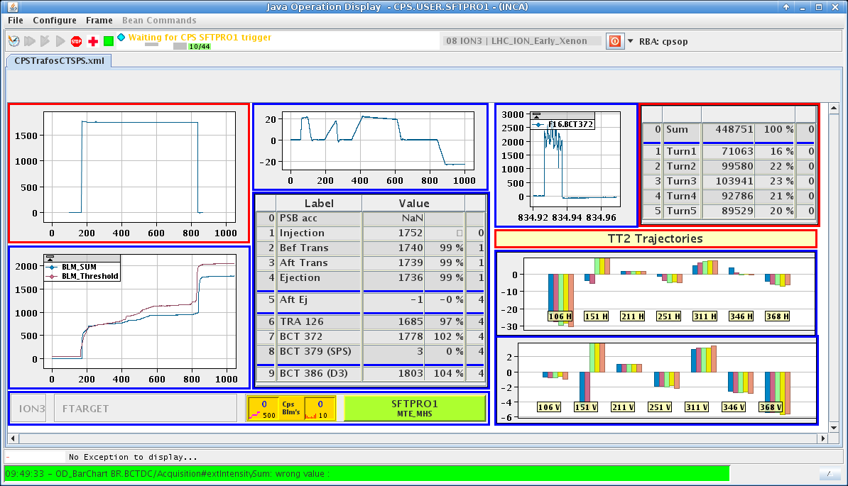
Operation display (MTE)

Slide 6
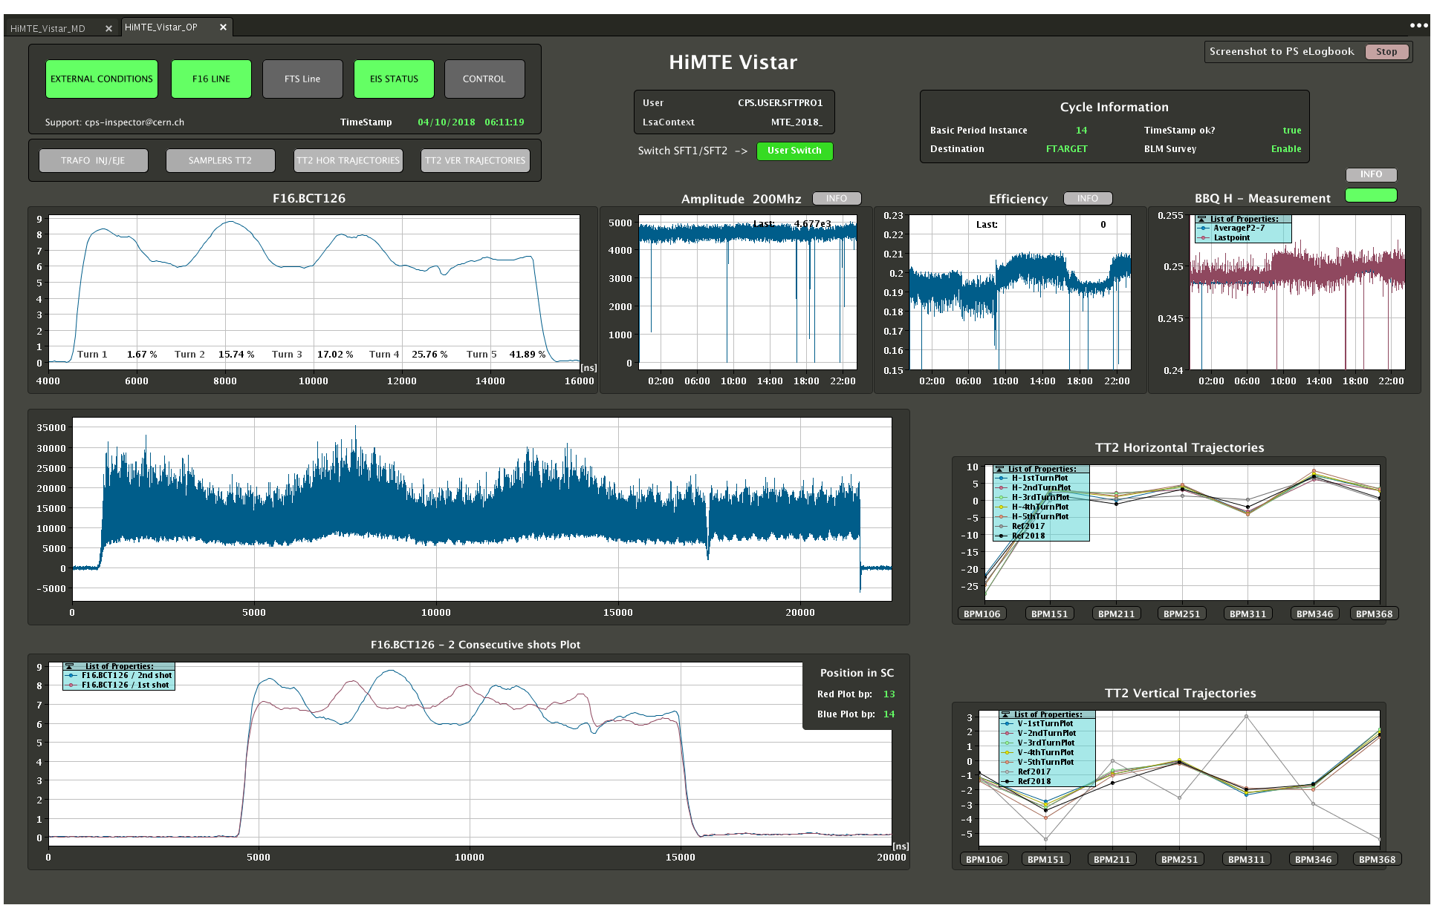
MTE Spill Inspector Vistar
Spill structure
1^{st/2nd} instance
200MHz capture
Tune
Trajectories

Slide 7
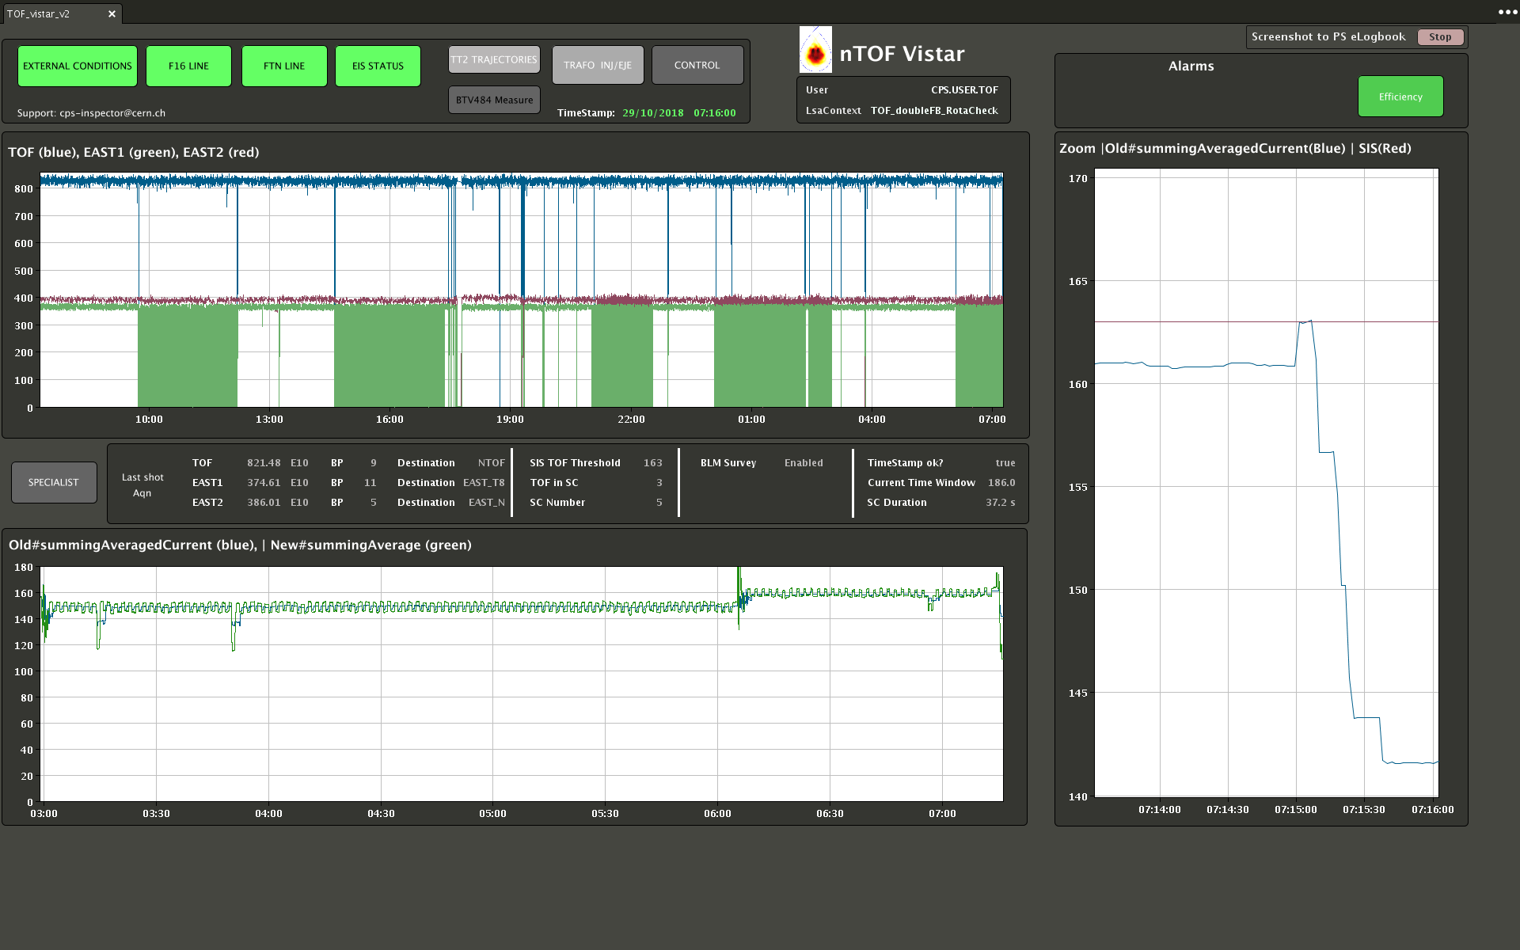
NToF Inspector Vistar
Intensity history
TOF/EAST cycles
Average intensity

Slide 8
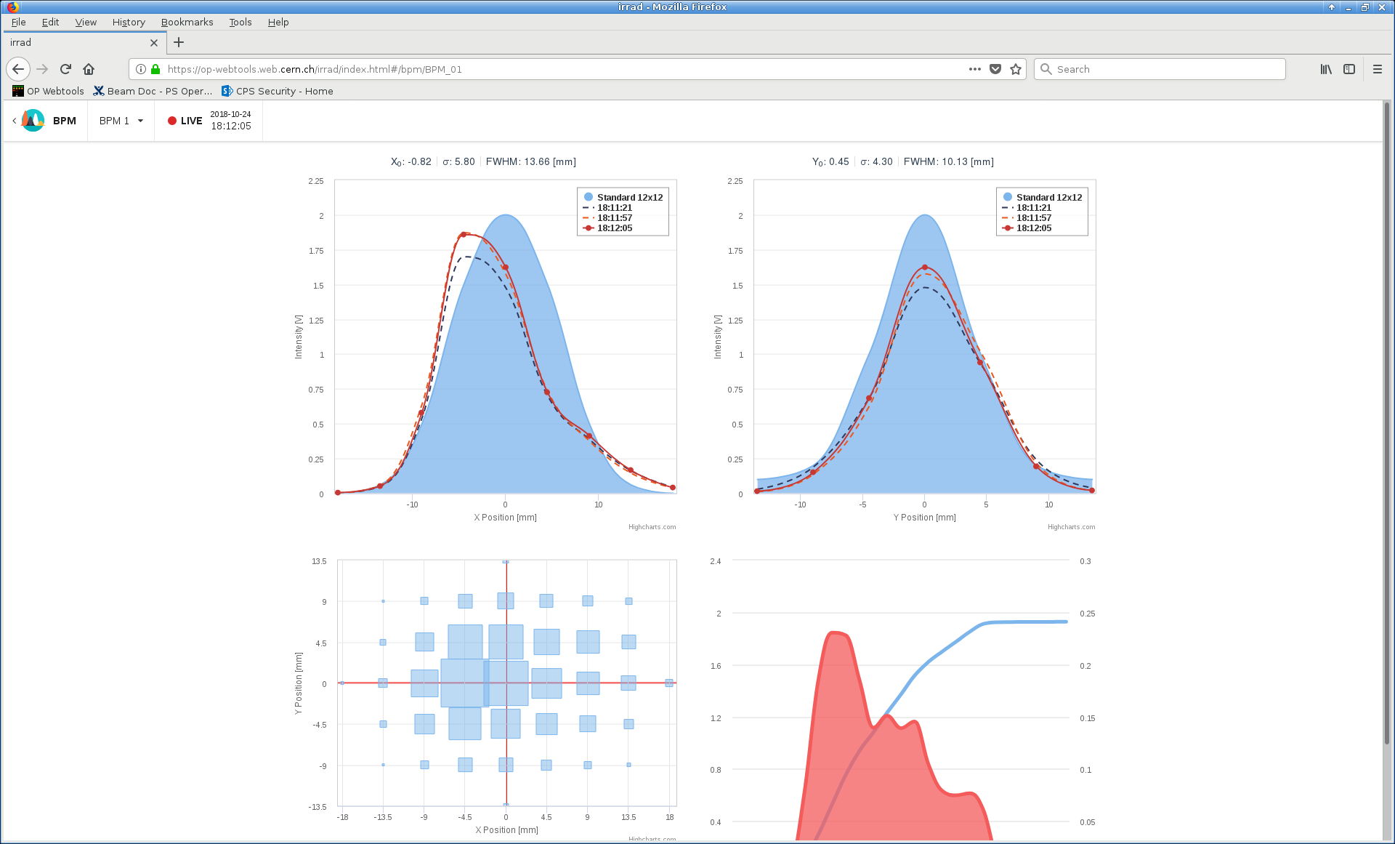
IRRAD Vistar
Beam profiles
Reference
No history

Slide 9
Occasional measurements
Bunch splitting / bunch length (from BSM)
Longitudinal parameters
Emittance, momentum spread (Tomoscope)
Injection oscillations (Tomoscope)
Satellite population (Tomoscope/BSM)
RF signals and loops (voltage, phase, synchro,…)
Transverse injection oscillation amplitude
Tunes along the cycle

Slide 10
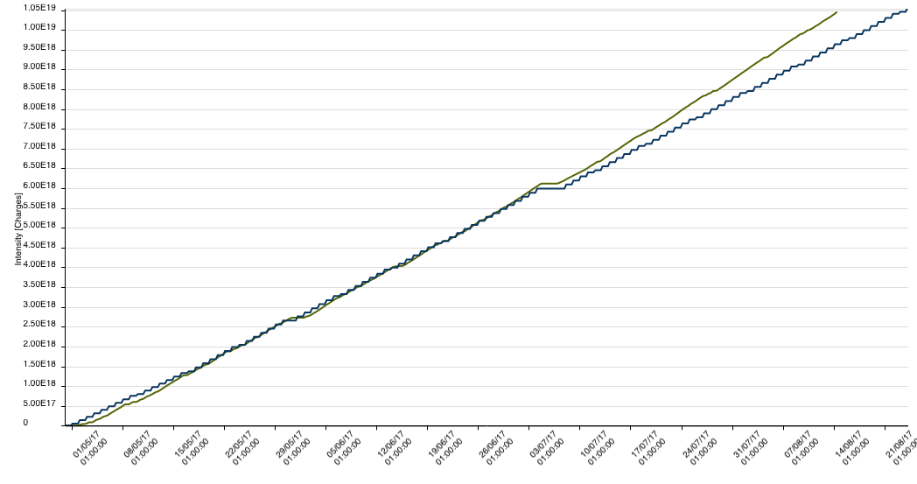
Off-line
Many beam measurements are logged in DB (intensity, losses, wire scans, …)
Some private scripts to look at long-term evolution (J.Dalla-Costa, O.Hans, F.Tecker)
Occasionally used
NToF integrated intensity statistics web page
Intensity evolution

Slide 11
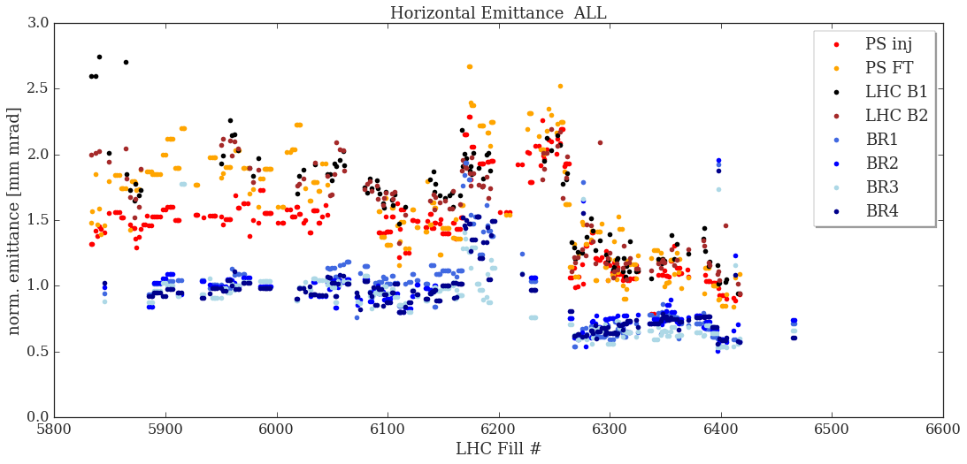
LHC emittance
Regular beam emittance measurements by the wire scanner
Injection/Flat top
3 measurements for average
Logged for LHC super table

Slide 12
Parameters for monitoring
Intensity at various times in the cycle => transmission
Emittance (from WS, regular for LHC, otherwise occasional)
Longitudinal (Emittance, momentum spread, splitting, injection oscillations, satellite population, extracted bunch length)
Losses (BLMs, integrated, along the cycle, time windows)
Radiation monitors
Orbit / Trajectory (mean / RMS along the cycle, wrt reference) – TT2 (5-turn MTE)
Injection oscillation amplitude
Spill structure (MTE TT2, EAST)
Tunes (offline, online for MTE splitting)
B-field, PFWs

Slide 13
Post-LS2
BQM
In a first phase longitudinal beam parameters only
Up to now no available wall-current monitor (WCM) channel
Additional WCM to be installed after LS2
Hardware copy of the existing WCM, preparation started
Cables pulled
Longitudinal parameters of the beam only defined during the very last turns! => Too late to dump in the PS => only “flag” the beam and dump it in the SPS
Additional logging
Emittance from BGIs (non-destructive! => online)
SuperCycle composition with LSA users!
Intensity points intermediate plateau

Slide 14
Summary
Online BQM: Individual programs to follow evolution
some occasional measurements
Offline BQM:
LHC beam emittance for Supertable
Intensity, MTE spill, tune, losses, etc. logged
Occasional analysis by scripts
Post-LS2: BQM to be added
Common tool is welcome

Slide 16
Monitoring details (1)
Intensity - online:
Before/after Injection 1/2
Start/End intermediate flat top – after start 2nd ramp (BCT Hotspots and CTIM to be added)
Before/after Transition
Start Flat top (BCT Hotspot and CTIM to be added)
Before/after Extraction 1/2
TT2 (several BCTs)
Transmission - online:
To be defined from the above
Emittance:
Regular WS measurements of LHC beam by the operators for offline, also MTE
Occasionally for other beams
Eventually BGI (non-destructive!) - same times as intensity points

Slide 17
Monitoring details (2)
Longitudinal:
Cycle
Reference measurements with Tomoscope (RF manipulations, injection oscillation, ...) - on demand
Longitudinal emittance and SigmaP/P via Tomoscope - fixed C-time, on demand
Evaluation of satellite population (ghosts) via Tomoscope/BSM - fixed C-time, on demand
Bunch length (and SigmaP/P - Abel transform – some development needed ) via BSM - fixed C-time, online and realtime
RF signals and loops (RF voltage, phase, synchro...) - all cycle, online and realtime
Extraction
Bunch splitting symmetry at extraction (intensity in different bunches) via BSM – later on BQM
Bunch length at extraction
Losses - online:
BLMs in ring and TT2, EAST, total losses during beam presence
Injection, transition (local or global)?
Radiation monitors ?

Slide 18
Monitoring details (3)
Orbit/Trajectory - online:
Orbit mean and RMS along the cycle (wrt reference)
Injection oscillation amplitude
Trajectory TT2 (MTE for 5 turns)
Spill structure - online:
MTE spill in TT2
EAST spill
Working point:
Tunes along the cycle
Offline
Online for splitting of MTE
Dedicated BQM next YETS
Offline for Beam Quality Analysis:
B-field measurement
PFWs
SuperCycle composition !!! With mapping, LSA

