Slide 1
UTTPS external Tubing
G. Schwering
June 25th, 2019

Slide 2
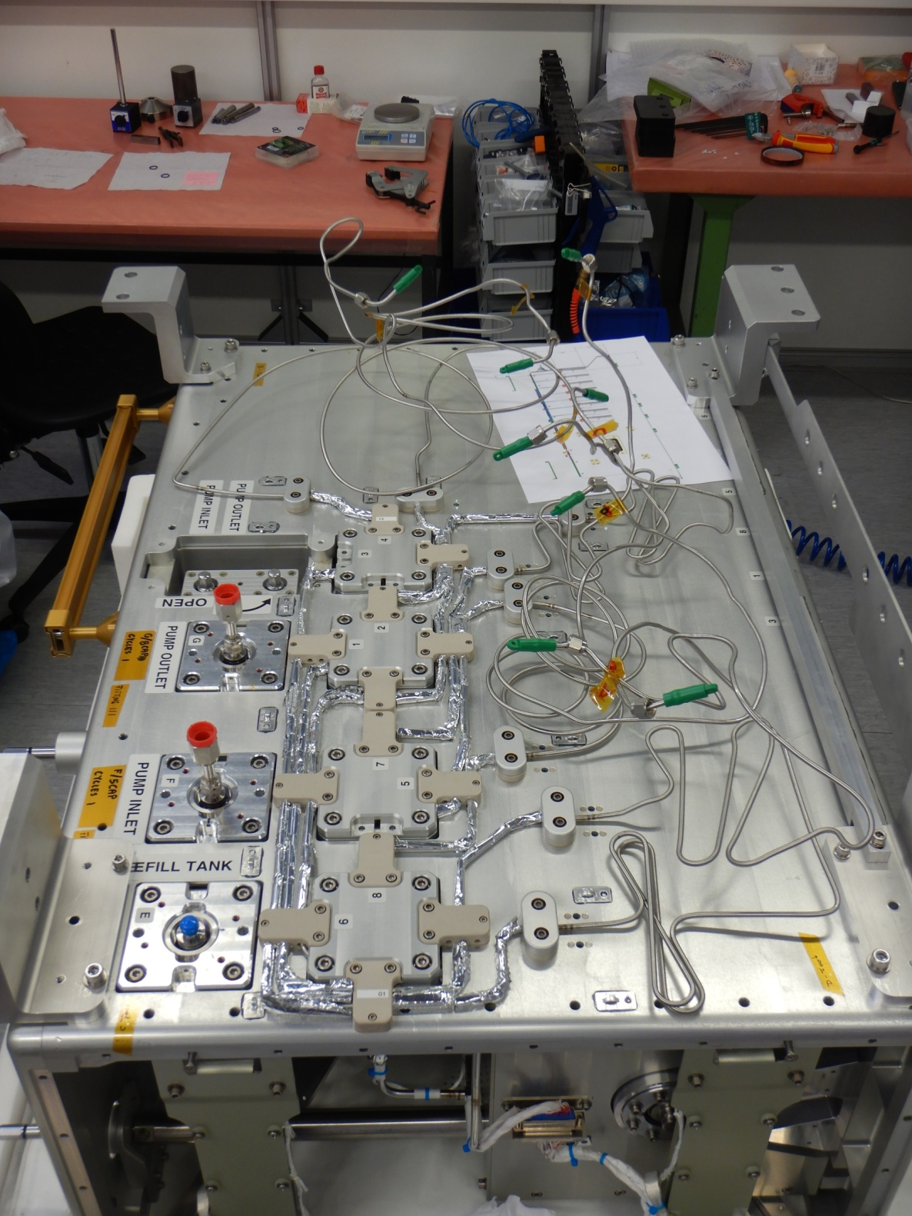
Current situation UTTPS

Slide 3
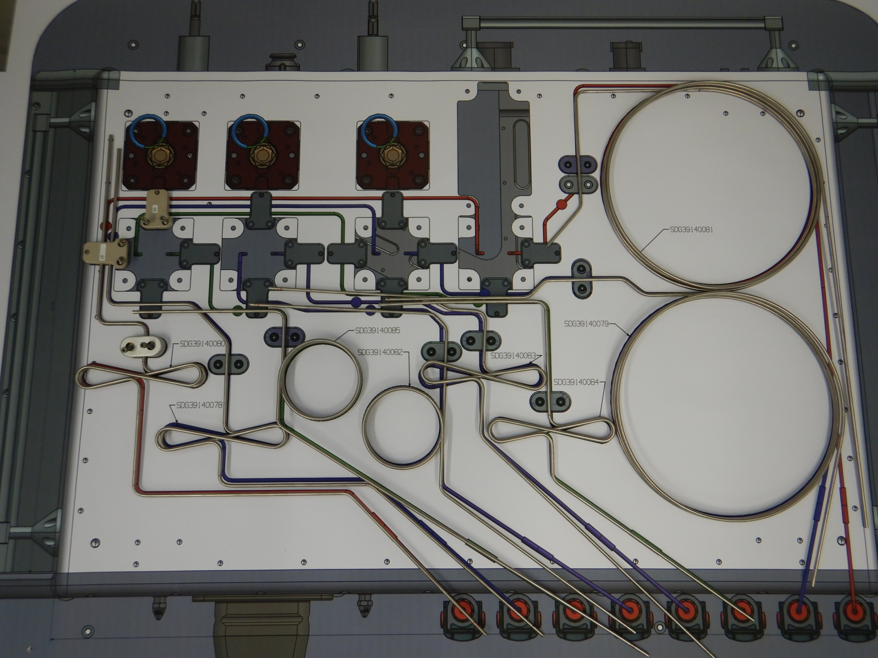
All tubes bent by M. Vergain

Slide 4
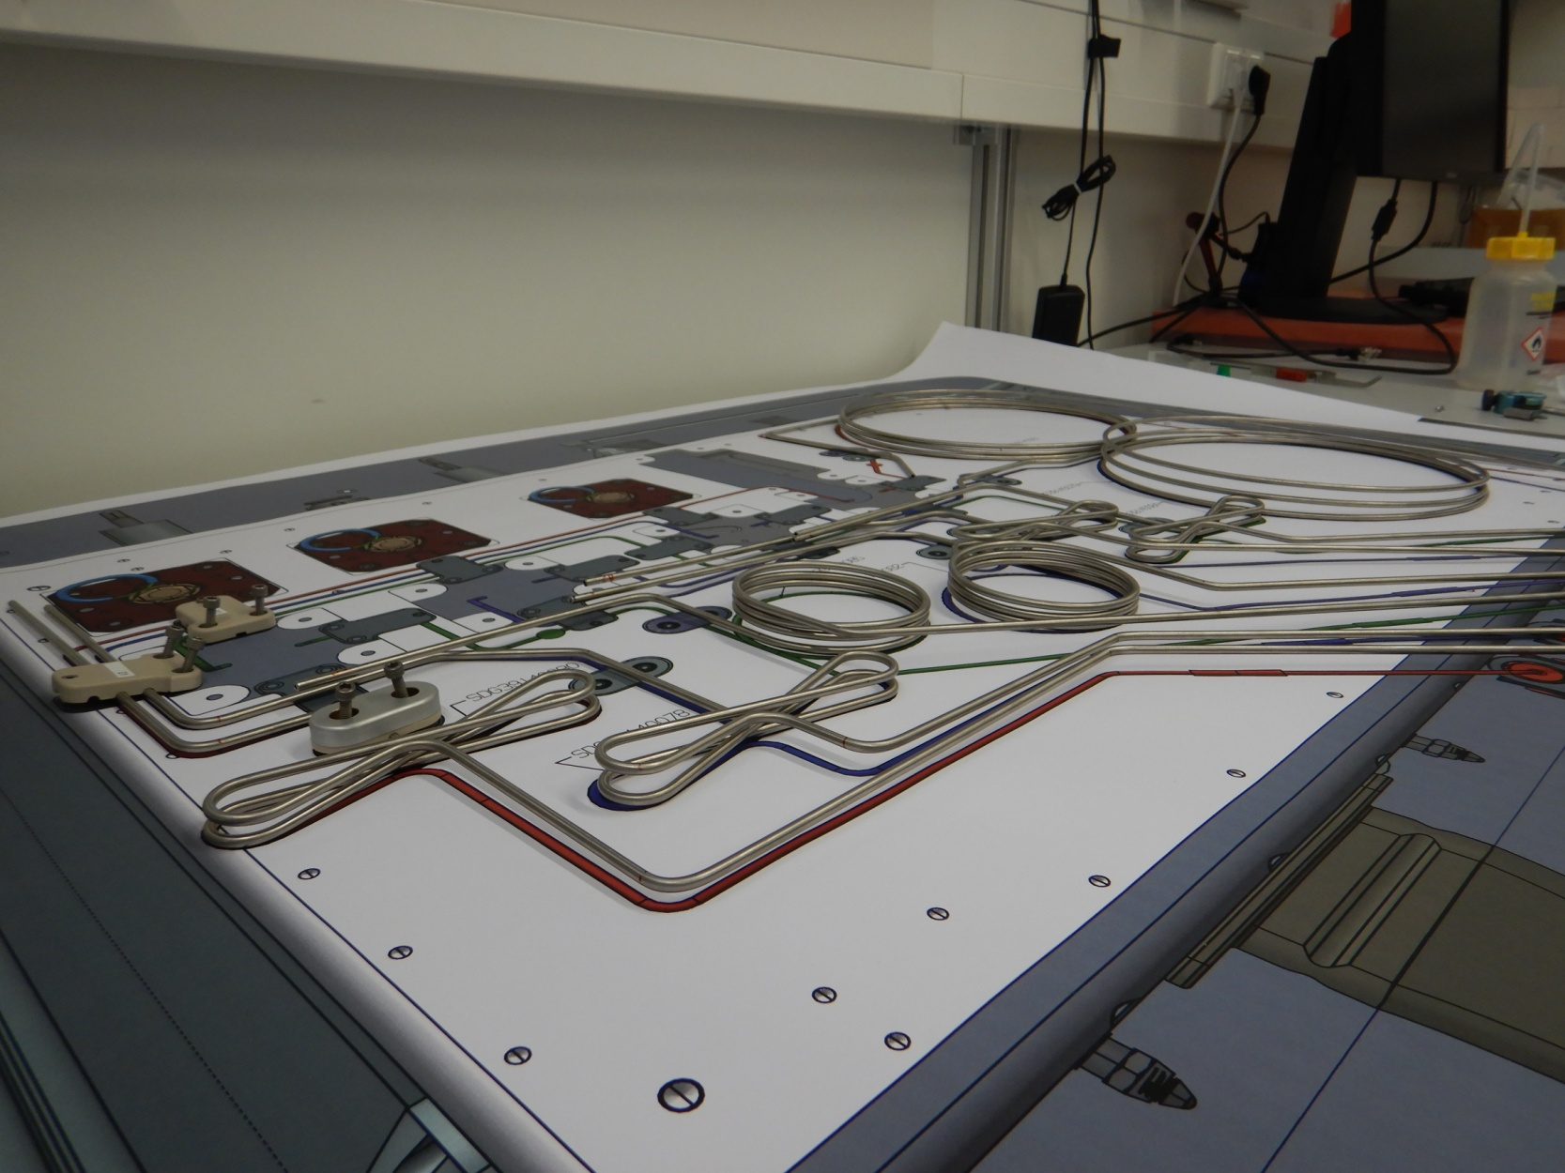
All tubes bent by M. Vergain

Slide 5
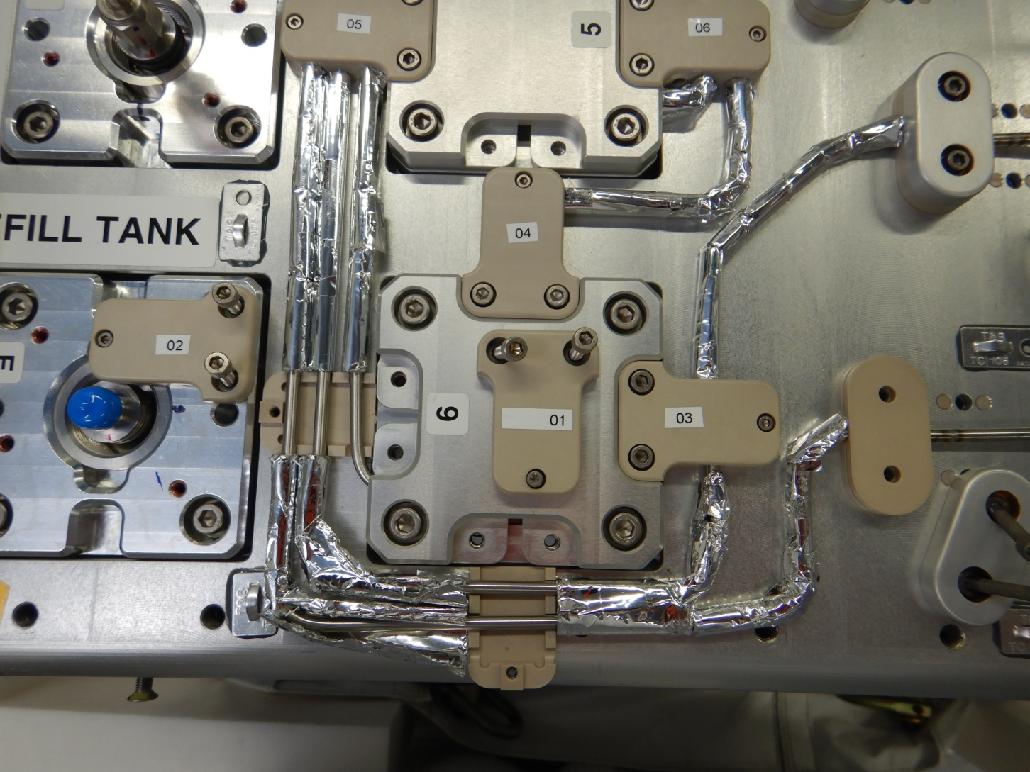
Removed brackets at the simplest welding positions
Screws of peek brackets had almost no running torque during first installation.
Now even less.

Slide 6
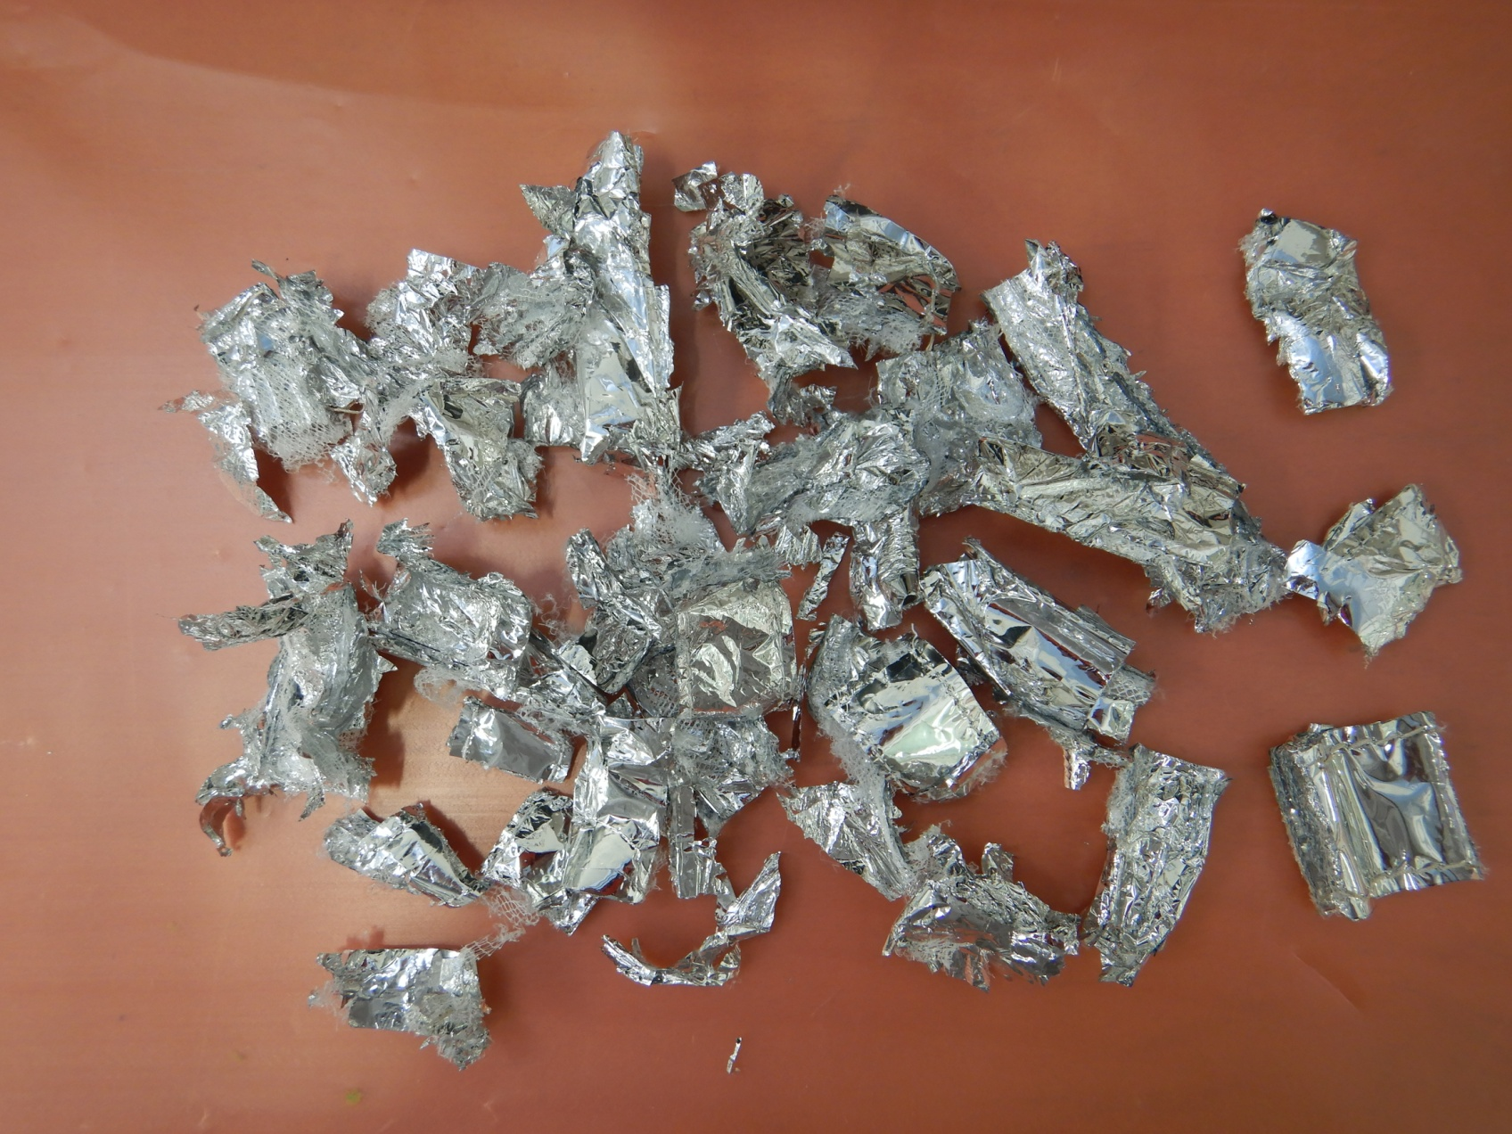
Sorry, Craig…

Slide 7
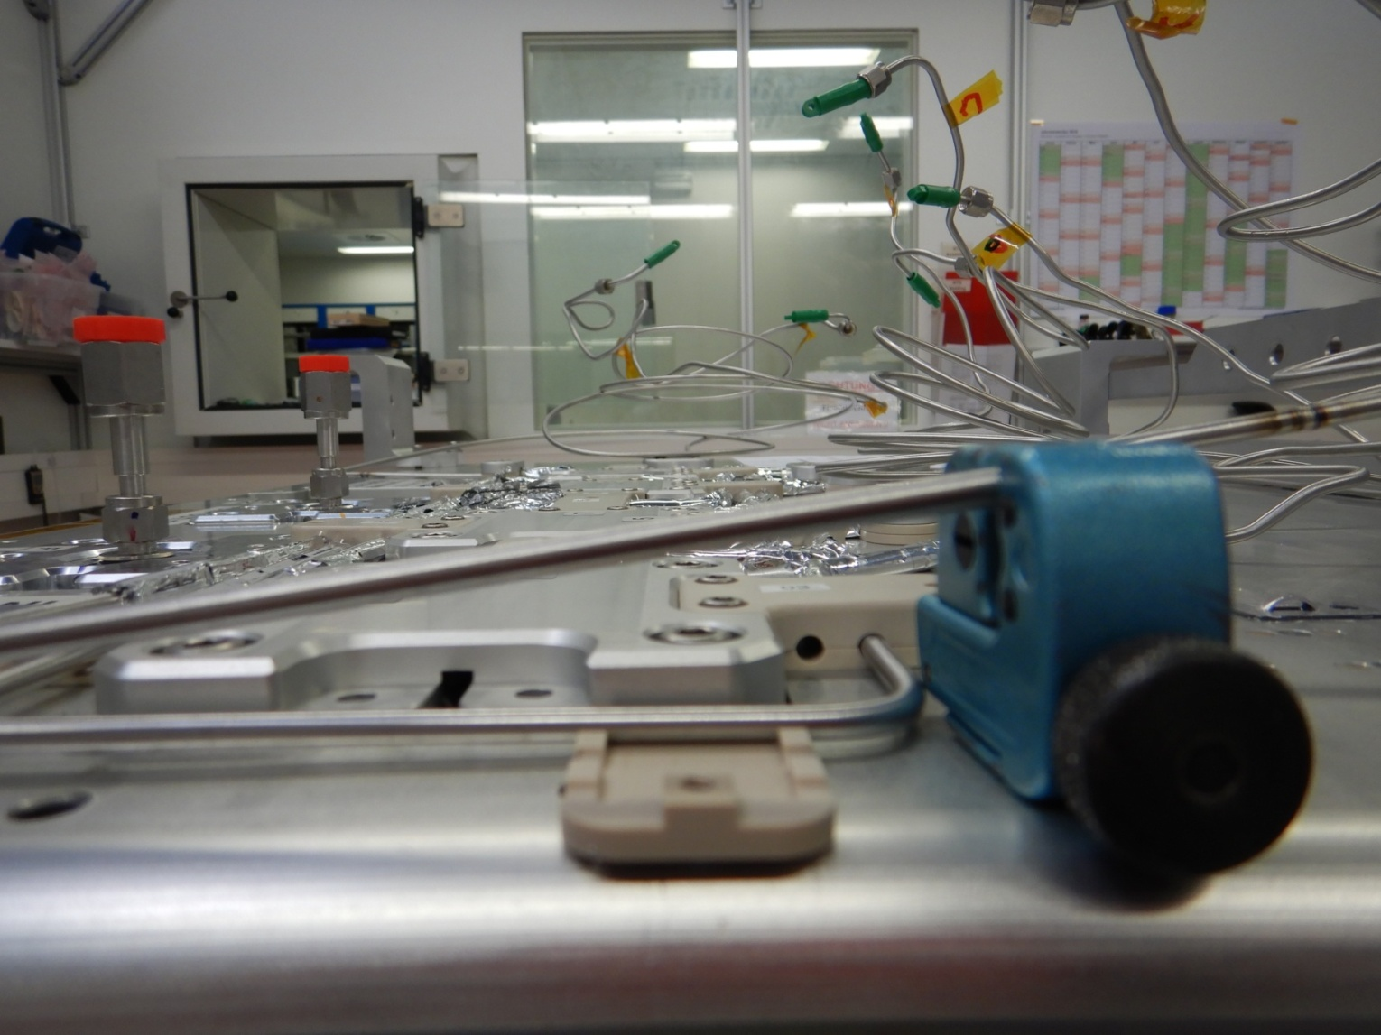
Tube cutting tool …
Weld head is about the same size (not larger).
We have work out, how to fix tubes during welding to prevent bad alignment or distortion.

Slide 8
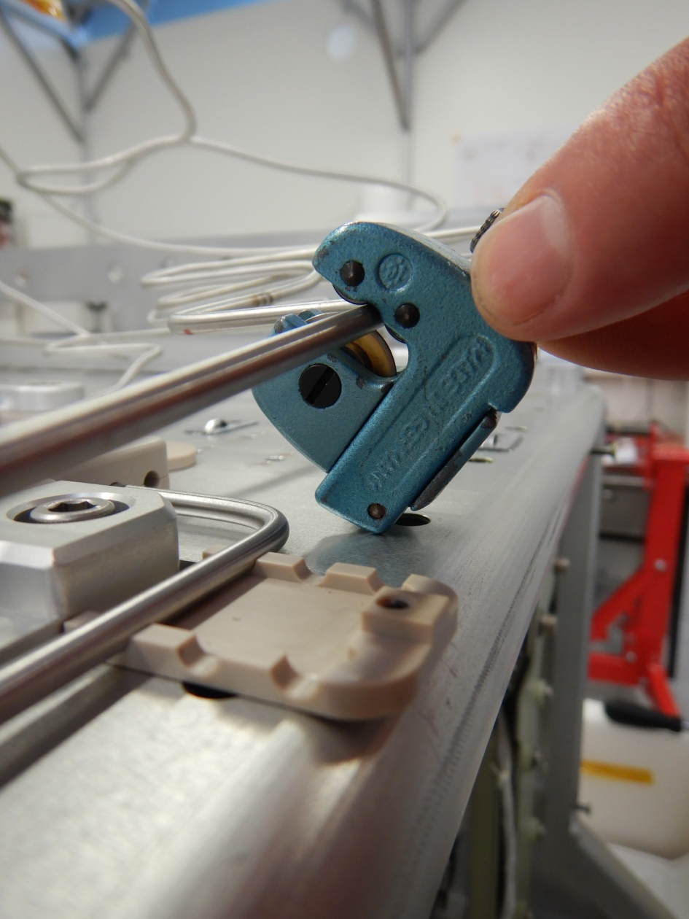
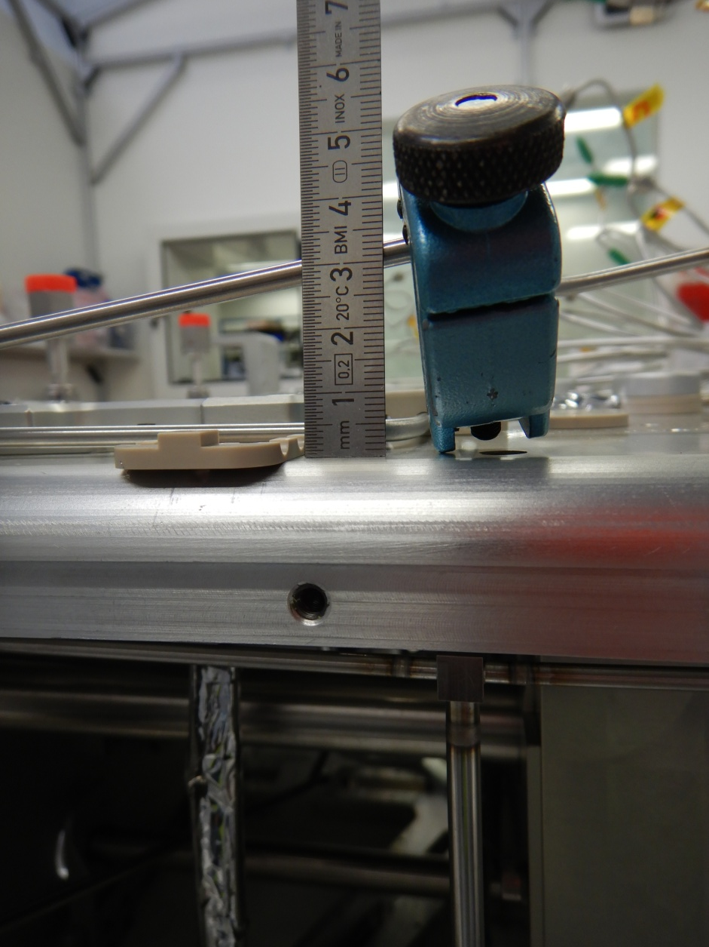
…needs space

Slide 9

Welding positions
B2
A2
D2
C2

Slide 10
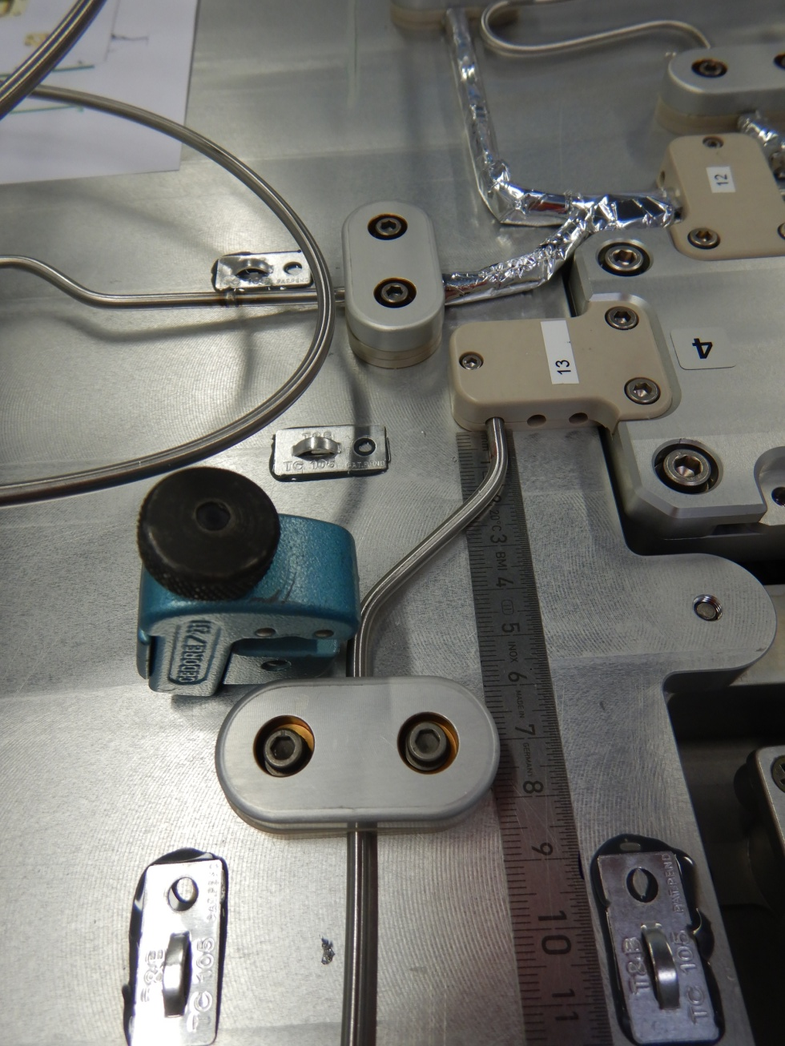
Very bad welding position B2
lever arm < 4cm
no
alternative
welding
position

Slide 11
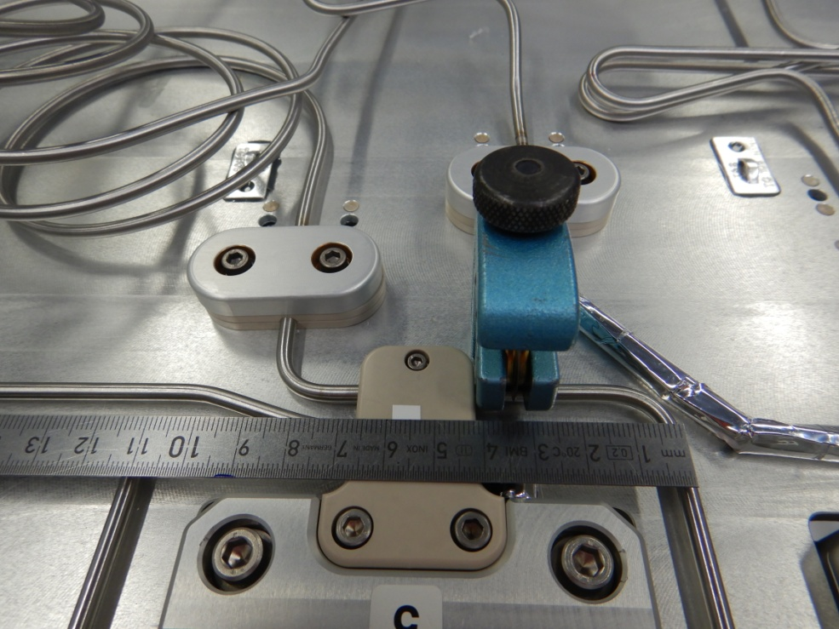
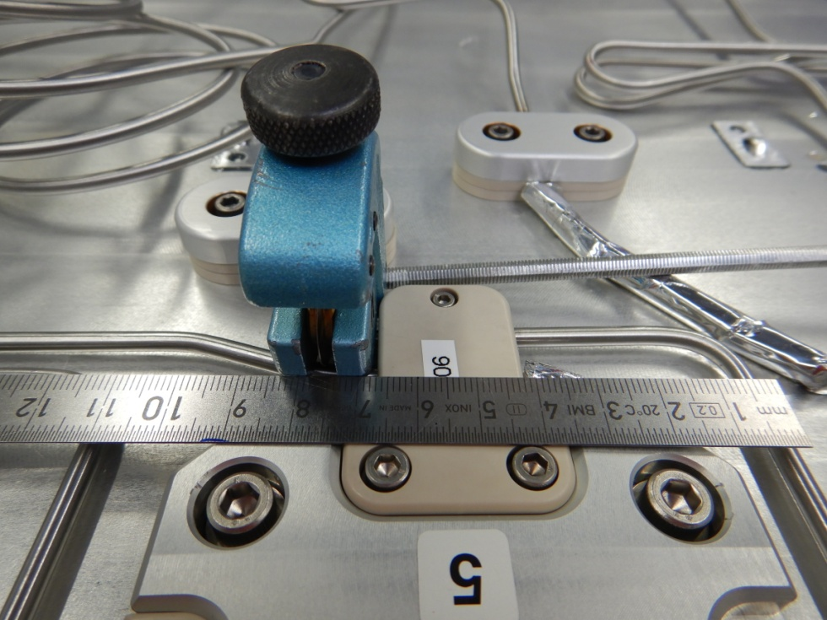
Very bad welding position D2
lever arm = 3.5cm
(+ 6cm rectangular)
lever arm = 7cm
(+ 6cm rectangular)
Alternative welding position

Slide 12
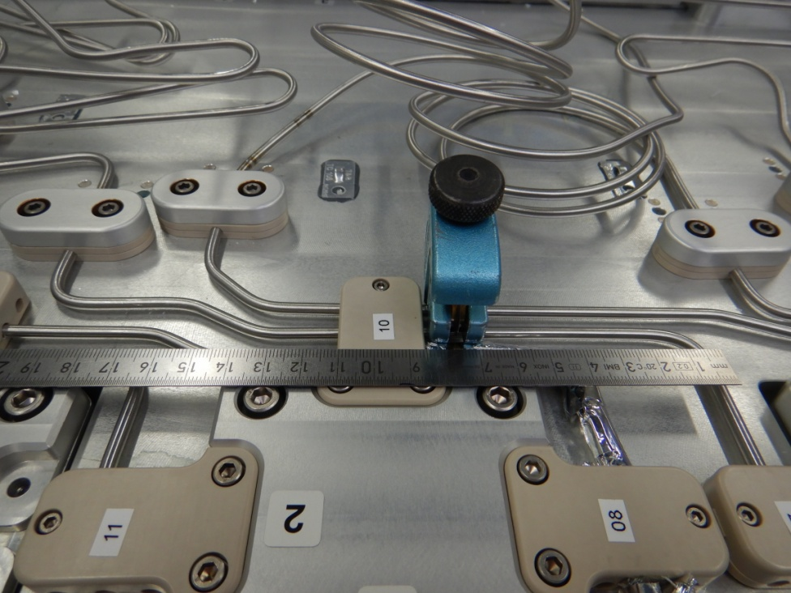
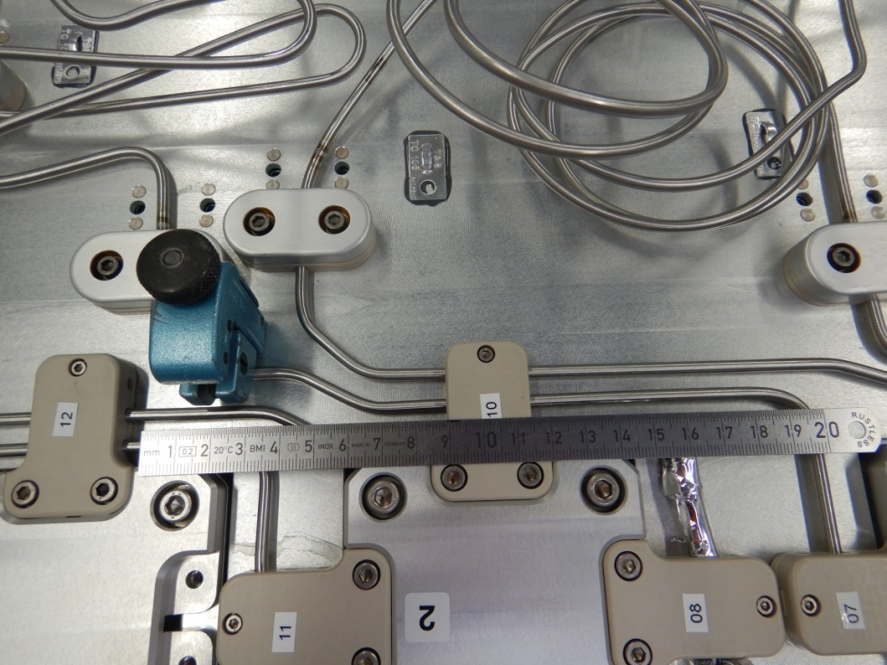
Very bad welding position C2
lever arm = 7cm
lever arm = 17cm
Alternative welding position

Slide 13
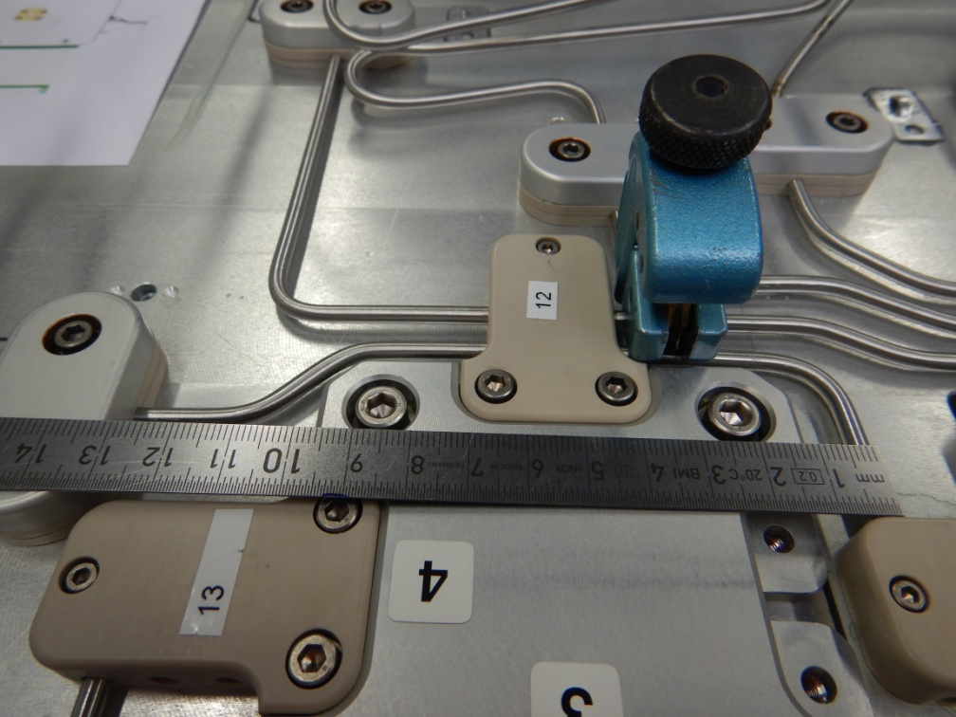
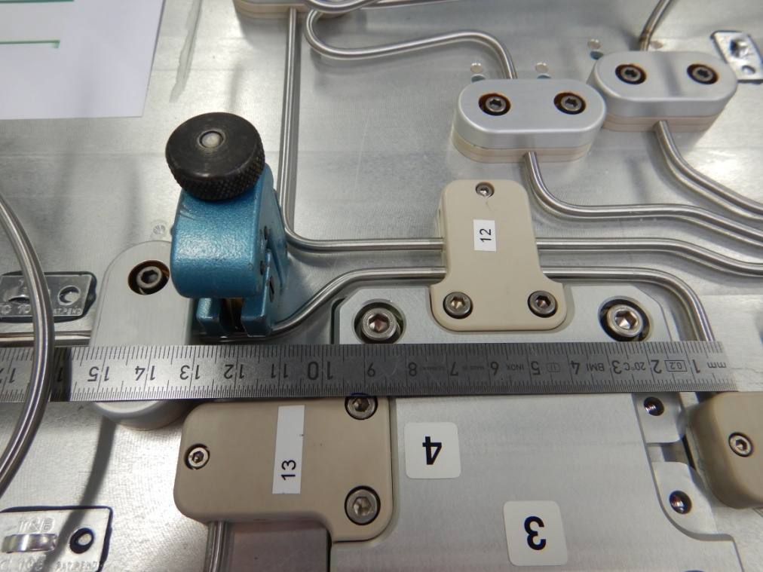
Very bad welding position A2
lever arm < 4cm
lever arm >10cm
Alternative welding position

Slide 14
Has to be lifted up like:
>45º
<25º
puts a lot of stress on „Y“
or with less stress on „Y“

