Slide 1
UTTPS AAF fixation for transport
G. Schwering
July 1st, 2019

Slide 2
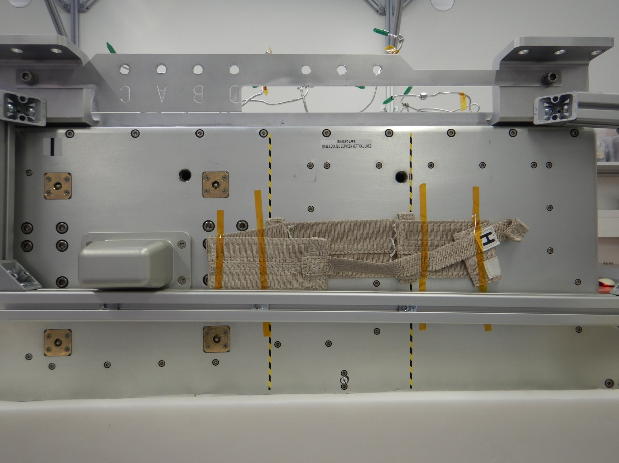
Port plate
Fixation points for engine stand to be used for turning UTTPS at Wallops

Slide 3
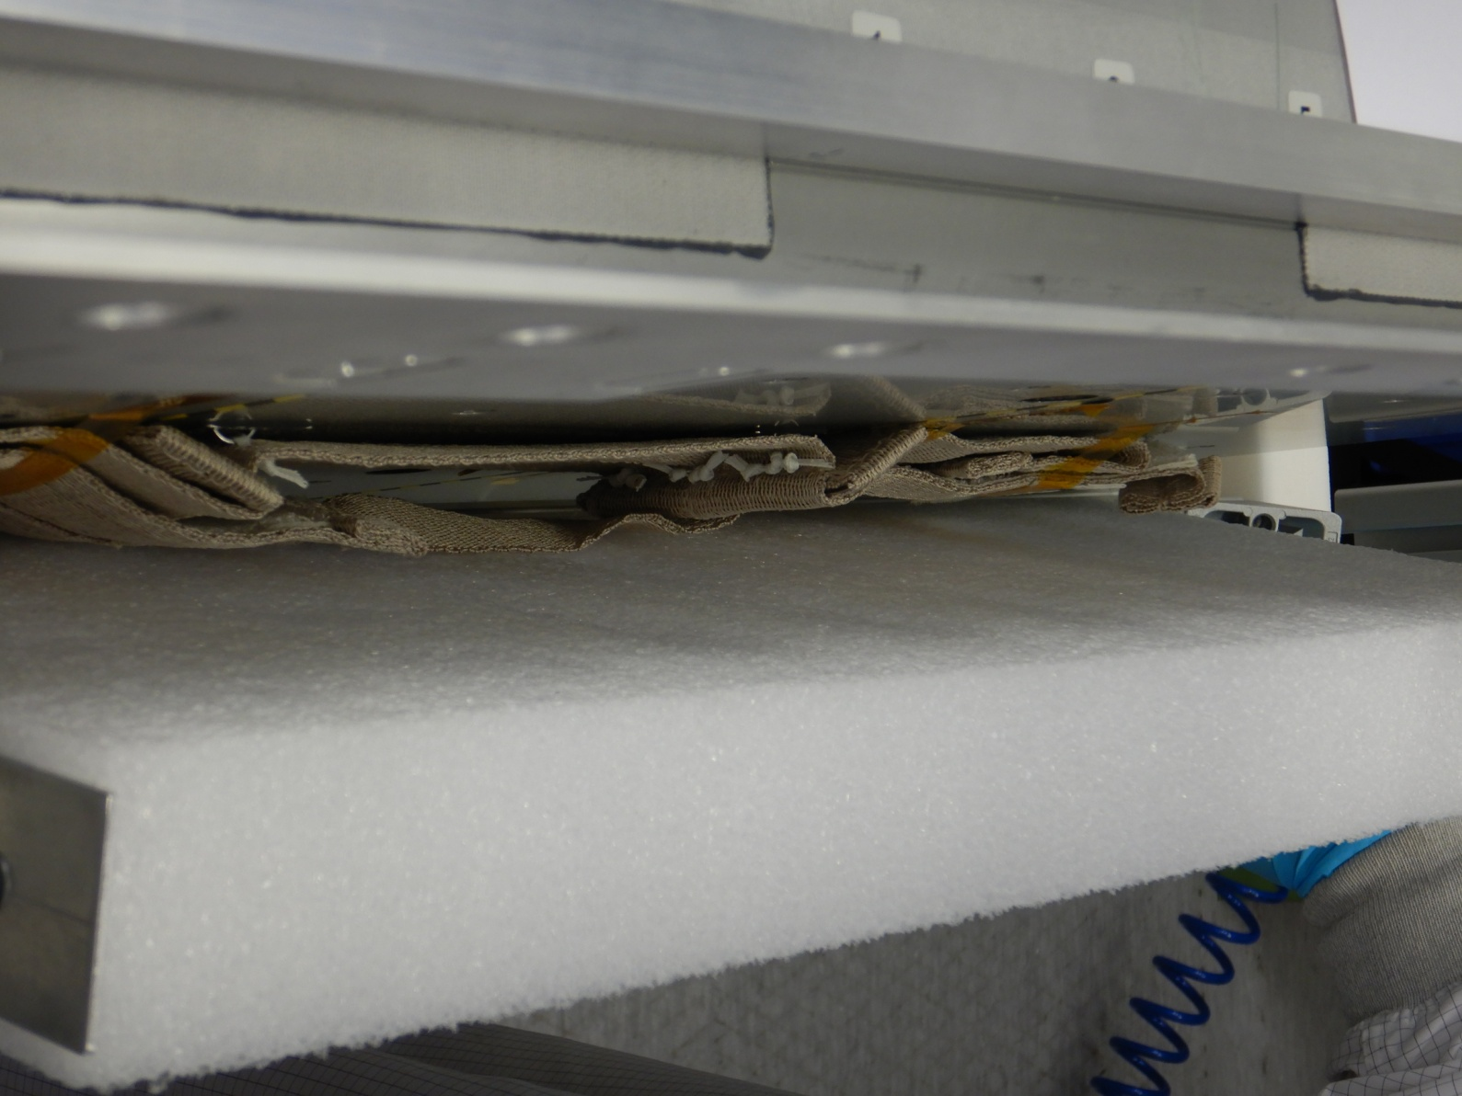
AAF „bag“
Creates some extra distance between Port Plate and AFF (fixation)

Slide 4
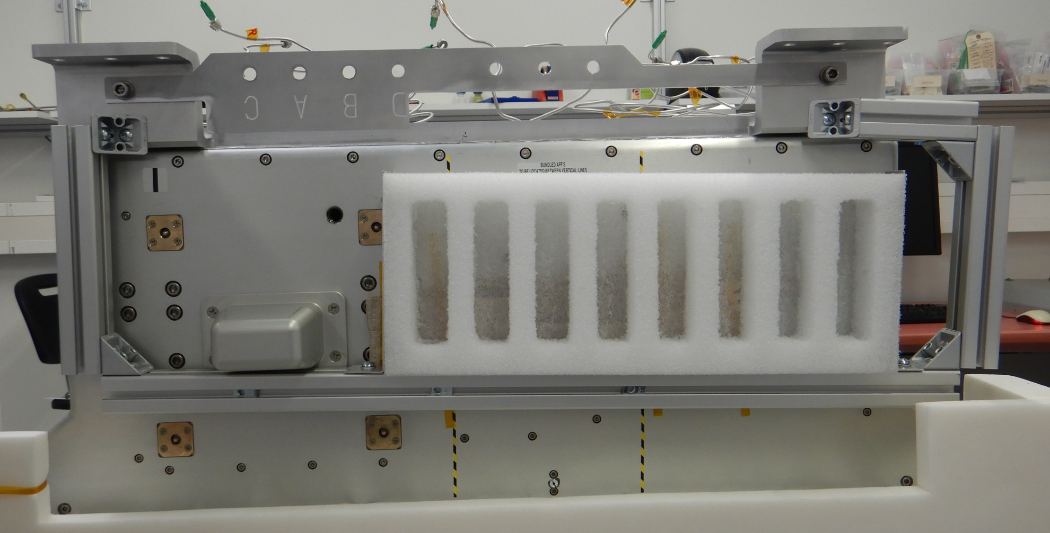
AAF transport fixation
0th version
A2
B2
Bridge for
Wallaps procedure
Push this down (maybe up) and split this to free fixation points

