Slide 1
Diamond Beam Shift Review
June 2019
- Daniel Harryman, Lorraine Bobb

Slide 2
IBPM Position Commissioning
- Daniel Harryman, Lorraine Bobb

Slide 3
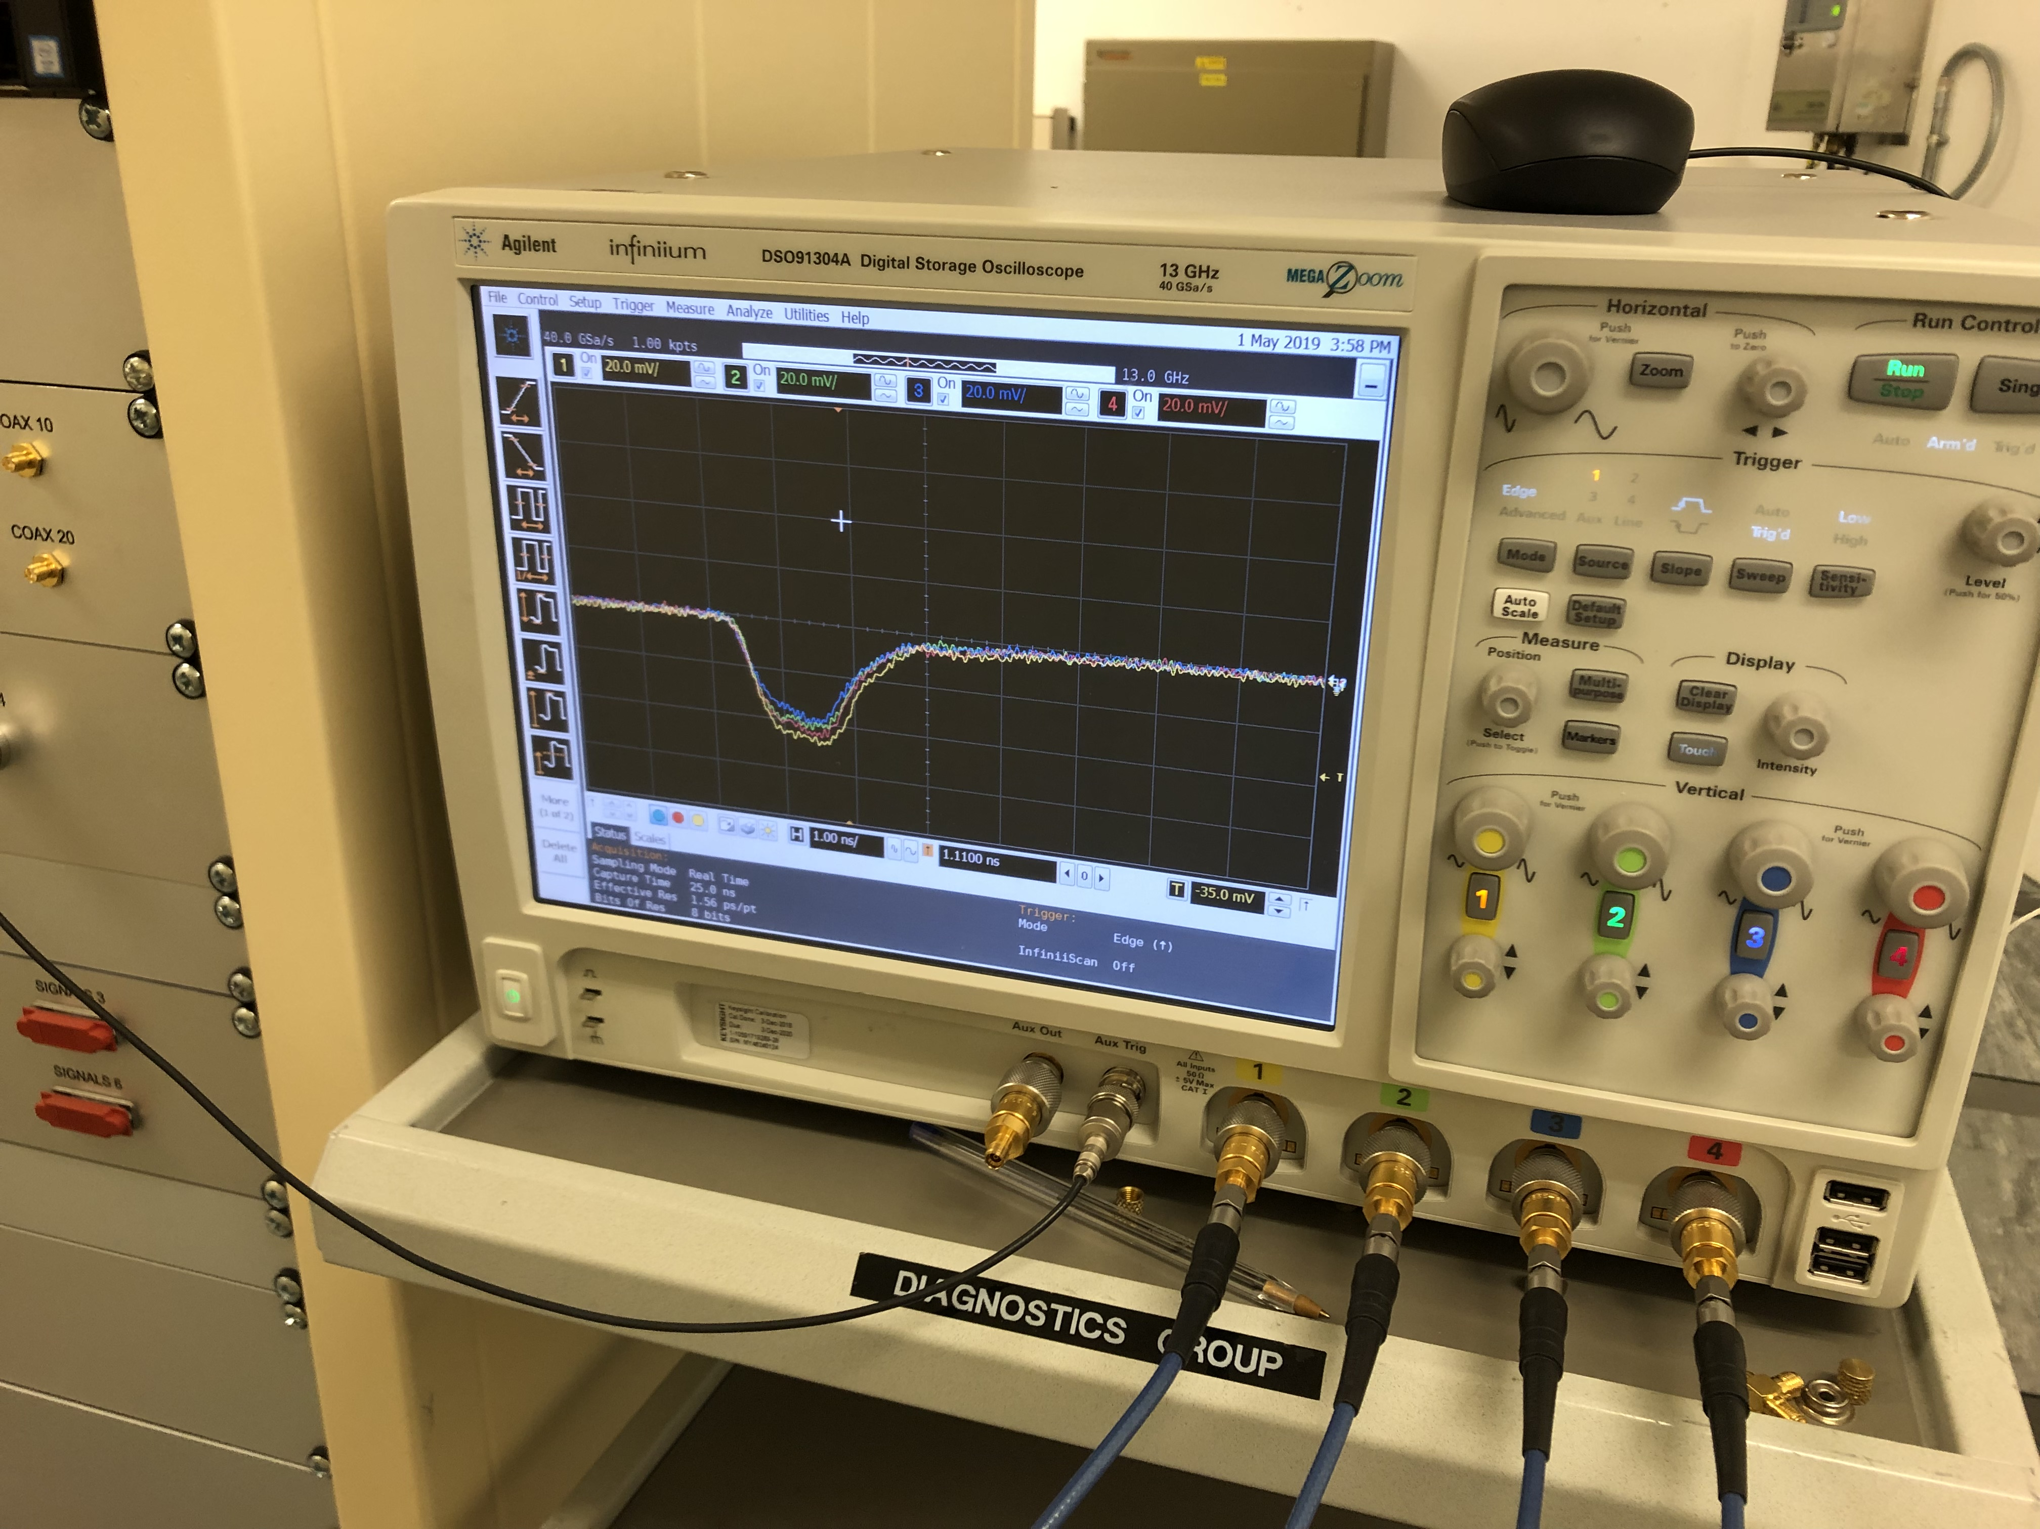
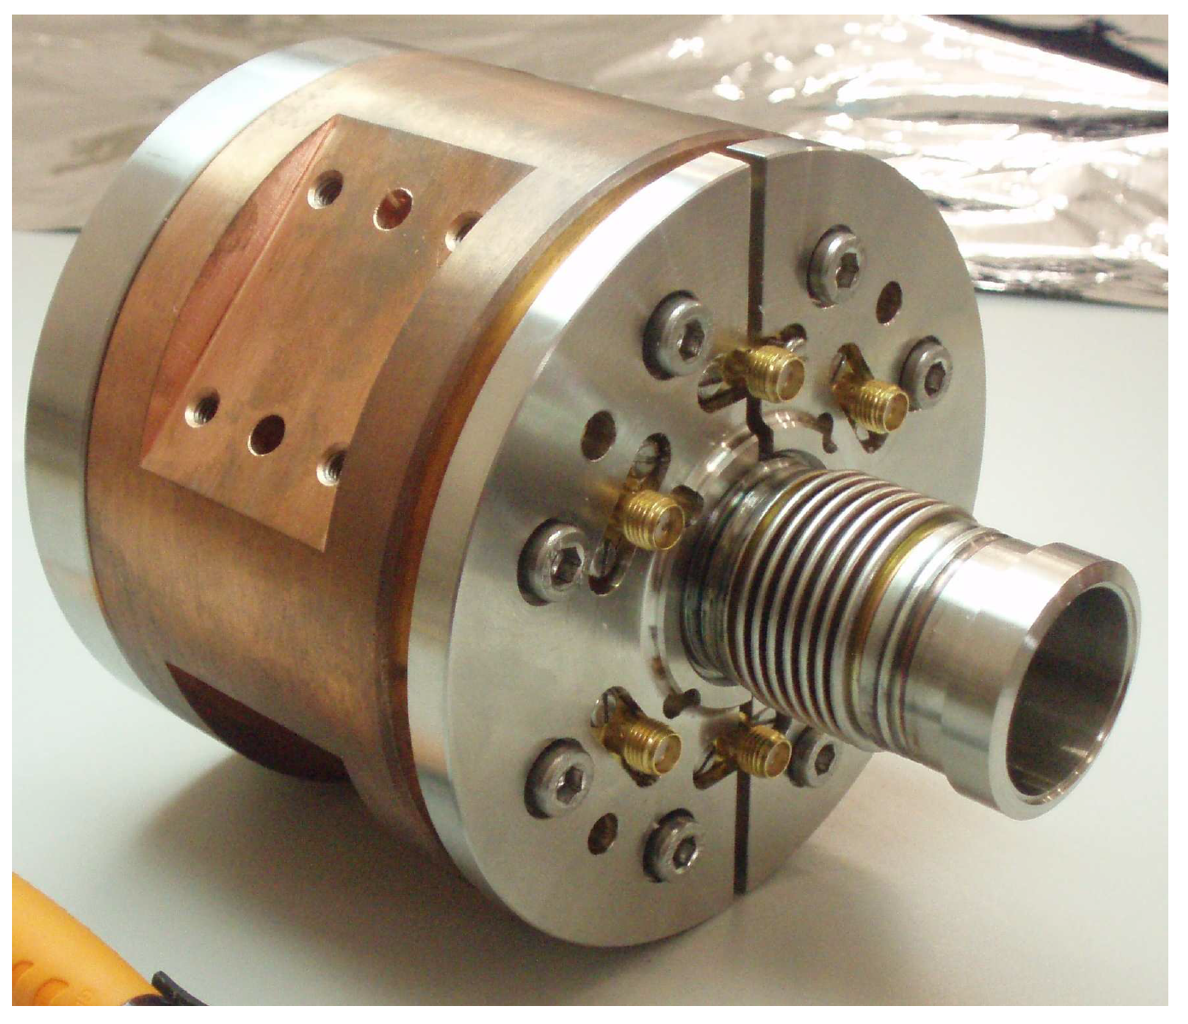
IBPM Commissioning
B+
ChDR IBPM, outputs beam position and intensity.
Connected to an Agilent DSA90000 scope for DAQ.
Positive coordinates for pickups seen as B and C. negative are A and D.
A-
*(0,0)
C+
*Beam going into the page.
D-

Slide 4
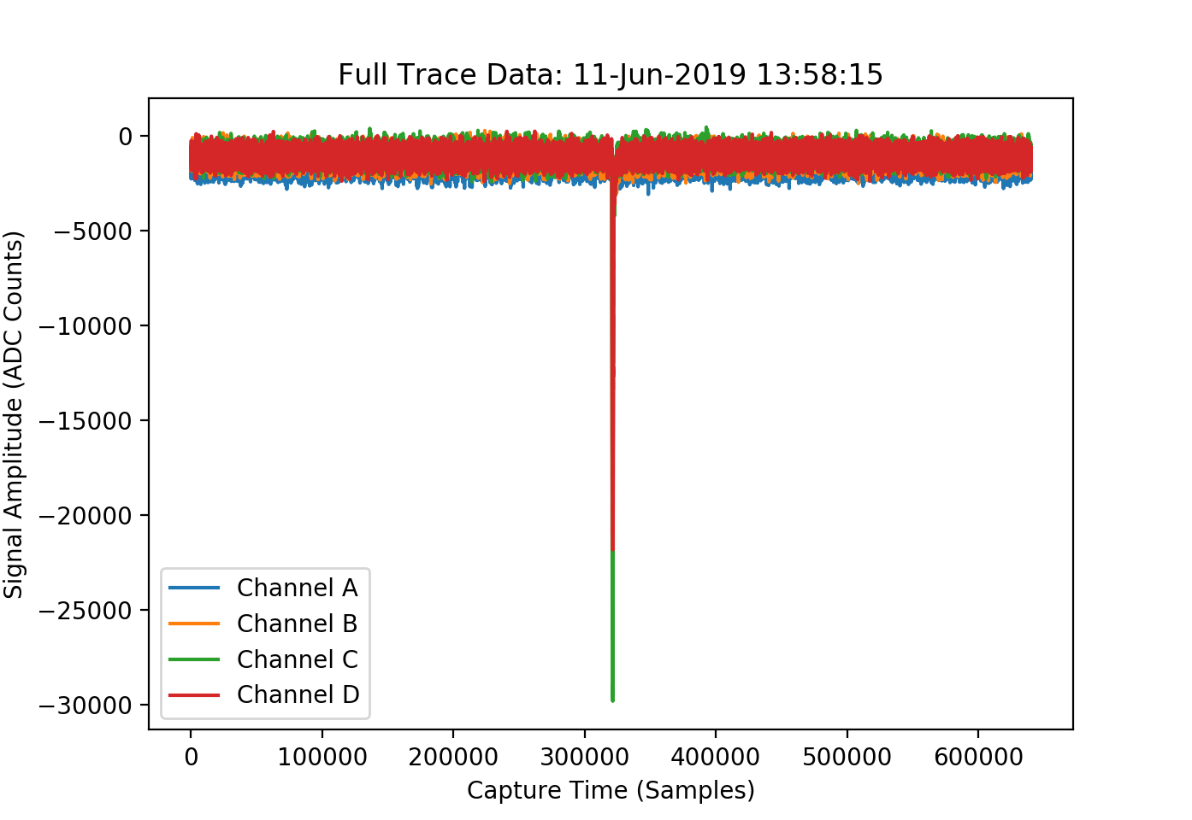
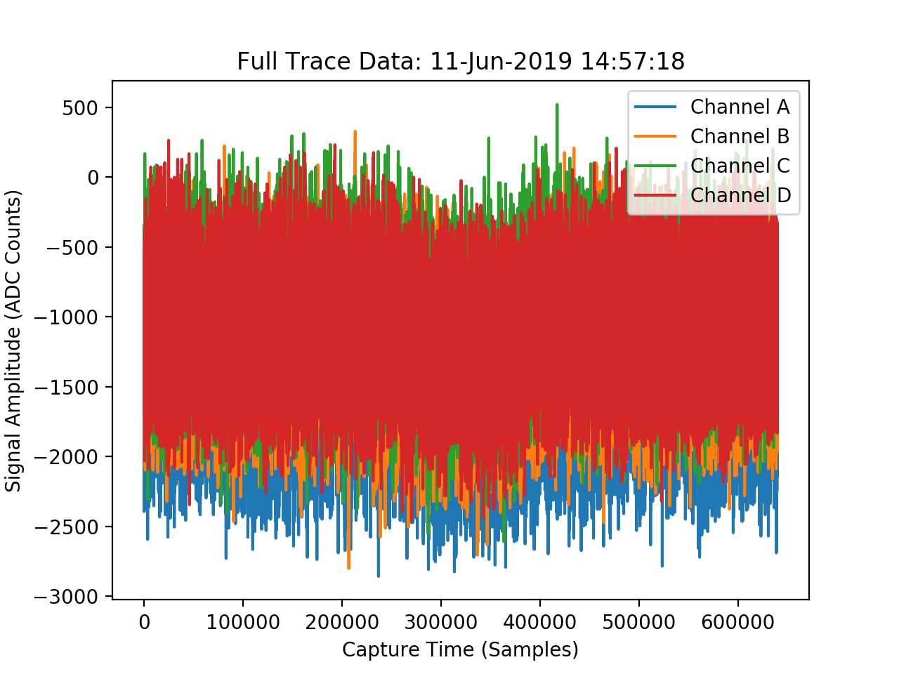
IBPM Commissioning
Single Bunch Data looks very good.
MultiBunch data…… Not so good.
Unsure if this is due to bunch charge, or response. Each bunch has lower charge when running in MultiBunch at Diamond.
Analysis carried out in Single Bunch mode.

Slide 5


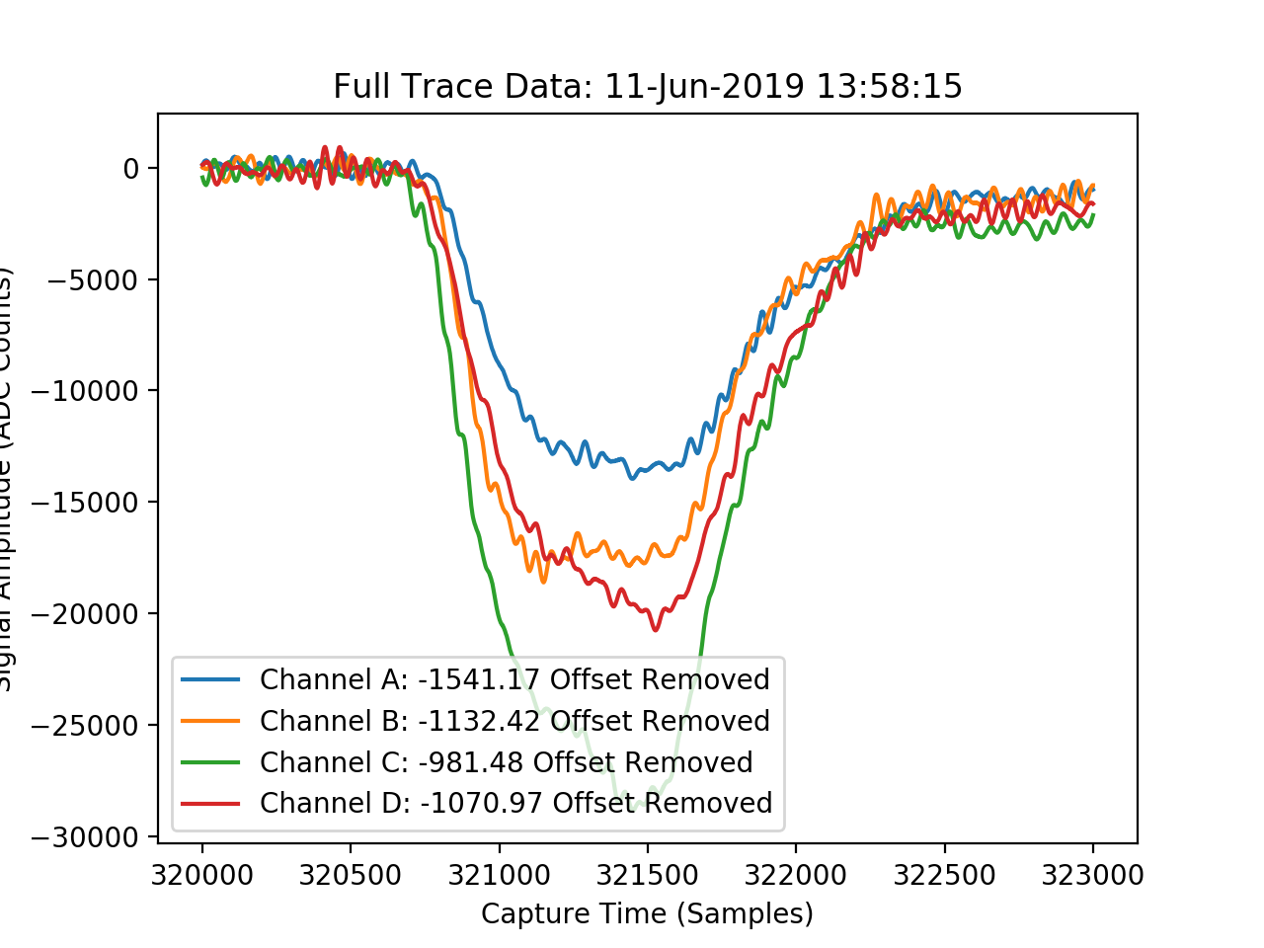
IBPM Commissioning
Channel offsets removed, then window set to integrate over.
Beam position given as difference over sum.
Window size was set to 2nS (same as bunch length). Due to jitter and number of files to process this was increased to ≈6nS.
kx = 13.8mm
ky = 13.8mm

Slide 6
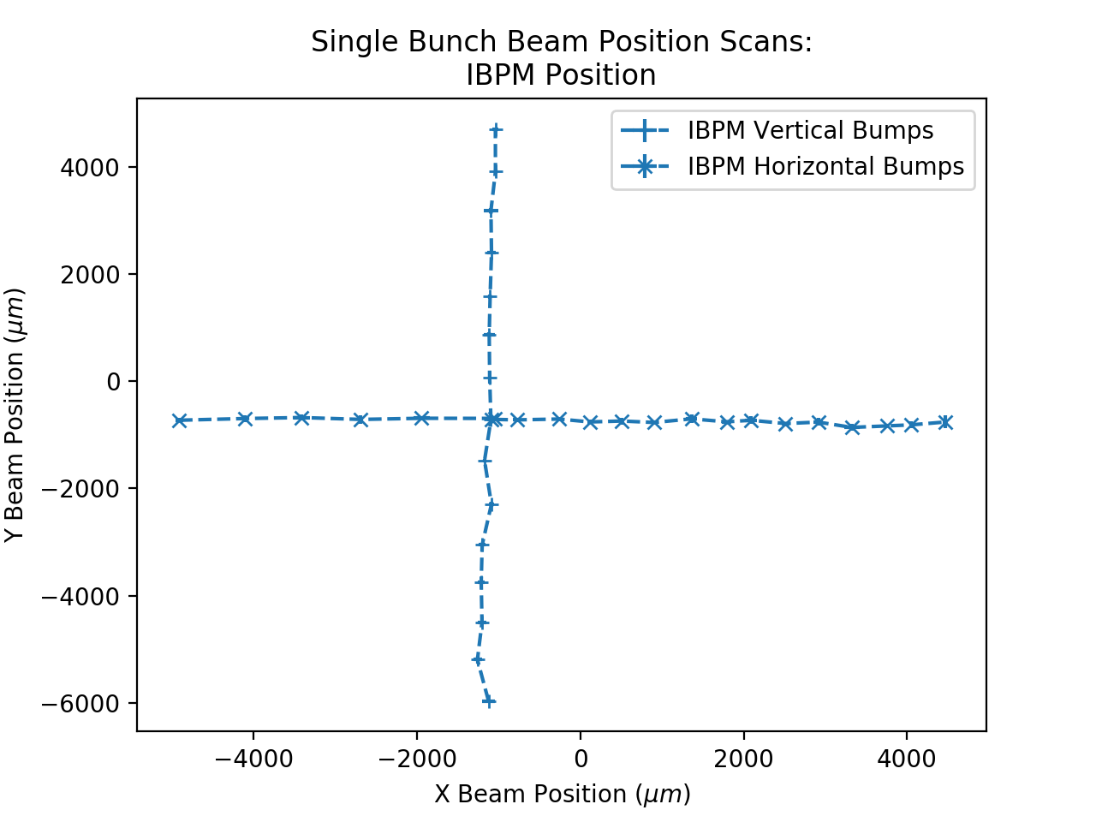
IBPM Commissioning
Horizontal and Vertical Beam Bumps applied, average data taken for 3 beam shots at each position.
Data Displayed is mean values with error bars of the standard deviation.
13.8mm given for kx and ky

Slide 7
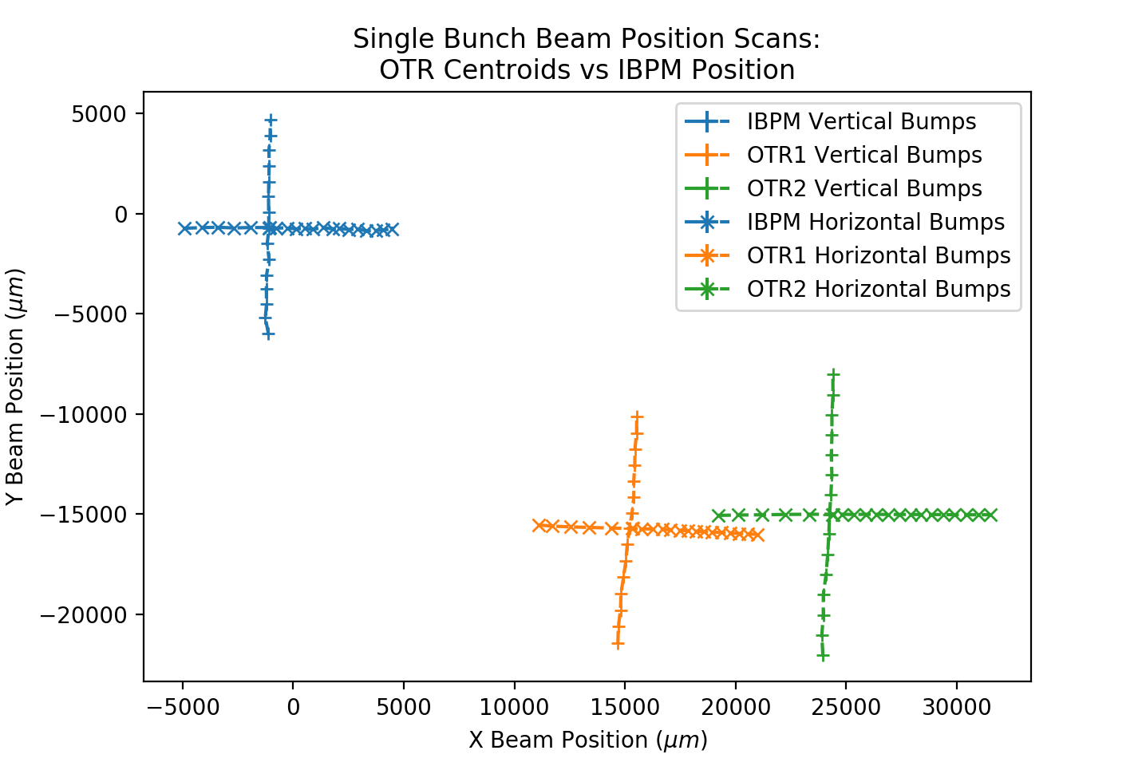
IBPM Commissioning
OTR Centroids vs IBPM Beam position.
As before mean value over 3 shots displayed with standard deviation as error bars.
Relative movement between all three monitors looks reasonable, will take into account OTR offsets.
Offsets not applied.

Slide 8
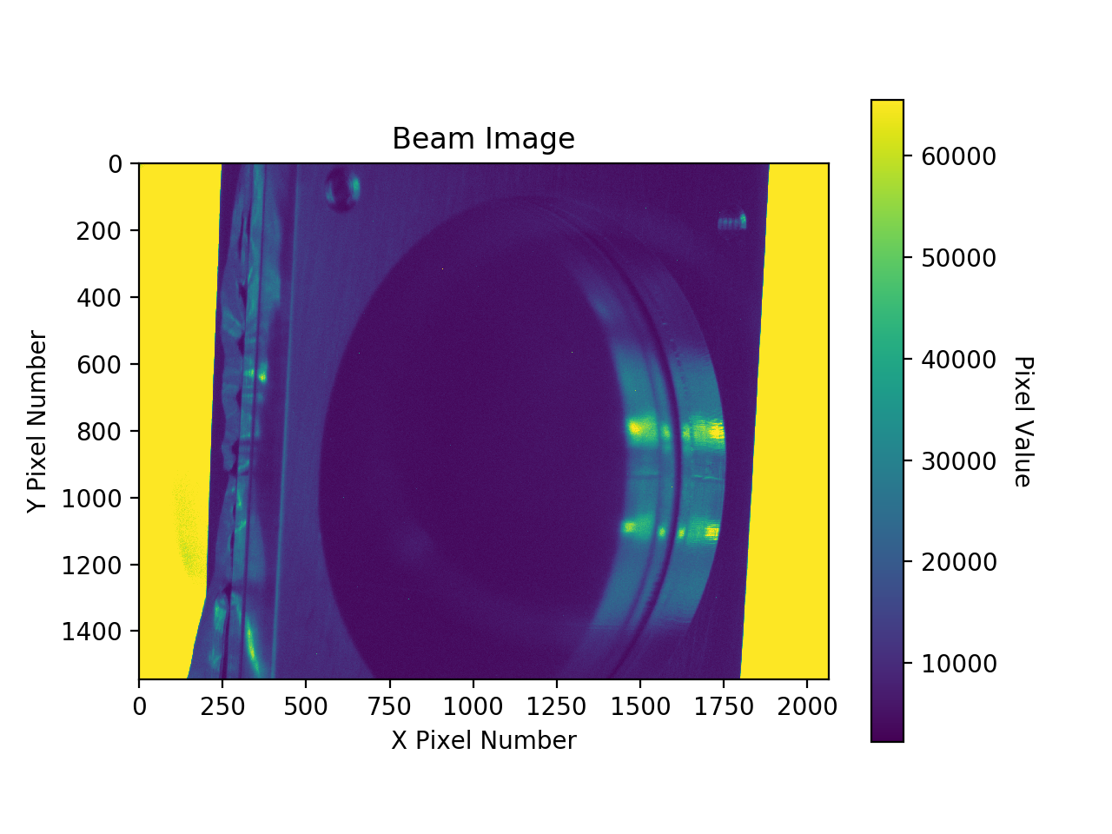
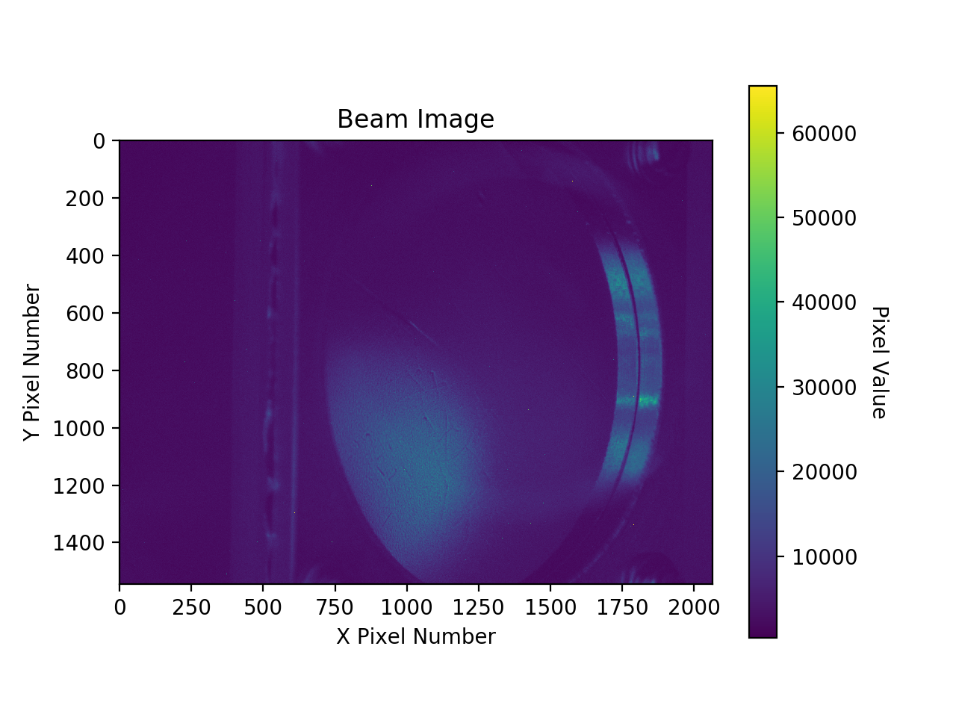
IBPM Commissioning
OTR1 Reference Image:
  Screen Xmin = 538, Screen Xmax = 1610,
  diff = 1072, diff/2 = 536
  Assume X Centre is 1074.
OTR2 Reference Image:
  Screen Xmin = 712, Screen Xmax = 1804, diff = 1092, diff/2 = 546
  Assume X centre is 1258 pixels.
Vertical Adjustment:
  First Guess is to use central line of the image as 0, as the screens are movable. i.e assume both OTR1 and 2 Y centre point is at 786 pixels.

Slide 9
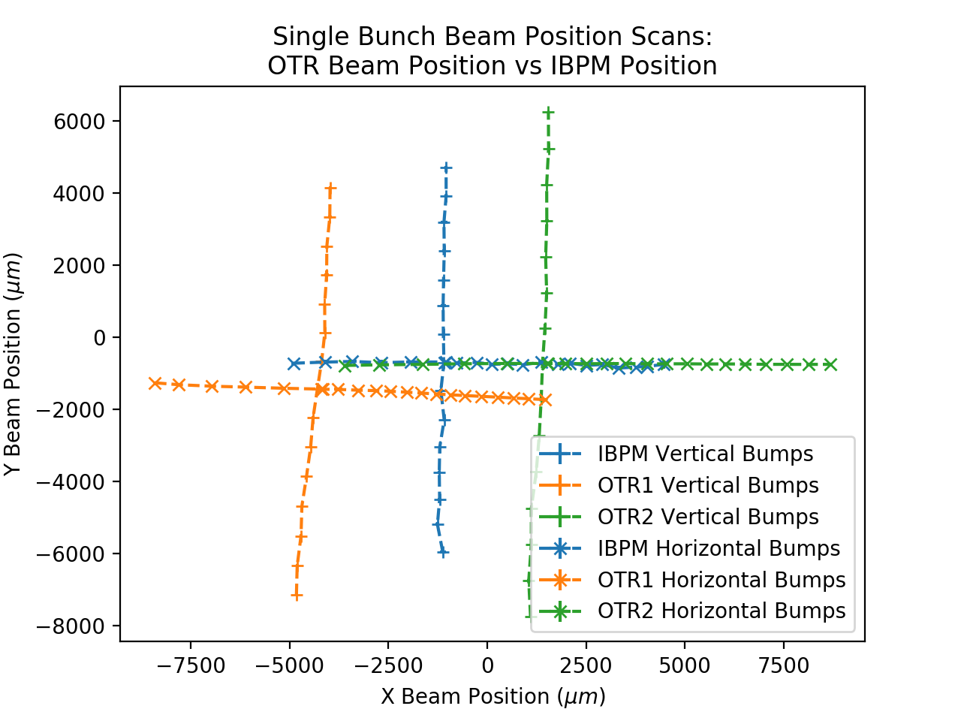
IBPM Commissioning
OTR Centroids vs IBPM Beam position.
As before mean value over 3 shots displayed with standard deviation as error bars.
Relative movement between all three monitors looks reasonable, will take into account OTR offsets.
Offsets not applied.

Slide 10
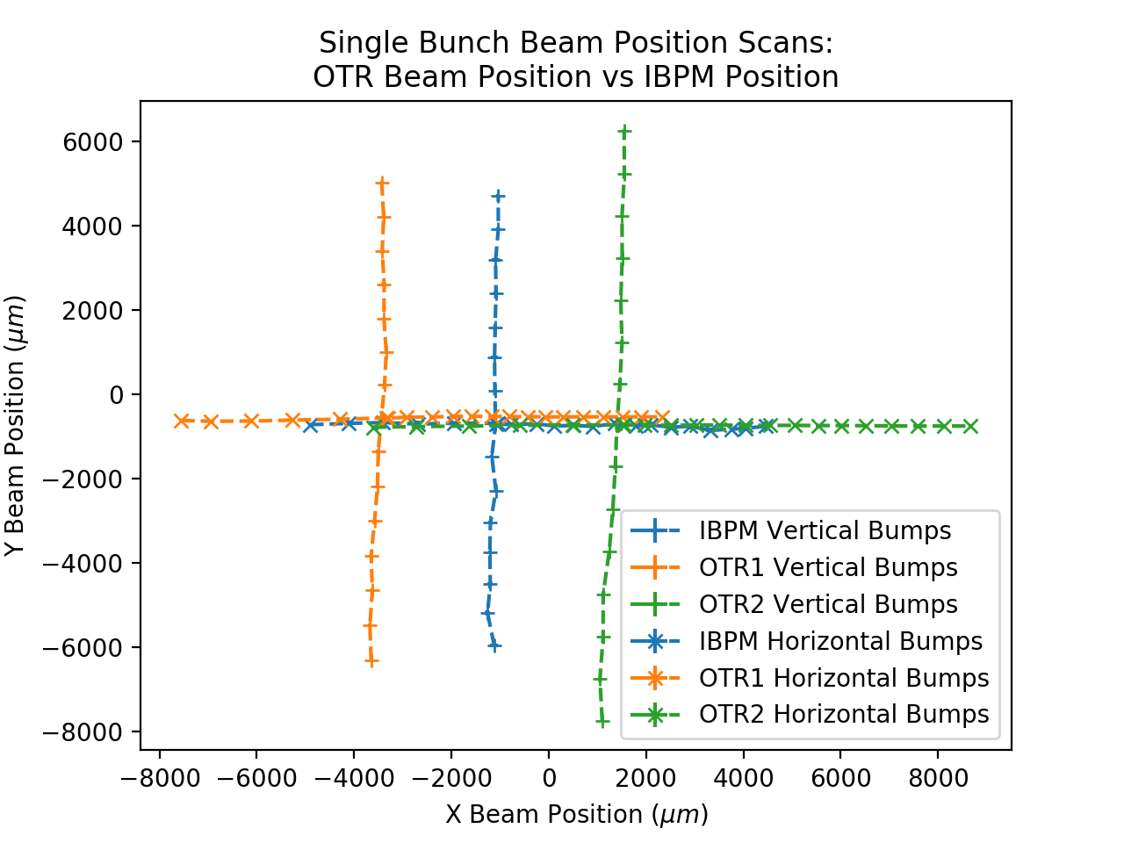
IBPM Commissioning
OTR 1 has a 3.2 degree tilt:
x y pixel values converted from cartesian to polar. Then adjusted by 3.2 degrees.
Using Available information, this is the best match between monitors .

Slide 11
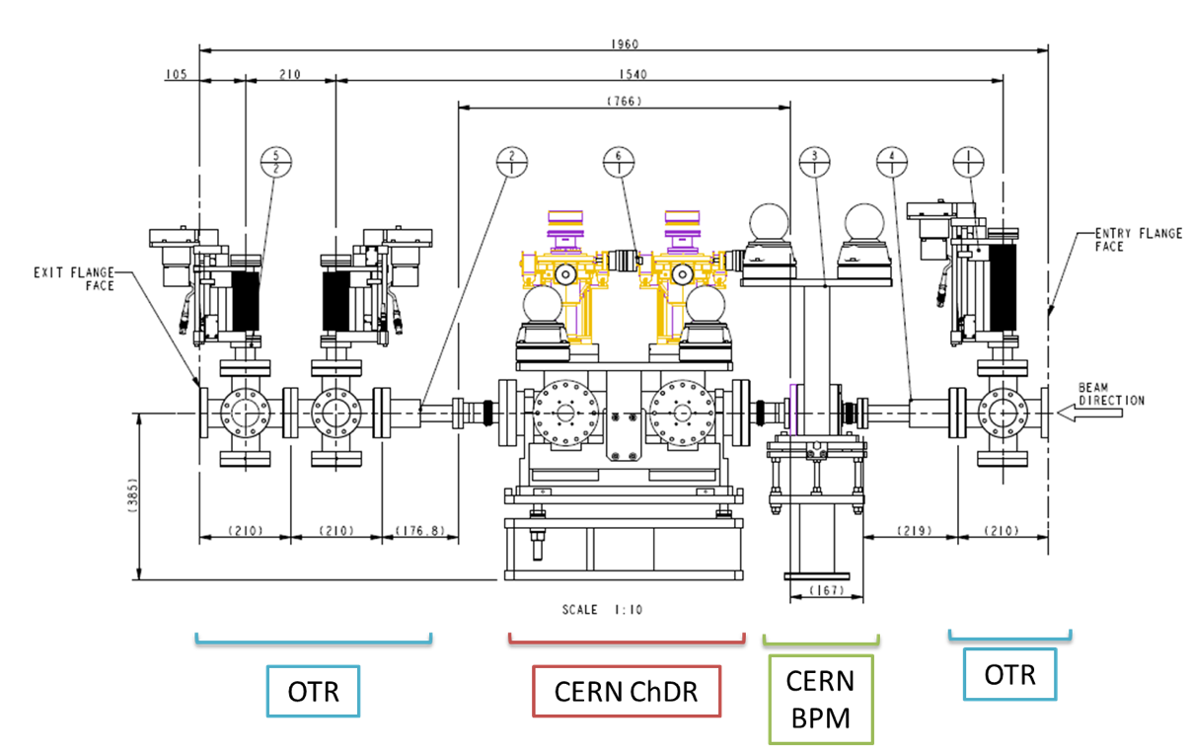
IBPM Commissioning
Looking at the Shifts:
  As the correctors that apply the beam bump are upstream, you would expect, the OTR1 maximum shift to be the least, and the OTR2 shift to be the most.
Y Ranges from:
  OTR1: 5022 to -6311 μm: Span: 11333 μm
  IBPM: 4711 to -5975 μm: Span: 10686 μm
  OTR2: 6250 to -7752 μm: Span: 14002 μm
X Ranges from:
  OTR1: 2325 to -7553 μm: Span: 9876 μm
  IBPM: 4467 to -4905 μm: Span: 9372 μm
  OTR2: 8671 to -3615 μm : Span: 12286 μm
Could be error in magnification scaling factor?
OTR3
OTR2
OTR1

Slide 12
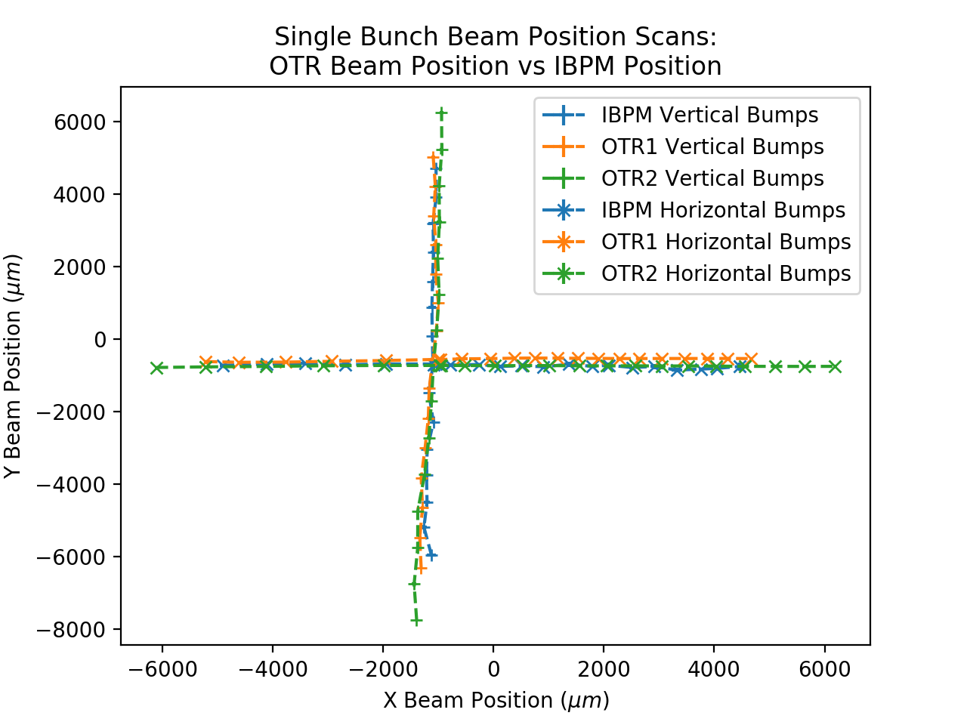
IBPM Commissioning
Additional X shifts:
  OTR1 +129 pixels: ≈ +2.4mm
  OTR2 -137 pixels: ≈ -2.5mm
  Total OTR1 X Shift: 945 pixels
  Total OTR2 X Shift: 1387 pixels
OTR2 could be slightly off angle?

Slide 13
IBPM Commissioning
OTR1 to IBPM – 497.5cm
IBPM to OTR2 – 1031.5cm
OTR1 to OTR2 – 1529cm
Waiting for updated IBPM scaling values before calculating trajectory through BTS.

Slide 14
IBPM Charge Commissioning
- Daniel Harryman, Lorraine Bobb

Slide 15
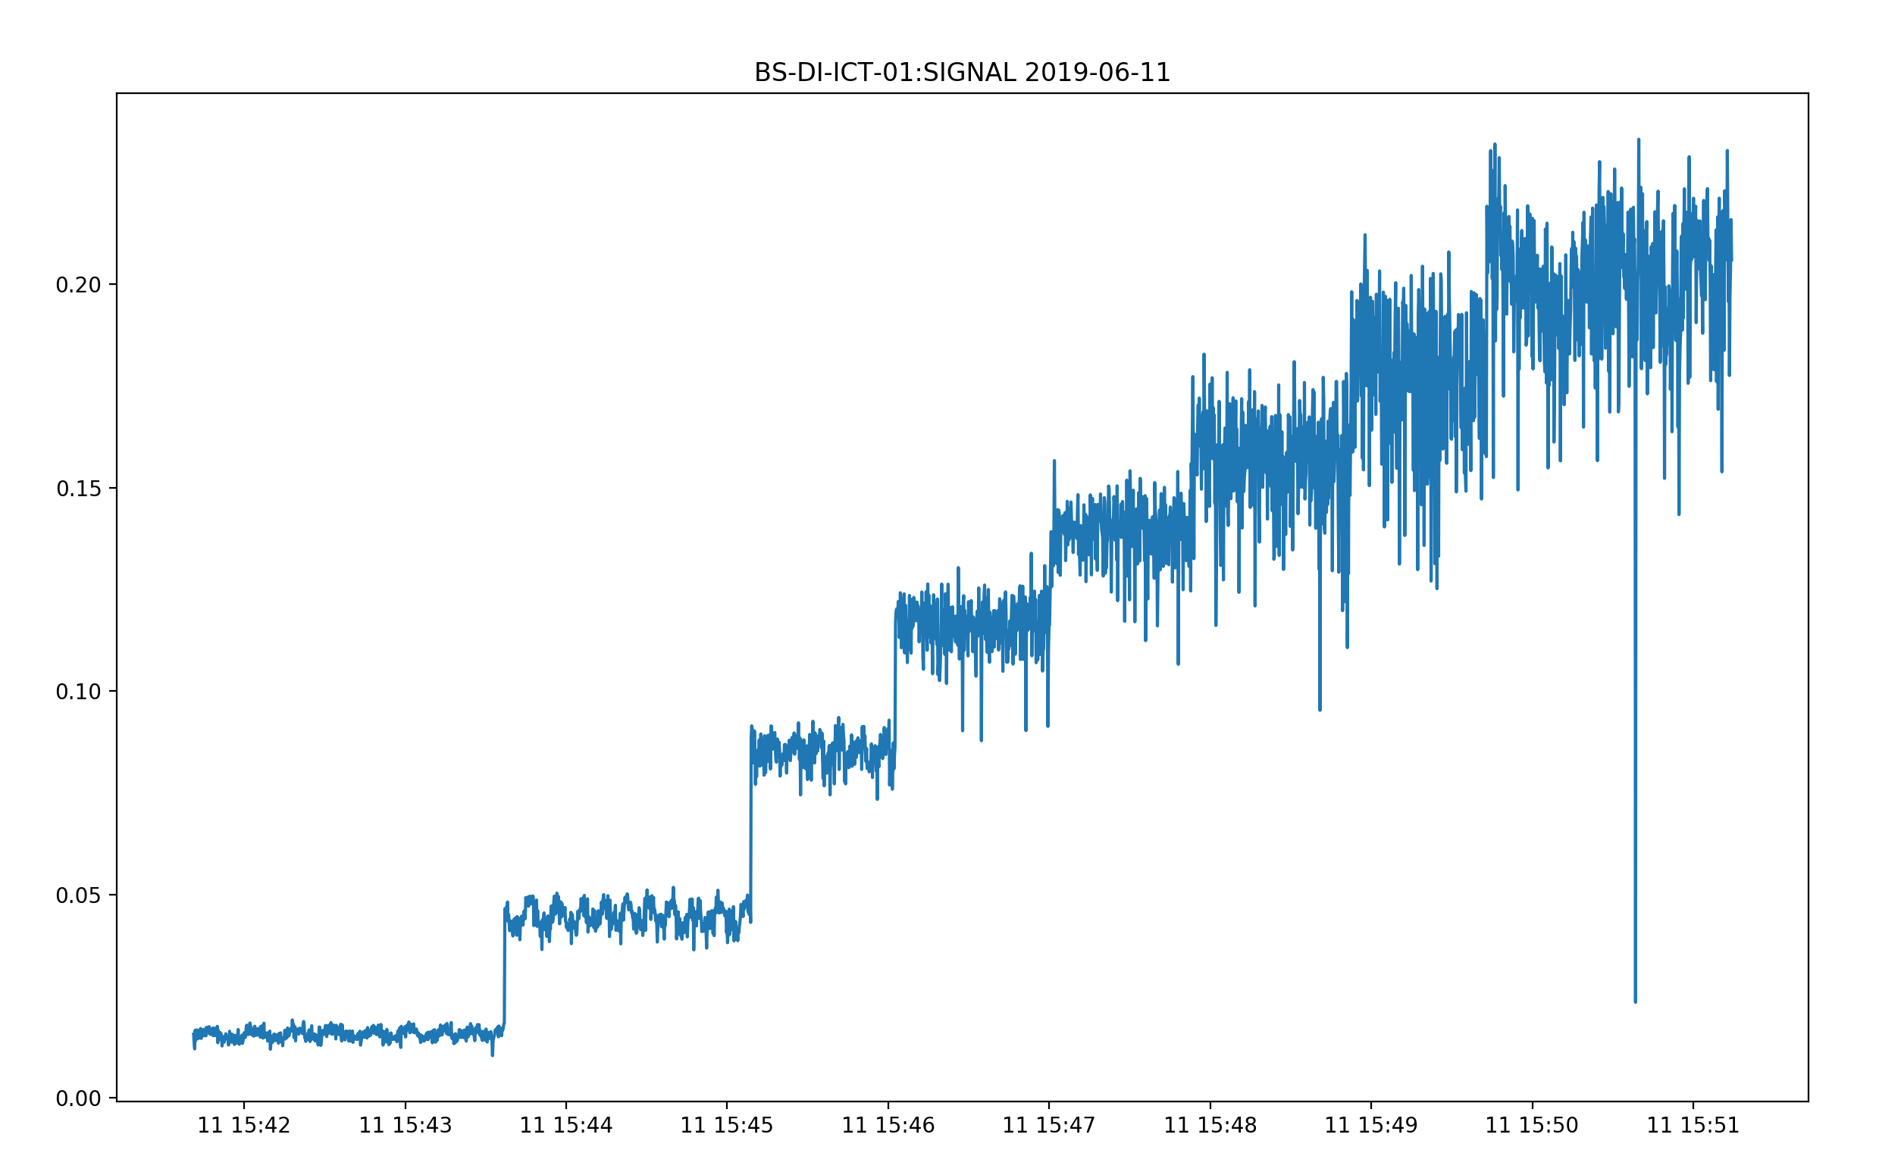
IBPM Commissioning
Accelerator set to single bunch mode.
Gun Bias voltage changed from 140V (minimum charge) to 70V (maximum charge).
ICT Charge monitored and logged to text file.
Plot shows charge in nC vs timestamp.

Slide 16
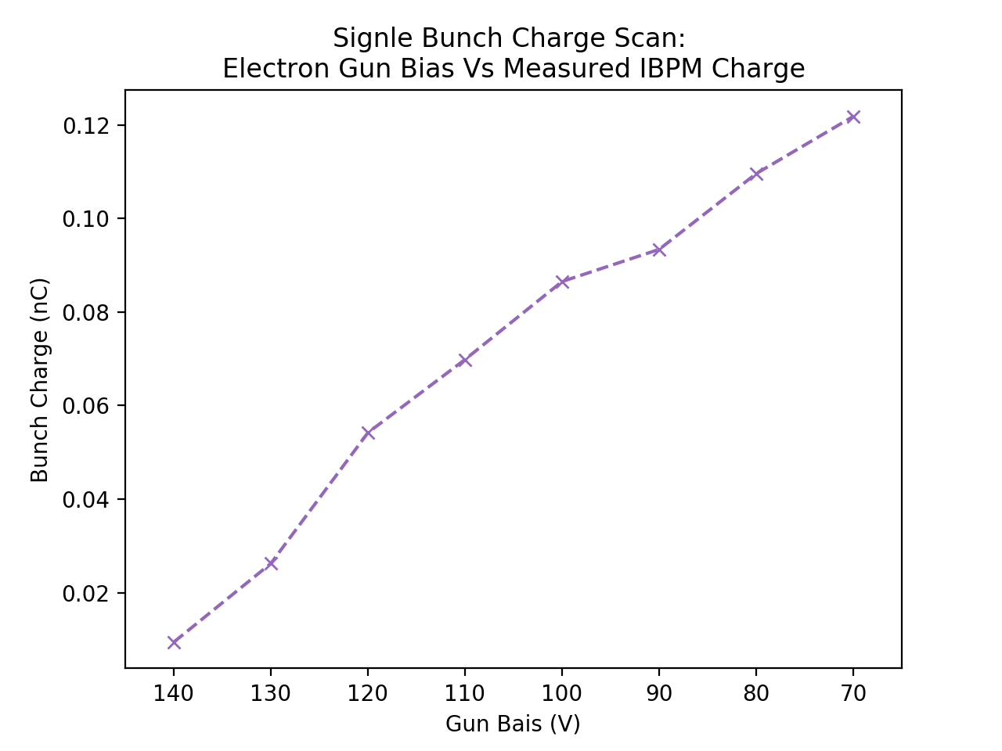
IBPM Commissioning
Scale Value of 0.4 used.
Not confident with scaling value from ADC counts to Volts.
Needs slightly better investigation, will go to Diamond, load up setting and feed known voltage signal.

Slide 17
IBPM Commissioning
Single shot IBPM Position Data seems good, multibunch needs to be investigated further. Single bunch would work for ChDR studies however.
Unsure about addition horizontal offsets on OTR1 and OTR2, could be due to factor of IBPM cabling, position of OTR targets in the vacuum chamber, or optical alignment.
Waiting for updated scaling factors before calculating the beam trajectory.

Slide 18
Calculating the Impact Parameter
- Daniel Harryman, Lorraine Bobb

Slide 19
Calculating the Impact Parameter

Slide 20
Calculating the Impact Parameter

Slide 21
Calculating the Impact Parameter

Slide 22
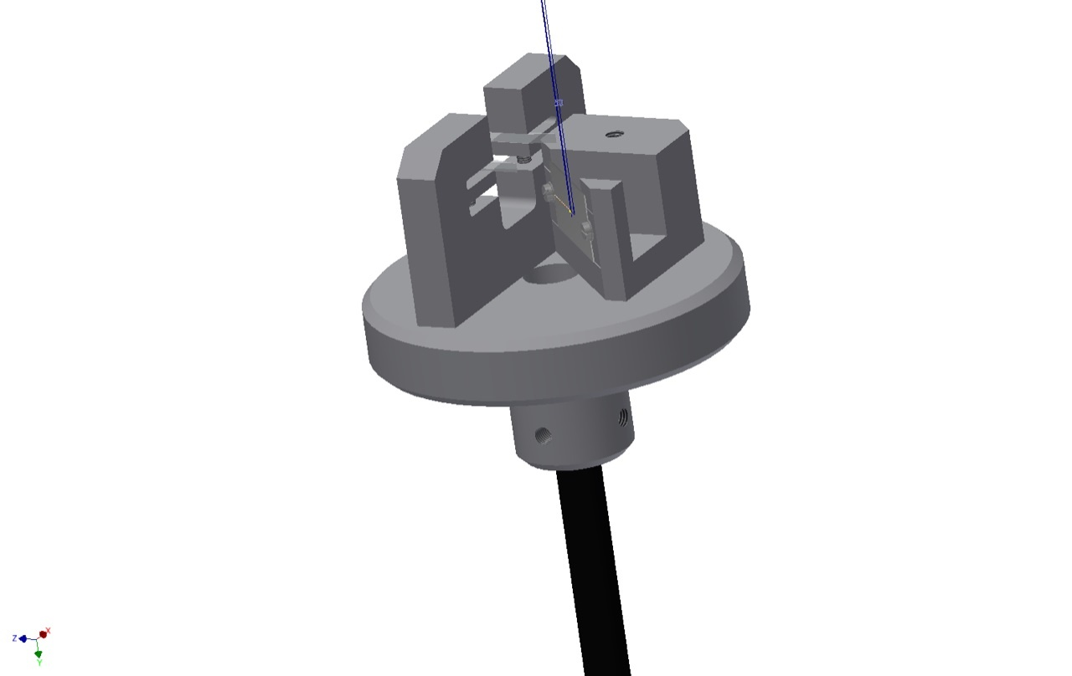
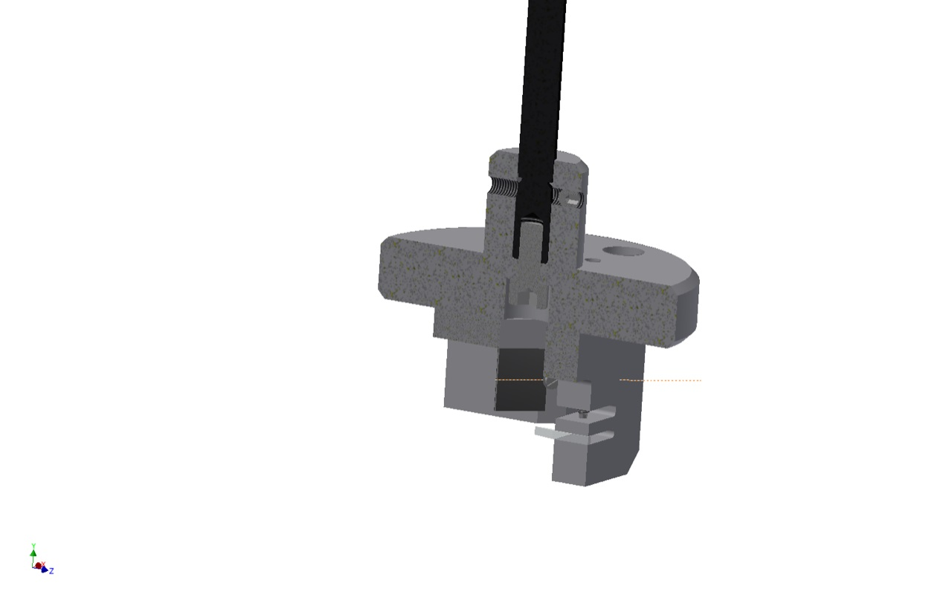
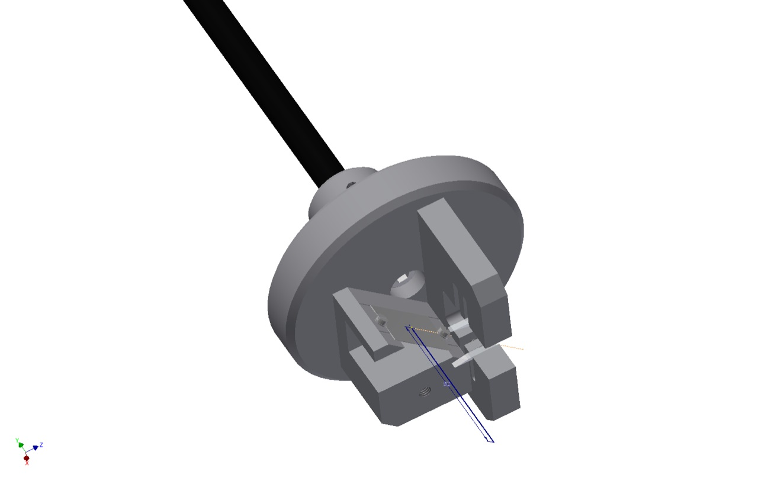
Calculating the Impact Parameter

Slide 23
Calculating the Impact Parameter
ChDR Target.
OTR Target

Slide 24
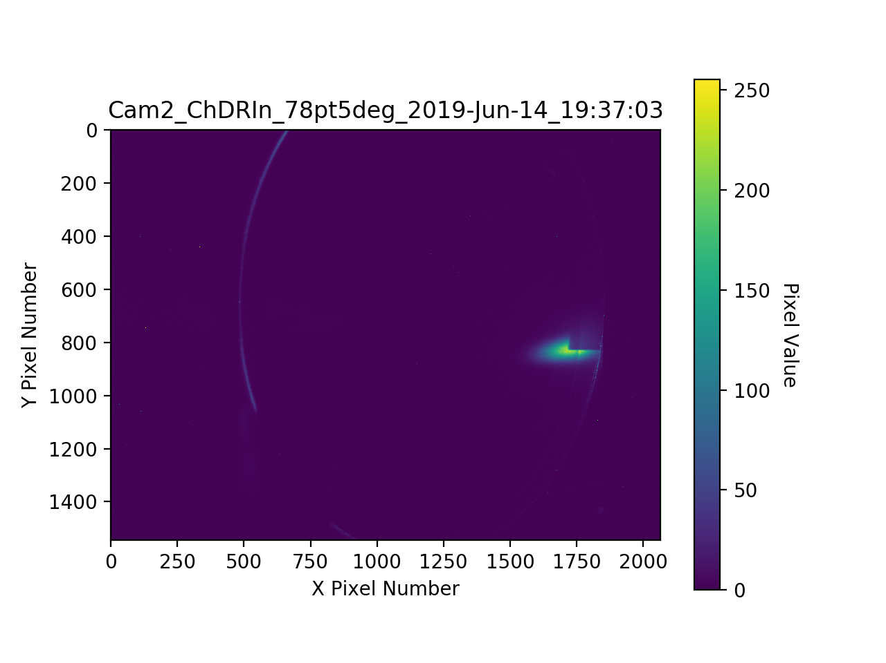
Calculating the Impact Parameter
ChDR Target Holder set at -59.5mm.
Beam bumped over until the ChDR target holder shadow can be seen on OTR2.

Slide 25
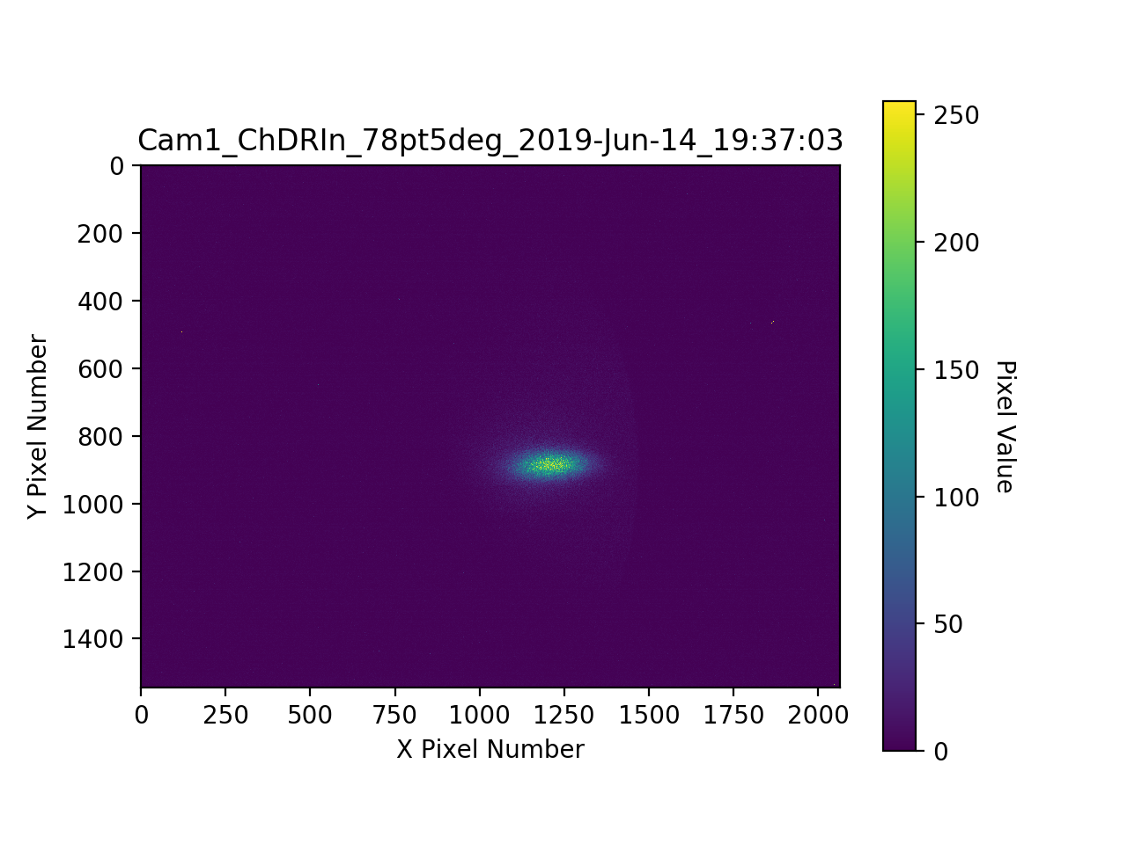
Calculating the Impact Parameter
ChDR Target Holder set at -59.5mm.
Beam bumped over until the ChDR target holder shadow can be seen on OTR2.

Slide 26

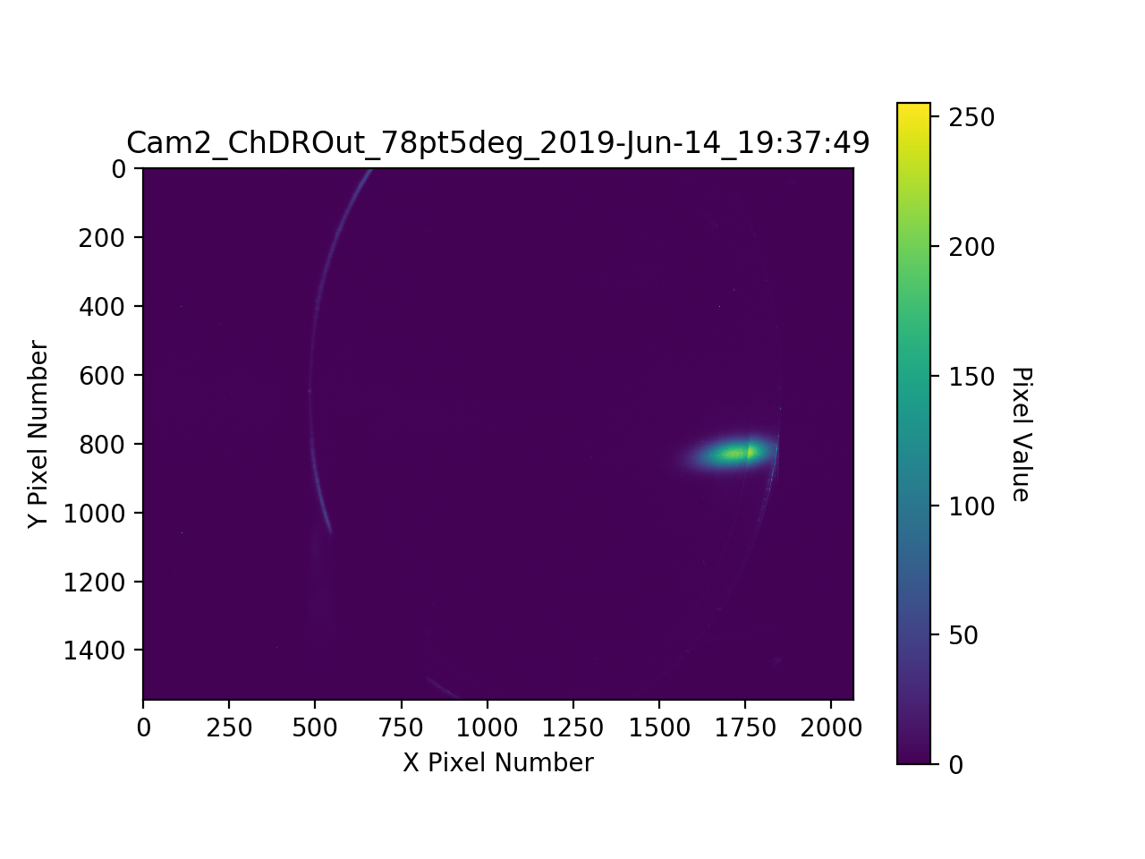
Calculating the Impact Parameter
ChDR Target Holder set at -59.5mm.
Beam bumped over until the ChDR target holder shadow can be seen on OTR2.
ChDR target holder removed to view beam position and shape.
OTR2 reflected off of target holder, makes centroid results unreliable.

Slide 27
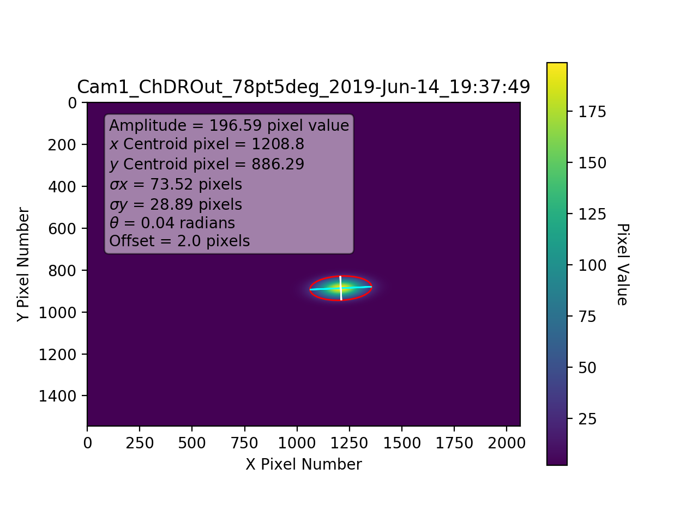
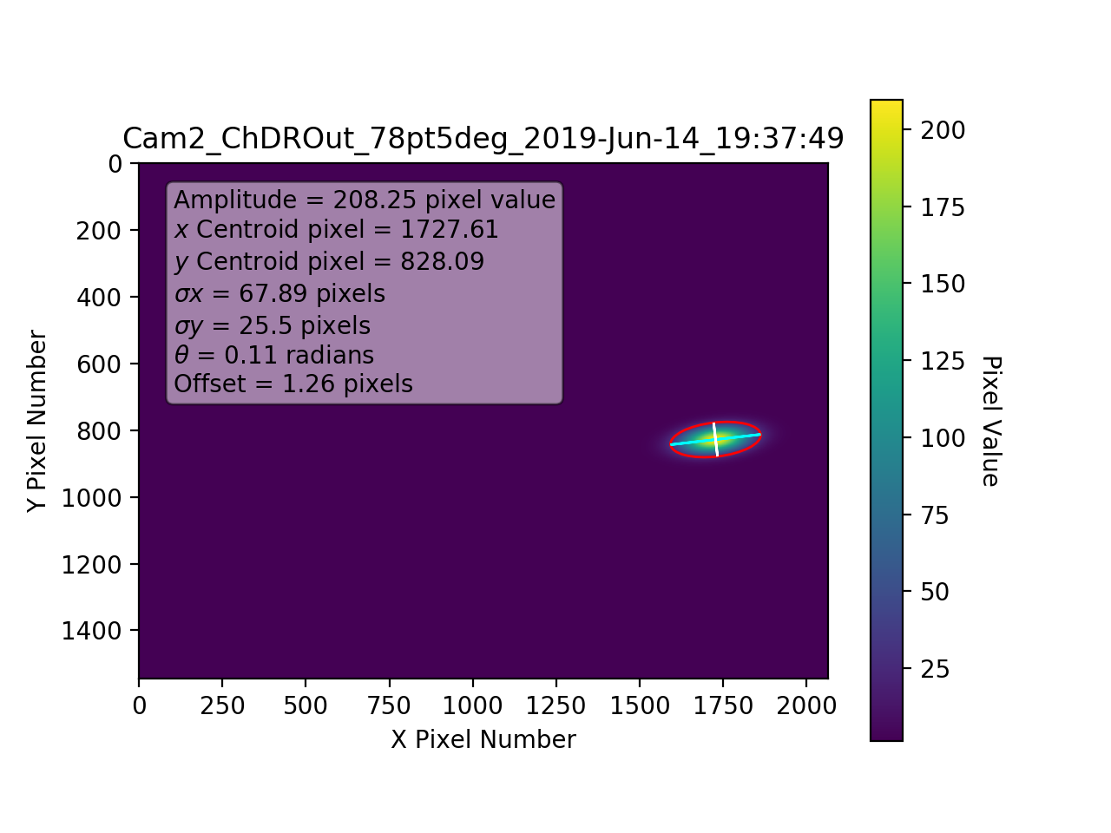
Calculating the Impact Parameter
ChDR Target Holder set at -59.5mm.
Beam bumped over until the ChDR target holder shadow can be seen on OTR2.
ChDR target holder removed to view beam position and shape.
OTR2 reflected off of target holder, makes fit unreliable.

Slide 28
Calculating the Impact Parameter
ChDR Target Holder set at -59.5mm.
Beam bumped over until the ChDR target holder shadow can be seen on OTR2.
ChDR target holder removed to view beam position and shape.
OTR2 reflected off of target holder, makes fit unreliable.

Slide 29
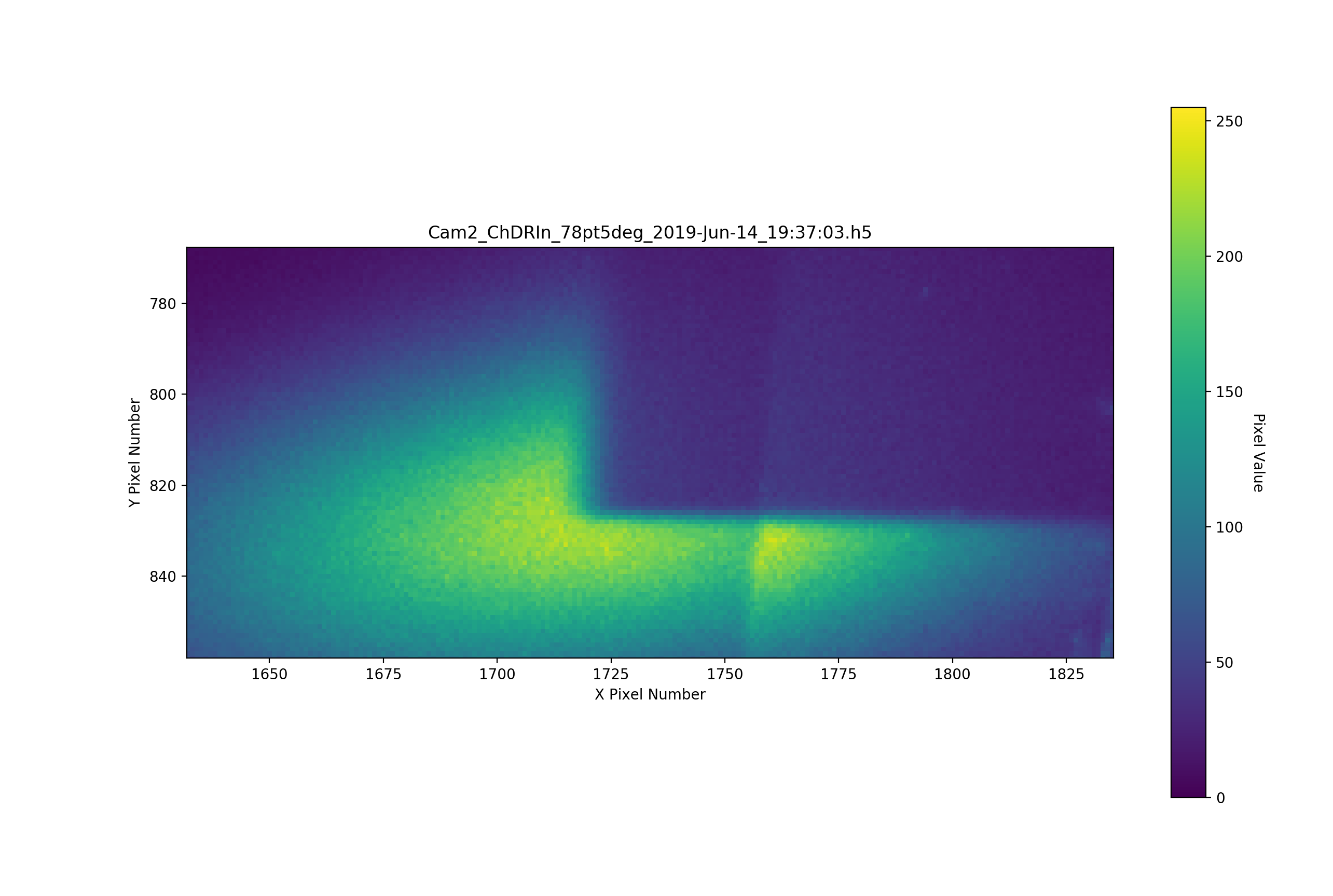
Calculating the Impact Parameter
ChDR Target Holder set at -59.5mm.
Beam bumped over until the ChDR target holder shadow can be seen on OTR2.
ChDR target holder removed to view beam position and shape.
OTR2 reflected off of target holder, makes fit unreliable.
Zoomed in on OTR2 image, shows the target holder corner at: (1720, 825) pixels.

Slide 30
Calculating the Impact Parameter

Slide 31
Calculating the Impact Parameter
Using the cross referencing data specified in the IBPM commissioning part, the beam position to impact parameter relationship can be calculated for all of the monitors.
Previous impact parameter scans and new impact parameter scans can be processed using new impact parameter information.
Full IBPM scaling factors are needed, before data can be trusted completely, this includes scope voltage scaling factor.

