Slide 1
Application of New PICMG µTCA for Physics Specifications to Accelerator Control
Ray Larsen , SLAC & Kay Rehlich, DESY
TWEPP 2010 Workshop
Aachen, Germany
September 22, 2010

Slide 2
Topics
1. Background & PICMG xTCA for Physics Initiative
2. Industry Developments to new Physics Standards
3. DESY R&D for XFEL Controls
4. SLAC R&D for ILC, Main Linac Upgrade
5. Summary Conclusions
6. Acknowledgments

Slide 3
1. Background & PICMG xTCA for Physics Initiative

Slide 4
Background: ILC at SLAC, DESY
ILC Snowmass 2005
  Proposed ATCA as model for ILC controls and beamline instrumentation systems
  Based on simulation model showing ILC needed large improvements over many existing systems to achieve goal of 85% uptime
  Led to pilot R&D programs at SLAC for I&C, magnet power supply systems, modulators, tunnel AC electrical systems, 2-tunnel design
  Led to DESY proposals for ATCA (LLRF) and µTCA (Tunnel Controls) under XFEL
Joint formation of Standards Collaboration 2009
  First ATCA Workshops at FNAL 2007 and Dresden 2008
  Led to formation of new PICMG standards collaboration for Physics May 09
    Lab-Industry collaboration for new IO standards ATCA, µTCA
    µTCA double-wide vastly improved analog design space
    Timing and triggering extensions maintain PICMG industry base compatibility

Slide 5
PICMG Physics Membership
  Lab members
    Founding Members: DESY, FNAL, IHEP, SLAC
    Additional Lab Members: IPFN Lisbon, ITER, CERN
  Industry Members
    Founding Members: Cypress Point Systems, Performance Technologies, Triple Ring Technologies
    Additional Members: ~43 companies total
  Hardware Committee, Software Committee
    See next slide

Slide 7
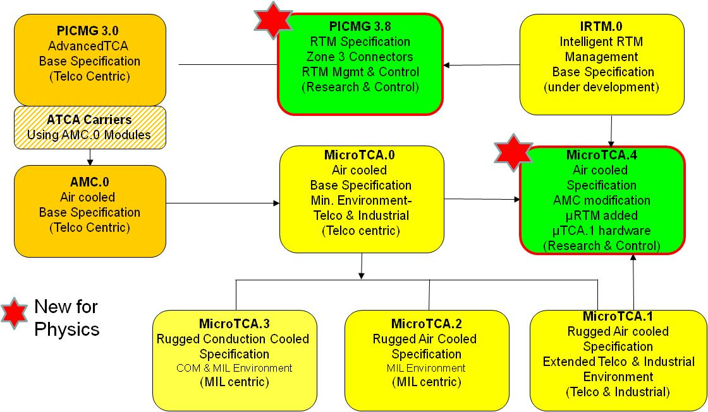
ATCA-MicroTCA Spec Family

Slide 8
PICMG Subcommittees & Work Products
  Coordinating Committee
    General community committee to suggest new work products, form teams for new lab-industry open-source standards extensions
  Hardware Committee (Timing & Synchronization):
    Goal: Hardware extensions for both ATCA, µTCA (MTCA)
    Work Products: Mechanics for standard IO; AMC and RTM modules, precision timing and triggering distribution
    Chair R. Downing, Secretary V. Pavlicek, Editor R. Somes (meet weekly)
  Software Committee (Architectures & Protocols):
    Goal: Software guidelines for high availability, interoperability
    Work Products: Software design for high availability; standard management products such as HPM.1; generic real time application drivers; preferred practices; open source solutions for physics
    Chair S. Simrock. Secretary Gus Lowell, Editor R. Larsen (try to meet weekly)
  Coordinating Committee
    Determine overall program, formation new subcommittees, work products
    Chair Ray Larsen, Secretary Gus Lowell, Editor Zhen’An Liu (meet monthly as needed)

Slide 9
Work Products Deliverables
HW WG1 SOW reviewed in Committee June 8, 2009
  1. Rear I/O for ATCA connectors, keying, e-keying
  2. IPMI for AMC RTM power, JTAG, hot swap
  3. µTCA double-wide AMC, µRTM, IPMI, power, JTAG, hot swap
SW WG2 SOW Charter
  Routing and Protocols
  Latency
  High Availability Software
  System/Rack/Module Management
  Operating Systems & Infrastructure, processing & Libraries
  Processing and Operations Libraries
  Common blocks APIs for processing, software-firmware mgmt
  Auto-faílover software design
Reference Designs
  Test all specifications with reference designs
  Develop standard infrastructure toolkit for lab R&D groups

Slide 10
2. Industry Developments to new Physics Standards

Slide 11
Industry Developments for Physics
ATCA
  Standard design drawings for new RTM interface2 Standard shelves 6-Pack & 12-Slot
  In pubs drafting at SLAC for spec figures
µTCA
  Shelf & Module Prototypes from 3 vendors
    6 payload slot development unit, non-redundant low cost. Latest unit with Physics timing backplane now in delivery
    12 payload slot production prototype fully redundant dual star backplane
    Test modules of AMC and RTM dual wide units
  Modules
    Power & cooling units, MCH Hub Switcher w/shelf manager, controllers all available from multiple vendors
  Application AMCs
    10 Ch fast ADC 2Ch DAC in test ing for DESY RF
    Other industry designs in progress by DESY, SLAC & Stockholm

Slide 12
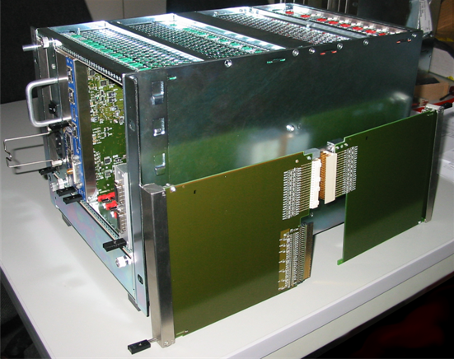
MTCA Prototype Chassis, AMC, µRTM
6-Slot shelf
RTM I/O Connector
Rear I/O
Panels
2-wide RTM
Front
Panels
Courtesy
K. Rehlich
DESY
2-wide AMC
Backplane Edge Connector

Slide 13
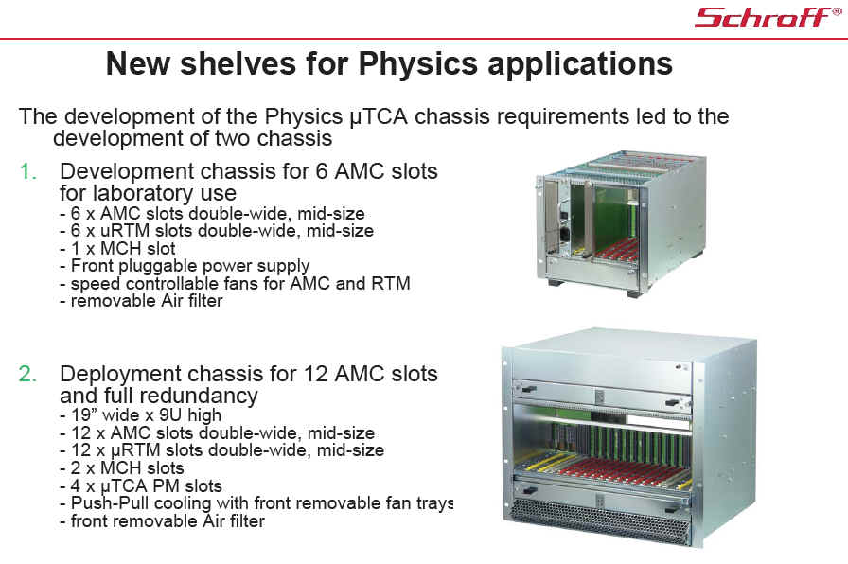

Slide 14
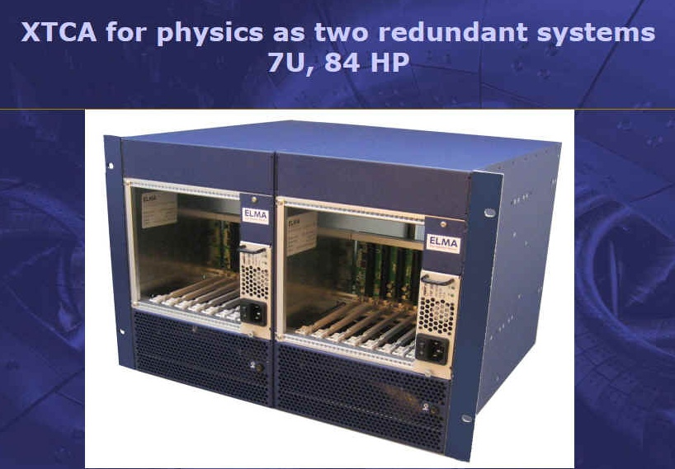
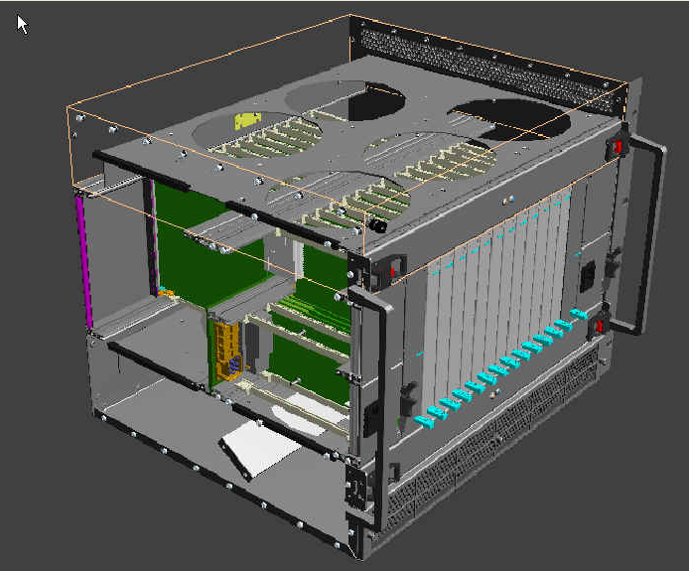
ELMA 6 & 12-Slot xTCA4Physics Shelves
Dual 6-Slots in Rackmount
12-slot Design in Progress

Slide 15
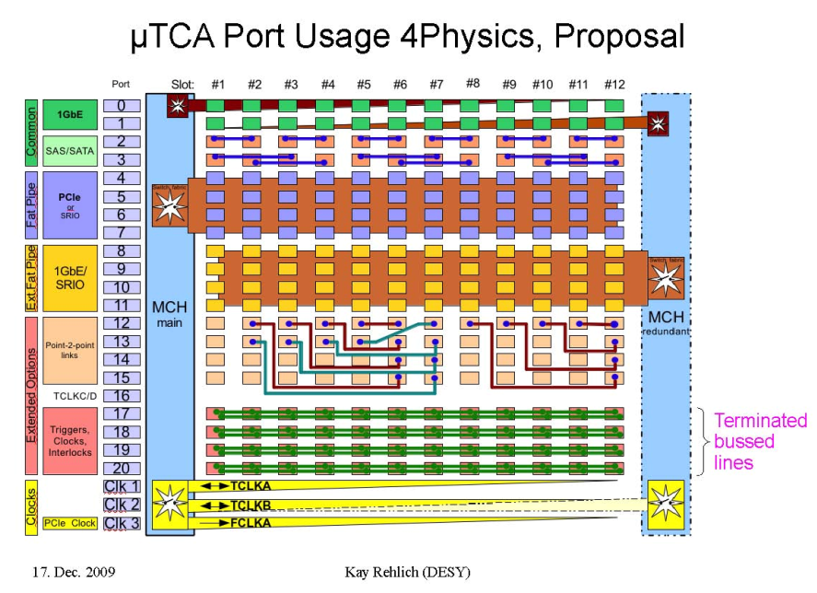
Backplane Timing, Vector Sum, Interlock Lines
Vector
Sums
Interlock
Sums

Slide 16
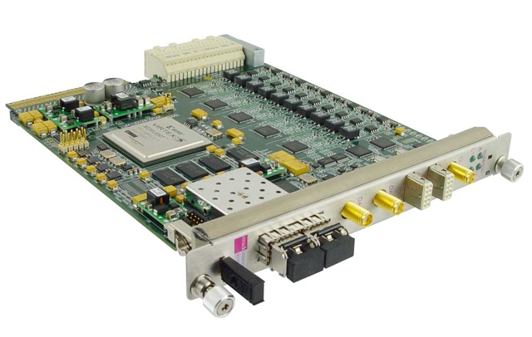
Struck SIS 8300 RF Digitizer
RTM Connector
AMC Connector
10 Ch 16 bit 125 MSPS
2 Ch 16 bit DAC output
Virtex 5 FPGA

Slide 17
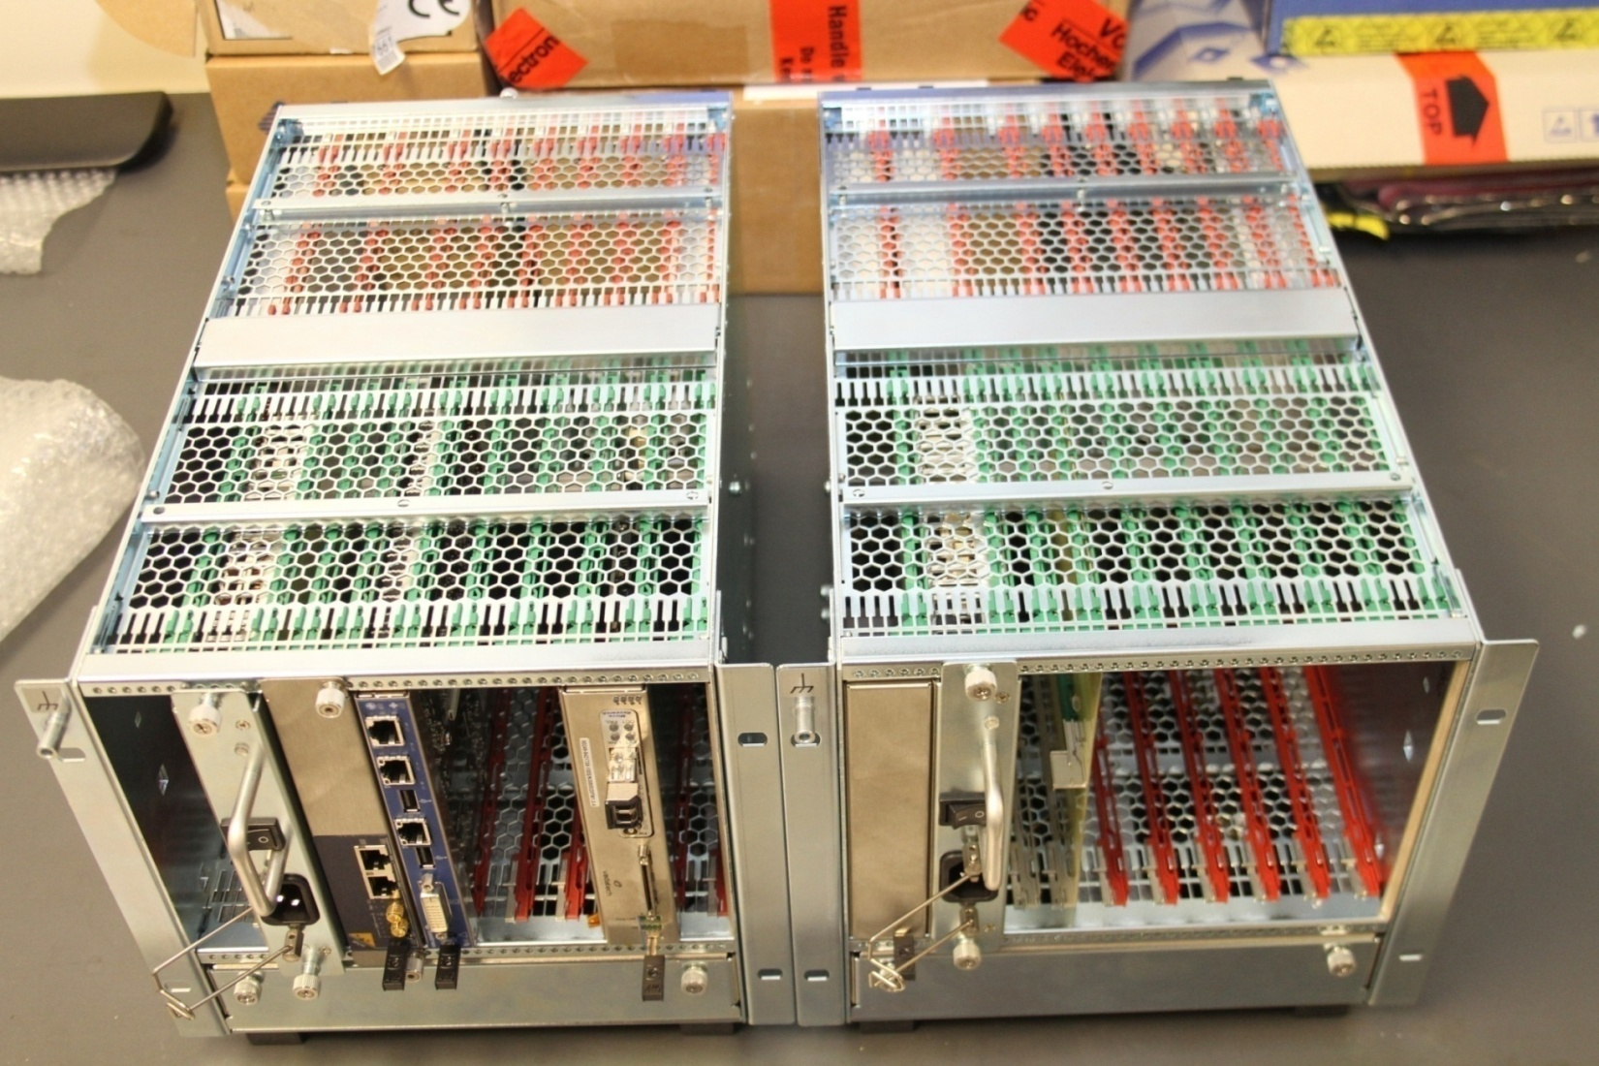
6-Payload Slots w/ Physics Backplanes

Slide 18
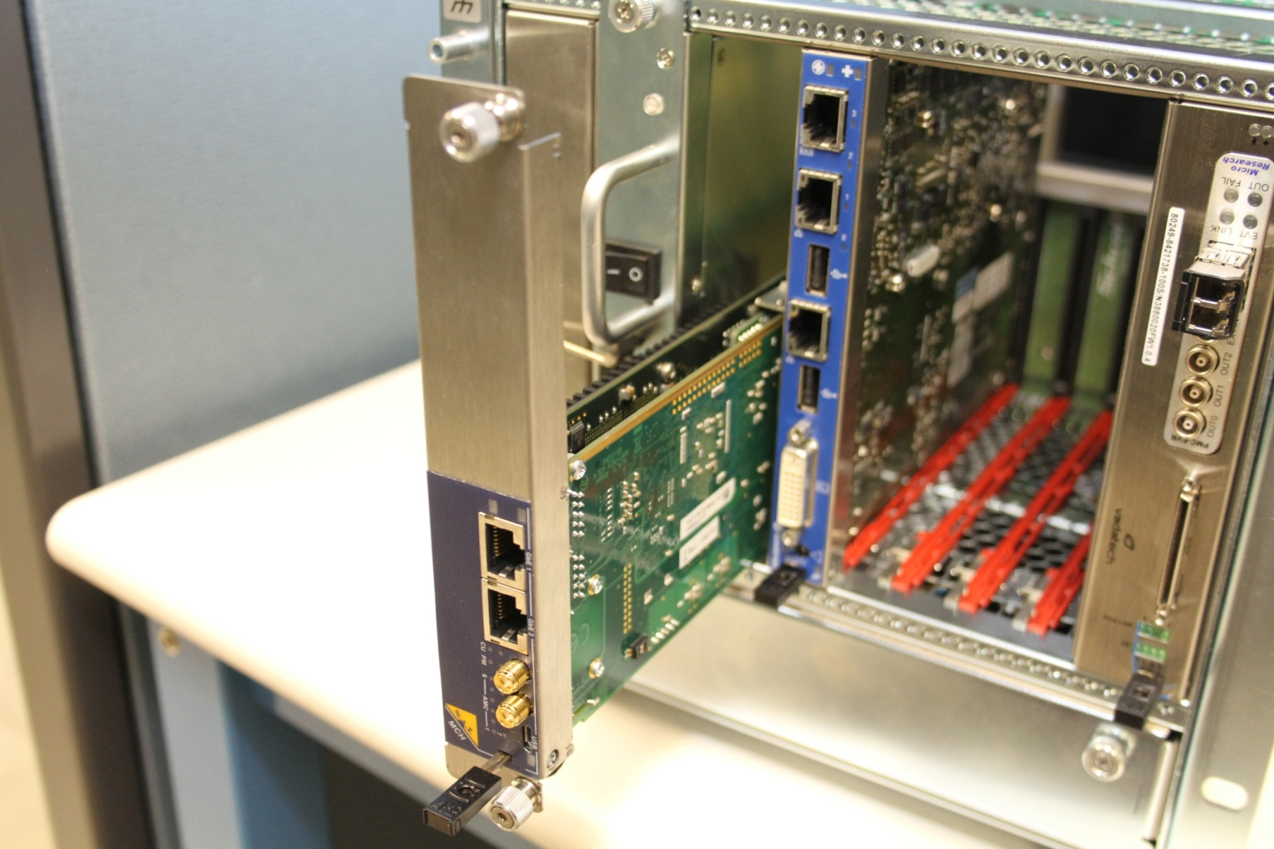
6-Slot w/ 2-wide Modules
MicroResearch PMC
Event Receiver
(Front IO Only)
Kontron IOC Processor
NAT MCH
Vadatech PMC Adapter
(Front IO Only)

Slide 19
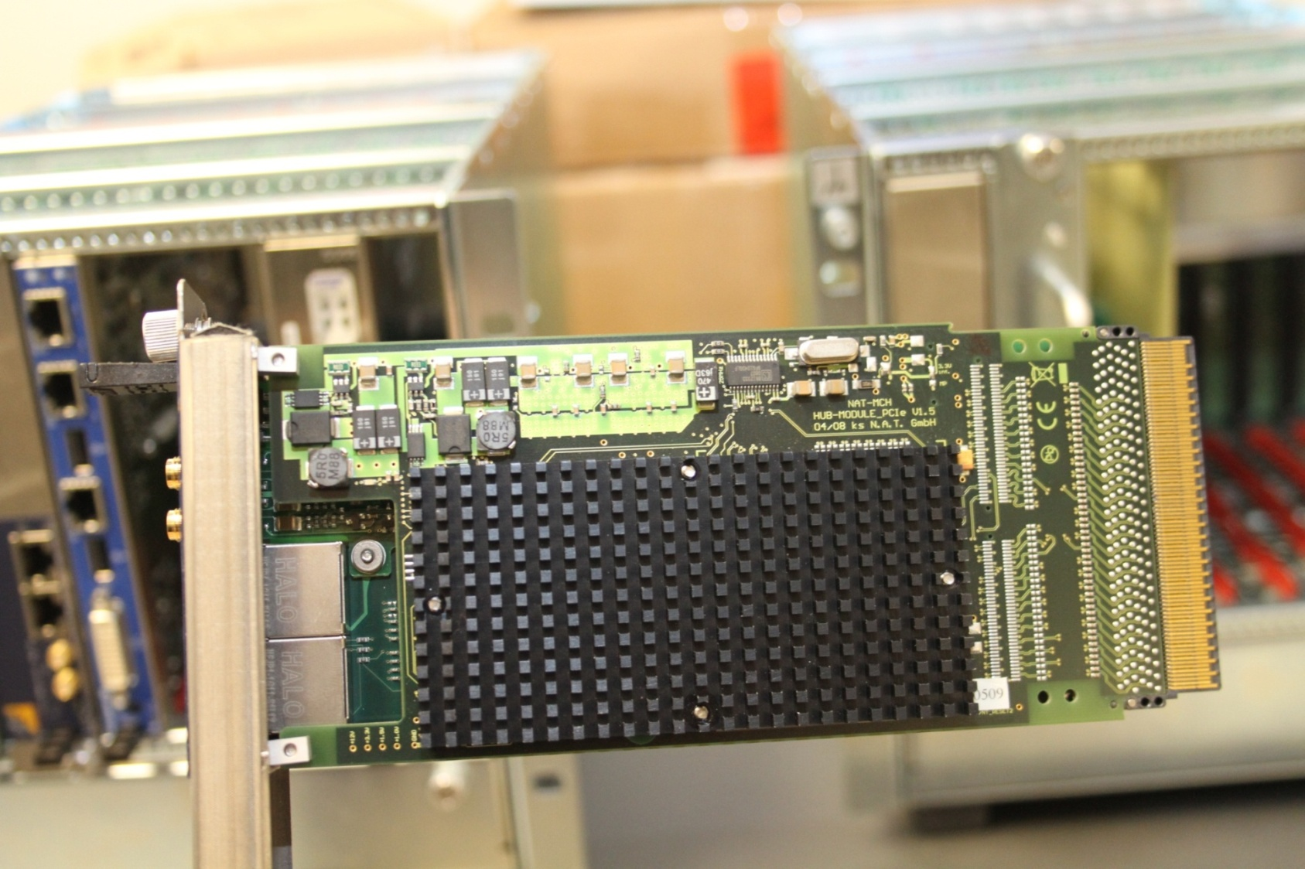
Standard MCH in 2-wide Panel Detail

Slide 20
3. DESY R&D for XFEL Controls

Slide 21
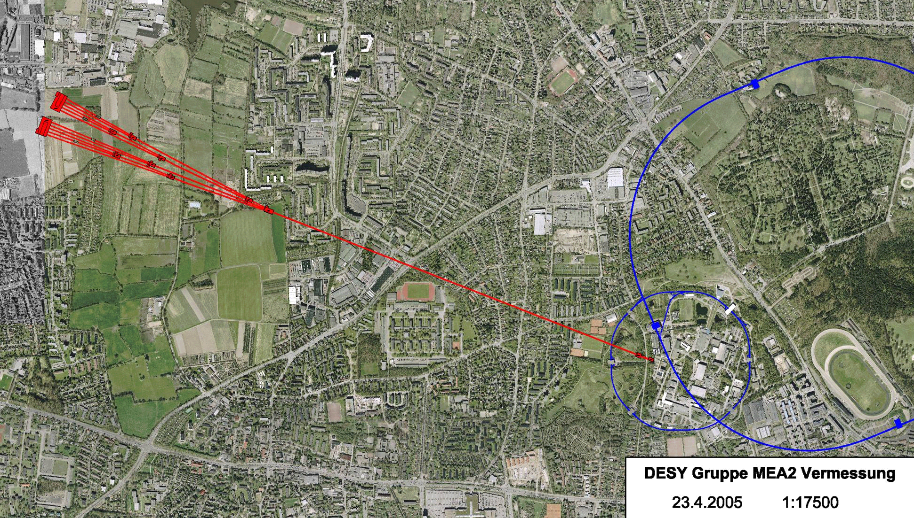
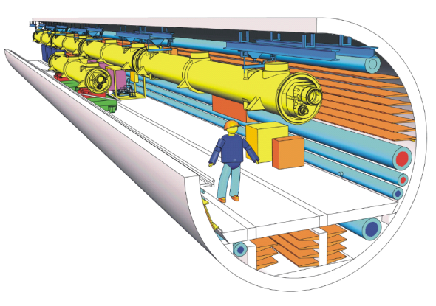
DESY: µTCA for the XFEL
HERA
3.3 km
XFEL
FLASH
DESY
Hamburg City Centre (7km)

Slide 22

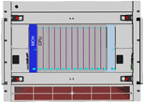
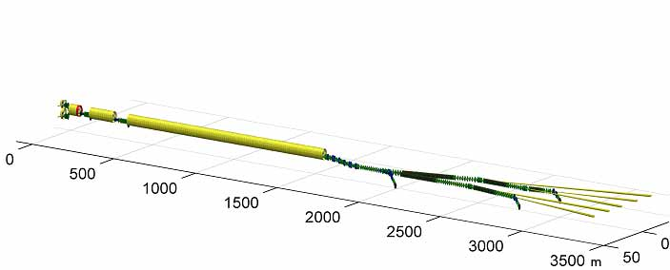
XFEL: µTCA Controls Inside Tunnel
Coupler Interlock
Diagnostics
Crates in one RF section
Klystron Control
LLRF Control
BPM
Front-end
Special format
Superconducting linac
Experiments

Slide 23
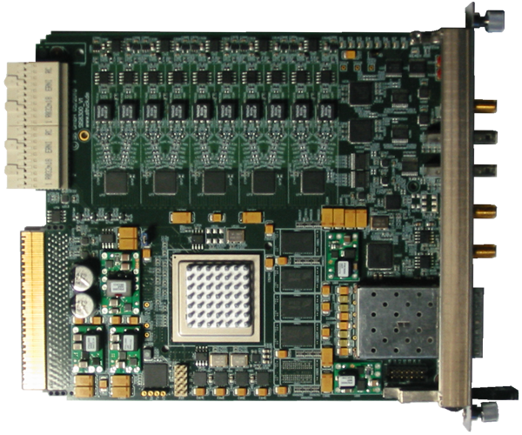
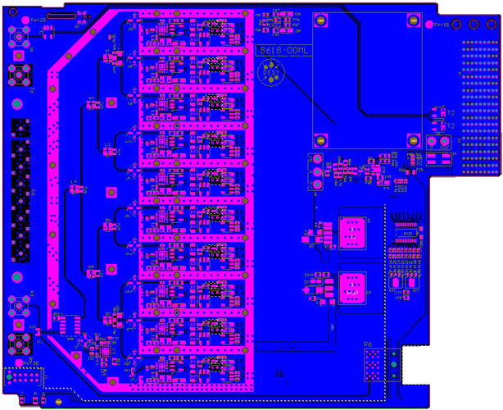
Double Size RTM w/ ADC AMC
µRTM:
1.3GHz down converter
Pulse shaper for photo diodes
BPM interface
AMC Struck SIS8300:
ADC: 10 channel, 16 bit, 125MSPS
FPGA: XILINX Virtex5
DAC: 2 channels

Slide 24
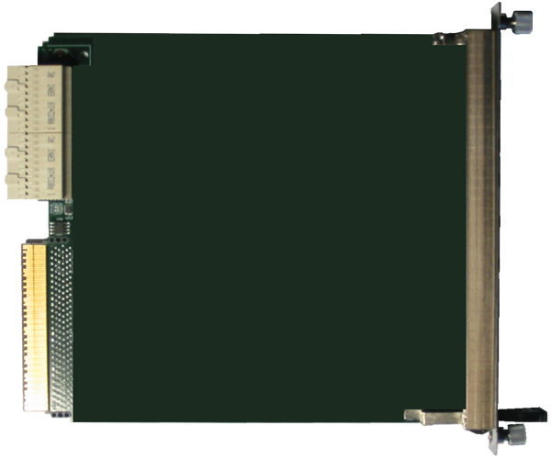
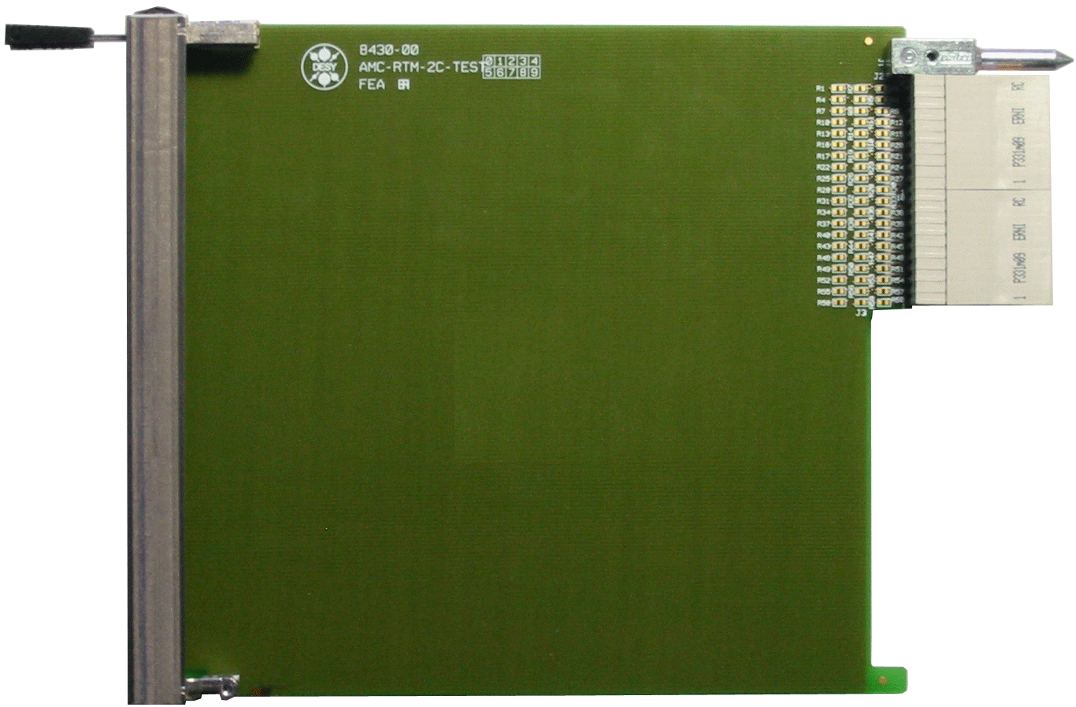
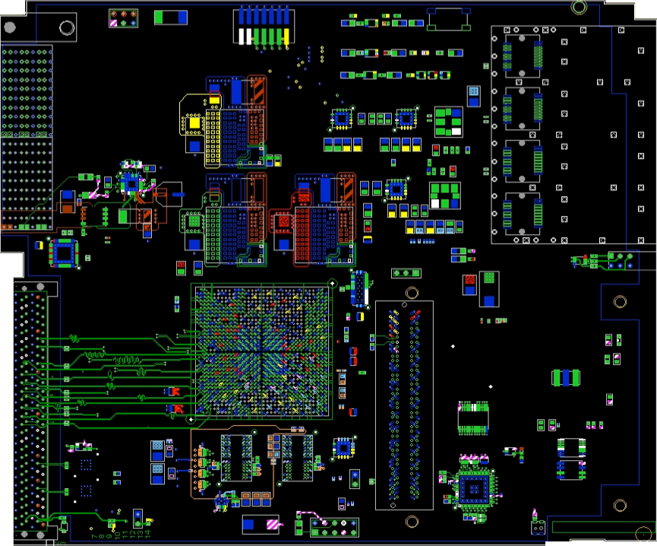
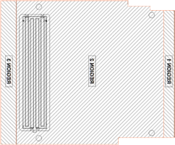
Double Size RTM and Digital AMC
4 * SFP
4*SFP
Virtex 5
FMC
Application specific µRTM:
different interlock modules
Wire Scanner interface
….
Versatile DESY AMC 2:
54 diff pairs to RTM
Virtex 5 based digital I/O
1 FMC slot + 4 SFP slots

Slide 25
Double Size Versatile AMC: DAMC2
+3V3_RTM
Hot-Swap µRTM
controller
+3V3_MP
Clk_FMC
Crosspoint Switch,
Clock distribution
TCLKA/Clk1
JTAG controller
JTAG_AMC
+12V_RTM
+12V
Clk_SFP
TCLKB/Clk2
JTAG_FPGA
Hot-Swap_Switch
Clk_FPGA
JTAG_MMC
10 to 945 MHz
JTAG_FMC
Clk_RTM
µRTM connectors
IPMI_RTM
SEL_CLK
CLK_F
I2C
JTAG
RTM Bus
(53 diff. Pairs)
Virtex 5
XC5VLX50T-1
FF1136C
JTAG
ISP_PROM
Clk_FPGA
JTAG_FPGA
Four SFP connectors
Clk_SFP
SFP_Control
MLVDS_BUS
MLVDS
drivers
MLVDS_FPGA
32 single ended
Port 17-20
38 single ended
SFP_GTP
PCIExpress
3 or 4 GTP Lanes
Port 4-7
+3V3
FCLKA/Clk3
+2V5
+1V8
Clk_FMC
4GTP
+1V0
Port 12-15
FMC_Diff_Bus
AMC Edge Connector
34 dif. pairs
TCLKA/Clk1
TCLKB/Clk2
MMC
Atmega128
Hot-Swap_AMC
IPMI_FMC
+12V_Payload
JTAG_MMC
+2V5
FMC connector
JTAG_AMC
IPMI_FMC
Data
Power_OK
DC-DC
LDO
+3V3
+12V_Payload
32 bit
Address
Control
+3V3_MP
IPMI_RTM
13 bit
26 bit
+2V5
+3V3_MP
IPMI/I2C_MMC
Power_OK
+1V8
JTAG_FMC
Enable_MMC
Thermo
Thermo Sensor
DDR2
1Gbit
+1V8
+1V2
GA[2:0]
+0.9V_TT
+1V0
SEEPROM
E-keying
+0.9V_REF
+0.9V_TT
+0.9V_REF

Slide 26
MTCA Backplane Timing Distribution
2 radial clocks per AMC,
low jitter
MCH
Cross-
Point-Switch
Backplane
AMC
Timing
AMC
ADC
AMC
ADC
Enc.Clock
Enc.Clock
Trigger
Trigger
Interlock
Interlock
8 bussed lines,
M-LVDS for
Clocks, triggers, interlocks
Central Timing

Slide 27
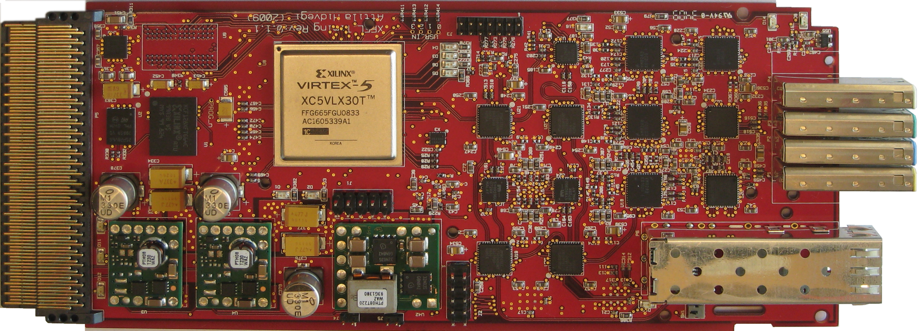

Timing Module Prototype
Timing AMC (University of Stockholm)
Fiber optic links w/ drift compensation
ps stability
AMC module is receiver and transmitter
Clock, trigger and event distribution

Slide 28
4. SLAC R&D for ILC & Main Linac Upgrade

Slide 29
Current SLAC xTCA R&D
ILC Funded R&D
  Develop µTCA industry supported infrastructure* based on new standards
    Shelf, Physics IO applications modules and RTMs,
    Reference design
    IPMI & Power
    Timing & triggering support
    * Components available from at least trwo vendors
  Demonstrate managed platform on L-Band RF Test Stand
    Klystron & SC Cavity Coupler testing – joint with FNAL
    Developed ATCA VME Adapter for VME interlocks (now dropped)
    Developing MicroTCA interlock system to replace VME+RTMs with 1/3 number of boards
    Interface new Marx Modulator embedded controls and diagnostics to µTCA interlock system

Slide 30
SLAC R&D 2
Major Lab Controls Upgrade Initiative (new)
  Upgrade Controls for entire 2-mile linac (Currently CAMAC w/ VME Distributed Overlay in LCLSI)
  Phase I: Pilot demonstration of single RF station and 40 ft of beamline instruments
  Phase II: Upgrade 80 RF stations for LCLSI and 80 more stations for LCLSII
  LCLSII approved for construction by ~2015
    Uses middle 10 Sectors of Linac, 80 RF Stations
    Convert all CAMAC instrumentation for LCLS II
Major Issue: Time and resources to develop µTCA solution

Slide 31
µTCA Station Node w/RF & Interlocks

Slide 32
Are we ready for µTCA Prime Time?
Strategy of current ILC xTCA for Physics standards R&D program
  Equip, train lab engineers to master µTCA
  Develop key infrastructure for controls, DAQ applications
  Procure industry prototypes for lab development
  Use R&D funds, new upgrade opportunities to develop key modules with industry (XFEL model already working)
  Develop Reference Designs, hardware-software test environment including IPMI (Intelligent Platform Management Interface)
  Acquire engineering tools, invest in training programs

Slide 33
Strategy for Linac Upgrade Project
Collaborate to minimze development time, cost
  Work w/ DESY & other labs to develop >/= 2 industry sources for key infrastructure & applications modules
  Available now in Physics platform:
    Shelves, power & cooling, MCH, Processors (Schroff, Elma, PT, NAT, Kontron, ATMEL, Vadatech...)
  In progress/discussion:
    Timing modules* (DESY-Stockholm-Vendors TBD)
    RF, BPM digitizers (DESY-Struck, SLAC-Vadatech)
    Industry-Pack Adapters (2-3 IPs) (TEWS, Vadatech)
    FPGA generic AMC w/ FMC Adapter (DESY-EMC, SLAC-Vadatech)
      * 3 versions: Tx-Rx, Tx, Rx

Slide 34
Generic AMC Solution Examples
GENERIC AMC | APPLICATION | RTM1 | RTM2 | RTM3
10 Ch ADC-DAC 125 MSPS 16 bit | LLRF Control | Adapter to IPMI managed downconverter | Photodiodes pulse shaper | BPM calbration- filter- gain
4 Ch ADC 125 MSPS 16 bit | BPM (2), Toroids (2) BLEN (1) | Model 1 with minor options serves all (5)
FPGA DAMC2 w/FMC option | Fast-slow interlocks, opto TxRx | Interlock Analog | Wire Scanner Analog | Other
FPGA Interlock w/20MSPS ADCs (in dsgn) | 16/30 Fast/Slow interlocks mod-kly, vacuum... | 2 KSPS ADCs, gain adjust
3-IP Adapter Interface | Modulator cntrl Motor drivers Readback | IO analog conditioning, calibration | App dependent | App dependent

Slide 35
Upgrade Strategy 2
Develop linac RF section node in single 12-slot µTCA shelf including:
  RF station downmix, digitize, FPGA processer, feedback, protection interlocks, klystron power supplies
  Modulator, power supplies Enet interface
  Profile Monitor Beam Length readout, control
  Stripine, cavity BPMs
  Toroids, Beam Containment Toroids
  Vacuum gauge readout, pump control
  Cable plant, adapters to RTM cables, rack cooling
  Industry AMC payload modules w/ mostly lab-designed RTMs
Concentrate in-house engineering on subsystems
  System design, RTM design, FPGA FW, SW & EPICS design

Slide 36
Upgrade Proposal Status
Presentation overall plan at management review late October 2010
  First estimate resource loaded schedule submitted for pre-review
  Engineering manpower, project managment team presonnel in development
  xTCA experienced SW-FW engineers on board
Total Upgrade timetable in discussion
  Several stages over 5-6 years for LCLS I & II, HEP experiments using sectors 0-20 over next 4 years)
Successful Lab-Industry Collaboration essential

Slide 37
5. Summary Conclusions
The lab-industry collaboration will shortly submit spec ATCA3.8 & MTCA.4 for PICMG approval
An addendum will be submitted for ATCA3.6 to cover timing distribution recommendations
DESY has been instrumental in leading development and industry initiatives for key modules due to urgency of XFEL schedule
The PICMG community and industry members have contributed vital resources toward prototypes to make the standard possible
SLAC-ILC has funded the international standards committees and introducing xTCA into the lab is underway
SLAC is hoping to gain aproval for a major linac upgrade program based on µTCA lab-industry accomplishments
The continuation of the lab-industry standards collaboration gives a strong basis for this proposal

Slide 38
6. Acknowledgments
The authors gratefully acknowledge:
  The generous support of the entire PICMG management & organization in hosting the physics work
  The rich contributions from industry partners particularly key members of Schroff, ELMA, Positronix and Performance Technologies and others too numerous to mention
  The enthusiastic key support of members of all the PICMG member labs, again too numerous to mention
  The TWEPP 2010 Program Committee for promoting broad discussion of new standards for Physics and the importance of interlab-industry collaboration

Slide 39
Thanks for your attention!

