Slide 1



Datao Gong
On behalf of the ATLAS Liquid Argon Calorimeter Group
Department of Physics, Southern Methodist University
Dallas Texas 75275, U.S.A.
dtgong@physics.smu.edu

Slide 2
Outline
Introduction
Design of LOCs1
Lab and Irradiation Test
Plan - LOCs6
Summary

Slide 3
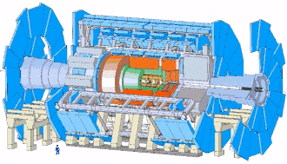
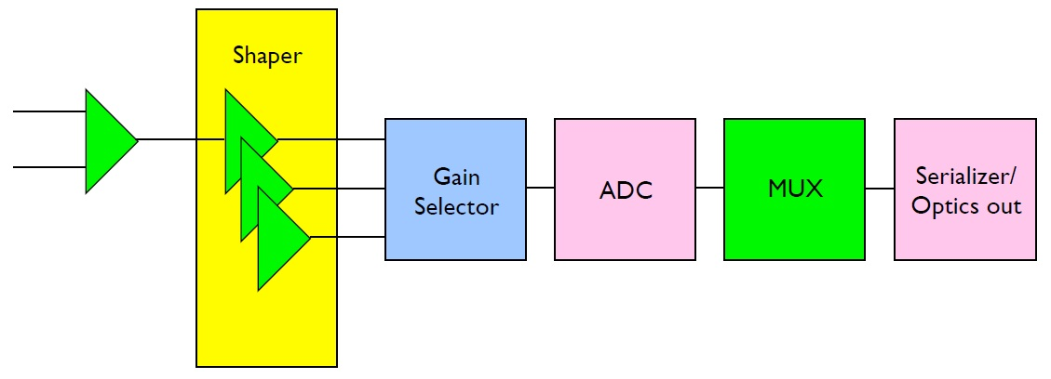
Introduction
The ATLAS detector
architecture of the proposed FEB for upgrade
There are 128 channels on each Front End Board (FEB). A total of 1524 FEBs are read out by optical links. For the upgrade, it is proposed to remove
L1 trigger from the front end. Data from ADC will be streamed off the detector.
The requirements for the link upgrade:
100 Gbps data rate per FEB.
20% redundancy to improve the link reliability.
Power: 80 W/FEB leads to a proposal of 20 W/link, 100 mW/Gbps for the serializer
Radiation tolerance.

Slide 4
Why Silicon on Sapphire (SOS) ?
SOS is one type of Silicon on Insulator (SOI) CMOS technology. Transistors
are manufactured on a thin silicon layer grown on top of a sapphire wafer. The substrate is the insulating sapphire crystal instead of silicon.
Eliminates the parasitic drain capacitance → Fast
Reduces the crosstalk between circuit elements → Low noise
Makes transistor radiation tolerant
- Total Ionizing Dose (TID) effects are negligible when substrate is
grounded.
- Better Single-event effects (SEE) immunity than bulk CMOS.
There is no Single-event Latchup (SEL) mechanism.
Radiation tolerance at transistor level greatly simplifies our design task.
More details about the radiation tolerance of SOS CMOS technology can be seen in
Michael King’s poster (Poster ID# 27).

Slide 5
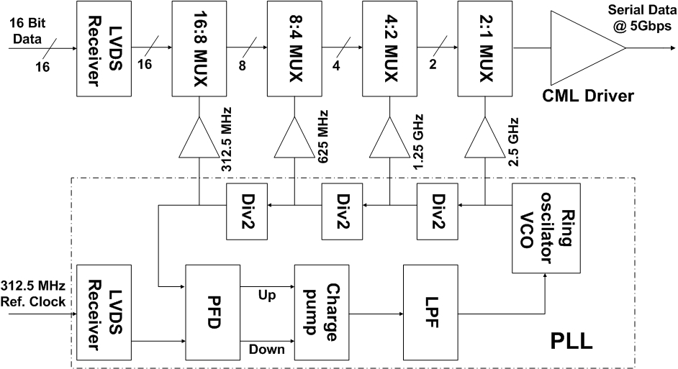
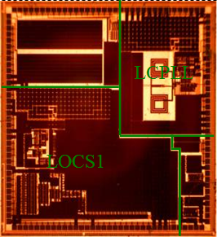
Design of LOCs1
3 mm
3 mm
Design diagram
Die micrograph
Ring oscillator based PLL provides clocks up to 2.5 GHz
16:1 CMOS multiplexer has a tree architecture
5 Gbps serial data output through a differential CML driver
Submitted for fabrication in Aug 2009 and delivered in Nov 2009
More design details can be found in the poster session of TWEPP 2009.

Slide 6
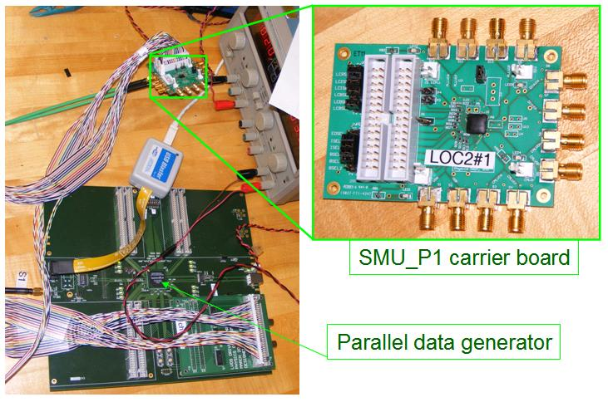
Test Setup in Lab
12 Chips wire bonded
7 boards work
463 ±13 mW @ 5Gbps
5 boards do not work:
2 boards power open
2 boards power short
1 board has a stuck bit
Chip or wire bonding problem?—more tests with demo-link will tell.
LOCS1 #1
FPGA board provides 312.5 MHz clock and 16 bit parallel data to a chip carrier board, both in LVDS
5 Gbps PRBS serial data output to an oscilloscope or BERT for measurements.

Slide 7
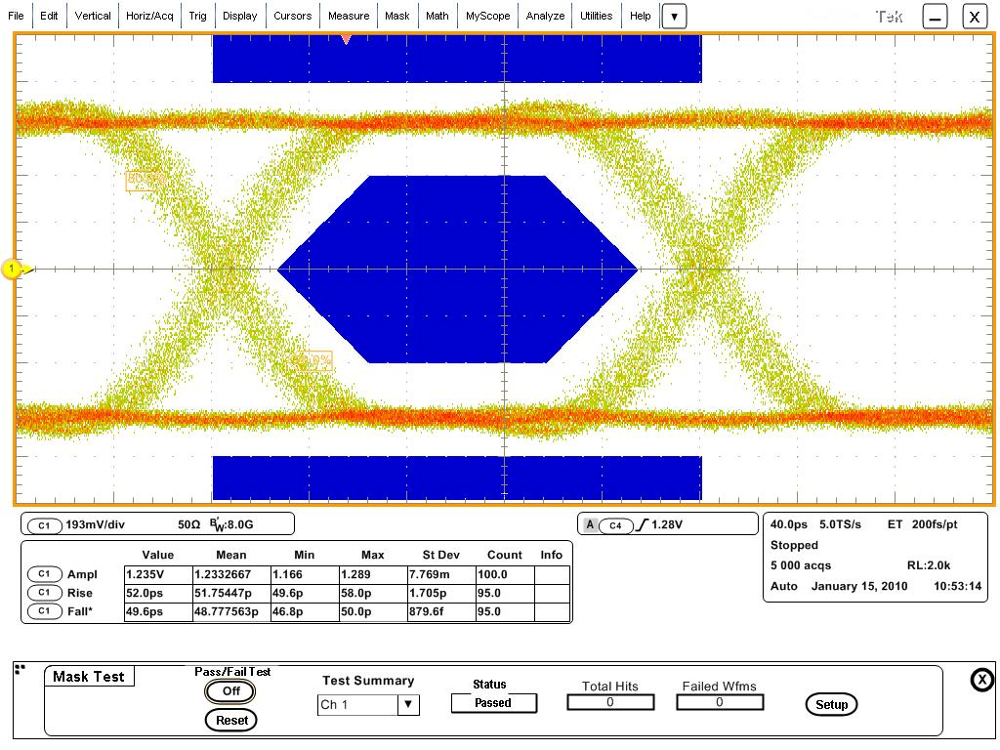
Lab test with an oscilloscope
Eye diagram at 5 Gbps and eye mask adapted from FC 4.25 Gbps and scaled up to 5 Gbps
Amplitude (V) | 1.16 ±0.03
Rise time (ps) | 52.0 ±0.9
Fall time (ps) | 51.9 ± 1.0
Total Jitter @ BER 10⁻¹² (ps) | 61.6 ± 6.9
Random Jitter (ps) | 2.6 ±0.6
Total DJ (ps) | 33.4 ±6.7
DJ: Periodic (ps) | 3.0 ± 2.3
DJ: ISI (ps) | 3.0 ± 2.3
DJ: Duty cycle (ps) | 15.2 ± 3.8
Eye diagram at 5 Gbps
The mask is adapted from FC 4.25 Gbps and scaled up to 5 Gbps
The measurements are made with Tektronix DSA 72004 and differential probe
P7380SMA.

Slide 8
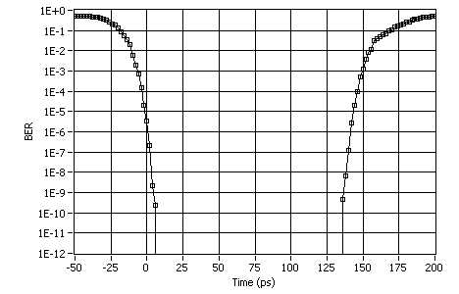
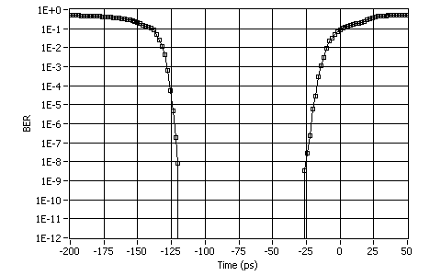
Lab test with a BERT
5 Gbps
5.8 Gbps
Eye opening at BER of 10⁻¹² is 122±18 ps at 5 Gbps
Data rate range at BER of 10⁻¹² varies board by board
Lower limit from 3.8 to 4.0 Gbps
Upper limit from 5.7 to 6.2 Gbps
The measurements are made with Anritsu MP1763C and MP1764C as clock
generator and error detector.

Slide 9
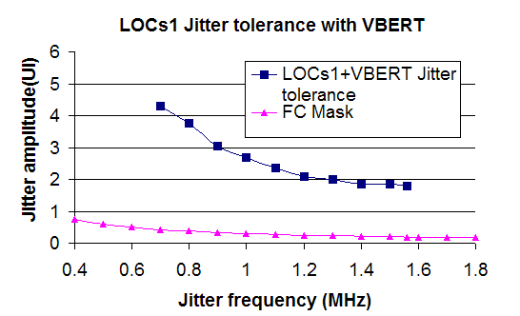
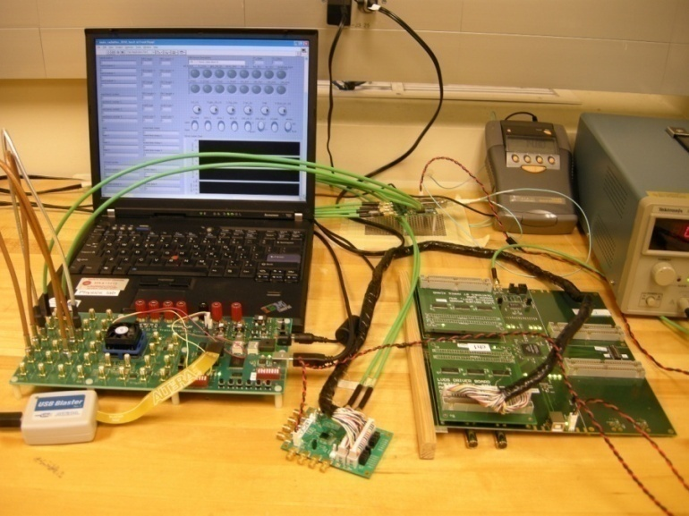
Lab test with the VBERT
VBERT is a powerful and portable BER test system developed at SMU for both in lab and irradiation tests Please see Annie Xiang’s poster (poster ID# 89) for details.
The FPGA board provides parallel data and clock to LOCs1.
Altera Stratix II GX signal integrity evaluation board functions as the deserializer and error detector.
Sinusoidal jitter is injected on the reference clock of LOCs1.
Complete error information is recorded in a log file in PC.
Jitter tolerance is larger than 1.8 UI when jitter frequency less than 1.56 MHz

Slide 10
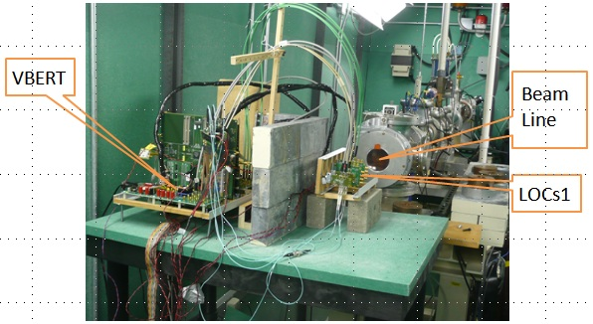
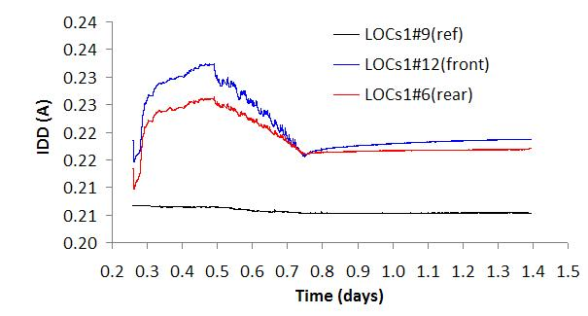
Proton beam test at IUCF
Test setup:
200 MeV Proton beam at IUCF
Two LOCs1 chips (#6 and #12 ) inside the beam are running throughout the test
One LOCs1 chip (#9) works in shielded area as reference
SEE are checked by VBERT which is also shielded
Test results:
SEE: Cross section is small. See next slide
TID:
1. Chips are functionally running during the beam test;
2. No bit error is observed after beam test;
3. Total power supply currents change less than 6% during the irradiation.
Beam Stop

Slide 11
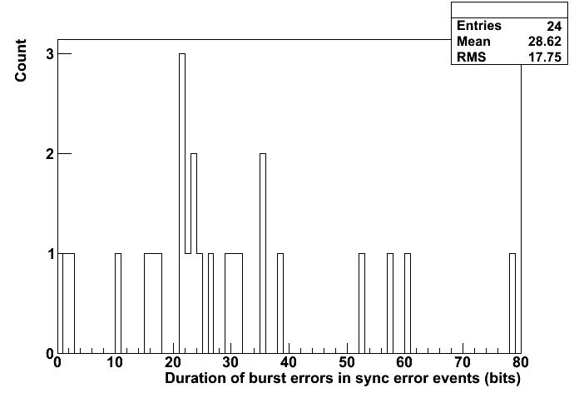
SEE analysis
Two types SEE errors observed:
Single bit errors
  A total of 5 bits flipped during the test. The links continue to function.
Synchronization errors
  A burst of few bits flipped in a duration up to 80 bits as shown in this plot. This burst of errors follows a shift (for- or backward) of one bit in the received data.
  Cause still under investigation. Possible reason: SEU in transmitter clock unit induced word misalignment in the receiver.
  The link can be recovered at receiver side by making word alignment.
Board# | # of single bit errors | # of sync. errors
6 | 0 | 16
12 | 5 | 8

Slide 12
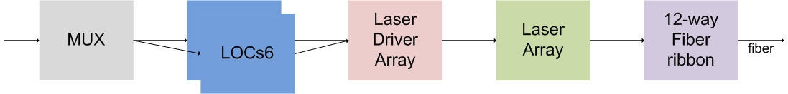
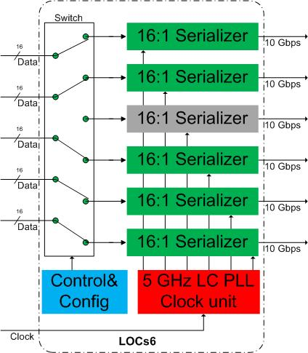
Next version — LOCs6
Parallel optical link may be a solution for 100 Gbps data rate/FEB
  Two serializer chips with a 12-way fiber ribbon per FEB.
  Each chip has an array of six 16:1 serializers each running at 10 Gbps.
  One of the six serializers can be configured as a redundant channel.
  The clock unit may be shared by the serializers to reduce the power.

Slide 13
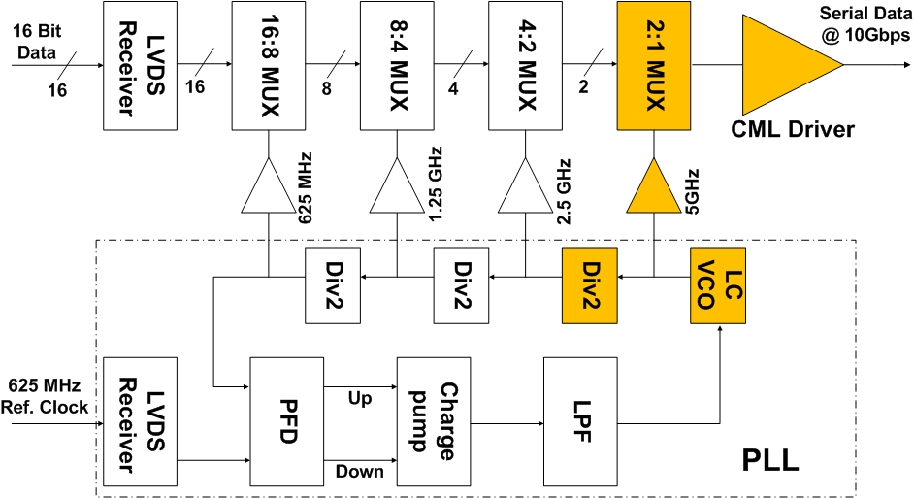
10 Gbps 16:1 serializer design diagram
The key components
needed to be redesigned:
  1. 5 GHz LCPLL, LC VCO
  2. CML driver for 10 Gbps
  3. 2:1 MUX @ 5GHz
  5 GHz Divider
  Clock buffer
  The core part of this serializer has same architecture as LOCs1.
  A few components need to be redesigned for 5 GHz operation frequency.
  We choose to use CML circuit for its low noise and high speed performance.

Slide 14
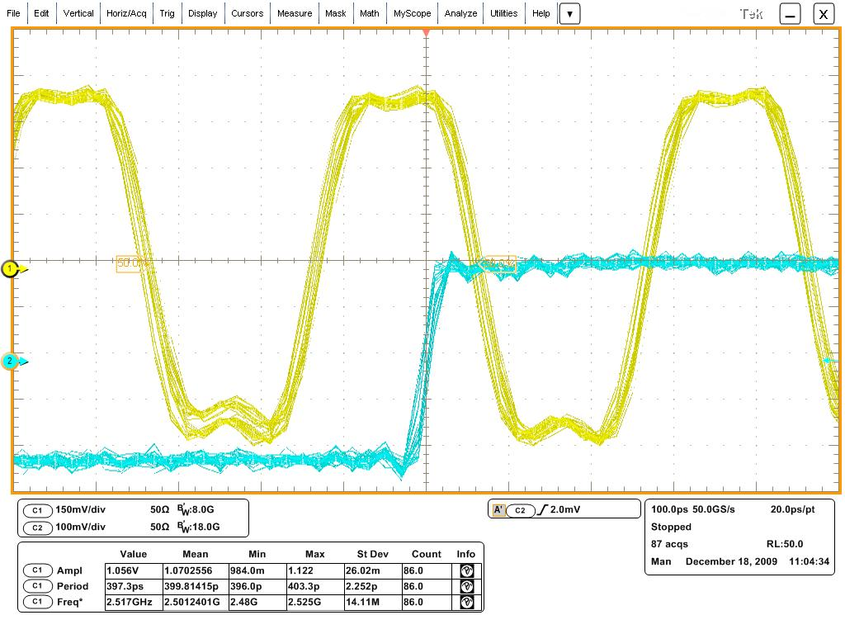
5 GHz LC PLL
We have tested the first version of LC PLL on the same die as LOCs1. More details are available in T.Liu’s poster (Poster ID# 116)
Tuning range: 4.7 to 5 GHz.
  Expected: 3.79 to 5.01 GHz.
  Found a bug in the divider in PLL.
Power consumption: 121 mW
  Compare: Ring oscillator based PLL, 173 mW at 2.5 GHz
Random jitter: 1 - 2.5 ps (RMS)
Deterministic jitter:< 17 ps (pk-pk)
output clock locks to input clock
The LC PLL will be used in 10 Gbps serializer with two changes:
Slightly adjust the frequency.
Fix the bug in the divider.

Slide 15
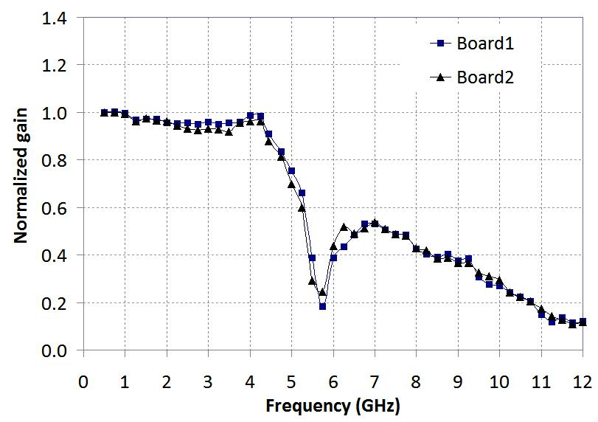
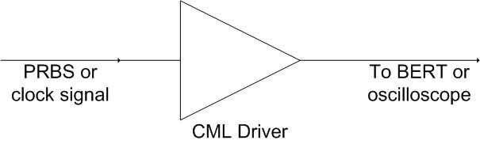
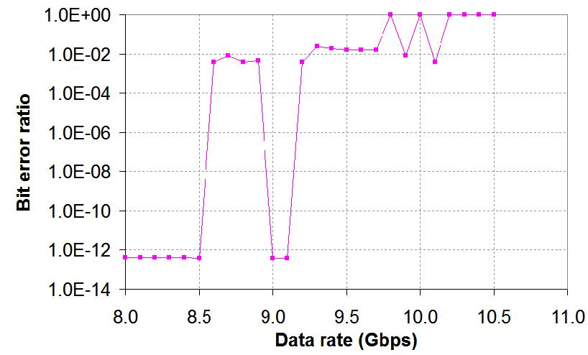
CML driver
We have tested a separate CML driver on the die, same design as used in LOCs1:
Bandwidth: ~5 GHz
Data rate: up to 8.5 Gbps
Plan to use inductive peaking to boost its bandwidth for 10 Gbps data transmission
CML driver test schematic
output clock locks to input clock

Slide 16
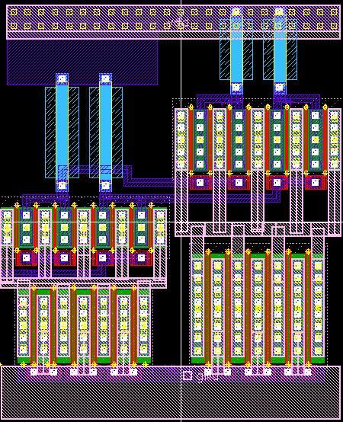
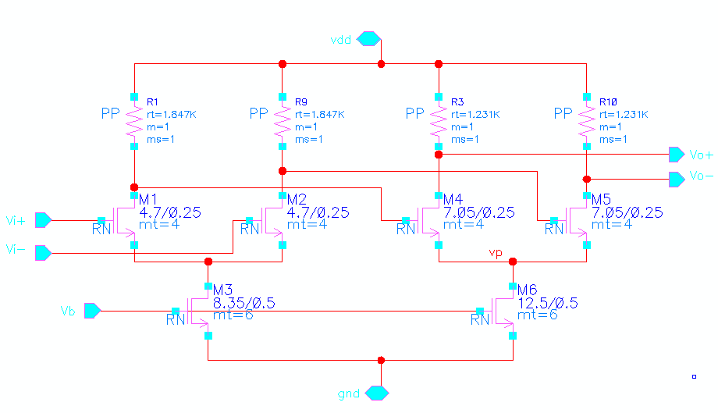
High speed CML circuit design
We designed a CML buffer for 5 GHz
clock fan-out. More CML circuit
components are ongoing.
Parameters for the CML buffer:
Swing > 200 mV
Freq > 5 GHz
Power: ~8 mW
Two stage design
Fan out two identical buffer without signal attenuation
Schematic and Layout of the CML buffer

Slide 17
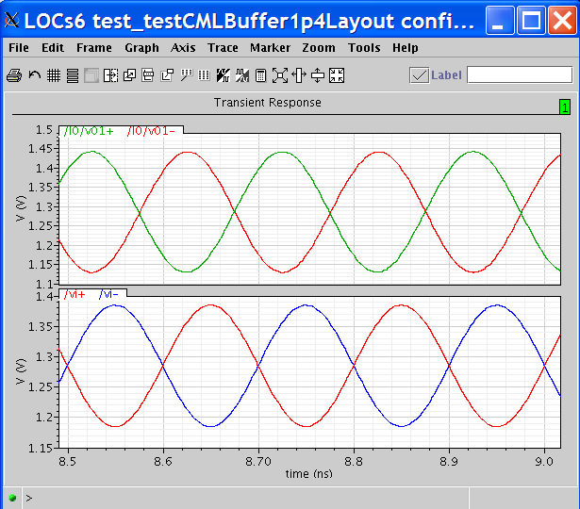
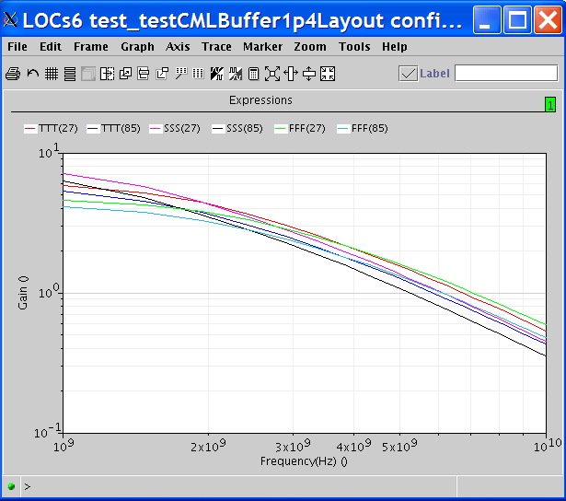
CML buffer Post-layout simulation
V(v)
Output
Gain
V(v)
Input
5 GHz
time (ns)
Frequency (Hz)
Input and output of CML buffer
at typical corner and room temperature
Frequency response at different temp and corners
CML buffer fans out two identical buffer above 5GHz at different corners and temperature based on post-layout simulation
17

Slide 18
Summary
Successfully designed LOCs1, a 5 Gbps 16:1 serializer chip. Both laboratory and irradiation tests indicate that we have achieved the design goals.
We have started to design LOCs6, a 6 lane serializer array with 10 Gbps/lane to deliver 50 Gbps/chip with 20% redundancy or 60 Gbps/chip without redundancy. The approach looks promising so far.

Slide 19
Acknowledgments
We thank US-ATLAS for funding this project. We are grateful for all the people who have been assisting us in the design and testing of the LOC chips. We are especially in debt to Paulo Moreira, Fukun Tang and Christine Hu for their help in the design of LOCs1.
Thank you!

