Slide 1
The front-end Electronics
for the LHCb upgrade.
Jan Buytaert (C.E.R.N.)
On behalf of the LHCb collaboration.
TWEPP 2010 Workshop, Aachen, September 21, 2010

Slide 2
Outline :
The LHCb upgrade plan & main issues.
The new trigger/daq architecture.
Overview of the subdetector modifications.
Subdetector electronic developments.
Summary.

Slide 3
The LHCb upgrade.
The Plan:
 | E | Peak L (10³²cm⁻²s⁻¹) | ∫ L
2011 | 7 TeV | 2 | 1 fb⁻¹ | = LHCb design luminosity !
2012
2013 | >10 TeV | 2 | 1 fb⁻¹
2014 | >10 TeV | 2 | 2 fb⁻¹
2015 | >10 TeV | 2 | 2 fb⁻¹ | Total ∫ L ~ 6 fb⁻¹
2016 |  |  |  | Install LHCb upgrade !
2017 | >10 TeV | 10 | 10 fb⁻¹
2018 | >10 TeV | 10 | 10 fb⁻¹
The increase in luminosity ‘only’ requires stronger beam squeezing , i.e. does not depend on any LHC upgrade.
A ‘letter of intent’ will be submitted very soon to LHCC.

Slide 4
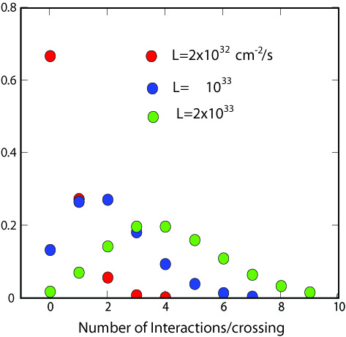
The occupancies.
Peak L ( 10³²cm⁻²s⁻¹ ) | 2 | 10 | 20
Average # of interactions/crossing | 0.4 | 2.0 | 4.0
Average # of interactions/non-empty crossing | 1.3 | 2.4 | 4.3
66%
Present
Upgrade
16%
The occupancies will only increase by ~ 2 due to multiple interactions.
The current detector granularities are adequate and no major detector changes required.
The exact beam conditions are under discussion with LHC.
0%
empty bunch
crossings

Slide 5


L0 trigger efficiency.
  Problem: the L0 hadron hardware trigger loses efficiency at higher luminosities. The event yield is even dropping...
    Because the DAQ event readout rate is limited to 1MHz, the trigger thresholds must be raised …
  2 solutions:
    A more sophisticated hardware hadron trigger or
    No hardware trigger, increase the readout rate and implement trigger in a CPU farm !
      Full detector information available.
      Flexible algorithm.
      Double the hadron trigger efficiency .

Slide 6
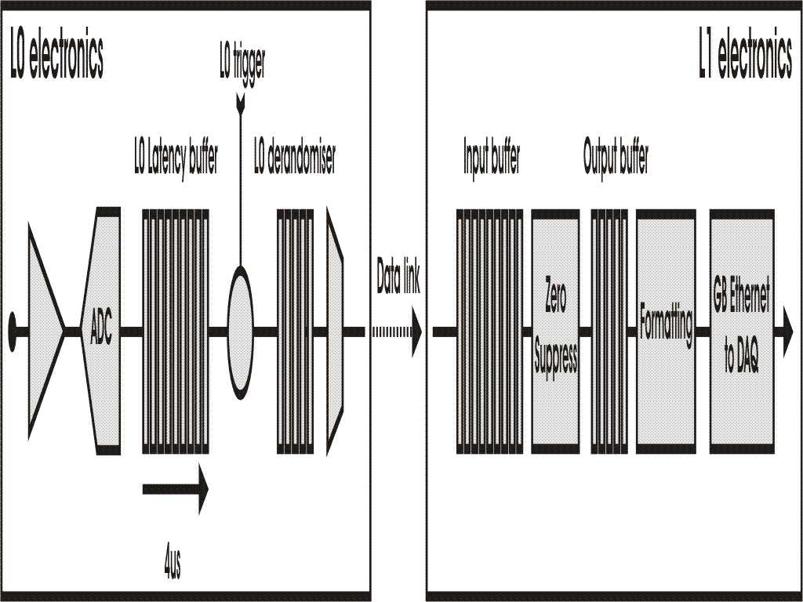
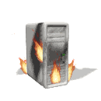
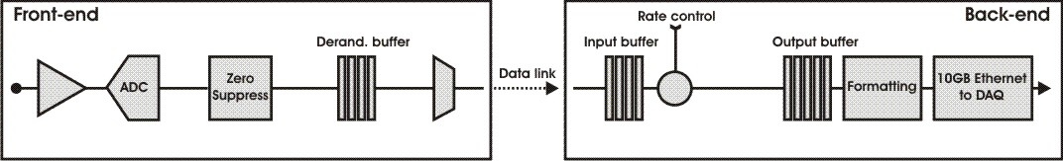
New Trigger/DAQ architecture.
Readout
Supervisor
L0 Hardware
Trigger
Current
HLT
1 Gb
Ethernet
1 MHZ
Tell1
Readout
Supervisor
Interaction
Trigger
10 Gb
Ethernet
HLT++
Upgrade
40 MHZ
1…40 MHZ
Tell40
    All frontend electronics must be adapted or redesigned to
      readout all collision data @ 40MHz
      and zero-suppress to minimize data bandwidth.
    The L0 hardware trigger is re-used to reduce the event rate to match the installed router and CPU farm capacity (staging). Initially run at ~ 5MHz.
(Tell 40: talk of
J.P. Cachemiche on
wednesday)

Slide 7
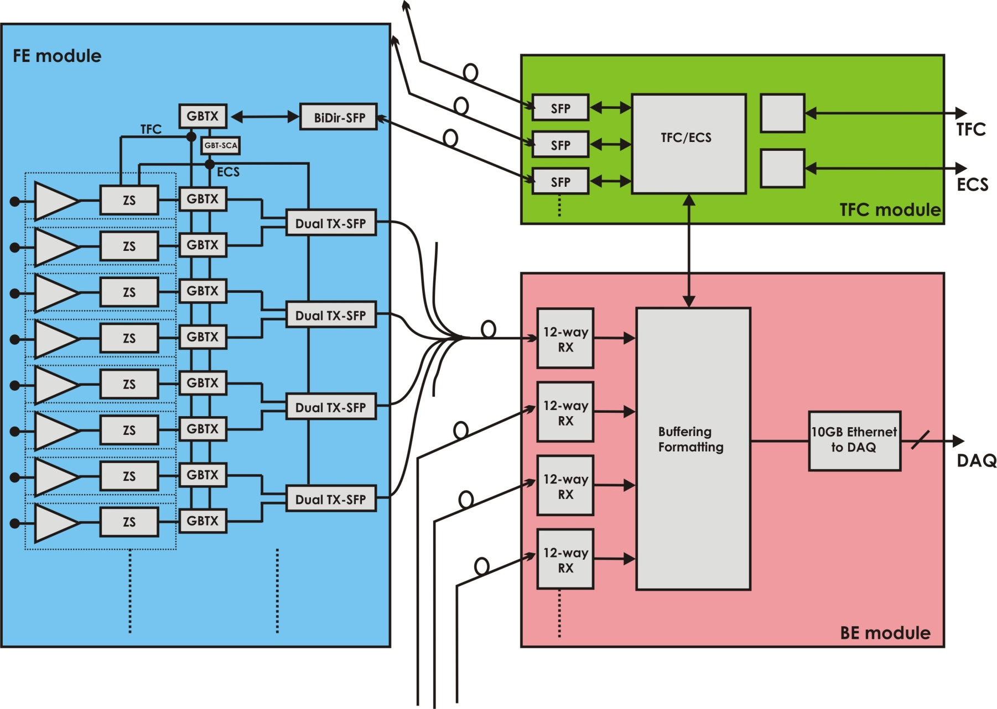
Typical Subdetector readout & control:
GBT
links
Number of GBT links:
 | Data | TFC/ ECS
Velo | 2496 | 52
OT | 3456 | 72
IT | 1200 | ~100
RICH | 2476 | ~200
Calo | 952 | 238
Muon | 1248 | 104
Total = | 11684 | 766
<100meter
Total optical links required ~ 13000.
LHCb has already 8300 links installed today.
Bundle of 8 x 12way ribbon

Slide 8
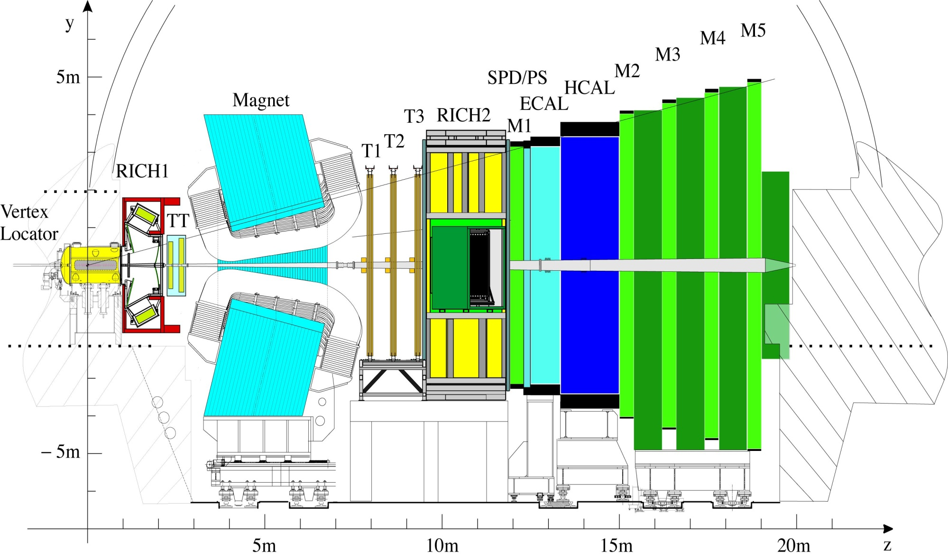
LHCb detector.
Ecal, Hcal
Shaslik & Tilecal
with MaPMT readout
RICH
HPD + Si-pixel
Muon
MWPC
VELO
Si strips
Trackers TT,T1,T2,T3
Outer region: straw tubes
Inner region: Si strips
(See talk of K. Henessy on Friday).

Slide 9
Main detector modifications.
VELO and RICH:
  Fullz new sensor modules and photon detectors (because they are highly integrated with the FE-electronics) :
    VELO : pixel sensors will replace R-Phi strip sensors.
    RICH : multi-anode PMT’s will replace Hybrid photon detector (HPD) tubes.
Tracker :
    Inner Tracker : Keep current Si strip sensors or use scintillating fibers.
    Outer Tracker : Keep straw tubes and part of the FE electronics.
Calorimeters:
  Keep MaPMT’s, but at reduced HV to avoid ageing.
    -> 5x lower signal gain -> to maintain S/N, need lower noise -> new amplifiers …
  Possibly remove pre-shower (PS) and scintillating pad (SPD).
Muon:
    Detector and FE electronics stay unmodified.
    The M1 station will be removed.

Slide 10
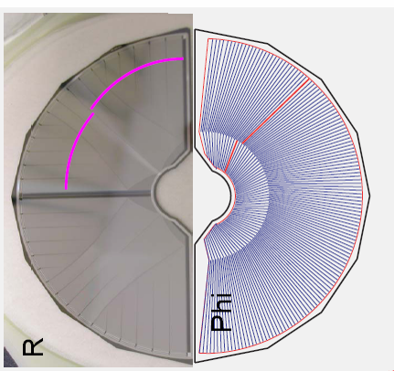
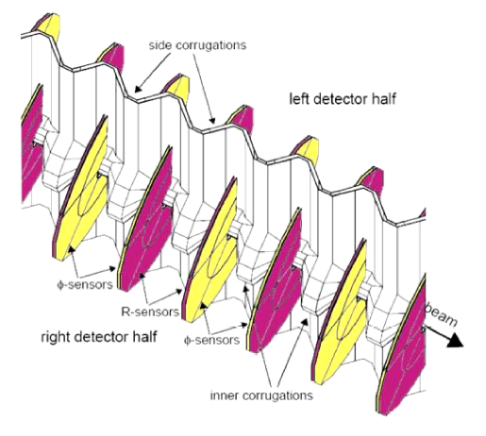
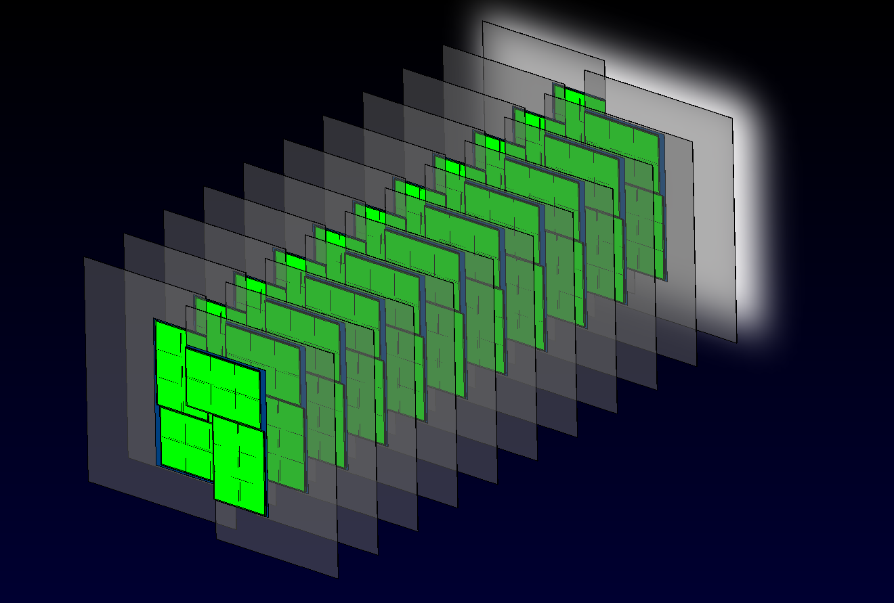
VELO upgrade.
Current VELO R&Phi strips
Upgrade : Pixel Sensor tile
ASIC
~43mm
~15mm
ASIC
ASIC
Top Sensor 150um
Cooling channel
ASIC100um
CVD diamond 300um
Connector
ASIC100um
Current VELO module layout
Bot Sensor 150um
Pixel module
Sensor tile
Connector
Connector

Slide 11
VELO upgrade.
Design of a readout asic VELOPIX’ in close collaboration with TimePix2.
  256x256 pixel array, 55um x 55um pixel size.
  Minimal insensitive area (~5%)
  Analog requirements identical.
  Simultaneous meaurement of Time-over-threshold and time identification of hits.
  Radiation hardness TID 400Mrad.
Specific VELOPIX:
  Highest average particle rate is 200MHz/cm².
  =>12Gb/s data generation rate /asic !
  Clustering and formatting in pixel.
  ‘Superpixel’ = group digital logic of 4x4 pixels in a single area.
  High speed column readout (8bit@40MHz).
  4 multi-Gbit output links.
  Total power budget < 3W@ 1.2 V
Bipolar Input charge
Leakage current compensation
Peaking time | ≤ 25ns
Preamp output linear dynamic range | < 40 Ke-
ENC (σ_{ENC}) | ~75 e-
Detector capacitance | < 50 fF
Discriminator response time | < 2ns
Full chip minimum detectable charge | < 500 e-
Threshold spread after tuning | < 30 e-
Pixel analog power consumption @ 1.2V | < 15-20 µW
220 um
~140 um
A
A
A
A
A
A
A
A
220 um
Super pixel
Digital
A
A
A
A
A
A
A
A

Slide 12
VELO upgrade.
Module readout concept :
Vacuum tank
48 Diff Cu lines @3.2Gb/s ~ 1m
Low mass
48 optical links
@3.2Gb/s ~60m
10Gb interface
vacuum feed-throughs
½ Tell 40
Electro-optical
Total of 52 modules in full system.
Work is starting on the link technology.

Slide 13
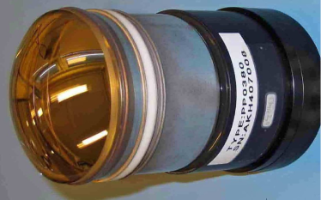
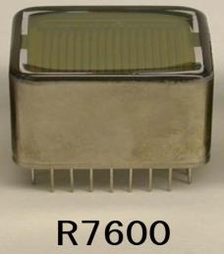
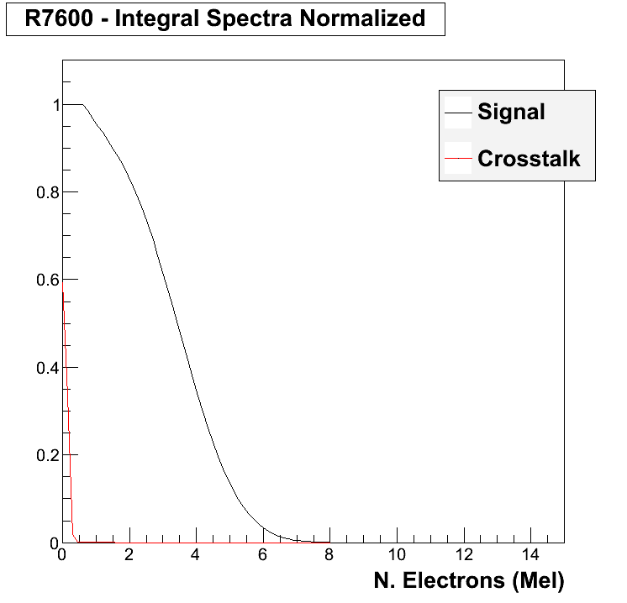
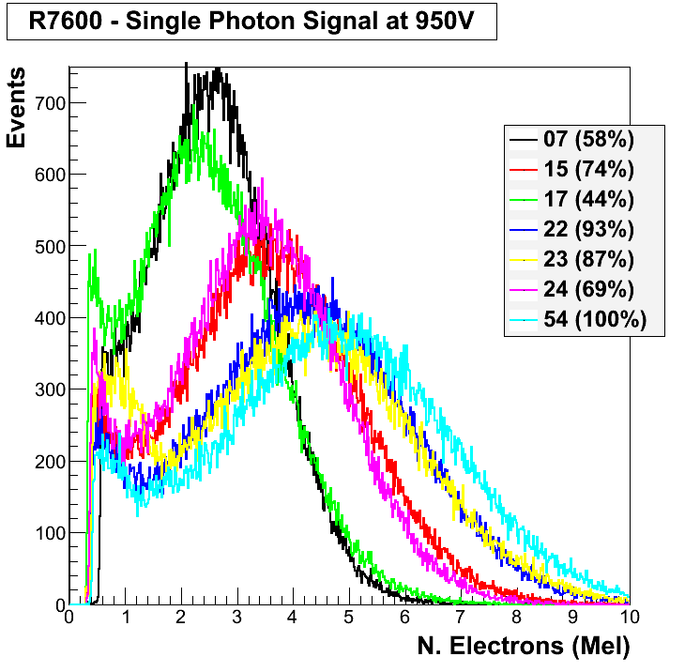
RICH upgrade.
Change of photon detector :
  Inter-pixel crosstalk in R7600 is much less than in previous models :
32×32 pixels
Pixel size 2.5×2.5 mm2
8×8 pixels
Pixel size 2×2 mm2
  Larg pixel gain variation.
  => Electronic gain must be adjustable per pixel.

Slide 14
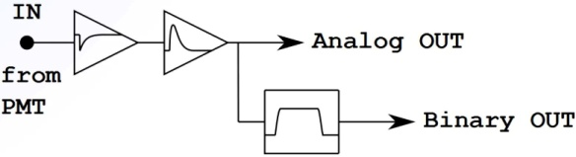
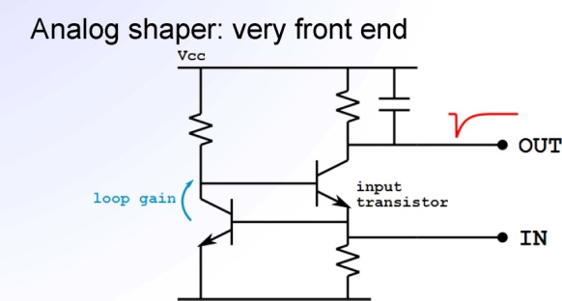
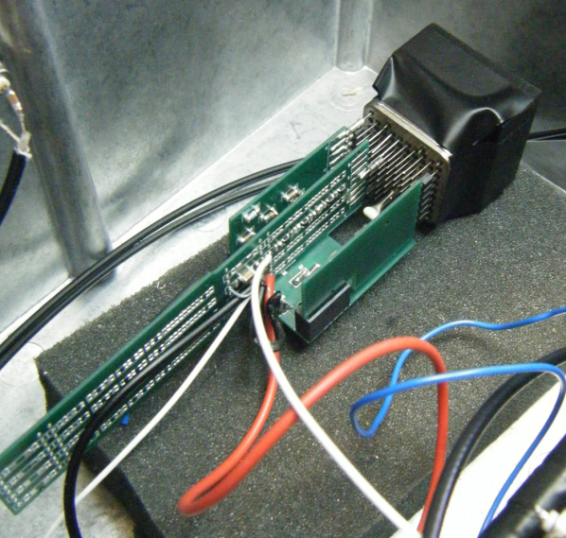
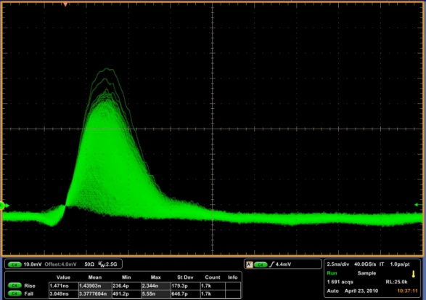
RICH upgrade.
Discrete component prototyping:
8-channel PCB
Using SiGe npn transistors.
Total power dissipation < 10 mW/channel
Low noise ~2.2nV/√Hz
rise-time =1.4 ns, fall-time = 4ns
Next:
  Start design of asic version.
  Prototype of digital functionality in FPGA.
(INFN Milano Biccoca. Submitted to NIM A)
10ns

Slide 15
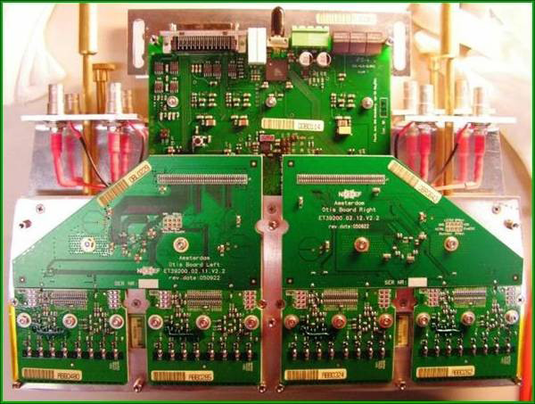
Outer Tracker upgrade.
Current FE boards (432)
Upgrade
8 Fibers (25 Gb/s)
GOL (1.6 Gb/s)
opical board
2 x GBTX
6.4 Gb/s
2 x GBTX
6.4 Gb/s
2 x GBTX
6.4 Gb/s
2 x GBTX
6.4 Gb/s
LVDS Drivers
LVDS Drivers
LVDS Drivers
LVDS Drivers
OTIS TDC
OTIS TDC
FPGATDC 16ch
FPGATDC 16ch
FPGATDC 16ch
FPGATDC 16ch
FPGATDC 16ch
FPGATDC 16ch
FPGATDC 16ch
FPGATDC 16ch
2xASDBLR
2xASDBLR
2xASDBLR
2xASDBLR
2 x ASDBLR
2 x ASDBLR
2 x ASDBLR
2 x ASDBLR
ASDBLR boards are reused.
OTIS TDC replaced by FPGA TDC.
1GOL replaced by 8 GBT

Slide 16
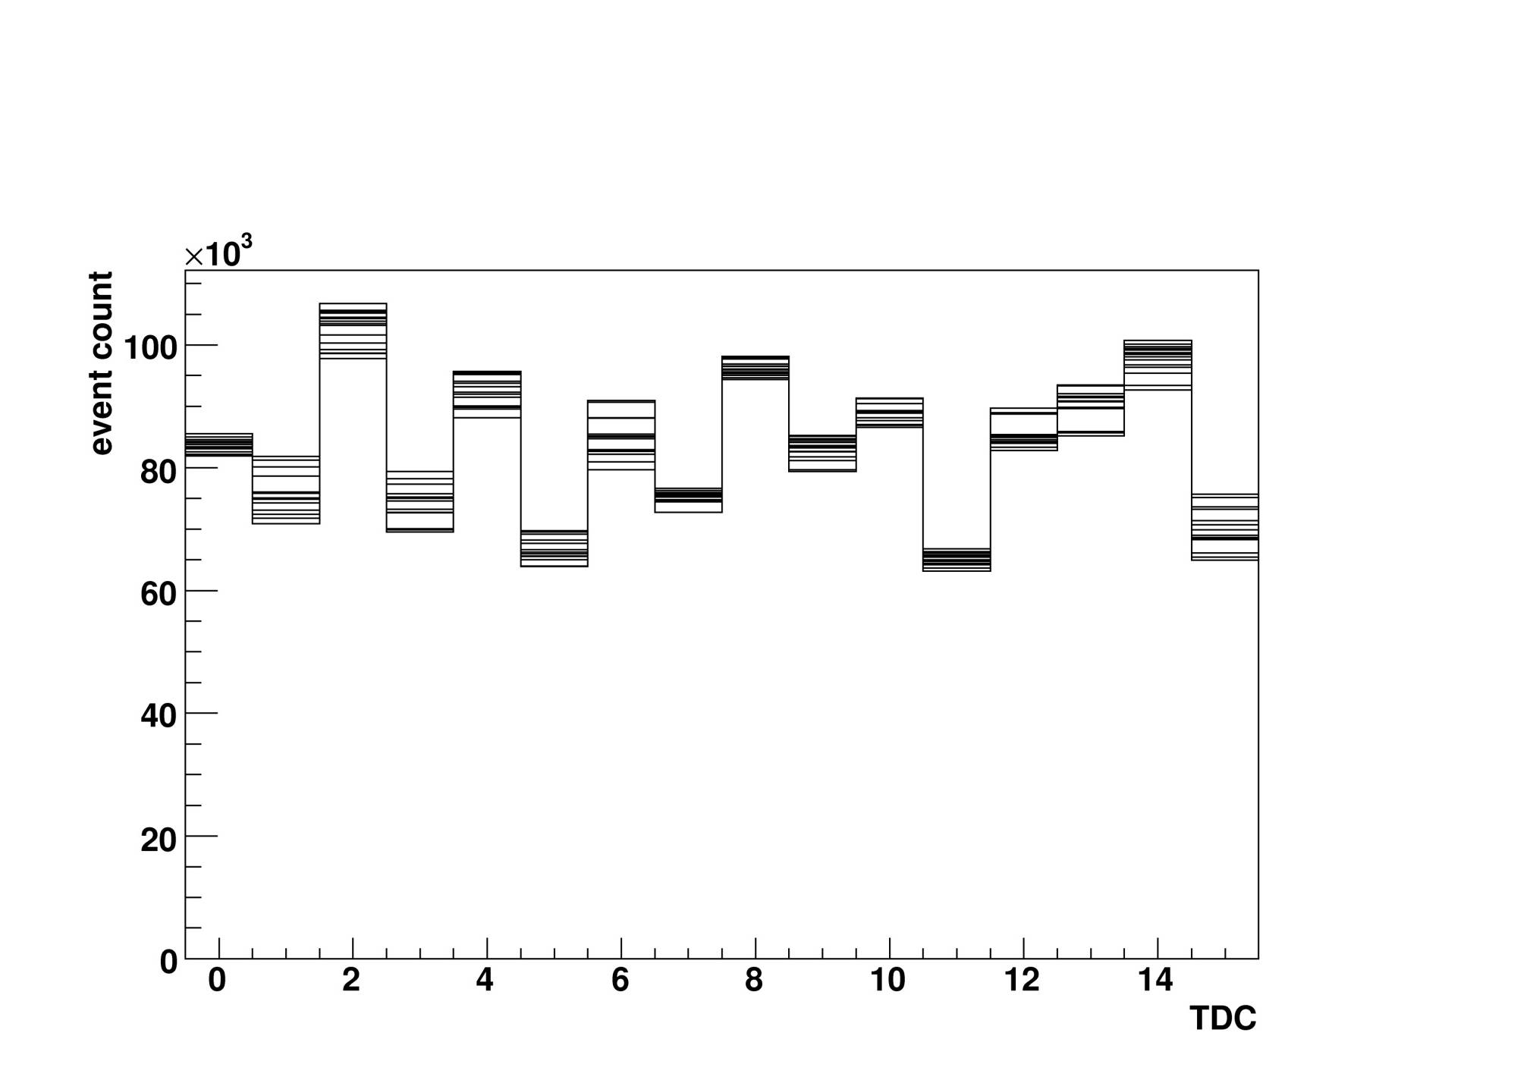
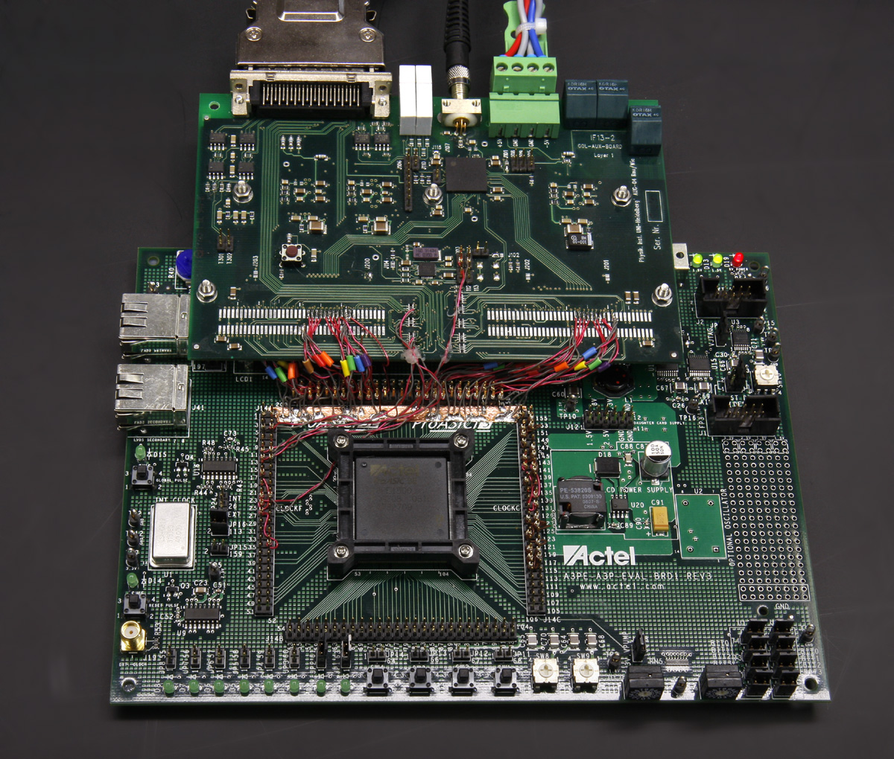
Outer Tracker upgrade.
All logic is implemented in ACTEL Proasic3E FPGA for radiation tolerance .
  16 Channel 4 bit TDC design finished.
    INL and DNL checked.
    Good temperature stability checked.
  Zero Suppression and data formatting.
  Output on parallel bus (20 bit @ 160 MHz) to GBT.
  I2C interface for configuration.
Prototyping :
Differential non-linearity ~0.2 bin
bin size ~ 1.57 ns
TDC count bin

Slide 17
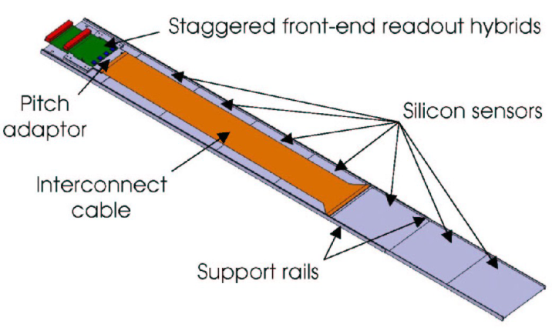
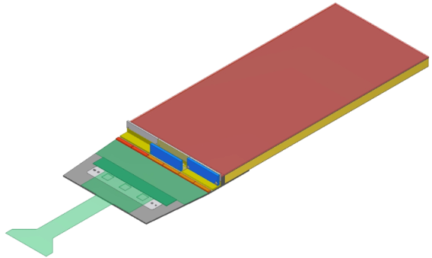
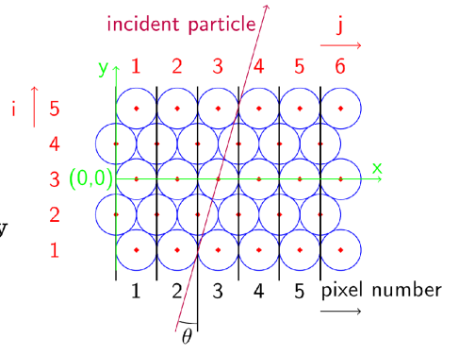

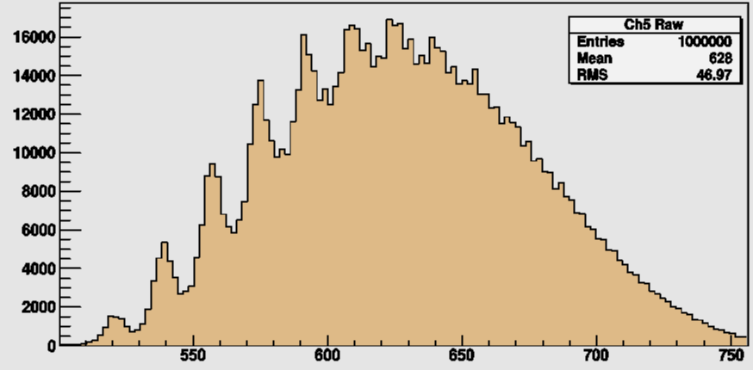
Inner Tracker upgrade.
Option1 : reuse Si strip ladders.
  Need to develop a new rad-hard, binary ASIC (cfr ATLAS) with 40MHz readout… not yet started.
Option 2 : Scintillating fibers with SiPM readout.
5 layer of 250 um fibers
MIP spectrum measured
with Beetle ASIC : S/N ~30.
128 SiPM array
SiPM cell coverage
Photon
peaks
Radiation hardness for 10¹⁰ neutron/cm² ? under study.…

Slide 18
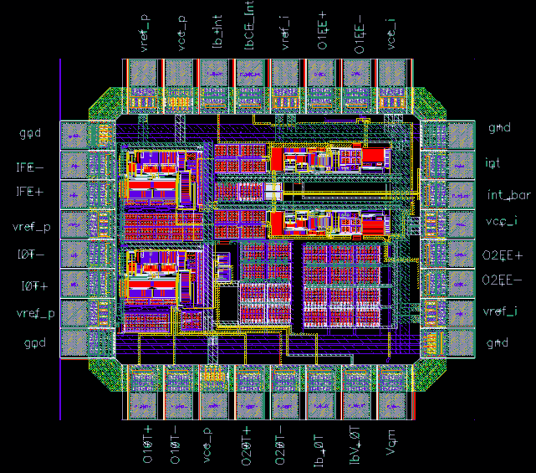
Calorimeter upgrade.
The HV (and PMT gain) has to be decreased by a factor 5 to avoid premature ageing.
  ->the preamplifier input equivalent noise must be decreased accordingly.
A new frontend asic is being designed.
  The signal is alternated every 25 ns between two integrators. The non-ative integrator is reset.
A first prototype of preamplifier and switched integrators has been designed and submitted in AMS 0.35 um SiGe BiCMOS.
∫
S/H
I
I
Current amplifier
∫
S/H
ADC Driver
Integrators
Analog mux

Slide 19
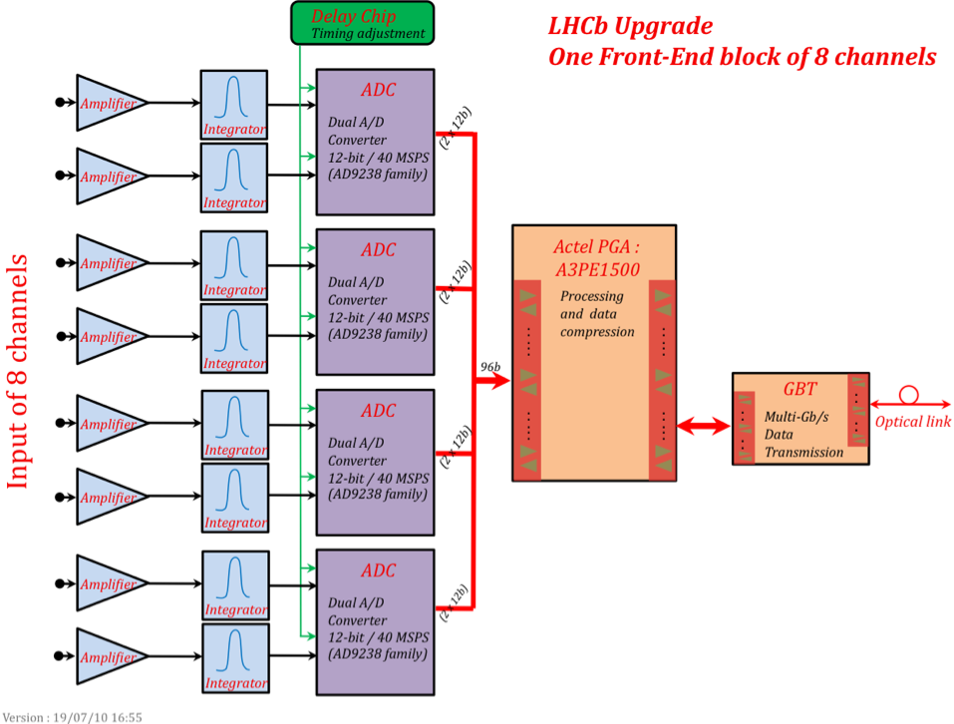
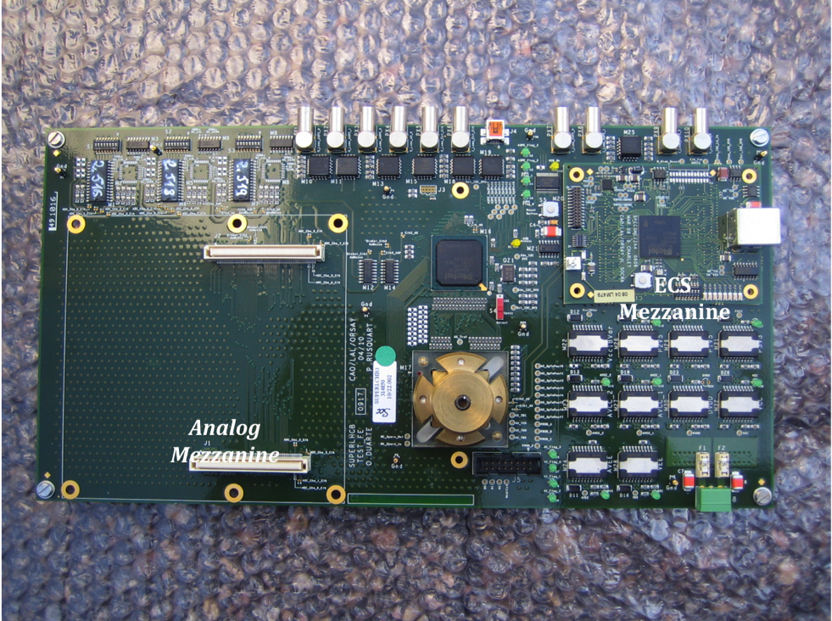
Calorimeter upgrade.
New front end cards : 32 PMT signals
  Extensive use of FPGA’s (AX and APA) for data compression, trigger and ECS
Prototype of digital electronics
AD9238
dual 12bit 40Ms/s ADC
4 channel asic

Slide 20
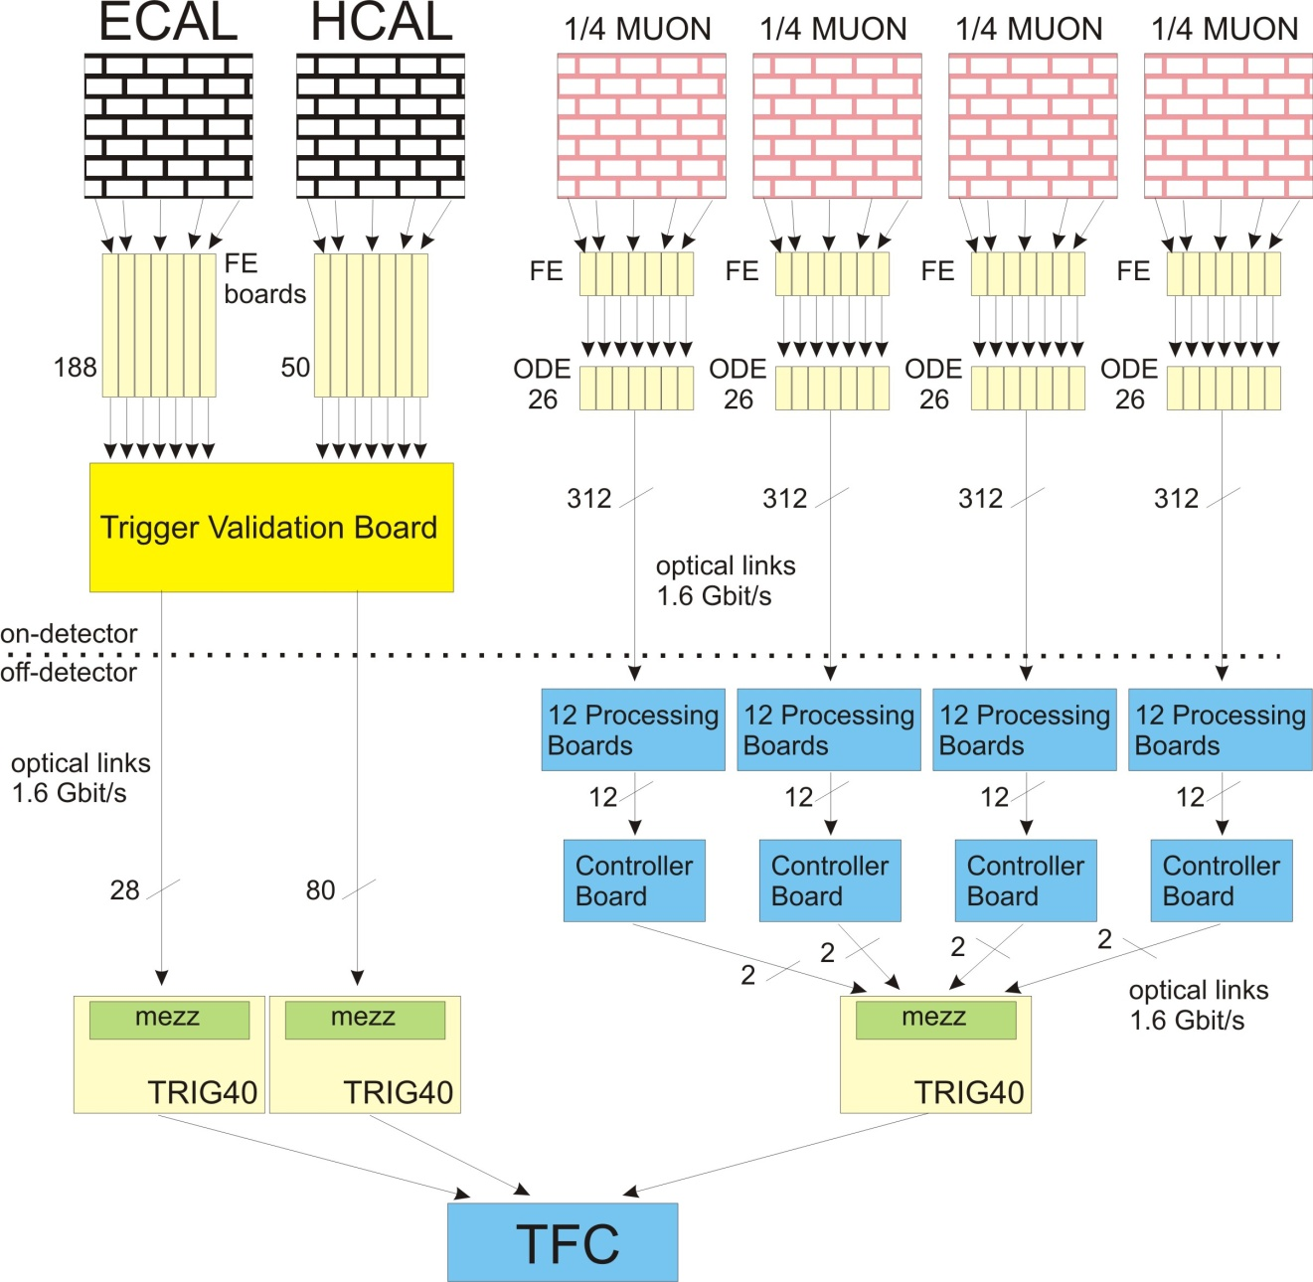
Muon upgrade & Interaction trigger.
Existing
boards.
New ‘interface’
boards.
Interaction trigger.
Muon DAQ path.

Slide 21
Summary.
LHCb has a firm plan for its upgrade in 2016.
No major detector changes needed, except VELO and RICH.
All front-end electronics must be adapted or redesigned for 40 MHz readout and zero suppression.
The subdetectors electronic developments are well underway.
Extensive use of radiation tolerant FPGA’s to avoid ASIC design where possible.

Slide 22
Backup slides

Slide 23
Pixel matrix readout architecture.
16x
Super pixel
Pixel matrix readout architecture
  Internal bus speeds:
    Column bus : 8bit@40MHz
    Output bus : 16bit@320MHz
  Total ASIC output : ~12.8 Gb/s.
  Buffering in :
    Super pixel : 2 clusters
    Super pixel group FIFO : ~400 bit
    Output FIFO: multi kbyte
Simulation shows losses< 0.5% in highest occupancy conditions.
Analog
frontend
Analog
frontend
Analog
frontend
Cluster
logic
buffer
4x
Super pixel
Super pixel
FIFO
Super pixel
Super pixel
Super pixel group
16x
Super pixel group
Super pixel group
Super pixel group
Super pixel group
Column bus
Super pixel
column
EOC
logic
16x
Super pixel
column
Super pixel
column
Periphery &
Output port
Super pixel
column
Super pixel
column
Output bus
~ 3.2Gb/s
FIFO
Serializer
Driver
4 x

