Slide 1

Low-cost bump bonding activities at CERN
Sami Vähänen, Timo Tick & Michael Campbell
Sami Vähänen – CERN TWEPP-10 Workshop 22-September-2010

Slide 2
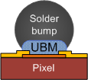
Outline
Introduction
Under Bump Metal (UBM) deposition
Electroless Nickel (EN) process introduction
Test vehicle chip description
Flip chip tests and results
Solder ball placement technology and test on a Timepix chip
Summary
Sami Vähänen – CERN TWEPP-10 Workshop 22-September-2010

Slide 3
Low-Cost µ-Bump Bonding - Introduction
Bump bonding (BB) costs for a single pixel detector unit have been € 200 – € 300.
  ReadOut Chip (ROC) : Sensor Chip (SC) : BB (cost ratio) = 1:2:7!
Increase in pixel detector area in the LHC upgrade – coverage of ten(s) of square meters?
  BB is a major cost issues and a motivation for the low-cost study
Issue with low BB volumes at CERN
  No constant need for BB technology
  High price of BB services
  Flip chip assembly part has caused the rise in total costs during last two years (pie diagrams)
Studied low-cost BB technologies have to exist still after 10 years and have to be compatible with 300 mm wafers.
Development has to be done on all fields of the pie diagrams for getting to ultimate low-cost BB solution.
Sami Vähänen – CERN TWEPP-10 Workshop 22-September-2010

Slide 4
UBM Deposition
Electroplating has typically been used for solder bumping pixel of wafers.
  Well characterized and reliable technology, but rather expensive in small-scale production.
Electroless Nickel (EN) under bump metallization (UBM) is studied as a corner stone for low-cost BB in this presentation because:
  EN is suitable for various flip chip scenarios
  EN can be processed without lithography
  Batch processing - high-volume capability and affordable price
  Reliable UBM – thick Ni as diffusion barrier for solder
Electroless technology could substitute traditional electroplating processes in certain bump size/pitch window in combination with complementary solder deposition techniques.
  Solder ball placement solutions are also studied for low-cost solder deposition.
  Anisotropic conductive films (ACF) could be used, but there aren’t many suitable films available for area array type fine-pitch applications (issues with small pad area).
This presentation focuses on the testing of EN UBM’s.
Sami Vähänen – CERN TWEPP-10 Workshop 22-September-2010

Slide 5
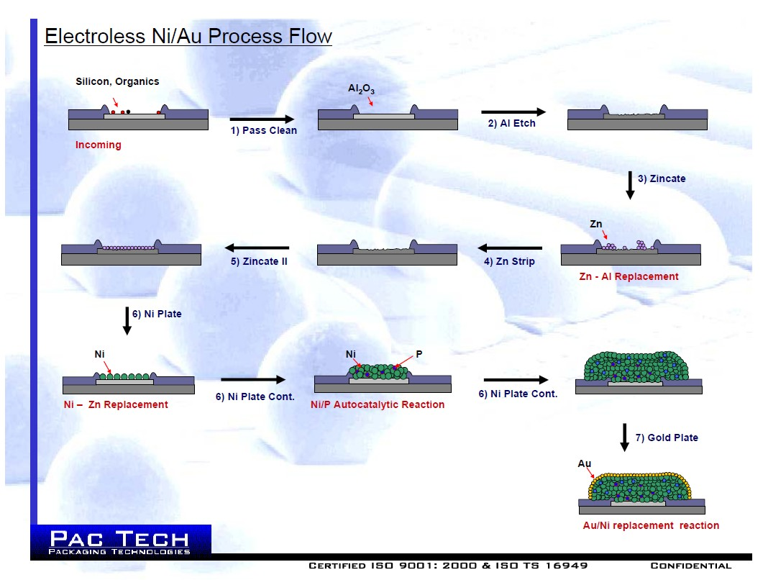
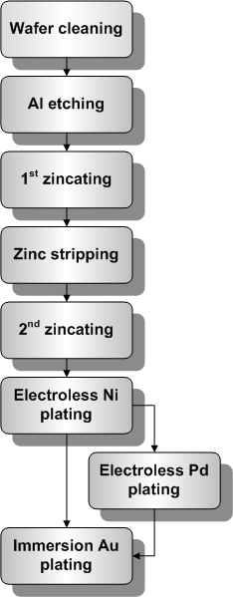
Electroless Nickel (EN) Process Flow
Source: Pac Tech publications, ref #62: http://www.pactech.com/index.php?option=com_content&view=article&id=154&Itemid=21
Sami Vähänen – CERN TWEPP-10 Workshop 22-September-2010

Slide 6
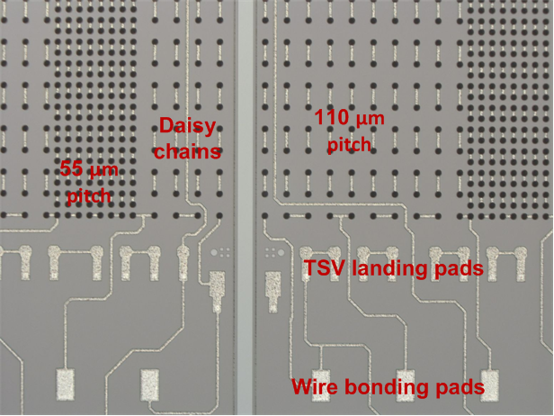
CERN Test Vehicle Wafers (1/2)
To use EN on real wafers, the process have to be tested and characterized.
Test vehicle layout was designed at CERN to serve the low-cost flip chip, TSV and large area tiling development work.
  Typical interconnection densities for pixel detectors (55 µm & 110 µm pitch).
Test vehicle has daisy chains and Kelvin test structures to characterize the interconnection yields and resistances at three interfaces:
  Flip chip bumps (21k/chip)
    32 daisy chains
    2 Kelvin bump test structures
  TSV’s (196/chip)
    33 daisy chains
    5 Kelvin vias
  BGA joints (100/chip)
    2 daisy chains
Layout is also suitable for chip-to-wafer and wafer-to-wafer bonding.
Wafers were processed at VTT by the authors.
Picture of CERN Test Vehicle dummy readout chip
Sami Vähänen – CERN TWEPP-10 Workshop 22-September-2010

Slide 7
CERN Test Vehicle Wafers (2/2)
Wafers (150 mm) were processed in two batches :
  1st batch of 24 wafers processed with AlSi(1%) wiring layer – typical for sensor wafers
    Electroless Nickel – Electroless Palladium – Immersion Gold (ENEPIG) UBM process at Pac Tech
  2nd batch of 17 wafers processed with AlSi(2%)Cu(1%) wiring layer – very close to the topmost metal on readout wafers AlSi(1%)Cu(0.5%).
    Electroless Nickel - Immersion Gold (ENIG) UBM process at Pac Tech
The purpose of two separate batches was to study the EN quality with and without having Cu alloyed in Al.
A third small batch of wafers was processed using the standard VTT electroplating process. Eutectic tin-lead solder bumps with Ni UBM were electroplated on the wafers.
  Well known and reliable bumping technology
  Most of the chips were bonded on electroless UBM pads
  A small number of chips were used as a flip chip reference
Sami Vähänen – CERN TWEPP-10 Workshop 22-September-2010

Slide 8
ENIG UBM on Test Vehicle Chips
SEM pictures of ENIG UBM pads on test vehicle chips are presented below.
  UBM diameter ~ 27 µm, height 4 µm
Picture on the left, a single ENIG UBM pad.
Picture on the right taken with Angle-Selected Backscattered (AsB) mode.
  Heavy elements (Ni UBM pads) are shown as brighter colours
Sami Vähänen – CERN TWEPP-10 Workshop 22-September-2010

Slide 9
ENEPIG UBM Tests with Timepix Wafers
Test vehicle wafers were used for gathering statistics from FC assemblies.
Real CMOS wafers were processed with ENEPIG to see if the EN UBM process is feasible on real pixel wafers.
ENEPIG UBM was grown on Timepix wafers with two different pitches
  55 µm – without photoresist mask
  110 µm – with photoresist masking. Chips were electrically measured after EN process – no degradation in electrical performance.
ENEPIG UBM pads on Timepix chip (55 µm pitch)
ENEPIG UBM pads on Timepix chip (110 µm pitch)
Sami Vähänen – CERN TWEPP-10 Workshop 22-September-2010

Slide 10
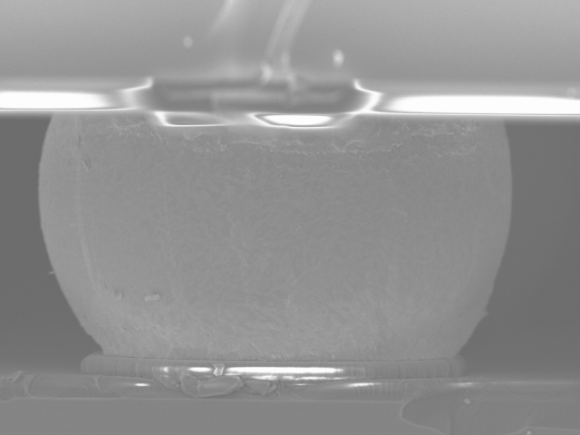
Flip Chip Tests and Results
Silicon chip
Al wire
Electroplated Ni UBM
SnPb Solder bump
ENIG = electroless Ni/Au UBM
Al wire & passivation
Silicon chip
Sami Vähänen – CERN TWEPP-10 Workshop 22-September-2010

Slide 11
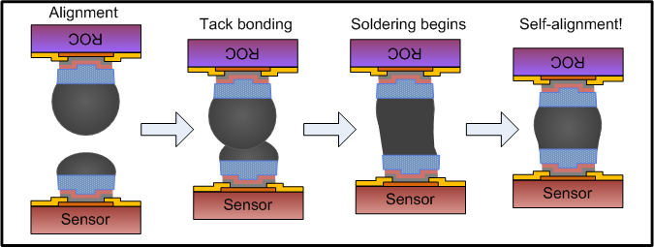
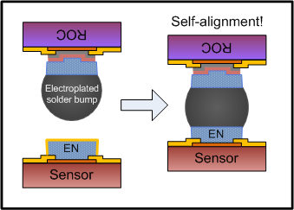
Bump Structure & Assembly Procedure
Assemblies were built using three different flip chip structures
  Reference structure: electroplated (asymmetric) solder bump structures used on both sides of chips to be mated (picture 1)
  AlSi(1%)–ENEPIG structure: Electroplated solder bumps soldered on ENEPIG UBM (picture 2)
  AlSi(2%)Cu(1%)–ENIG structure: Electroplated solder bumps soldered on ENIG UBM
Flip chip bonding was done with FC150 flip chip bonders, with tack bonding cycle.
Assemblies were picked up on a tray and run through a batch reflow process at 230 ˚C in reducing ambient.
1
2
Reference technology using VTT process
Soldering on EN using ENEPIG and ENIG UBM pads
Sami Vähänen – CERN TWEPP-10 Workshop 22-September-2010

Slide 12
Results from Daisy Chain Structures - Yield
Calculated yields based on functional daisy chains can be seen on table below:
Reference technology had 100 % yield.
AlSiCu-ENIG technology showed also very good yields which indicates that the technology is good enough to be used for pixel chips.
Notice the poor yield with AlSi-ENEPIG technology, especially if the average resistance per joint is limited to 1 Ω max (resistances from wiring weren’t eliminated)
  Major contact resistance issue at AlSi – ENEPIG interface
Sami Vähänen – CERN TWEPP-10 Workshop 22-September-2010

Slide 13
Results from Daisy Chain Structures
Resistances of complete daisy chains have been plotted in the graph below.
  Huge differences in daisy chain resistances with AlSi(1%)-ENEPIG UBM technology (red bars)
  Reference and AlSiCu-ENIG technologies have equivalent resistances
Sami Vähänen – CERN TWEPP-10 Workshop 22-September-2010

Slide 14
Results from Kelvin Structures (1/2)
Kelvin bump structures revealed more detailed information about individual FC joint resistances.
Issue with the first batch of electroless UBM’s (AlSi-ENEPIG). Graph below.
  Joint resistances varied in the range of several decades, which also explains the huge variation in the daisy chain resistances.
Reason behind the unstable joint resistance values was studied with the help of cross-sectional samples of the bump structures and inspecting them with SEM.
Sami Vähänen – CERN TWEPP-10 Workshop 22-September-2010

Slide 15
Results from Kelvin Structures (2/2)
Joints made with reference and AlSiCu-ENIG technologies showed much smaller and more stabile joint resistances (average 19 mΩ) than done with AlSi-ENEPIG.
4 µm thick electroless Ni causes a rise in the joint resistance for electroless deposited UBM’s.
Standard deviation of 7 mΩ is perfectly fine, but larger than with reference technology.
Sami Vähänen – CERN TWEPP-10 Workshop 22-September-2010

Slide 16
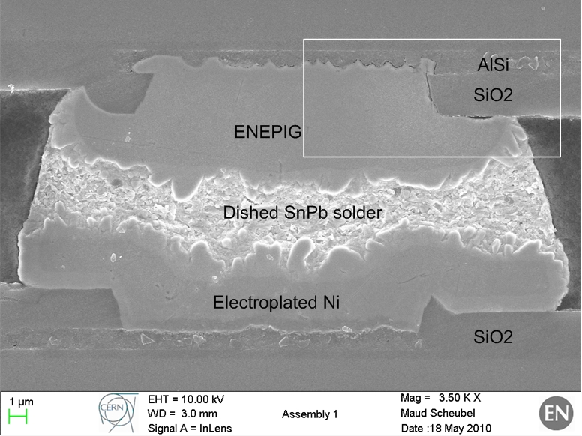
SEM Imaging of Bump Structure(s)
Cracks were found at AlSi(1%) – ENEPIG interface (left picture).
  Hundreds of bump structures were inspected and tens of cracks were found
The cracks would be a very logical reason behind the high daisy chain resistances and variation of resistances.
  Cracks are critical if dealing with small passivation openings (20 µm in this case)
AlSi-ENEPIG
AlSiCu-ENIG
Sami Vähänen – CERN TWEPP-10 Workshop 22-September-2010

Slide 17
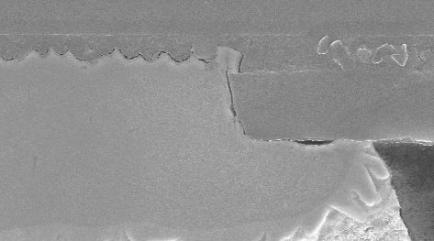
SEM Imaging of Bump Structure(s)
No cracks were found at AlSi(2%)Cu(1%) - ENIG interface (right picture).
Note the difference in the roughness between Al – EN interfaces
  AlSiCu-ENIG interface is much smoother
    Better mechanical contact
    Lower contact resistance
Having Cu in Al really improves the quality of Al-Ni interface!
AlSi-ENEPIG
AlSiCu-ENIG
Zoom-in
Zoom-in
Crack at AlSi-Ni interface
Seamless AlSiCu-Ni interface
Sami Vähänen – CERN TWEPP-10 Workshop 22-September-2010

Slide 18
Solder Ball Placement Tests
Sami Vähänen – CERN TWEPP-10 Workshop 22-September-2010

Slide 19
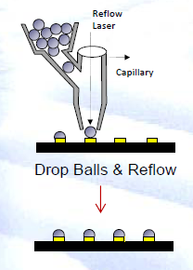
Solder Ball Placement– Standard Process
Solder ball placement technology is very interesting because:
  Balls can be moved on wafers/chips individually or in a group (very cost-effective)
  Solder volume is very precisely controlled
  It is economically wise solution - investing only on the solder spheres, not the electroplating chemistry
  Reworking possibility – high bumping yields
  Solder balls are available in small sizes (40 µm)
Classic solder ball jetting system using capillary force to place the solder spheres on UBM pads.
Pac Tech

Slide 20

Solder Ball Placement – “Spitting” Process
The solder ‘spitting’ process uses a nozzle combined with a high-powered laser to instantly heat and to drop the molten solder balls in place one by one in sequence.
  No mechanical contact to wafer
  Relatively slow process (≈ 10 balls/s), but it may be appropriate for single chip (no complete wafers) prototyping in combination with EN UBM
  Process has been used in industry for placing BGA-like bumps on wafers for moderate volume production. Technique has relatively low NRE costs
  Yield enhancement by replacing missing bumps following group ball placement
Advanced solder ball “spitting” system for placing individual solder spheres.

Slide 21
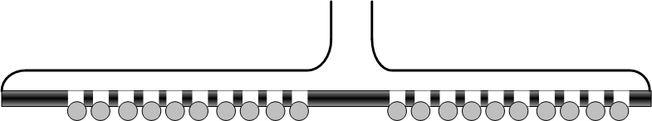
Solder Mass Transfer Process – “Gang Ball Placement”
The ultimate low-cost solder ball placement process is the mass transfer of solder spheres on the whole wafer at the same time.
Stencil grid with predefined holes and vacuum is used to lift the solder sphere.
Solder bumping defects can be repaired with the singe solder ball placement systems
Limited by ball size, minimum 60 µm at present therefore suitable for 100 mm pitch
Pac Tech foresees 40 µm bumps coming in 1-2 years.
Solder mass transfer is very efficient process to attach the solder spheres to wafer

Slide 22
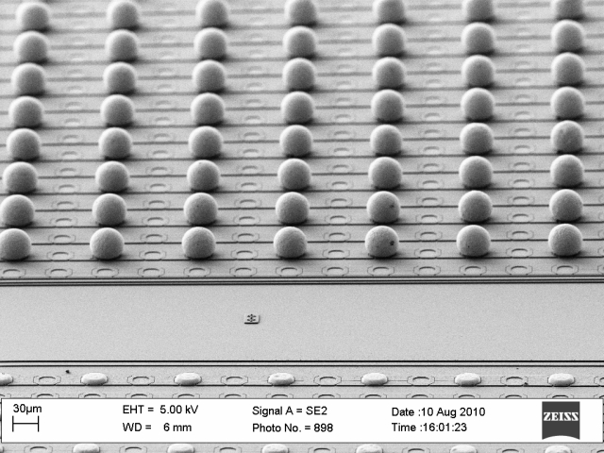
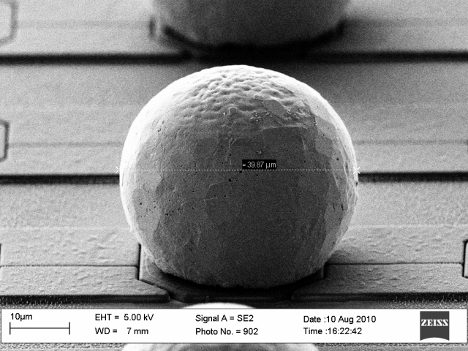
Solder Ball Placement Test
40 µm sized solder balls (very advanced) were jetted (spitting process) on a Timepix chips with ENEPIG UBM with 110 µm pitch at Pac Tech.
Individual shear tests were done (30 bumps), giving an average shear force of 8 grams / bump (good results).
Looking forward to do more SBB tests on Timepix chips
Sami Vähänen – CERN TWEPP-10 Workshop 22-September-2010

Slide 23
Summary
Sami Vähänen – CERN TWEPP-10 Workshop 22-September-2010

Slide 24
Summary
Electroless Nickel (EN) UBM’s are studied because:
  EN is a high volume capable & low cost technology, which is available in small volumes
  EN makes various flip chip assembly scenarios possible
  EN is a step towards the ultimate low-cost bump bonding process with small-scale wafer volumes
Sami Vähänen – CERN TWEPP-10 Workshop 22-September-2010

Slide 25
Summary
Electroless Nickel (EN) UBM’s are studied because:
  EN is a high volume capable & low cost technology, which is available for us
  EN makes various flip chip assembly scenarios possible
  EN is not a complete solution for solving the high price of BB, but it is a major step towards the right direction
Test vehicle chips were assembled with different bump structures and daisy chain and individual resistances were measured.
  EN process worked well on AlSiCu metal – success!
    Very similar results as with the reference technology
  More development is needed with AlSi(1%) (sensor) metallization to overcome the cracking issues at Al-Ni interface.
    However, the read out electronics is robust and could probably live with resistance variation
Sami Vähänen – CERN TWEPP-10 Workshop 22-September-2010

Slide 26
Summary
Electroless Nickel (EN) UBM’s are studied because:
  EN is a high volume capable & low cost technology, which is available in small volumes
  EN makes various flip chip assembly scenarios possible
  EN is a step towards the ultimate low-cost bump bonding process with small-scale wafer volumes
Test vehicle chips were assembled with different bump structures and daisy chain and individual resistances were measured.
  EN process worked well on AlSiCu metal – success!
    Very similar results as with the reference technology
  More development is needed with AlSi(1%) (sensor) metallization to overcome the cracking issues at Al-Ni interface.
    However, the read out electronics is robust and could probably live with resistance variation
For proof of concept ENEPIG UBM has been processed also on real CMOS wafers (Timepix).
  More test to be done
Sami Vähänen – CERN TWEPP-10 Workshop 22-September-2010

Slide 27
Summary
Electroless Nickel (EN) UBM’s are studied because:
  EN is a high volume capable & low cost technology, which is available in small volumes
  EN makes various flip chip assembly scenarios possible
  EN is a step towards the ultimate low-cost bump bonding process with small-scale wafer volumes
Test vehicle chips were assembled with different bump structures and daisy chain and individual resistances were measured.
  EN process worked well on AlSiCu metal – success!
    Very similar results as with the reference technology
  More development is needed with AlSi(1%) (sensor) metallization to overcome the cracking issues at Al-Ni interface.
    However, the read out electronics is robust and could probably live with resistance variation
For proof of concept ENEPIG UBM has been processed also on real CMOS wafers (Timepix).
  More test to be done
Solder ball placement process have been demonstrated with Timepix ROC’s with 110 µm pitch.
Sami Vähänen – CERN TWEPP-10 Workshop 22-September-2010

Slide 28
THANK YOU FOR YOUR ATTENTION!
Sami Vähänen – CERN TWEPP-10 Workshop 22-September-2010

