Slide 1


The FE-I4 Pixel Readout System-on-Chip for ATLAS Experiment Upgrades
Tomasz Hemperek on behalf of ATLAS Pixel Collaboration

Slide 2
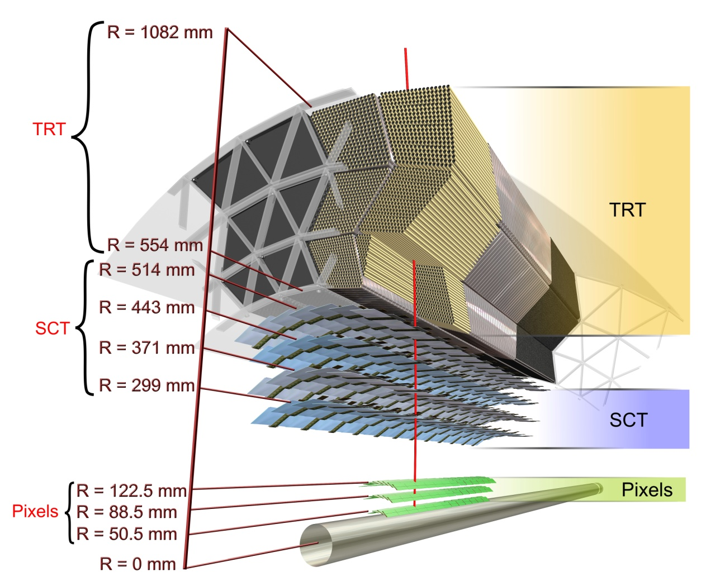
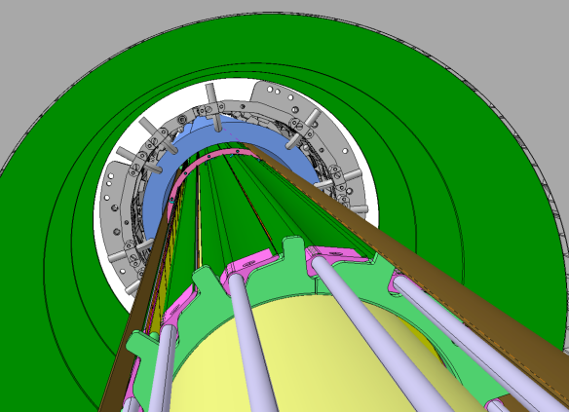
ATLAS Detector
Pixel Detector:
3 barrels
112 staves
1744 modules
80 million channels
Existing B-layer
IBL
Beam pipe
IBL = New Insertable B-Layer at 33 mm

Slide 3
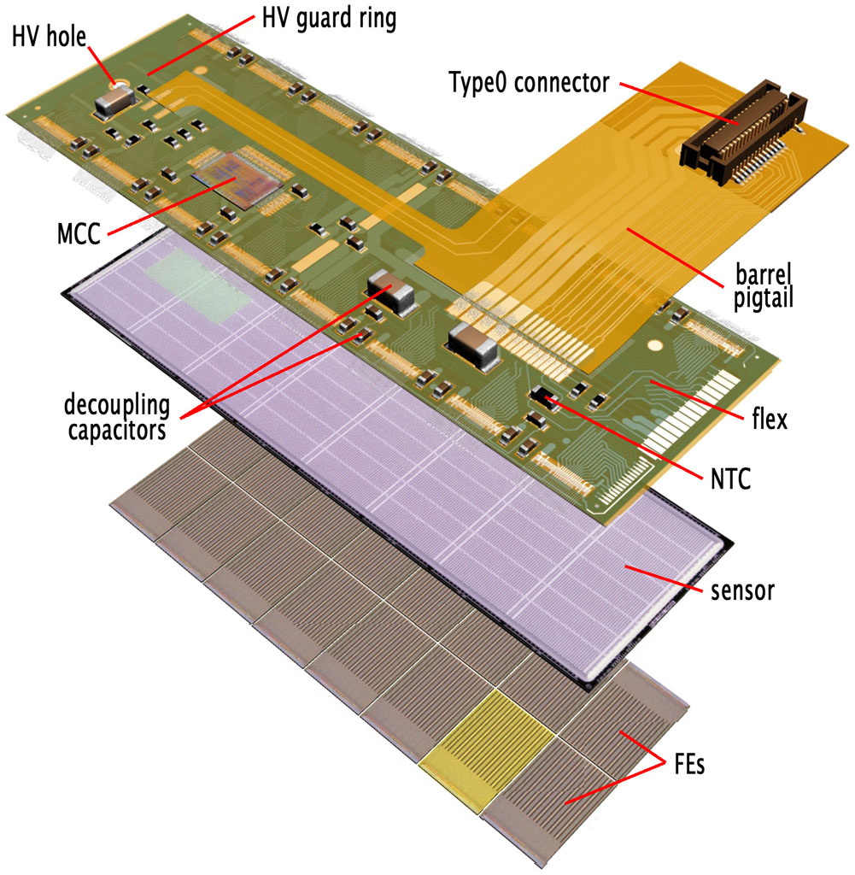
Current Pixel Detector Module
16-front-end chip (FE-I3) module with a module controller chip (MCC)
Planar n-on-n DOFZ silicon sensors, 250 μm thick
Designed for for 1 x 10¹⁵ 1MeV n_{eq} fluence and 50 MRad

Slide 4
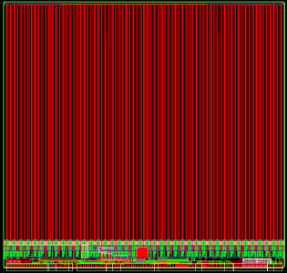
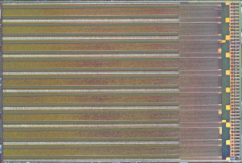
Front End Chip
FE-I3
FE-I4
8mm
16.8mm
2.8mm
7.6mm
2mm
20.2mm
Pixel Size [μm²] | 50×400 | 50×250
Pixel Array | 18×160 | 80×336
Chip Size [mm²] | 7.6×10.8 | 20.2×19.0
Active Fraction | 74 % | 89 %
Output Data Rate [Mb/s] | 40 | 160
Transistor Count [M] | - | ~80

Slide 5
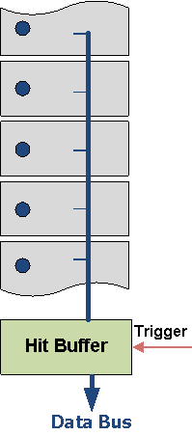
Inefficiencies
Double Hit
Column Waiting (FE-I3)
Vth
1. Record
2. Transfer
3. Trigger
4. Transmit
LE
Time over Threshold ~Q
Vth
ToT
Lost LE

Slide 6
Motivation
SLHC
IBL
LHC

Slide 7
New FE improvements
New technology
Smaller pixel size
Bigger chip size and active area
New digital architecture
New analog pixel
Reduce number of external components
New powering schemes
Decrease cost (per area)
Better radiation hardness

Slide 8
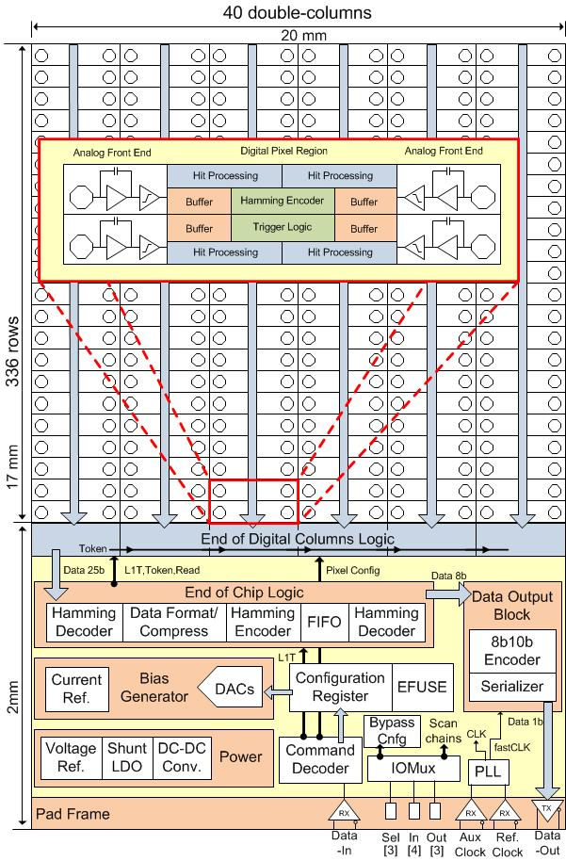
FE-I4 Functional Overview
Pixel Array
Double Column
4 Pixel Region
End Of Chip Logic
Data Output Block
Phase Lock Loop
Command Decoder
SEU-Hard Memory
DACs & Reference
Power
Pads / RX /TX

Slide 9
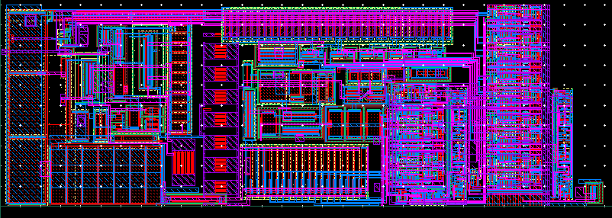
Analog Pixel
Two-stage architecture optimized for low power, low noise and fast rise time
Additional gain Cc/Cf2~ 6
More flexibility on choice of Cf1
Charge collection less dependent on detector capacitor
Decoupled from preamplifier DC potential shift caused by leakage
Local DACs for tuning feedback current and global threshold
Charge injection circuitry
TDAC
Amp2
50 μm
discri
Preamp
FDAC
150 μm

Slide 10
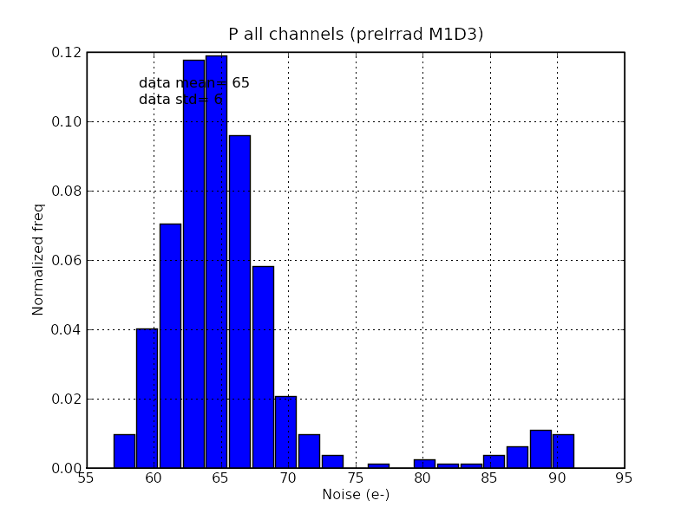
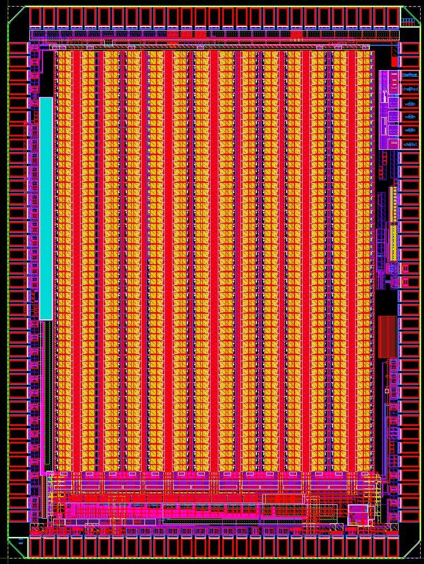
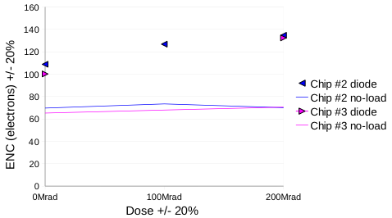
FE-I4-P1 (Prototype)
Noise Measurements
61x14 pixel array
Silicon proven
RadHARD up to 200MRad
<ENC> = ~65 e
(loaded ~400 fF)
Noise Measurements (Irradiation)

Slide 11
4 Pixel Region
Cluster size projection
Pixel organization
Mean: 1.76
Mean: 1.87
4 analog pixels are connected to one digital region
Analog pixels can operate and be tested independently from digital part

Slide 12
Digital Region (simplified)
Receiving hit
Generate leading edge
Start ToT counter
Assign first free memory and latency counter
Generate trailing edge
Store ToT value
Check for trigger when latency counter finished
Indicate ready to read status (release token)
- Hit Processing
- ToT Counter
- ToT Memory
Read memory
- Latency Counter
- Triggering/Readout
Release memory after read

Slide 13
FE-I4 Inefficiency
Regional Buffer Overflow
FE-I4 Inefficiency (3.7cm)
Memories | Simulation
 | IBL | 10xLHC
5 | 0.047% | 2.19%
6 | 0.011% | 0.65%
7 | <0.01% | 0.16%
SLHC
IBL
LHC
Mean ToT = 4

Slide 14
Column Readout
Two prioritized token scenario (column and periphery level)
One data bus
End of column logic selects column to read
Chip control logic controls trigger and read
Data is always read in the same order
All buses including address (thermal encoded) protected with hamming encoding

Slide 15
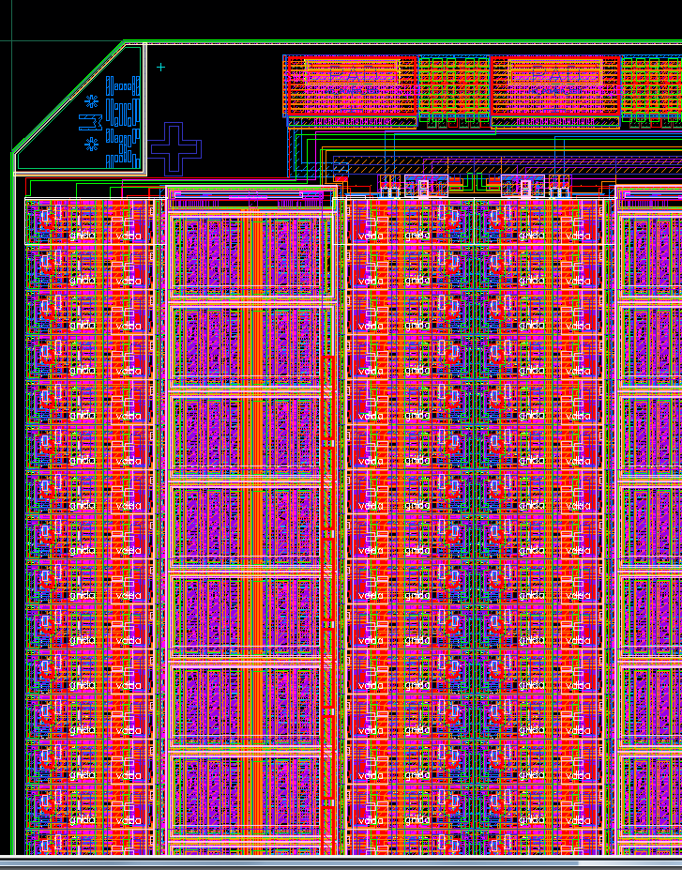
Pixel Array Layout
50x250μm
Analog Pixel
Digital Region

Slide 16
Framing / Transmission
40MHz Clock Domain
160MHz Clock Domain
Hamming Encoded Pixel Data
Event Builder
Re-Formatting
Hamming Decoder
Asynchronous redundant FIFO (8x32bit)
Data Switch
Serializer
TX
Framing
8b10b Encoding
Header
Service
Readout Control
Re-formatting: Data reduction about 25% and 8-bit word format

Slide 17
Powering
DC/DC
Saving cable material budget
Reduction of cable power losses
Serial Power

Slide 18
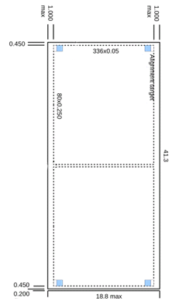
New Module Concept
Sensor technology independent.
Decision on sensors after prototyping with FE-I4
Minimum amount of external components
Flex
Sensor
FE-I4

Slide 19
Design Flow
Design in “big A small D” methodology
Blocks designed and verified individually
Full chip digital and mixed-signal verification
Work synchronization with integrated Revision Control System
Big chip = many difficulties with software and PDK!
Analog Block
Design & Verification
Digital Block
Design & Verification
Integration
Full Chip
Verification

Slide 20
Verification
Full chip verification based on Open Verification Methodology (OVM) with multiple physics based and random test
Modeling
Interfaces
ANALOG
ARRAY
(digital part)
DIGITAL
ARRAY
FE-I4
DETECTOR
(PIX)
OUTPUT
(RECEIVE)
MANUAL
SLOW COMMAND
(CMD)
END OF COLUMN
END OF CHIP
COMMAND DECODER
PLL
PLL
REGISTER MEMORY
DATA OUTPUT
- verilog model
- Implementation (RTL/gate)

Slide 21

Conclusion
Project duration: ~3 years
Design team: ~21 persons+
FE-I4A last official shipping date: This Thursday (23rd September 2010)
Test setup readiness ramping-up, on time for IC back
Tests: Wafer, single-chip, bump-bonded (planar, 3D, diamond), irradiation
Design team
Bonn: D. Arutinov, M. Barbero, T. Hemperek, A. Kruth,
M. Karagounis
CPPM: D. Fougeron, F. Gensolen, M. Menouni
Genova: R. Beccherle, G. Darbo
LBNL: S. Dube, D. Elledge, J. Fleury (LAL),
M. Garcia-Sciveres, D. Gnani, F. Jensen, A. Mekkaoui
NIKHEF: V. Gromov, R. Kluit, J.D. Schipper, V. Zivkovic

Slide 22
Extra Slides

Slide 23
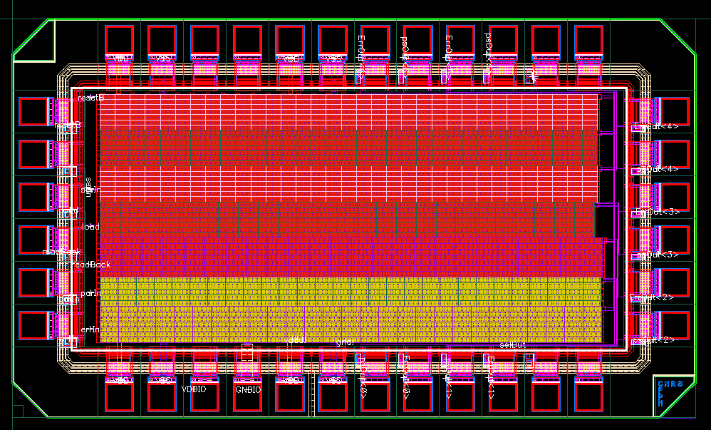
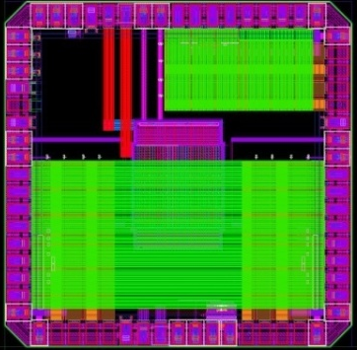
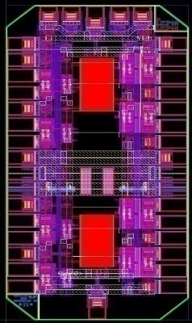
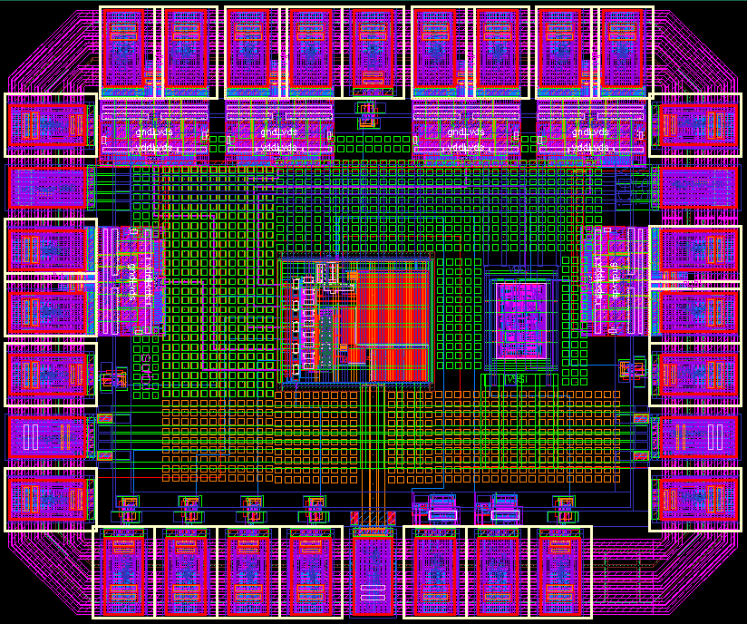
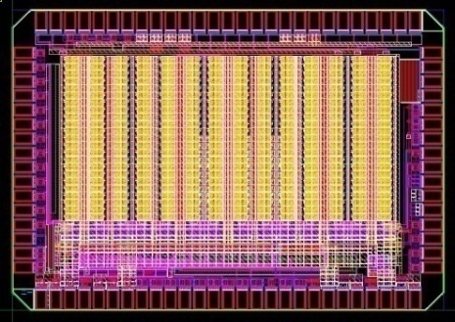
Test Chips
FE-I4-P1
LDO
Regulator
SEU test IC
Control Block
FE-I4-P1
61x14 Array
ShuLDO+trist LVDS/LDO/10b-DAC
Charge
Pump
4-LVDS Rx/Tx
Capacitance
Measurement
low power discri.
turboPLL:
PLL core + PRBS + 8b10b coder + LVDS driv
DACs
Current
Reference

Slide 24
Clocking
Phase Lock Loop (PLL) type 2
Voltage Controlled Oscillator (VCO) at 640 MHz (x16)
Lost of Lock Detection
2 Independent output multiplexers
Silicon Proven

Slide 25
Data Transmission
LVDS TX
LVDS RX
Transition speed up to 330 MHz
RadHARD up to 200MRad
Silicon Proven

Slide 26
Shunt-LDO
Combination of LDO and shunt transistor
„Shunt-LDO“ regulators having completely different output voltages can be placed in parallel without any problem regarding mismatch & shunt current distribution
„Shunt-LDO“ can cope with an increased supply current if one FE-I4 does not contribute to shunt current e.g. disconnected wirebond
Can be used as an ordinary LDO when shunt is disabled
Silicon Proven

Slide 27
RadHARD Memory
Silicon Proven
RadHARD and SEU Tolerant

