Slide 1


Performance of ALICE detector and electronics under first beam conditions
TWEPP 2010, Aachen, Germany, 20-24 September
Gianluca Aglieri Rinella
On behalf of the ALICE Collaboration

Slide 2
Outline
Overview of ALICE and status of selected subsystems
pp data taking
Synchronization, luminosity, SEUs

Slide 3
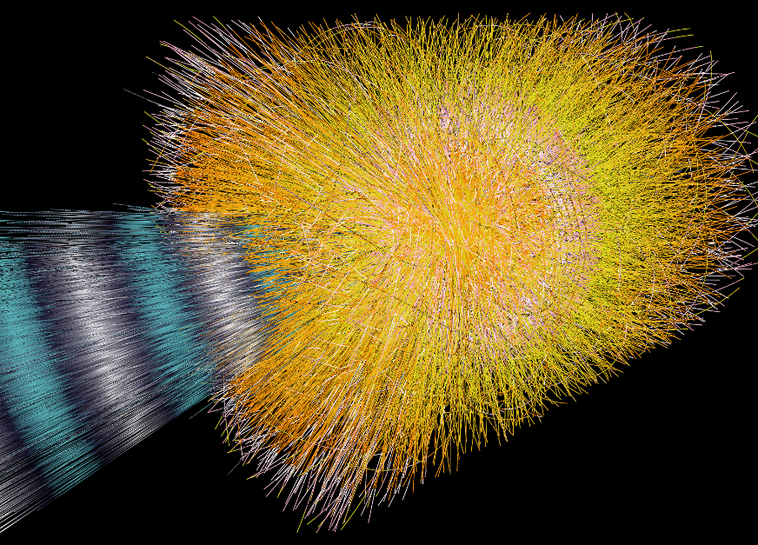
General purpose Heavy Ion detector
  Extreme particle multiplicity (dN/dη=8000)
  ~8 kHz Pb-Pb interaction rate
High granularity tracking, lower readout rate detectors
TPC, Silicon Drift
Large event size: ~90 MB (Pb-Pb)
Specific trigger rate and DAQ bandwidth requirements
p-p collisions data
  Reference for Heavy Ions and complementary to other LHC detectors

Slide 4
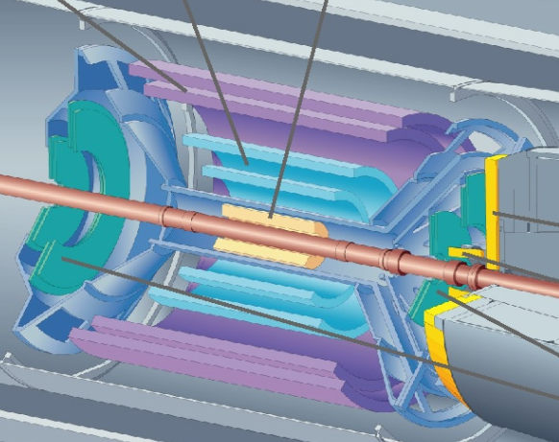
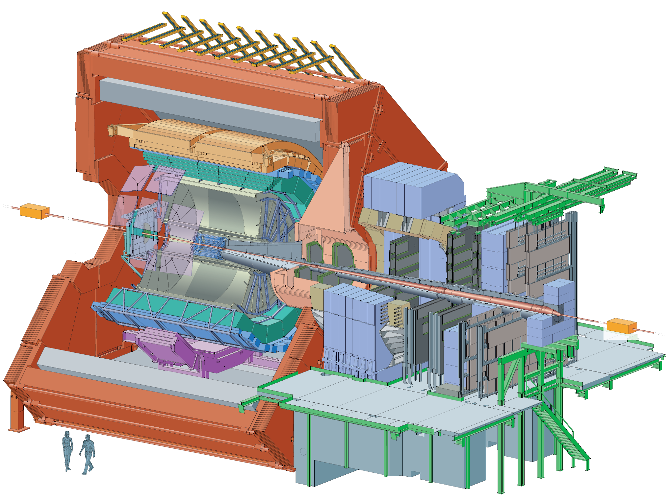
Inner Tracking
Strip
ACORDE
Drift
TOF
Pixels
TRD
TPC
Dipole
HMPID
ZDC
3 Tm
EMCAL
0.5 T
PHOS
Absorbers
Solenoid
y
z
Muon Tracker
Muon Trigger
x
T0
V0
FMD
PMD

Slide 5
On detector integrated circuits
Inner Tracking System
  Hybrids, Al-Polymide flex circuits
Radiation tolerant ASICs
  2200 Gy, 8·10¹¹ cm⁻² (1 MeV neq)
  26 Gy, 4.1·10¹¹ cm⁻² (1 MeV neq)
 | Inner Tracking | Qty
Pixels | ALICE1LHCb, DigPilot, AnPilot, GOL | 1 560
Drift | PASCAL, AMBRA, CARLOS, GOL | 9 360
Strips | HAL25, ALCAPONE, ALABUF | 27 168
0.250 μm, Mixed Signal, Radiation Tolerant
 | Tracking - PID | Qty
TPC | PASA (0.35 μm), ALTRO | 69 696
TRD | PASA, TRAP (0.18 μm) | 55 104
TOF | NINO, HPTDC | 38 232
HMPID | GASSIPLEX (0.7 μm), DILOGIC (0.7 μm) | 13 440
MUON | MANAS, MARC | 85 000
  < 2 Gy, 2.4·10¹¹ cm⁻² neq
  Standard CMOS
  Flash based FPGAs
0.250 μm when not explicitly mentioned

Slide 6
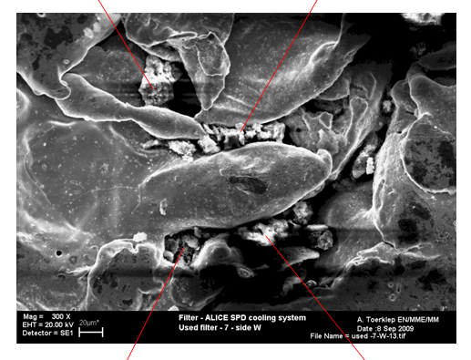
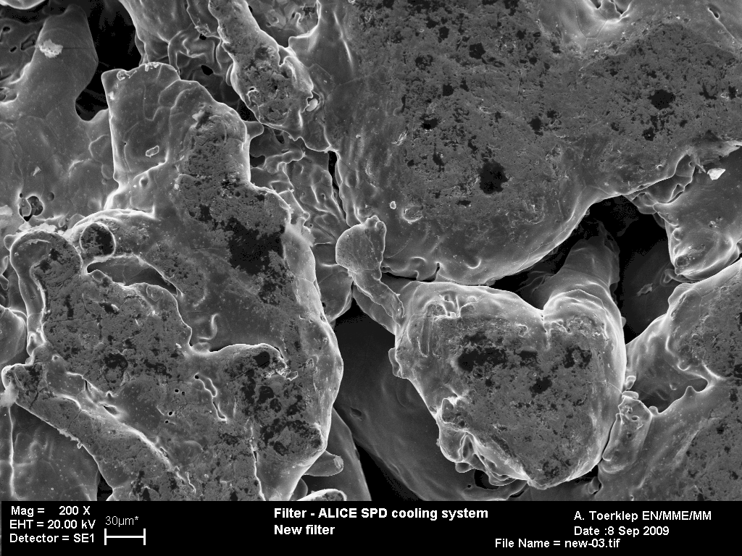
Inner Tracking System
 | Pixels | Drift | Strips
Readout | Binary | Digitized | Digitized
Total channels | 9.83·10⁶ | 133·10³ | 2.61·10⁶
Active modules | 94 of 120 (78%) | 240 of 260 (92.3%) | 1557 of 1698 (91.7 %)
Active channels in active modules | 98.8 % (1.2% dead, 0.01% noisy) | 98.3 % | 98.5 %
Active channels | 77 % | 91 % | 90.3 %
Pixels
Modules off for high temperature, low cooling flow
Electrical issues on 1 module on 120
Drift
Bias or FEE issues on 16 modules
Broken hybrid connections on 4 modules
Strips
Electrical issues on 6 half ladders
Few modules masked for configuration and noise issues
Pixels: clogging of cooling lines filters

Slide 7
Central barrel detectors and muon tracker
 | TPC | TRD | TOF | HMPID | Muon tracker
FE features | ADC, Digital filtering on FE | ADC, Tracklet processing on FE | TOT discrimination, TDC inside the magnet | Track&Hold, Analog filtering, digital processing | Track&Hold
FE Modules | 4 356 | 27 552 | 6 372 | 3360 | 17 000
Readout channels | 557 568 | 4.6·10⁵ (1.18 ·10⁶) | 152 928 | 161 280 | 1.08 ·10⁶
Active fraction | 99.7 % | 91.6 % | 95 % | 85 % | 96 %
TPC
  5 FECs damaged by HV trips, 768 ch
  ASICs issues: 362 ch
  Off for noisy location: 576 ch
TRD
  7 of 18 modules installed
  6.2 % channels with HV issues
  2.2 % with FE issues
TOF
  Off channels: TDC boards to replace, crates cooling
HMPID
Cherenkov radiators damaged
0.2% channels dead/noisy
MUON
4% channels with LV instabilities, replacement of LV connections

Slide 8
ALICE Central Systems
Central Trigger
CTP
High Level Trigger
TTC
DDL
DCS
DAQ
Notes:
DCS controls hardware – all type of interfaces
Dedicated custom DDL link from all detectors to DAQ

Slide 9
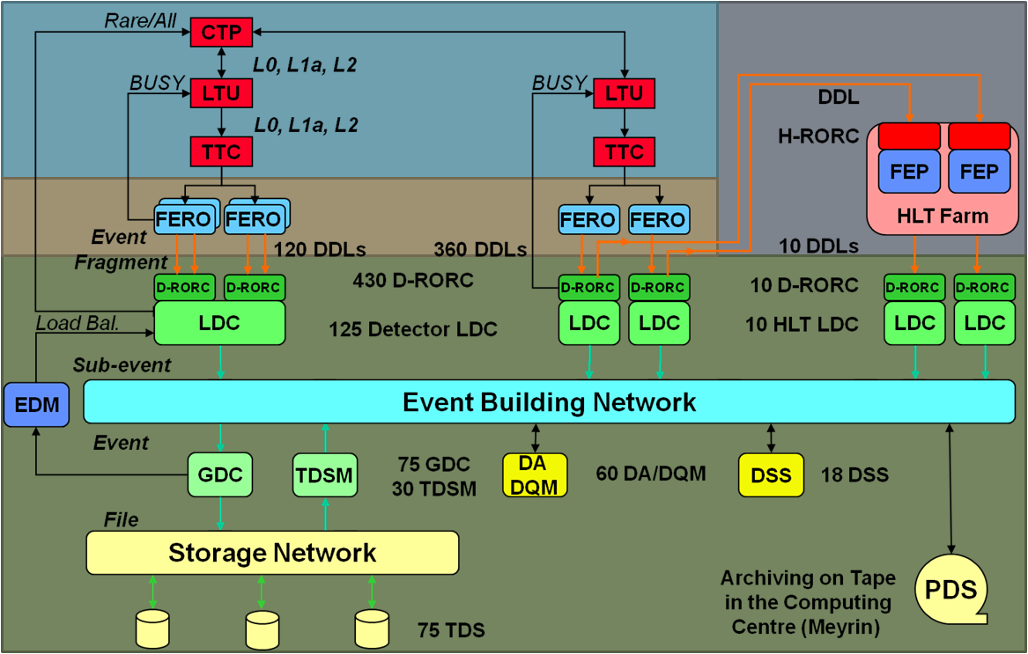
Trigger, DAQ, High Level Trigger
High Level Trigger
Central Trigger
DAQ
Notes:
Trigger interfaces to each detector via LTU
Clock tree partitioned
Custom DDL interface provides the bandwidth from the FE to DAQ/HLT
DAQ and HLT are separate PC farms, redundant bandwidth but great versatility

Slide 10
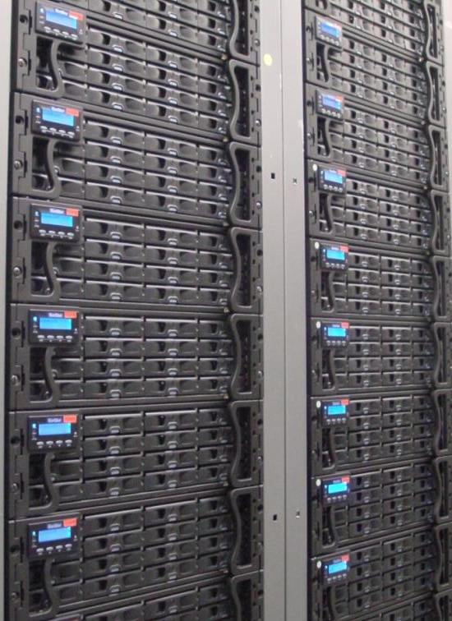
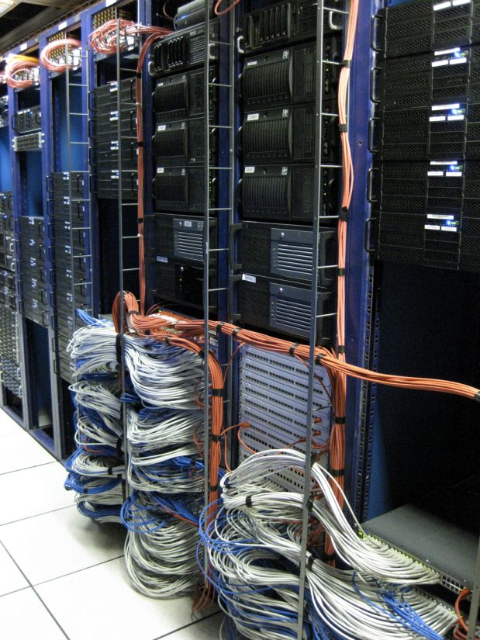
DAQ and HLT status
DAQ Data throughput | Required | Tested
DAQ to Transient Storage | 1.25 GB/s (H.I.) | 4.5 GB/s
DAQ to Permanent Storage | 100 MB/s (pp) 1.25 GB/s (H.I.) | 2.5 GB/s
HLT front end and infrastructure nodes final and complete
  ~1000 CPUs
53 of 153 computing nodes installed
Full pp, partial HI processing capability

Slide 11
Overview of ALICE and status of selected subsystems
pp data taking
Synchronization, luminosity, SEUs

Slide 12
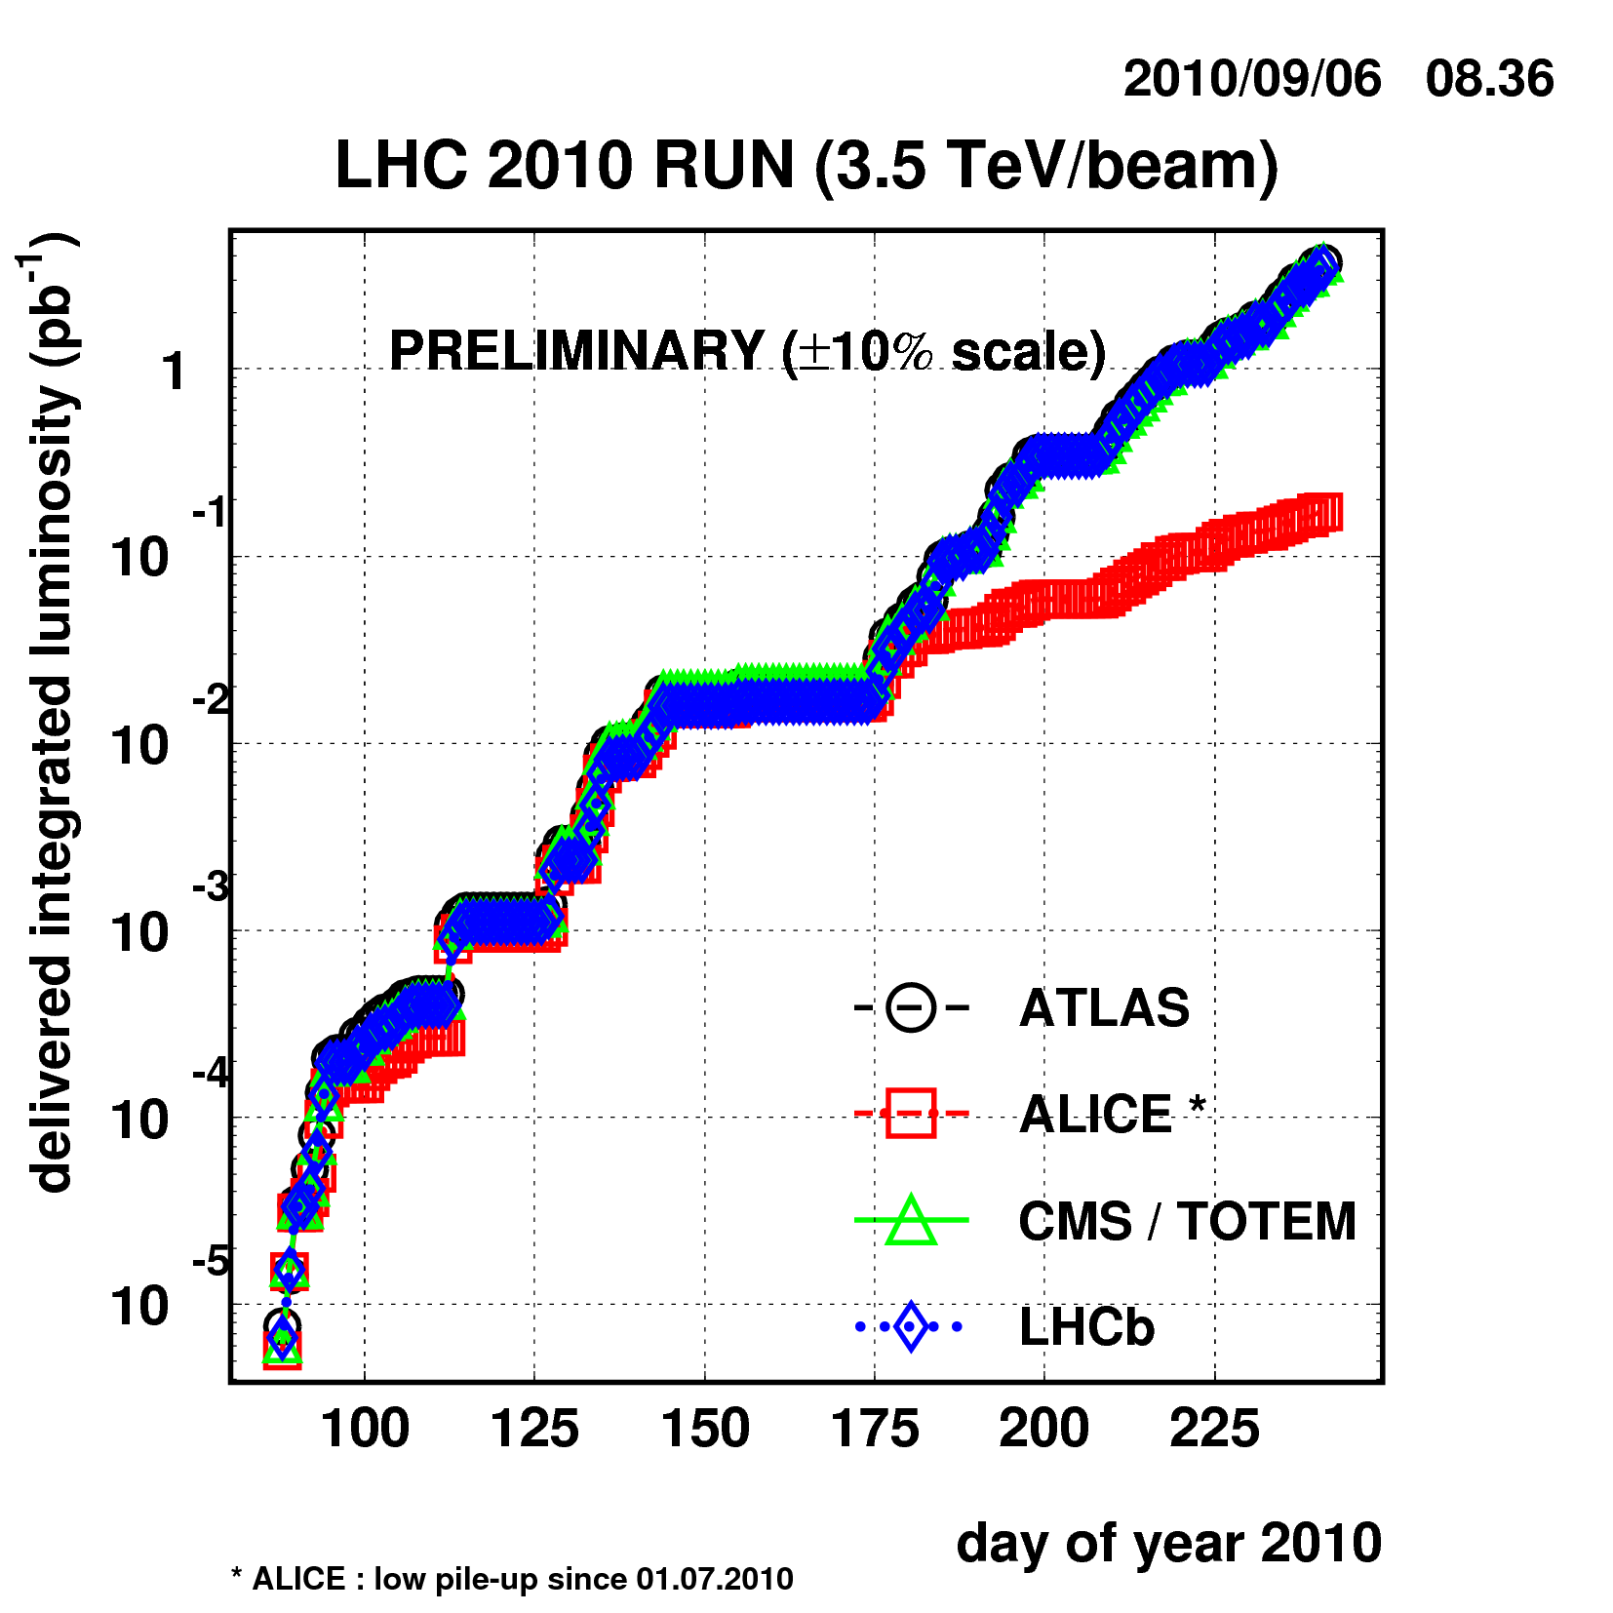
Luminosity at LHC IP 2
ALICE 2010 pp objective
Efficiently collect good minimum bias sample
Low pile-up in TPC
~ 1 collision per event
~ 10 kHz pp interaction rate
Beams displaced
  β*= 3.5 m, Δx= 266 μm (3.8 σ)
  L ~ 2.5·10²⁹ cm⁻²s⁻¹ (14 coll. bunches)
ALICE: low pile-up since 1.07.2010

Slide 13
Trigger configuration (2010 pp)
V0 A
SPD
V0 C
Interaction trigger (Minimum Bias) | At least one particle in V0 or SPD (Δη = 8)
Muon trigger | High p_{t} muon in the forward muon arm
High multiplicity trigger | High SPD occupancy
Live time sharing between MB and rare triggers
HLT selection running
  No events rejected, sufficient DAQ capability

Slide 14
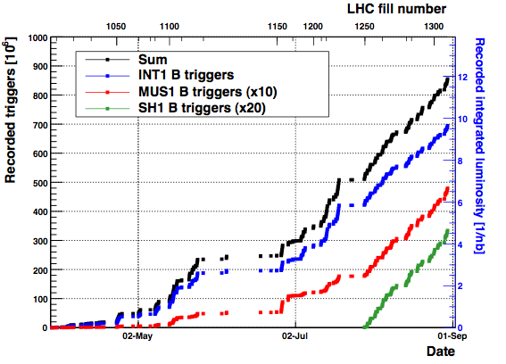
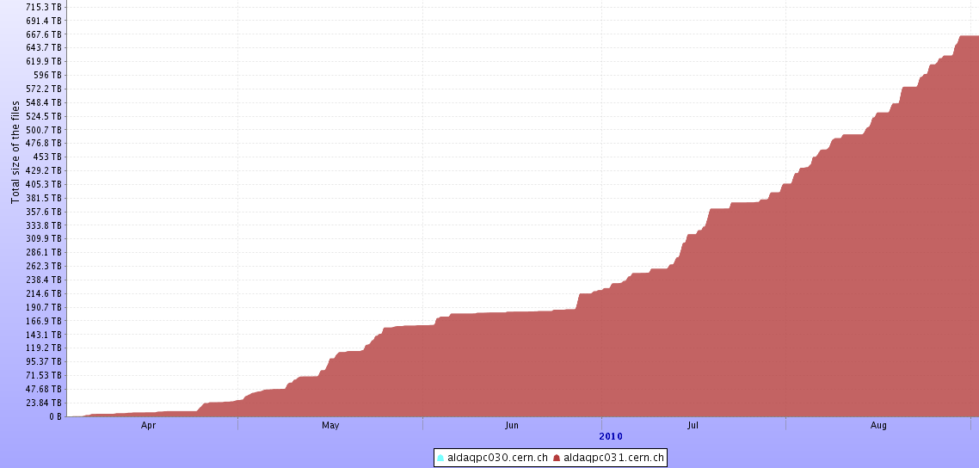
Data taking
Recorded triggers
All 7 TeV pp triggers ~860 M
Minimum bias 694 M
50 M Muon triggers
16 M High multiplicity
Efficiency 79 %
Typical run duration 1 h
 | 7 TeV pp run*
Rate to tape MB Muon High Mult | 530 Hz 420 Hz 60 Hz 34 Hz
Event Size | ~980 kB
Bytes to tape | 530 MB/s
File size on CASTOR
700
(*) 6h 7 TeV pp run 130795, logbook values
  LHC fill scheme 1000ns_50b_35_14_35
  14 interacting bunches
  ~9 kHz interaction rate, μ < 0.05
TB
0
days

Slide 15
Overview of ALICE and status of selected subsystems
pp data taking
Synchronization, luminosity, SEUs

Slide 16
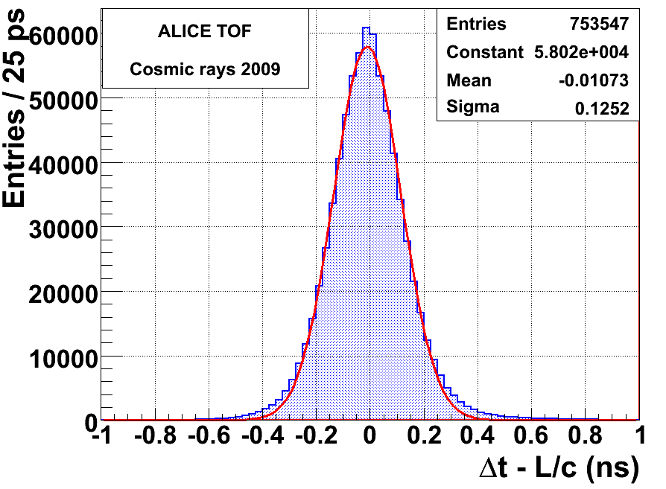
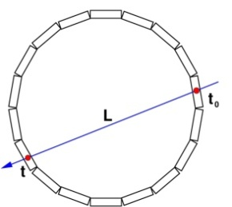
Fine phase tuning of detectors clock
SPD strobe window time tuning
SPD
  Compensated fiber lengths and transmitters skew (+/- 1 ns)
  Fine time scan (TTCrx fine delay) of SPD clock with colliding beams
  Set optimal phase in the clock domain
TOF
  Dedicated low jitter clock used (no TTC data)
  Compensated skew across 72 crates due to fiber lengths (+/- 1 ns)
  Phase alignment (TTCrx fine delay)
σ_{TOF}=σ/√2
= 88 ps

Slide 17
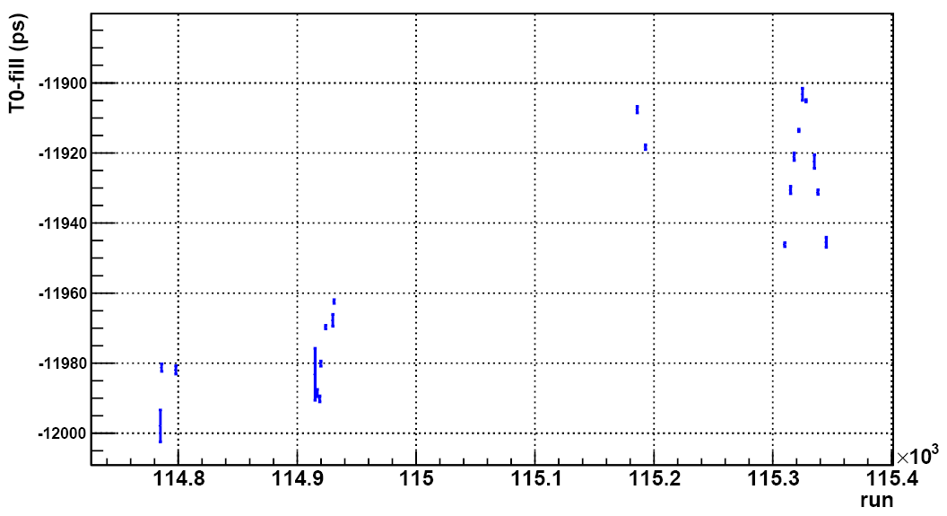
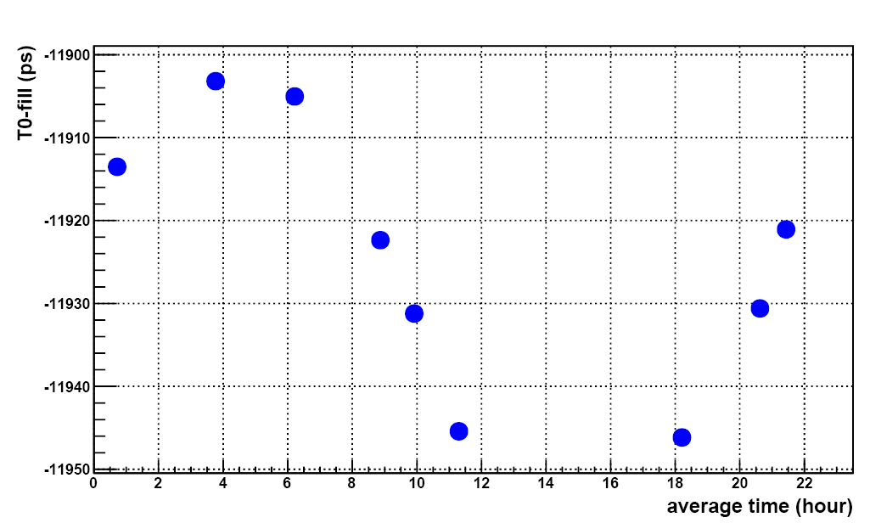
Bunch clock drift first seen by TOF
TOF saw clock variations soon (22/4/2010)
Day-night variations
~70 ps
Long LHC fill
UTC average day time

Slide 18
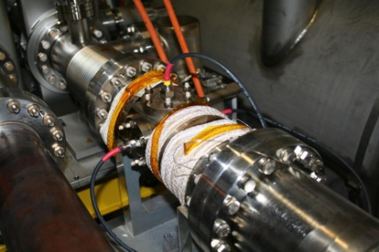
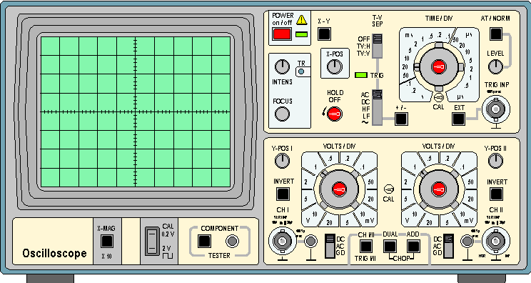
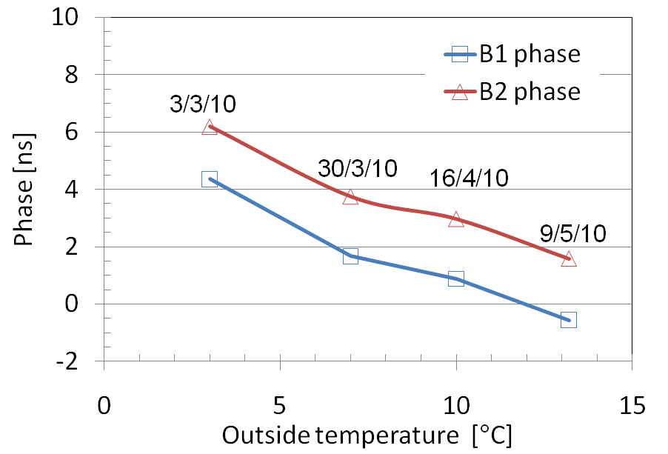
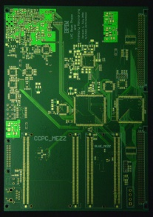
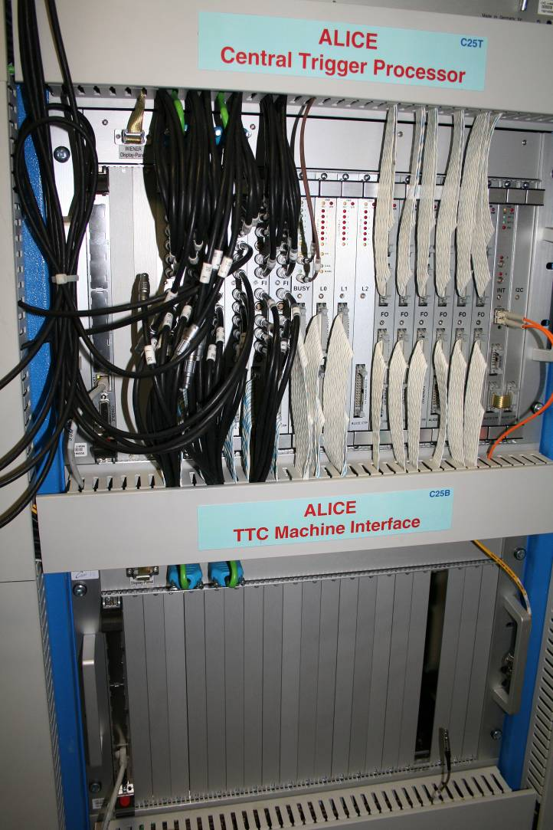
Beam Pickup BPTX/BPIM
Monitoring of bunches wrt to LHC clock
Seasonal clock phase drift
Check fill scheme, abort gap, ghost bunches
Triggering
Bunch crossing z (cogging)
Electronics in common with LHCb
See talk by F. Alessio at 12:00
A side
C side
BPTX-BEAM1
I.P.
BPTX-BEAM2
146.2 m
145.3 m
PC
BPIM boards
DCS
0BPA
0BPC
ALICE Central Trigger

Slide 19
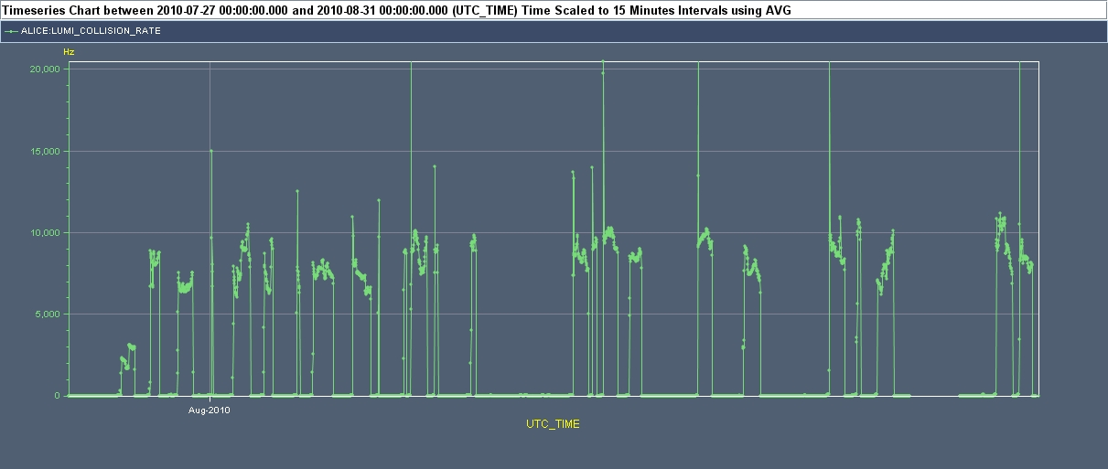
Luminosity monitoring
Hz
10000
5000
UTC Time
LHC
Rate of interaction trigger
Interaction record (IR)
  Interaction rate vs bunch ID measured
  Bunch by bunch specific luminosity
Trigger rate
DCS
Lumi
Trigger Detector
Central
Trigger
IR
DAQ

Slide 20
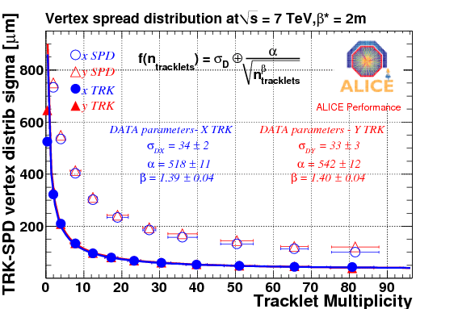
Luminous region
Vertex reconstruction offline
  Intensive fitting algorithm
  Full ITS + TPC
Unfolding of vertex
reconstruction resolution
σ_{dx} ~= 34 μm

Slide 21
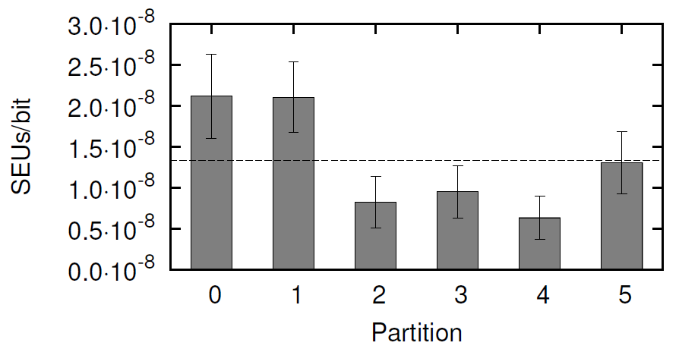
TPC SEU measurement
Interactions (*) | Bits | SEUs
381 600 | 5.60 ·10⁹ | 58
154 500 | 5.60 ·10⁹ | 17
OFF | 4.90 ·10⁹ | 0
Write fixed bit pattern to ALTRO pedestal memory
Read the pattern at the end of run
(*) Time integral of LHC.BRANB.4L2:TOTAL_LUMINOSITY

Slide 22
Summary
ALICE recording pp data according to research programme
Installed electronic systems working to specifications
Consolidation of systems progressing
Looking forward to Pb-Pb collisions

Slide 23
Spares

Slide 24
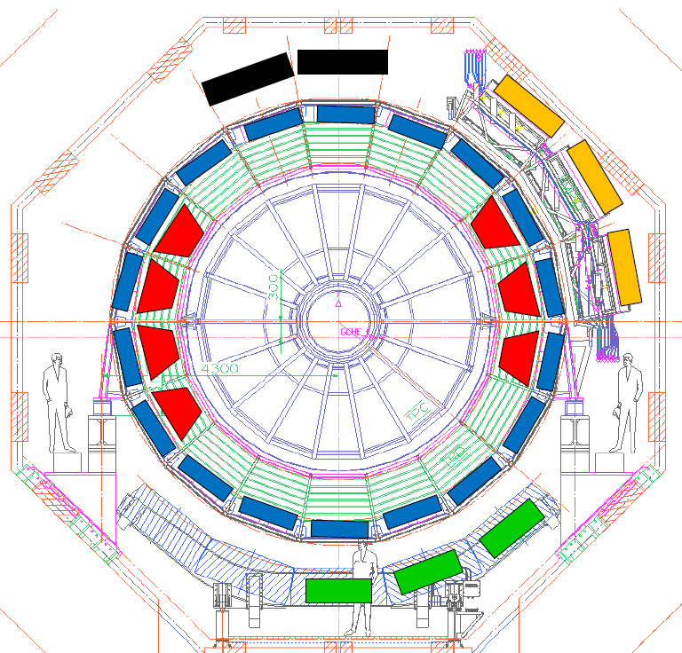
Detectors configuration 2010
ITS, TPC | 100 %
TOF, HMPID | 100 %
V0, T0, FMD, PMD, ZDC | 100 %
TRD (7/18) | 39 %
PHOS (3/5) | 60 %
EMCAL (4/10) | 40 %
Full hadron and muon capability
Partial photon, electron
(PHOS, EMCal, TRD)

Slide 25
Central barrel
Tracking
Inner Tracking (SPD, SDD, SSD) | Silicon Pixels, Drift, Strips Low p_{t} spectrometer, Vertex dE/dx particle identification (Drift, Strips) Pixel Trigger
Time Projection Chamber (TPC) | High resolution, efficient, large p_{t} range tracking dE/dx particle identification 90 m³, Ne/CO₂/N₂, MWPC
Particle Identification
Transition Radiation Detector (TRD) | > 1GeV/c electrons identification and tracking Trigger, Tracklet processor distributed in the FE
Time of Flight (TOF) | Hadronic identification, Trigger 100 ps, Multi-gap Resistive Chambers
High Momentum PID (HMPID) | Highest p_{t} hadron identification 10 m² Proximity focusing RICH with CsI photocathode
Electromagnetic calorimeters
Photon Spectrometer (PHOS) | High resolution, high granularity electromagnetic calorimeter PbWO₄ scintillating crystals, Trigger
Electromagnetic Calorimeter (EMCAL) | Large acceptance, Pb scintillator sampling calorimeter Enhance jet capabilities, jet quenching, Trigger

Slide 26
Muon Arm and Forward Detectors
Forward Muon Spectrometer
Muon Tracking | Stand-alone muon spectrometer, passive absorbers, dipole magnet Heavy quark vector-mesons resonances (J/ψ …) 10 planes, Cathode pad chambers, 100 m² 100 μm resolution, high occupancy
Muon Trigger | Low p_{t}, high p_{t} thresholds (0.5-2 GeV/c) 4 planes Resistive Plate Chambers, 140 m²
Forward and Trigger detectors
T0 | 25 ps resolution event time measurement (TOF) Cherenkov counters
V0 | Minimum bias trigger, beam-gas rejection Segmented scintillators
Forward Multiplicity Det. (FMD) | Forward charged particles multiplicity Rings of silicon strip sensors
Photon Multiplicity Det. (PMD) | Arrays of gas proportional counters
Zero Degree Calorimeter (ZDC) | Energy of non-interacting nucleons, geometry of HI collisions Quartz fiber sampling hadron and em calorimeters, PMTs
ACORDE | Cosmic rays physics Array of very large scintillators on top of the solenoid Hight p_{t} cosmic muon trigger for alignment and calibration

Slide 27
On detector integrated circuits
 | Inner Tracking | Qty
Pixels | ALICE1LHCb, DigPilot, AnPilot, GOL | 1 560
Drift | PASCAL, AMBRA, CARLOS, GOL | 9 360
Strips | HAL25, ALCAPONE, ALABUF | 27 168
Inner Tracking System
  Hybrids, Al-Polymide flex circuits
Radiation tolerant ASICs
  2200 Gy, 8.0·10¹¹ cm⁻² neq (Pixels)
  26 Gy, 4.1·10¹¹ cm⁻² neq (Strips)
0.250 μm, Mixed Signal, Radiation Tolerant
 | Tracking - PID | Qty
TPC | PASA (0.35 μm), ALTRO | 34848+34848
TRD | PASA, TRAP (0.18 μm) | 141 696
TOF | NINO, HPTDC | 19116+19116
HMPID | GASSIPLEX (0.7 μm), DILOGIC (0.7 μm) | 10080+3360
MUON | MANAS, MARC | 85 000
  < 2 Gy, 2.4·10¹¹ cm⁻² neq
  Standard CMOS
  Flash or SRAM based FPGAs

Slide 28
Central systems
Central Trigger Processor (CTP) | ALICE interface to LHC clock signals Trigger decision on trigger detectors inputs Past Future Protection for HI pile-up Distribution of clock, orbit, trigger messages to all detectors on TTC LTU interface to all detectors FERO
DAQ | Very large bandwidth from FEROs, to/from HLT, to storage 200 MB/s custom optical data link (DDL) from all detectors
HLT | Event selection, event size compression, QA Independent Farm Very flexible at the price of larger bandwidth
DCS | Configuration and control of all systems Interface to LHC
ECS | Supervisory control and configuration interfaces ALICE Configuration Tool

Slide 29
Event sizes and readout rates
Readout rates depend on occupancy. Values quoted were tested with no beams.
pp event sizes from 6h pp reference run 130795, low pile-up conditions.
 |  | pp event size [kB] | Pb-Pb size [kB] | Max readout rate [Hz]
Pixels | SPD | 6 | 140 | 3300
Drifts | SDD | 15 | 1500 | 990
Strips | SSD | 40 | 160 | 3265
Time Projection Chamber | TPC | 700 | 75 900 | 3500
Transition Radiation Detector | TRD | 64 | 8000 | 3500
Time of Flight | TOF | 21 | 180 | 2400
High Momentum PID | HMPID | 18 | 120 | 3300
EM Calorimeter | EMCAL | 16 |  | 1600
Photon Spectrometer | PHOS | 11 | 20 | 1200
Muon tracker Muon trigger | MTK MTR | 34 7 | 150 | 1200 6500
Zero Degree Calorimeter | ZDC | 0.7 |  | 9000
Photon Multiplicity Detector | PMD | 26 | 120 | 1200
Forward Multiplicity Detector | FMD | 15 |  | 4800
V0 | T0 | 6 |  | 13000
T0 | V0 | 0.3 |  | 35000
ALICE Cosmic Ray Detector | ACORDE | 0.1 |  | 9000
ALL ALICE |  | 980 | 86 300

Slide 30
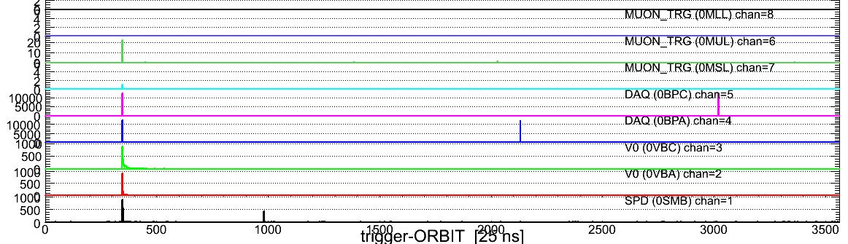
Alignment of first level trigger inputs
9 May 2010
2 bunches per beam
Central Trigger samples all inputs with BC clock
  Snapshot Memory
    Real time recording of trigger inputs over ~300 orbits
Time alignment
  Reduction of firmware and cabling latencies

Slide 31
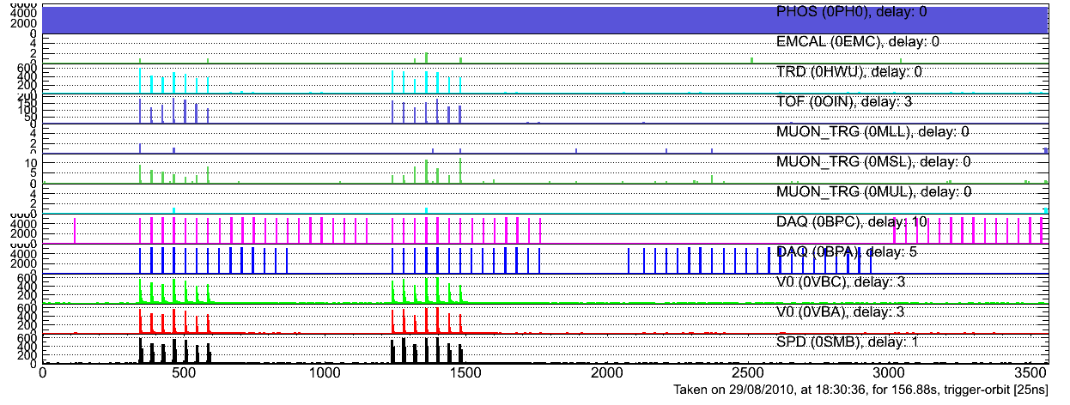
Alignment of first level trigger inputs
Central Trigger samples all inputs with BC clock
  Snapshot Memory
    Real time recording of trigger inputs over ~300 orbits
Discrete time alignment
  Reduction of firmware and cabling latencies

