Slide 1
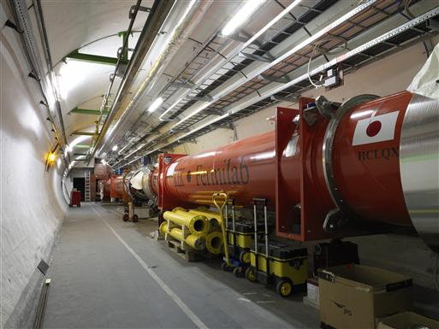

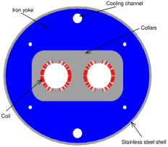

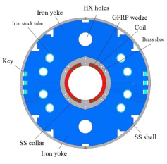
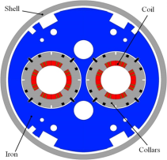
The critical zones around IP1 and IP5
ATLAS
CMS
4. For collimation we also need to change the DS in the continuous cryostat: 11T Nb₃Sn dipole
3. Need also o modify a large part of the matching section
e.g. Crab Cavities &
D1, D2 & corrector
2. Need also to change TAS and TAN passive absorbers and collimators
➔ TAXS and TAXN
New triplet Nb₃Sn
required due to:
-Radiation damage
-Need for more aperture
Changing the triplet region is not enough for reaching the HL-LHC goal!
More than 1.2 km of LHC !!
Plus technical infrastructure (e.g. Cryo & Powering)
Alignment and aperture are critical for HL-LHC performance reach!!!

Slide 2
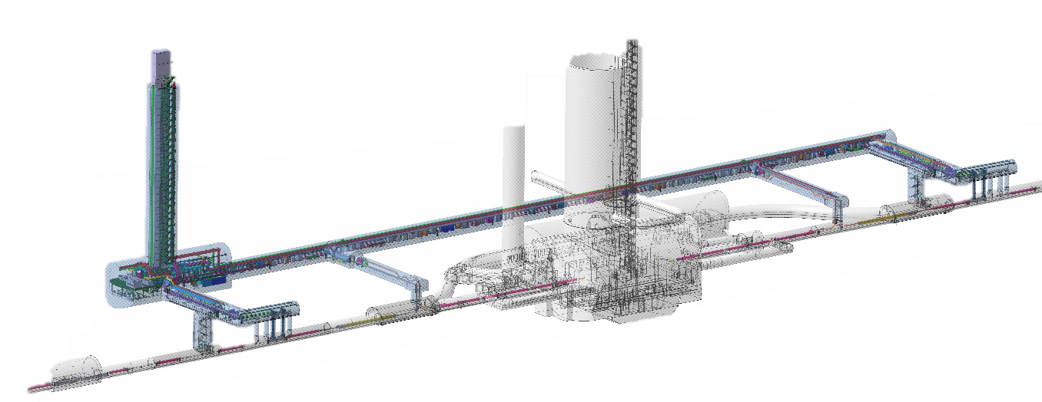
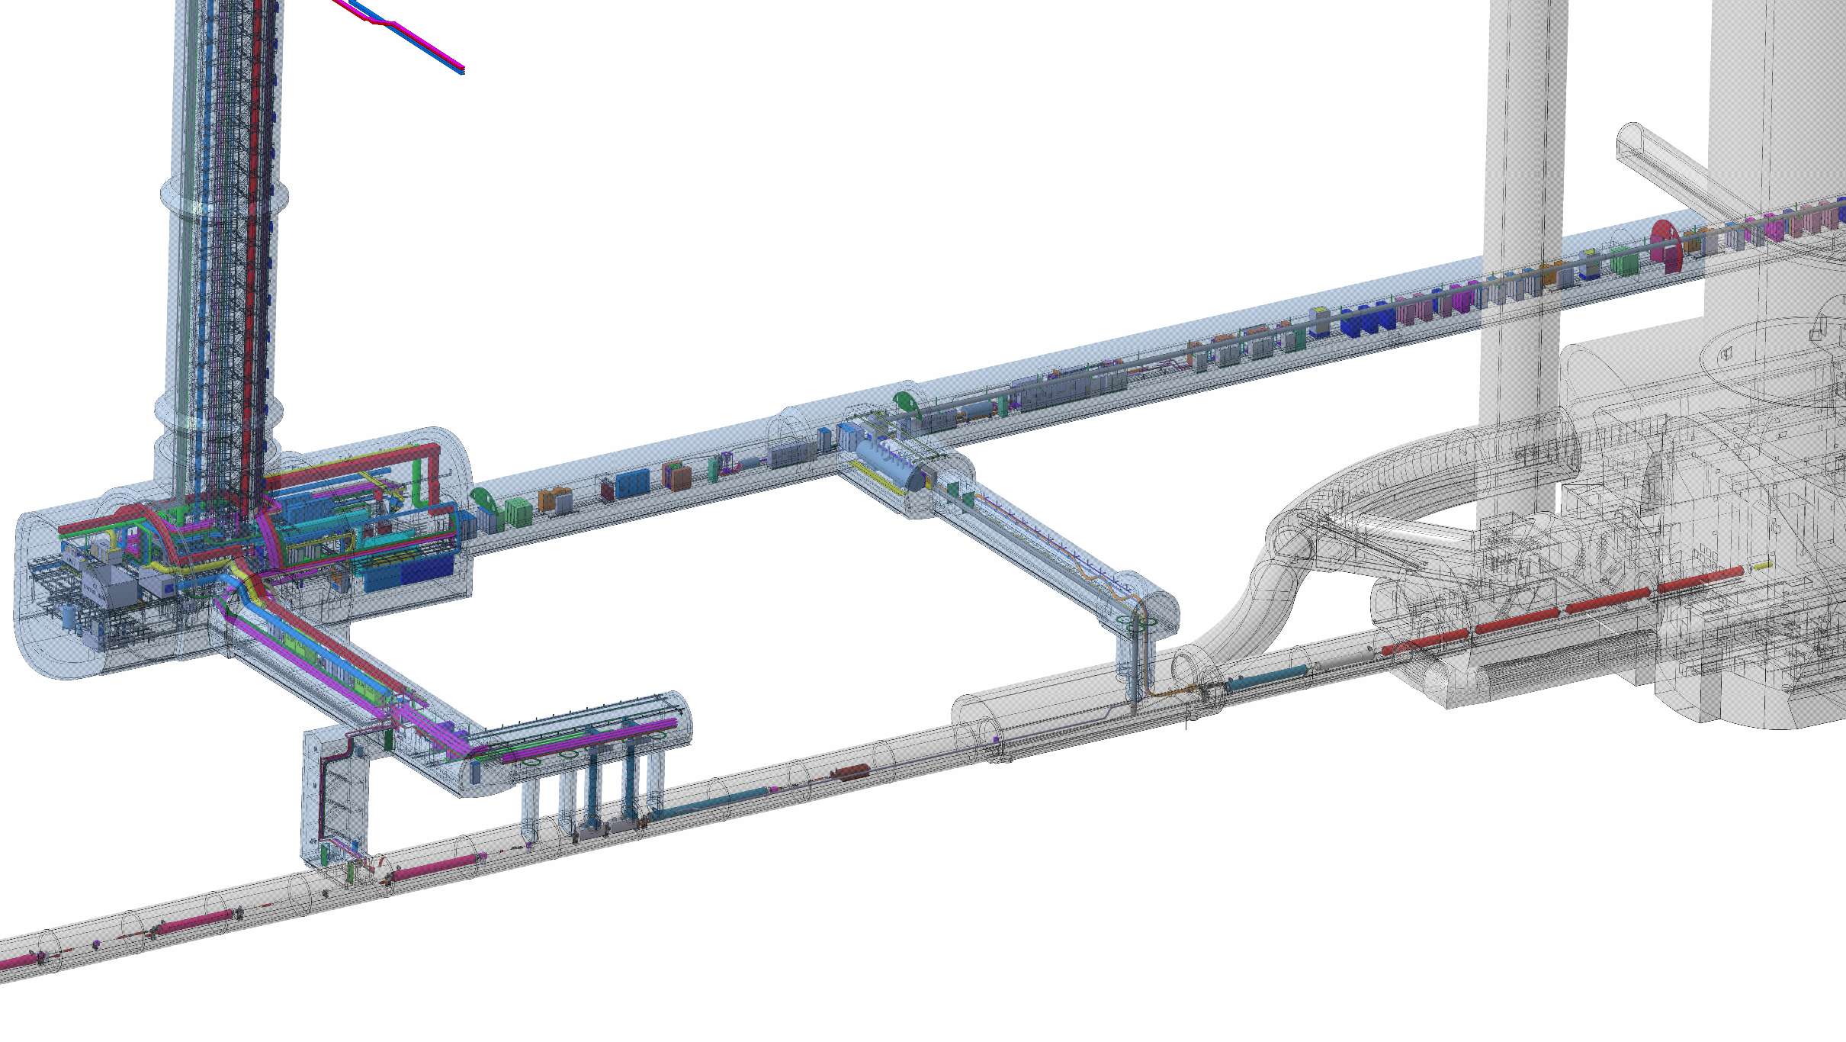
New underground structures for the HL_LHC!
P5
Power Converters
QDS
DFHX_2
DFHX_1
DFHM
US57
UR55
UL57
SCLINK
VALVES
BOX
COLD BOX
Q2A
Q1
UJ57
Q3
Q2B
UA57
CP
Cooling and Ventilation
R571
D1
UPR
DFX
TAXN
CRAB CAVIITIES
D2
HL-LHC WP15
Q4
Q5
2

Slide 3
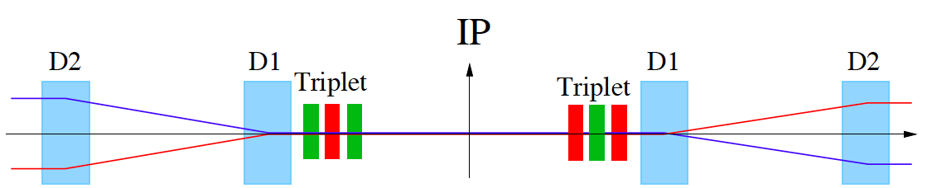
HL-LHC Insertion Regions around Experiments
Insertion Layout:
ca. 150m
ca.50m
Parallel to point focusing of triplet:
Offset of the triplet magnets generates transverse shift of the bunches at the IP equal to the triplet offset
➔ σ = 7.5μm ➔ 4μm triplet alignment error separates the beams at the IP
➔ Operation requires regular orbit correction along the Matching Section
Requires sufficient aperture margins in the elements of the Matching Section
or regular re-alignment campaigns
HL-LHC proposes a fully remote alignment system to cope with the radiation environment
and to allow regular alignment campaigns

Slide 4
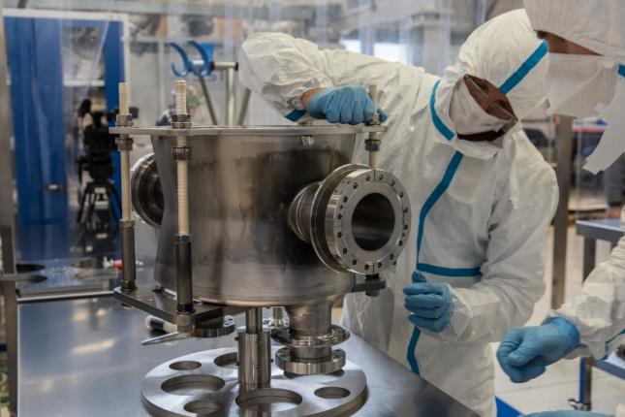
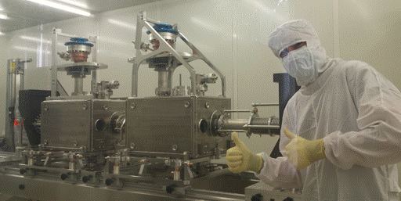
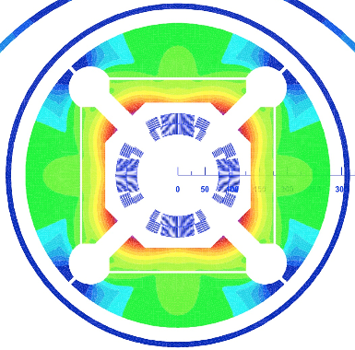
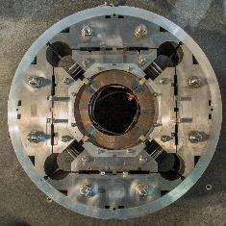
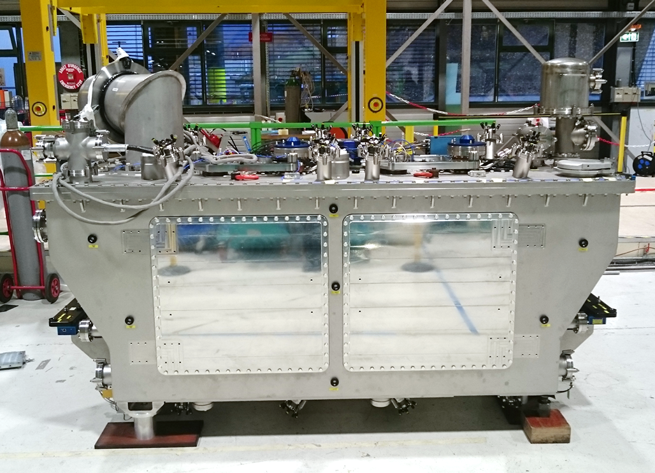
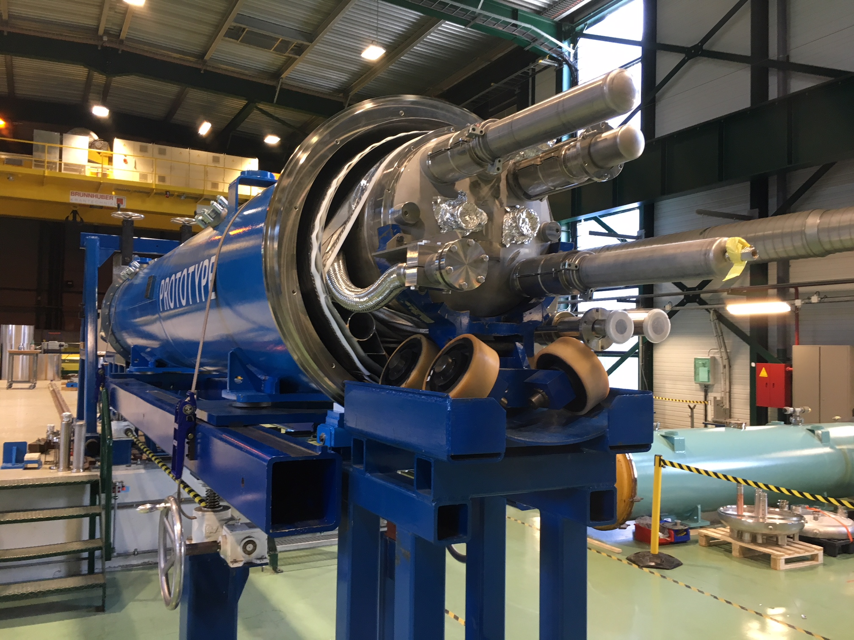
Alignment of Active components Inside a Cryostat
Crab Cavities
Superconducting magnets
Requires innovative solutions for high precision Internal Metrology!

Slide 5
Review of the HL-LHC Alignment and internal Metrology
Mandate of the review:
The main objective is to review the alignment solutions foreseen for HL-LHC, with a focus on the
internal metrology, the monitoring of inner triplet cold masses and crab cavities inside their cryostat and
full remote alignment systems.
Scope of the review:
The scope of this review is:
To examine the soundness of the proposed solutions individually and as a global system;
To verify that all requirements from equipment owners and machine operation are duly covered;
To check that the interfaces between WP15.4 and the other WPs are clear;
To check the readiness of the solutions proposed and evaluate the associated risk if any;
To evaluate the related test plan, acceptance criteria and the overall schedule;
To examine the procurement strategy, identifying possible risks;
To put in evidence possible integration issues and safety aspects.

Slide 6
Review of the HL-LHC Alignment and internal Metrology
Review Panel members:
Georg Gassner (SLAC, Chairman),
Johannes Prenting (DESY),
Jean-Philippe Tock (CERN) and
Jörg Wenninger (CERN)
Horst Friedsam (FNAL) via remote connection.
Secretarial support: Elodie Kurzen
Scientific secretary: Mark Jones
Review link persons: Hélène Mainaud Durand and Paolo Fessia.

Slide 8
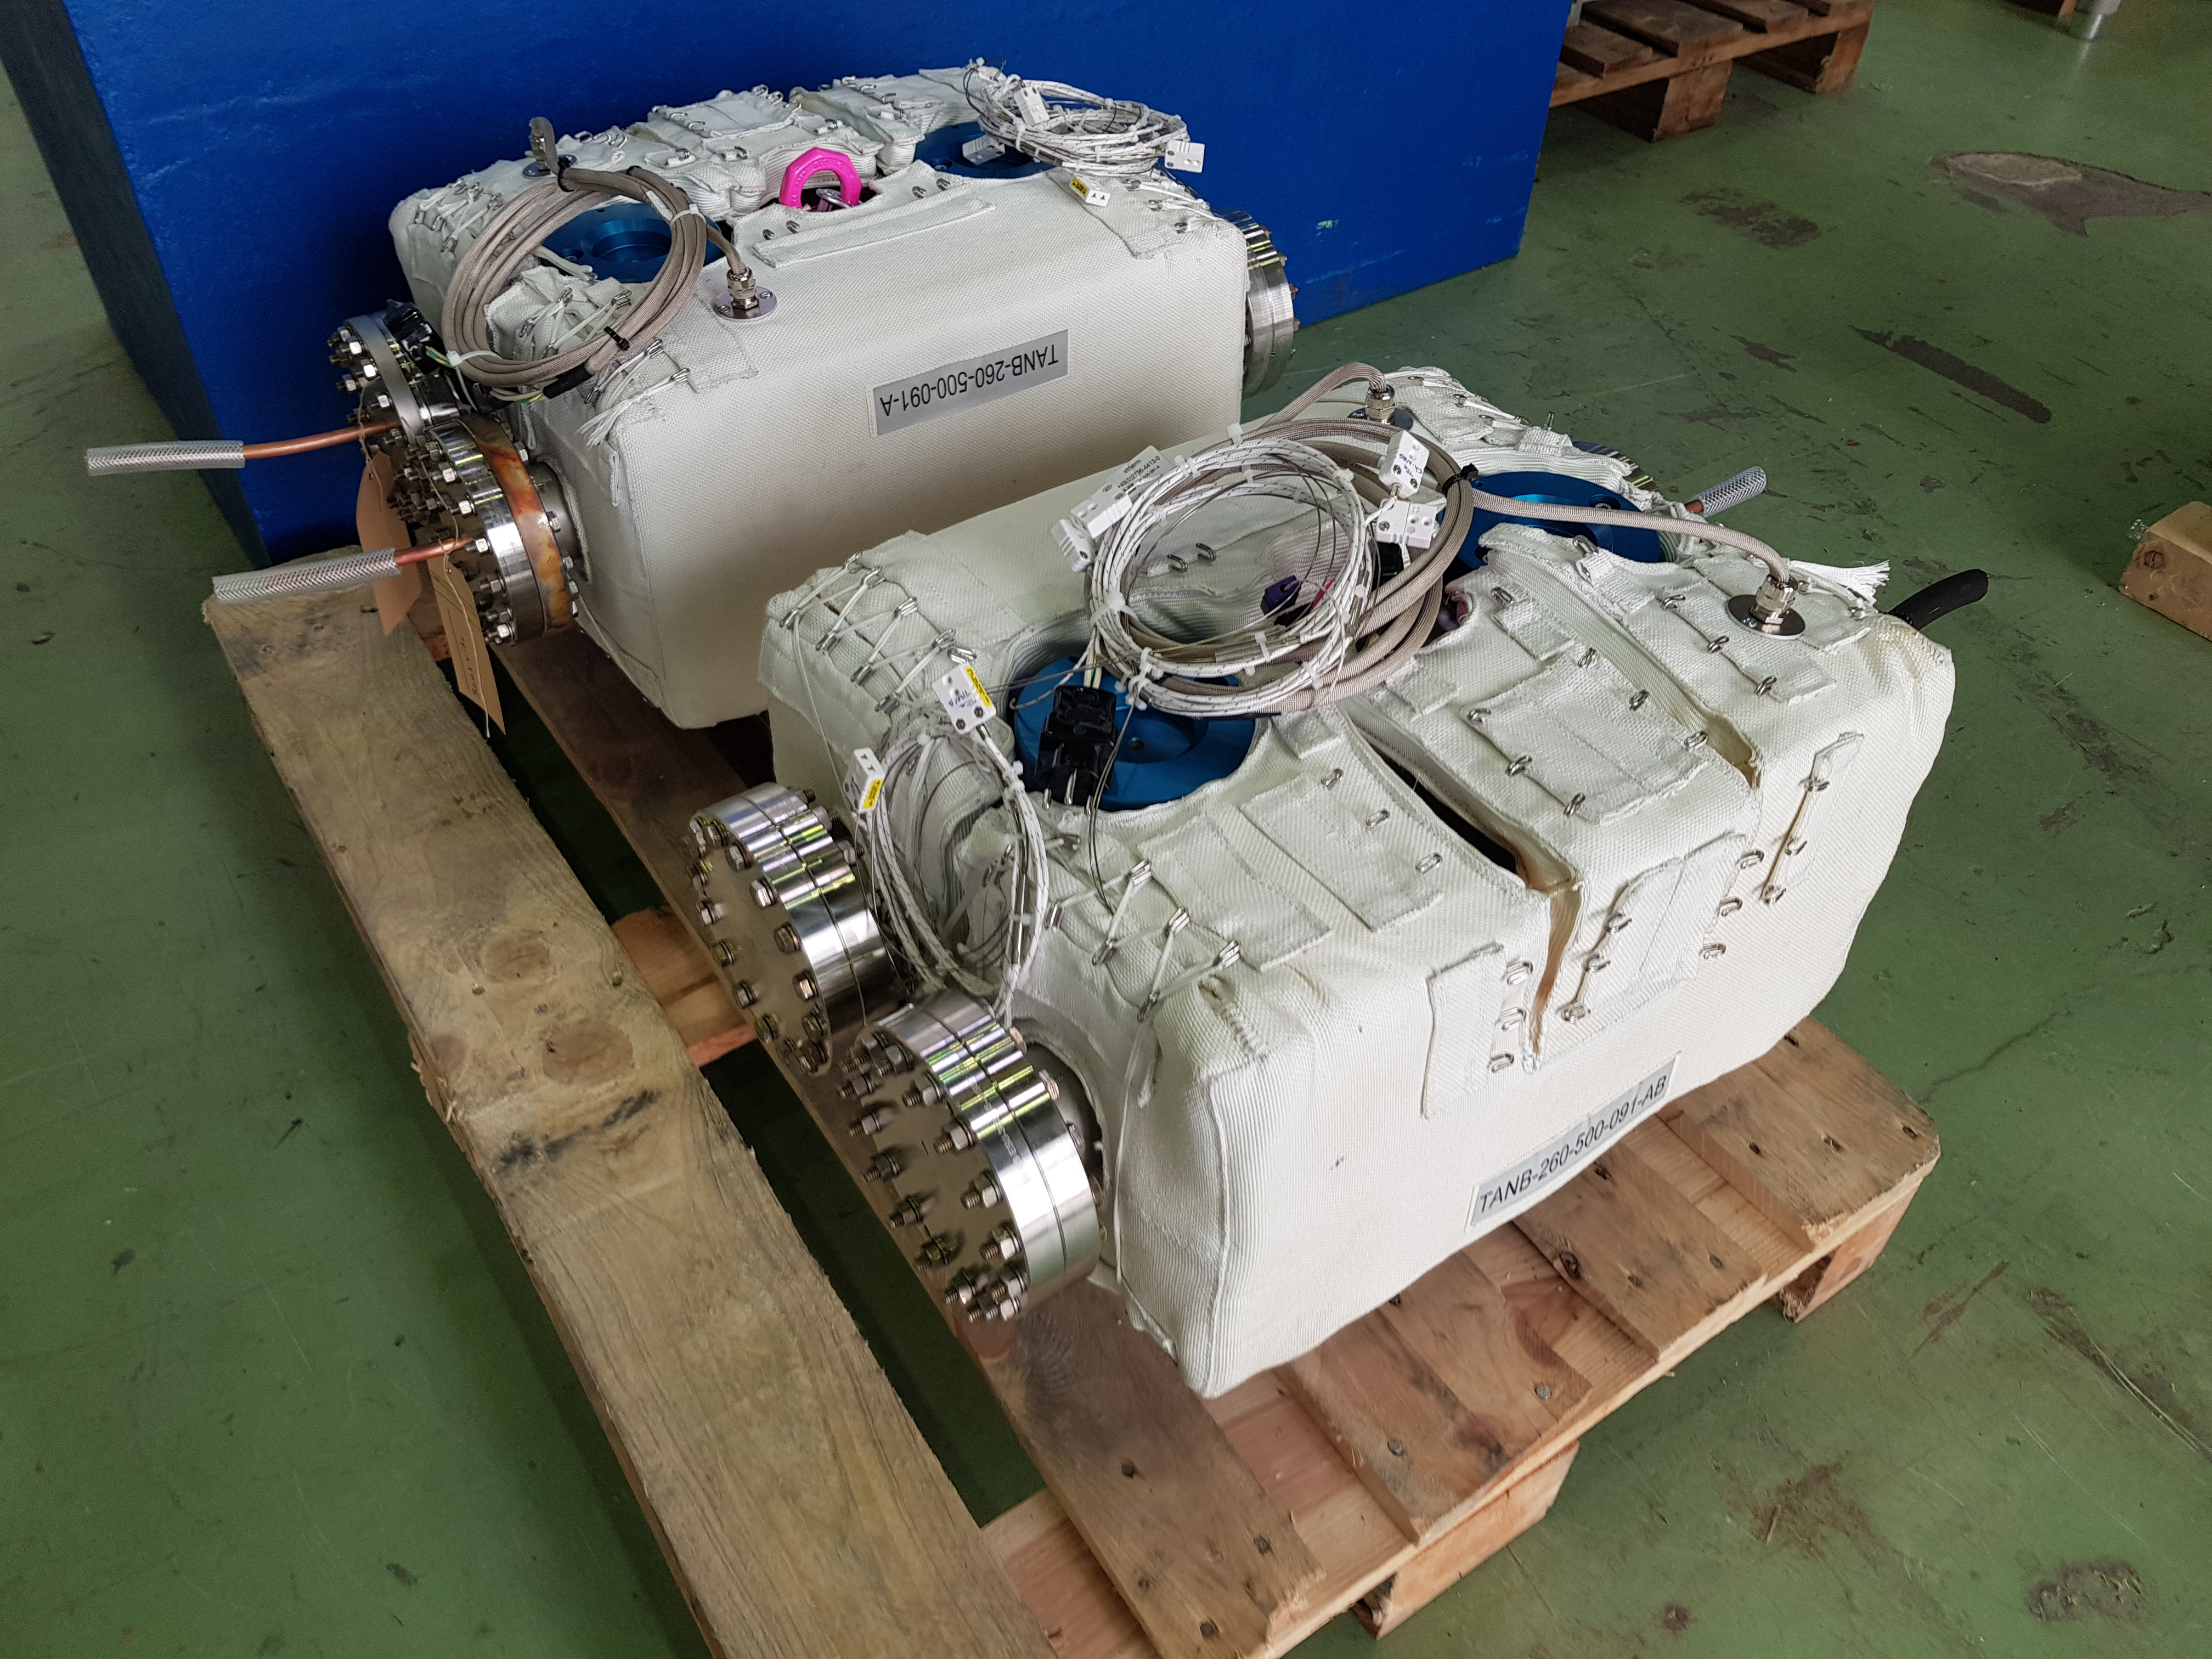
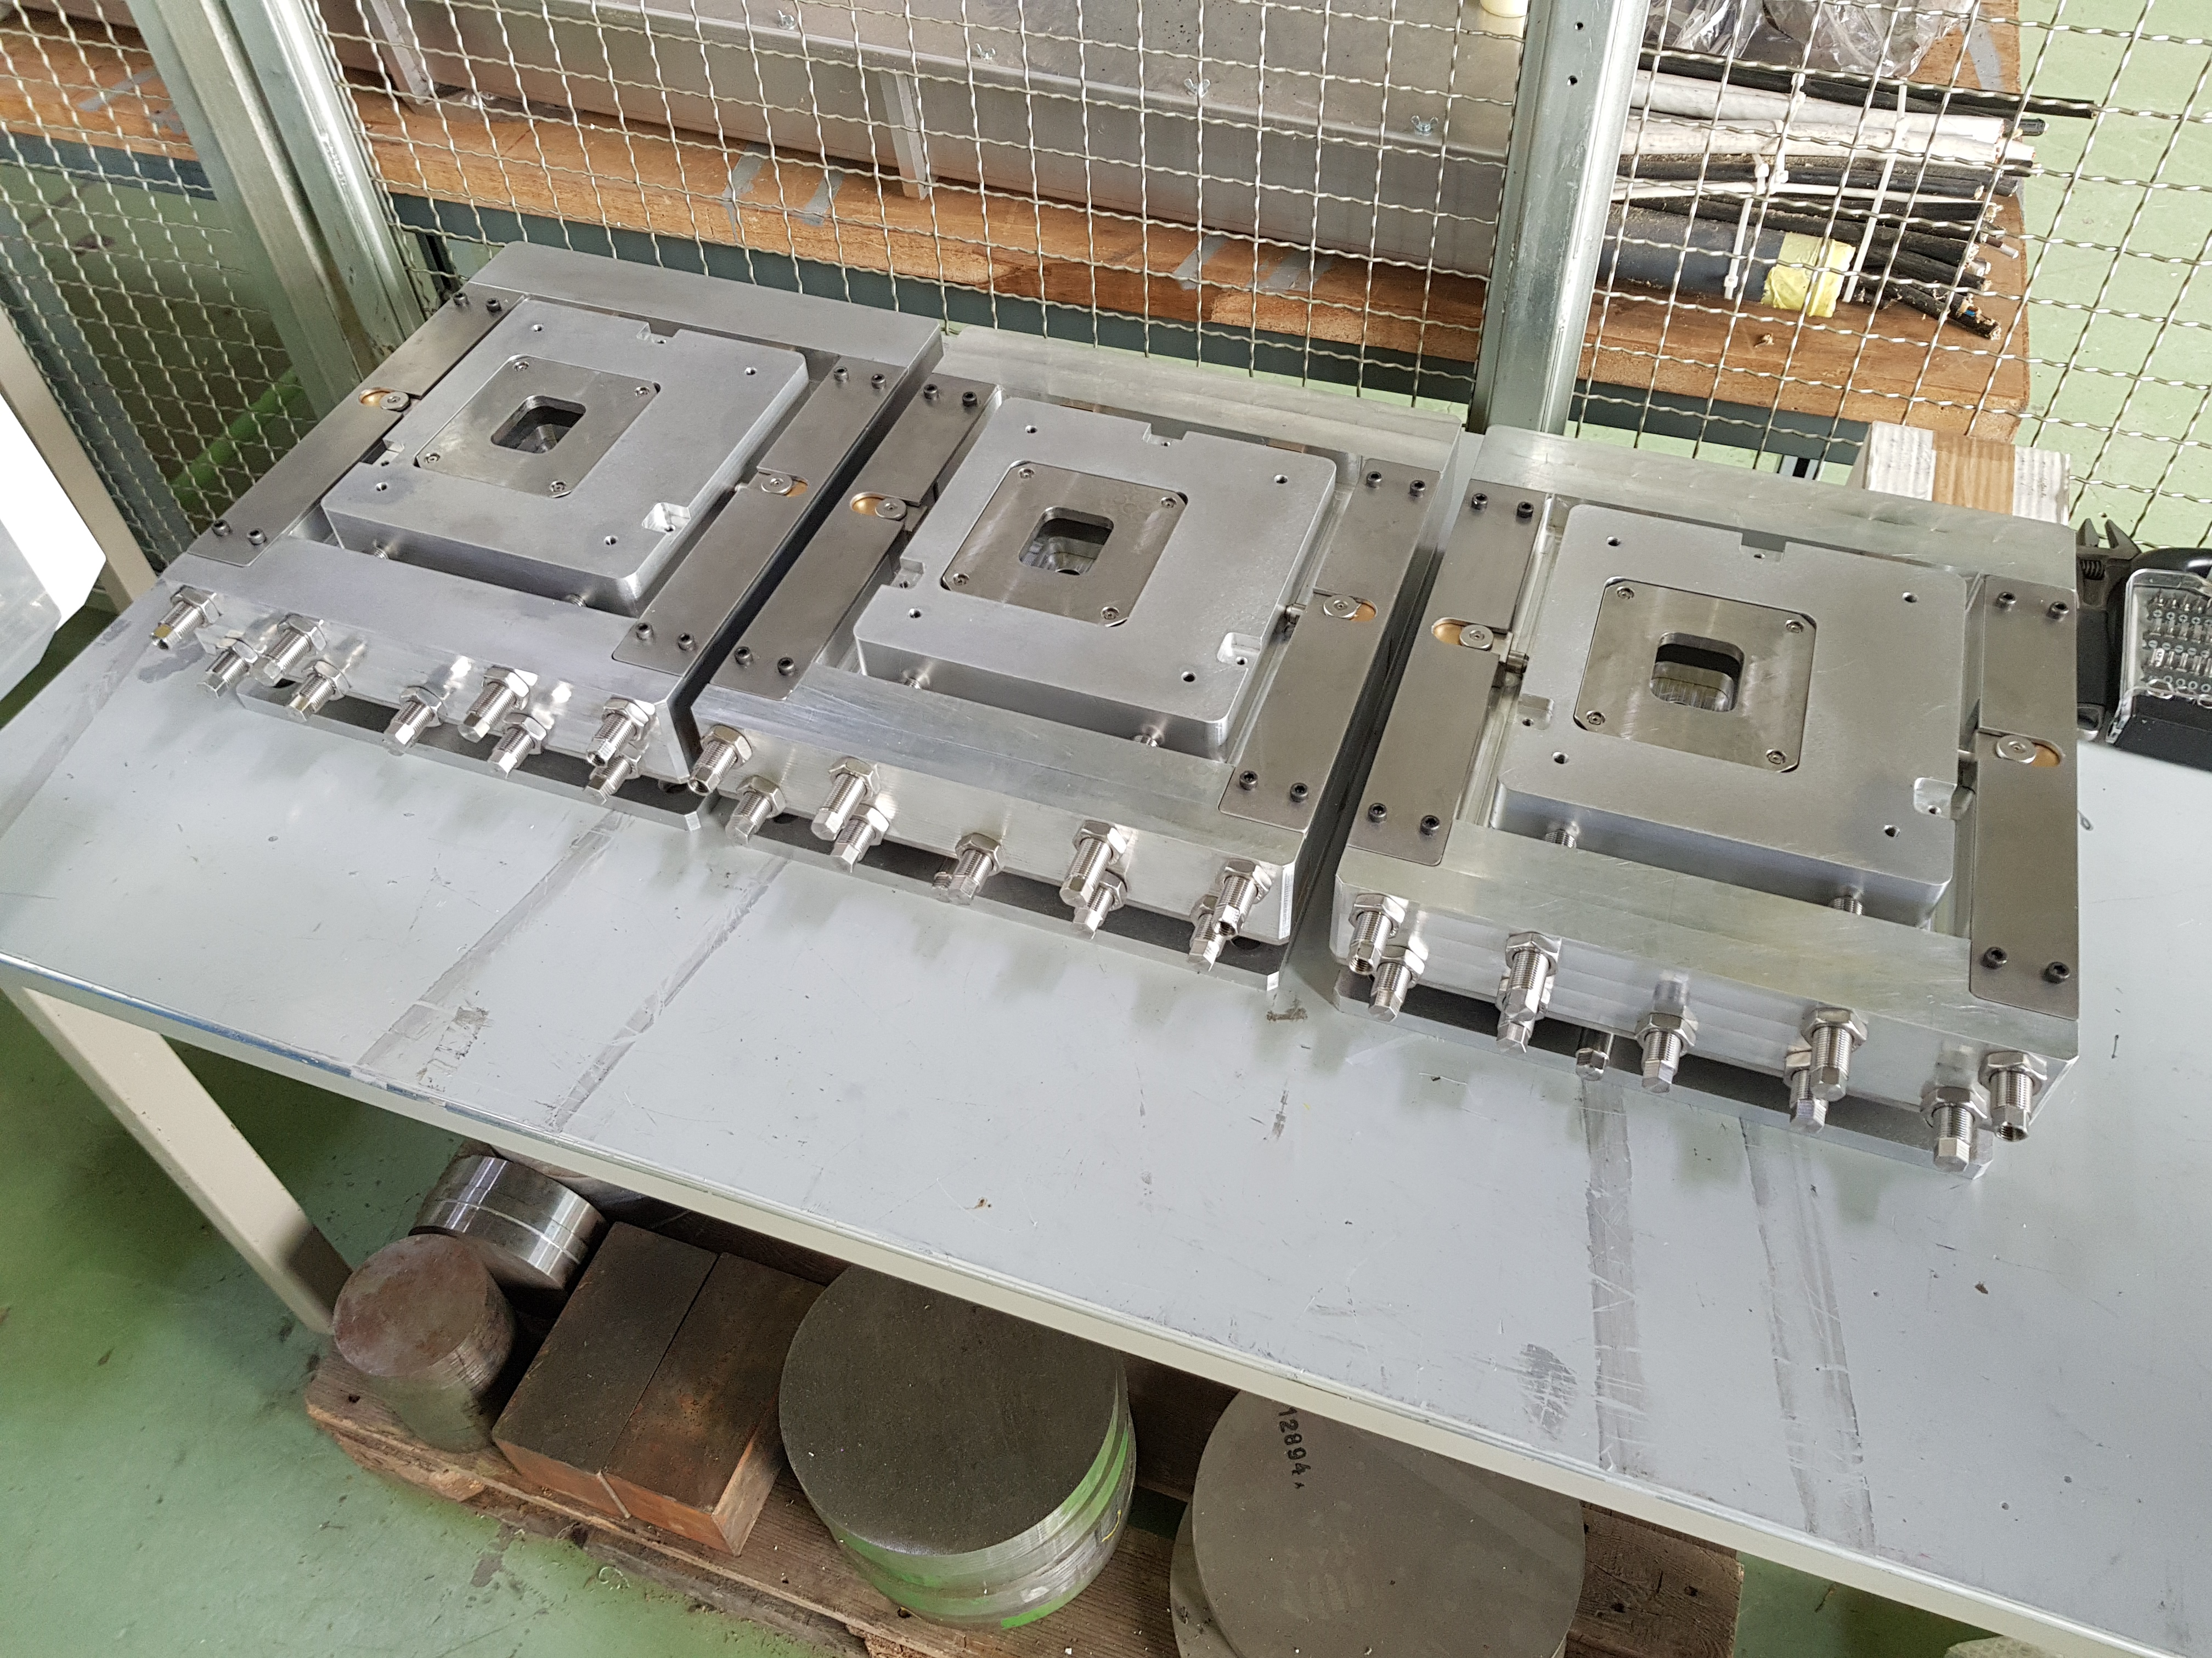
TAXNB – absorber of neutrals - necessary for the LHCb upgrade
First harware for HiLumi (installation Sept’19)
The new precise alignement tables for TANB.
The 2 TANB ready for installation
HiLumi WP8 – Collider-Experiment interface (EN-EA)
8

