Slide 1

Overview of WP15.4 inside the HL-LHC project
H. Mainaud Durand
Review of HL-LHC alignment and Internal Metrology (WP15.4)

Slide 2
Outline
Introduction to WP15.4
What was achieved in the LHC & lessons learnt
HL-LHC context
HL-LHC alignment strategy
What will not be covered during the review
What will be covered

Slide 3
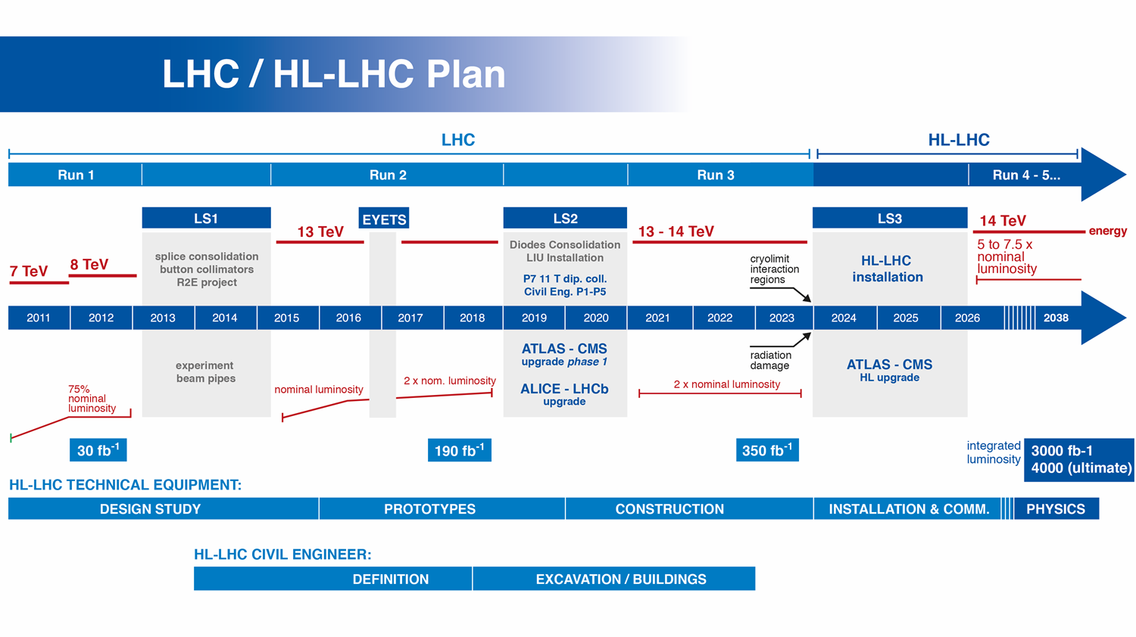

Slide 4
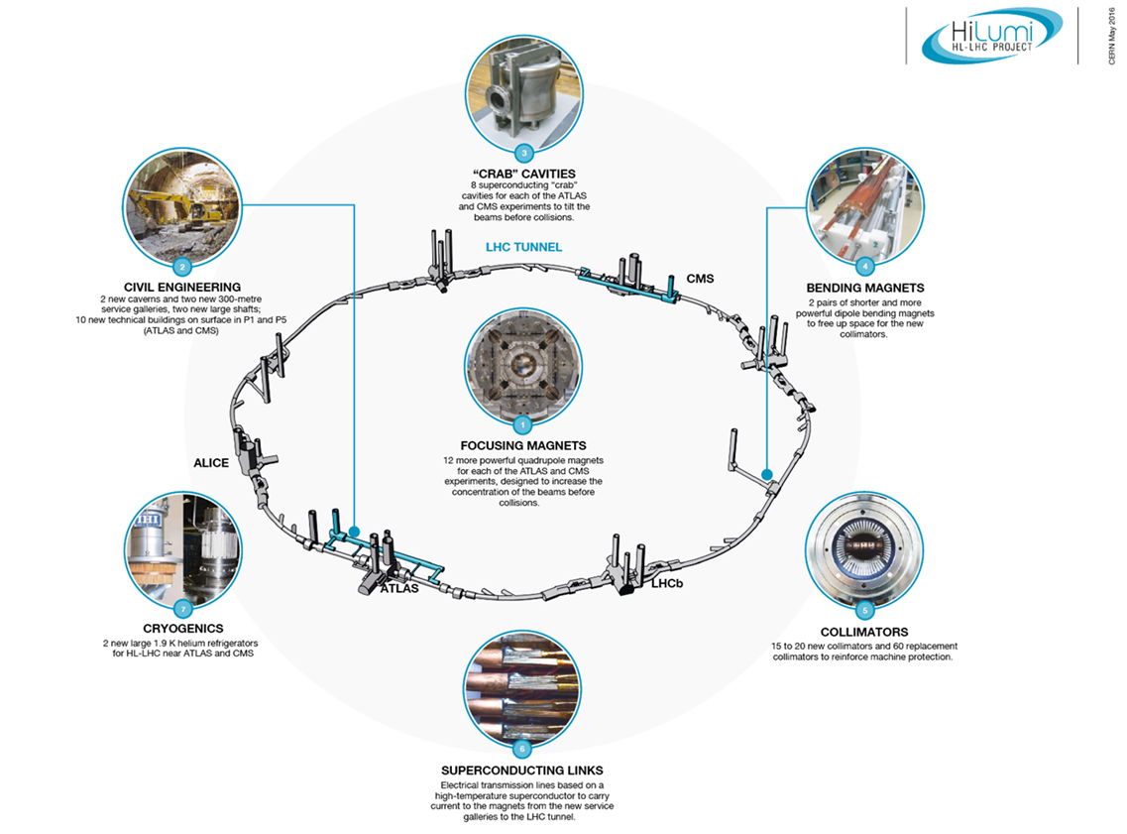
The HL-LHC Project
Impact on Alignment & internal metrology:
  New surface buildings and new underground galleries:
    Redetermination of the geodetic network
    Determination of the LSS azimuths in the LHC
    Follow-up of geodetic aspects of civil engineering
  New components (to be installed in LS2 and LS3)
    Internal metrology
    Assembly measurements
    Fiducialisation measurements
    Marking
    Pre-alignment
    Smoothing
    Permanent monitoring & remote adjustment solutions
  Development of new alignment solutions:
    For the internal monitoring of components inside their cryostat
    For the permanent monitoring
    For the remote adjustment
Major intervention on more than 1.2 km of the LHC

Slide 5
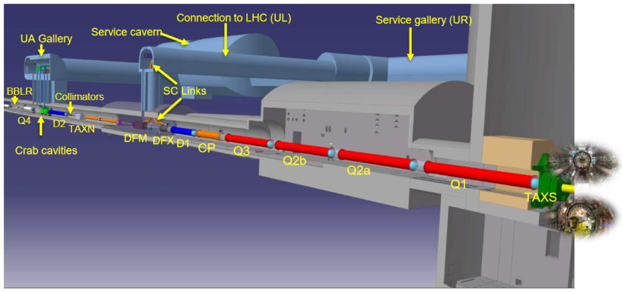
The tunnel and HL-LHC major components
Intersection
Point (IP)

Slide 6
Introduction to WP15.4
WP15.1: Integration
WP15.2: Installation
WP15.3: De-Installation
WP15.4: Alignment & internal metrology

Slide 7
Introduction to WP15.4
Mandate of WP15.4:
  Cover all geodetic aspects of the project
  Perform the alignment of the components of the beam lines & specific components in MDI area
    Using standard means when possible
    With specific alignment systems (sensors & actuators)
  Cover the internal metrology aspects
  Carry out the as-built measurements needed in all newly equipped area

Slide 8
Introduction to WP15.4
All tasks related to alignment & internal metrology for HL-LHC divided into 4 WPs:
  Internal metrology
  Monitoring of the position of the inner triplet magnet cold mass & crab cavities w.r.t their cryostat
  Standard alignment
  Remote determination of the position and readjustment of the components
WP 15.4.1
WP 15.4.2
WP 15.4.3
WP 15.4.4
Internal metrology
Internal monitoring
Standard alignment
Remote alignment

Slide 9
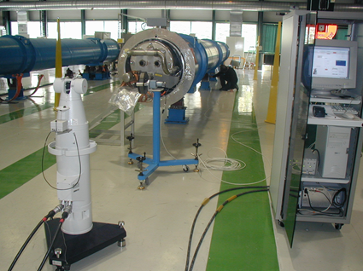
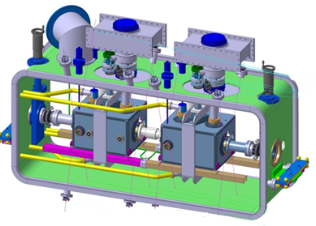
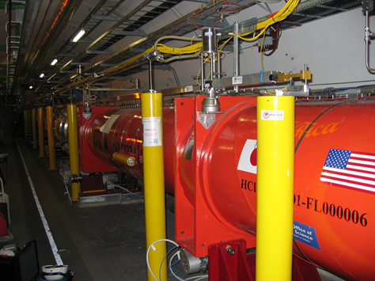
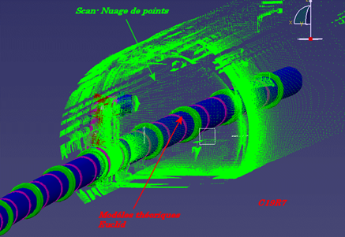
Introduction to WP15.4
WP 15.4.1
WP 15.4.2
WP 15.4.2
WP 15.4.2

Slide 10
Introduction to WP15.4

Slide 11
What was achieved in the LHC
Monitoring of the relative position
Re-adjustment if needed
Initial alignment
Smoothing
Fiducialisation
Within +/- 0.1 mm ? (1σ)
Within +/- 0.1 mm (1σ)
Beam
Within a few µm
Fiducialisation
Smoothing
Determination of the magnetic axis / geometric axis with respect to external fiducials
What was achieved:
Cold measurements performed at Fermilab (IT quadrupoles)
Warm measurements performed at CERN, with an uncertainty of measurement of ± 0.05 mm
Stability of the cold mass inside the cryostat ????

Slide 12
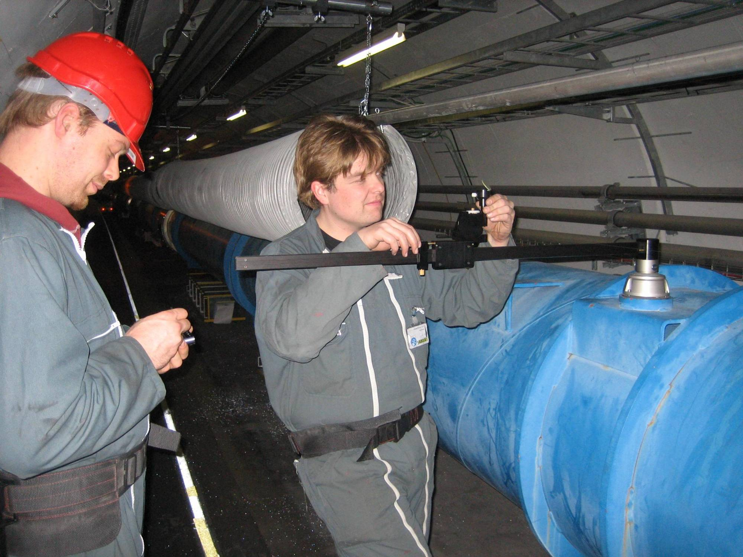
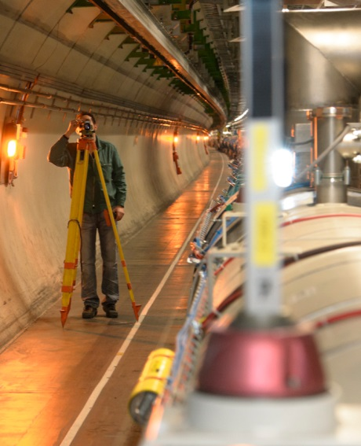
What was achieved in the LHC
Smoothing
Final errors of alignment of one triplet fiducials w.r.t. main elements of the Matching Section: ± 0.1 mm (1σ) requested but not achieved in radial.
For all other main components of the Matching Sections: smoothing of ± 0.15 mm (1σ) over 110 m. Achieved.

Slide 13
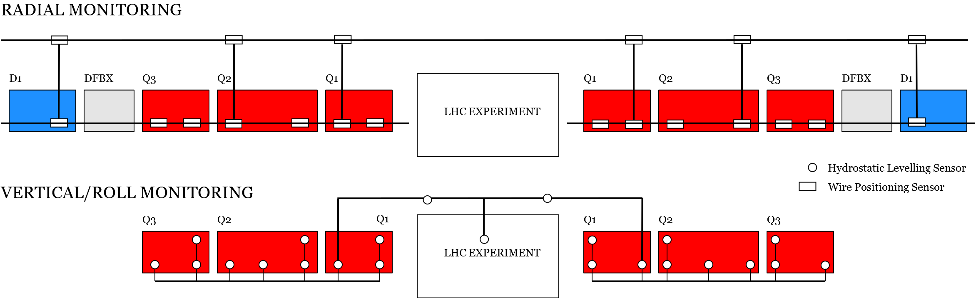
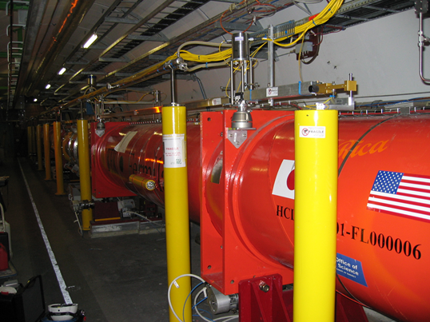
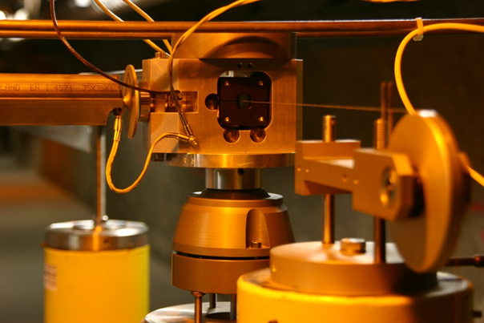
What was achieved in the LHC
Monitoring of the position of the fiducials
Re-adjustment if needed
What was achieved:
Monitoring within a few microns accuracy
Adjustment: resolution < 10 µm
Issues met on motorized jacks:
Motorized jacks used outside the limits of what was specified from the loads and stroke point of view: jacks in contact with their longitudinal stop, creating slip/stick effect
Leading to an unpredictable behavior of the triplet during remote adjustment
As a consequence: loss of weight on jacks and risk to displace remotely the jacks transversally

Slide 14
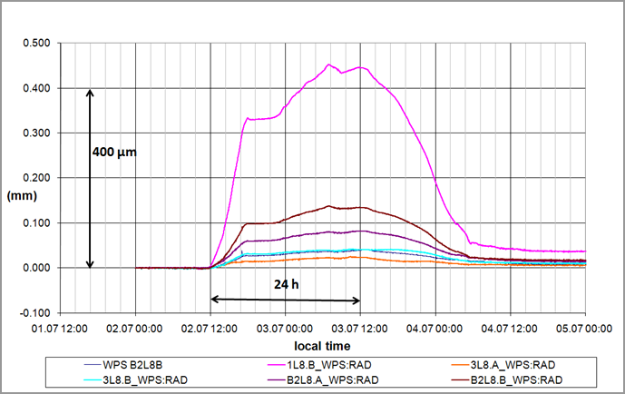
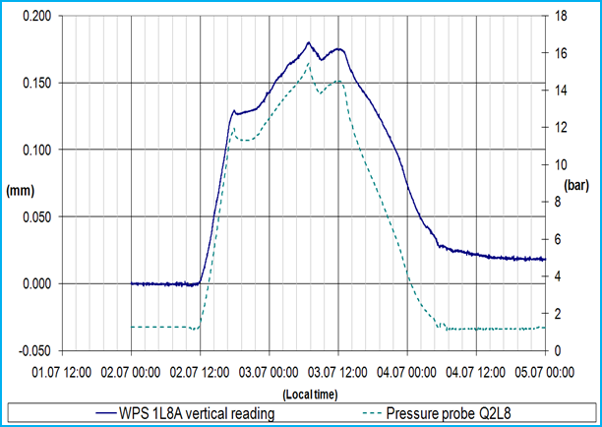
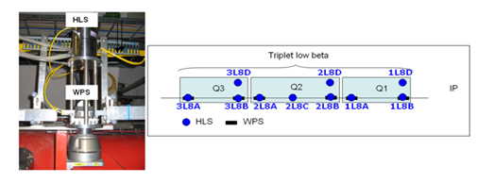
What was achieved in the LHC
From the operation point of view
Important misalignments seen due to mechanical stresses caused during cool-down → remote fine tuning very interesting when no access is possible anymore
Two ways to solve displacements of cryostats:
  Remote alignment using WPS readings and motorized jacks
  Magnetic corrections

Slide 15
Lessons learnt
Fiducialisation
Warm and cold measurements should be performed at CERN
As it seems difficult to develop a supporting system of cold mass + transport restraints for the magnet guaranteeing no displacement of the cold mass during transport, the monitoring of the position of the cold mass inside the cryostat w.r.t the fiducials will be needed.
Straightness of the cold mass, position of vacuum pipe and position of fiducials have to be controlled during the manufacturing
Initial alignment and smoothing
Smoothing difficult to perform due to shieldings, ventilation, permanent systems in the area
Improve link between triplet and LSS
Extend the permanent wire up to Q5
Extend the HLS system in a safer area

Slide 16
Lessons learnt
Remote alignment
Performance of the alignment systems:
  Only 1 wire (out of 10 installed in the LHC) broke in more than 8 years (because of cabling team)
  A lot of progress was achieved on the WPS sensors thanks to the CLIC studies where «absolute» sensors are needed: e.g. the position of the sensor coordinate system is known with respect to the component to be aligned
3D models of this area absolutely needed
A place of training before going down is needed too.

Slide 17
Outline
Introduction to WP15.4
What was achieved in the LHC & lessons learnt
HL-LHC context
HL-LHC alignment strategy
What will not be covered during the review
What will be covered

Slide 18
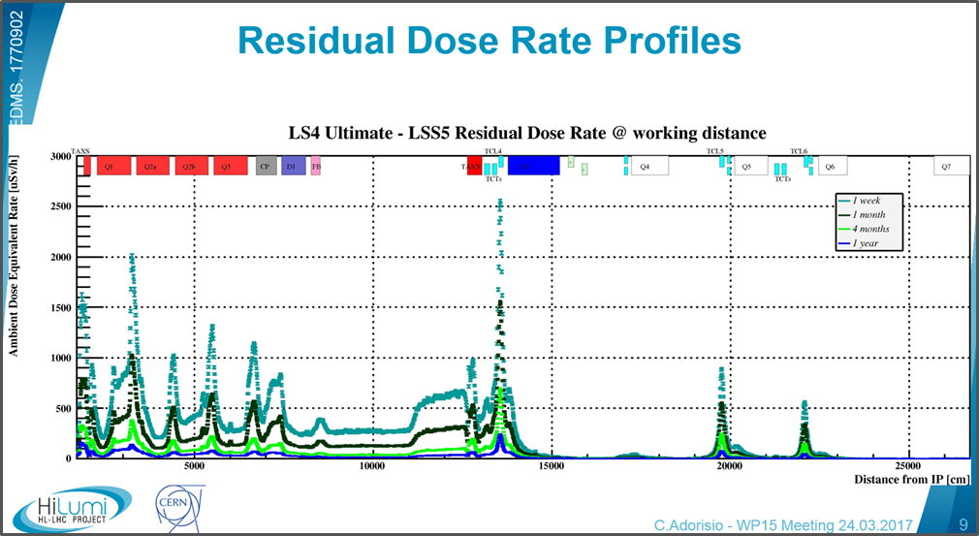
HL-LHC context
High radiation levels
Maximum Total Dose at 60 cm below the beam (jack location) for “ultimate HL-LHC”: less than 2 MGy.
Ground motion: 0.3 mm/year max. per year, (except in a very specific area: 0.7mm/y )
New galleries could result in additional ground motion, but this is very difficult to estimate

Slide 19
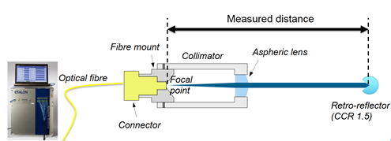
Solution proposed for internal monitoring
From the LHC experience: we know at the micron level the position of the cryostat, but not what happens inside → difficult to correlate with beam.
Displacements up to ± 0.5 mm (3σ) seen on the LHC dipoles after transport (EDMS 677511)
Decision to include in the baseline the internal monitoring of the inner triplet cold masses using laser interferometer (less «invasive» solution)
Validation of the commercial solution based on Frequency Scanning Interferometry (FSI), providing absolute distance measurements.

Slide 20
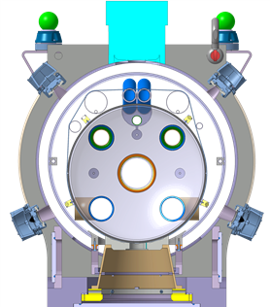
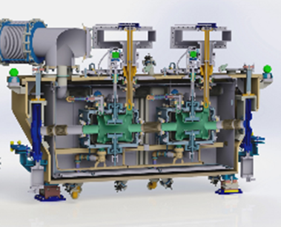
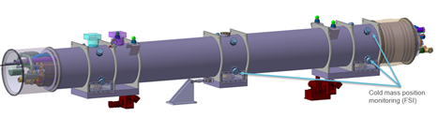
Solution proposed for internal monitoring
Monitoring of the position of one or several components inside a vacuum vessel using absolute distance measurement between an optical collimator (located on the cryostat) and a target (located on the internal component), with no contact.
Measurement context:
  Technical vacuum: 10⁻⁶ mbar,
  Total Ionizing Dose : 5 MGy max. at the level of the component, 1 MGy max. at the level of the cryostat,
  From ambient temperature (cryostat) to cryogenic temperature (2K) (component).
Position of the cold mass inside the IT quadrupoles
Position of the two crab cavities inside their cryostat

Slide 21
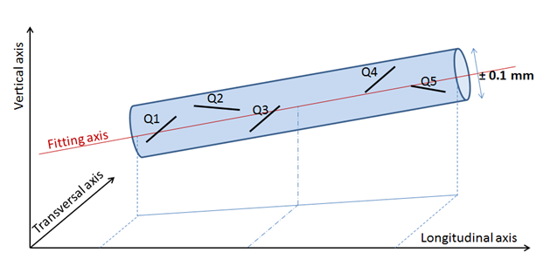
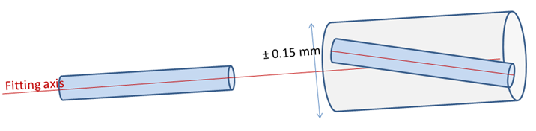
Alignment solutions: towards FRAS
Alignment = determination of position + adjustment
Considering the environment, ground motions, alignment requirements from beam dynamics: decision to perform the remote alignment of all the main components of a LSS (using sensors for the position determination and motors for the remote adjustment), based on the LHC solutions applied on the LHC inner triplets.
Mechanical axes of the magnets included in a cylinder with a radius of 0.1 mm
Mean axis of right side included in a cylinder with a radius of 0.15 mm around the mean axis of left side

Slide 22
Towards Full Remote Alignment System
Remote alignment foreseen initially only for the main components
Considering the uncertainty in the position of the inner tracker w.r.t. machine after the first installation and other components that might need a remote alignment considering the high level of radiations, a deeper study was launched to propose the Full Remote Alignment System.
The components were classified into 3 types:
  Components needing a remote alignment
  Components to be aligned at the end of a YETS or LS
  Components to be measured at the end LS (static components that will never need an adjustment)

Slide 23
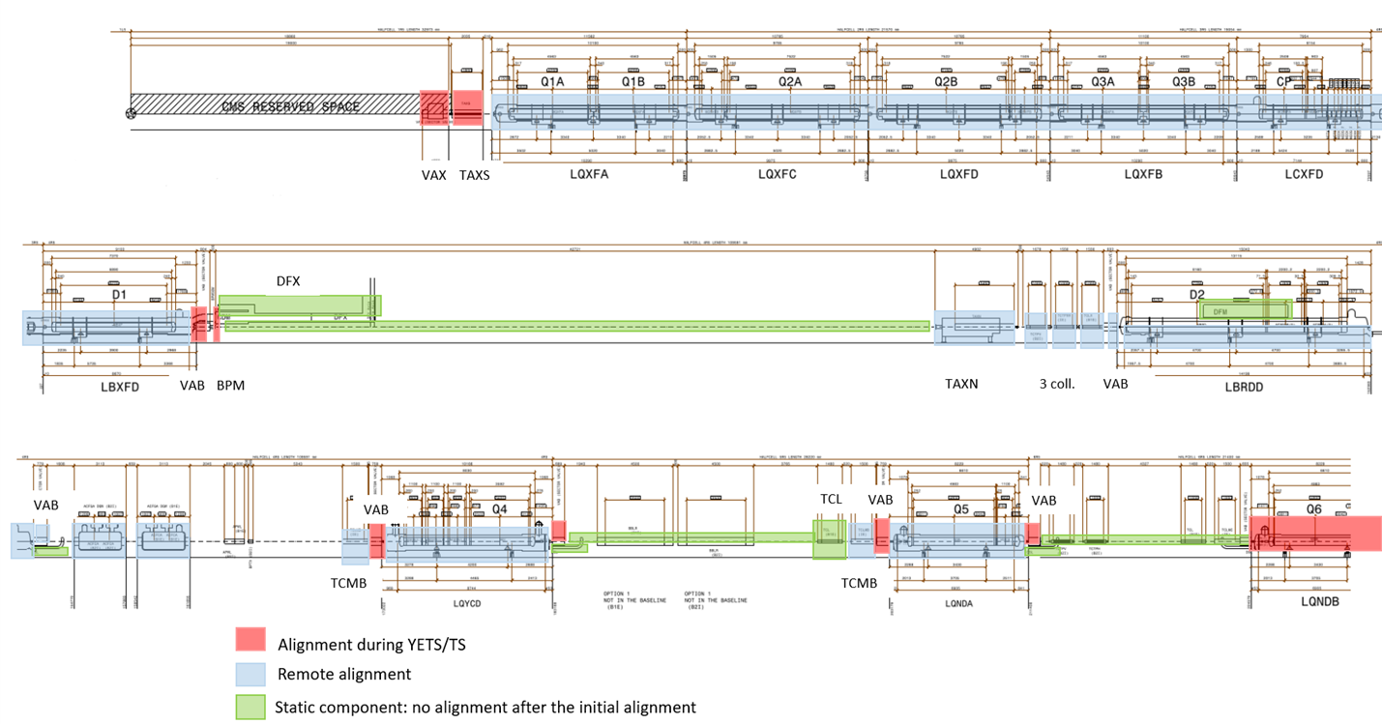
FRAS: summary

Slide 24
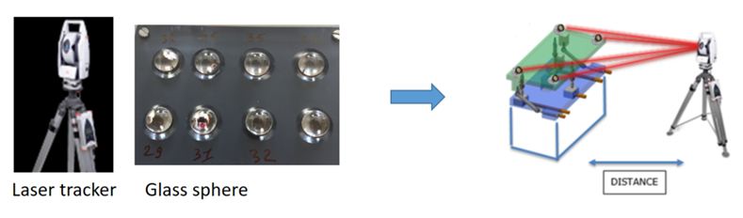
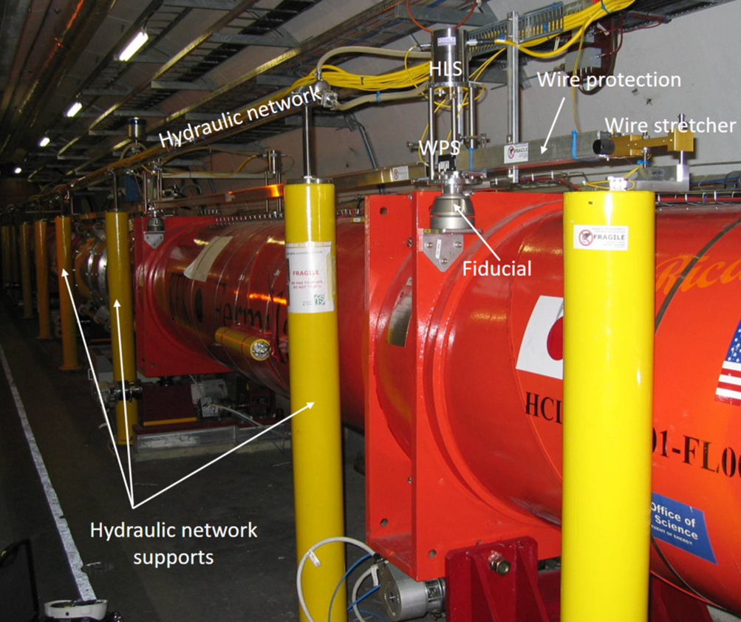
Solution proposed for the position determination
Measure the position of components using Laser tracker and permanent targets
Only at the end of YETS and LS
In the tunnel
Measure the position using permanent sensors installed on the cryostat
Continuous and remote measurements
From the CCC

Slide 25
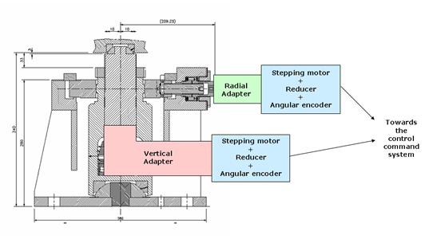
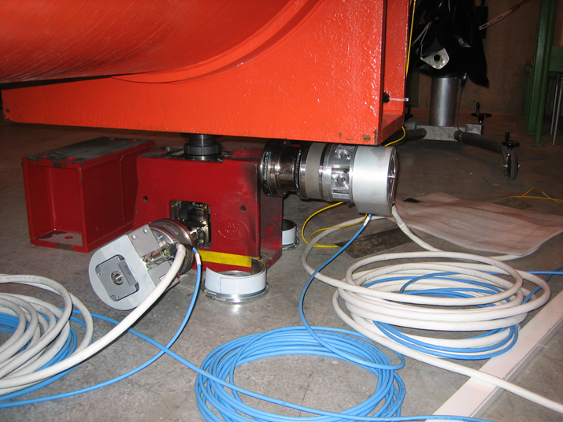
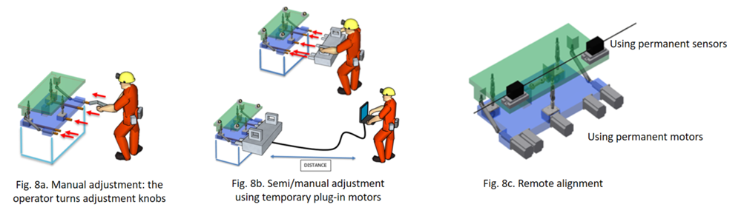
Solution proposed for the adjustment solution
For components with a weight above 2t: jacks, with motorization when needed
For components with a weight below 2t: platforms, with motorization when needed

Slide 26
Mandate and scope of the review
Mandate : to review the alignment solutions foreseen for HL-LHC, with a focus on the internal metrology, the monitoring of inner triplet cold masses and crab cavities inside their cryostat and Full Remote Alignment System
Scope of the review:
  To examine the soundness of the proposed solutions individually and as a global system
  To verify that all requirements from equipment owners and machine operation are duly covered
  To check that the interfaces between WP15.4 and the other WPs are clear
  To check the readiness of the solutions proposed and evaluate the associated risk if any
  To evaluate the related test plan, acceptance criteria and the overall schedule
  To examine the procurement strategy, identifying possible risks
  To put in evidence possible integration issues and safety aspects

Slide 27
What will not be covered during the review
Geodetic aspects
Fiducialisation and internal metrology for HL-LHC components to be installed during LS2
Standard alignment activities (determination of the underground geodetic network, marking, jacks heads alignment, initial alignment w.r.t. geodetic network, smoothing)
3D scans
R&D on train measurements

Slide 28
What will be covered during the review
Internal monitoring
Fiducialisation aspects

Slide 29
What will be covered during the review
Full Remote Alignment System (FRAS)

Slide 30
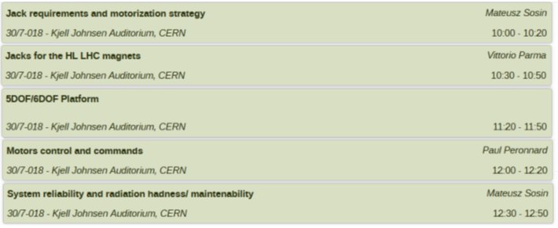
What will be covered during the review
Adjustment solutions
Position determination solutions
Perspectives and conclusions

Slide 31
Conclusion
WP15.4 includes a large variety of activities in the survey and alignment field, from the internal metrology to the development of new methods of measurements through geodetic aspects. It concerns components to be installed during LS3, but also during LS2.
This review will address the activities that are the more risky from the technical and cost aspects, as requiring new developments or interacting with a lot of different work packages of the HL-LHC project.

Slide 32
Thank you very much!

