Slide 1
FSI qualification for Internal monitoring
Alignment review 2019
Vivien RUDE
2019-08-26

Slide 2
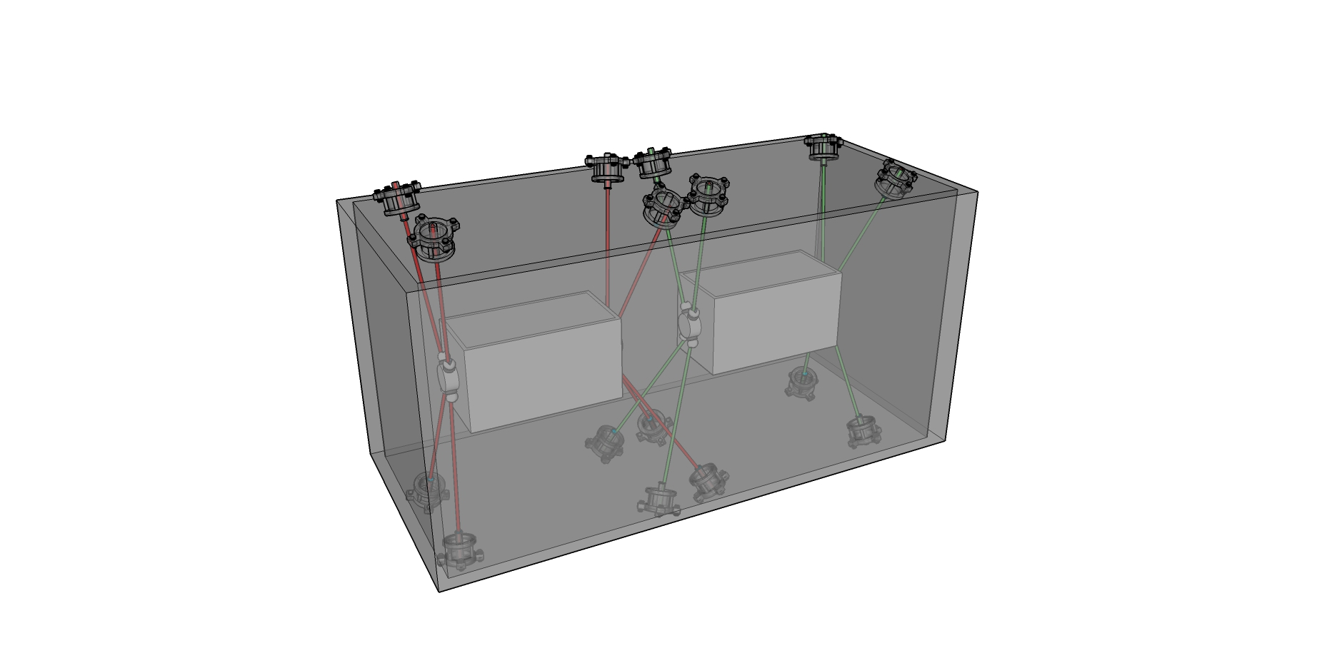
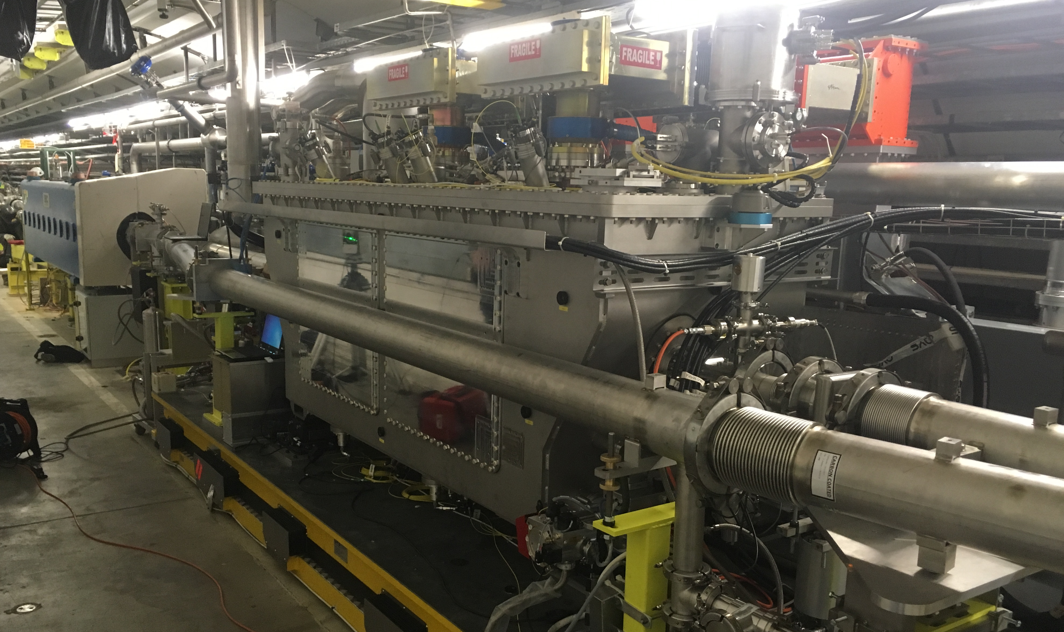
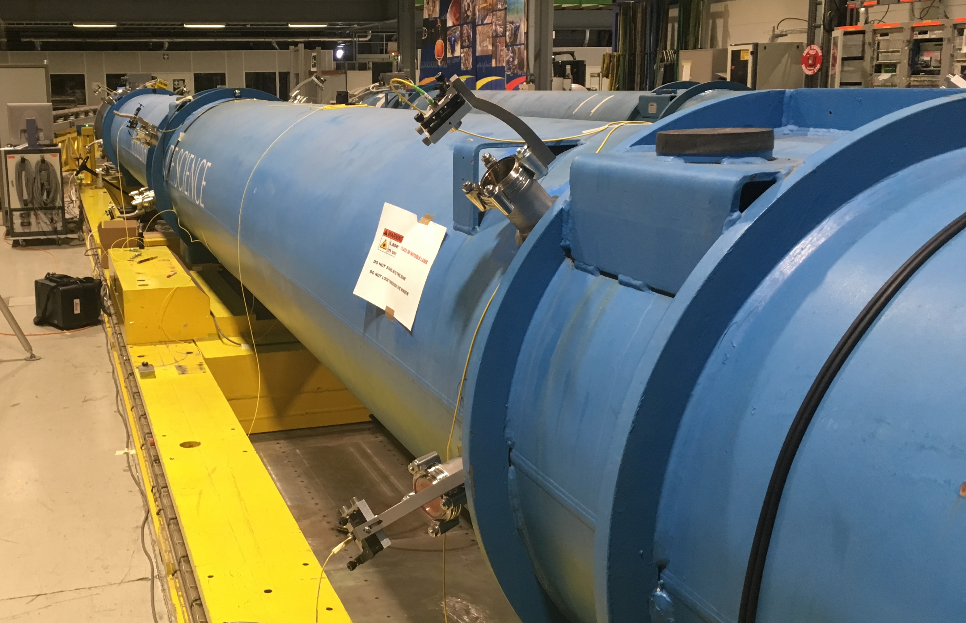
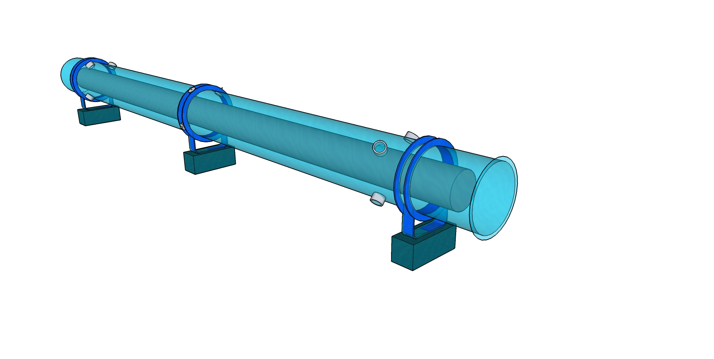
Outline
Crab-Cavities in SPS accelerator
Internal monitoring
Crab-Cavities project
Dipole Test project
(Test for HL-LHC quadrupole)
Dipole-test in SM18

Slide 3
Internal monitoring
Objective : determine the position of inner component inside a vacuum vessel (Cryostat, Cryomodule)
Environment :
Temperature : 1.9 K (Cryogenics conditions) ≈ - 271°C
Vacuum : 10-6 mBar
Radiation : 1 MGy / year
Accuracy :
0.1 mm w.r.t. vacuum vessel
Dipole
Crab-Cavities

Slide 4
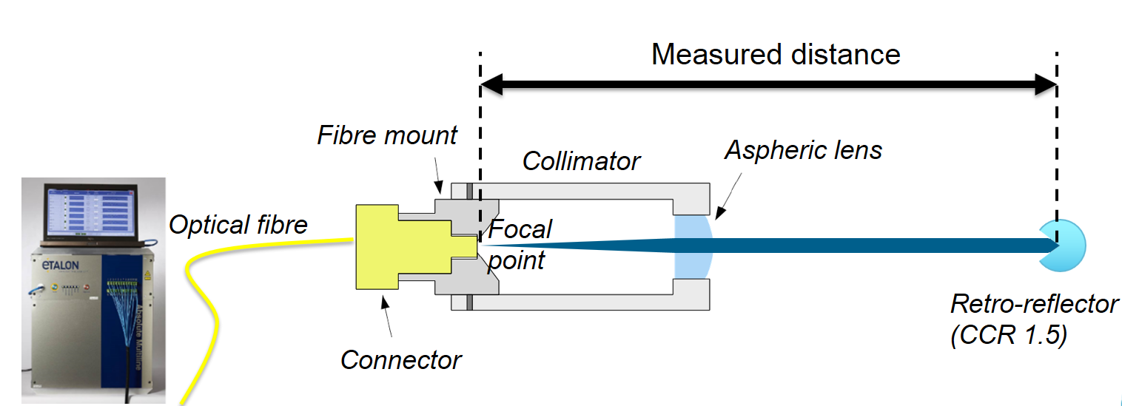
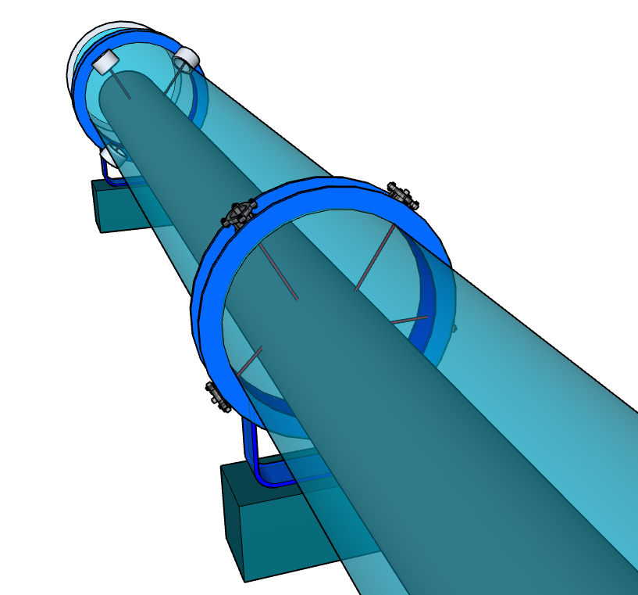
FSI : Frequency Scanning Interferometry
Absolute distance measuring interferometric technique
Accuracy :
0.5 µm per meter

Slide 5
Crab-cavities project
Feedthrough
Cryomodule
Crab-cavities

Slide 6
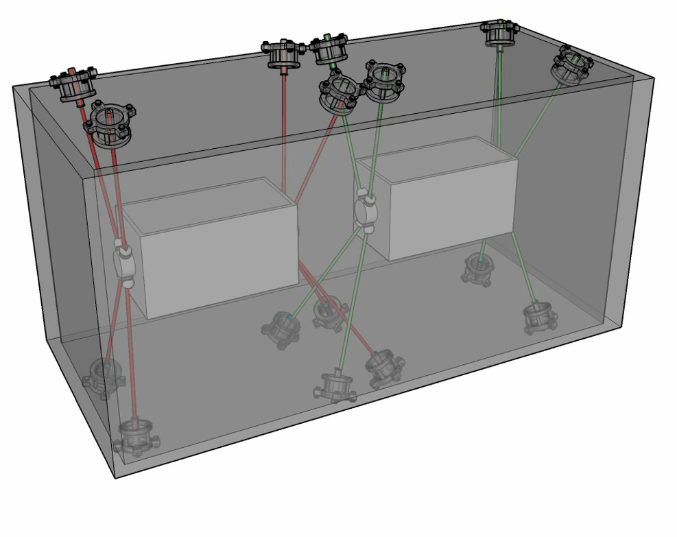
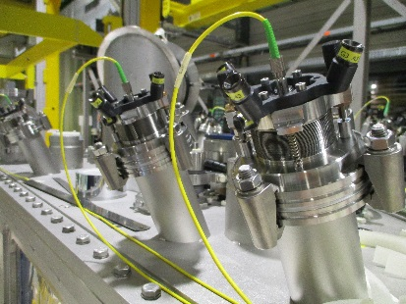
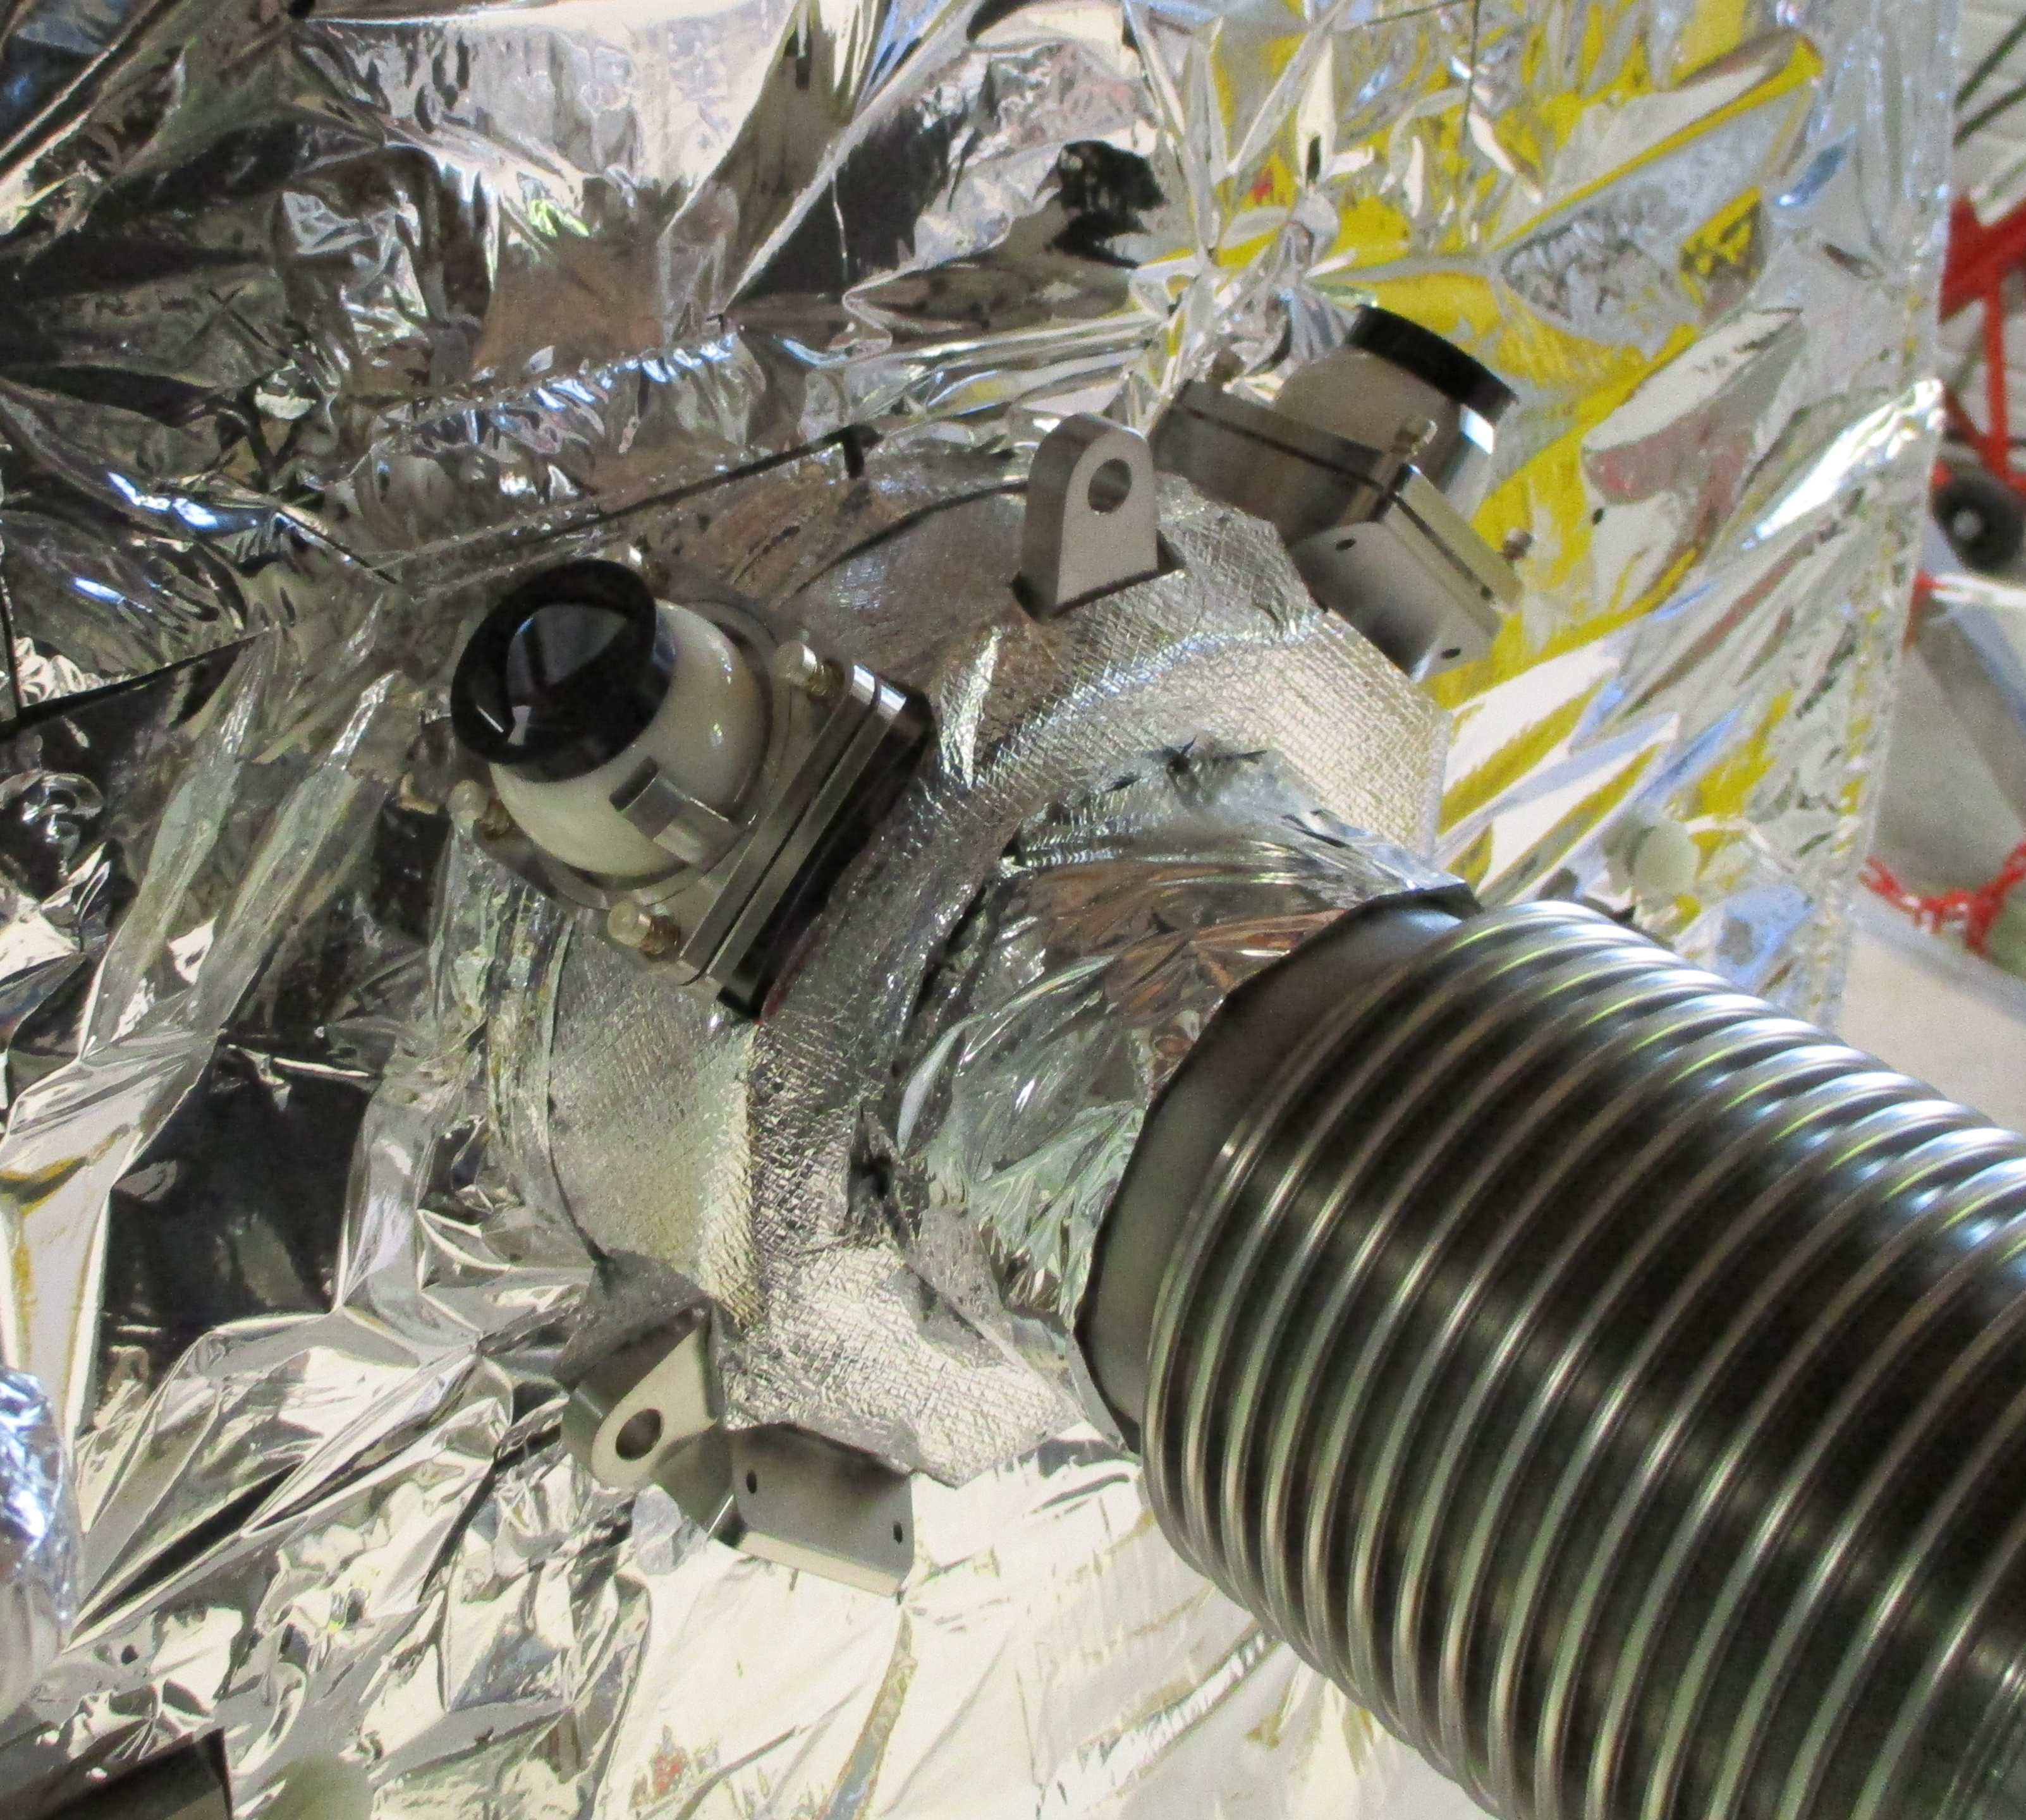
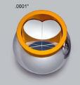
Configuration
8 FSI distances by Cavity for 7 unknowns
beam
Vacuum : Ambient
Temperature : Ambient
Cryomodule
Thermal shielding
Vacuum : 10⁻⁶ mbar
Temperature : 4 K
Cavity

Slide 7
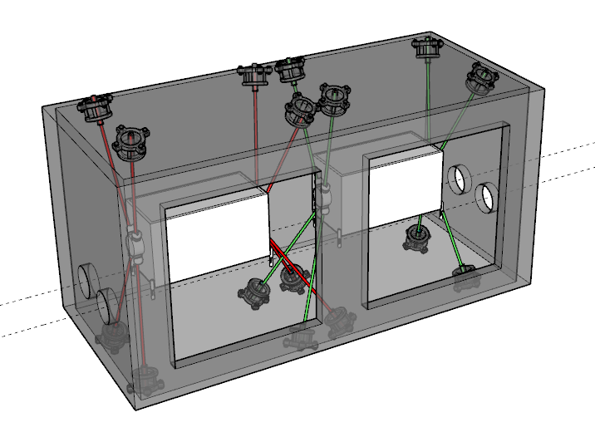
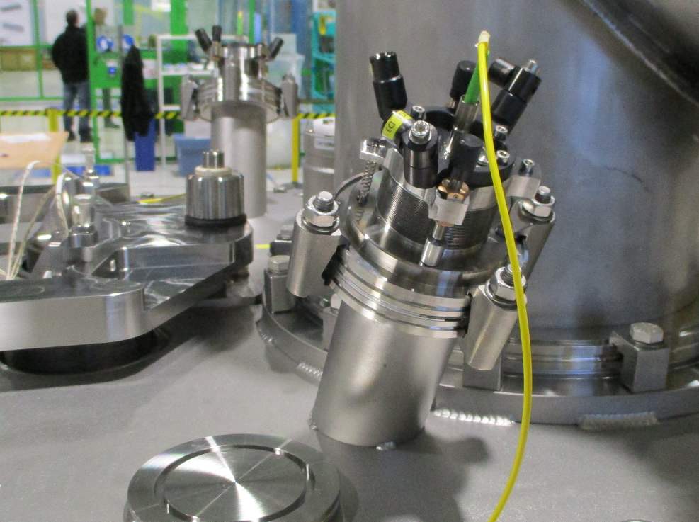
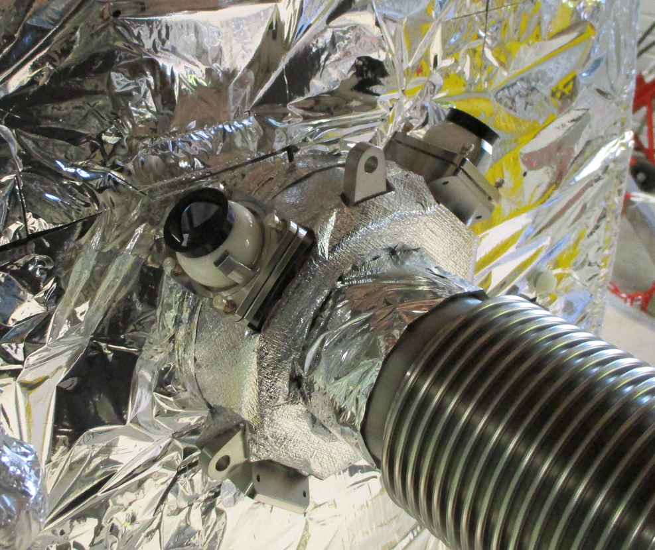
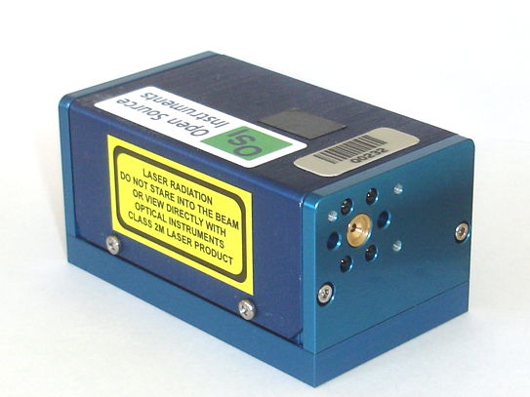
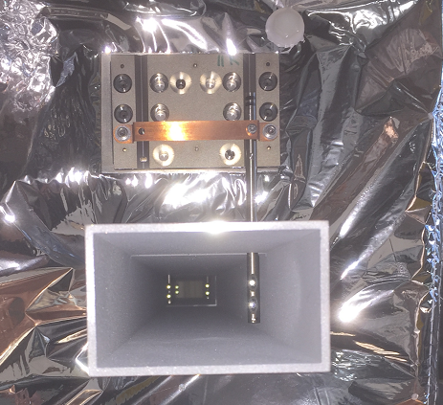
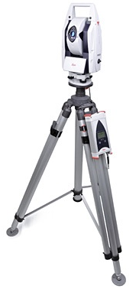
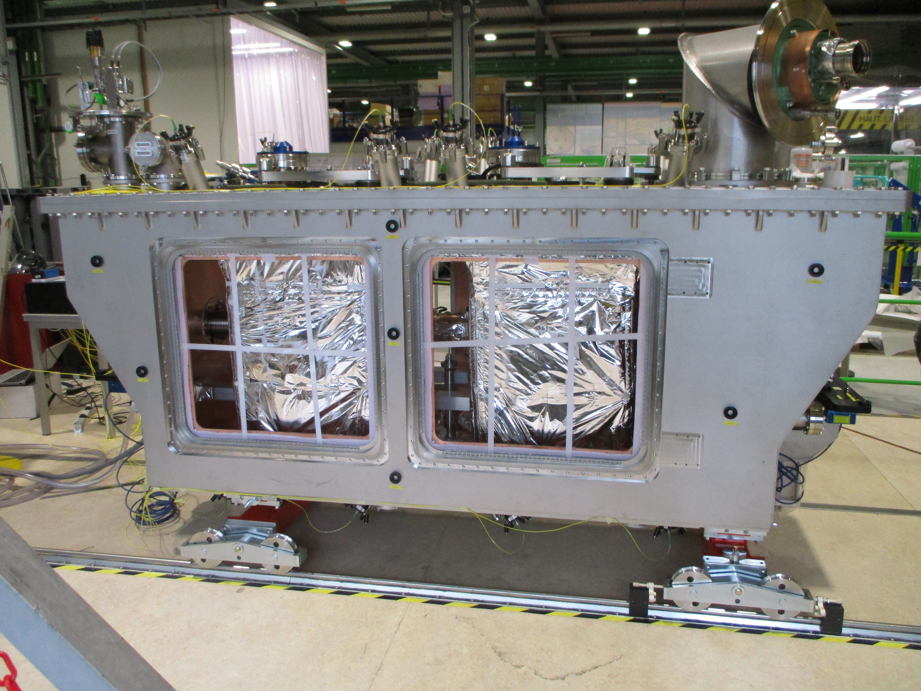
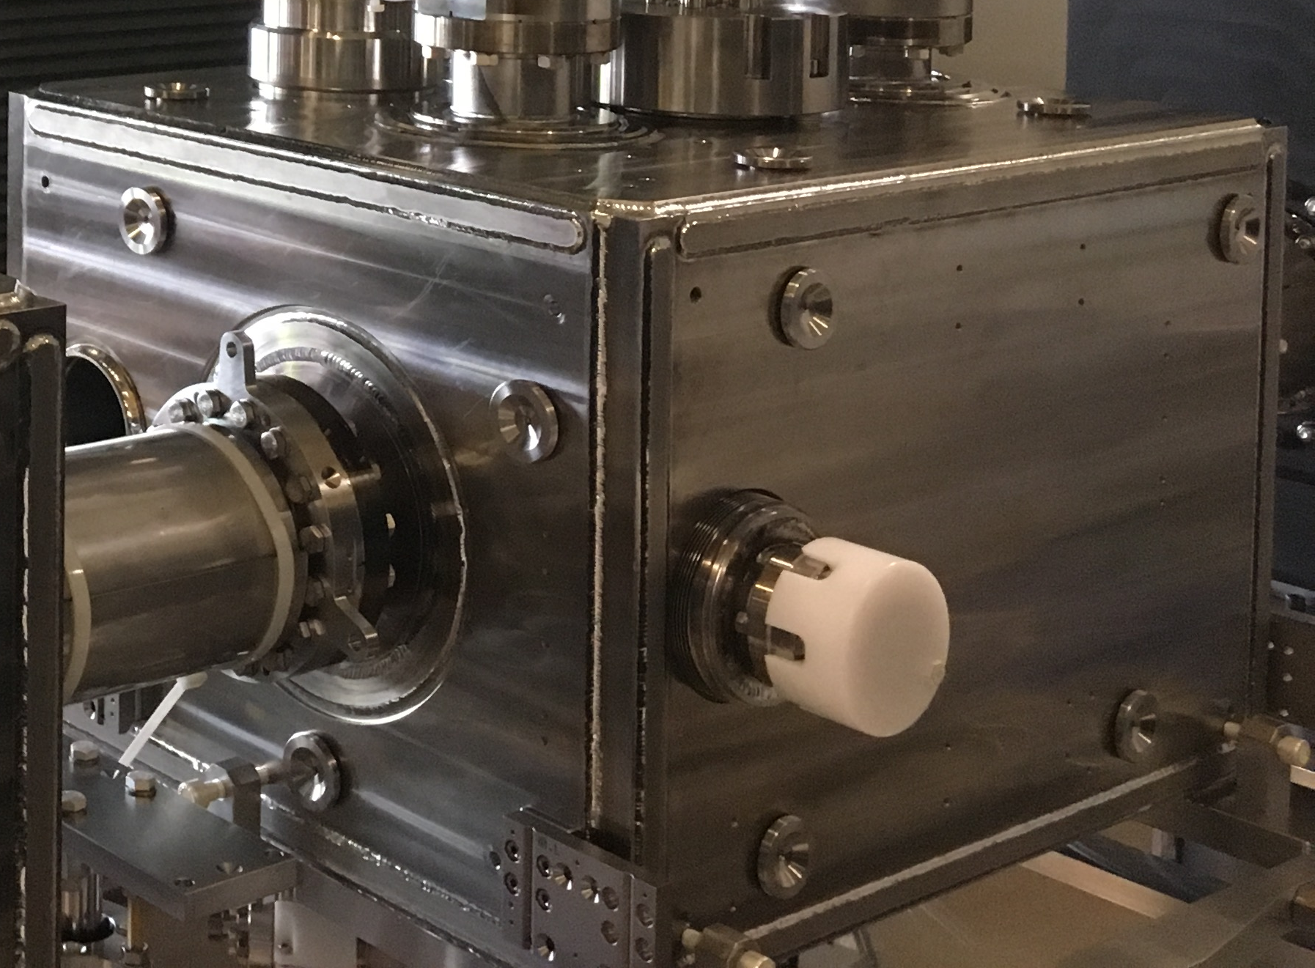
Validation at Warm condition
FSI
(absolute distances)
BCAM
(Angle measurements)
Laser Tracker
(Angles and distances measurements)

Slide 8
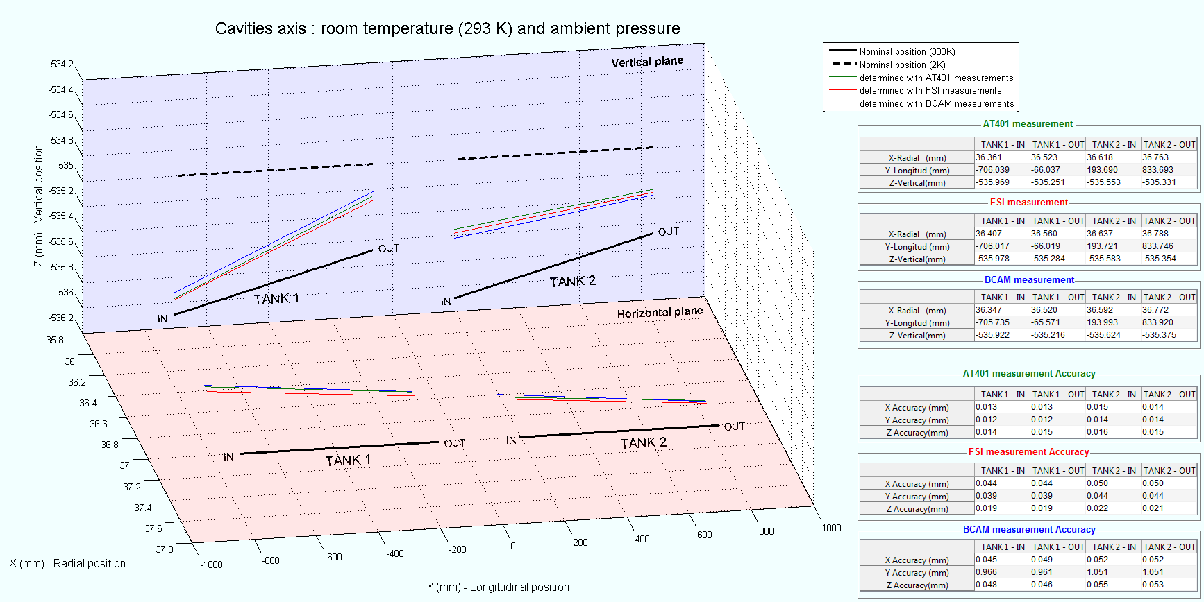
Intercomparison between FSI / BCAM / Laser Tracker (Before cooling down)
FSI, BCAM systems precision better than 50µm (1σ), crosschecked with AT401 laser tracker measurements

Slide 9
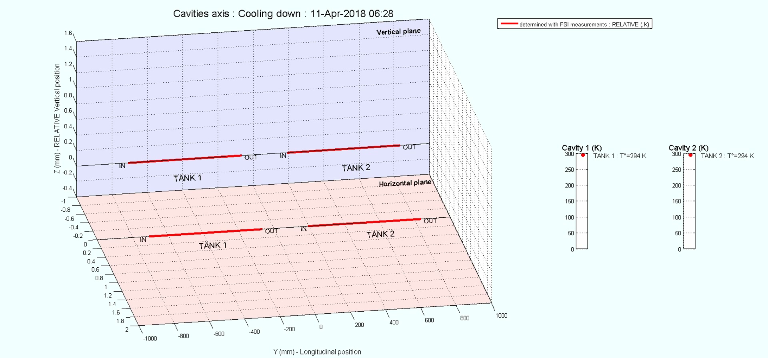
Cooling Down in SPS : From 293 K to 4K
Accuracy : < 50 µm (1σ)

Slide 10
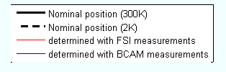
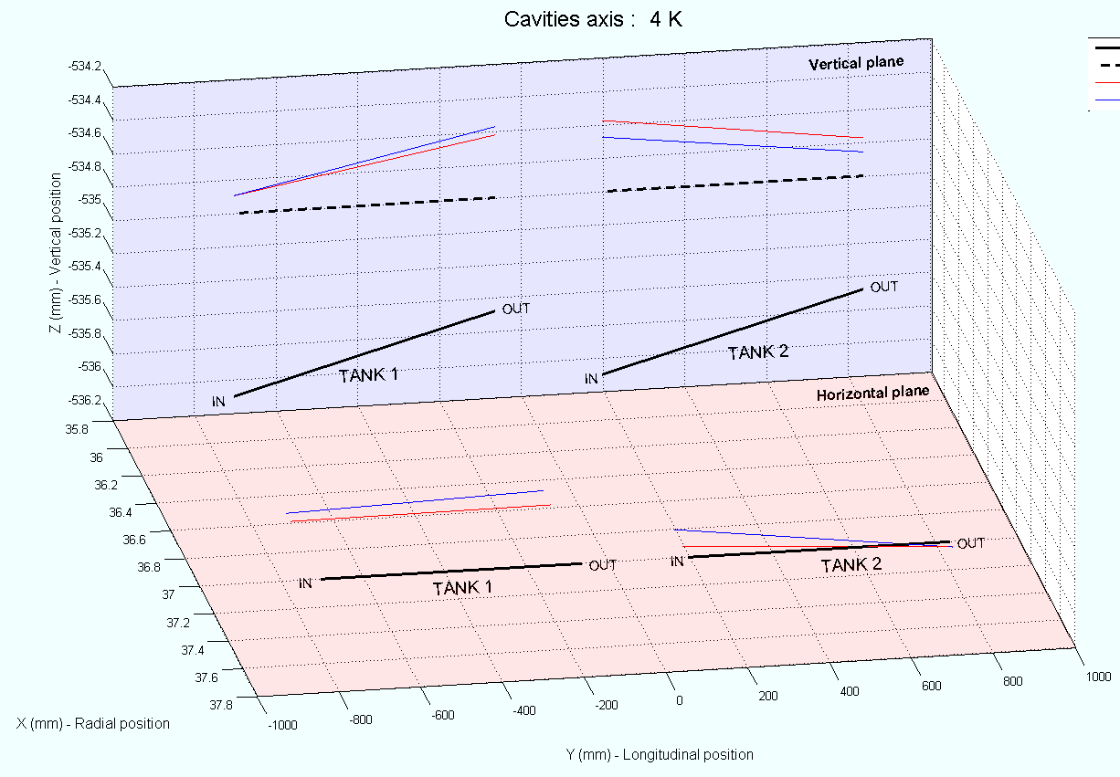
Intercomparison at Cold condition (FSI – BCAM)

Slide 11
Long term stability
Since April 2018, the monitoring of the Crab-cavities worked correctly.
Parameter | Precision (1σ)
Tx (radial) | +/- 25 μm
Ty (longitudinal) | +/- 45 μm
Tz (vertical) | +/- 10 μm
Rx (pitch) | +/- 30 μrad
Ry (roll) | +/- 150 μrad
Rz (yaw) | +/- 70 μrad
Scale | +/- 60 ppm
Redundancy :
8 observation for 7 unknowns → 1 degree of freedom
If some optical sight views are not possible → Hypothesis (for example : Fixed Ry or Tx)

Slide 12
Dipole test

Slide 13
Objective
In order to validate the internal monitoring solution for the Low-Beta quadrupoles, a dipole has been used as test setup.
Section 1
Section 2
Section 3
Vacuum : 10⁻⁶ mbar
Temperature : 1.9 K

Slide 14
Configuration
Long object (15 m) → Cryostat and cold mass may not be considered as rigid body → Measurement on 3 sections
Deformation up to 0.25 mm has been observed
on the cryostat and the cold mass
during transport and during cool down
Section 1
Section 2
Section 3
12 distances measurements (FSI system)
3 sections

Slide 15
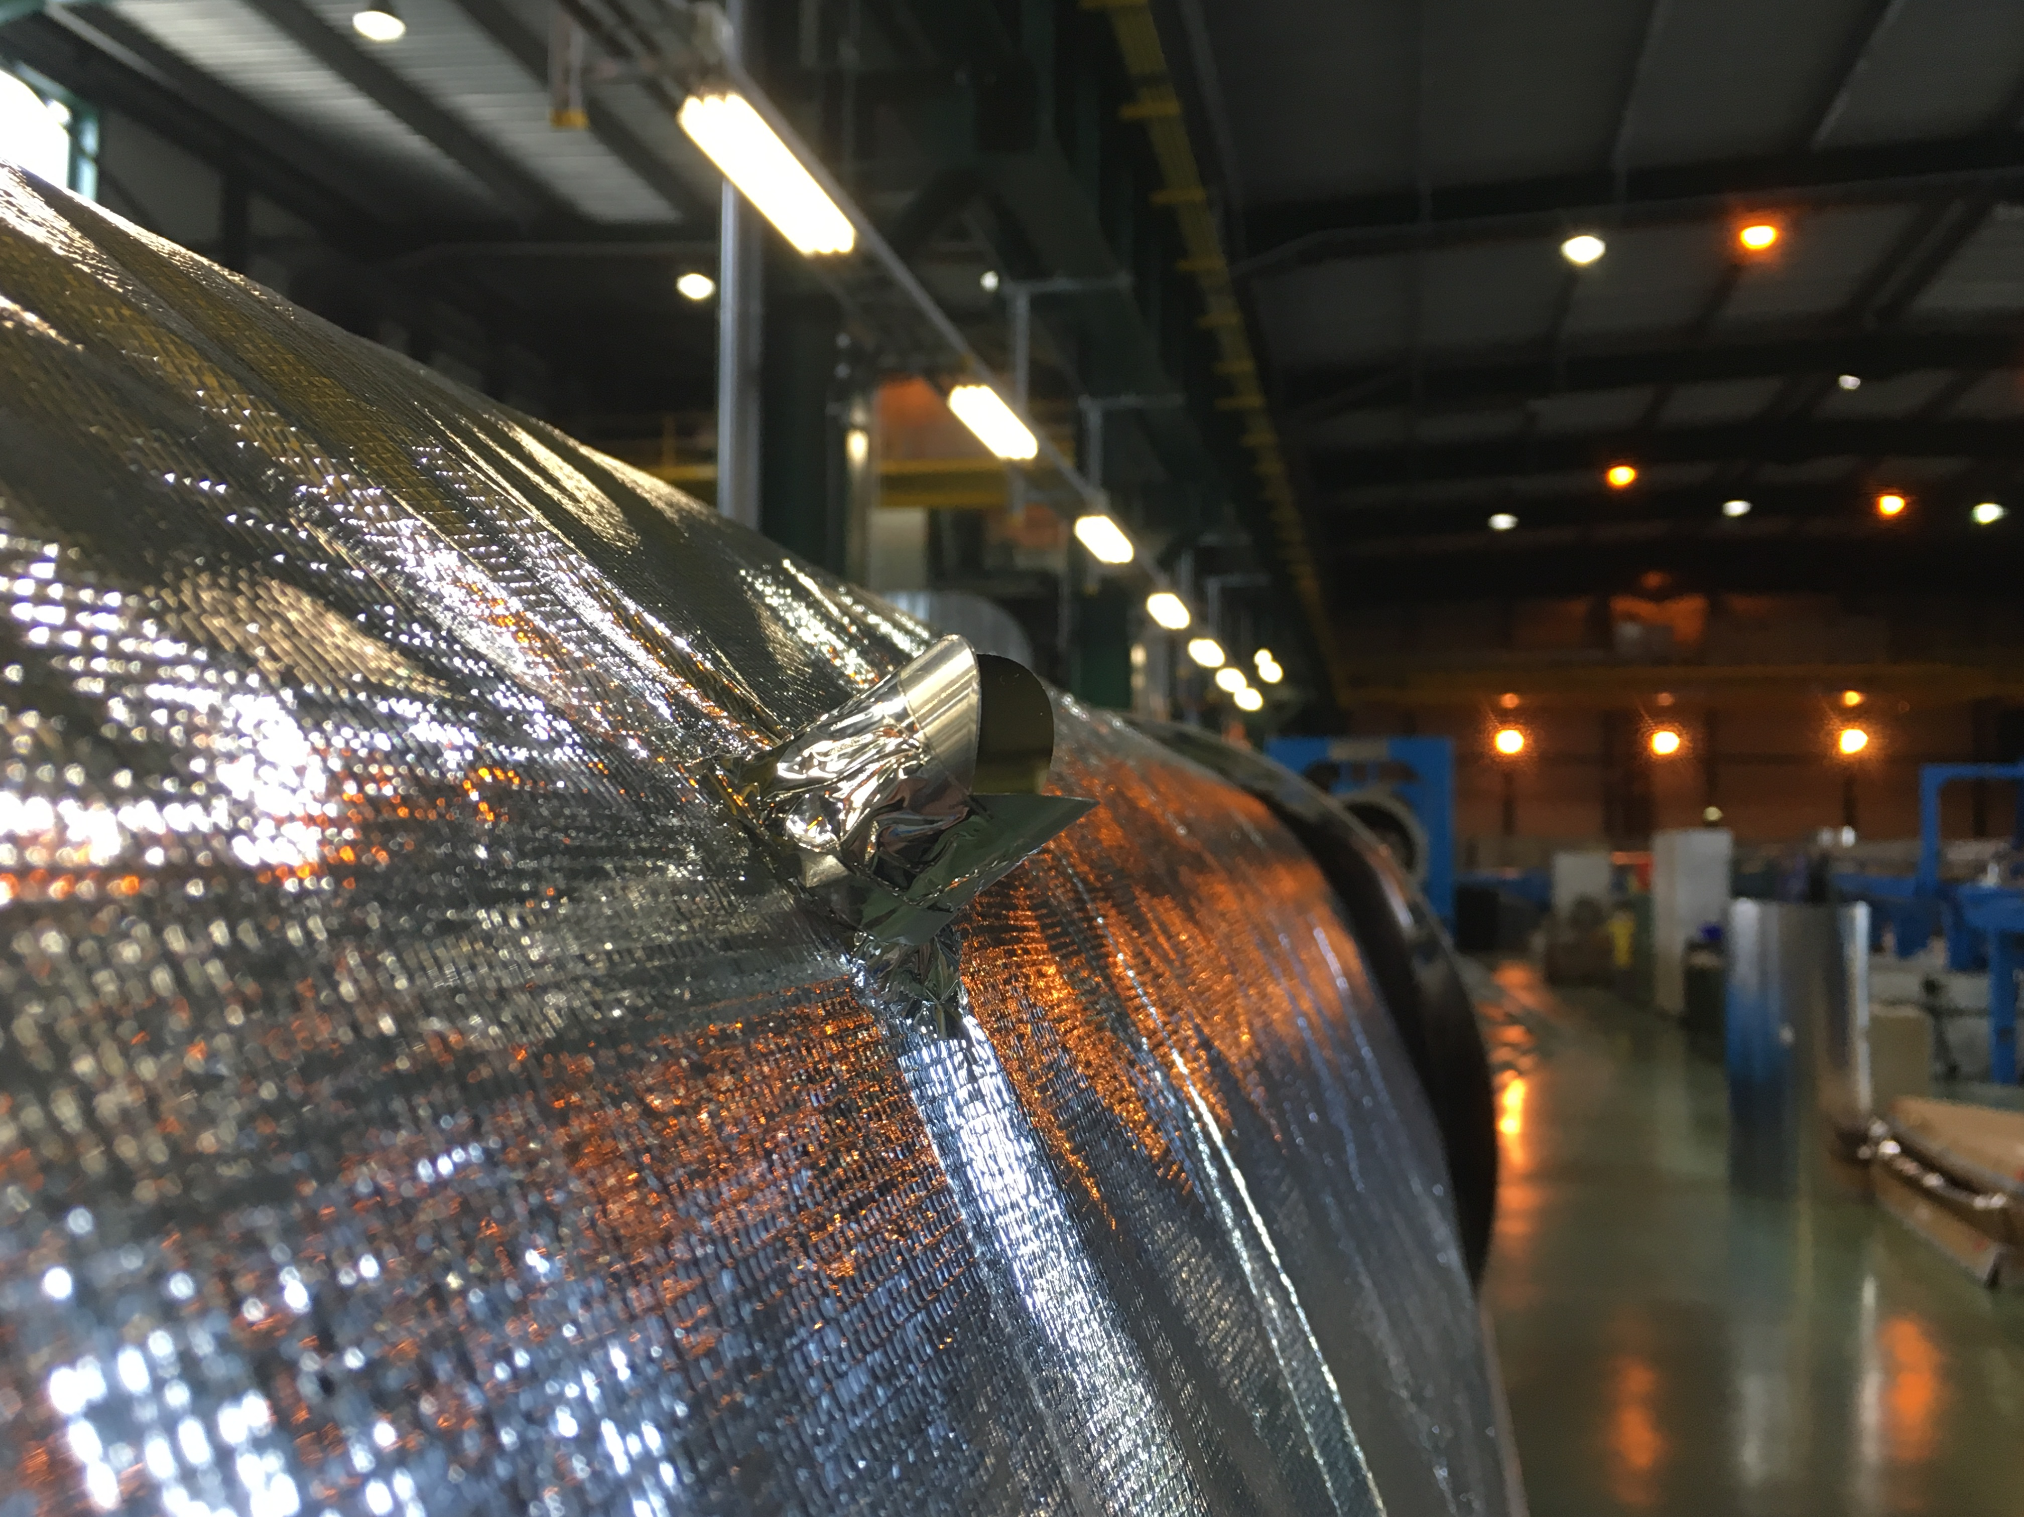
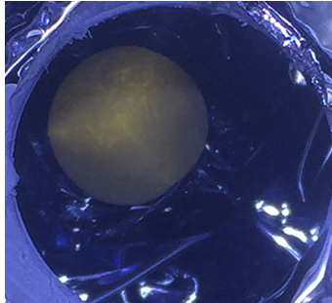
Summary of first tests (2017 - 2018)
Cryo-condensation
Cryo-condensation on the laser reflectors is a main showstopper for optical distance measurements in “dusty” cryostat

Slide 16
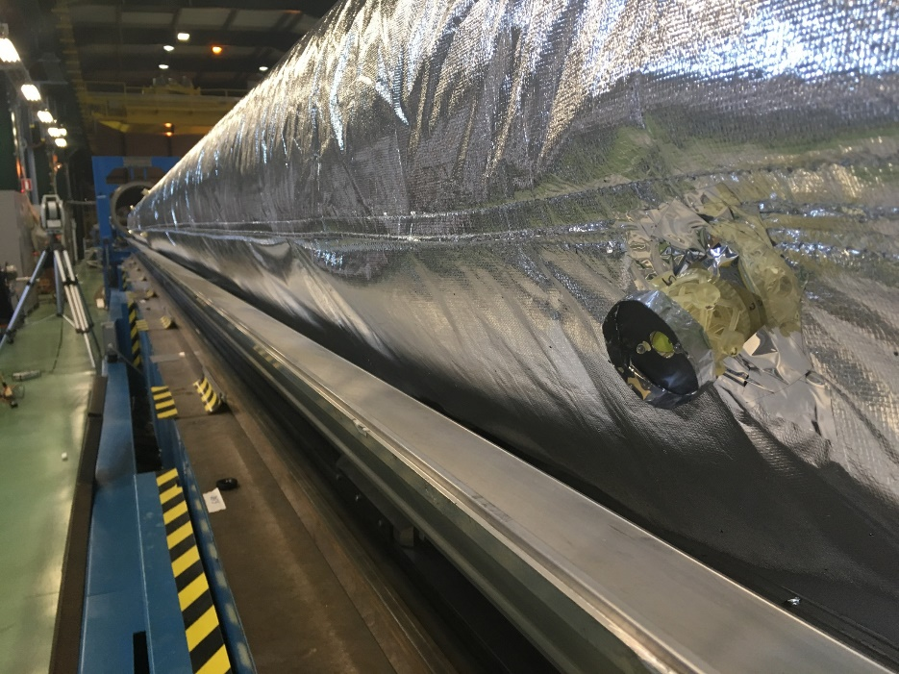
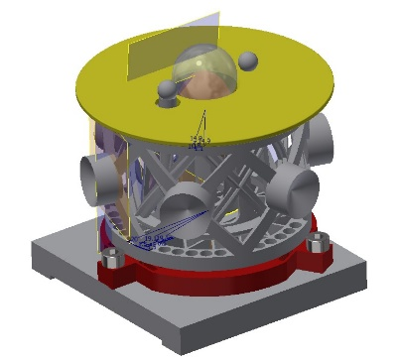
Insulated support

Slide 17


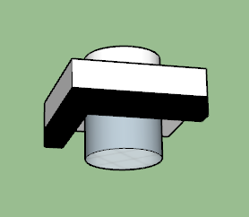
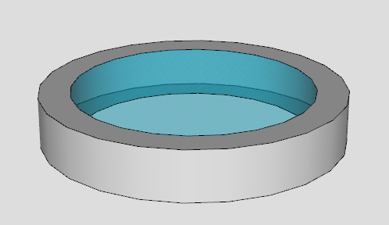
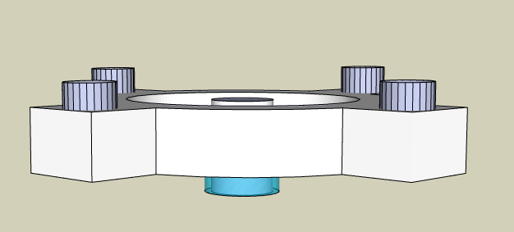
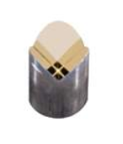
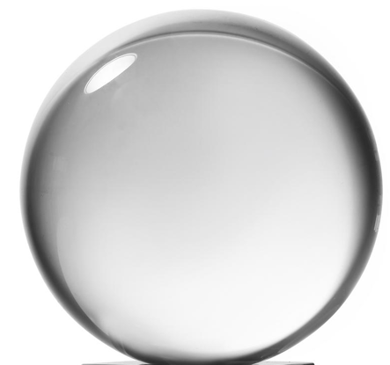
Test summary (end 2018)
Acquisition system : FSI
Commercial : Etalon
Multi-Targets : CERN
FSI Head
Feedthrough (adjustable)
Feedthrough (fixed)
Window
Collimator
Parallel lens
Divergent collimator
Vacuum : Ambient
Temperature : Ambient
Cryostat
Thermal
shielding
Targets
Newport reflector (3 mirrors)
Glass sphere without coating
Glass sphere with coating
Vacuum : 10⁻⁶ mbar
Temperature : 180 K
Temperature : 4 K
Cold mass
Target Support
Insulated target
Nothing

Slide 18
Schedule
3 Cooling-down

Slide 19
Legend
Section 1
WARM (293 K)
ETALON (FSI)
Window (crossing)
Newport prism
Laser tacker
Newport prism / Glass sphere
Section 1
MT-FSI
Window (crossing)
Glass sphere
MT-FSI
Window (crossing)
Newport prism
ETALON (FSI)
Window (crossing)
Glass sphere with coating
+/- 0.1 mm
MT-FSI
Window (crossing)
Glass sphere with coating
COLD (4K)
MT-FSI
Feedthrough
Glass sphere with coating

Slide 20
Legend
Section 2
+/- 0.1 mm
WARM (293 K)
ETALON (FSI)
Window (crossing)
Newport prism
Laser tacker
Newport prism / Glass sphere
Section 2
MT-FSI
Window (crossing)
Glass sphere
MT-FSI
Window (crossing)
Newport prism
ETALON (FSI)
Window (crossing)
Glass sphere with coating
+/- 0.1 mm
+/- 0.1 mm
MT-FSI
Window (crossing)
Glass sphere with coating
COLD (4K)
MT-FSI
Feedthrough
Glass sphere with coating

Slide 21
Legend
Section 3
WARM (293 K)
ETALON (FSI)
Window (crossing)
Newport prism
Laser tacker
Newport prism / Glass sphere
Section 3
MT-FSI
Window (crossing)
Glass sphere
MT-FSI
Window (crossing)
Newport prism
ETALON (FSI)
Window (crossing)
Glass sphere with coating
+/- 0.1 mm
+/- 0.1 mm
MT-FSI
Window (crossing)
Glass sphere with coating
COLD (4K)
MT-FSI
Feedthrough
Glass sphere with coating

Slide 22
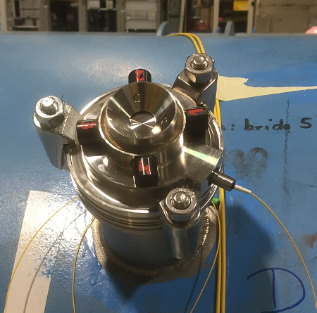
Conclusion
Multi-Targets
Acquisition system
Acquisition system : FSI
Commercial : Etalon
Multi-Targets : CERN
Targets
Newport reflector (3 mirrors)
Glass sphere without coating
Glass sphere with coating
Feedthrough
Cryostat
Divergent
collimator
FSI Head
Feedthrough (adjustable)
Feedthrough (fixed)
Window
Target Support
Insulated target
Nothing
Glass sphere
WITH coating
Collimator
Parallel lens
Divergent collimator
Cold mass
Insulated target

Slide 23
Internal monitoring
Crab-cavity
Triplet
Z (mm)
Z (mm)
Y (mm)
Y (mm)
X (mm)
X (mm)
Parameter | Precision (1σ)
Tx (radial) | +/- 25 μm
Ty (longitudinal) | +/- 45 μm
Tz (vertical) | +/- 10 μm
Rx (pitch) | +/- 30 μrad
Ry (roll) | +/- 150 μrad
Rz (yaw) | +/- 70 μrad
Scale | +/- 60 ppm
Parameter | Precision (1σ)
Tx (radial) | +/- 50 μm
Ty (longitudinal) | +/- 55 μm
Tz (vertical) | +/- 15 μm
Rx (pitch) | +/- 5 μrad
Ry (roll) | +/- 1500 μrad
Rz (yaw) | +/- 5 μrad
Scale | +/- 10 ppm

Slide 24
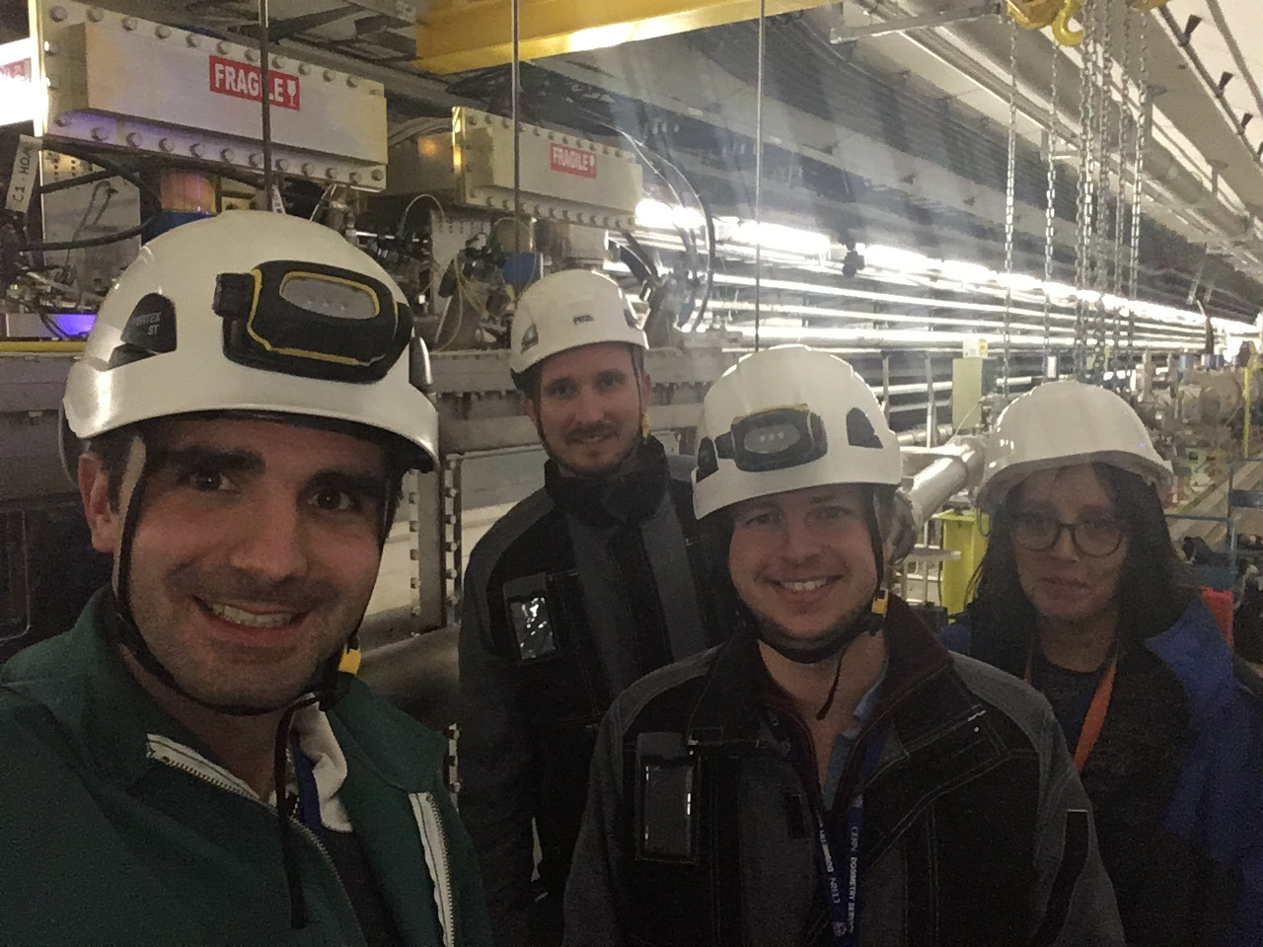
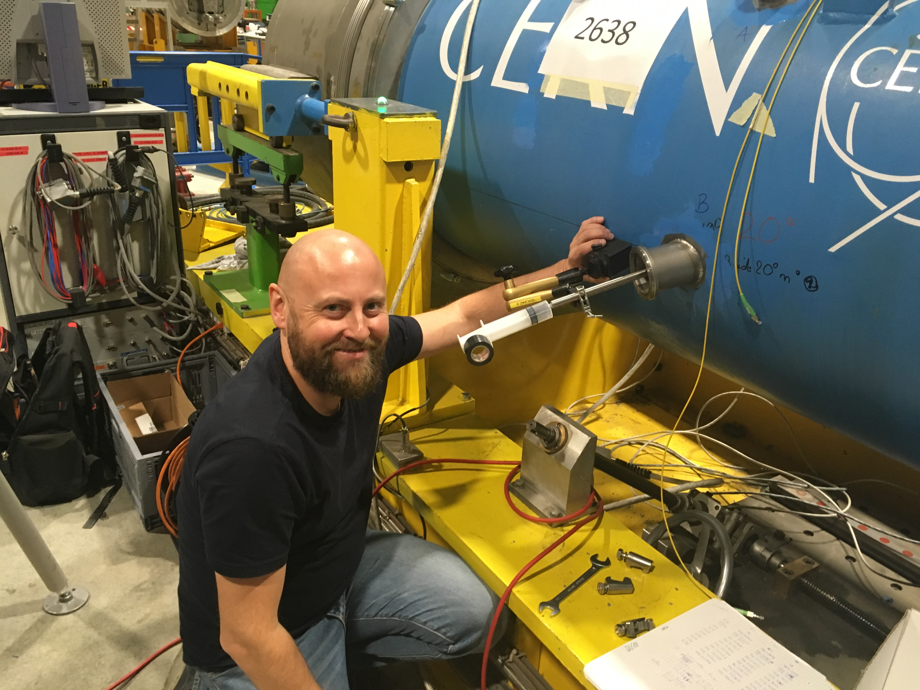
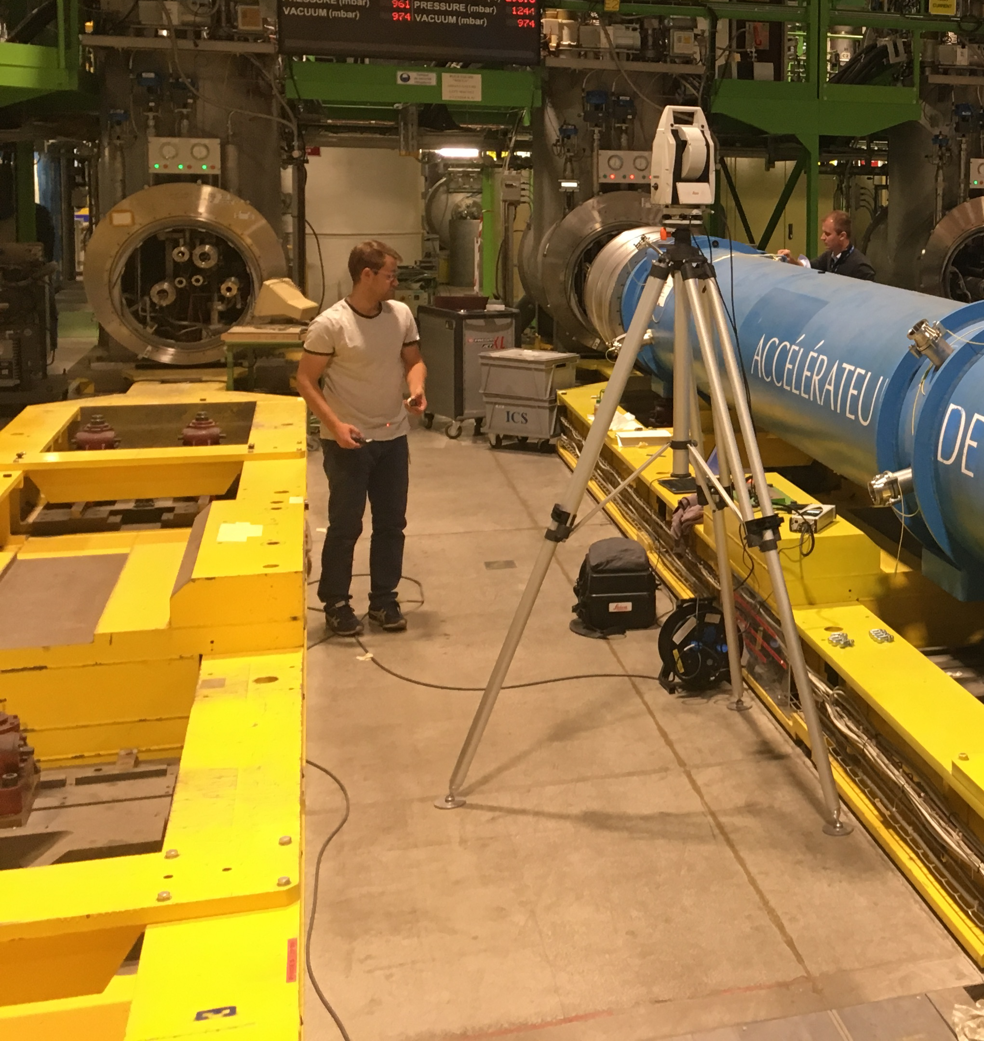
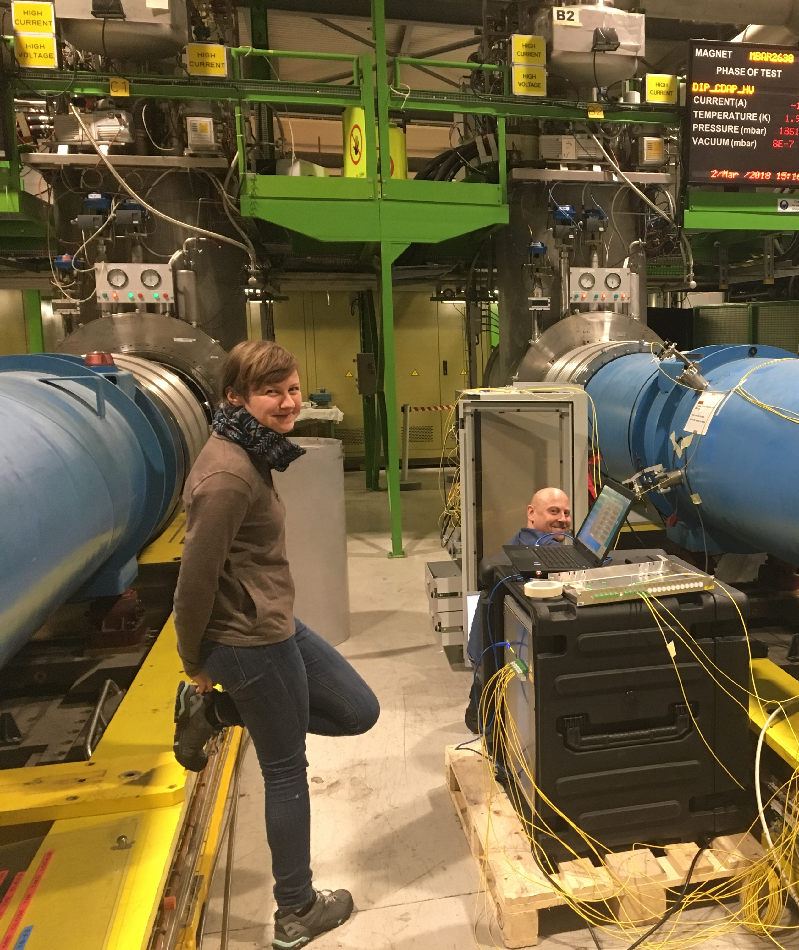
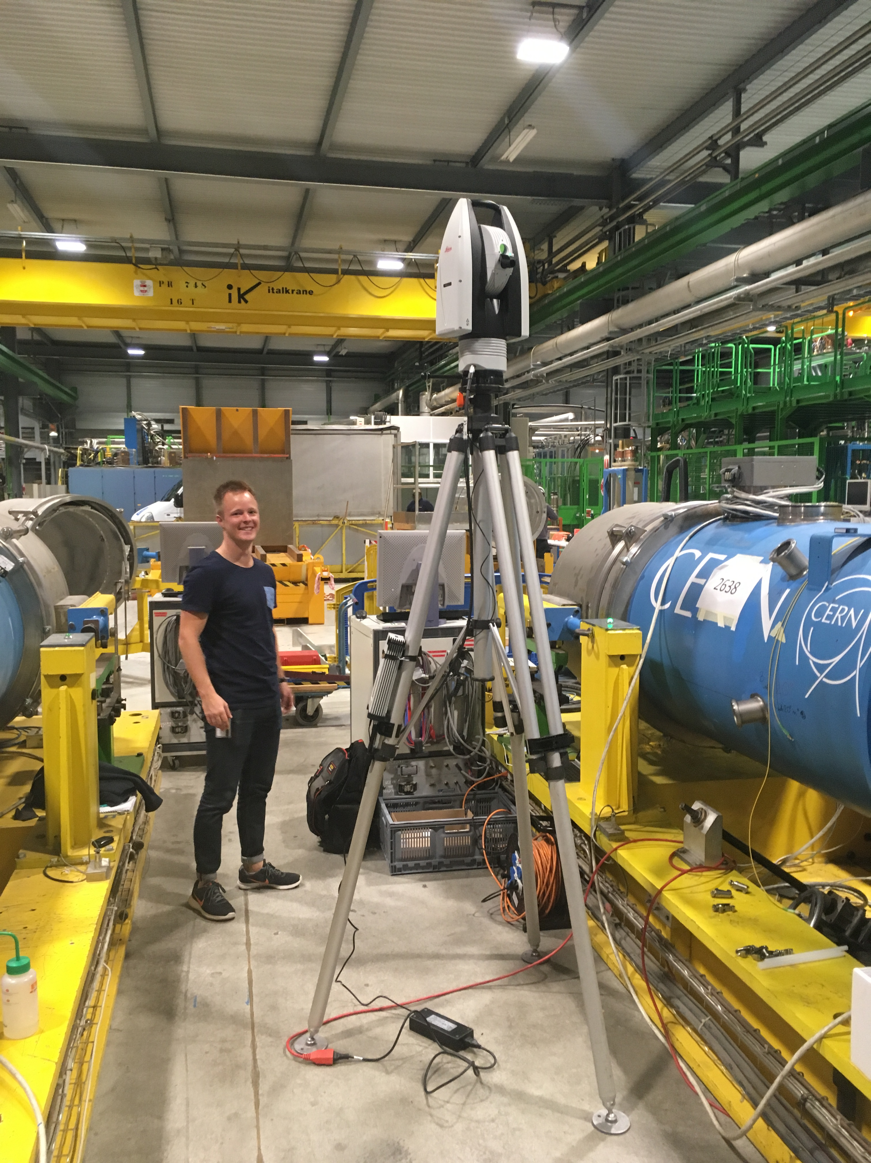
Thank you for your attention
On behalf of :
Mateusz Sosin
Hélène Mainaud Durand
Thibault Dijoud
Mathieu Duquenne
Anna Zemanek
Kacper Widuck
Jan Gabka

Slide 25
SPARE

Slide 26
Legend
Section 1
WARM (293 K)
ETALON (commercial)
Window (crossing)
Newport prism
Laser tacker
Newport prism / Glass sphere
Section 1
Multi-targets
Window (crossing)
Glass sphere
Multi-targets
Window (crossing)
Newport prism
ETALON (commercial)
Window (crossing)
Glass sphere with coating
+/- 0.1 mm
Multi-targets
Window (crossing)
Glass sphere with coating
COLD (4K)
Multi-targets
Feedthrough
Glass sphere with coating

Slide 27
Legend
Section 2
+/- 0.1 mm
WARM (293 K)
ETALON (commercial)
Window (crossing)
Newport prism
Laser tacker
Newport prism / Glass sphere
Section 2
Multi-targets
Window (crossing)
Glass sphere
Multi-targets
Window (crossing)
Newport prism
ETALON (commercial)
Window (crossing)
Glass sphere with coating
+/- 0.1 mm
+/- 0.1 mm
Multi-targets
Window (crossing)
Glass sphere with coating
COLD (4K)
Multi-targets
Feedthrough
Glass sphere with coating

Slide 28
Legend
Section 3
WARM (293 K)
ETALON (commercial)
Window (crossing)
Newport prism
Laser tacker
Newport prism / Glass sphere
Section 3
Multi-targets
Window (crossing)
Glass sphere
Multi-targets
Window (crossing)
Newport prism
ETALON (commercial)
Window (crossing)
Glass sphere with coating
+/- 0.1 mm
+/- 0.1 mm
Multi-targets
Window (crossing)
Glass sphere with coating
COLD (4K)
Multi-targets
Feedthrough
Glass sphere with coating

Slide 29
Thermal contraction : From 293 K to 4 K
CONTRACTION | Cav 1 |  | Cav 2
 | IN (mm) | OUT (mm) | IN (mm) | OUT (mm)
Simulation | 1.097 | 0.678 | 1.097 | 0.678
SM18 | 1.321 | 0.843 | 1.295 | 0.832
SPS | 1.310 | 0.834 | 1.320 | 0.835

Slide 30
Calculation
Cryostat
COLD mass
Z
X

Slide 31

Phase 4 : Results (Warm condition)
Section 1
A / B/ C / D
Section 2
I / J / K / L
Z (mm)
Section 3
E / F / G / H
X (mm)
Y (mm)

Slide 32
Phase 4 : Results (Warm condition)
WARM 2
WARM 1
WARM 2
WARM 1
WARM 1
WARM 3
WARM 3
WARM 2
WARM 3

Slide 33
Phase 4 : Results (Cold condition)
Section 1
A / B/ C / D
Section 2
I / J / K / L
Z (mm)
Section 3
E / F / G / H
X (mm)
Y (mm)

Slide 34
Phase 4 : Results (Cold condition)
+/- 0.1 mm
+/- 0.1 mm
+/- 0.1 mm

