Slide 1

FSI choices and next steps
H. Mainaud Durand,
On behalf of HPA section
Review of HL-LHC Alignment and Internal Metrology (WP15.4)

Slide 2
Outline
A short reminder
FSI choices
Next steps
Conclusion

Slide 3
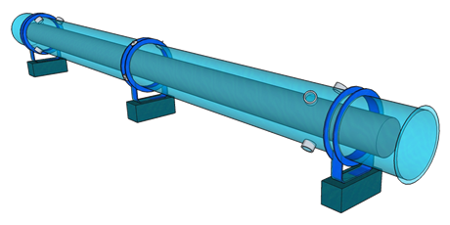
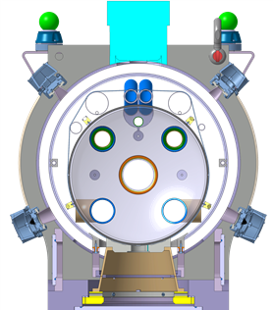
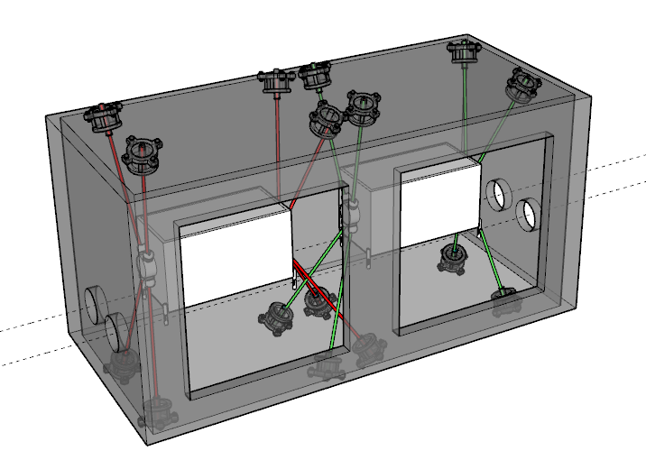
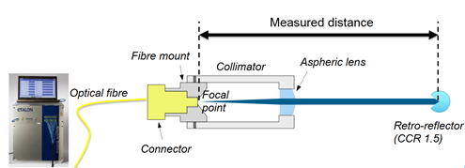
A short reminder
One absolute distance measurement = one measurement channel, consisting of:
    1 target on the IT /flange of CC
    1 support of target
    1 cryostat interface
    1 channel acquisition system:

Slide 4
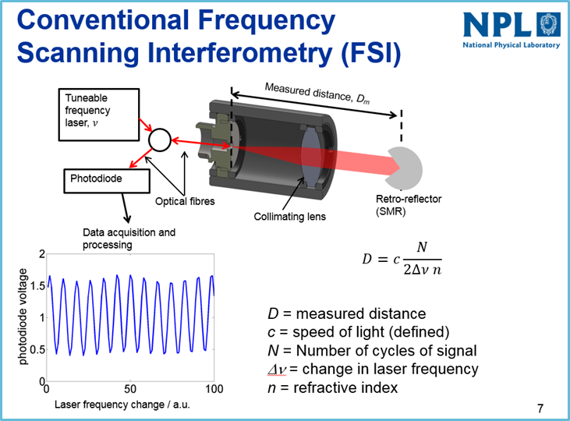
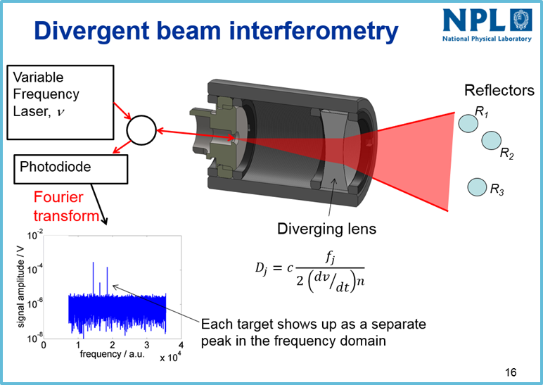
FSI choices: measurement system
ETALON FSI
MT-FSI
On the shelf system
Limited lateral range
Need to orientate precisely the beam
Limited/no return signal (cryo-condensation)
High cost
In-house system
Divergent beam: far larger lateral range
No need to orientate precisely the beam
More sensitive to vibrations
More robust concerning (cryo-condensation)
Same performance through inter-comparison tests.
The choice of a measurement system has a direct impact on the other components (targets & cryostat interface)

Slide 5
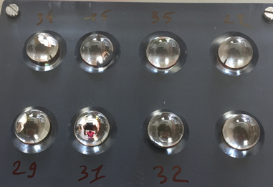
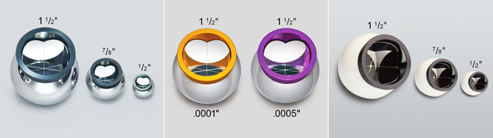
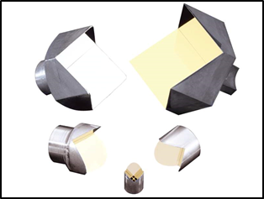
FSI choices: targets
Glass spheres
BMR
Hollow prism
Low cost (<100 CHF)
Very good sphericity
Irradiation tests ok at 5 MGy
Easier integration on the support
Very good return signal
Risk of scratches
Needs a proper orientation
Measurements with an AT4xx TBC
High cost (>2 kCHF)
Very good sphericity
Irradiation tests ok at 5 MgGy
Easier integration on the support
Needs a proper orientation
Better for a collimated beam
Medium cost ( ̴ 300 CHF)
Irradiation tests ok at 5 MGy
Better for a collimated beam

Slide 6
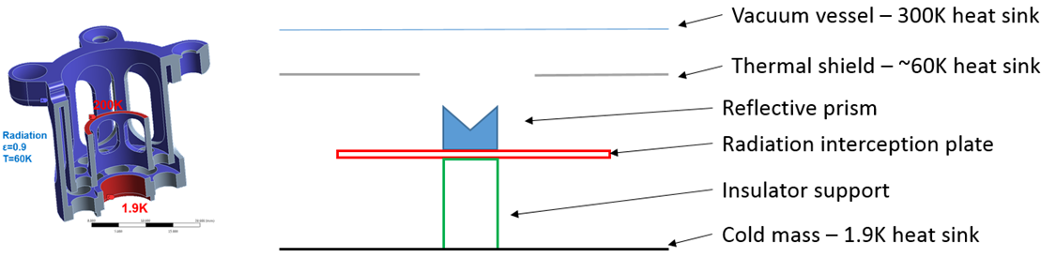
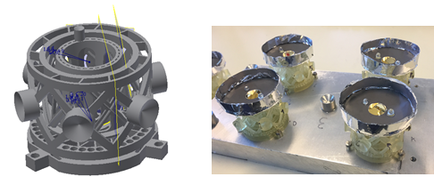
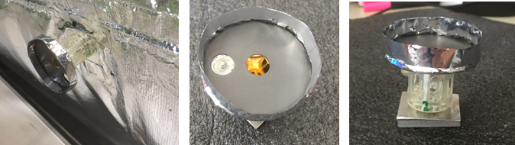
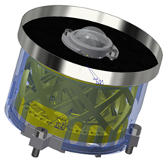
FSI choices: targets supports
Generation 1
Generation 2
Generation 3

Slide 7
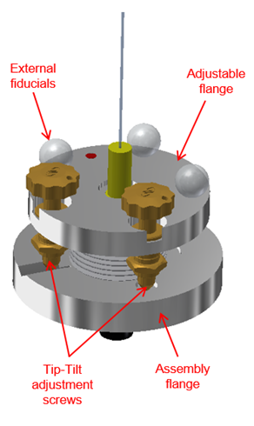
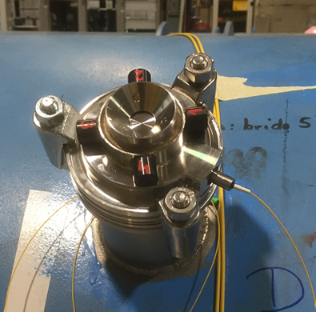
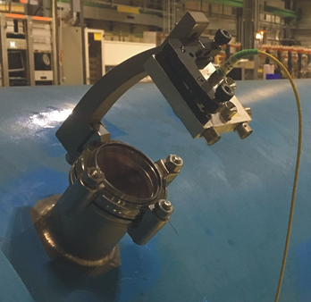
FSI choices: cryostat interface
Feedthrough
Simplified feedthrough
Viewport
High cost ( ̴ 3 kCHF)
Allows to orientate the beam
Irradiation tests ok at 5 MGy
Not compatible with integration
Medium cost ( ̴ 1 kCHF)
Compact
Does not allow to see the target
Only usable with divergent beam as no possibility of orientation
Low cost
Allows to see the target
Irradiation tests ok at 5 MGy
Optical fiber to be protected
Not compatible with integration

Slide 8
FSI choices: summary
For the IT cold mass
For the crab cavities

Slide 9
Initial strategy

Slide 10
Strategy
Validation on a test magnet (Dipole)
Validation of performance
Accuracy and precision
Long term stability
Cryo-condensation issues
Finalisation of the last tests
Irradiation of the targets and supports
Final tests on targets
Final tests on the feedthroughs
Validation on the RFD prototype in SPS
Validation of performance
Accuracy and precision
Long term stability
Cryo-condensation issues
Measurements on the Q2 prototype at CERN
Measurements on the string test
Performance target in all conditions

Slide 11
Next steps: dipole test
Objectives of these tests:
Validation of the final configuration for the crabs cavities & Inner triplet
Validation of the whole calculations analysis, of the associated uncertainties of measurements
Preparation of a “failure” analysis (what would happen if we lose 1 / 2 /3 channels?)
Preparation of calculations software

Slide 12
Next steps: other tests and studies
Irradiations tests from 5 MGy to 10 MGy: under way, on the glass spheres, optical fibers
Additional irradiation tests TBC
Impact of scratches on glass spheres
Laser tracker measurements on coated glass spheres
In-house solution for the acquisition system: development of pre-serie (optimisation of the electronics components, use of FPGA, preparation of PCB)
As an option: use of such a system for vibrations measurements.

Slide 13
Next steps: strategy of procurement
What is needed:
Component | Total cost (kCHF) | IT cold masses units | CC units | Procurement solution(s)
Target | ̴ 30 | 192 + 24 (20) | 128 + 16 (13) | Procurement (2 companies) + Control @ reception
Target support | ̴ 100 | 192 + 24 (20) | 128 + 16 (13) | - External 3D printing + assembly at CERN - External contract
Feedthrough | ̴ 340 | 192 (24) | 128 + 16 | - In-kind contribution with Japan - External contract
Additional targets and targets supports for IT pre-series foreseen for the string test + CC prototype.
Procurement of targets, target supports, feedthroughs for pre-series as soon as dipole tests and additional tests are ok.
Procurement of targets and target support for series to be launched in 2021.
Procurement of feedthroughs foreseen in 2022 via in-kind, 2021 (if no in-kind)

Slide 14
Next steps: strategy of procurement
What is needed:
Component | Cost (kCHF) Per unit | IT cold masses units | CC units | Procurement trategy
Acquisition syst. | ̴ 1 kCHF / channel | 192 + 16 | 128 + 16 | In-house External contract
1 FSI measurement for the RFD crab cavity tests in SM18 and SPS (beginning of 2021 – 2022)
1 FSI measurement system for the string test (beginning of 2022 - 2023)
2 FSI measurement system for additional tests (validation of CC, cold masses) end of 2020-2024
We will need 4 FSI measurement systems in the tunnel (double deck) in 2025
Proposal to launch the manufacturing of the 4 FSI measurement systems ASAP

Slide 15
Conclusion
A new solution for the internal determination of the position of components inside cryostats has been proposed and validated successfully.
The design of the final components is nearly finished and the configuration of measurements will be validated during the dipole tests foreseen in September in SM18. All the tests are targeted to be finished before the end of the year.
This will allow to launch the procurement of all the targets, support targets for the prototypes and series of IT cryo-magnets and crab cavities.
The development of the acquisition system shall be finished and validated before the end of 2020, to launch the procurement ASAP
Concerning the feedthroughs, an in-kind contribution from Japan is under study.

Slide 16
Thank you very much

