Slide 1
Advantages of full remote alignment system for beam dynamics
R. De Maria, D. Gamba
Review of HL-LHC Alignment and Internal Metrology, 26/8/2019

Slide 2
Table of contents
Alignment needs around the ATLAS and CMS experiments:
  What we need to align and why
  Advantages of full remote alignment system (FRAS)

Slide 3
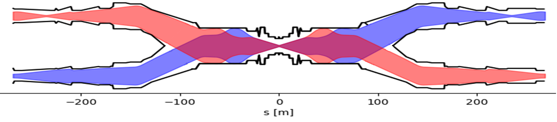
Alignment needs around ATLAS and CMS
HL-LHC simplified lattice and beam envelopes around the experiments
Q7-Q4
C
D2-D1
Q3-Q1
EXP
Q1-Q3
D1-D2
C
Q4-Q7
Alignment is needed for:
inner tracker to be transversely aligned to the interaction point (IP) for reducing radiation damage and improve track reconstructions (<1 mm)
quadrupoles to be transversely aligned to the reference orbit within orbit corrector budget and reduce orbit distortions (<0.5 mm)
crab cavities to be transversely aligned to the beam orbit to keep RF power within the operational limits (<1 mm)
Alignment of non active elements is also needed to:
Preserve stay clear regions for the beam at low β*
Maintain effective shielding of protecting masks for superconducting magnets

Slide 4
Experiment needs
Experiments (ATLAS and CMS) asked that the machine should be able to adjust the IP within ±2 mm in horizontal and vertical planes during beam commissioning:
  inner tracker cannot be easily mechanically aligned,
  the experiments do not expect to control the positioning of the inner tracker better than few mm
  observed ground motion can be in the order of several mm after several years
The beam orbit can be adjusted:
  with orbit correctors (as in the LHC so far), but it costs magnet strength or number of magnets and residual orbit distortions in the triplets and crab cavities (for the HL-LHC)
  by re-aligning the machine from Q5 left to Q5 right
Q1
CC
Q4
Q1
Inner Tracker
Q5
Q4
CC
Q7
Q5
Q6
TAS
Q7
Q6
TAS
Present HL-LHC baseline relies on FRAS to realign the IP

Slide 5
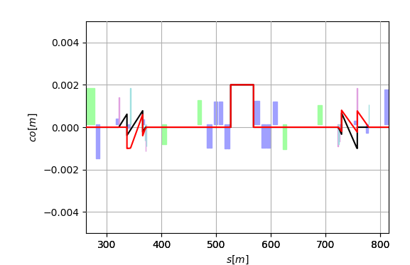
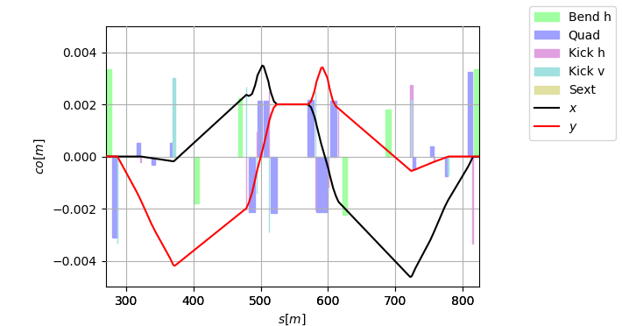
IP offset with/without FRA
Residual orbit in the elements with an IP offset of 2 mm in H and V
With full alignment
Without full alignment
IP
CC
CC
IP
CC
CC
IP offset without full alignment system:
requires a re-alignment of the crab cavities up to 4 mm
reduces available aperture for the beam:
  triplets up to 3 mm
  Q4-Q5 up to 4.5 mm
  tertiary collimators up to 3 mm
costs orbit corrector strength budget

Slide 6
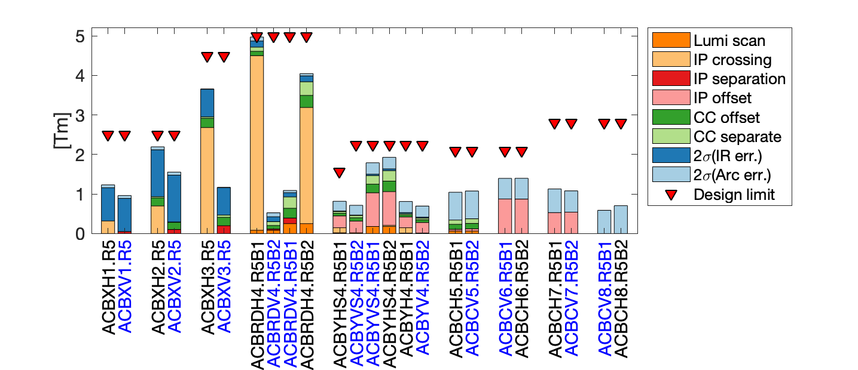
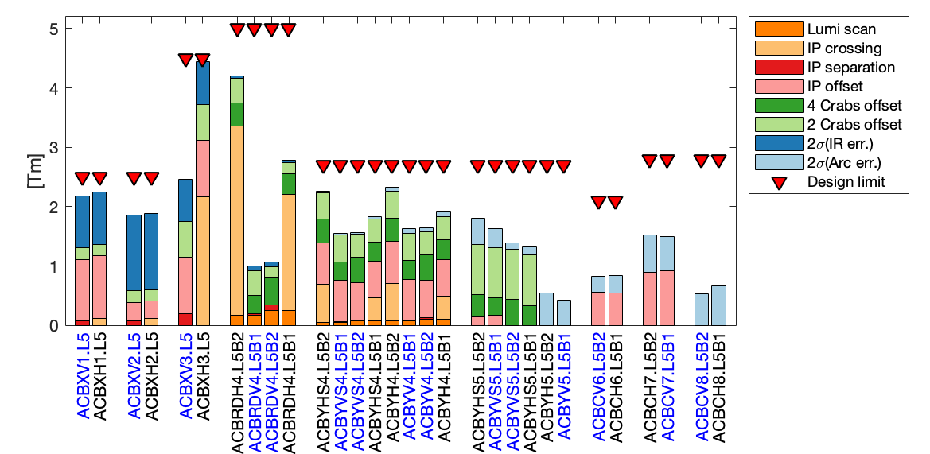
Orbit corrector budget with/without FRAS
HL-LHCV1.4 after MS optimization
HL-LHCV1.3 before MS optimization
FRAS allows re-using of LHC orbit correctors and magnet assembly:
Q4: 16x MCBY 1.9K -> 12x MCBY at 4.5K with FRAS
Q5: 12x MCBY 1.9K -> 4x MCBC at 4.5K with FRAS
Additional potential benefits:
Perform orbit corrector strength minimization during beam-commissioning (better orbit residual)
Mitigate impact of non-conform orbit correctors by performing ad-hoc fine tuning with circulating (safe) beam as reference
After matching section optimization,
IP offset during commissioning not feasible without FRAS

Slide 7
Apertures with FRAS
 | Old | FRAS | Old | FRAS
 | Round β*=15 cm |  | Flat β*=7.5 cm
TAXS | 15.4 | 15.4 | 13.3 | 13.3
Triplets | 12.0 | 13.1 | 11.8 | 12.7
TAXN | 15.4 | 17.3 | 12.4 | 13.9
D2 | 15.5 | 19.3 | 12.9 | 14.5
Q4 | 14.5 | 19.3 | 10.4 | 13.6
Q5 | 24.8 | 21.1¹ | 17.6 | 14.9¹
Q6 | 25.5 | 26.7 | 18.0 | 18.9
Aperture requirements (beam σ)
> 12 σ in triplets
> 14.6 σ in Q6
> 19.2 σ elsewhere
¹due to reduced Q5 aperture from 70 mm to 56 mm after MS optimization
Aperture estimates based on LHC design assumptions on ground motion and fiducialization which are under review for HL-LHC.
Fully remote alignment system allows full β* reach for round and flat optics

Slide 8
Conclusions
Full remote alignment system is an essential component to reach HL-LHC performance goal:
It allows to fulfill experiment requirements with better performance
It allows reusing existing assemblies for Q4 and Q5 with even gain in aperture
It has the potential of providing better orbit correction and mitigate risks of non-conformities

Slide 9
Backup

Slide 10
Detailed lattice
TAXS
MCBXFB
MCBXFB
MCBXFA
HLLHCV1.4
IP
Q1
HV
Q2a
Q2b
HV
Q3
HV
CP
D1
MQXFA
MQXFB
MQXFB
MQXFA
MBXF
1.9K
TCLX
TCLM
TCLM
B1(E)
D2
H
V
C
C
H
V
H
Q4
H
Q5
MBRD
V
H
C
C
V
H
V
MQY
V
MQML
B2(I)
TAXN
TCT
MCBRD
MCBY
4.5 K
4.5 K
1.9 K
MCBC

Slide 11
Summary of strengths with remote alignment
Knobs and correction for:
±295 µrad crossing angle in H/V plane (H in the figure)
±0.75 mm separation in V/H plane (V in the figure)
±2 mm IP offset Q1-Q4 displaced by 2 mm + Q5 1 mm + and correctors
±0.1 mm IP movement independent for B1/B2 for luminosity scan
2 σ correction of ±0.5 mm residual quad. misalignment and ±0.5 mrad dipole tilt.
Short range orbit adjustments (±0.2 mm CC adjustment)
Assume remote alignment for IP shift and orbit corrector minimization during beam commissioning.
NC 60 A
Example for Right 5 with H crossing.
Symmetries applies for V crossing and left side.

Slide 12
Constraints for linear and linear optics correction
Long. misalignment ± 2 mm (uniform distr.) Reason: optics/beta*
Tilt of average field ± 1 mrad (uniform distr.) Reason: coupling
See TDR and HL-Book.

Slide 13
Transverse tolerances on Apertures
 | Ground motion |  |  | Fiducializaton |  |  | IP Offset (1)
 | r [mm] | h [mm] | v [mm] | r [mm] | h [mm] | v [mm] | r [mm]
TAXS | 2.0 | 0 | 0 | 0 | 0.5 | 0.5 | 2.0
Triplets | 0.6 | 0 | 0 | 0 | 1.0 | 1.0 | 0.0
BPMs | 0 | 0 | 0 | 2.5 | 0 | 0 | 0.0
TAXN | 0.84 | 0.36 | 0 | 0 | 1.0 | 1.0 | 0.0
TCL-TCT | 0.84 | 0.36 | 0 | 0 | 1.0 | 1.0 | 0.0
D1 | 0.6 | 0.36 | 0 | 0 | 1.0 | 1.0 | 0.0
D2/Q4 | 0.84 | 0.36 | 0 | 0 | 0.9 | 0.6 | 0.0
Crab b.s. | 0.5 | 0 | 0 | ? | ? | ? | 0.0
Q5 | 0.84 | 0.36 | 0 | 0 | 0.9 | 0.6 | 0.35
Q6 | 0.84 | 0.36 | 0 | 0 | 0.9 | 0.6 | 0.8
r
v
h
(1) Displacement of the aperture and the actual orbit due the combined effects of alignment position and orbit leakage.

