Slide 1

Vacuum: Full Remote Alignment System
EDMS#: 2219953
V. Baglin, J. Hansen, G. Riddone
Review of HL-LHC Alignment and Internal Metrology (WP15.4)
26.08.2019

Slide 2
Outline
Baseline and requirements
Vacuum components to be aligned
  D1 to TAXN (drift tubes with supports)
  TAXN to D2
  D2 to Crab Cavities
  Q4-Q5 Magnets
Clearance for the VABs at D2, Q4 and Q5
Readiness and risks
Conclusions
FRAS
Documentation:
P. Fessia, H. Mainaud Durand, “Full Remote Alignment Specification”. EDMS 2166298 ➔ collaboration WP2, 12 and 15.4
J. Hansen and R. Rego, “Vacuum FRAS functional specification”, 12/04/2019, EDMS 2113939

Slide 3
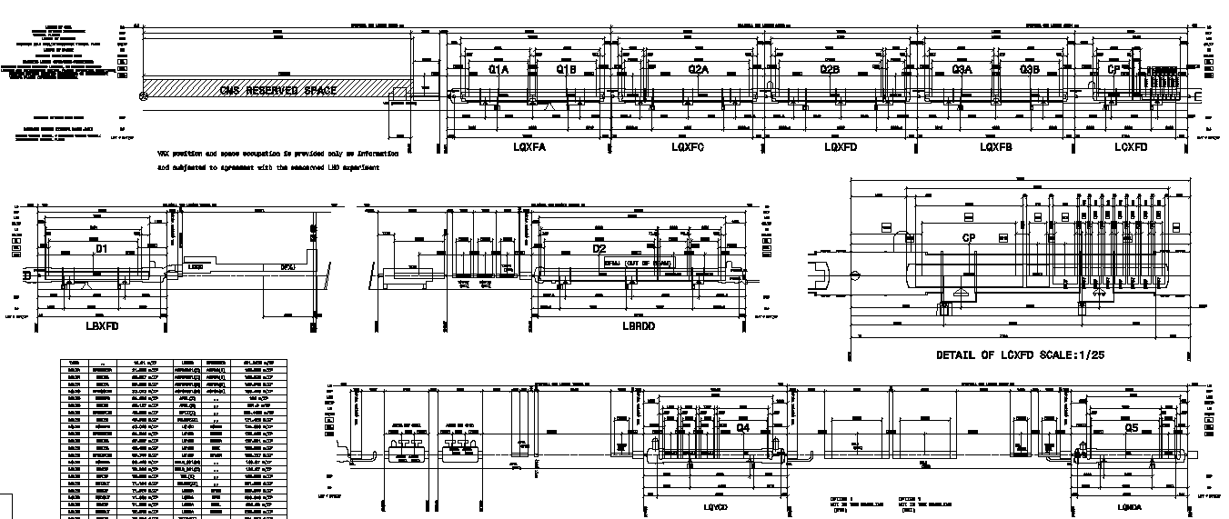
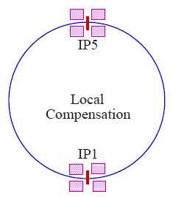
Baseline for alignment of IP1 and IP5
Layout :
IP5 Right
-IP5 left and IP1 will have the same
alignment configuration
CMS
VAX
Q1-D1
VAB
BPM
TAXN
Collimators
VAB
VAB
D2
MASK
VAB
VAB
Collimator
MASK
VAB
VAB
LHC
C. Cavities
Q4
Q5
Remote aligned
Manual aligned by Survey
Manual aligned by TE/VSC or Survey

Slide 4
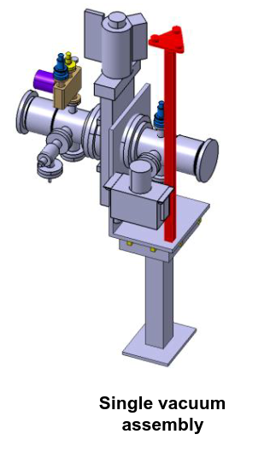
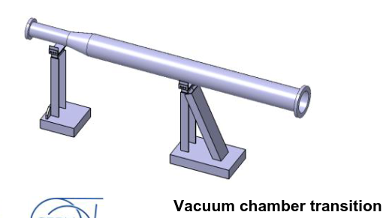
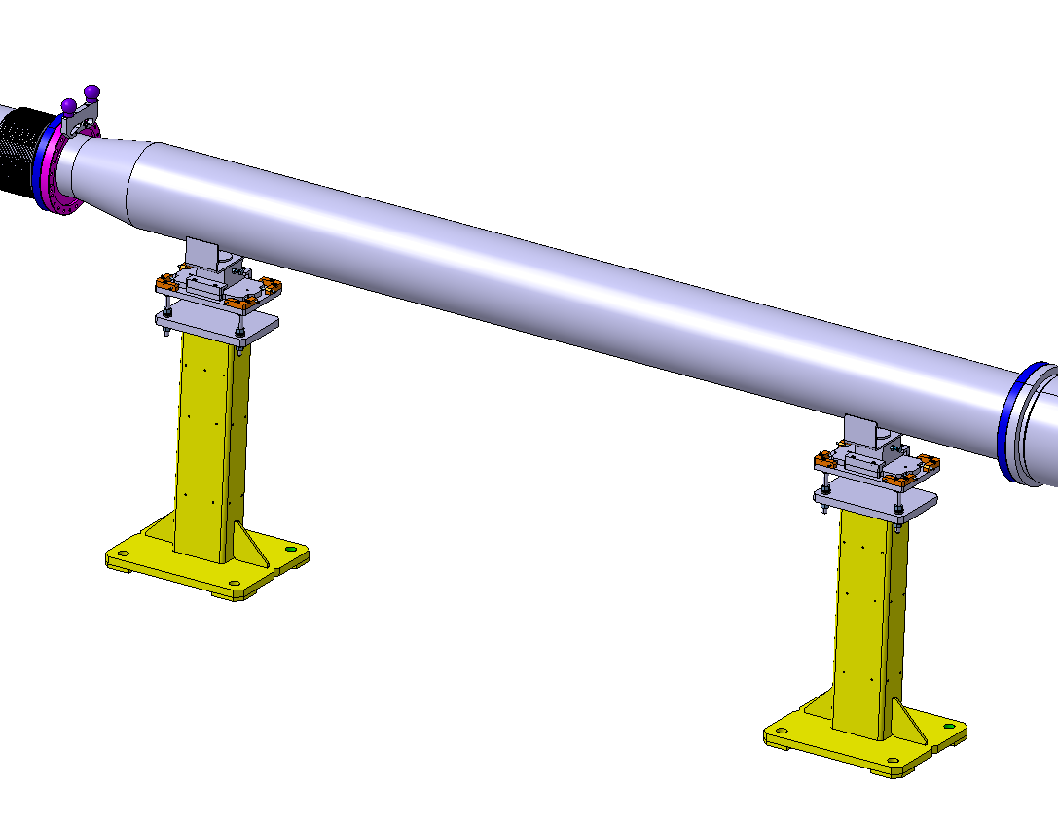
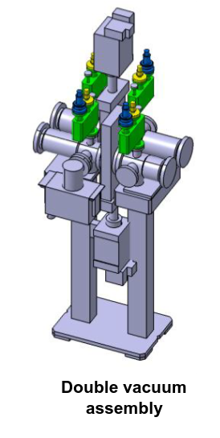
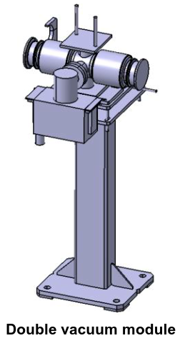
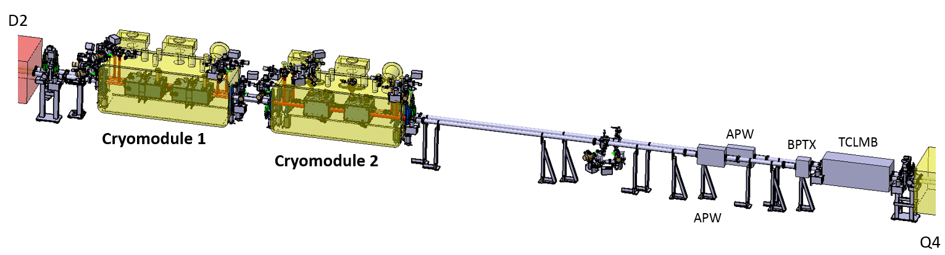
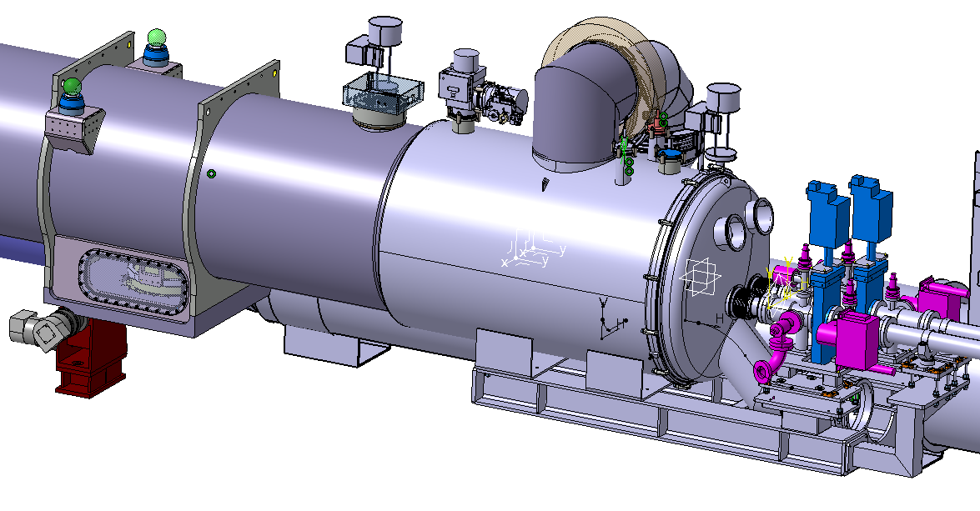
Vacuum components to be aligned
Case 1: Components to be aligned by Survey
Case 2: Components aligned by TE/VSC
Manually aligned:
(support only or with vacuum component)
BPM
Transition Vacuum Chambers with supports
Transition Vacuum Chambers with supports
VCT
VAB
VM
VAB
Remote aligned together with magnet:
Vacuum Chambers with supports
VAB
Double valve module

Slide 5
Requirements
Beam size was provided by R. de Maria in May 2018 (meeting between WP2, 12 and 15.4 in sept 2019 for final documentation).
The remote alignment transversal stroke for all components is fixed to +/- 2.5 mm.
This value needs to be subtracted from the aperture when fixed components are considered. These fixed components are the ones manually aligned either by TE/VSC or SU.
Mechanical Aperture:
  Apertures in radius including mechanical tolerances.
  Not including alignment tolerances.
  Apertures:
Alignment tolerances for first alignment:
  Manual aligned by TE/VSC (F): +/- 2 mm;
  Manual (S) or remotely (R) aligned by SU: +/- 0.5 mm.
Component | Inner radius [mm] | Aperture [mm]
VM (Pumping module) | 31.5 | 30.575
 | 40 | 39.075
 | 45 | 44.075
VVG (Sector valve) | 50 | 48
 | 31.5 | 31.100
Example:
VM ID63 when the alignment is:
- F: Aperture = 28.575 mm;
- S/R: Aperture = 30.075 mm.

Slide 6
Alignment approach for vacuum components
  Assembly on surface:
    Fiducialisation of each vacuum component.
  Installation in the tunnel:
    Alignment of each vacuum component with the support (TE/VSC will perform the adjustment of the equipment and SU will pilot the alignment of the equipment)
  During first year of operation:
    No realignment is foreseen.
  During later operation/During TS, YETS, LS.
    No need for realignment (sufficient aperture);
    The supports will have a quick connect plate:
      Alignment required if floor support has to be removed.
      No realignment required if VCT, VAB or VM is removed and reinstalled.
VCT
VAB
VM
.

Slide 7
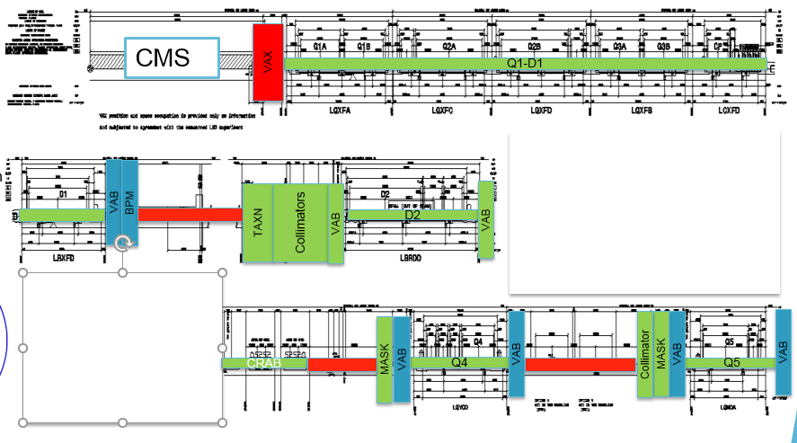
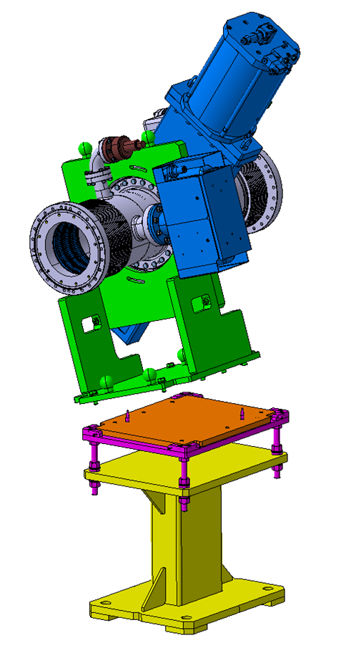
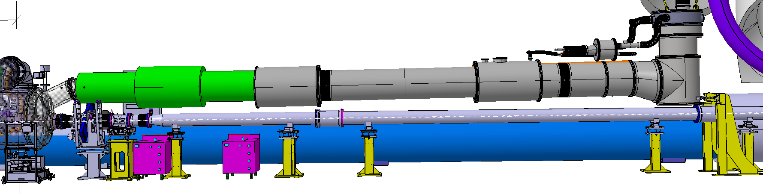
D1 to TAXN
IP5 Right
All items between D1 and TAXN will be manually aligned once at installation by Survey
Plug-in interface
ST0999873

Slide 8
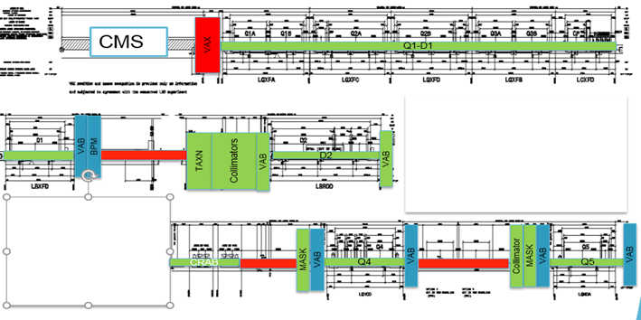
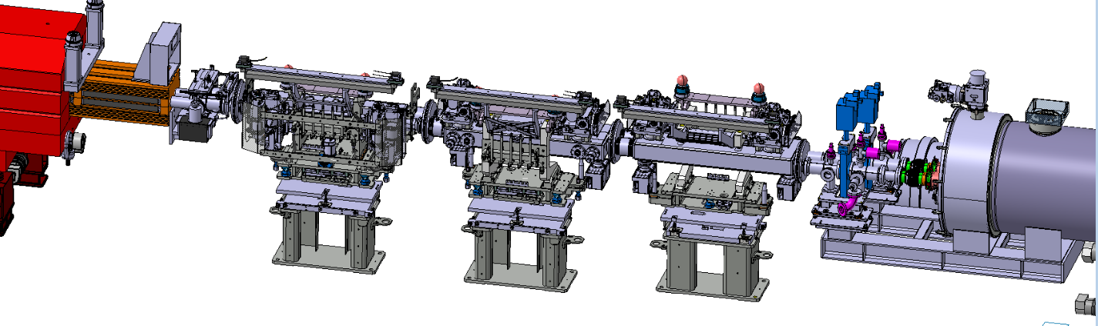
TAXN to D2
IP5 Right
All items between TAXN and D2 will be remotely aligned
All pumps, gauges and VVs are remotely aligned as:
  Incorporated on the collimators;
  Fixed to the TAXN;
  Fixed to D2.

Slide 9
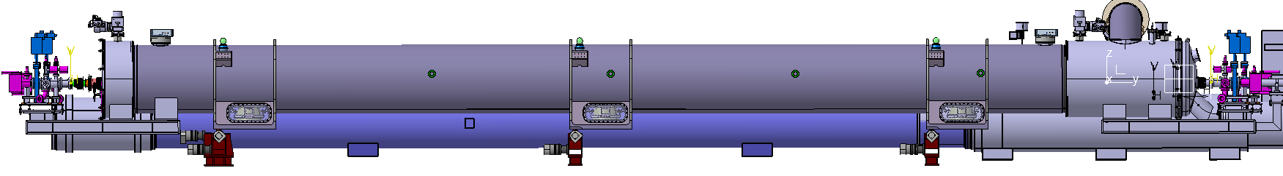
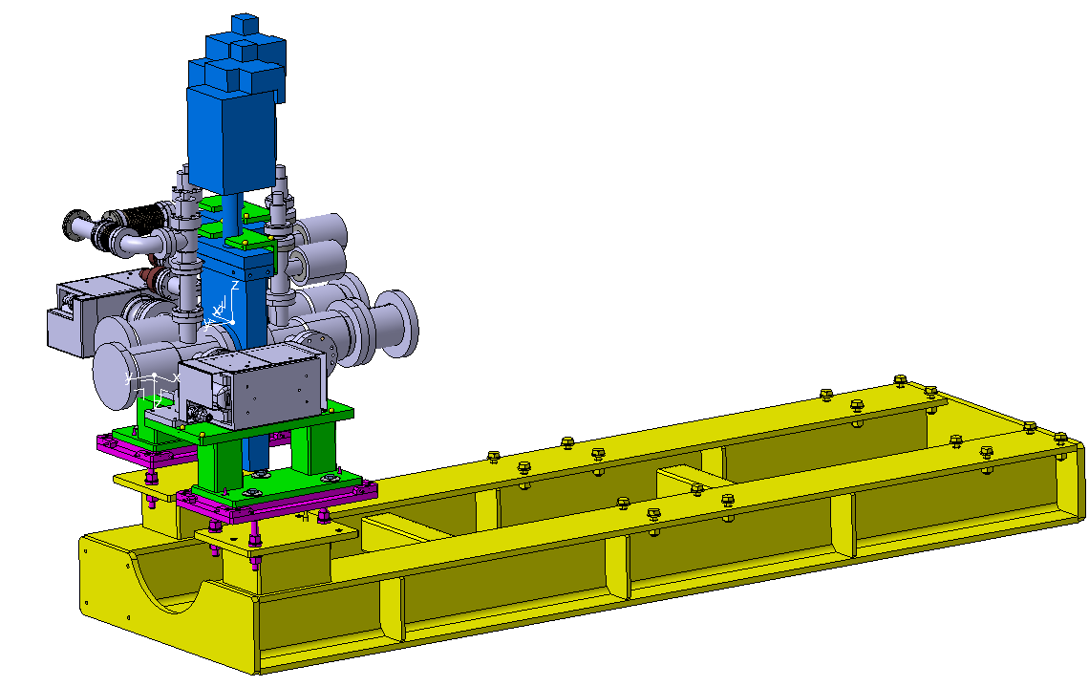
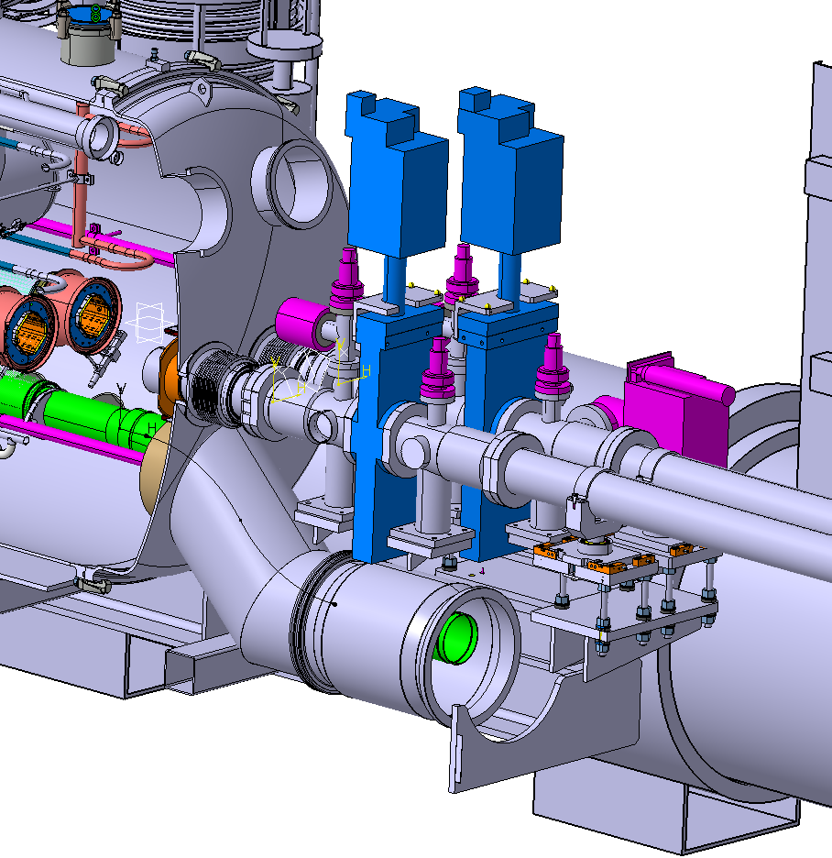
D2 Frame and valve support
Vacuum support:
  Fixed to D2 magnet
  Remote aligned with D2
  ECR for the sector valves fixed to D2 in preparation.
Frame will support:
  VABs (sector valves, bellows and pumping ports)
  The vacuum chambers on the crab cavity side.
Sector valve support:
  Can be installed after the assembly of the link;
  Will be installed and aligned separately on the frame;
  Each valve support has targets (“mires”) and will be aligned by SU.

Slide 10
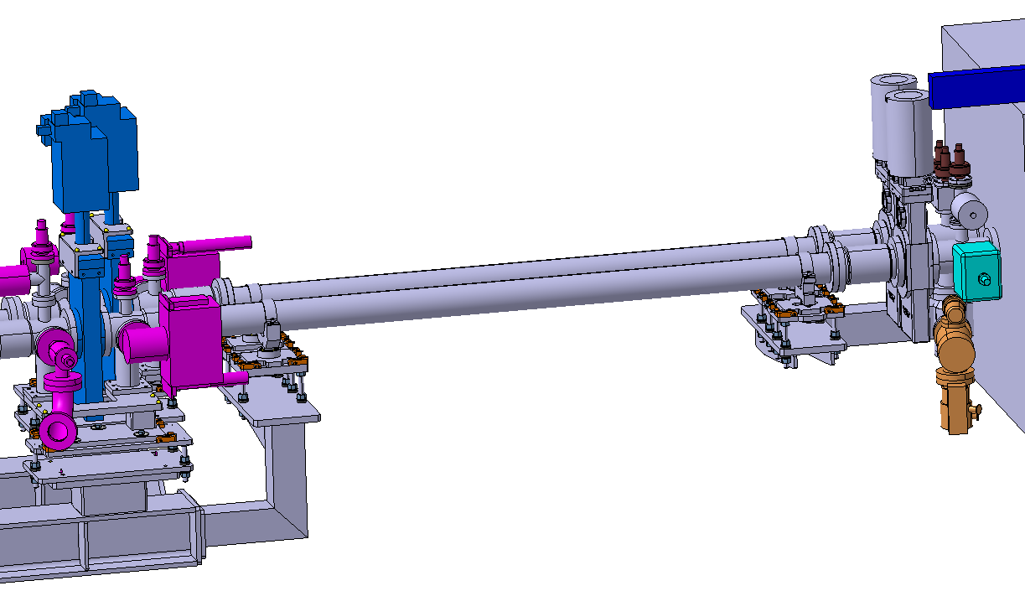
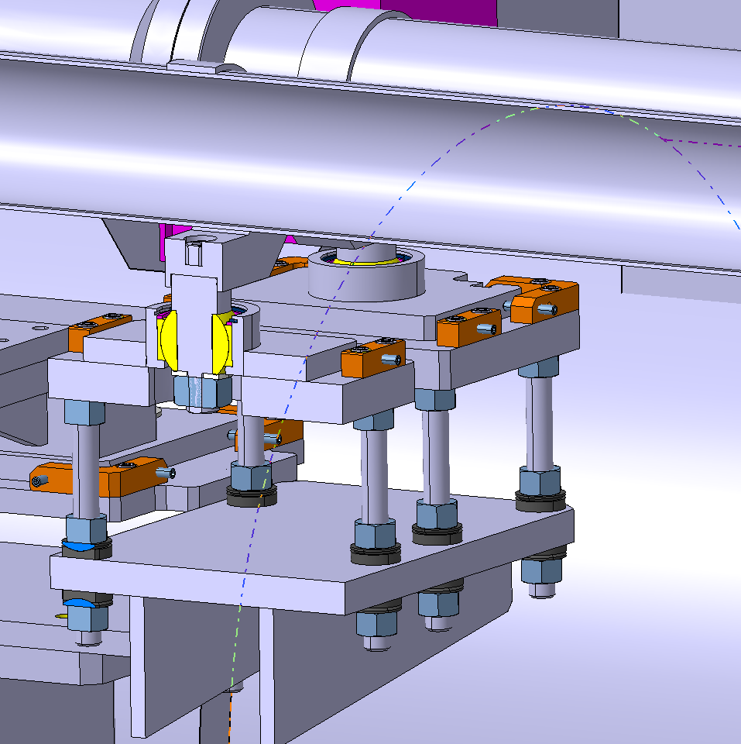
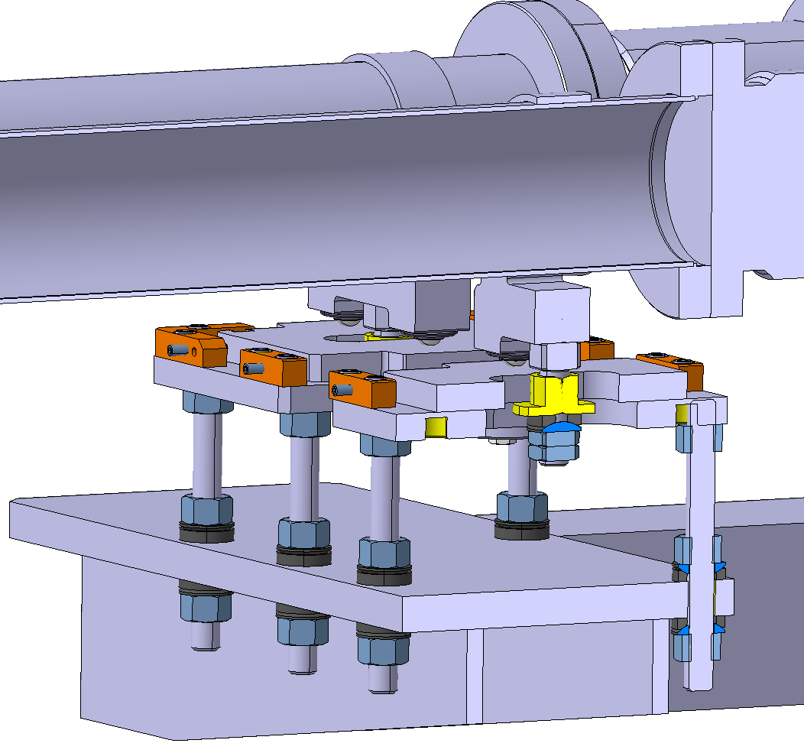
D2 to Crab Cavities
Vacuum chambers supported by the crab cavities and D2 frame;
D2’s support of the VCs:
  Fixed swivel point.
CCs cryostat’s support of the VCs:
  Roller (to compensate for alignment tolerances and bakeout expansions).
Fixed swivel point
Mobile roller support

Slide 11
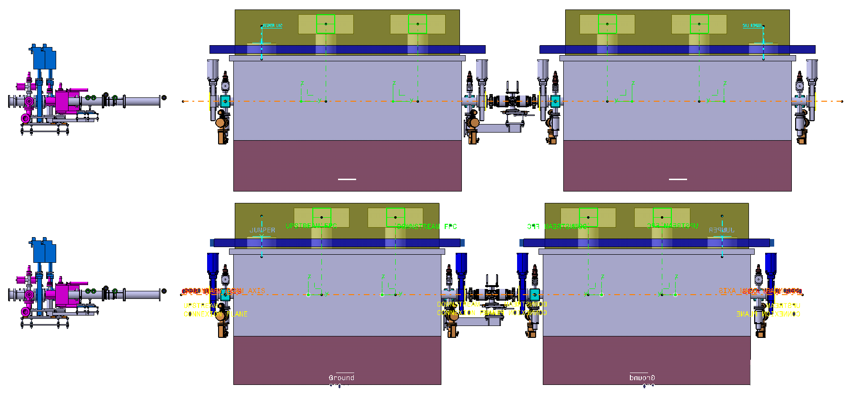
Crab Cavities
IP5 Right
The distance between the cavities and D2 and between the 2 cavities are the same for both versions (IP1 and IP5).
The DN80CF sector valve modules with pumps will be fitted in clean room directly on the crab cavity ➔ no alignment required
RFD
D2
RFD Crab Cavities
LHC – WP15 Integration (ST1088593_01)
DQW
D2
DQW Crab Cavities
LHC – WP15 Integration (ST1096196_01)

Slide 12
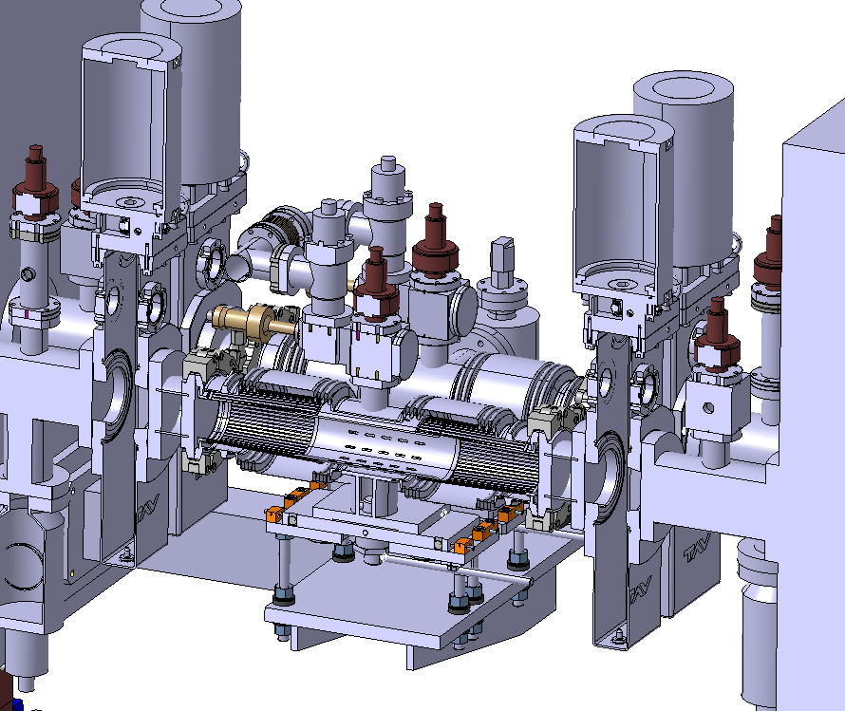
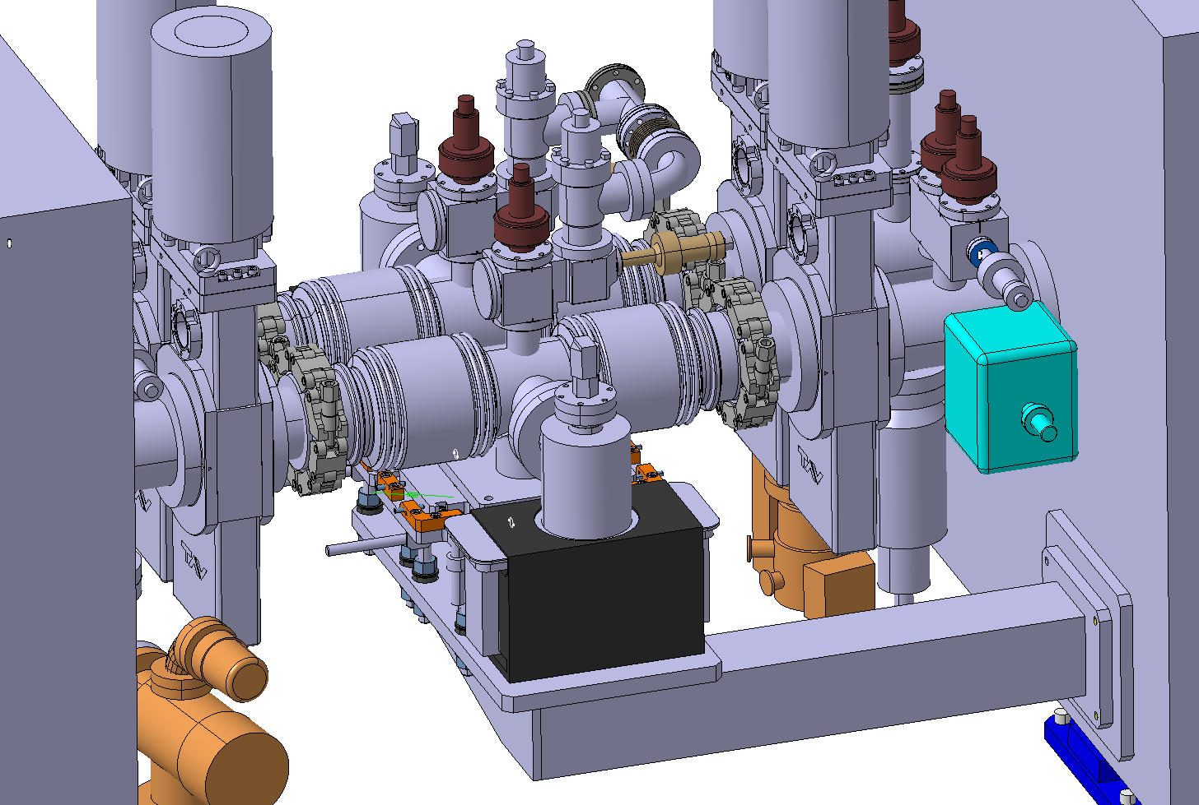
Crab Cavities (vacuum connection between cavities)
- The beam line pumping modules will be supported by the crab cavities and remotely aligned with the cavities.
- Manual alignment for each beam line required during first installation (no further alignment required).
- The pumping modules are quick connect modules
(no alignment required if removed and reinstalled).
Transport side
DFB side

Slide 13
Radius clearance for VAB at D2, Q4 and Q5
Smallest clearance values for VABs on the IP and ARC side of D2, Q4 and Q5
VAB |  | Smallest clearance after first alignment [mm] | Smallest clearance after moving the RATS
D2 | IP side | I&V = 7.5 / E&H = 2.7 | I&V = 7.5 / E&H = 2.7
 | Arc side | I&V = 8.6 / E&H = 8.4 | I&V = 8.6 / E&H = 8.4
Q4 | IP side | I&H = 4.4 / E&V = 4.6 | I&H = 1.9 / E&V = 2.1
 | Arc side | I&H = 6.2 / E&V = 6.4 | I&H = 3.7 / E&V = 3.9
Q5 | IP side | I&H = 10.5 / E&V = 10.4 | I&H = 8.0 / E&V = 7.9
 | Arc side | I&H = 8.3 / E&V = 7.9 | I&H = 5.8 / E&V = 5.4
Remotely aligned, no impact on clearance
Not remotely aligned, impact on clearance but enough margin
Nomenclature:
V: vertical;
H: horizontal;
I: interior beam line;
E: exterior beam line;
RATS: remote alignment transversal stroke.
Note:
Values taking into account the left side of P5

Slide 14
Readiness and risks
Drawings are in preparation for all new vacuum supports.
Prototypes of new supports will be ready by end of 2019
Prototypes supports will be installed on surface beginning of 2020 for WP12 and WP15.4 to perform installation and alignment tests.
Modification and validation by middle of 2020.
The procurement shall be ready by end of 2021 (relatively simple components with delivery time of approximately 2 months)

Slide 15
Summary
The alignment of vacuum component can be done with existing alignment solutions with the help from WP15.4.
Survey will perform the first alignment during installation of three types of components: transition vacuum chambers (VCT) adjacent to a Deformable RF bridge (DRF), single or double vacuum assembly with sector valves (VAB), double and single bellow vacuum module (VM).
TE/VSC will be in charge of the alignment of the transition and drift vacuum chambers that are not adjacent to any DRF.
All vacuum component to be remotely aligned are attached to other components which are remotely aligned ➔ none of these vacuum components require individual alignment
No realignment foreseen of vacuum components, as the aperture clearance is sufficient, and all components are fitted with targets for easy alignment check.
This presentation has been based on present knowledge. Analysis and conclusions might evolve if the final values will change (meeting on the final documentation between WP2, WP12 and WP15.4 scheduled in Sept 2019)

Slide 16
Thanks for your attention

