Slide 1
RF: review of the limitations in moving the components under vacuum and cold
G.Vandoni / R.Calaga – WP4
Review of HL-LHC Alignment and Internal Metrology, 26th August 2019

Slide 2
Contents
Specification: Internal alignment
Specification: FRAS
Constraints from FRAS on CC cryomodule interfaces
RF waveguides
Cryogenic connection to jumpers
Intermodule vacuum modules
Longitudinal RF beam phase pick-up (APWL)

Slide 3
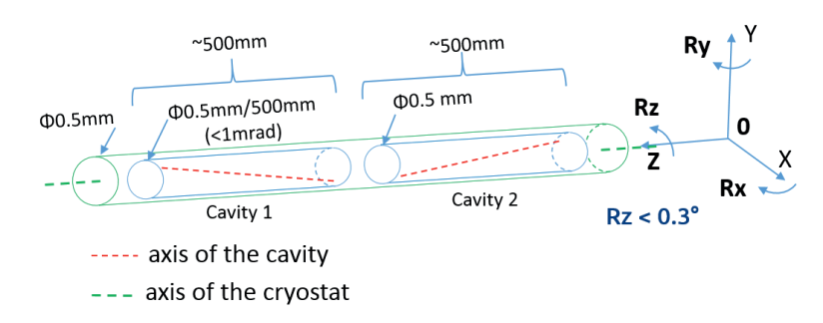
Specification: internal alignment
Cavity rotation in X-Y plane < 0.3° =5.2mrad per cavity (R_{z});
Cavity yaw Ry and pitch Rx w.r.t. the cryostat axis < 1 mrad=0.057º;
Transverse displacement of the cavities w.r.t. each other inside cryomodule:
  Intra-cavity alignment in transverse plane w.r.t. the cryostat axis < 0.5mm;
TDR HiLumi

Slide 4
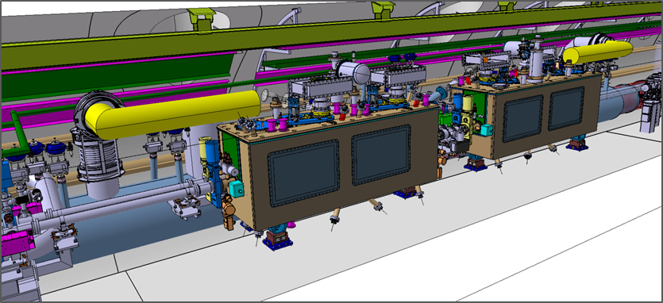
Specification: Full Remote Alignment
Rigid alignment of all components as a block from Q1 to Q5 within ±2.5mm
Independent movement of all individual equipment within connecting bellow’s stroke.
2 RF waveguides to transmission lines
RF Beam pick-up (APWL): between CC and Q4
Cryogenic jumper to QXL
Intermodule pumping modules / CC
Vacuum pipes

Slide 5
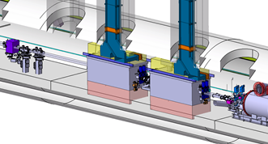
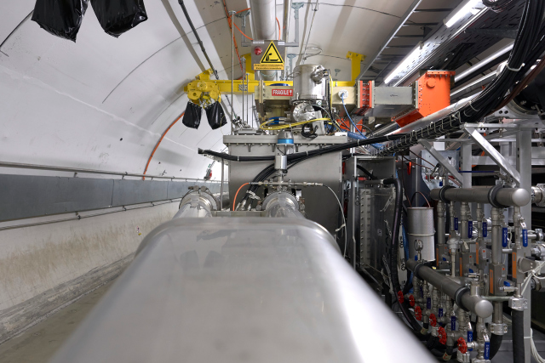
Constraints for interfaces: RF waveguides
Re-alignment movement tolerance (square bellows): ± 1 mm in ver/hor (waveguide axis)
Today’s view: To accommodate more, 1h access BE-RF-PM to free waveguide is required
Lab tests will be performed to verify up to ± 2.5mm.
No continuous monitoring of mutual position, only permanent target for alignment check in LS and YETS

Slide 6
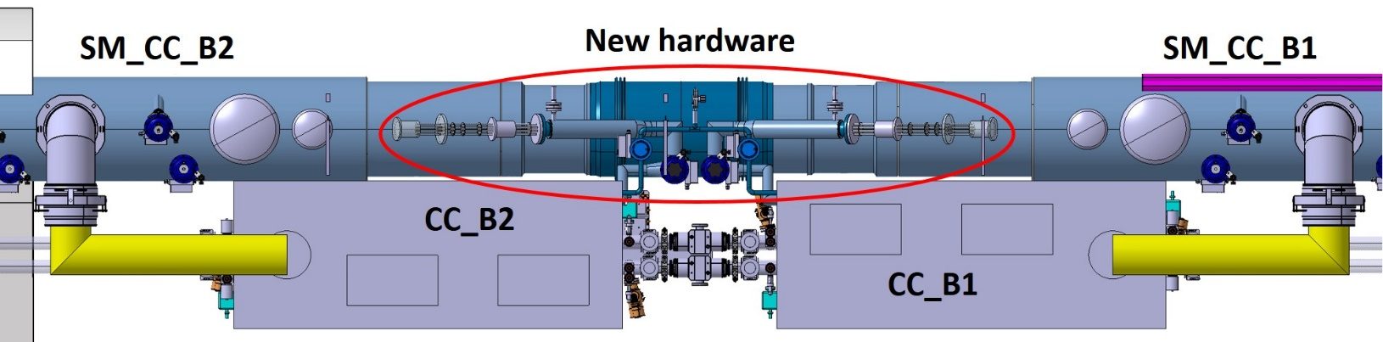
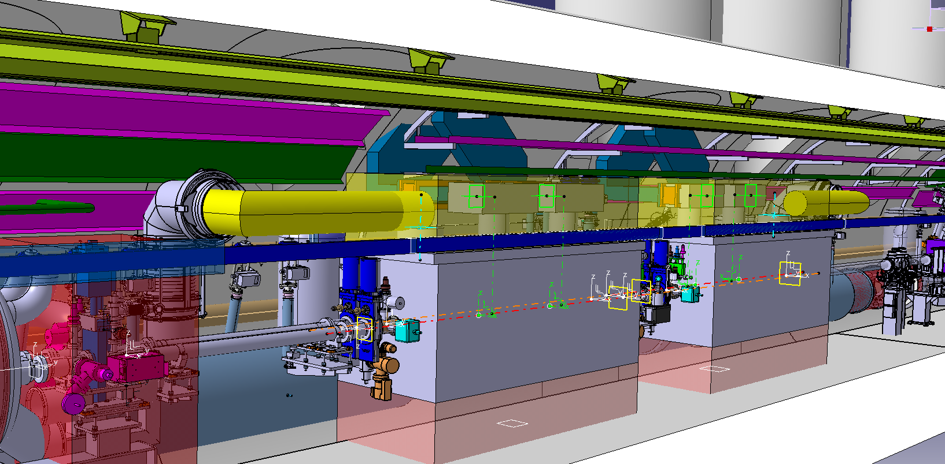
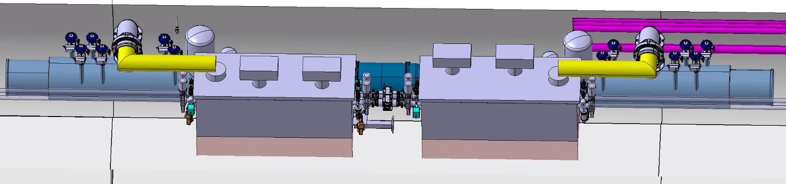
Constraints for Interfaces: Cryogenics
Cryo equipment aligned at installation.
Large flexibility of connection, no constraint after installation within the FRAS specification
Courtesy P.Fessia / Integration team / K.Brodzinski
See S.Claudet , this review

Slide 7
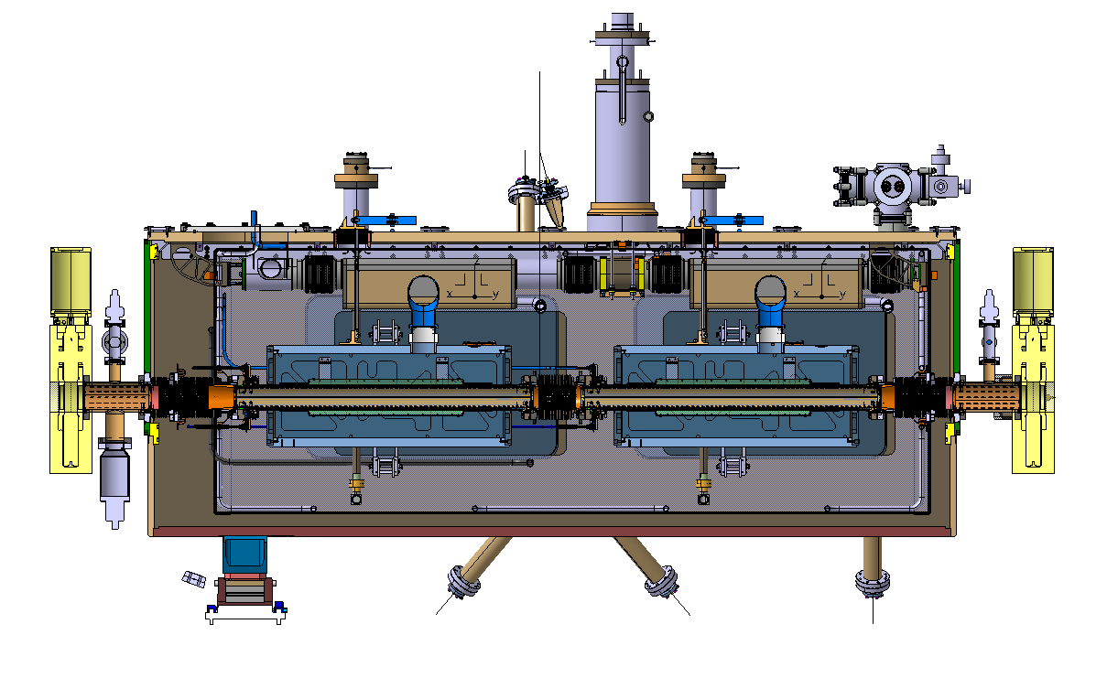
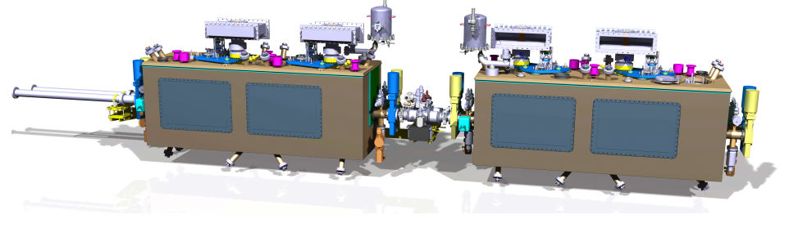
Constraints for Interfaces: Intermodule alignment
See G.Riddone, this review
Determined by aperture and related reduction by mechanical tolerances (flange/ valve mechanical tolerances)
Crab cavity φ 84mm, adjacent drift tube aperture is determined by beam screen aperture and related tolerances. Verification in progress for compatibility with FRAS.

Slide 8
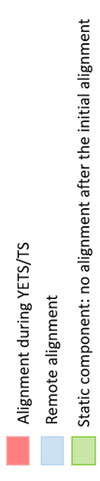
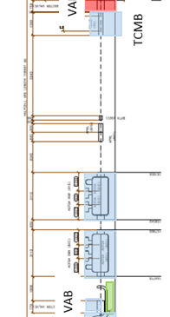
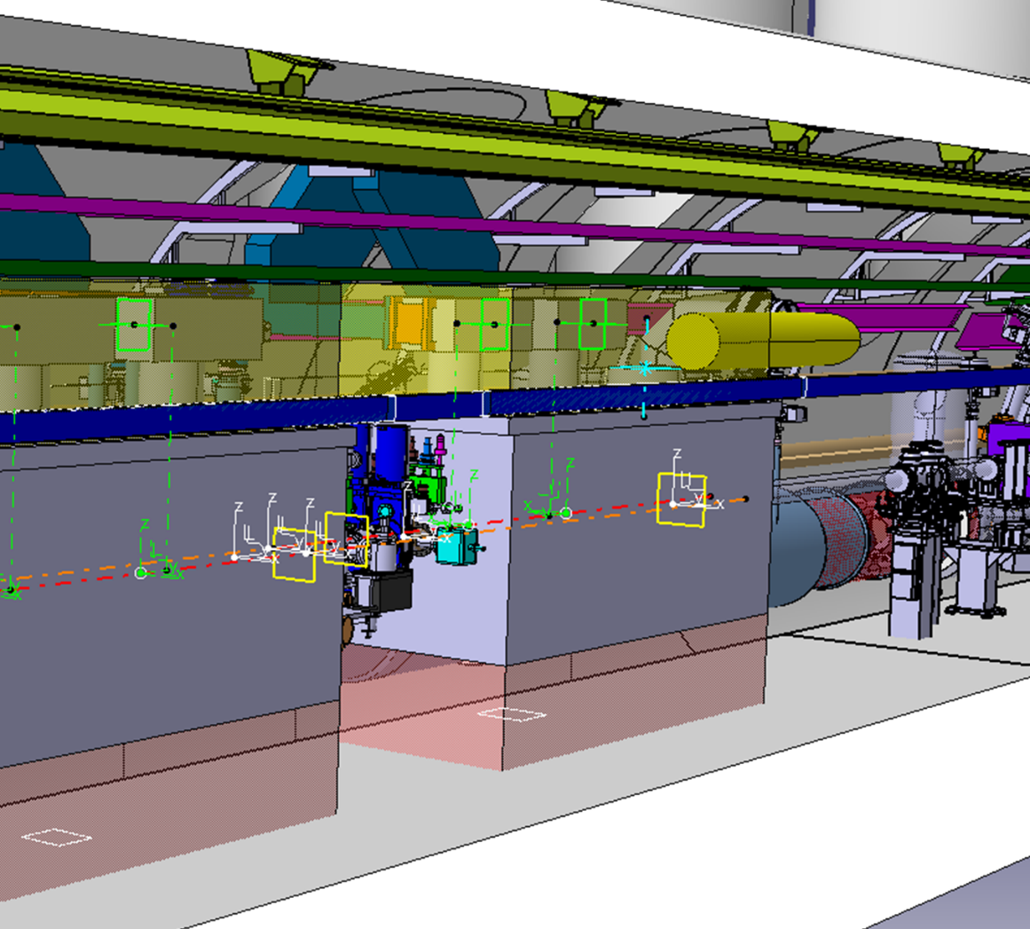
Constraints for interfaces: RF beam pick-up
Longitudinal RF pick up for beam phase reference: transverse reference tolerance is above ±2.5mm
Installed on individual platform, supported from the tunnel floor
Aligned transversally at installation
Supporting platform allows for transverse adjustment.
Permanent targets
Manual alignment in LSs

Slide 9
Information and figures from R.Calaga, O.Capatina, E.G. Mugica, T.Capelli, E.Montesinos, P.Fessia, H.Mainaud, M.Sosin, K.Brodzinski, Integration team, and many more

Slide 10
Project interfaces and knowledge transfer
 | SPS |  | HL-LHC
Type | DQW | RFD | DQW | RFD
Cavities from | CERN | CERN | RI (CERN contract) | ZANON (US-AUP contract)
Cryomodule from | CERN | UK (under UK1) | 1 x CERN (first) 4 x UK (under UK2) | 5 x TRIUMF
Strategy is in place for knowledge transfer to collaborating institutes, for
FSI installation (FSI CERN’s supply) and conventional and clean room alignment procedures during cryomodule assembly.
Alignment re-check at CERN during SM18 tests.
Notes:
FSI system not foreseen as a transport specification check device nor logging

