Slide 1
Beam Instrumentation (WP13)
FRAS requirements
M. Krupa for WP13
HL-LHC alignment review 26/08/2019

Slide 2
WP13 equipment in the FRAS area
Affected by FRAS:
  Beam Position Monitors (BPM) – 13 instruments
  Experiment timing (BPTX) – 1 instrument
  Luminosity monitoring (BRAN) – 1 instrument
Not affected by FRAS:
  Beam Loss Monitors (BLM) - ~40 instruments
Not in the baseline but would be affected by FRAS:
  Beam-Beam Long Range wire compensation (BBLR)

Slide 3
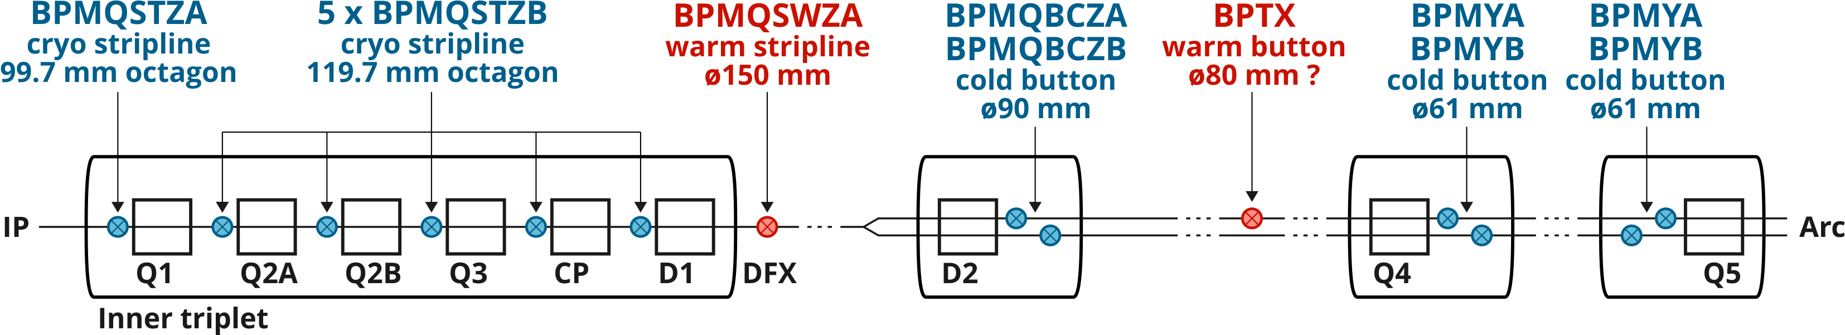
BPMs / BPTX in the FRAS area
Cold BPMs
Welded to the vacuum chamber
Aligned only during installation
Move rigidly with the magnet
Warm BPMs
Installed on individual platforms
Can be realigned during TS
Move “independently”

Slide 4
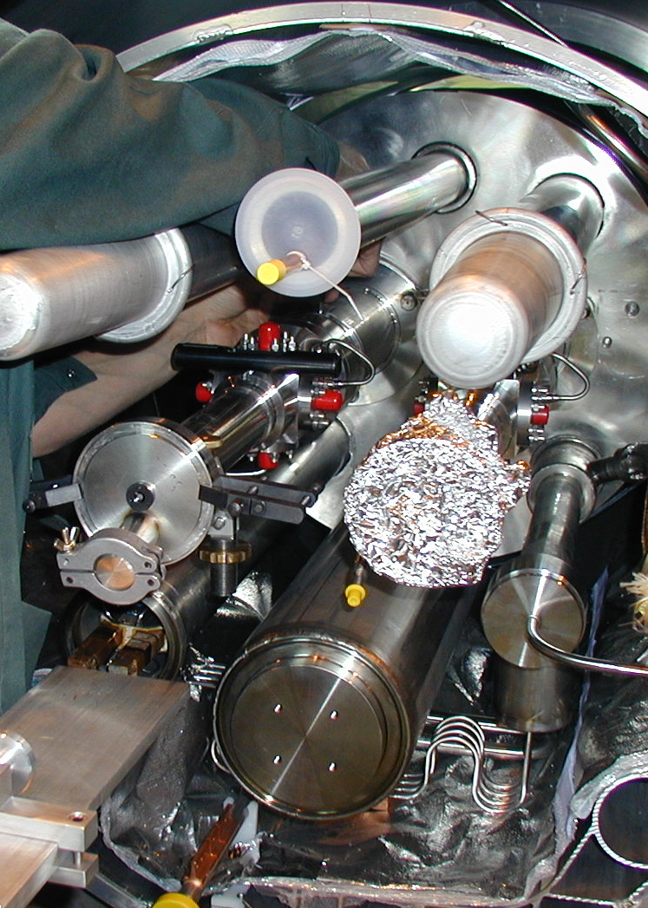
Cold BPMs
BPM is a part of the magnet assembly
D2 BPMs moved from outside (IP side) to within the D2 cryostat (arc side)
Position of each BPM is known:
  Metrology after manufacturing
  Electrical measurements in the lab
  Alignment during installation
  Measurement after installation
Offset and roll can be corrected
Roll
Offset
Leak check

Slide 5
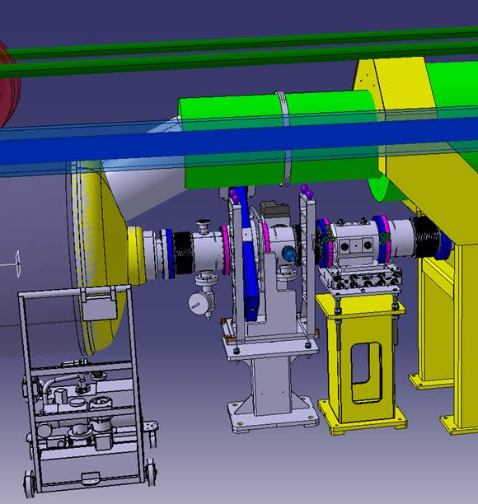
Warm BPM under the DFX / DCM
Installed on a semi-manual standardized alignment platform
Fiducialised on surface, aligned during installation, measured after installation
No WPS integration foreseen but permanent targets integrated
Realignment only during YETS and LS
  If other components are realigned what becomes the BPM reference?
  Can we assume that the BPM moves together with the D1 extremity?
DCM
D1
BPM
Alignment platform
Fixed support

Slide 6
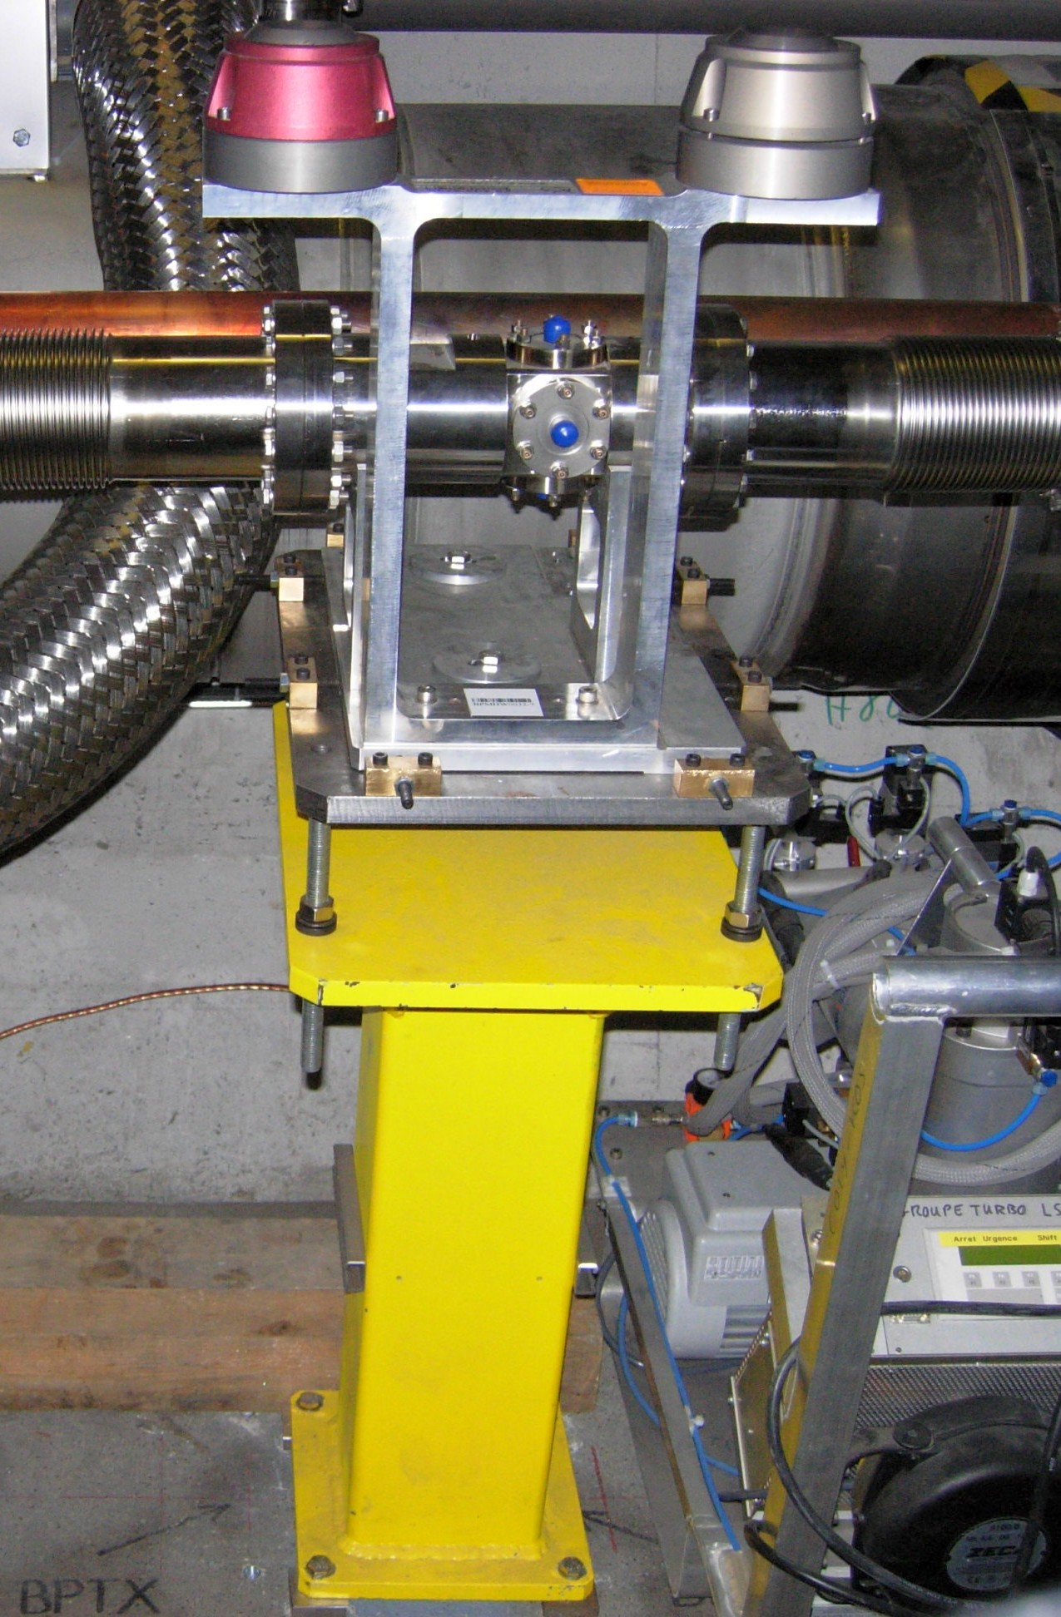
BPTX
Timing monitor used exclusively by the experiments
Precise transverse alignment not required for functionality
Installed like a typical BPM: fiducialised, aligned, measured
No realignment planned after installation
Required aperture large enough to allow ±5 mm displacement
WP13 plans to use 80 mm aperture – needs to be validated by WP2

Slide 7
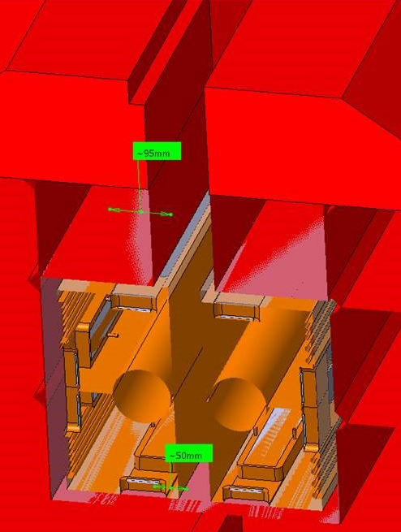
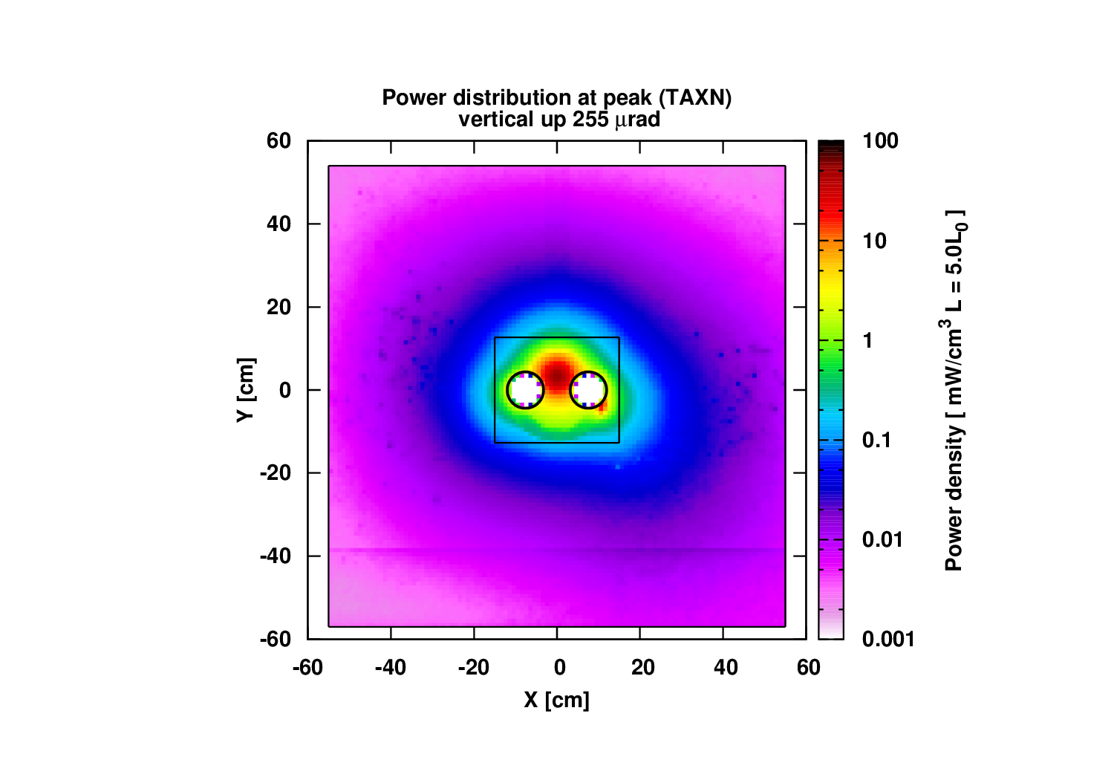
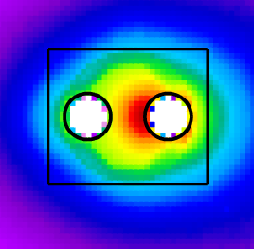
BRAN
Luminosity monitor integrated between the two beam pipes inside the TAXN
Measures the rate of neutral debris
Moves rigidly with the TAXN
HL-LHC BRAN needs to handle changing crossing angle – effect comparable to the instrument’s transverse movement
Realignment towards the optimal orbit is only good for the BRAN signal
Horizontal crossing
Vertical crossing
BRAN
rods
BRAN
rods
BRAN
Off-centered shower
Sensitive to crossing angle
Centered shower
Not sensitive to crossing angle
BRAN envelope inside TAXN

Slide 8
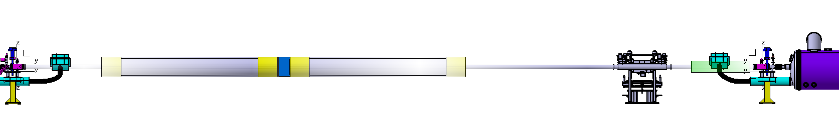
BBLR
If wire BBLR compensation becomes HL-LHC baseline, remote alignment will be requested for the wire chambers
3 – 4 m long chambers installed between Q4 and Q5 on both beams, left and right of IP1 and IP5
Preferred alignment solution would be similar to platforms designed for WP5 equipment
BBLR
BBLR
TCL
TCLMB

Slide 9
Summary
Cold BPMs: move with the magnets, fully compatible with FRAS
Warm BPM under the DFX: open question how to establish a reference axis after other components are moved
BPTX: no alignment required for functionality, aperture large enough to accommodate ±5 mm displacement after installation
BRAN: moves with the TAXN, can cope with misalignment, realignment towards optimal orbit beneficial
BBLR: if it becomes baseline, remote alignment will be requested

Slide 10
Thank you for your attention

