Slide 1
Global
Optimization of the Matching Section and
Full Remote Alignment
S. Claudet, P. Fessia: Matching Section Optimization Coordinators (WPLs of the WP9 and WP15)
For Full Remote Alignment
R. De Maria [WP2]
R. Calaga (WPL), O. Capatina [WP4]
A. Bertarelli, M. Calviani, L. Gentini, S. Gilardoni, I. Lamas, S. Redaelli (WPL) [WP5]
V. Baglin (WPL), J. Hansen, R. Tavares [ WP12]
R. Jones, T. Lefevre [WP13]
A. Herty, H. Mainaud Durand, A. Masi, M. Sosin [WP15.4]
J. Uythoven, M. Zerlauth, J. Wenninger [Machine Protection]
Matching Section Optimization
R. De Maria, D. Gamba [WP2]
D. Duarte, H. Prin, E. Todesco (WPL), A. Vande Craen [WP3]
A. Ballarino (WPL), S. Claudet, V. Parma, A. Perin [WP6A]
J-P. Burnet, M. Martino (WPL) [WP6b]
D. Wollmann [WP7]
J. Metselaar, M. Sisti [WP9]
V. Baglin (WPL) [WP12]
M. Amparo [WP15.1]

Slide 2
Summary
Full Remote Alignment
  Present baseline and new proposal
  Alignment strategy and required stroke
  Advantages
  New possibilities for full Matching Section Optimization
Matching Section Optimization
  The magnet system simplifications
  The QRL-QXL optimization
  The Cold Powering
  The Warm Powering
Conclusions

Slide 3
A little bit of history
The original idea to investigate the possible benefits of a larger than foreseen deployment of the Remote Alignment capabilities came in April 2017
First study and proposal was presented January 2018 and the full study in November 2018 with final approval with all budget implications in February 2019
The analysis was performed on Optics 1.3 and the first Optics making use of the Full Remote Alignment Deployment was Optics 1.4
Presently we are at optics 1.5 that add some other optimization not linked to the alignment

Slide 4
Full Remote Alignment and Matching Section Optimization
Objectives
By products
Reduce dose to alignment team
Gain aperture margin in various equipment
Cope with
Experiment vs. machine misalignment in RUN IV
after the machine and experiment installation completion
Matching
Section Optimization
FRA
Yearly correct ground motion drift without man intervention in the machine
Reduce the requirement on the Matching Section orbit Corrector System
Provide tool to eliminate or at least minimize the residual alignment error using beam as reference
Mitigate spurious orbit deviations in the triplet (simplifying non linear corrections)
Cope with unexpected source of misalignment avoiding losses in performance of physics time

Slide 5
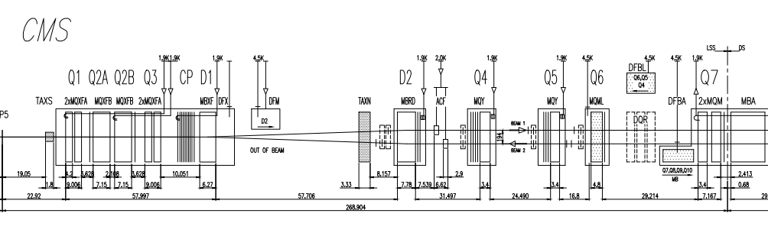
IP1 and IP5 HL-LHC
Synoptic of adjustment system only
Old Baseline vs Full Remote Alignment on optics 1.3
BASEL
INE
Motorized adjustment system, remotely controlled : adjustment during run, from CCC
Manual adjustment system: adjustment during LS,YETS,TS, personnel in the tunnel, access in front of element (special for TAXS)
Remote alignment compatible
NEW
PROP.
Full Remote Alignment applied to optics 1.3. before all modifications

Slide 6
Possible alignment strategies with fully remote alignment
 | Scheme 1: During operation or TS up 2.5 mm | Scheme 2: During TS Larger than 2.5 mm | Scheme 3: During YETS | Scheme 4: During LS 2 year RP cool down
Machine conditions | Machine operating conditions | Magnet cold but empty during movement | Magnet cold but empty during movement | Warm
Max stroke | +/- 2.5 mm | ±10 mm (jack excursion other limits apply) | ±10 mm (jack excursion other limits apply) | more
Time required per IP side Q1 to D1 | 30 min No access | 60 min No access | 60 min No access
Time required per IP Q1 to Q5 | 30 min No access | 2(L)+2(R) days Access for int. components. De-interconnection of the RF guides (from time point of view this fits into a TS) | 2(L)+2(R) days Access for int. components. De-interconnection of the RF guides (from time point of view this fits into a TS)
 | CD: NA | CD: >12 mSv | CD: 2.8 mSv | CD:0.3 mSv
Time required per IP side Q1 to Q6 | Not possible | 2 TS TS1: measure Between TS1 and TS2 compute TS2 realign | Measurement, computation and re-alignment in the YETS
 | NA | CD: >13 mSv | CD: 3.2 mSv | CD:0.4 mSv

Slide 7
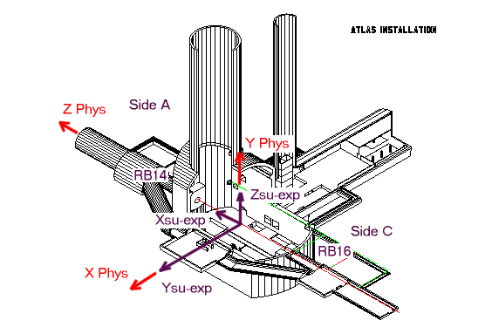
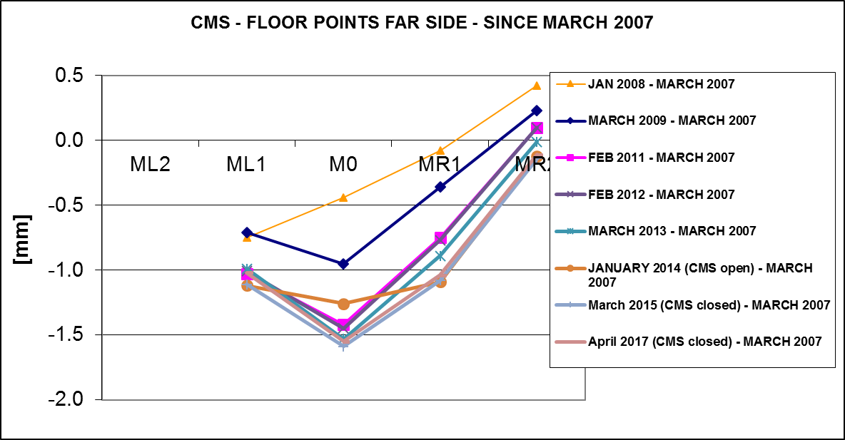
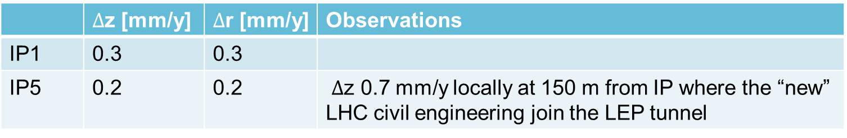
The needed stroke
The Survey team has linked the experiment cavern movement with the ones of the LSS
  For the vertical plane via the deep references (GITL) that are in machine tunnel for ATLAS and CMS
  For the radial plane via the GISB references points that are in the UPS survey galleries
Tunnel Levelling
Deep Reference L
Deep Reference R
 | $∆$z [mm/y] | $∆$r [mm/y] | Observations
IP1 | 0.3 | 0.3
IP5 | 0.2 | 0.2 | $∆$z 0.7 mm/y locally at 150 m from IP where the “new” LHC civil engineering join the LEP tunnel
The proposed value of ± 2.5 mm allow covering the movements
from LS to LS with a safety factor at least 2 (vs. 0.3 mm) avoiding major realignment intervention during other time slots.
Yearly changes shall be much smaller in the range of 0.2/0.3 mm
This meets the requirement of the experiment that asks for the possibility to compensate
+/-2 mm of IP shift and fits with the experimental vacuum system design and capability
In addition at LS3 partial overcompensation in the vertical plane (even in the assembly position of the inner tracker as proposed by CMS) could be applied on the base of the measurement that will be taken during LHC RUN III,
allowing to factorize in possible impact of the HL-LHC excavation that will have been completed in LS2
Courtesy WP15.4 team

Slide 8
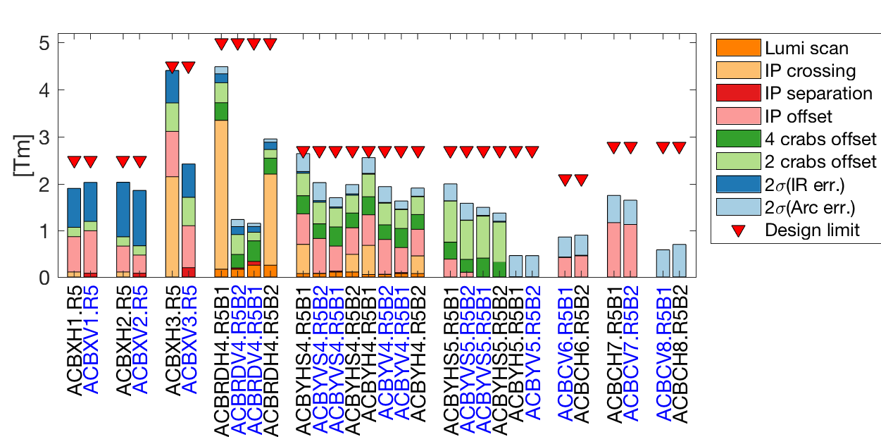
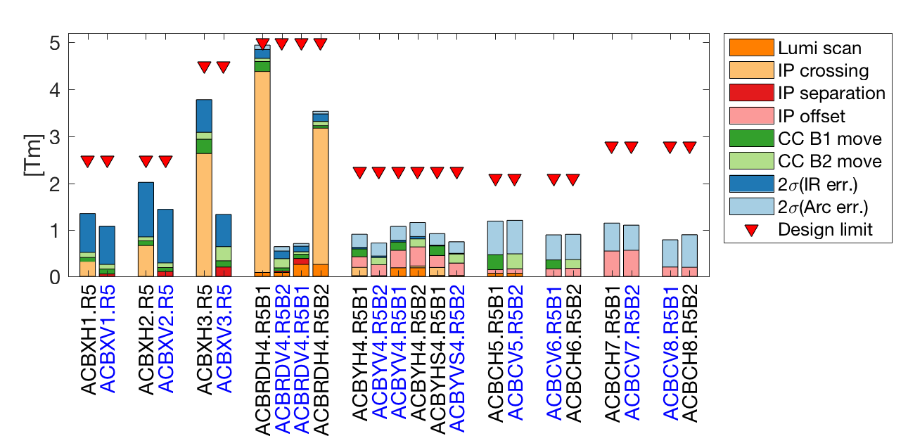
Orbit corrector strength requirements and aperture without and with remote alignment
Increased corrector margin here applied already to reduce set of correctors
Baseline
FRA
IP
Q1 Q2 Q3 D2
Triplets
Q4 Q5 Q6-8
Matching section
IP
Q1 Q2 Q3 D2
Triplets
Q4 Q5 Q6-8
Matching section
Right Point 5, H crossing.
Crossing: ±295 μrad
Separation: ±0.75 mm
IP Offset: ±2.0 mm
Luminosity scan: ±100 μm
Crab knobs: ± 1-0.5 mm (baseline only)
Imperfection (2σ): from uniform distribution of mainly ±0.5 mm quad. Alignment and 0.5 mrad / 20 units dipole errors.
FRA:
orbit bumps reduced at the crab cavities
IP offset performed by alignment
Limited crab beam adjustment still possible
 | Base | FRA | Base | FRA
 | Round β*=15 cm |  | Flat β*=7.5 cm
TAXS | 16.3 | 16.3 | 14.0 | 14.0
IT | 12.0 | 13.1 | 11.8 | 12.7
TAXN | 15.4 | 17.3 | 12.4 | 13.9
D2 | 15.5 | 18.6 | 12.9 | 14.7
Q4 | 14.5 | 18.3 | 10.4 | 13.0
Q5 | 24.8 | 28.2 | 17.6 | 19.9
Q6 | 25.5 | 25.9 | 18.0 | 19.3
Courtesy R, De Maria

Slide 9
The Matching Section Optimization
By products
Opportunities
Re-use present LHC Q4 and Q5 at 4.5 K
Gain aperture margin in various equipment
Re-optimize the cryogenic distribution reviewing the limits between QRL and QXL
Matching
Section Optimization
Review the capacity of the foreseen cryo plants at P1 and P5 (and also P4 sect 4-5)
FRA
Reduce the requirement on the Matching Section orbit Corrector System
Reduce the number of circuits for the correctors, leading to a reduction of the number of associated Power Converters
Limit the modifications to the DSL: the superconducting link presently feeding the Matching Section from Q6 till D2
Relax the design requirements on the TCLX and TCTX, reduce aperture TAXN for improved protection

Slide 10
Layout changes
MCBXFB
MCBXFB
MCBXFA
HLLHCV1.3
IP
Q1
HV
Q2a
Q2b
HV
Q3
HV
CP
D1
1.9K
B1(E)
D2
H
V
C
C
H
V
H
V
Q4
H
V
H
Q5
MBRD
V
H
C
C
V
H
V
H
MQY
V
H
V
MQY
B2(I)
MCBRD
1.9 K
MCBY
1.9 K
MCBY
1.9 K
MCBXFB
MCBXFB
MCBXFA
HLLHCV1.4
 | Round | Flat
TAXS | 16.3 | 14.0
Q1 | 17.4 | 15.9
Q23 | 13.1 | 12.7
D1 | 13.9 | 13.0
TAXN | 18.0 | 14.0
D2 | 19.5 | 15.0
CRABS | 28.3 | 20.1
Q4 Mask | 19.3 | 13.6
Q5 Mask | 21.0 | 14.9
Q6 Mask | 26.5 | 18.9
IP
Q1
HV
Q2a
Q2b
HV
Q3
HV
CP
D1
1.9K
B1(E)
D2
H
V
C
C
H
V
H
Q4
H
Q5
MBRD
V
H
C
C
V
H
V
MQY
V
MQML
B2(I)
MCBRD
1.9 K
MCBY
4.5 K
MCBC
4.5 K
Changes in optics 1.4 with respect to the optics 1.3:
Q4: reusing existing LHC Q4 cold mass (3 correctors instead of 4), no need of 1.9 K.
Q5: reusing existing LHC Q5 cold mass (1 corrector instead of 3), no need of 1.9 K.
Full deployment of remote alignment system to be used with safe beam.
Courtesy R, De Maria

Slide 11
Fulfilling Q4 Optics requirements
Q4L1&5
Q4R1&5
MQY
MCBYV
MCBYH
MCBYV
MCBYV
MCBYH
MCBYV
MQY
LHC
MCBYH
MCBYV
MCBYH
MCBYH
MCBYV
MCBYH
MQY
MCBYH
MCBYV
MCBYH
MCBYH
MCBYV
MCBYH
MQY
HL-LHC
MCBYV
MCBYH
MCBYV
MCBYV
MCBYH
MCBYV
Q4L1
Q4R1
Q4L5
Q4R5
LHC
HL-LHC
HL-Q4L1
HL-Q4R1
HL-Q4L5
HL-Q4R5
Allowing to have level gauges and Temp sensors in the highest side
Courtesy H. Prin

Slide 12
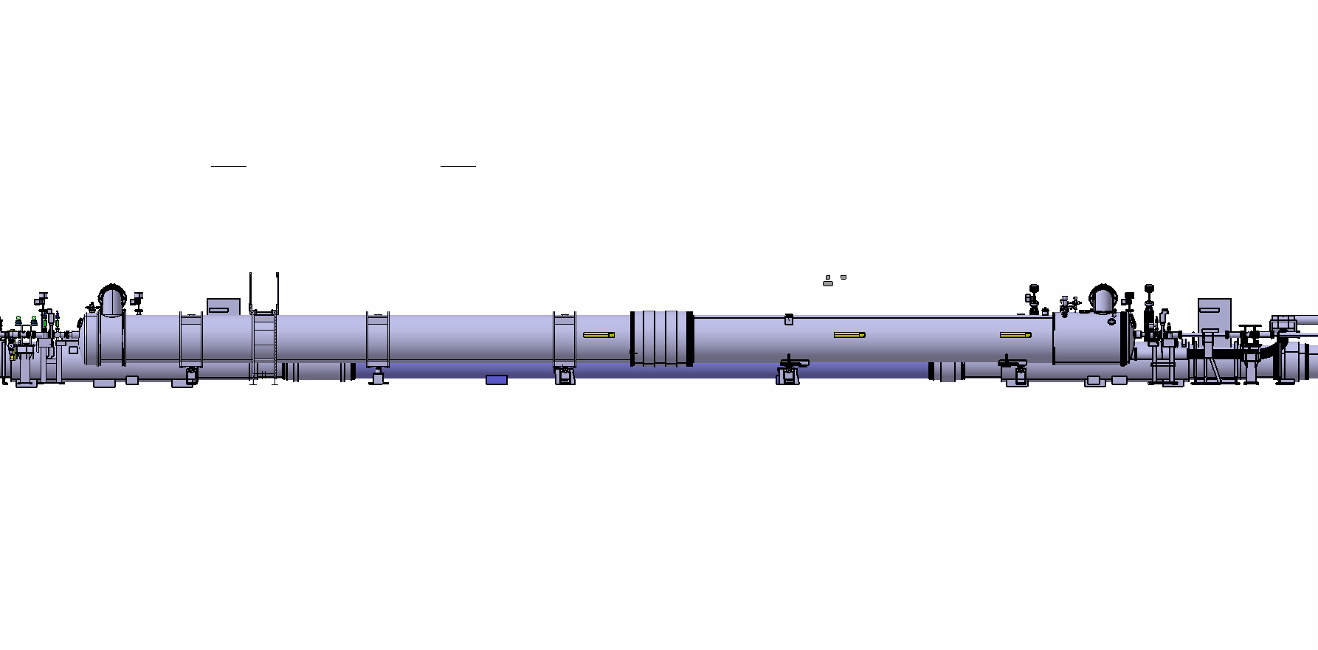
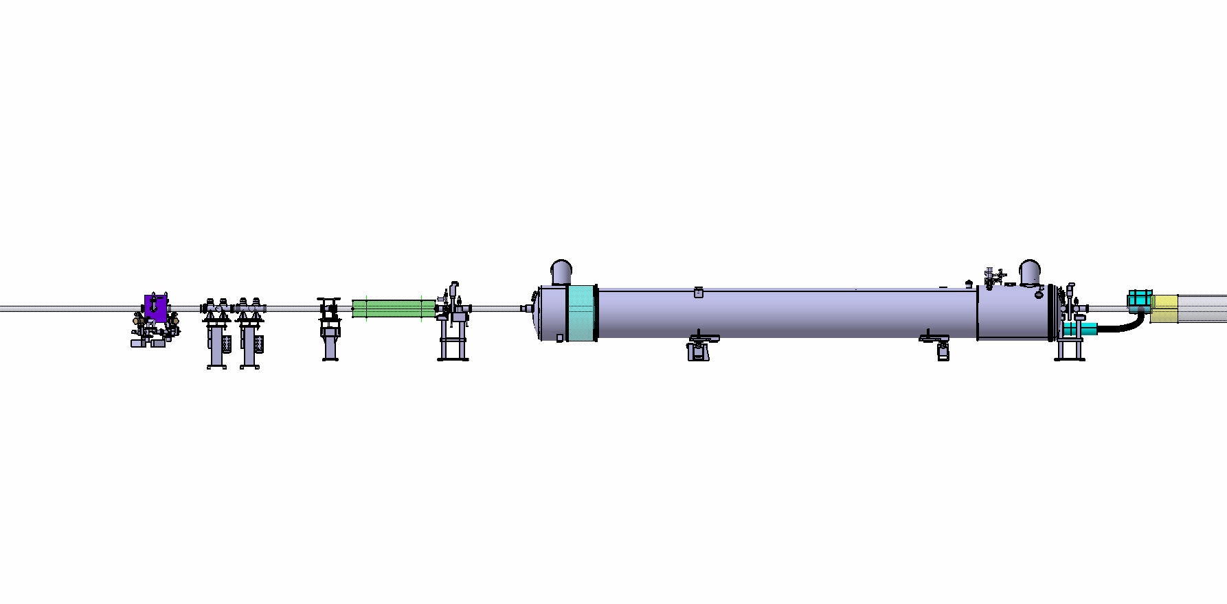
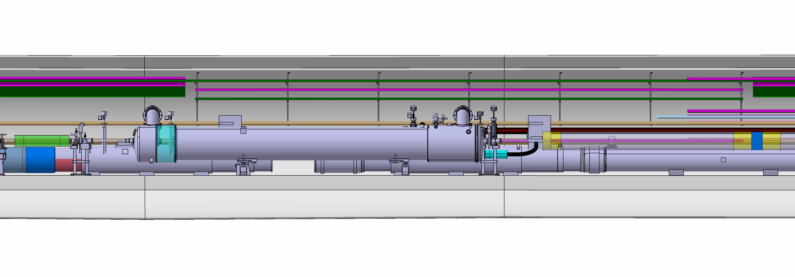
From D2 – Q4 (LHC) to Q4 (HL-LHC)
D2
Q4
Q4
LHC
HL-LHC
Courtesy D. Duarte

Slide 13
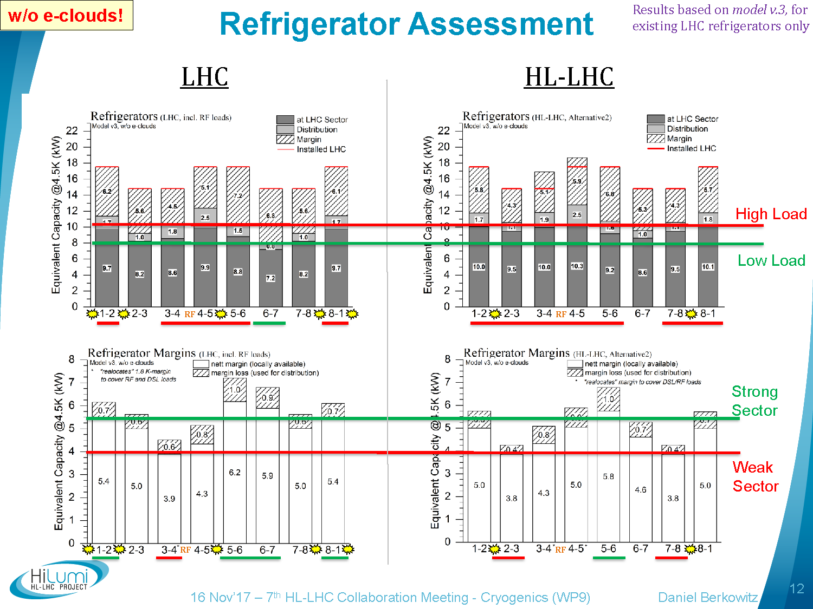
Cooling capacity: is it enough?
Cooling capacity for SAM’s & DFBL to come from main sector Refrigerators (~0.5kW_eq@4.5K)
Cooling capacity margins will be aligned on other sectors
(5-6 higher as no IT nor RF)
No “weak point/sector” created with this alternative

Slide 14
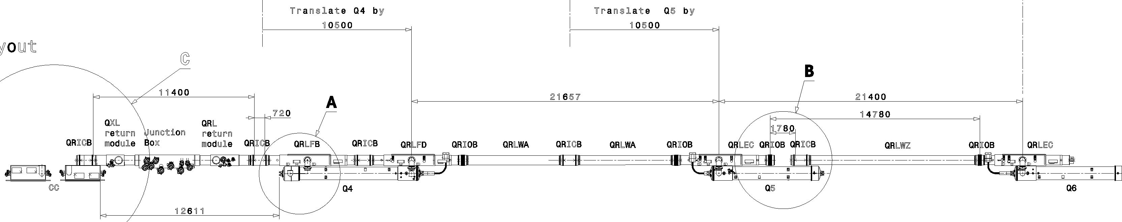
QRL / QXL optimisation in Right of 5
QXL-QRL Junction Module
HL-LHC Baseline layout
QXL
4
Present LHC machine and QRL layout
1
1
3
3
10.5m
10.5m
HL-LHC Matching Section Optimization layout
5 QXL
4
7
6
8
Translation of present QRL modules between Q4 and Q5
We leave QRLWZ and Q6 service module in place
New QXL-QRL Junction Module (11.4 m to be further optimised to avoid interference with CC2 area )
New QXL
Adaptation pipe elements
Pipe element adaptation
New modules Q4 jumper
Jumper extension ?
REUSE
NEW
LHCQXL___0004
Courtesy J. Metselaar, M. Sisti and WP9 team

Slide 15
Warm powering simplification
 |  | Baseline | Optimized approach
Q4 | Quadrupole | MQY | MQY
 |  | 1X HCRPHRA R2E-LHC4-6-8kA+08V | 1 X HCRPHRA R2E-LHC4-6-8kA+08V
 | Correctors | 8 MCBY | 6 MCBY
 |  | 8 X HCRPLBC R2E-HL-LHC120A-10V | 6 X HCRPLBC R2E-HL-LHC120A-10V
Q5 | Quadrupole | MQY | MQML
 |  | 1 X HCRPHSB R2E-LHC4-6-8kA+08V | 1 X HCRPHSB R2E-LHC4-6-8kA+08V
 | Correctors | 6 MCBY | 2 MCBC
 |  | 6 X HCRPLBC R2E-HL-LHC120A-10V | 2 X HCRPLBC R2E-HL-LHC120A-10V
Q6 | Quadrupole | MQML | MQML
 |  | 1 X HCRPHSB R2E-LHC4-6-8kA+08V | 1 X HCRPHSB R2E-LHC4-6-8kA+08V
 | Correctors | 2 MCBC | 2 MCBC
 |  | 2 X HCRPLBC R2E-HL-LHC120A-10V | 2 X HCRPLBC R2E-HL-LHC120A-10V
Courtesy M. Martino

Slide 16
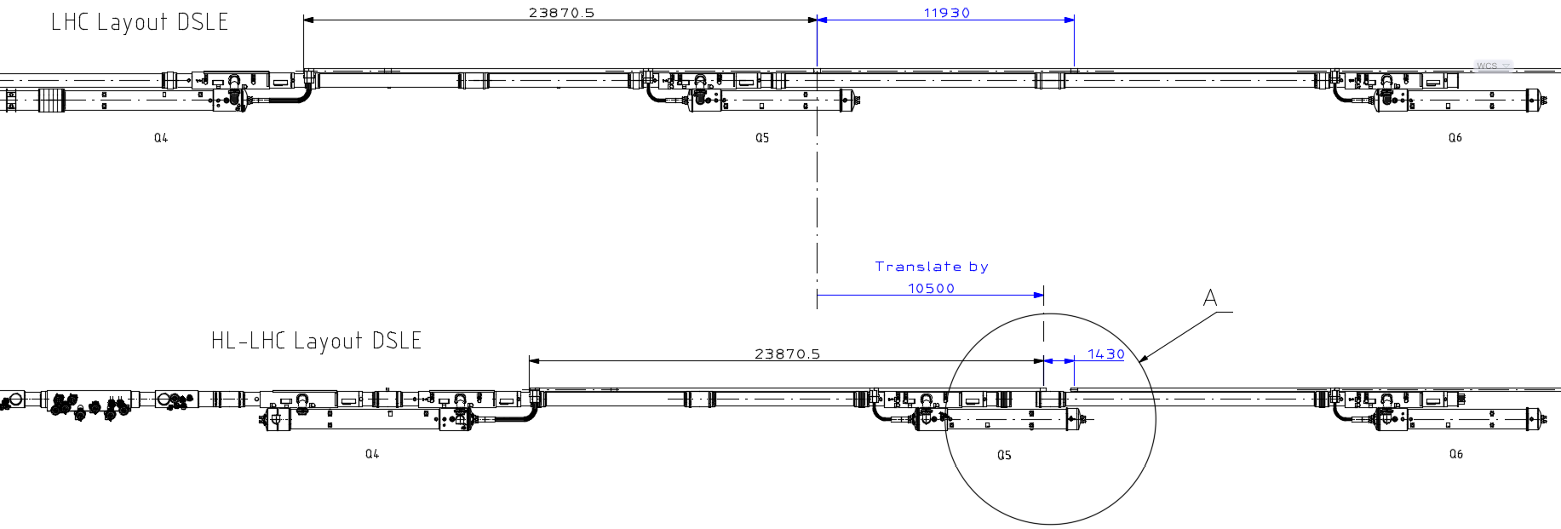
DSL optimisation in Right of 5
Present LHC machine and QRL layout
Cut and remove (11.93m)
HL-LHC Matching Section Optimization layout
LHCDSLE_0007
Courtesy S. Claudet, A. Perin and WP6A

Slide 17
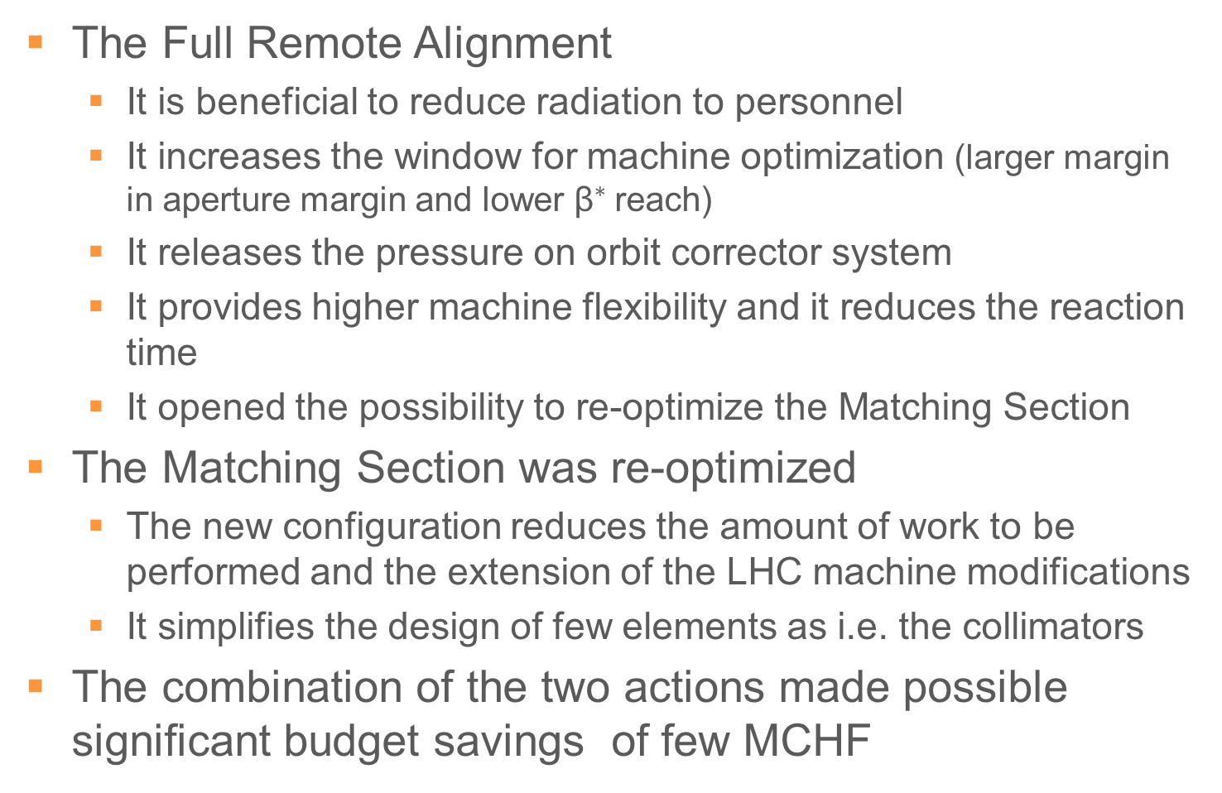
Conclusions
The Full Remote Alignment
  It is beneficial to reduce radiation to personnel
  It increases the window for machine optimization (larger margin in aperture margin and lower ${\text{β}}^{∗}$reach)
  It releases the pressure on orbit corrector system
  It provides higher machine flexibility and it reduces the reaction time
  It opened the possibility to re-optimize the Matching Section
The Matching Section was re-optimized
  The new configuration reduces the amount of work to be performed and the extension of the LHC machine modifications
  It simplifies the design of few elements as i.e. the collimators
The combination of the two actions made possible significant budget savings of few MCHF

