Slide 1

Machine Protection and Operational Aspects of the Full Remote Alignment System
J. Uythoven
With input from:
Jorg Wenninger, Daniel Wollmann and Markus Zerlauth
International Review of HL-LHC Alignment and Internal Metrology (WP15.4)
26 – 28 August 2019

Slide 2
Outline
Machine Protection and Operational Aspects of the Full Remote Alignment System
  Definition and experience so far
  What Machine Protection does not treat
  Hardware Interlocking
  Software Interlocking
  Procedures
  Crabs and BBLR
  Conclusions

Slide 3
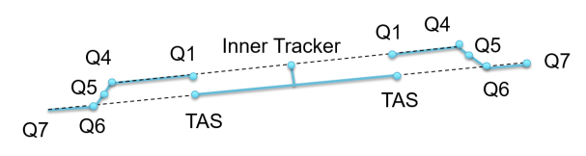
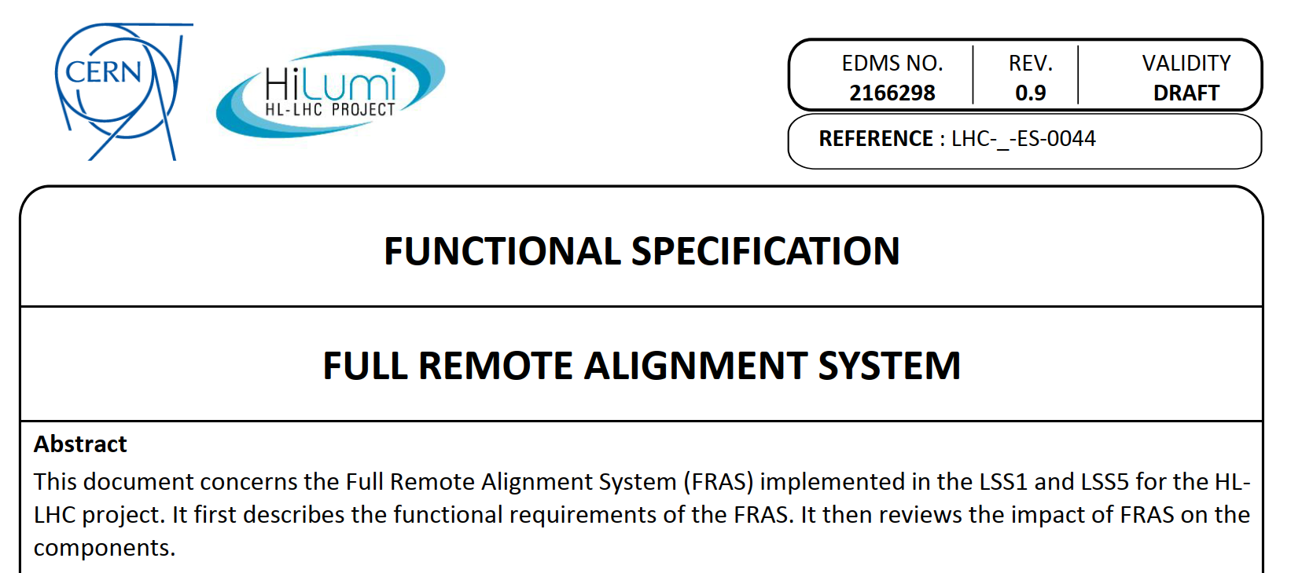
HL Remote Alignment System for IT
Remote alignment of machine elements between
Q1 and Q5 L/R of IP1 and IP5
Max remote stroke: ± 2.5 mm
See also:
P. Fessia in MPP meeting 9/11/2018 and HL TCC 15/11/2018

Slide 4
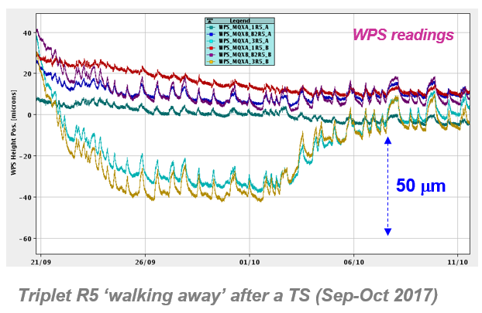
Present Interlocking of Triplet position
Actual triplet can already be remotely re-aligned
No connection to the Beam Interlock System
  Protection to move with or without beam based on
    Key required to power motors
    In possession of the Survey group – their responsibility
Software Interlock System
  Injection BIS interlocked by SIS, stops injection if any WPS sensor is more than 250 µm away from reference value
  It never stopped the beam (JW)
  SIS interlocking on motors
  was disabled; too many false
  triggers

Slide 5
Experience so far
See also presentation by Jorg in Full Remote Alignment Specification meeting 12 June 2019
  https://indico.cern.ch/event/808303/
Includes Operational aspects and Machine Protection aspects. It makes reference to two occasions when remote alignment was used
  6 May 2016 after the weasel event → warm-up / cool-down cycle caused triplet to move
    Re-aligned remotely without beam, moved it back
    Use WPS for reference. Still in re-start phase of the machine, with loss maps and intensity ramp up, 3 bunches, see link to slide of 830 meeting.
    No issues

Slide 6
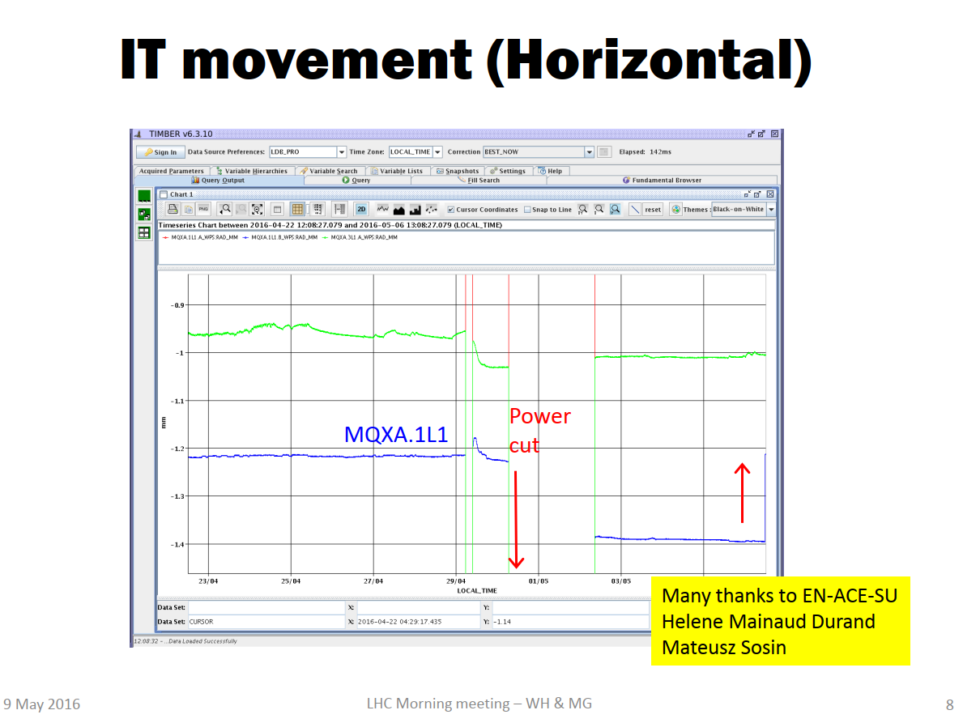
Remote alignment 6 May 2016
IT 1L1

Slide 7
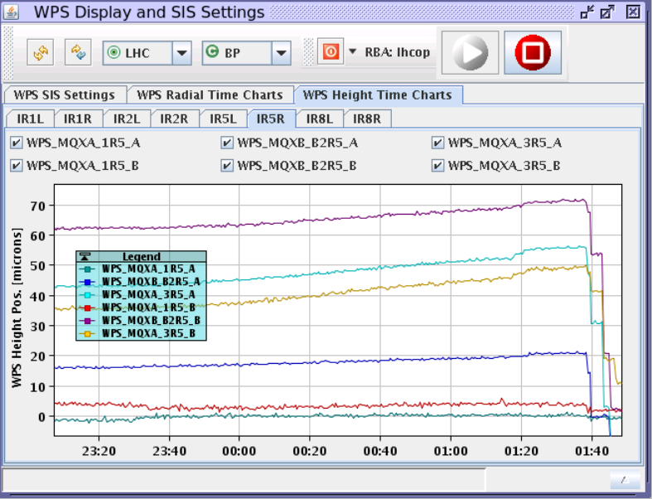
Only one re-alignment with beam
Saturday 8/10/2016 @ 01:30. Re-alignment of R5 triplet in H and V-plane at injection energy
  Experience was good, see report 830 meeting here
  Followed by a 2 bunch fill
  Followed by betatron loss
  maps in collision
  Followed by 10 bunch fill
  Discussion on what needed
  to be done at the moment of
  the action, no agreed upon
  procedures, not treated in
  the MPP meetings
    Not satisfactory

Slide 8
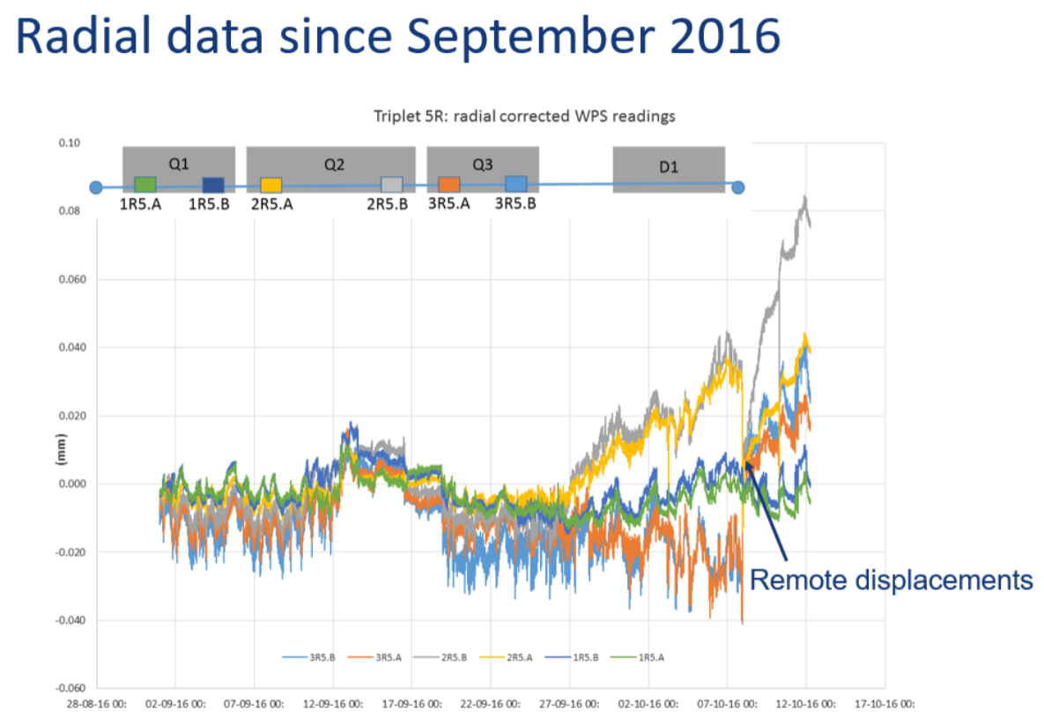
LMC 12/10/2016, HMD
Not mentioned that re-alignment was with beam
In this LMC there was an action for MPP to “understand the impact of the triplet movements on machine protection”. Not an action on remote alignment.

Slide 9

The Risks
During and following Remote Alignment of the elements between Q1 and Q5 the following risks have been identified
  Related to Equipment Protection
    Vacuum leaks because of bellow movements > limit
    Cryogenics leaks because of mechanical limits
    Loss of mechanical integrity
  Related to Machine Protection
    Beam induced damage to any equipment in the machine during or after the remote alignment – performed with or without beam

Slide 10
Hardware Interlocks: Proposal
During normal operation the motors driving the movement of the system should have no power
The motors can be powered by turning a key
  This key can be in the CCC cupboard and ideally the ‘lock’ in the CCR (preferred). Turning this lock it will
    Power the motors for remote alignment in IP1 or IP5
    Propose to have one key for IP1 and one key for IP5
    Will activate a maskable interlock to the Beam Interlock System (BIS). Connection to the BIS in IP1/IP5
    The system can only be used when there is no beam or ‘safe beam’. Unsafe beam will be dumped. The beam intensity and energy limit is determined by the Safe Machine Parameter flags
  Very similar solution as used for the Aperture Kicker (MKA) in Point 4. Only difference is that for MKA there is no danger when operated without beam.
  Re-aligning magnets with beam at injection, using a pilot bunch, is probably safer than re-aligning without beam and inject beam into an ‘unknown system’.

Slide 11
Software Interlocks
On top of the hardware interlocks, software interlocks can be defined (SIS)
  To check on drifts relative to reference positions
  Re-establish the SIS acting on the Injection BIC if quads have moved by > 250 µm. Exact value of the limit to be re-confirmed.
  Using SIS for tolerances related to bellows, does NOT seem the right thing, as it stops the beam and not the movement

Slide 12
Procedures
Procedures are as important as the hardware interlock
  Important for alignment with beam AND for alignment without beam
The procedures have to define
  If the movement of the cold mass concerned is smaller than 0.0X mm, no special verification is required.
  This needs full confidence in the new position measurement system
    If not → full verification after any powering of the motors
  For a position change above 0.0X mm it will be required to
    Perform a test cycle with a given small number of bunches; steering
    Perform loss maps – at given or all energies
    Perform an intensity ramp-up with defined steps in intensity and given time / number of fills
Procedures to be defined and approved before first beam following LS3
Under the responsibility of the Machine Protection Panel

Slide 13
Responsibilities
Who keeps the key ?
  Operations, access via card
Who check that procedures are followed ?
  Operations group
Mechanical integrity
  Equipment owner – not Machine Protection
Procedures to be written under the responsibility of the Machine Protection Panel and agreed upon by all parties involved, following edms release procedure
OP responsible that enforced procedures are followed
Hardware interlocking to be defined (including tests) between equipment owner and MPP team
  Does not protect against movement without beam
Establish the SIS interlocking: OP and MPP

Slide 14
Crabs and BBLR
Crab Cavities (baseline)
  Also remote alignment foreseen
  Same hardware and SIS interlocking required
    Include in the same hardware interlock ?
    Procedures to be different if only crabs are moved ?
Beam Beam Long Range Wire Compensation (not baseline)
  If installed, same questions as above
Questions to be answered in the MPP meetings

Slide 15
Conclusions
A hardware interlock on the powering of the motors, connected to a maskable input of the Beam Interlock System, is mandatory
  Present situation is probably too risky to align with beam
  Aligning without beam is even more dangerous for the next injection
  New IT, more likely that remote alignment will be used
  However, procedures will be heavy: loss maps, intensity ramp-up
Software interlocks by the SIS will improve functionality and safety after re-alignment without beam
Detailed procedures are important
  To be written and agreed upon, under coordination by the Machine Protection Panel
  To be followed after re-alignment (with or without beam) of any magnet/CC/BBLR
The remote alignment system is not to be used lightly, with or without beam. It will not become an operational knob ;-)

