Slide 1

FRAS Motorized Axes Control System
P. PERONNARD
Review of HL-LHC Alignment and Internal Metrology (WP15.4)

Slide 2
Outline
The control system requirements
Solution proposed: SAMbuCa
Development Timeline
Conclusions

Slide 3
FRAS Motorized axes IP5 summary
Racks location | Racks names | Cable length up to the sensors / actuators (m) | Axes type | Axes number | Axes` groups to be synchronized
UL557 | GYPOS_01 ÷ GYPOS_04 | 100 | Motion (stepping motor + resolver) | 60 | 30 +30
 |  |  | Load cells(TBC) | 36 ÷ 60 | 0
 |  |  | Position sensors (TBC) | 60 | 0
UR55 | GYPOS_01_R ÷ GYPOS_06_R | 300 | Motion (stepping motor + resolver) | 71 | 24+16+10+10+10
 |  |  | Load cells(TBC) | 31 | 0
 |  |  | Position sensors (TBC) | 31 | 0
UR55 | GYPOS_01_L ÷ GYPOS_06_L | 300 | Motion (stepping motor + resolver) | 71 | 24+16+10+10+10
 |  |  | Load cells(TBC) | 31 | 0
 |  |  | Position sensors (TBC) | 31 | 0

Slide 4
FRAS Motorized axes IP1 summary
Racks location | Racks names | Cable length up to the sensors / actuators (m) | Axes type | Axes number | Axes` groups to be synchronized
UR15 | GYPOS_01 ÷ GYPOS_04 | 100 | Motion (stepping motor + resolver) | 60 | 30 +30
 |  |  | Load cells(TBC) | 36 ÷ 60 | 0
 |  |  | Position sensors (TBC) | 60 | 0
US15 | GYPOS_01_R ÷ GYPOS_06_R | 300 | Motion (stepping motor + resolver) | 71 | 24+16+10+10+10
 |  |  | Load cells(TBC) | 31 | 0
 |  |  | Position sensors (TBC) | 31 | 0
US15 | GYPOS_01_L ÷ GYPOS_06_L | 300 | Motion (stepping motor + resolver) | 71 | 24+16+10+10+10
 |  |  | Load cells(TBC) | 31 | 0
 |  |  | Position sensors (TBC) | 31 | 0

Slide 5
FRAS Motorized axes summary
Axes type | Total Axes number
Motion (stepping motor + resolver) | 400
Load cells (TBC) | 194 ÷ 244
Position sensors (TBC) | 244
Limits switches | 1044

Slide 6
Control System Requirements
Sensors / Actuators
Sensors / Actuators Total Integrated Dose (TID) | < 2 MGray
Sensors / Actuators cable length from the electronics | 300 m
Maintenance | free
Life time | Min 10 years
Operation time | 86 h

Slide 7
Control System Requirements
Control system architecture & components
Axes positioning resolution | few µm
Axes motion synchronization | 1s per axes` groups (system can achieve 1 ms)
Motion start trigger | Software trigger
Modularity | Architecture scalable with number and axes` groups position in the racks
Flexibility | Conditioning electronics proper designed for the project actuators / sensors
Fields I/O connectivity | High Density / High robustness to avoid false contacts and oxidation
Maintainability | Mean Time To Repair < 10min
Long term investment | Full control of hw and sw for future upgrades / improvements

Slide 8
Control system architecture

Slide 9
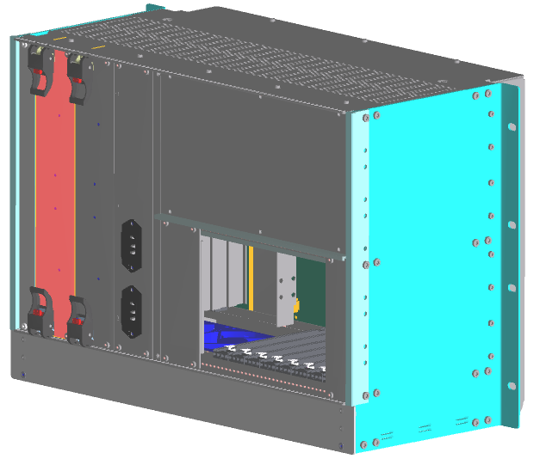
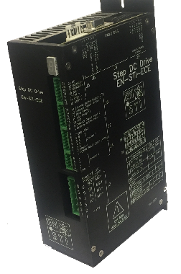
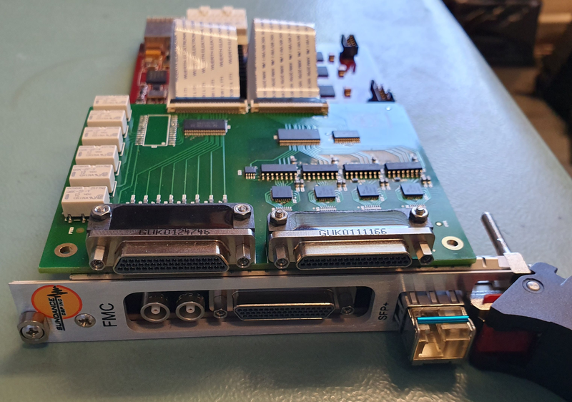
Low-level control: SAMbuCa
(Sensors Acquisition & Motion Control system)
Complete In-house solution (i.e. hw and sw)
Architecture :
  PXIe Front-ends in High Availability chassis
  PXIe chosen as successor of the PXI standard that is getting obsolete - Platform fully standardized at CERN with BE-CO (i.e. Cent OS 7 and C++)
  a PXIe FPGA Carrier and a set of FMC cards to cover the interfacing requirements with the field sensors and actuators
  EN-SMM step driver (long cables, open/closed loop)
  Focus on connection reliability and re-configurability
  Same control system solution to be adopted for the LHC Collimators low level control upgrade (HL-LHC – Collimation System International Review Feb2019)

Slide 10
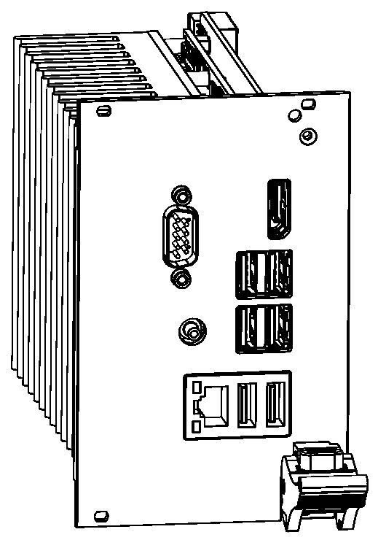
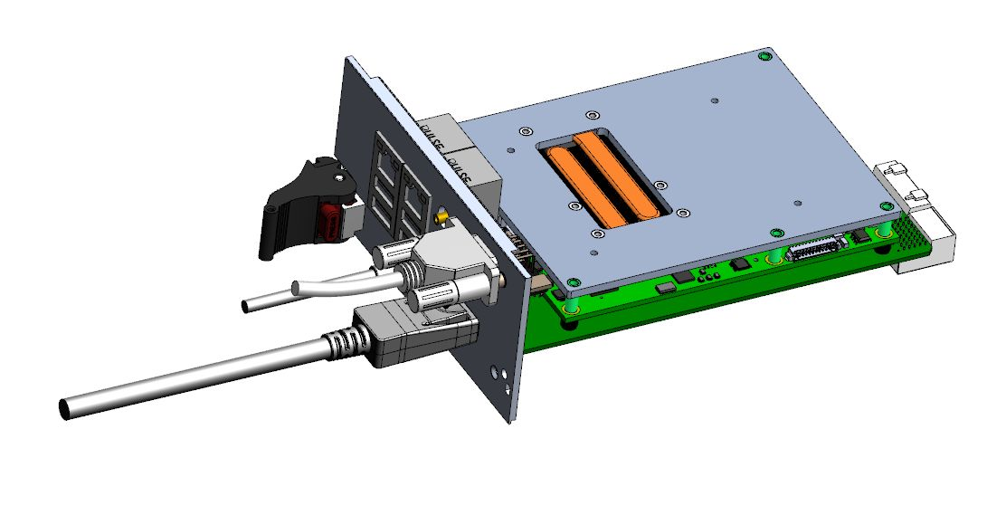
Low-level control: SAMbuCa
(Sensors Acquisition & Motion Control system)
PXIe Controller
  Based on COM-Express CPU modules
  Computing power chosen according to user needs
Will run Be/CO Linux and FESA class
Software framework and Linux drivers to configure and control the peripheral cards
Collaboration with BE/CO to ensure the compatibility with their ecosystem– Open Hardware
Design in progress – Outsourced to external company

Slide 11
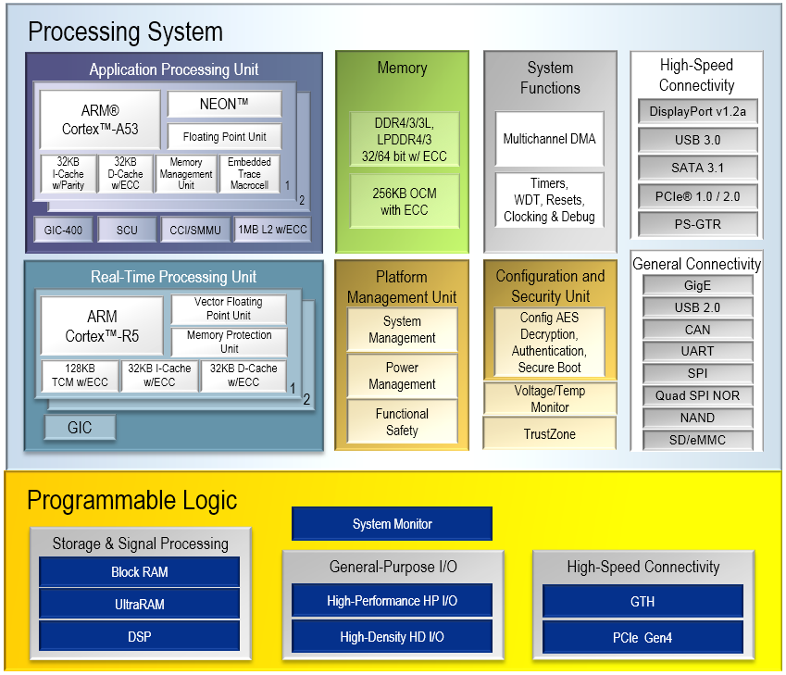
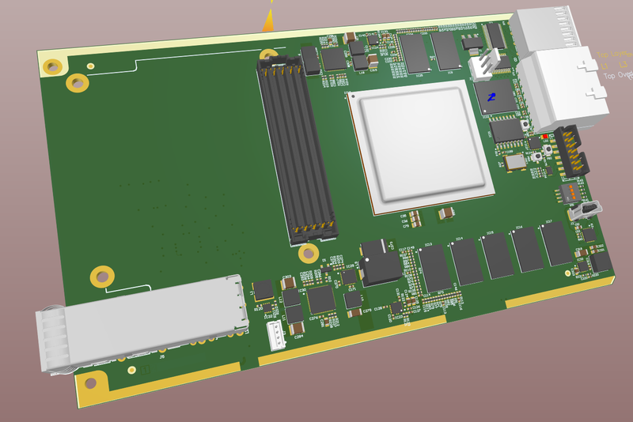
Low-level control: SAMbuCa
(Sensors Acquisition & Motion Control system)
PXIe FMC Carrier
  Based on Xilinx Zynq UltrasScale+
  PCIe Gen2x4
  4GB DDR4 memory with ECC for processor
  2GB DDR4 memory for programmable logic
  64GB eMMC flash
  Remotely reconfigurable from PXIe controller
  White-Rabbit support for synchronization
  HPC FMC connector fully wired to FPGA
  Board layout in progress, prototype expected by Q4 2019
Control algorithms executed either by ARM cores or programmable logic

Slide 12
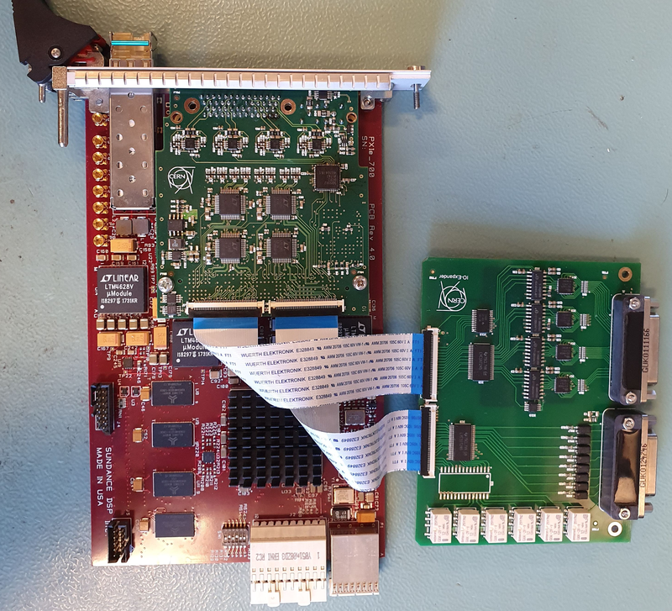
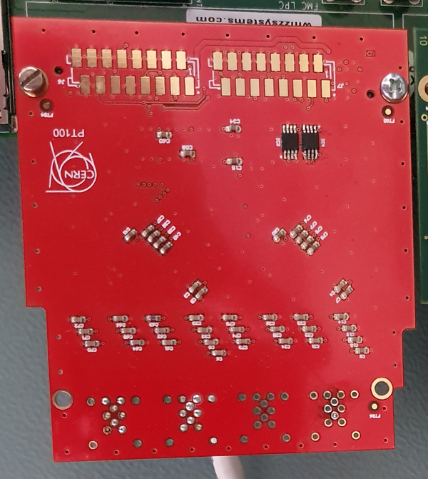
Low-level control: SAMbuCa
(Sensors Acquisition & Motion Control system)
Set of FMC cards
  8-ch LVDT/Resolver/Potentiometer analog front-end
  12-ch Thermocouple/PT100
  Digital IOs (limit switch, interlock, motor driver, …)
  Strain gauge
  Force sensor
  Optical fiber card to connect an expansion chassis (CompactPCI serial from BE/CO)

Slide 13
Low-level control: SAMbuCa
(Sensors Acquisition & Motion Control system)
Expansion chassis with DIOT (WP18 HL-LHC)
  https://wikis.cern.ch/display/DIOT/Distributed+IO+Tier+chassis
  Possibility to connect up to 4x chassis to PXIe FMC carrier
  Can be an option for slow application

Slide 14
Low-level control: SAMbuCa
(Sensors Acquisition & Motion Control system)
Rack layout example
  4 expansion chassis connected to PXIe FMC carrier via optical links
PXIe Chassis (8 peripheral slots)
PXIe Controller
Expansion Chassis #1
Application FMC Card
Expansion System Controller with FMC carrier
Expansion Chassis #2
PXIe Survey & Motion FMC carrier
Expansion Chassis #3
Expansion Chassis #4

Slide 15
Development Timeline
Proof of concept 2020
FRAS control system validation on string tests
Mass production and validation 2022-2023
Operational software 2024
Deployment and commissioning 2025-2026

Slide 16
Conclusions
Design study shared with LHC collimator control system
Building blocks profit of BE/CO developments foreseen in WP18 HL-LHC (expansion chassis)
SAMBUCA will ensure with respect to commercial solutions
  Full control on hardware and software components
  High-availability ensured by 15-years past experience on motion control for critical missions (e.g. LHC collimator control system)

Slide 17
Thank you

