Slide 1

Status of automatic measurements
H. Mainaud Durand
Review of HL-LHC Alignment and internal Metrology (WP15.4)

Slide 2
Outline
Context
Solution proposed
Next steps

Slide 3
Context
High radiation level → limited intervention time to perform the measurements
From the FRAS functional specification:
  All relative misalignments between adjacent components will be recorded in order to monitor the impact on the vacuum bellows.
  The position of the corresponding vacuum bellows will be deduced from the position of the adjacent components on which they are attached
  The position of all other bellows, pipes and RF waveguides will be controlled w.r.t. the tunnel main components during LSs.
Just the control of position, no adjustment foreseen
Use of permanent targets

Slide 4
Context
List of the intermediary components:
  BPM after D1
  DFX, DFM
  Cryolink
  APWL, BPTX
  TCL
  + QXL jumper flanges
  + Crab cavities RF waveguides
  + VSC components (transition chambers, drift vacuum chambers, vacuum modules)

Slide 6
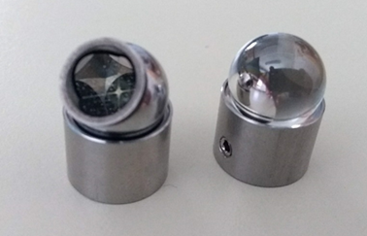
Context: strategy of alignment
Fiducialisation on surface: installation of 0.5’’ or 1.5’’ standard fiducials + permanent targets
Initial alignment w.r.t. tunnel underground geodetic network
“Smoothing” w.r.t. adjacent components → Determination of the position at t0.
Follow-up of the position, every YETS or LS
Determination of the delta and storage in a database.

Slide 7
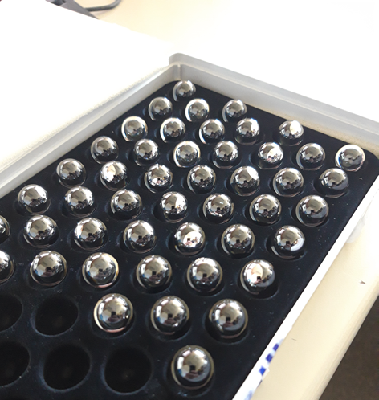
Solution proposed
Development of a semi-automatic method of measurement using laser tracker, knowing that one in place, these instruments can be piloted remotely.
This implies:
  The booking of lines of sight in the 3D models, from “repeatable” and known station location,
  The installation of permanent fiducials during the fiducialisation (or installation process).

Slide 8
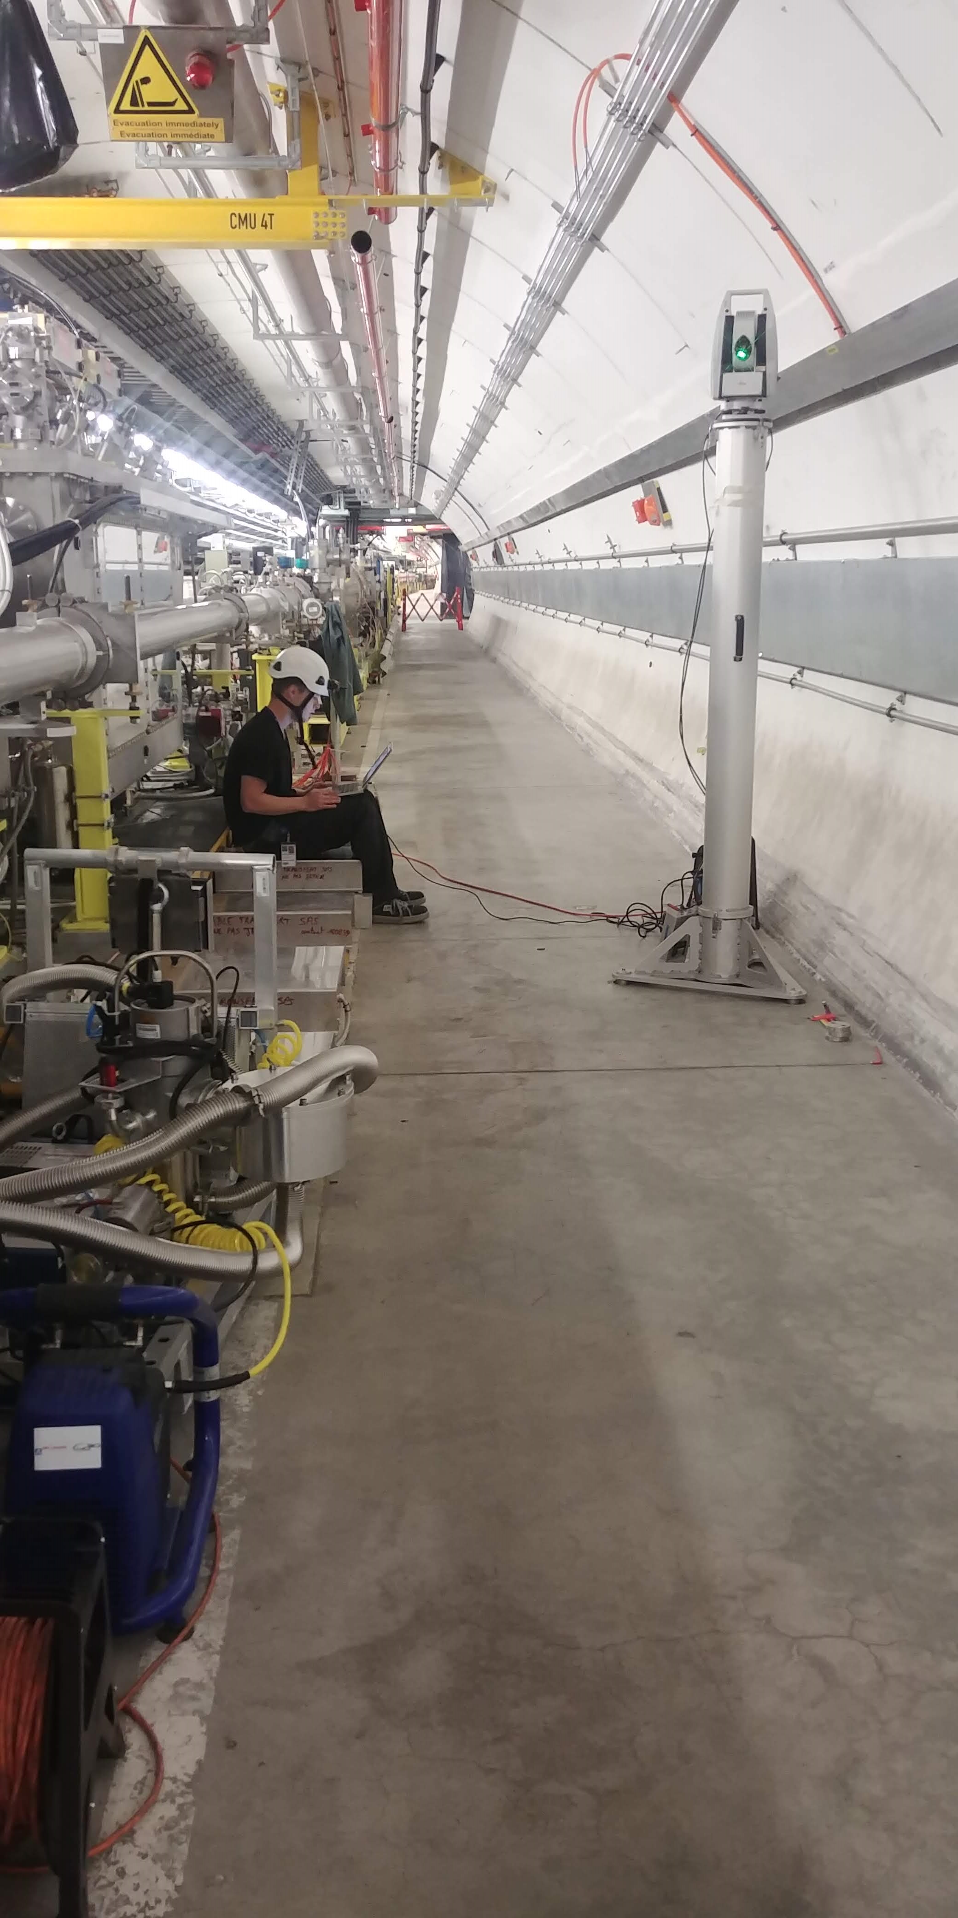
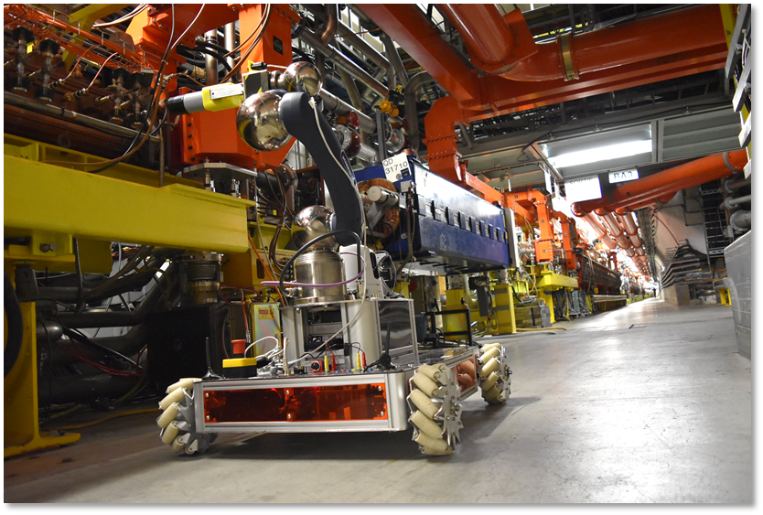
Solution proposed
Install the laser tracker at the same location and height on the tunnel floor, to keep the same lines of sight towards the targets of the components (save time of installation, be sure that there will not be any obstacles along the lines of sight).
  Integration of the lines of sights in the 3D models
  Marking of the laser tracker station on the tunnel floor
  Use of a plug-in version (SPS example)
  A robot station could be put in place as well in very radioactive areas.

Slide 9
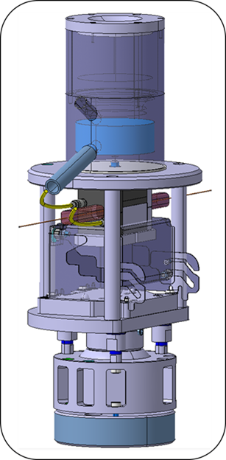
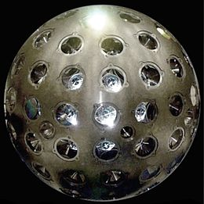
Solution proposed: permanent targets
Target = glass sphere with coating.
One drawback: the orientation of the target towards the measurement instrument
  Use of a specific target (with 3 glued target)
  Configuration of spheres according to the lines of sight

Slide 10
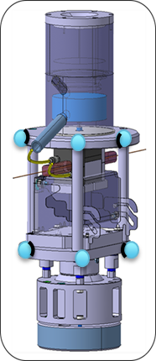
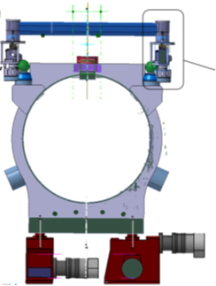
Solution proposed: concept
How to perform the measurements w.r.t. the main components?
Use the targets of the permanent sensors supports: their position is known (within a 10 µm accuracy) in the referential frame of the support.
The position of the stretched wire is known (within a 5 µm accuracy in the referential frame of the WPS).
Micrometric repeatability to install the WPS on its support
Component remotely aligned
Intermediary component
Component remotely aligned
Wire
protection
Station
Top view

Slide 11
Solution proposed: configuration
How to perform the measurements w.r.t. the main components?
Very preliminary

Slide 12
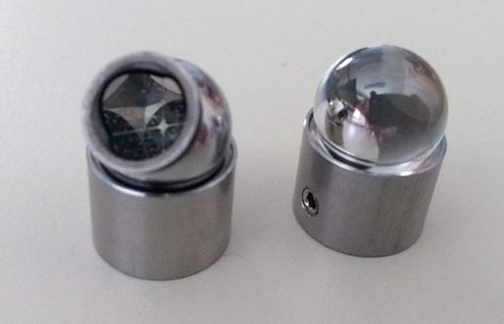
Solution proposed: first results
All visible points measured with regular 0.5’’ CCR using precise mode (2 circles, 5 seconds each)
All visible points measured with 0.5’’ glass ball with coating using precise mode
Additional measurements (another station / one circle measurements / max distance)
Data comparison
Series of measurements in SU geodetic base using:
  AT401 (CLIC)
  AT402 SN392506 (ASG)
  AT401 390769 (ASG)
  AT960 (ASG)
From A. Zemanek (June 2018)

Slide 13
Solution proposed: first results
Measurements performed with the CCR are considered as the reference.
AT960 gave the best results
AT401_2 didn’t measure above 3.6 m
From A. Zemanek (June 2018)

Slide 14
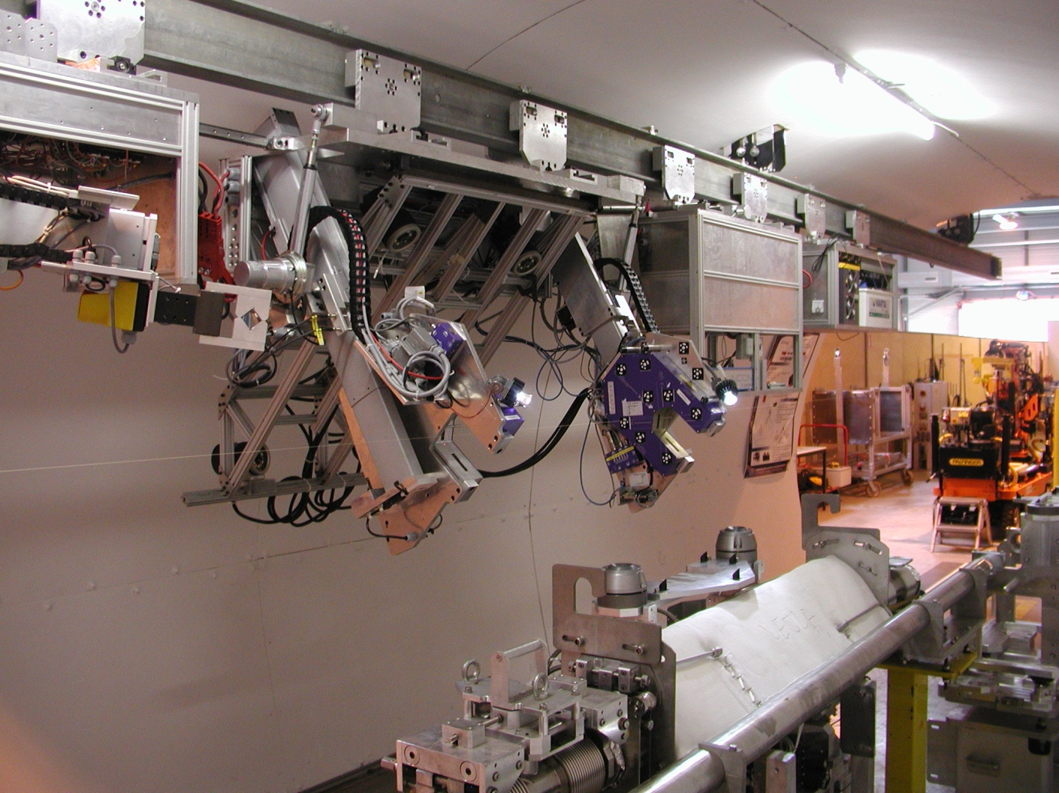
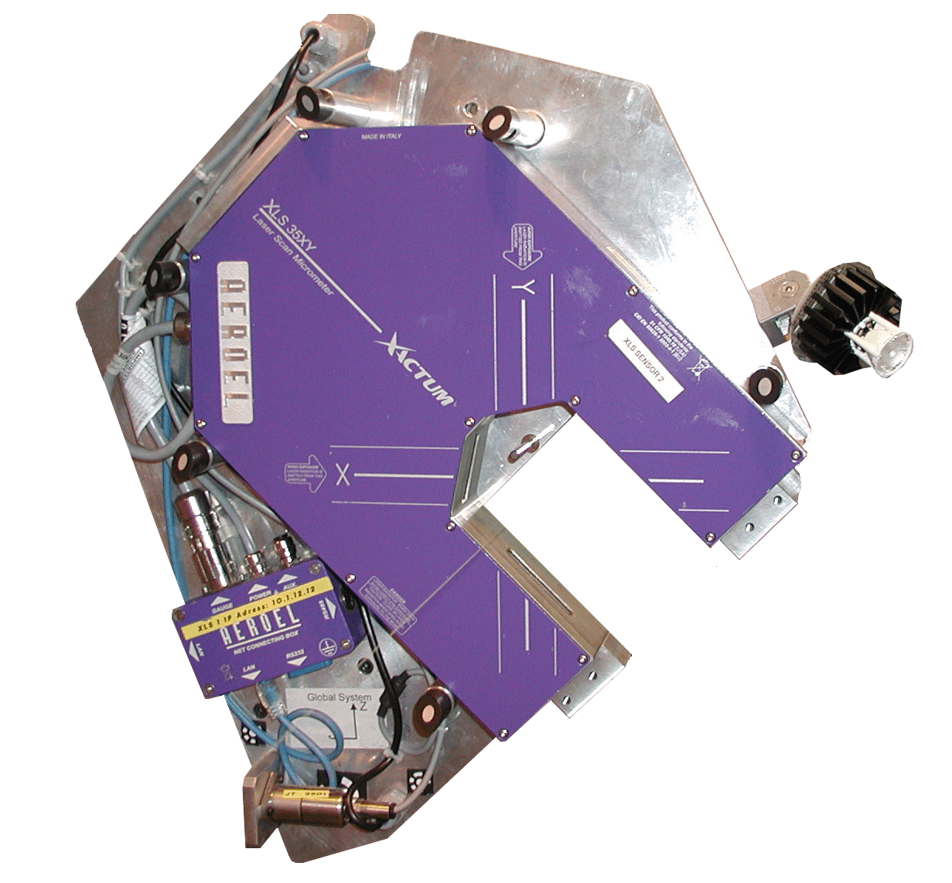
Another solution
Collimator
Traction unit
Sensor unit
Control unit
Quad
Quad
Battery unit
Targets
Wire Sensor
Cameras
Determination of the wire by photogrammetry

Slide 15
Another solution
Two drawbacks:
A temporary wire has to be installed during them measurements between D1 and Q6
The stretched wire can not be protected from air currents as it has to be visible for the photogrammetric measurements

Slide 16
Next steps
Perform simulations according to the configuration we will have in the tunnel to chose the best position for the measurement stations
Book the position of the stations and lines of sights in the 3D models
Propose “plug-in” pillars
Launch a deeper study on the measurements carried on coated glass sphere
Validate the concept of measurements on a test setup (the string test would be a very good place)
Study the possibility to use a robot to install the Atxxx at the correct position.
No resources are currently available for such a study.

Slide 17
Thank you very much

