Slide 1

What is foreseen on string test
Andreas Herty
Review of HL-LHC Alignment and Internal Metrology (WP15.4) – 26-28.08.2019

Slide 2
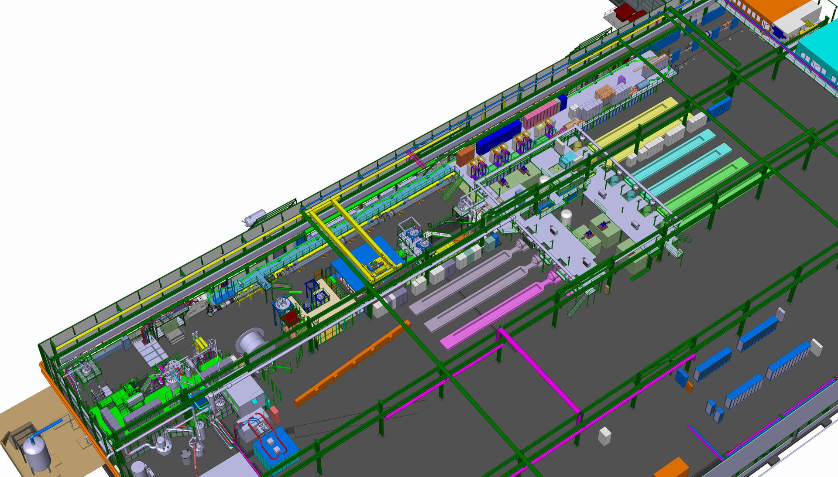
general layout in SM18
Thank you Antoine Kosmicki for the 3d view.

Slide 3
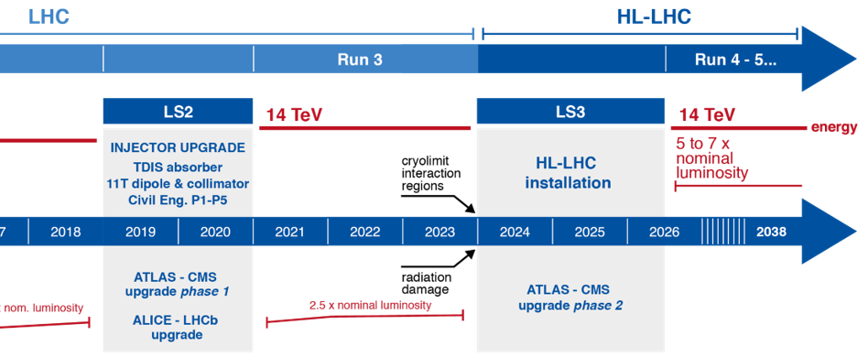
timeline & scope
test string timeline
infrastructure
installation
operation
The scope of the string test is to evaluate complete systems and their interaction with systems of other work packages, e.g. interconnection forces, vacuum forces, cold-warm relations.
^{(*)} from various presentation at HL-LHC Inner Triplet String Day: https://indico.cern.ch/event/741801/

Slide 4
WP15.4 contribution
Fiducialisation (covered during manufacturing)
Complete process of “standard measurements” for installation
  Geodetic network, QXL, jacks, alignment cryostats before interconnection
Validation of systems: integration and technical solution
  Installation, operation and validation of the continuous position determination systems
Full Remote Alignment Operation
  First time operation of Full Remote Alignment system; study impact on other systems
  (e.g. deformable RF bridges)
Maintenance during operation
  Maintenance scenarios for Work and Dose Planning time estimation (radio protection)
  and cryogenic access constraints due to helium spill risk (similar to LHC today)
Provide data for other work packages^{(*)}
  Movements during quenches, pump down, cool down
  Optional: vibration measurements
^{(*)} from various presentation at HL-LHC Inner Triplet String Day: https://indico.cern.ch/event/741801/

Slide 5
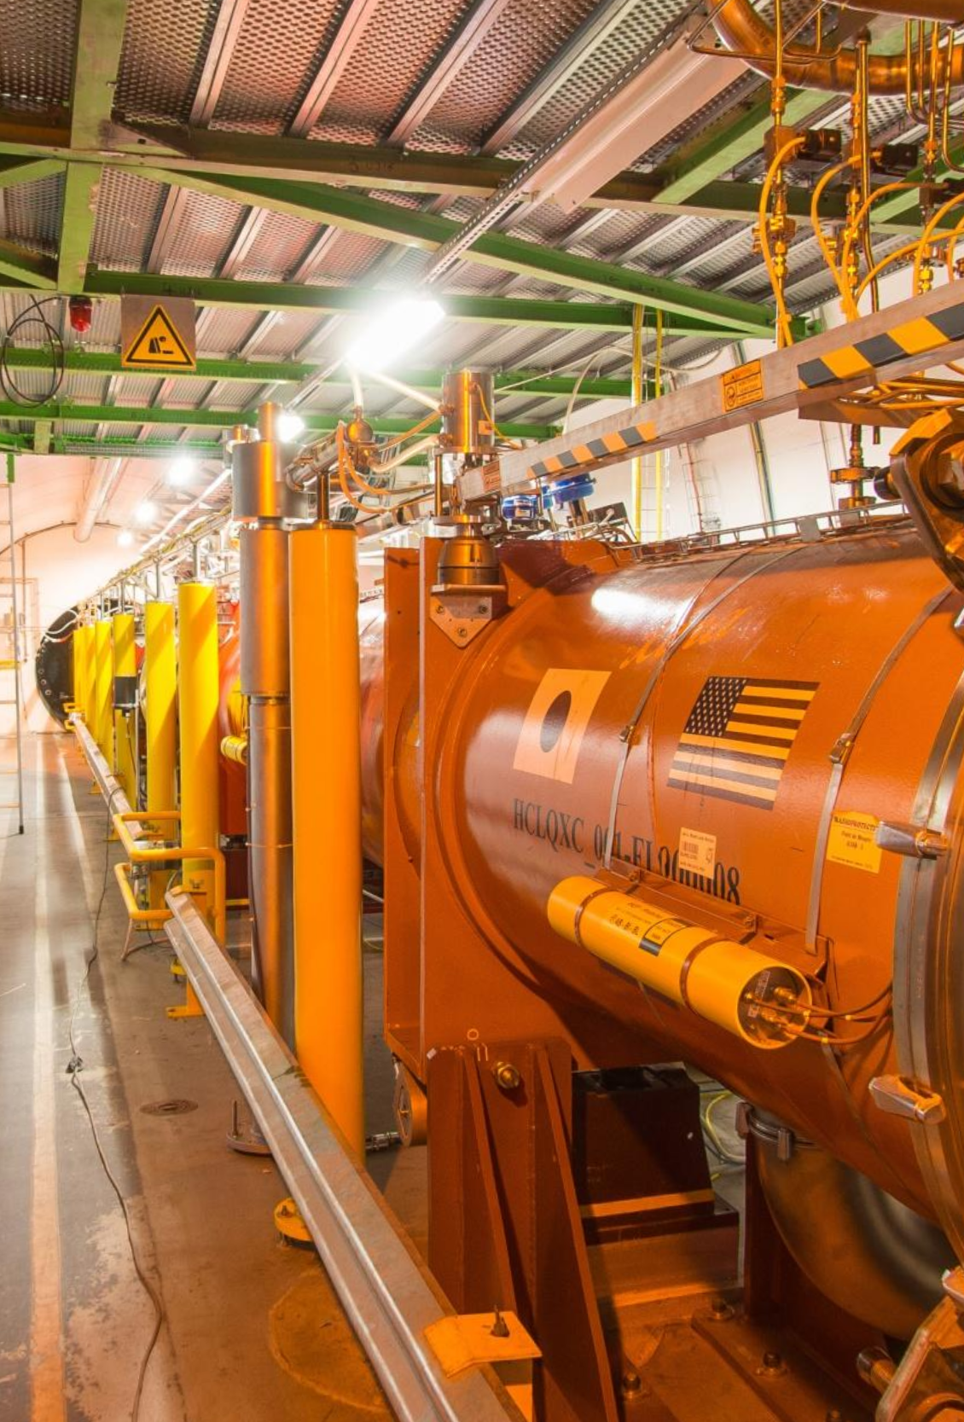
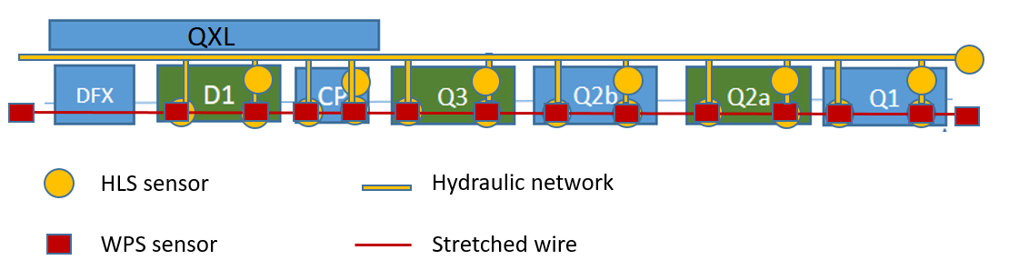
continuous position determination systems
To determine the position of the cryostats
14 WPS for radial and vertical
18 HLS for vertical and roll
6 MT-FSI lines for longitudinal position
4 MT-FSI inclinometers
To adjust the position of the cryostats
18 motorized jacks
To monitor the position of the cold mass inside the cryostat in Q1, Q2a, Q2b and Q3
48 MT-FSI lines

Slide 6
measurements of WP15.4 on string installation
Alignment (continuous position determination sensors, external)
micrometric relative movements between cryostats
overall position of the components in the SM18 geodetic network
Motorized jacks
  micrometric relative movements
  backlash behaviour under true load and stroke
Internal monitoring
  validate measurements under string conditions with interaction between components
  follow movements / deformations of interconnected cold masses during thermal cycles

Slide 7
installation layout
The Inner Triplet string test is a mock-up with HL-LHC components, thus some will reflect
true installation
  of internal monitoring, HLS and WPS systems on cryostat, inclinometers
allowing full evaluation of the behaviour from Q1 to D1
similar installation of
  Main hydraulic network of HLS, e.g. horizontal vs. slope installation;
  Supporting of main hydraulic network, e.g. vibrations;
  WPS wire protection;
  Different vibration and electromagnetic interferences possible
  should have no influence on test setup
Reuse as much as possible in later HL-LHC installation.

Slide 8
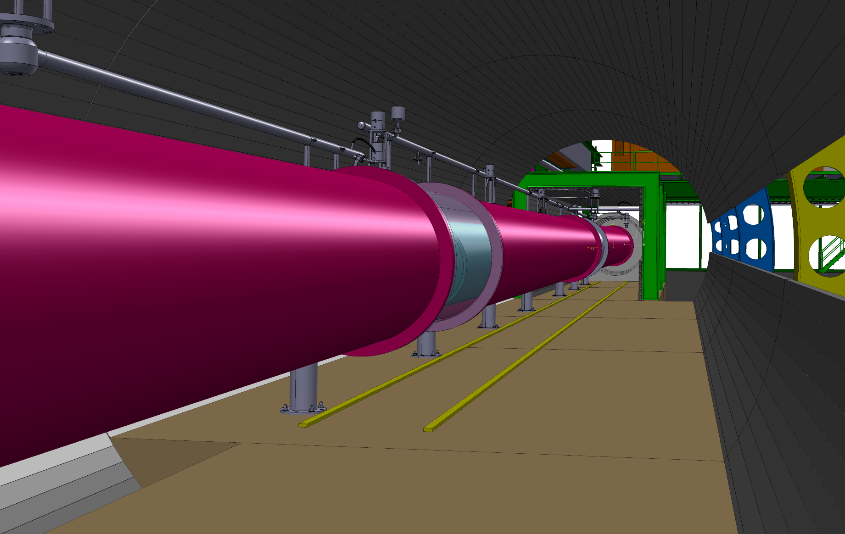
integration status
Integration of equipment will be from HL-LHC layout of the simulated point (5L), with minor modifications to handle the “similar installation” character of the string test.

Slide 9
summary
HL-LHC string test
is the only opportunity to check the alignment systems performance in a real environment before the installation in HL-LHC.
It will offer a fantastic analysis of the behaviour of interlinked cold masses and cryostats under different states allowing to validate simulations and assumptions.
It will allow to account and validate the impact of the interconnections on the single magnet kinematic.
From the schedule point of view, it provides a very important intermediary milestone before the LS3.
It offers a real size training and a very good opportunity to have a better understanding of other systems and their impact on the measurement systems.
The experience will not be the same in case of tests on stand alone components or if test need to be performed in the tunnel (time and risk mitigation).

