Slide 1

Summary
H. Mainaud Durand
Review of HL-LHC Alignment and Internal Metrology (WP15.4)

Slide 2
Outline
Schedule
Procurement strategy
Resource strategy
Potential issues raised during the review

Slide 3
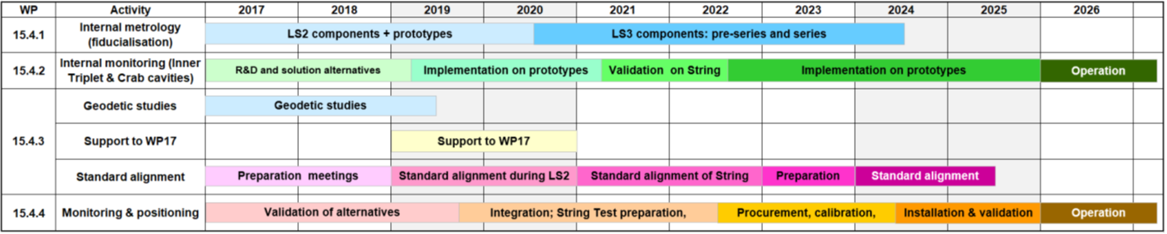
Schedule

Slide 4
Schedule

Slide 5
Towards installation (sensors)
Decision
Qualification tests
Upgrade
Pre-series procurement
Validation
Repeatability
Accuracy
Long-term stability
Impact of humidity
Impact of temperature
Irradiation tests
Impact of vibrations
HLS
Inclinometer
WPS
Longitudinal sensor
Wire to wire meas. System
Acquisition system
Capacitive remote electronics
Series procurement
Reception
Calibration
Installation
Documentation

Slide 6
Summary of tests setups
Test setup | Description | Scheduled
TT1 | Long term validation of in-house WPS, iHLS, iInclino Validation of new wire Validation of new stretching device + automatized wire stretching | July-Dec. 19
FSI lab | Cross-comparison tests (iHLS, cHLS, iInclino) | July-Oct. 19
Climatic | Climatic chamber to control the impact of T° and humidity | Jan-June 20
Dipole test | FSI configuration for IT and CC | Sept-Oct. 19
Irradiation tests | Qualification at Franhoffer institute // other irradiation facilities | June-Aug. 19 Jan-March 20

Slide 7
Sensors qualification plan
 | kWPS | iHLS | HLS-Lines | Inclin. | Acq. syst. | Remote elec. | Long range FSI
Repeatability |  |  |  | FSI lab
Accuracy |  |  |  | FSI lab
Long-term stability | TT1 | TT1 | TT1 | TT1 | TT1 | TT1 | TT1
T° impact | Climatic | Climatic |  | Climatic | Climatic | Climatic
Humidity impact | Climatic | Climatic |  |  | Climatic | Climatic
Irradiations tests

Slide 8
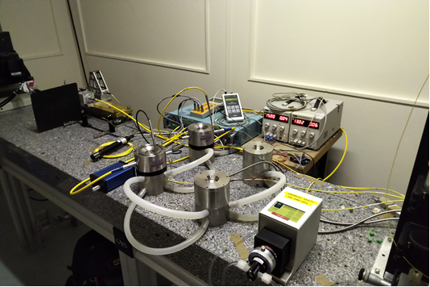
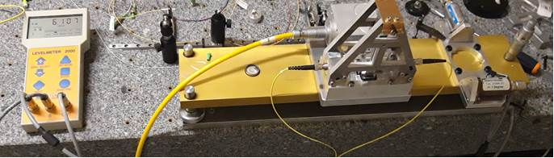
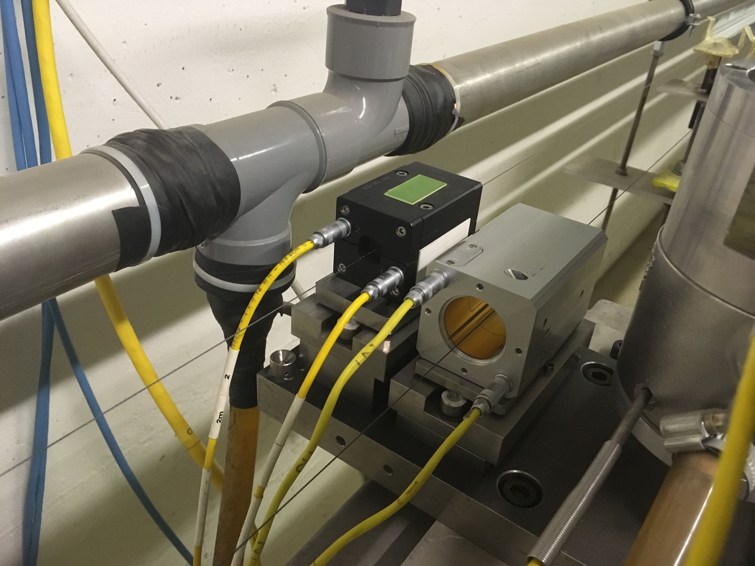
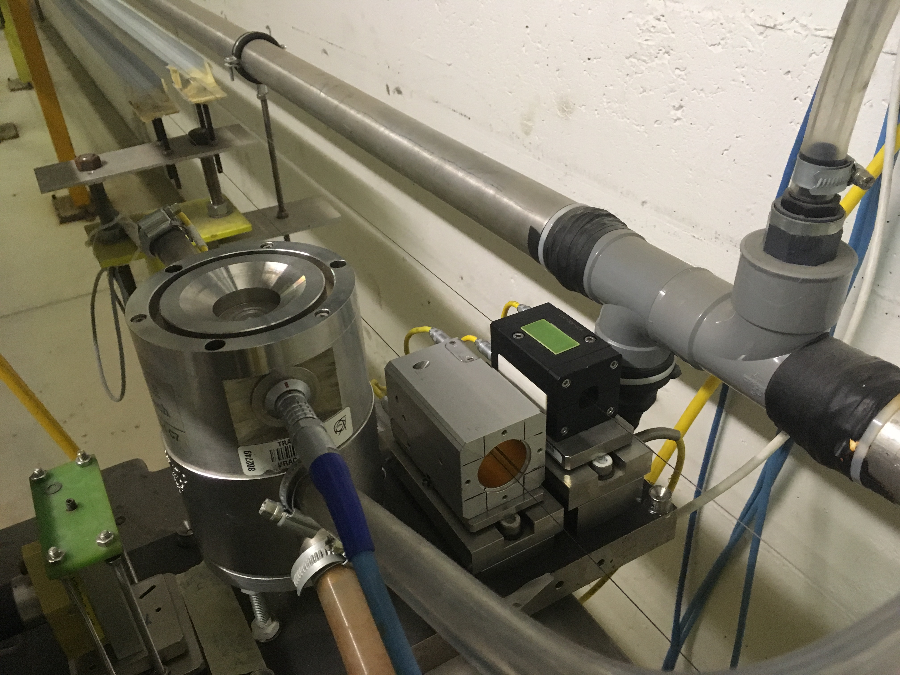
Cross-comparison tests
Between Inclinometer / cHLS and iHLS
FSI long distance / laser tracker / interferometer
kWPS and cWPS

Slide 9
Towards installation (all other systems)
Technical specification for all systems design
Study of concept, upgrade of existing solutions
Integration of all alignment systems
Design of a prototype
Sensors support
Hydraulic network & supports
Wire protection & supports
Remote diagnostic devices
Stretching devices
Wire to wire meas. system
Manufacture & assembly of a prototype
Installation
Preparation of installation drawings and procedures
Validation of a prototype
Storage of all data in MTF & EDMS
Insertion of series in 3D models
Design of series
Assembly and test of series
Order of series

Slide 10
Towards installation (motors assembly for jacks)
Upgrade of jacks design
Validation on a test setup
Procurement of pre-series for String test
Mech. Interface design
Procurement
Validation on the string test
Development of control/command (Sambuca project)
Procurement of series
Jacks (WP3, WP4, WP8)
Motors
Associated sensors (resolver, load cell)
Gearbox
Control/command system
Reception
Documentation
Installation

Slide 11
Towards installation (motors assembly for UAP platform)
Manufacture of joints & jigs
Validation of UAP concept
Adaptation to the equipment
Procurement of pre-series for test
Series procurement
Validation on the string test
Development of Motorized version
Development of control/command (Sambuca project)
Validation
UAP platform (WP5, WP13)
Motors
Associated sensors (resolver, load cell)
Gearbox
Control/command system
Documentation
Installation

Slide 12
Procurement strategy
Validation of concepts and prototypes
Development of pre-series
Towards industrialization
External manufacturing/assembly
In-house assembly
In-kind contribution
Motors
Sensors: WPS, HLS, resolvers, load cells
Associated supports
Diagnostics tools
FSI acquisition
Motors assembly
Inclinometers
Acquisition electronics
Wire stretchers
Feedthrough

Slide 13
Resources
WP15.4.1 and WP15.4.3:
  Staff;
  During LS2 or YETS contract services (for series components or scan activities for example)
WP15.4.2:
  Staff + MPA (fellows, PJAS)
WP15.4.4:
  Staff + MPA (fellows, PJAS) + FSU

Slide 14
Resources (MPA)
Very difficult to find persons knowing already our techniques:
We absolutely need overlaps between persons
We plan to extend one PJAS as fellow to keep the knowledge

Slide 15
Resources (MPA)
Very difficult to find persons knowing already our techniques:
We absolutely need overlaps between persons
We plan to extend one PJAS as fellow to keep the knowledge

Slide 16
Resources
MPA: Collaborations: past, current & future
  CNAM (France) [past]
  AGH (Poland) [current]
  ? [future]
Other resources (FSU, contract services, design office): what is foreseen.
 | 2019 | 2020 | 2021 | 2022 | 2023 | 2024 | 2025
FSU (kCHF) | 110 | 110 | 110 | 110 | 110 | 110 | 110
Design office (kCHF) | 30 | 100 | 100 | 100 | 50 | 10 | 10
Contract services (kCHF) | 0 | 60 | 60 | 60 | 60 | 60 | 60

Slide 17
Resources
Use of the multi-disciplinarity of the group

Slide 18
Resources
No staff at 100% on the project
High work load during LS2 where the same persons involved in FSI and FRAS are also in charge of the LHC low beta consolidation and maintenance of the alignment systems, but also a lot of experience gained!
Same situation concerning the persons in charge of fiducialisation, geodesy and standard alignment
One key person still on a Limited Duration contract.
FROM EHL-LHC needs – EN manpower meeting. Sept 18.
FTE per WP | 2019 | 2020 | 2021 | 2022 | 2023 | 2024 | 2025 | 2026
15.4.1 | 0.4 | 0.5 | 0.5 | 0.5 | 0.5 | 0.5 | 0.4 | 0.2
15.4.2 | 0.9 | 0.9 | 0.9 | 0.9 | 0.9 | 0.9 | 0.9 | 0.9
15.4.3 | 0.8 | 0.9 | 0.8 | 0.8 | 0.8 | 0.8 | 0.8 | 0.8
15.4.4 | 2.0 | 1.6 | 2.1 | 2 | 2.7 | 2.7 | 3 | 2.3
15.4 | 4.1 | 3.9 | 4.3 | 4.2 | 4.9 | 4.9 | 5.2 | 4.2

Slide 19
Material budget status

Slide 20
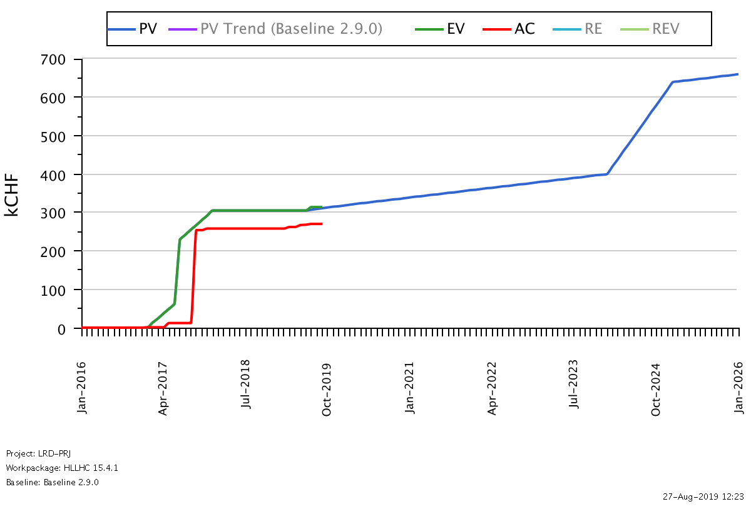
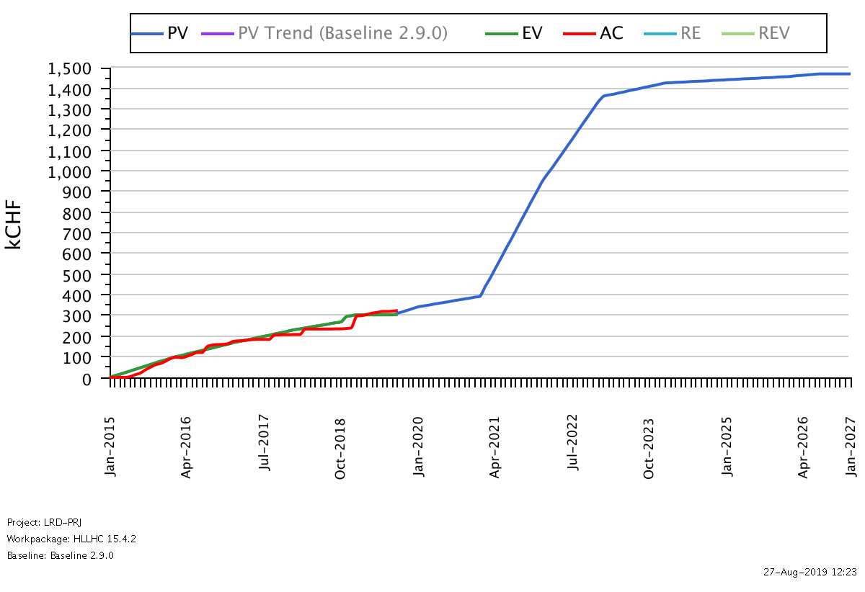
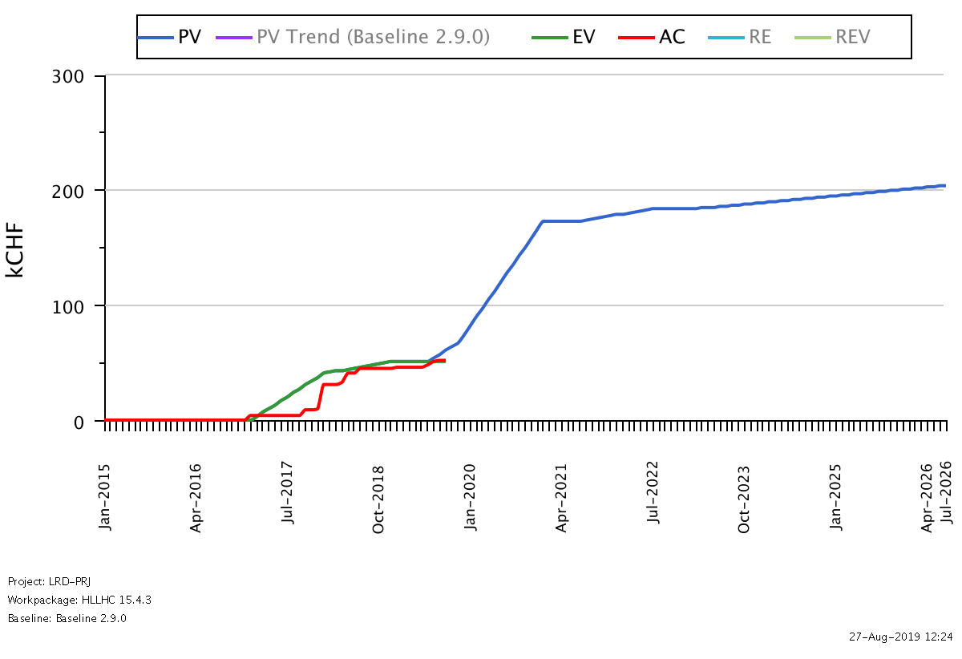
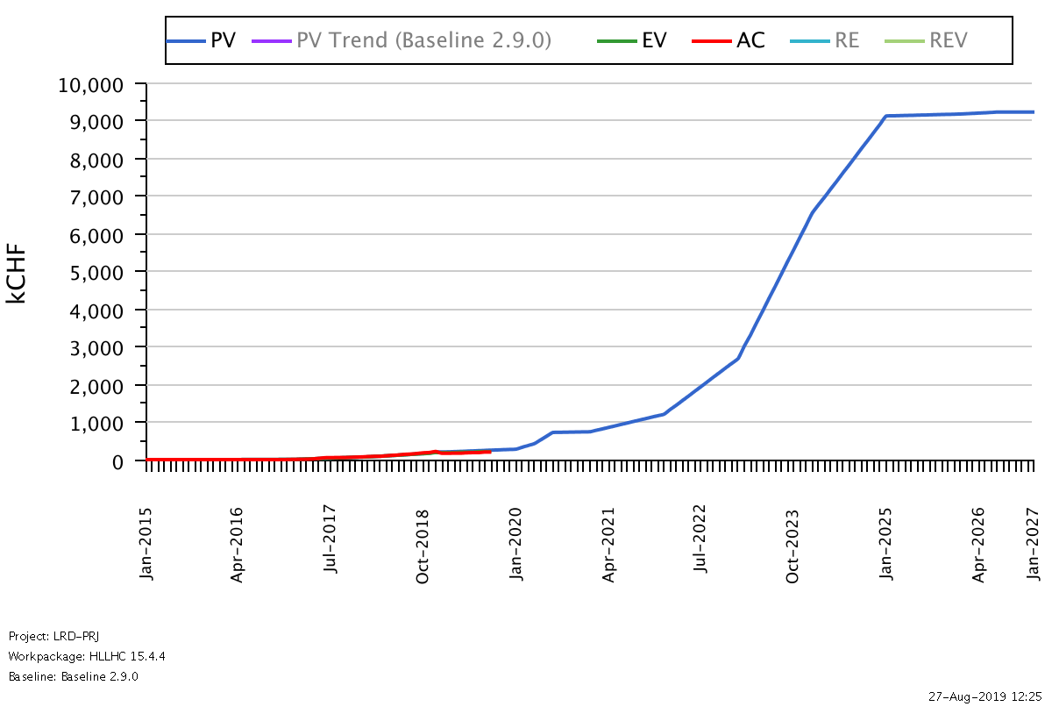
Material budget status per sub-sub WP
WP15.4.1
WP15.4.2
WP15.4.3
WP15.4.4

Slide 21
Summary
FSI system for the internal monitoring of IT quadrupoles and CC:
  Very satisfactory results obtained on the crab cavities prototype in SPS
  Two FSI systems evaluated through tests on a dipole.
  Cryo-condensation problem met on targets inside the dipole, a solution was found (with the help of TE/MSC)
  CERN MT-FSI chosen, with coated glass spheres, insulated support for targets and simplified feedthrough
  A final validation plan is defined and scheduled
  Procedures / workflow on the installation and measurements of FSI targets under finalisation

Slide 22
Summary
Internal monitoring:
  All magnets will be fiducialised after cold test at CERN
  Procedures are derived from existing LHC cryomagnet procedure
  Assembly workflow for all the components under definition in the frame of the WGA
  Measurement workflow defined for the crab cavities metrology assembly
FRAS:
  Allows to save radiations to the personal, a reduction of correctors strength, a gain in aperture for several components
  Opens the possibility to optimize the MS section and to important budget savings.
  All strategy/requirements/solutions/interfaces defined in the functional specification, to be endorsed by the TCC next month.
  Still a few cases under discussion (vacuum valves in front of D2, BPM after D1, BBMR not considered as not in the baseline)

Slide 23
Summary
Solutions for adjustment
  Preliminary results from the 181 string test show that operational issues on present LHC jacks are understood; they could be used for HL-LHC, considering small improvements to be compatible with space requirements
  Their re-engineering is targeted this Autumn; procurement strategy: in-kind contribution from Serbia
  Small UAP platform fully validated; design of big UAP under way.
  Standardization of the motors control/command system via SAMbuCA project
Solutions for position determination:
  Volume integrated for all alignment systems and their diagnostic tools in the 3D models
  Alignment sensors under validation, final choice next year.

Slide 24
Thank you very much

