Slide 1
Huawei and Rackspace cloud project highlights
IT R&D Meeting
Tim Bell
02 July /2019

Slide 2
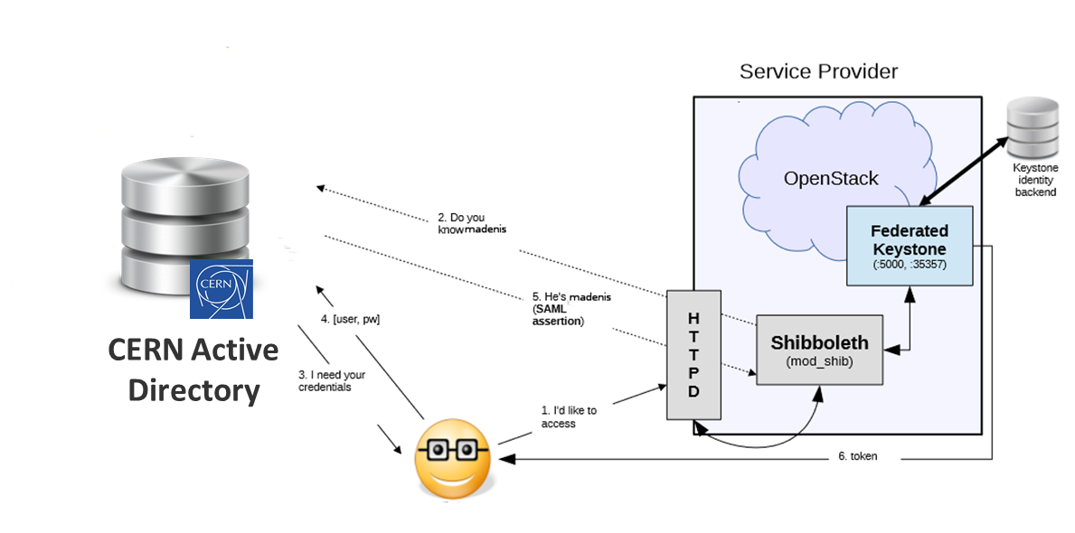

Cloud Federation
Rackspace (2013-2015) – 1 fellow in IT-CM
Support Multi-cloud federated identity of CERN on-premise OpenStack cloud
Maps between user in cloud A to project in cloud B
First released in OpenStack Kilo release
Used in production at CERN for Indigo Dataclouds and to add Kerberos support
Results fed into the AARC and GEANT identify federation projects
Contributions also from Red Hat and IBM
Fellow now at Facebook
LOGIN: madenis
LANGUAGE: EN
DEPARTMENT: IT/OIS
FULLNAME: Marek Denis
ID: madenis
GROUP: openlab
Project: development

Slide 3
Containers as a Service
# | Company | Commits
1 | NEC | 577
2 | IBM | 415
3 | Huawei | 326
4 | CERN | 261
5 | Intel | 259
6 | Rackspace | 168
7 | Red Hat | 157
8 | EasyStack | 136
 | *independent | 112
9 | Fujitsu | 110
Rackspace (2015-2017) – 1 fellow in IT-CM
Develop Magnum, a one-click Container clusters in OpenStack
Quota, accounting and permissions consistent with VMs and storage
In production at CERN from 2016
Over 400 clusters running today at CERN
  Kubernetes (324)
  Docker (67)
  Mesos (9)
Widely deployed (including Blizzard!)
Fellow is now a CERN LD

Slide 4



Cloud Scaling
Huawei (2017-2018) – 1 fellow in IT-CM
OpenStack clouds scale by sharding smaller cells
Cells was an experiment feature from 2013
Project with Huawei to make this function fully supported and the default
  Large scale clouds such as Deutsche Telekom
Deployed in production in 2018
  Now >80 cells
Significant tuning post-production supported by openlab fellow
Fellow extended by IT following project completion
Child Cell
Geneva
controllers
compute-nodes
Load Balancer
Geneva
Top Cell
Geneva
Child Cell
Budapest
controllers
compute-nodes

Slide 5
Spot Instances
Huawei (2017-2018) – 1 fellow in IT-CM
Some cloud resources are available opportunistically
  Hardware before/after production use
  Buffer from annual purchases for services
Project to develop Amazon-like Spot instances
  Can be terminated with little notice
Project developed in collaboration with SKA, OpenStack Scientific SIG and Huawei
Production usage at CERN planned during 2019 for experiment restartable workflows
Fellow extended by IT following project completion

Slide 6
Ceph Performance
Rackspace (2017-2018) – 1 fellow in IT-ST
Cloud storage at CERN is provided using Ceph
  Block, Object, File shares
Project with Rackspace was to optimize performance for CERN’s use cases
  Rackspace Private Cloud product uses Ceph
Achieved 500K IOPS on 20 node cluster with tuning and code enhancements
Improved Ceph tools for monitoring and tracing
Fellow extended by IT following project completion

Slide 7
Conclusions
Cloud collaboration projects in openlab have funded 9 person years of effort addressing common needs
Projects have allowed enhancements for open source software to be developed in collaboration with industry
  Often attracts further companies and labs
Communities receptive to joint development given CERN’s challenging use cases
  Additional contributions from other companies
Upstream collaboration with open source foundations simplifies agreements
  NDA and IP handled by foundation bylaws
Cost effective model for CERN
  Community helps with mentoring and future maintenance
Affordable and flexible for companies to acquire talent
  Risk of non-renewal such as management re-organisation

Slide 8
References
CERN Technical Blog
  https://techblog.web.cern.ch/techblog/
Openlab project pages
  https://openlab.cern/project/openstack-clouds
  https://openlab.cern/project/cloud-storage
Final talks to conferences
  Spot Instances - https://www.openstack.org/summit/denver-2019/summit-schedule/events/23187/improving-resource-availability-in-cern-private-cloud
  Cells V2 - https://www.openstack.org/summit/denver-2019/summit-schedule/events/23287/whats-new-in-nova-cellsv2
  Containers - https://www.openstack.org/summit/denver-2019/summit-schedule/events/23713/magnum-project-update

