Slide 1
HL-LHC power converter requirements
Thermal settling drift
Miguel Bastos
153rd WP2 meeting - CERN - 6/R-012 – 03/07/2019

Slide 2
HL-LHC Power converter requirements
Requirements were revised and approved this year, new version of CERN-ACC-2017-0101 document to be released
As a reminder, values and definitions of some parameters were revised, and the effect of temperature considered separetely, as shown below
 | PC REQUIREMENTS SUMMARY - ACCURACY CLASSES
 | 0 | 1 | 2 | 3 | 4
Resolution [ppm] | 0.5 | 0.5 | 1.0 | 1.0 | 1.0
Initial uncertainty after cal [2xrms ppm] normal | 2.0 | 2.0 | 3.0 | 7.0 | 10.0
Linearity [ppm] [max abs ppm] uniform | 2.0 | 2.0 | 5.0 | 8.0 | 9.0
Stability during a fill (12h) [max abs ppm] uniform | 0.7 | 1.9 | 5.0 | 8.0 | 9.5
Short term stability (20min) [2xrms ppm] normal | 0.2 | 0.4 | 1.2 | 2.0 | 5.0
Noise (<500Hz) [2xrms ppm] normal | 3.0 | 5.0 | 7.0 | 15.0 | 19.0
Fill to fill repeatability [2xrms ppm] normal | 0.4 | 0.8 | 2.6 | 4.0 | 5.0
Long term fill to fill stability [max abs ppm] uniform | 8.0 | 8.0 | 19.0 | 40.0 | 45.0
Temperature coefficient [max abs ppm/C] uniform | 1.0 | 1.2 | 2.5 | 5.5 | 6.5
12h Delta T for HL-LHC [max C] constant | 0.5 | 1.0 | 5.0 | 5.0 | 5.0
1 y Delta T for HL-LHC [max C] constant | 0.5 | 1.0 | 5.0 | 5.0 | 5.0
 | 0 | 1 | 2 | 3 | 4
Stability during a fill (12h) [2xrms ppm] | 1.0 | 2.6 | 15.5 | 33.1 | 39.1
Fill to fill repeatability [2xrms ppm] | 0.7 | 1.6 | 14.7 | 32.0 | 37.9
long term fill to fill stability [2xrms ppm] | 9.3 | 9.3 | 26.3 | 56.1 | 64.1

Slide 3
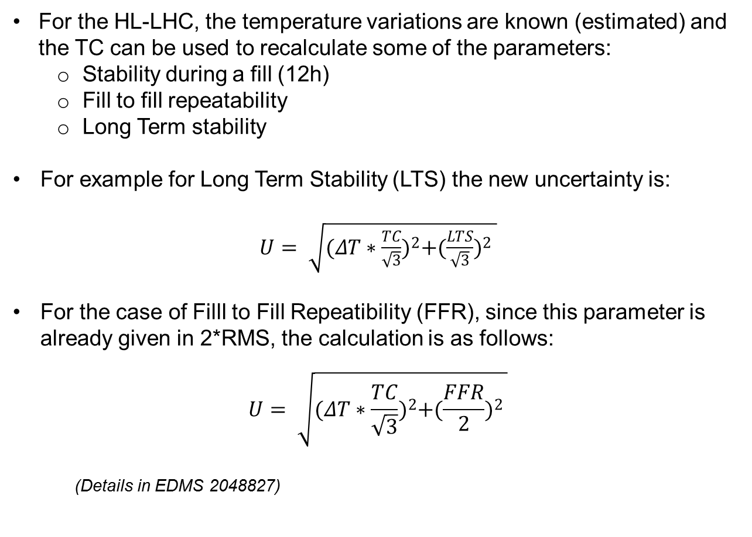
HL-LHC Power converter requirements
For the HL-LHC, the temperature variations are known (estimated) and the TC can be used to recalculate some of the parameters:
    Stability during a fill (12h)
    Fill to fill repeatability
    Long Term stability
For example for Long Term Stability (LTS) the new uncertainty is:
$U= \sqrt{{(ΔT∗\frac{TC}{\sqrt{3}})}^{2}+{{(\frac{LTS}{\sqrt{3}})}^{2}}^{ }}$
For the case of Filll to Fill Repeatibility (FFR), since this parameter is already given in 2*RMS, the calculation is as follows:
$$U= \sqrt{{(ΔT∗\frac{TC}{\sqrt{3}})}^{2}+{{(\frac{FFR}{2})}^{2}}^{ }}$$
  (Details in EDMS 2048827)

Slide 4
HL-LHC Power converter requirements
The final values are presented in 2 x RMS. resulting in the final table shown below..
 | PC REQUIREMENTS SUMMARY - ACCURACY CLASSES
 | 0 | 1 | 2 | 3 | 4
Resolution [ppm] | 0.5 | 0.5 | 1.0 | 1.0 | 1.0
Initial uncertainty after cal [2xrms ppm] normal | 2.0 | 2.0 | 3.0 | 7.0 | 10.0
Linearity [ppm] [max abs ppm] uniform | 2.0 | 2.0 | 5.0 | 8.0 | 9.0
Stability during a fill (12h) [2xrms ppm] | 1.0 | 2.6 | 15.5 | 33.0 | 39.0
Short term stability (20min) [2xrms ppm] normal | 0.2 | 0.4 | 1.2 | 2.0 | 5.0
Noise (<500Hz) [2xrms ppm] normal | 3.0 | 5.0 | 7.0 | 15.0 | 19.0
Fill to fill repeatability [2xrms ppm] | 0.7 | 1.6 | 14.5 | 32.0 | 38.0
Long term fill to fill stability [2xrms ppm] | 9.5 | 9.5 | 26.5 | 56.0 | 64.0
The distributions and limits of the parameters impacted by the temperature variation change with respect to the previous table.
Details in EDMS doc 2048827

Slide 5
HL-LHC Power converter requirements
 | PC REQUIREMENTS SUMMARY - ACCURACY CLASSES
 | 0 | 1 | 2 | 3 | 4
Resolution [ppm] | 0.5 | 0.5 | 1.0 | 1.0 | 1.0
Initial uncertainty after cal [2xrms ppm] normal | 2.0 | 2.0 | 3.0 | 7.0 | 10.0
Linearity [ppm] [max abs ppm] uniform | 2.0 | 2.0 | 5.0 | 8.0 | 9.0
Stability during a fill (12h) [max abs ppm] uniform | 0.7 | 1.9 | 5.0 | 8.0 | 9.5
Short term stability (20min) [2xrms ppm] normal | 0.2 | 0.4 | 1.2 | 2.0 | 5.0
Noise (<500Hz) [2xrms ppm] normal | 3.0 | 5.0 | 7.0 | 15.0 | 19.0
Fill to fill repeatability [2xrms ppm] normal | 0.4 | 0.8 | 2.6 | 4.0 | 5.0
Long term fill to fill stability [max abs ppm] uniform | 8.0 | 8.0 | 19.0 | 40.0 | 45.0
Temperature coefficient [max abs ppm/C] uniform | 1.0 | 1.2 | 2.5 | 5.5 | 6.5
12h Delta T for HL-LHC [max C] constant | 0.5 | 1.0 | 5.0 | 5.0 | 5.0
1 y Delta T for HL-LHC [max C] constant | 0.5 | 1.0 | 5.0 | 5.0 | 5.0
 | 0 | 1 | 2 | 3 | 4
Stability during a fill (12h) [2xrms ppm] | 1.0 | 2.6 | 15.5 | 33.1 | 39.1
Fill to fill repeatability [2xrms ppm] | 0.7 | 1.6 | 14.7 | 32.0 | 37.9
long term fill to fill stability [2xrms ppm] | 9.3 | 9.3 | 26.3 | 56.1 | 64.1
The performance of power converters described above is essentially defined by:
    ADCs (Analogue to digital conversion), DCCTs (current measurement) and Current regulation loop -> Low Frequency
    Voltage source and load -> Medium and high frequency

Slide 6
HL-LHC Power converter requirements
Therefore...
Performance requirements for the power converter translate into even tighter performance requirements for ADCs and DCCTs.
For example, class 0 requirement for 12h stability of a power converter is 0.7ppm and for the DCCT it is 0.5ppm.
 | Class 0
 | FGC3.2-EXT-AC-D0
 | total PC | dcct | adc | notes
Resolution [ppm] | 0.5 |  | 0.2
Initial uncertainty after cal [2xrms ppm] normal | 2.0 | 1.0 | 1.0 | sum of rms
Linearity [ppm] [max abs ppm] uniform | 2.0 | 1.0 | 1.0 | sum of max
Stability during a fill (12h) [max abs ppm] uniform | 0.7 | 0.5 | 0.2 | sum of max
Short term stability (20min) [2xrms ppm] normal | 0.2 | 0.1 | 0.1 | sum of rms
Noise (<500Hz) [2xrms ppm] normal | 3.0 | 2.0 | 1.0 | sum of rms
Fill to fill repeatability [2xrms ppm] normal | 0.4 | 0.3 | 0.1 | sum of rms
Long term fill to fill stability [max abs ppm] uniform | 8.0 | 4.0 | 4.0 | sum of max
Temperature coefficient [max abs ppm/C] uniform | 1.0 | 0.8 | 0.2 | sum of max

Slide 7
HL-LHC Power converter requirements
The DCCTs
DCCTs are power devices that measure high (e.g. 18kA) currents by transforming them down to smaller currents (e.g. 5A)
A current step in the power converter corresponds to a current step in the DCCT and therefore a power dissipation step
As a consequence, a drift due to thermal settling of the resistor used to measure the DCCT output current, is more likely to happen during ther first minutes after a current step

Slide 8
HL-LHC Power converter requirements
Impact for HL-LHC
The LHC ramps up the current in 10..20 minutes. On arrival to flat top we expect the DCCT to have higher drift in the first few minutes.
Until now : this drift was included in the 12h stability specification, but if we exclude the initial 5 minutes after arrival to the flat top, a critical specification of the DCCT could be relaxed
It seems reasonable to assume that the machine doesn’t need to operate at full performance on arrival to the flat top (no physics), so...
Can we consider a period of 5 minutes were the DCCTs are allowed to settle, before they have to perform within the 12h stability ?

Slide 9
HL-LHC Power converter requirements
If yes, then the following new table is proposed, including a new specification:
  Stability at the end of ramp (5min): Variation of the delivered current (for a constant reference) during the first 5 minutes after the current reaches the flat top
 | PC REQUIREMENTS SUMMARY - ACCURACY CLASSES
 | 0 | 1 | 2 | 3 | 4
Resolution [ppm] | 0.5 | 0.5 | 1.0 | 1.0 | 1.0
Initial uncertainty after cal [2xrms ppm] normal | 2.0 | 2.0 | 3.0 | 7.0 | 10.0
Linearity [ppm] [max abs ppm] uniform | 2.0 | 2.0 | 5.0 | 8.0 | 9.0
Thermal settling drift - first 5 minutes of flat top [max abs ppm] uniform | 0.5 | 1.5 | 1.5 | 3.0 | 6.0
Stability during a fill (12h) [2xrms ppm] | 1.0 | 2.6 | 15.5 | 33.0 | 39.0
Short term stability (20min) [2xrms ppm] normal | 0.2 | 0.4 | 1.2 | 2.0 | 5.0
Noise (<500Hz) [2xrms ppm] normal | 3.0 | 5.0 | 7.0 | 15.0 | 19.0
Fill to fill repeatability [2xrms ppm] | 0.7 | 1.6 | 14.5 | 32.0 | 38.0
long term fill to fill stability [2xrms ppm] | 9.5 | 9.5 | 26.5 | 56.0 | 64.0

