Slide 1
  ARTS AT CERN
Creativity across Cultures

Slide 2
    Arts at CERN is the official arts program of CERN and the leading world wide art and science programme fostering the dialogue between artists and physicists.

Slide 3
Vision
To foster significant exchanges between art & physics.
To participate of an international cultural community eager to connect with CERN.
Notes:
Vision
The arts program of the world’s largest laboratory of particle physics was created to explore notions of creativity, human ingenuity and curiosity.
At Arts at CERN we pioneer new models of bringing together artists and scientists. Artists across all creative disciplines are welcome to experience the way the big questions about our universe are pursued by fundamental science.
Arts at CERN fosters conversation about art and science by supporting artistic innovation and access to this unique creativity-driven environment.
At CERN, there are few collaborators and for each artists we find them a mentor.

Slide 4
Framework
Artists across all creative disciplines are welcome to experience the way the big questions about our universe are pursued by fundamental science
The artists must apply to the open calls to take part in our programs.
Each program (except from the visiting artists) runs an annual competition, with a jury board formed by cultural and scientific experts.
Notes:
Vision
The arts program of the world’s largest laboratory of particle physics was created to explore notions of creativity, human ingenuity and curiosity.
At Arts at CERN we pioneer new models of bringing together artists and scientists. Artists across all creative disciplines are welcome to experience the way the big questions about our universe are pursued by fundamental science.
Arts at CERN fosters conversation about art and science by supporting artistic innovation and access to this unique creativity-driven environment.
At CERN, there are few collaborators and for each artists we find them a mentor.

Slide 5
Governance (CERN Cultural Advisory Board)
Andrea Bellini (Director of Centre d’Art Contemporain de Genève)
Frédérick Bordry (CERN’s Director for Accelerators and Technology)
Serge Dorny (Director of Opéra National de Lyon)
Ariane Koek (Former Head of the Arts at CERN)
Laurent Le Bon (President of Picasso Museum, Paris)
Notes:
Vision
The arts program of the world’s largest laboratory of particle physics was created to explore notions of creativity, human ingenuity and curiosity.
At Arts at CERN we pioneer new models of bringing together artists and scientists. Artists across all creative disciplines are welcome to experience the way the big questions about our universe are pursued by fundamental science.
Arts at CERN fosters conversation about art and science by supporting artistic innovation and access to this unique creativity-driven environment.
At CERN, there are few collaborators and for each artists we find them a mentor.

Slide 6
  988
Collide Int 2017

Slide 7
  500
applications/year

Slide 8
  49
nationalities 2018

Slide 9
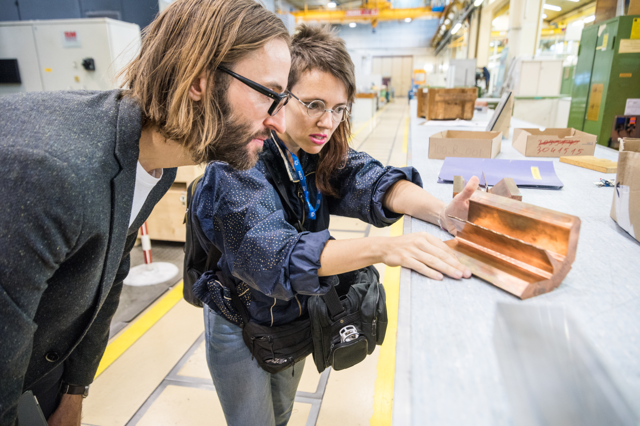
Collide Program
A residency award of up to three months to invite artists to further their artistic practice in connection with fundamental research at CERN
Notes:
International (Currently with city of Barcelona), Helvetia (foundation Helvetia) and Geneva (Canton of Geneva)

Slide 10
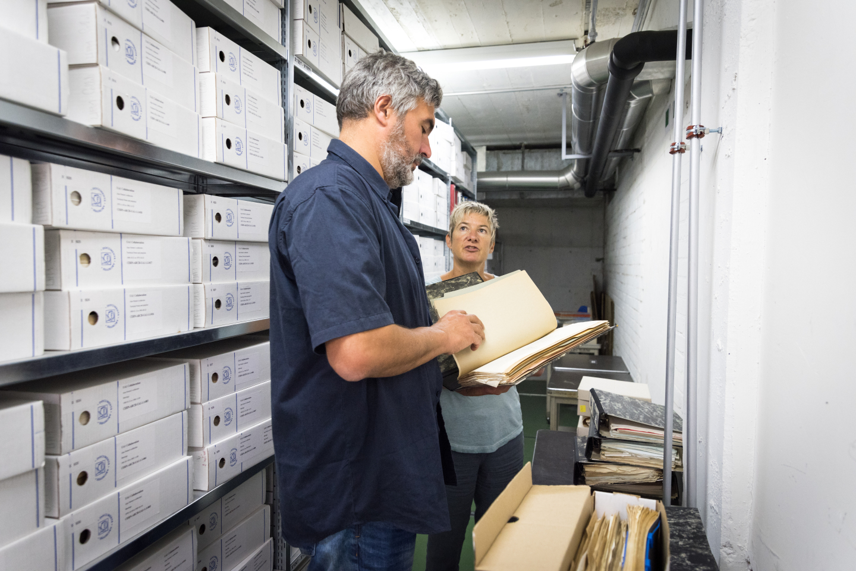
Accelerate Award
A country-specific award for artists from different geographies to access the residencies program at CERN for one month.

Slide 11
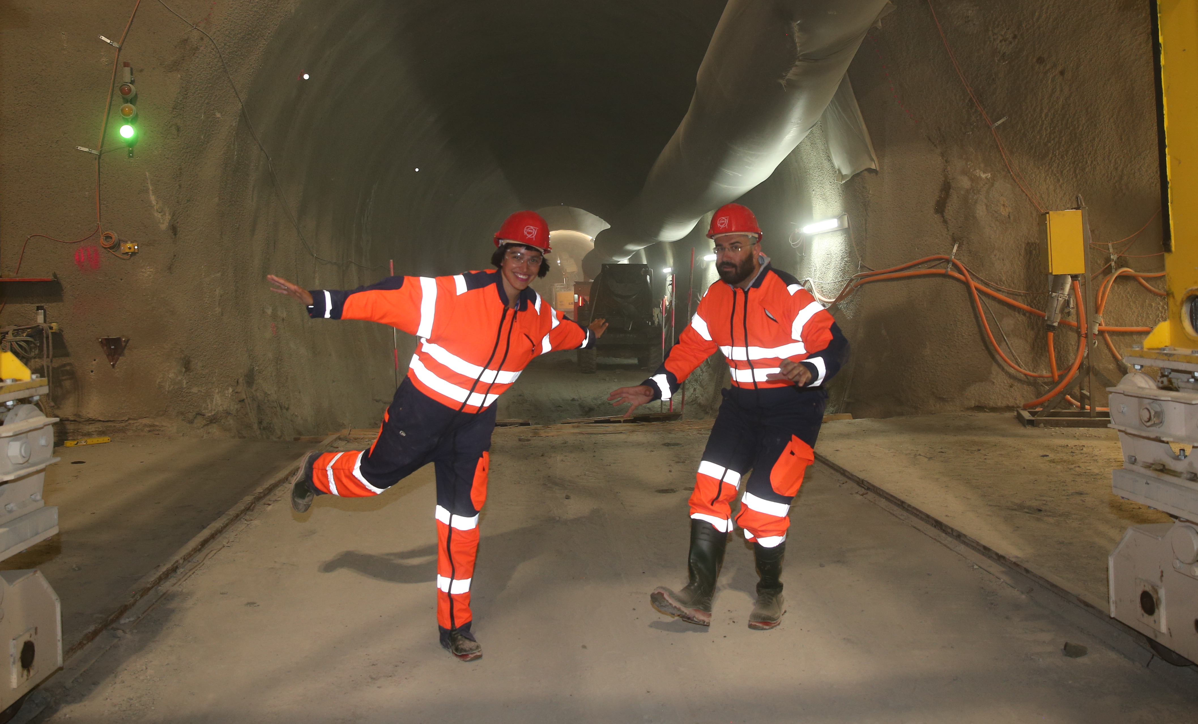
Guest Artists
This programme aims to show what the laboratory offers to the arts and creativity from an interdisciplinary approach.
Notes:
A number of Guest Artists are invited every year, including the artists that were selected as Honorary Mentions in Collide International.

Slide 12
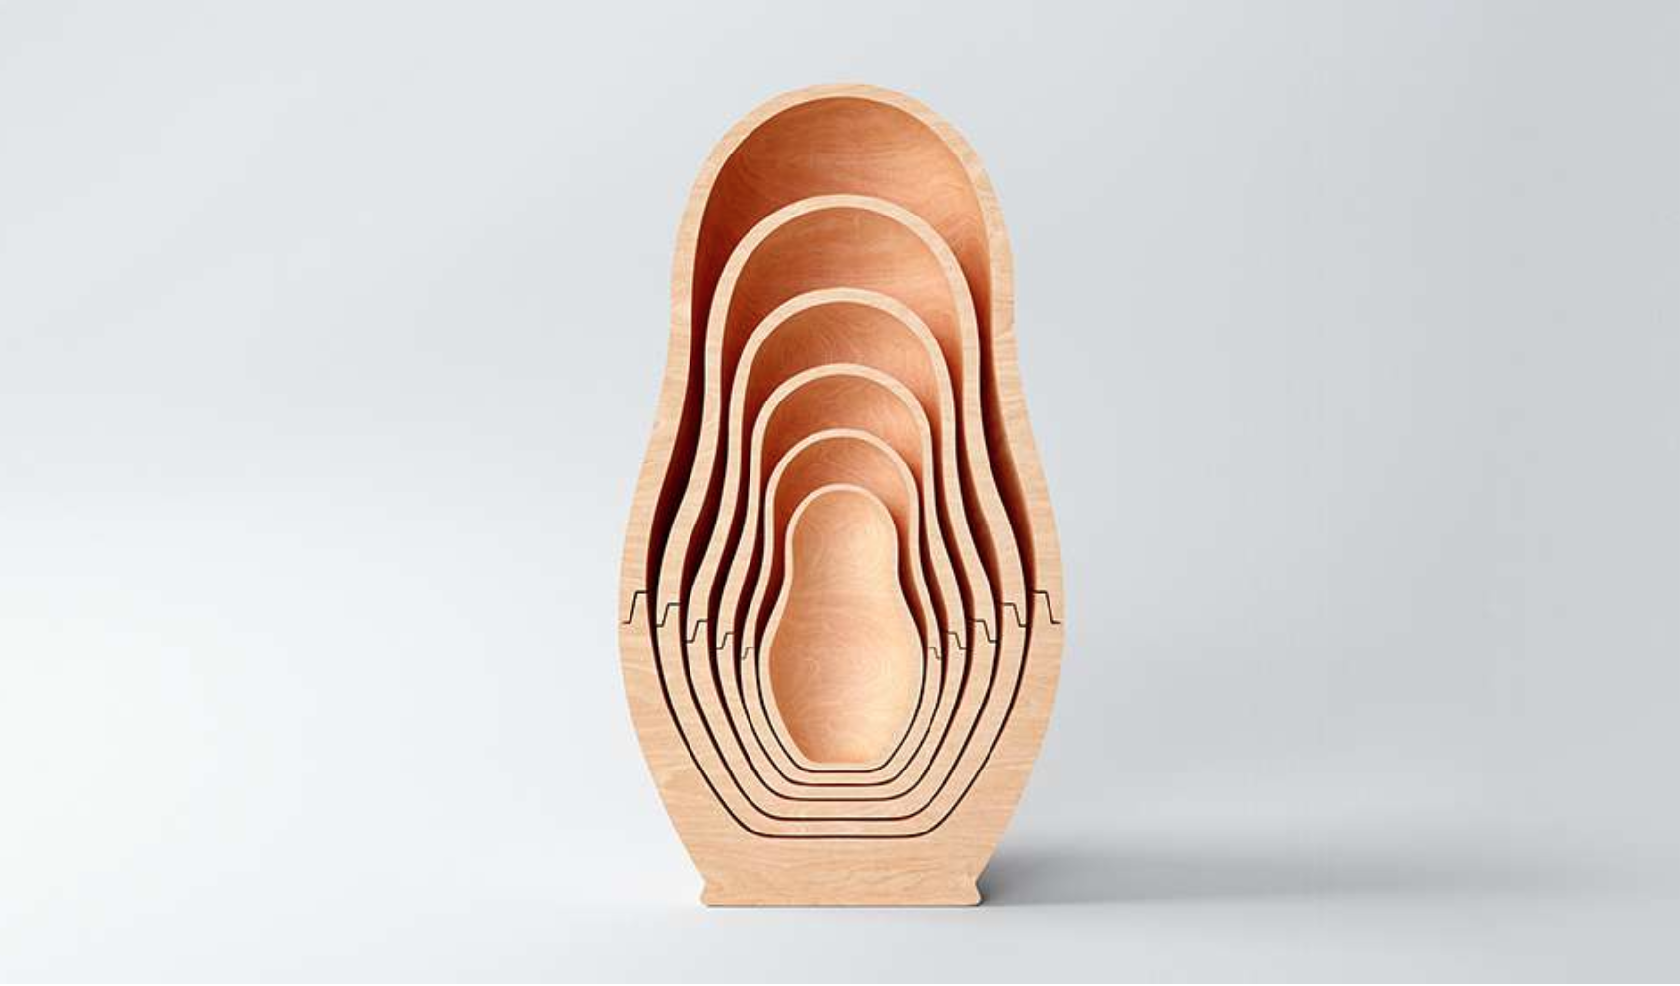
Art Commissions and Exhibitions
Fosters artistic production resulting from the dialogue between art & physics.
Notes:
Broken Symmetries - Foundation for Art and Creative Technology in LIVERPOOL
QUANTICA - Centre de Cultura Contemporanea in Barcelona

Slide 13
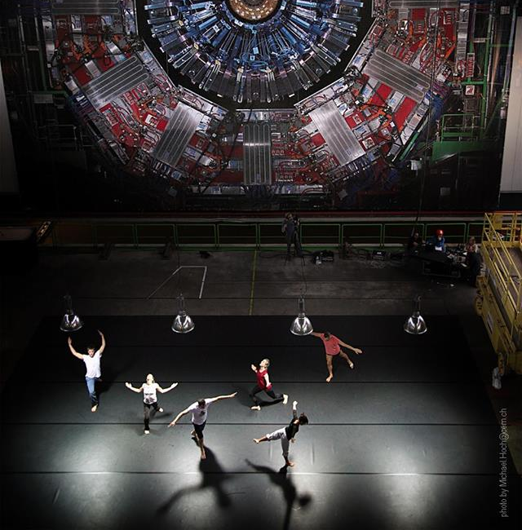
Quantum at CMS dectector. Cia. Gilles Jobin
Open Days CERN, September 2013
Notes:
1st CERN Cultural Policy- 2011 -

Slide 14
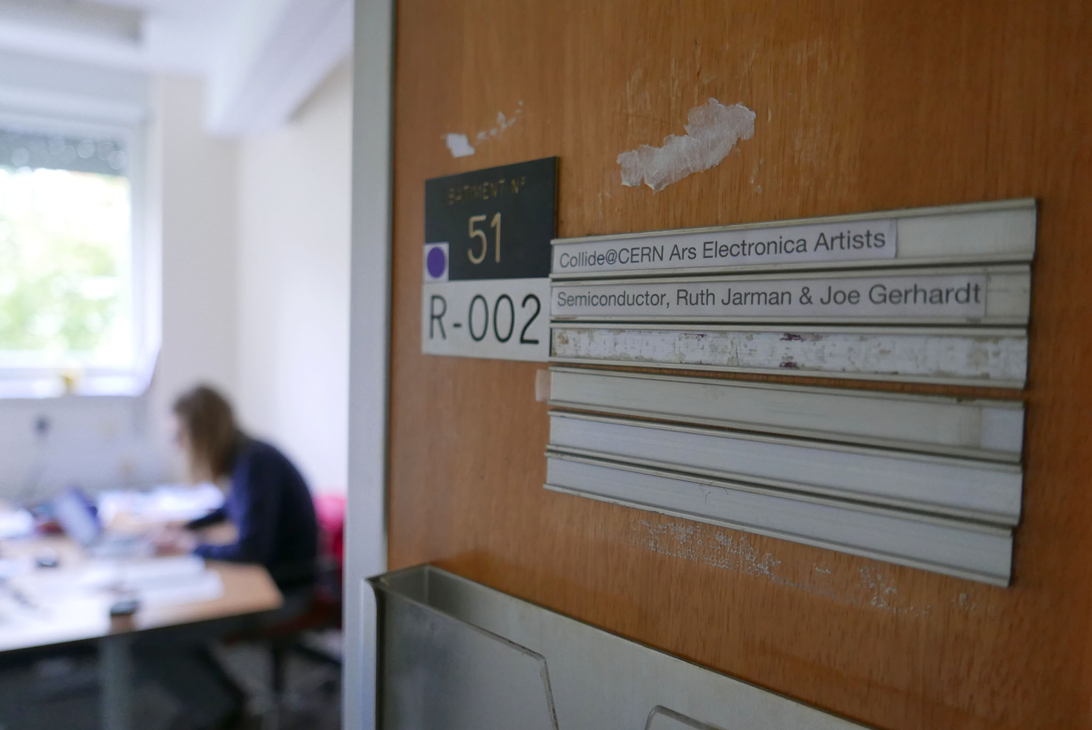
Notes:
Semiconductor - composed by a due Ruth and Joe, did they first residency at CERN in 2015,
In 2017 they began to work with ATLAS experiment / Sussex University and in special collaboration with Mark Sutton -
this led them to create HALO - Audemars Piguet Art Commission for Art Basel 2018 curated by Mónica Bello - head of Arts at CERN

Slide 15
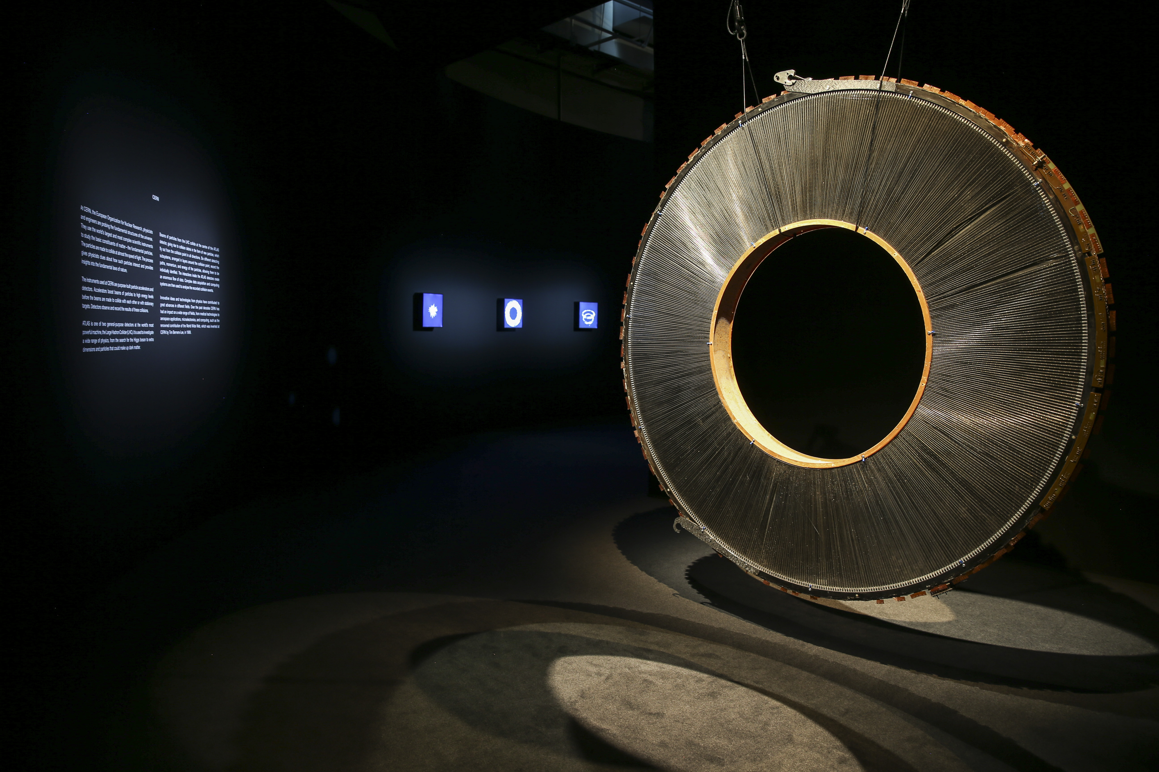
HALO.
Audemars Piguet Art Commission
ATLAS Transition Radiation Tracker
Art Basel 2018
Notes:
Using CERN heritage - ISR ATLAS Prototype Wheel at Art Basel as part of HALO

Slide 16
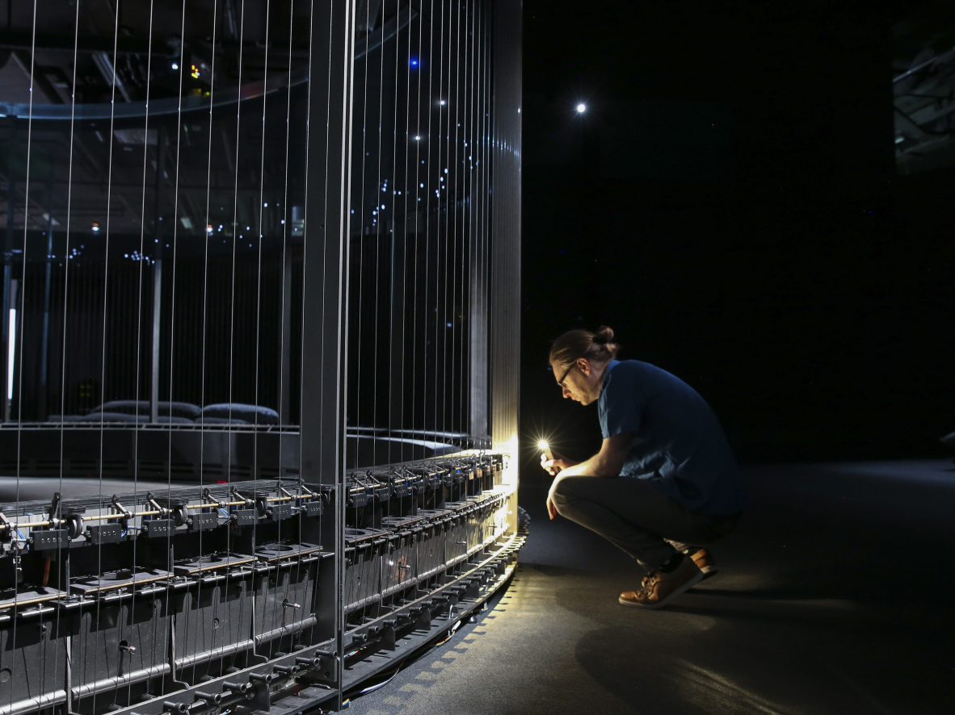

Slide 17
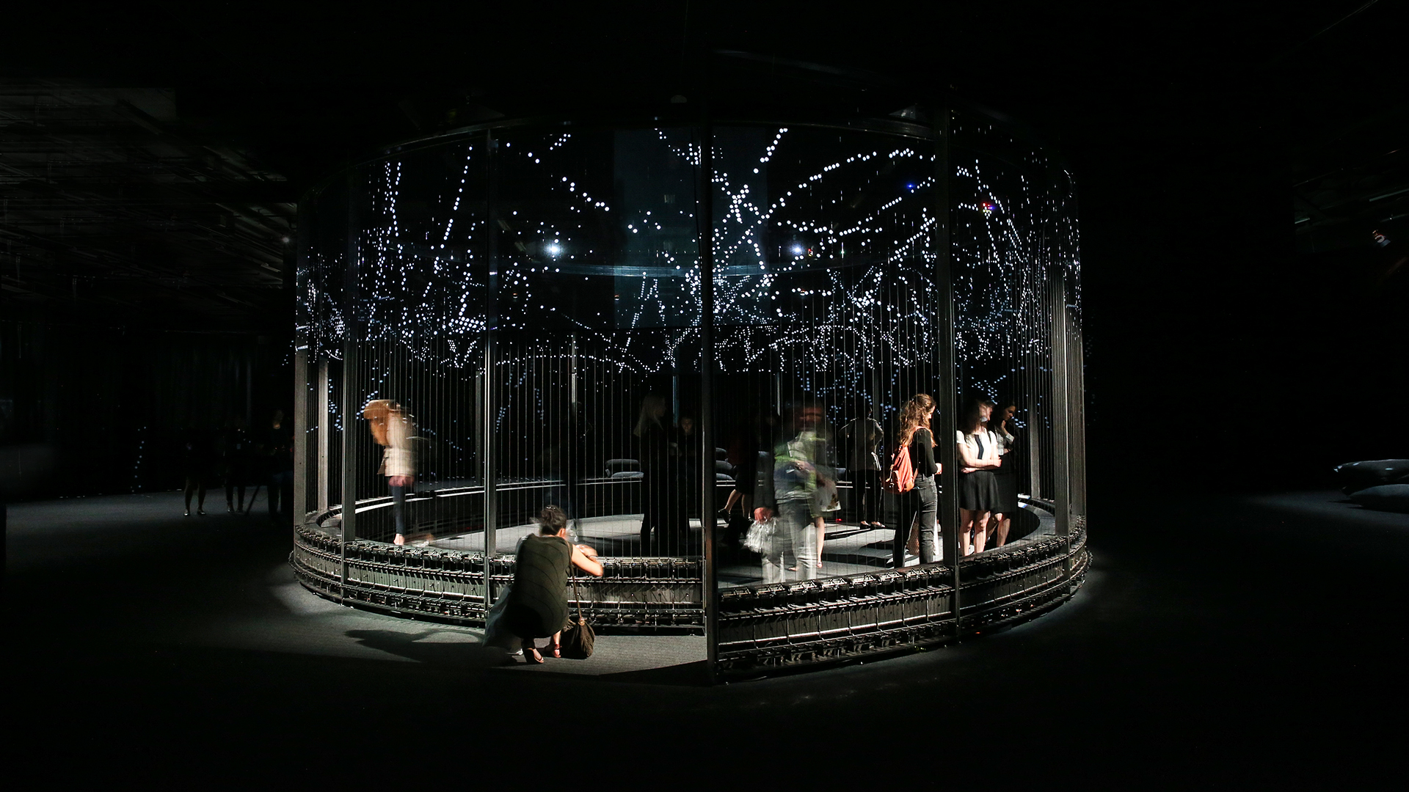
HALO. Audemars Piguet Art Commission
Art Basel 2018
Notes:
PLAY video
https://vimeo.com/277303237

Slide 18
Arts at CERN
https://arts.cern/

