Slide 1



Automation of magnet model generation with SIGMA
Short-term internship programme
February 1st – July 25st
Barakat Bokharaie
Supervisor: Matthias Mentink

Slide 2
Overview
Objective & motivation
What is SIGMA?
Restructuring
Automatic definition of:
  Quench heaters
  Solver settings
  Mesh settings
  Output plots
Validation
Documentation
Summary

Slide 3
Objective
Restructure SIGMA for reduction of computation time and model complexity
Automate the creation of Quench Heaters in models generated from SIGMA
Automate the definition of standard simulation settings in COMSOL:
  Automatic creation of solver settings
  Automatic creation of mesh
  Automatic creation of frequently used plots

Slide 4
Motivation
Why is a restructuring required?
  ↑ Complexity → ↑ Variables → ↑ Time
    Complexity reduction becomes vital!
Take the user of SIGMA in account:
  Completely automated with minimum set of features
    QHs, solver settings, mesh, output plots
    Reduced risk of input errors
    Less setup time – more simulations
    Consistency across different models and simulations

Slide 5
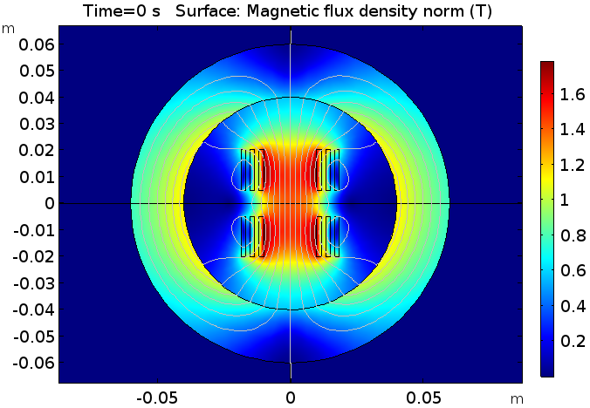
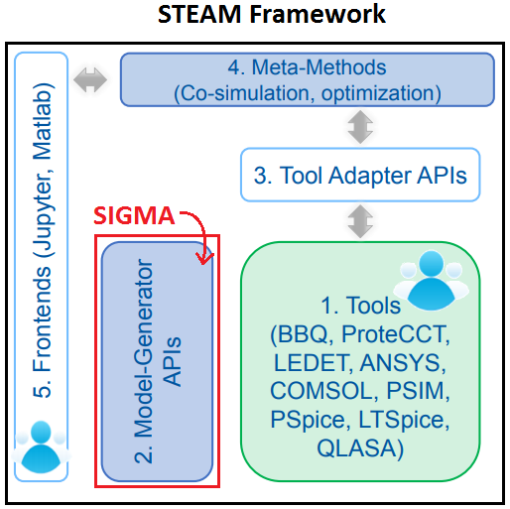
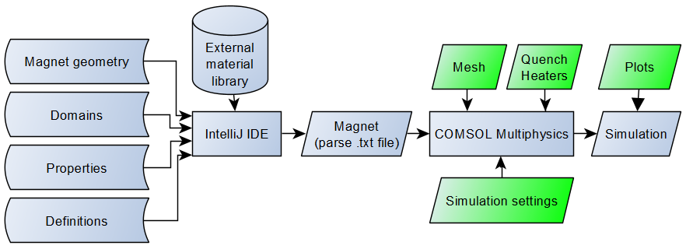
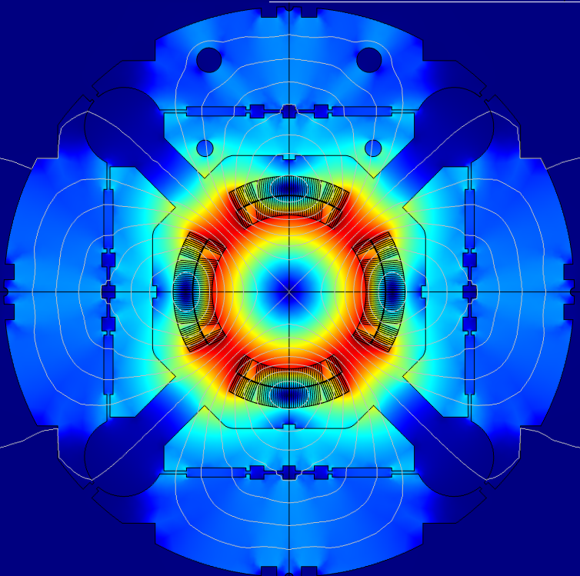
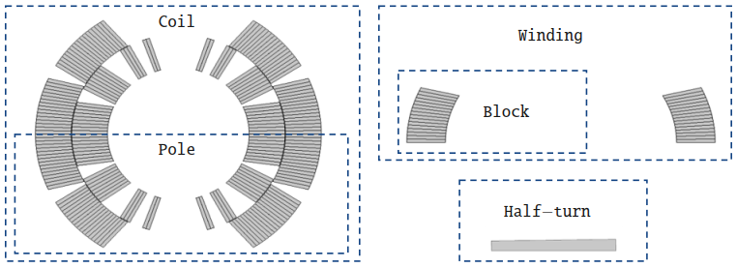
What is SIGMA?
Part of the STEAM framework
Simulation of Transient Effects in Accelerator Magnets
Java-based tool using the COMSOL API for generating magnet models
How SIGMA works:
Magnet geometry in SIGMA:
T0 magnet model
Courtesy of M. Maciejewski, SIGMA, STEAM Workshop
STEAM SIGMA Documentation v1.2,
EDMS nr. 2141579
MQXF magnet model

Slide 6
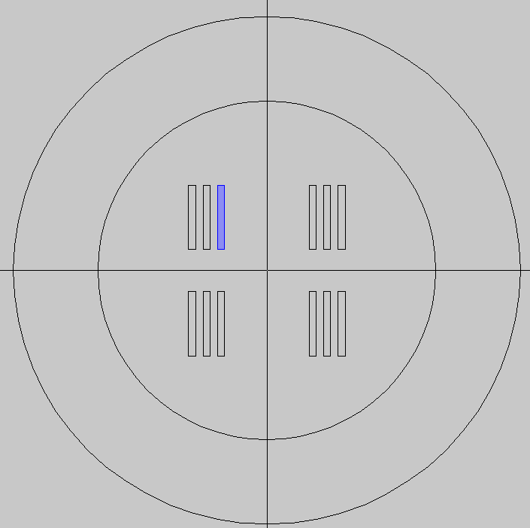
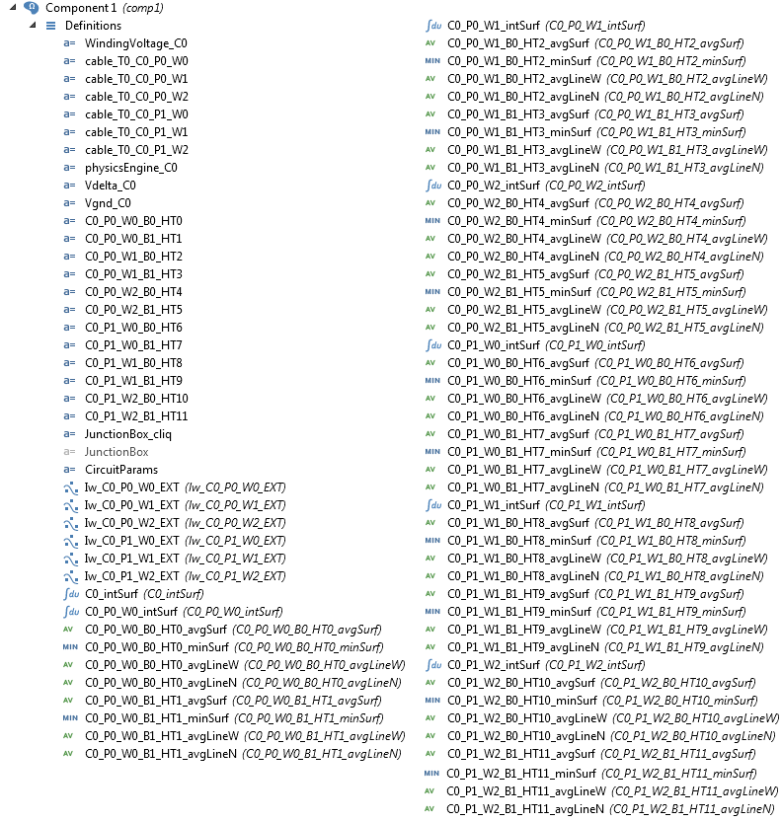
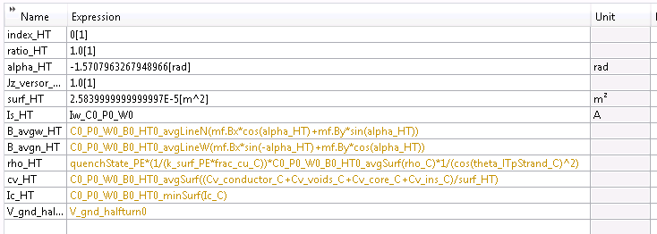
Before restructuring SIGMA
Variables before restructuring:
For every half-turn:
  3 averaging operators
  1 minimum operator
  1 variable group (with 12
  variables)
For every winding:
  1 integration operator
Voltage and current described
  on half-turn level
Example: Magnet_T0
6
Variable group generated pr. half-turn
Magnet_T0 definitions, before restructuring

Slide 7
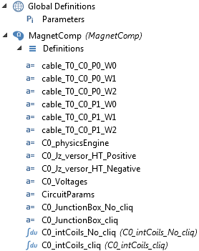
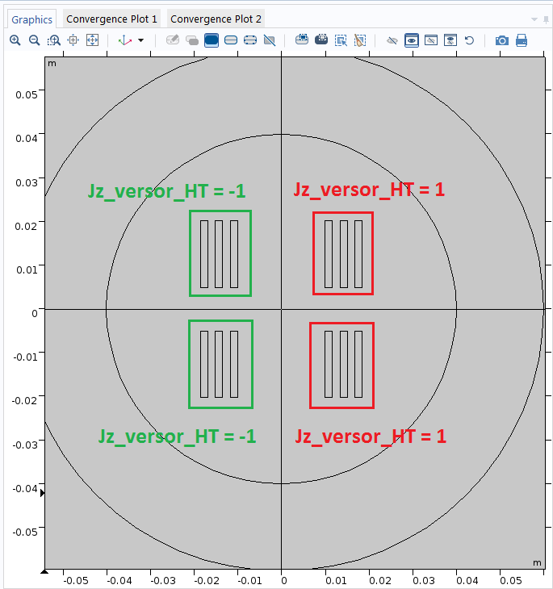
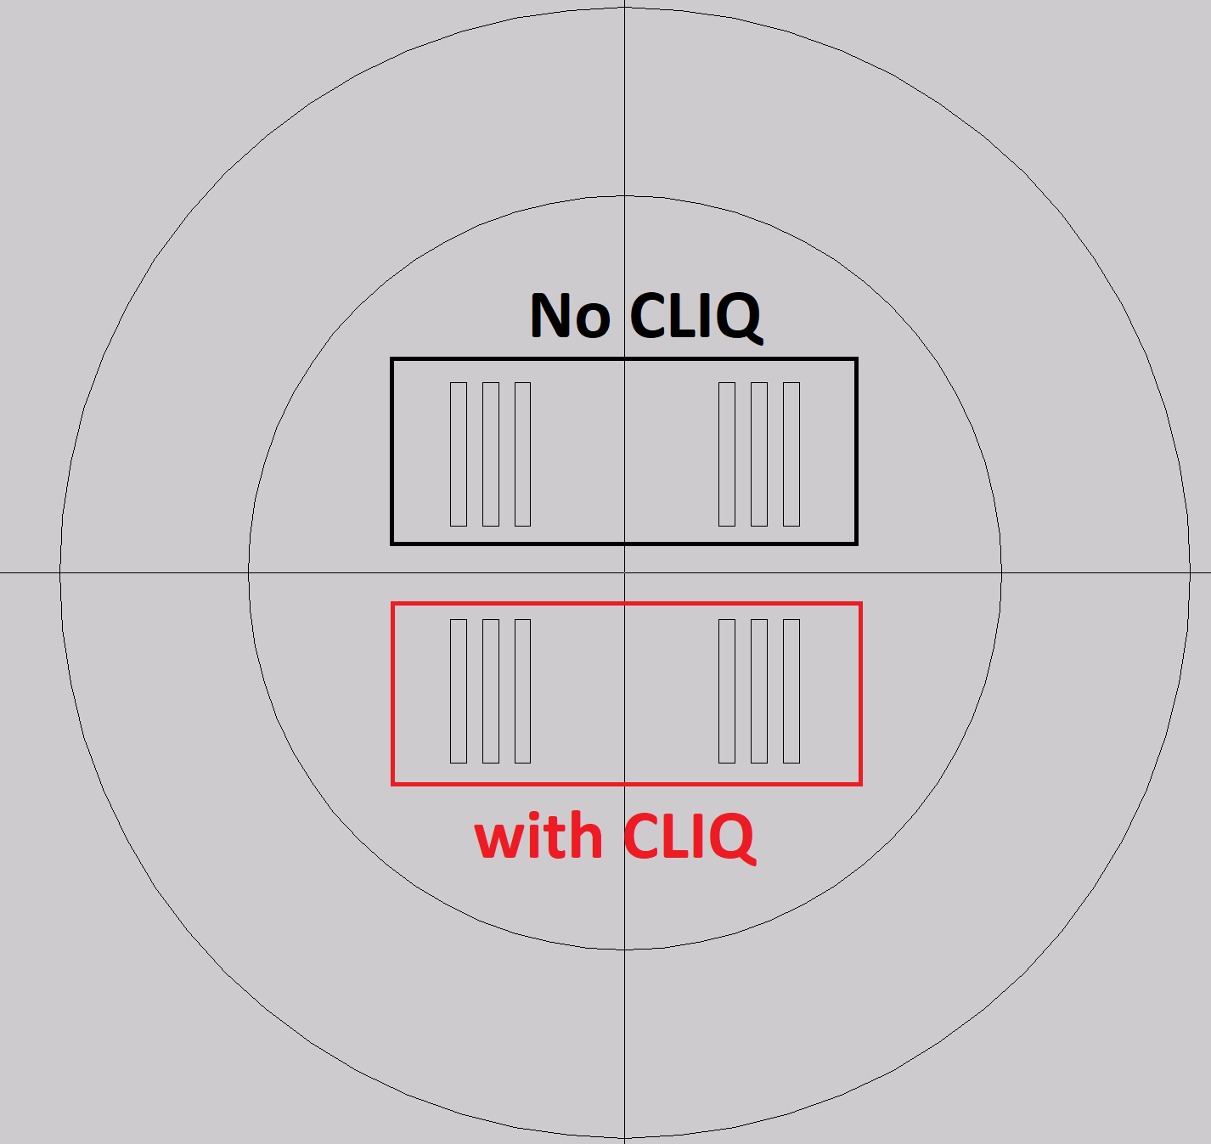
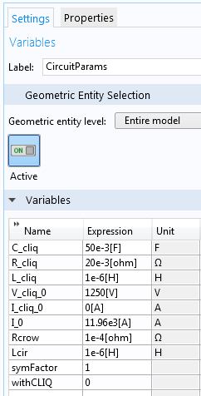
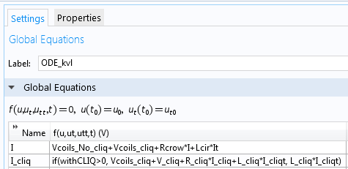
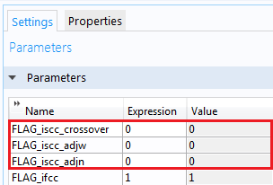
After restructuring SIGMA
V_Coils_no_cliq
Changes:
  Globally assigned polarity and coil currents
  Coil voltage calculation with a single integration operator per coil section depending on CLIQ
  Easy enabling / disabling of CLIQ
Gains:
  Significantly reduced complexity
  Significantly reduced computational time
Costs:
  ISCC physics disabled
  Extra post-processing required to find local voltage-to-ground
Current: I
Unchanged
Current: I+I_cliq
V_Coils_cliq
Significantly reduced
complexity of definitions
Current polarity assigned globally
Coil currents and voltages assigned globally
I_cliq depends on value of withCLIQ
Deleting iscc physics

Slide 8
Before and after restructuring - comparison
Reduced complexity!
From this….
…to this!

Slide 9
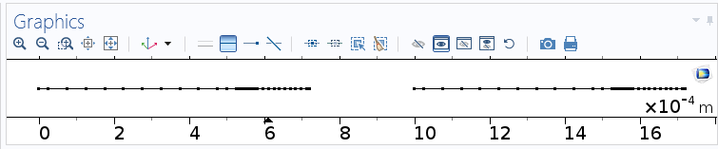
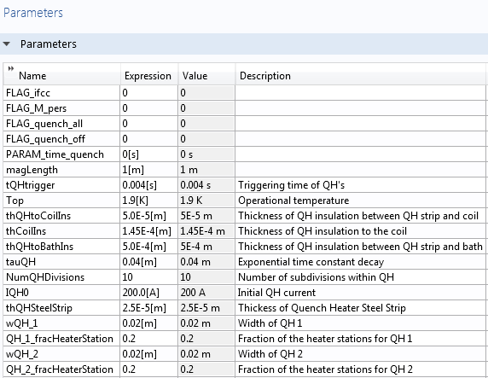
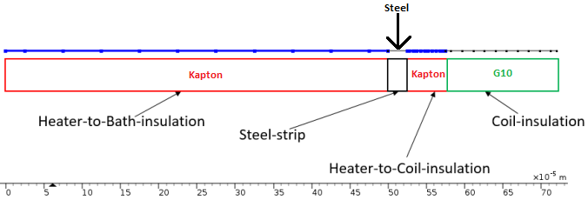
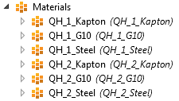
Automatic creation of Quench Heaters
Automatic generation of additional COMSOL component with:
Multiple quench heaters, implemented in HT module
Automatic coupling to the 2D magnet component
Correct geometry
Automatic generation of relevant material properties
Quench heater geometry [1]
Added global definitions
Added materials in quench heater component
[1] STEAM SIGMA Documentation v1.2, EDMS nr. 2141579

Slide 10
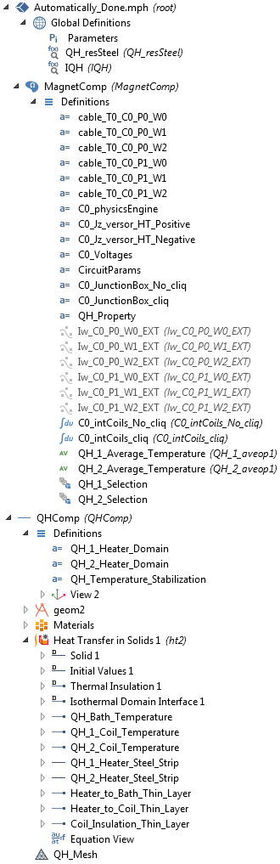
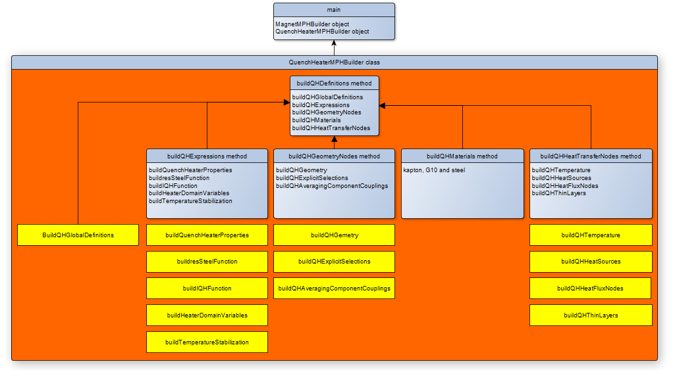
Automatic creation of Quench Heaters

Slide 11
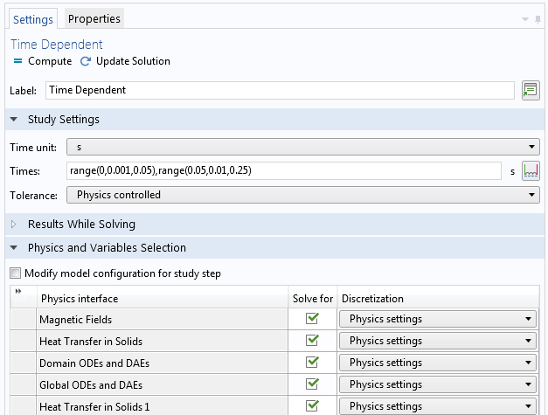
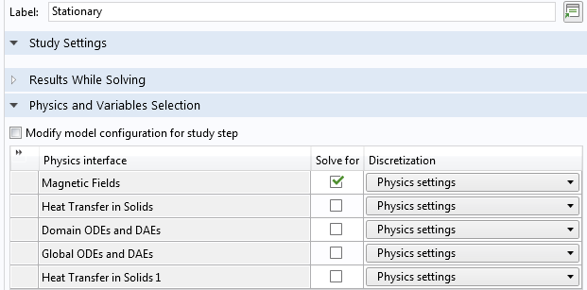
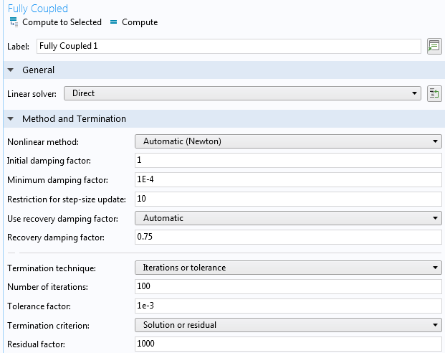

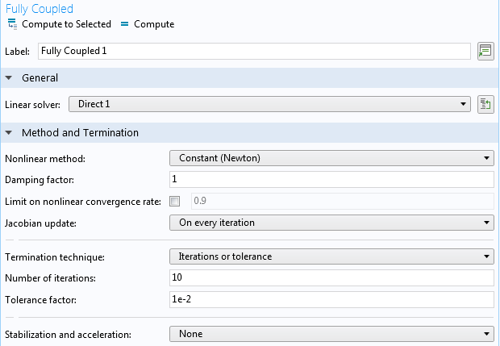
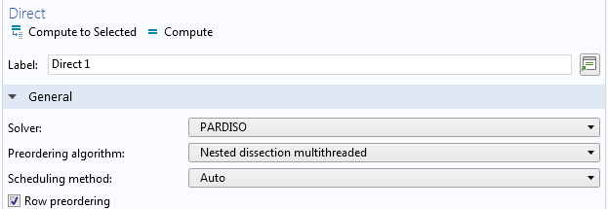
Automatic definition of standard COMSOL settings
Creation of two studies:
Stationary
Time dependent
Solver configuration
Transient solver settings
Stationary solver settings

Slide 12
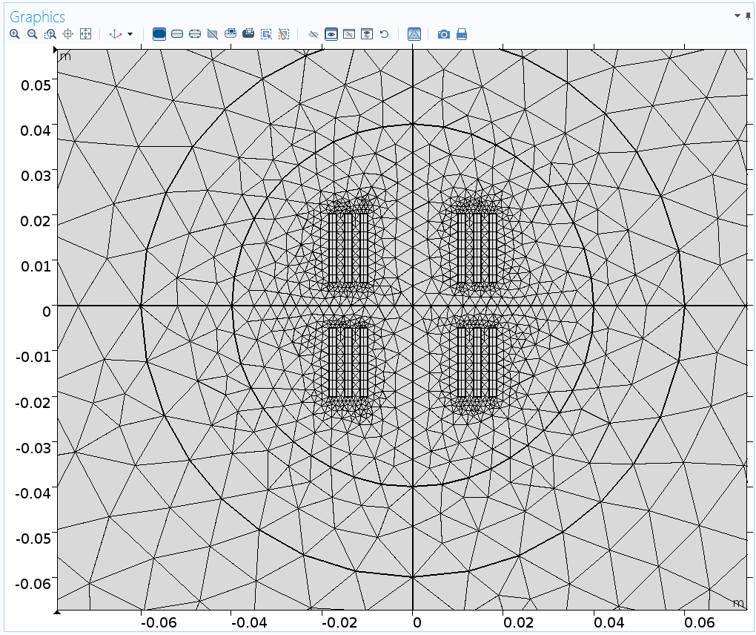
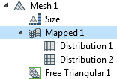
Automatic definition of standard COMSOL settings
Creation of different meshes:
Mapped
Free Triangular
Mesh settings: Mapped (coils) + triangular (rest)
Mesh after automatic generation

Slide 13
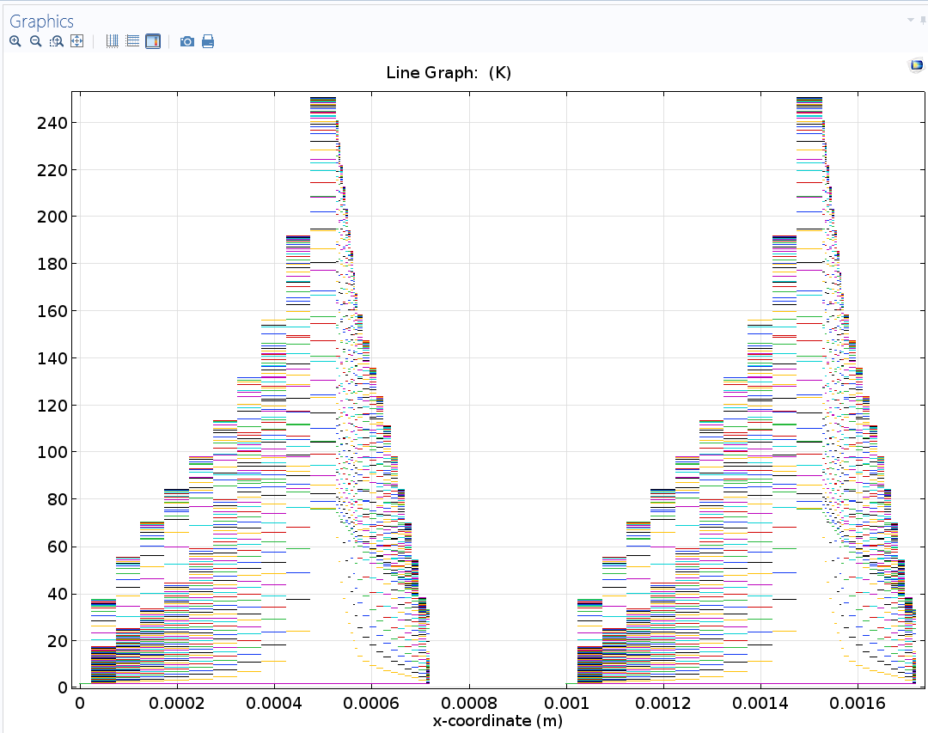
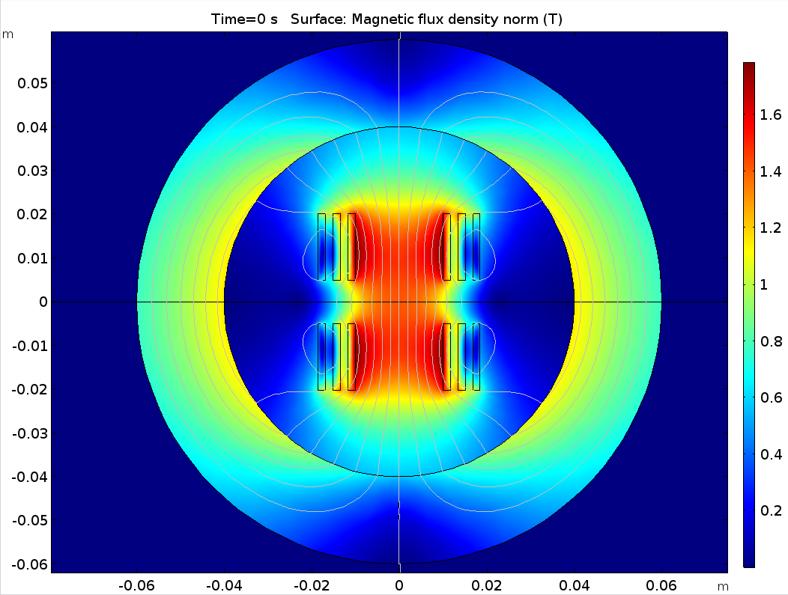
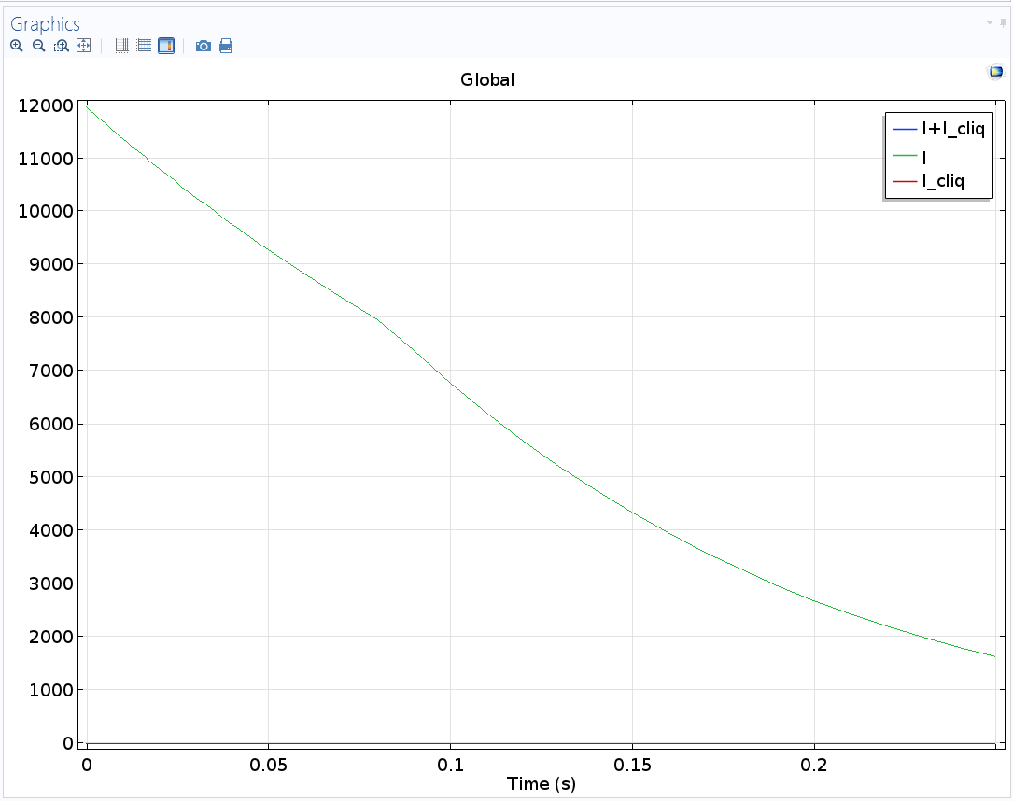
Automatic definition of standard COMSOL settings
Quench heater temperatures
Stationary magnetic field
Magnet circuit discharge (EE + QHs)
Creation of plots:
Magnetic flux density
Currents
QH temperatures

Slide 14
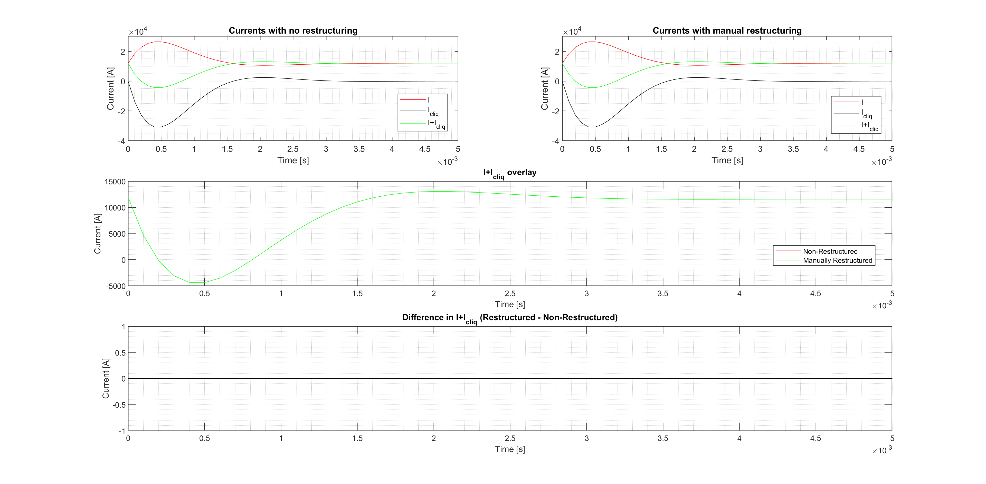
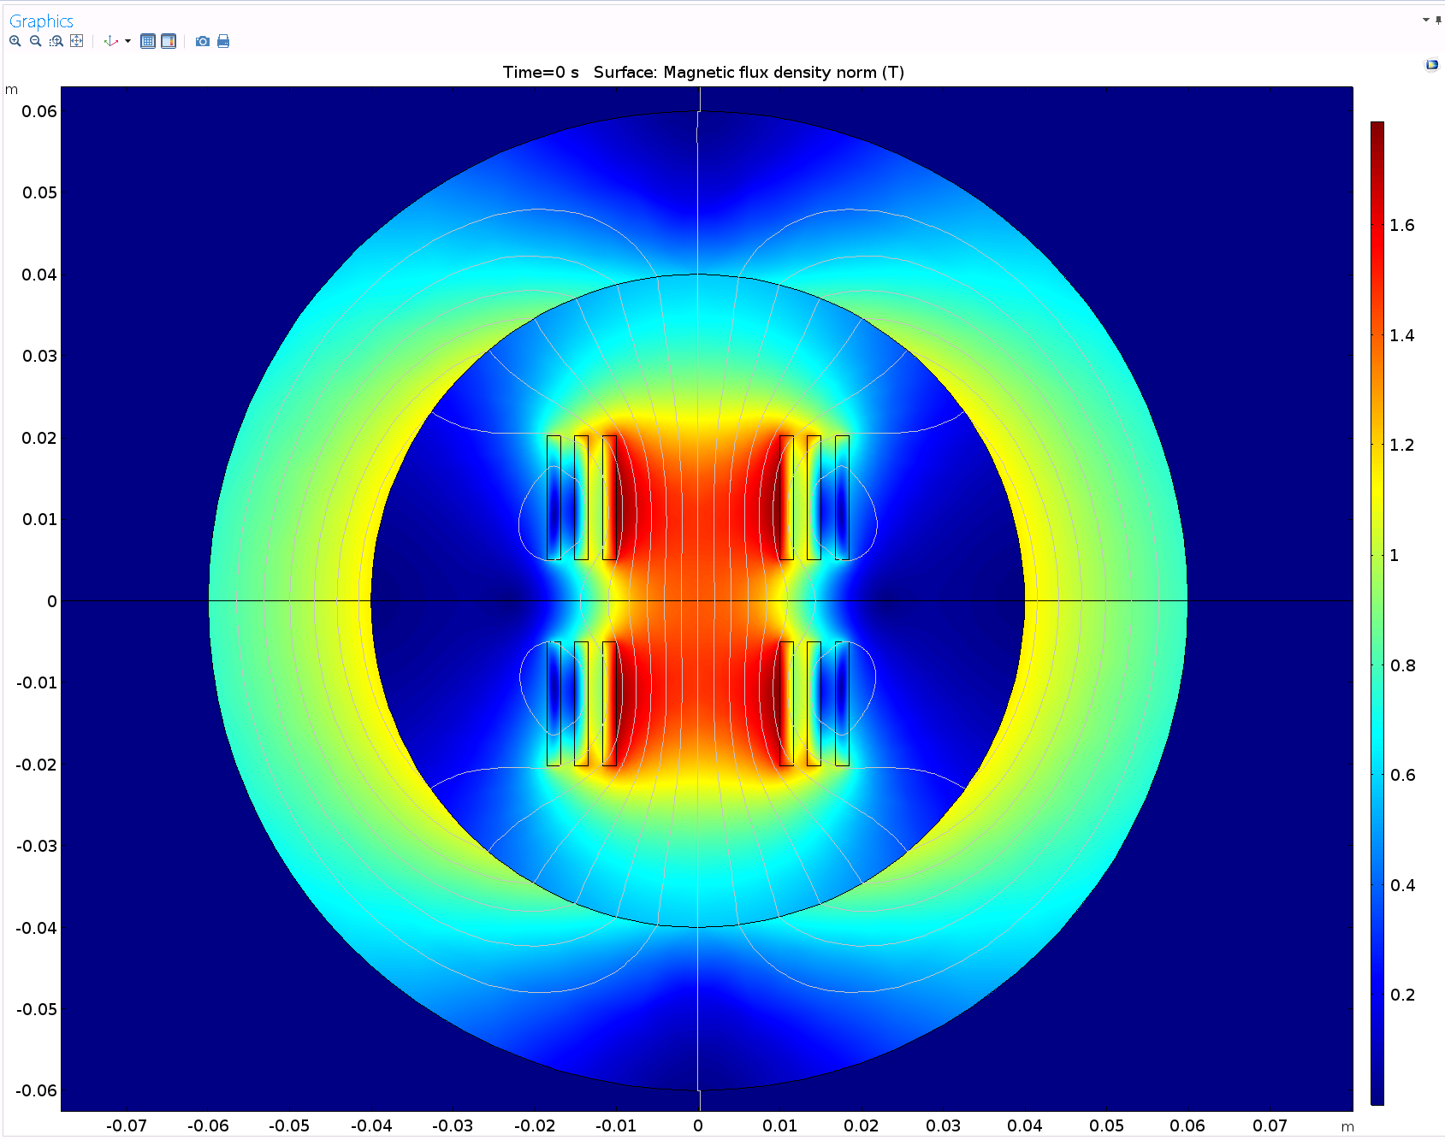
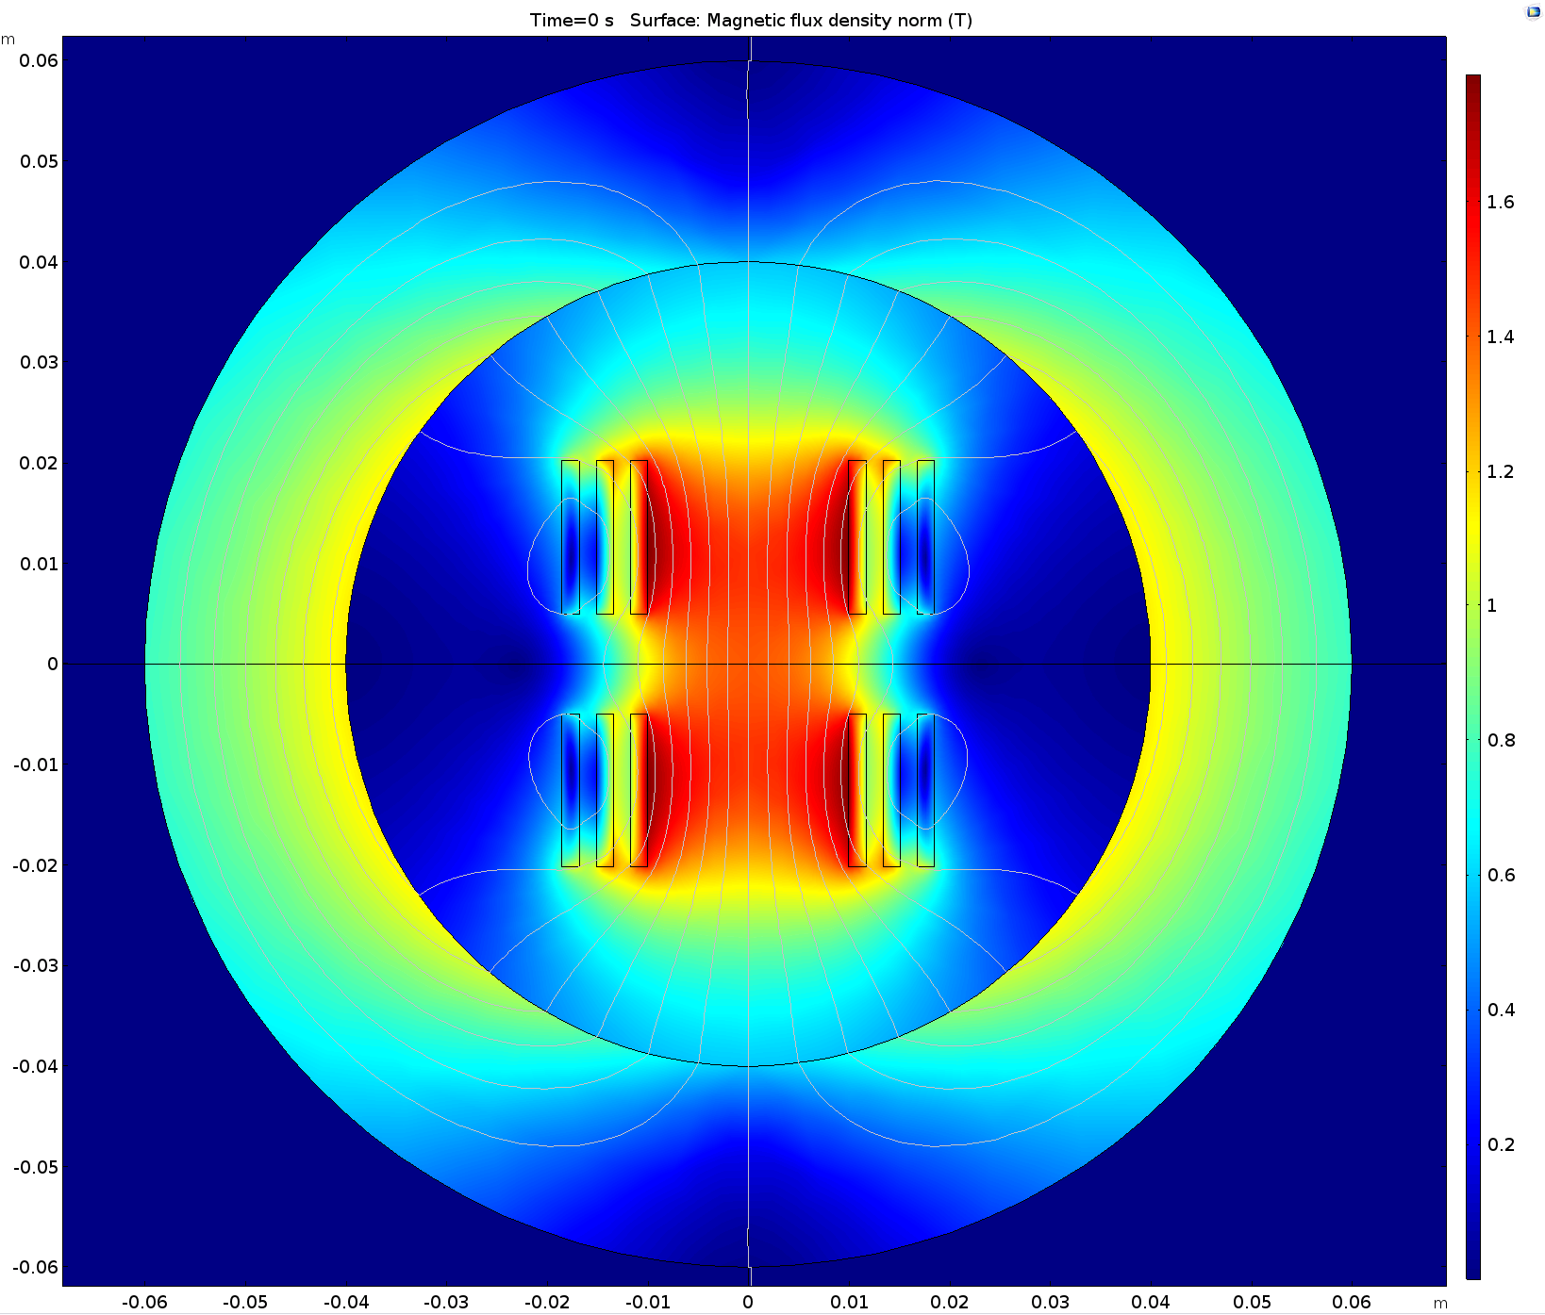
Validation (1/2): Comparison of non-restructured and restructured models
No difference in magnetic flux density
No difference in current during discharge
→ Consistent!
Magnetic flux density in non-restructured model
Magnetic flux density in manually restructured model

Slide 15
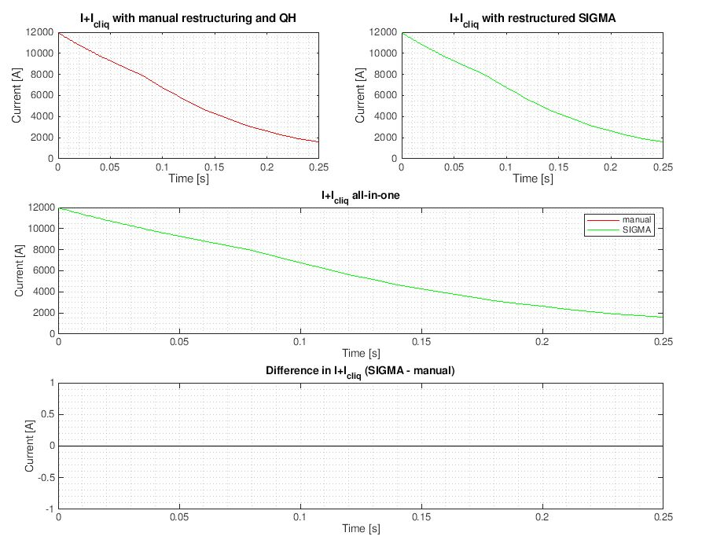
Validation (2/2): Comparison of manual and automatically generated Comsol models
Identical current discharge
→ Consistent!

Slide 16
Attained speedup due to restructuring
So, does the restructured model run faster??
Non-restructured | Restructured
Time-range: range(0,0.001,0.05),range(0.05,0.01,0.25)
67s | 64s
Time-range: range(0,0.0002,0.005) range(0.005,0.0005,0.05),range(0.05,0.01,0.25)
169s | 79s
Results:
Modest improvement for T0
More improvement for higher complexity models previously demonstrated (11 T double aperture: 15x reduction in computational cost)

Slide 17
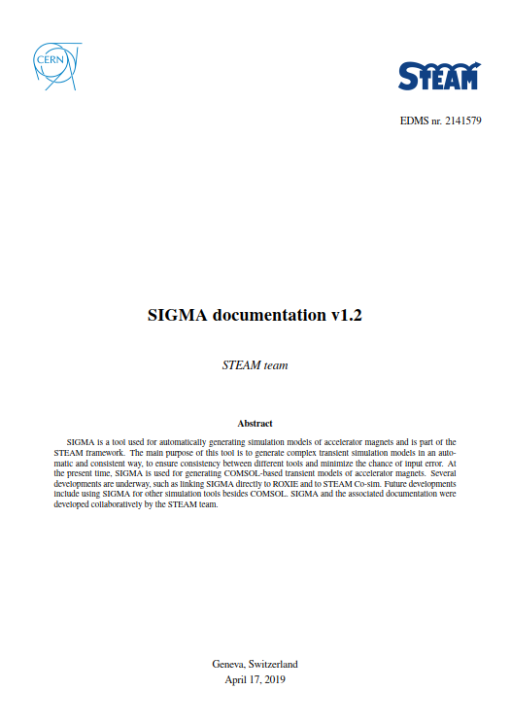
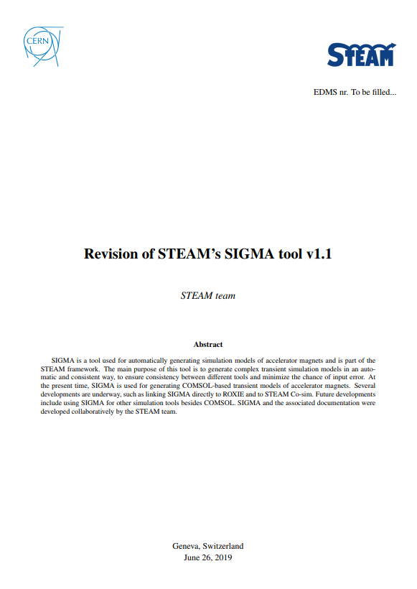
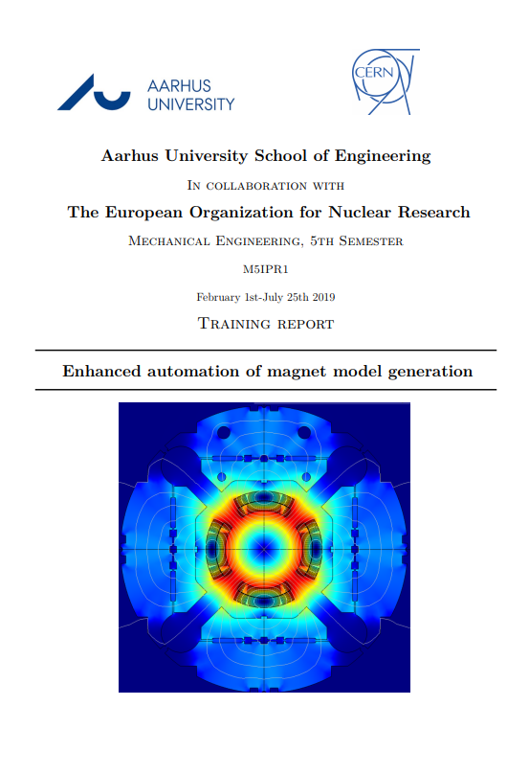
Documentation (work in progress)
Documentation of revisions made to SIGMA
Training report for Matthias, Aarhus University (AU) and future students from AU at CERN
STEAM SIGMA documentation

Slide 18
Summary
Completed:
SIGMA restructured for reduction in complexity and computation times
Automatic QHs added with correct geometry, properties and coupling to 2D magnet model
Automatic solver settings, mesh and output plots added
Documentations (in progress)
To do:
Make number of QHs a magnet property
Code convention
Test classes

Slide 19
Thank you for your attention!
Questions?

