Slide 1


Welcome
Visit of Team Finland
Lead by Ambassador, Mr. Timo Rajakangas
November 1st, 2019
to Accelerating Science and Innovation
Notes:
1

Slide 2
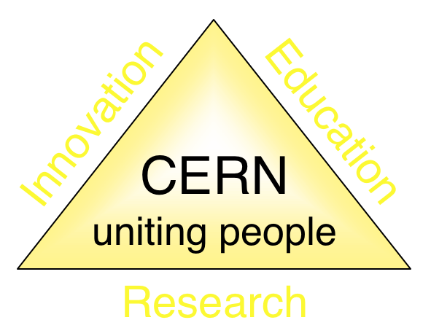
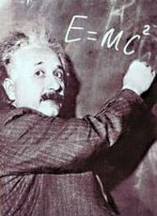
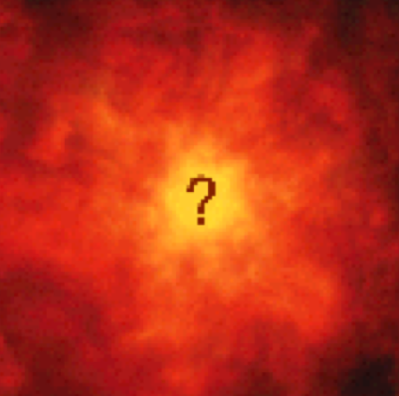
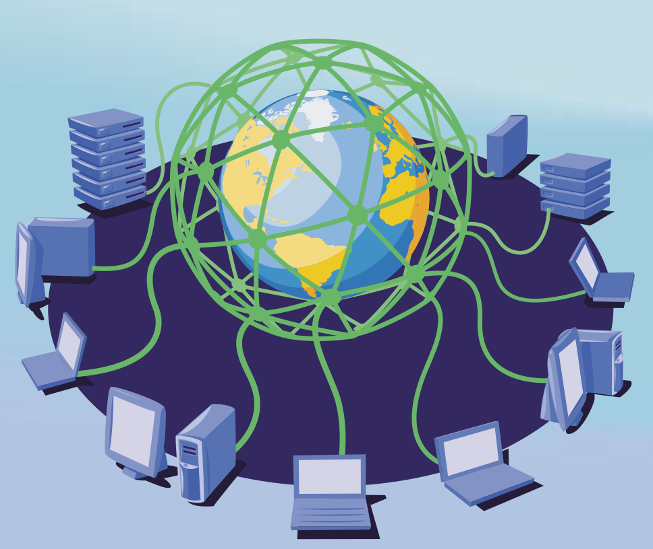

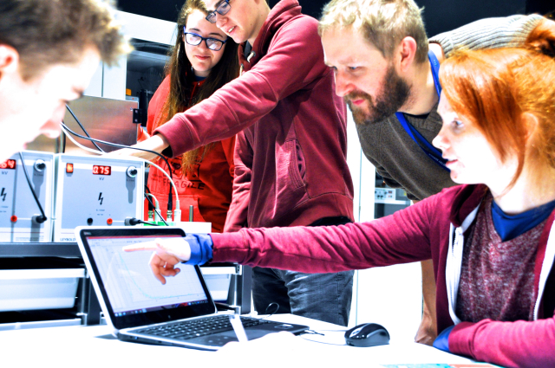
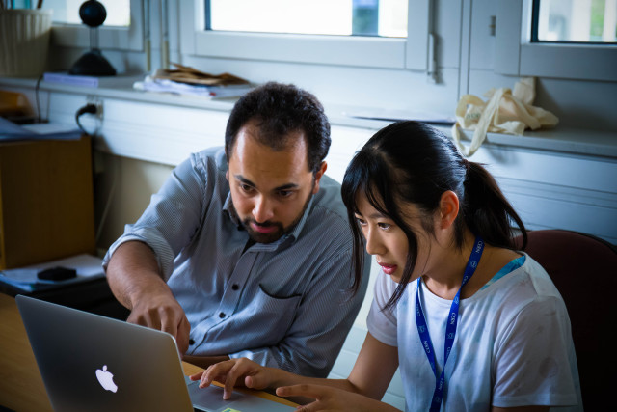
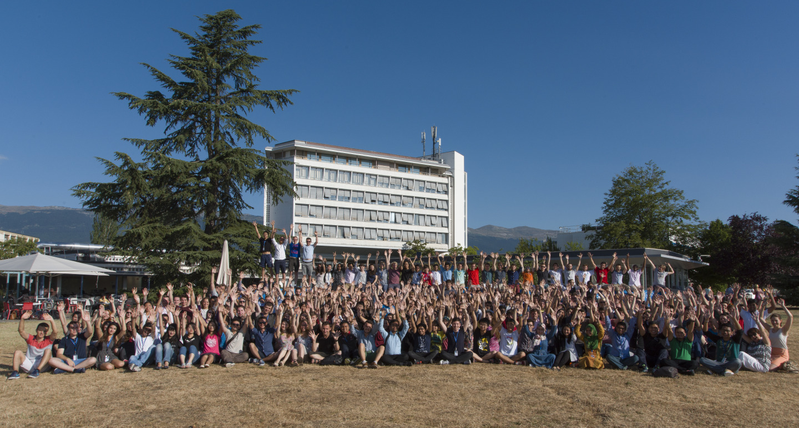
The Mission of CERN
Push back the frontiers of knowledge
E.g. the secrets of the Big Bang …what was the matter like within the first moments of the Universe’s existence?
Develop new technologies for accelerators and detectors
Information technology - the Web and the GRID
Medicine - diagnosis and therapy
Train scientists and engineers of tomorrow
Unite people from different countries
and cultures
Notes:
2

Slide 3
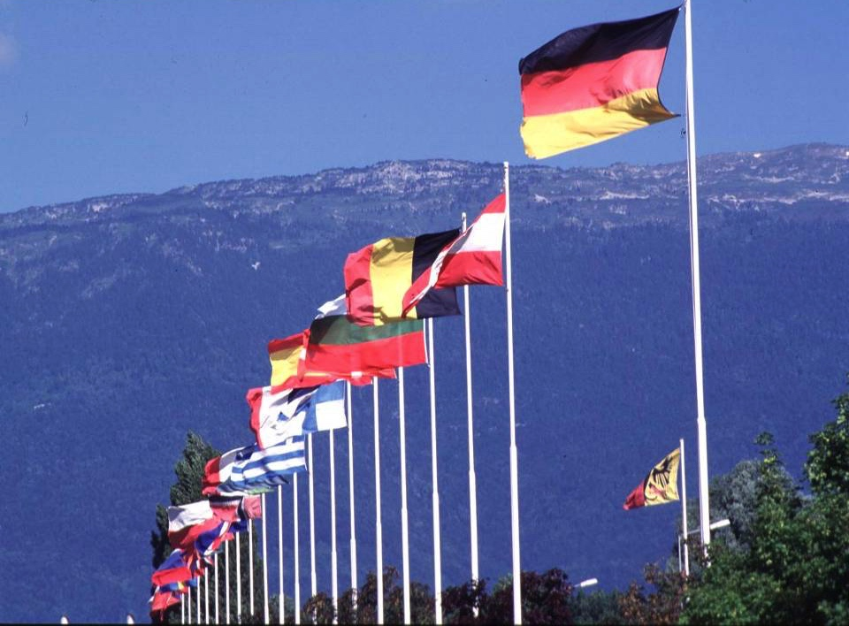

CERN: founded in 1954: 12 European States
“Science for Peace”
Today: 22 Member States
~ 2600 staff
~ 1800 other paid personnel
~ 14000 scientific users
Budget (2019) ~ 1200 MCHF
Member States: Austria, Belgium, Bulgaria, Czech Republic, Denmark, Finland, France, Germany, Greece, Hungary, Israel, Italy, Netherlands, Norway, Poland, Portugal, Romania, Slovak Republic, Spain, Sweden, Switzerland and
United Kingdom
Associate Members in the Pre-Stage to Membership: Cyprus, Serbia, Slovenia
Associate Member States: India, Lithuania, Pakistan, Turkey, Ukraine
Applications for Membership or Associate Membership:
Brazil, Croatia, Estonia
Observers to Council: Japan, Russia, United States of America;
European Union, JINR and UNESCO
3
Notes:
3
----- Meeting Notes (09/01/2013 14:16) -----
nnn

Slide 4
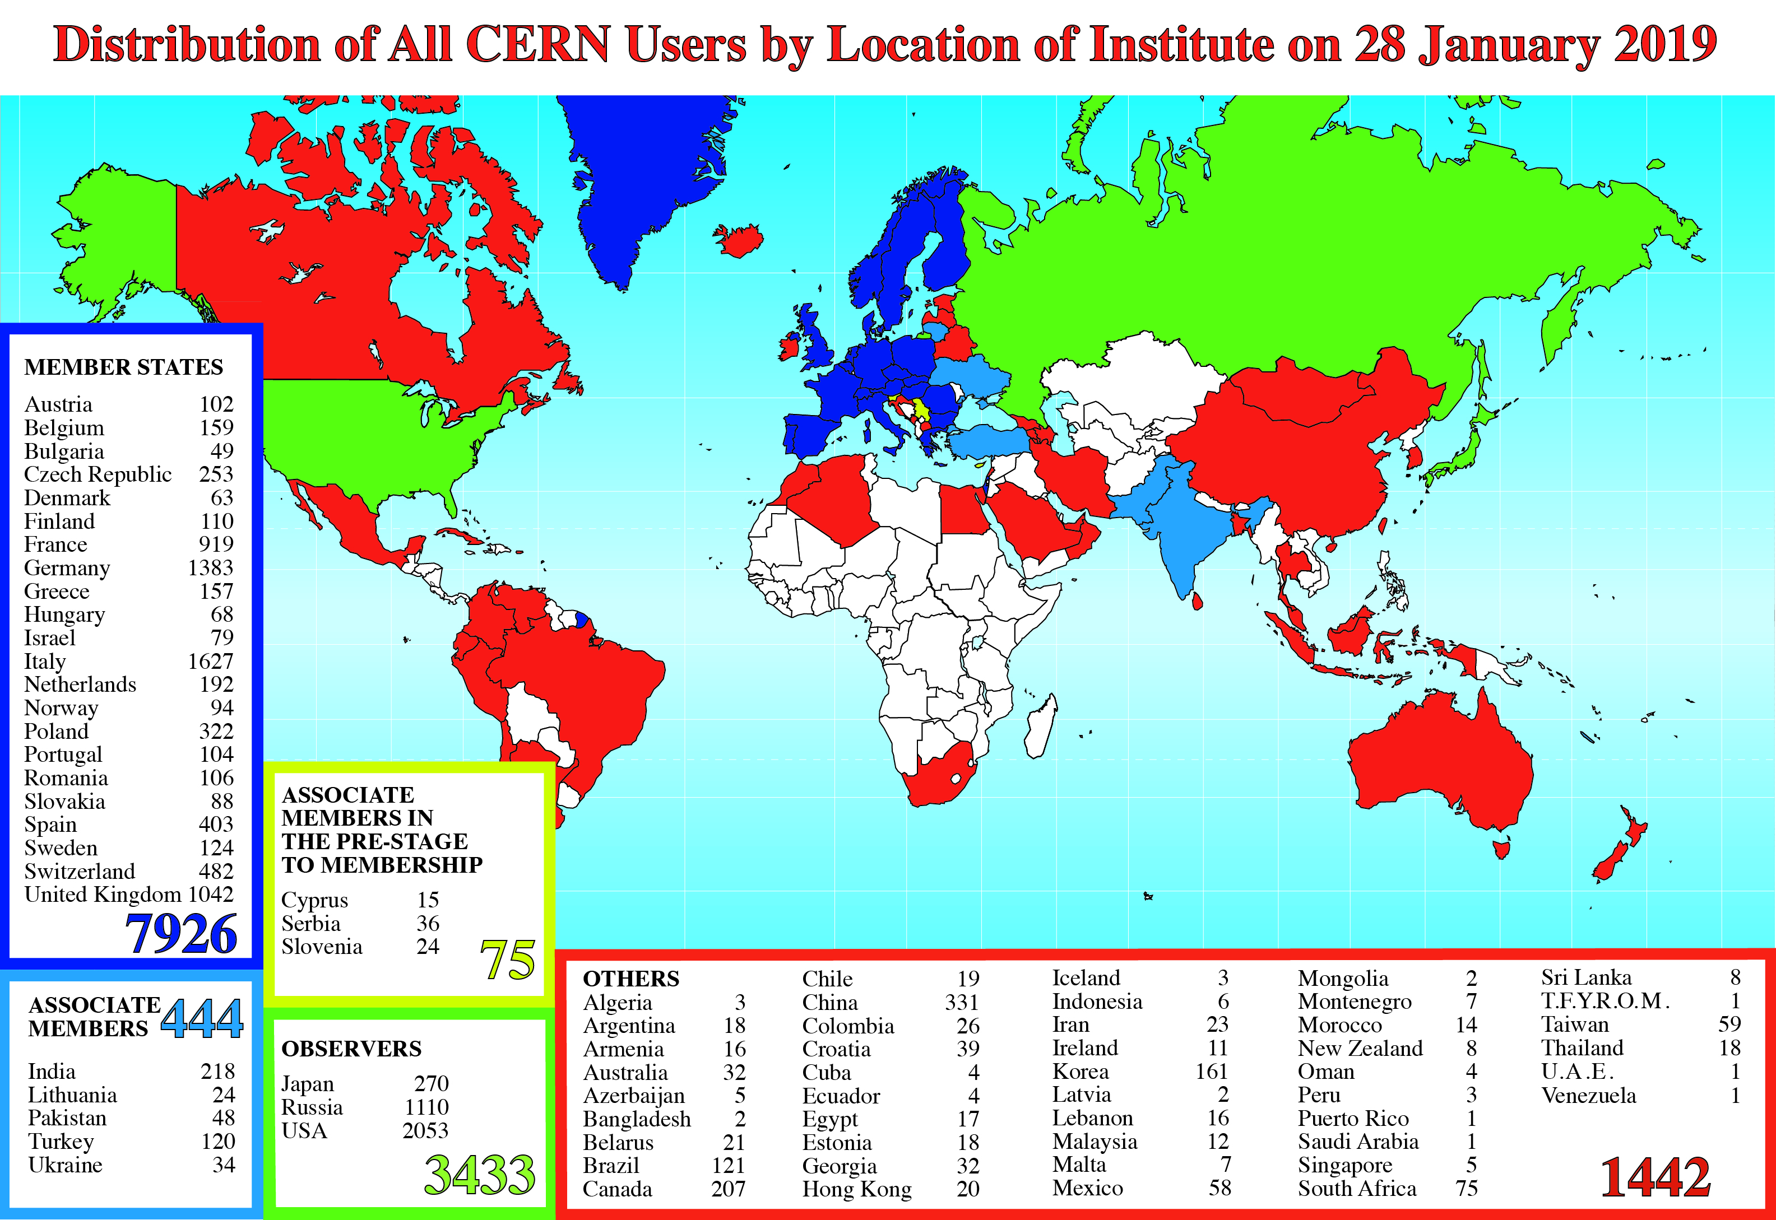
Science is getting more and more global
CERN: x staff, x fellows
Notes:
4
4

Slide 5
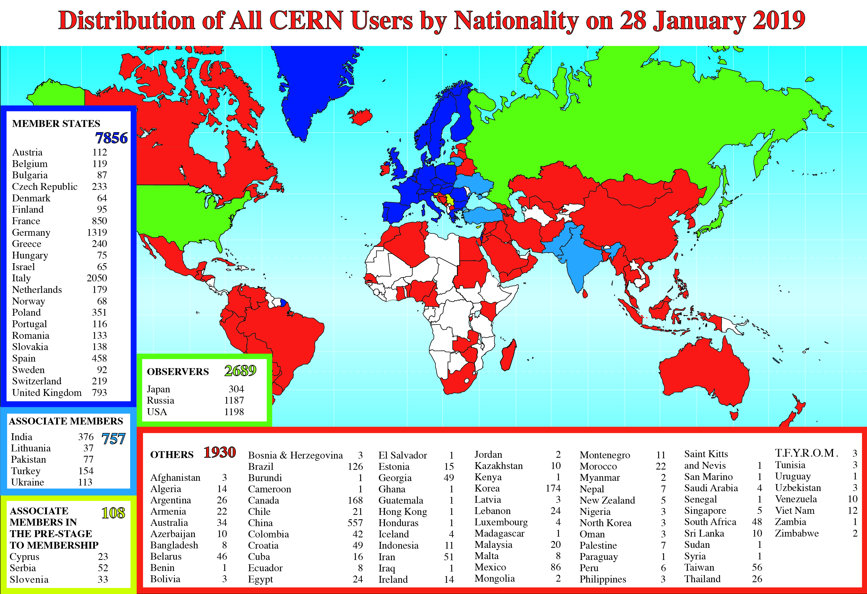
Science is getting more and more global
Notes:
5
5

Slide 6
Age Distribution of Scientists
- and where they go afterwards
27
Today:
>3000 PhD students
in LHC experiments
65
They do not all stay: where do they go?

Slide 7
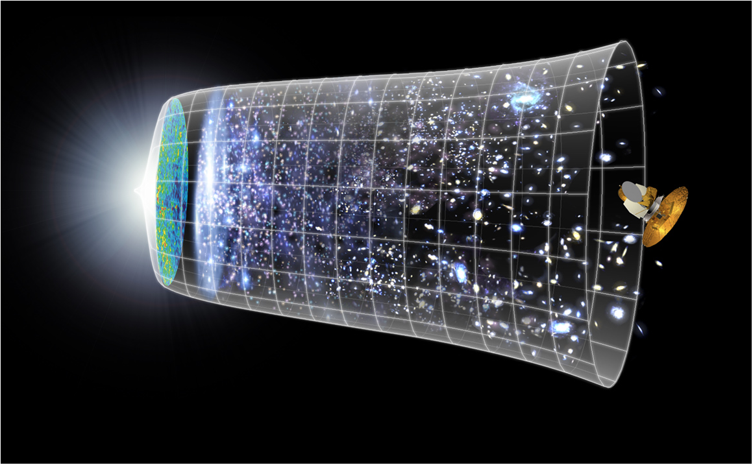
Next Scientific Challenge:
to understand the very first moments of our Universe after the Big Bang
Big Bang
WMAP
13.8 Billion Years
Today
10²⁸ cm

Slide 8
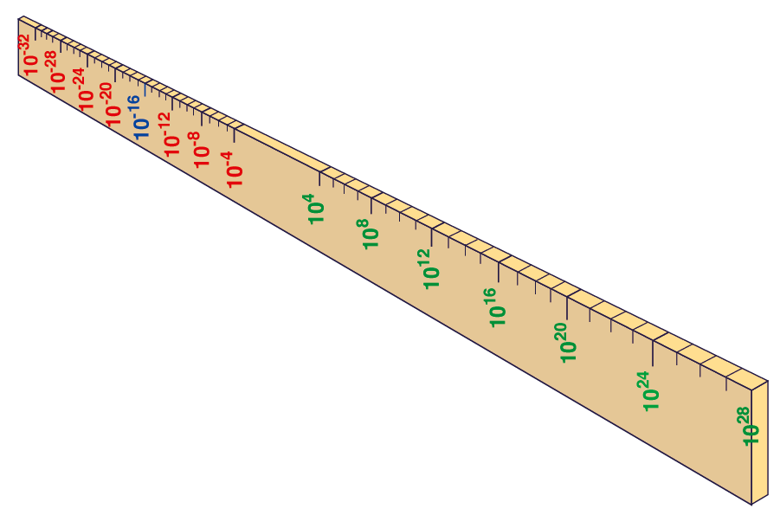
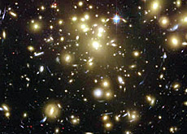
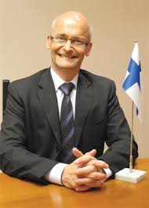
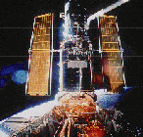
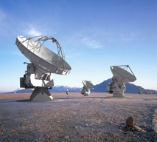
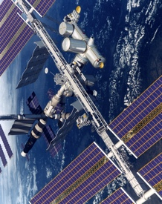
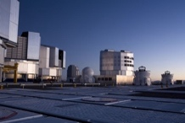
Big Bang
Proton
Atom
Radius of Earth
Earth to Sun
Radius of Galaxies
Universe
Hubble
ALMA
cm
AMS
VLT
Notes:
8
60 Grössenordnungen

Slide 9
Next Scientific Challenge:
to understand the very first moments of our Universe after the Big Bang
Big Bang
WMAP
380,000 years

Slide 10



Big Bang
Proton
Atom
Radius of Earth
Earth to Sun
Radius of Galaxies
Universe
LHC
Super-Microscope
Hubble
ALMA
cm
Reproducing conditions
Looking back
AMS
VLT
Notes:
10
60 Grössenordnungen

Slide 11
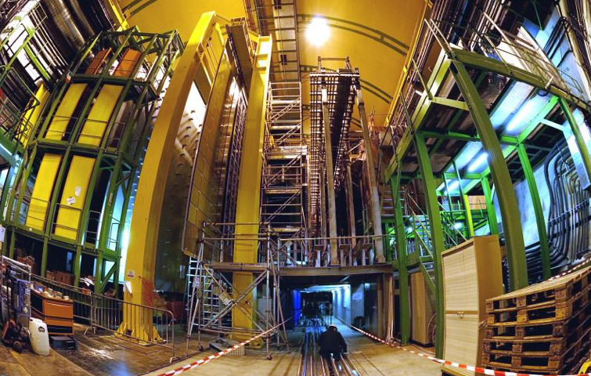


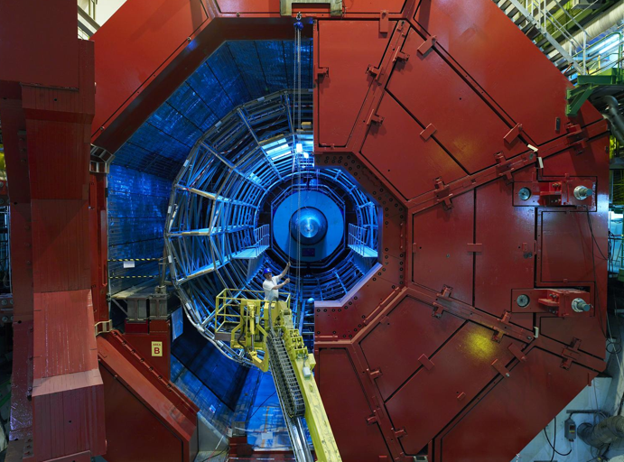

2010: a New Era in Fundamental Science
LHCb
CMS
ATLAS
Exploration of a new energy frontier
in p-p and Pb-Pb collisions
ALICE
LHC ring:
27 km circumference
Notes:
11

Slide 12
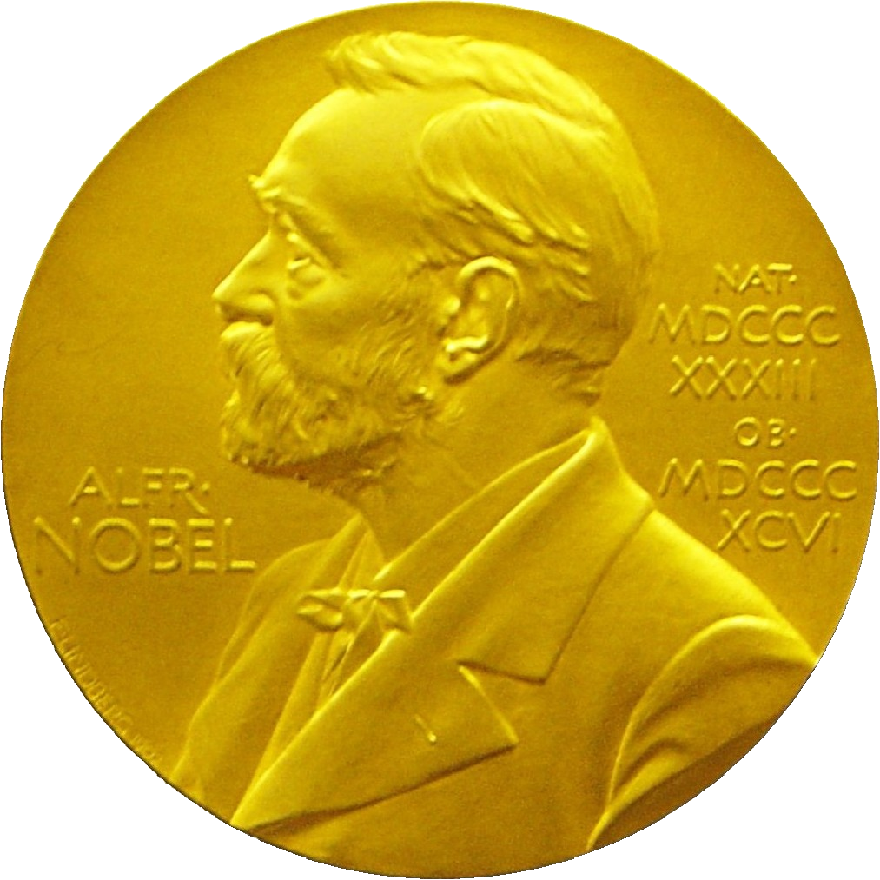
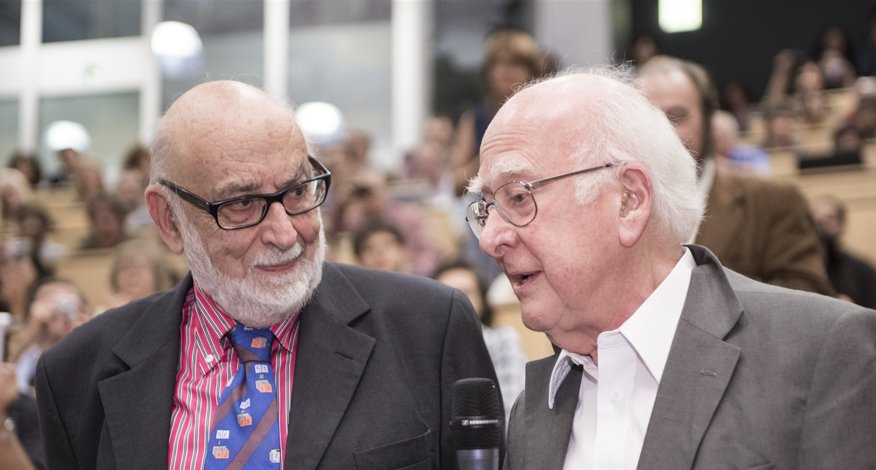
Discovery 2012, Nobel Prize in Physics 2013
The Nobel Prize in Physics 2013 was awarded jointly to François Englert and Peter W. Higgs "for the theoretical discovery of a mechanism that contributes to our understanding of the origin of mass of subatomic particles, and which recently was confirmed through the discovery of the predicted fundamental particle, by the ATLAS and CMS experiments at CERN's Large Hadron Collider”.

Slide 13
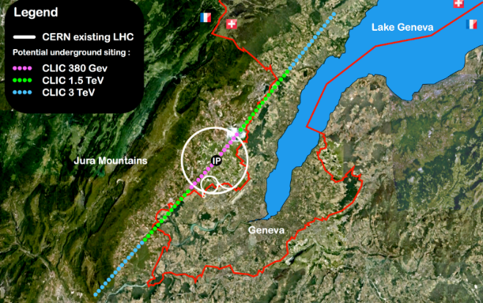


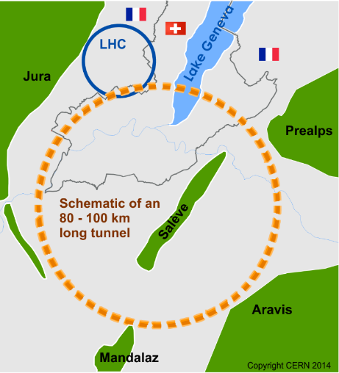
Future of particle physics
High Luminosity LHC until 2035
Ten times more collisions than
the original design
Studies in progress:
Compact Linear Collider (CLIC)
Linear e⁺e⁻ collider √s up to 3 TeV
Future Circular Collider (FCC)
New technology magnets →
100 TeV pp collisions in 100km ring
e⁺e⁻ collider (FCC-ee) as 1st step?
HE-LHC in the present LHC tunnel
with FCC-hh technology?
European Strategy for Particle Physics
Preparing next update in 2020

Slide 14
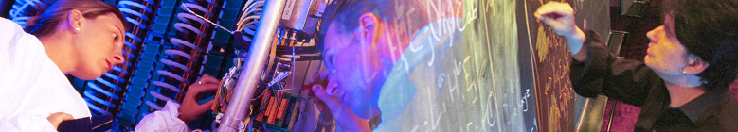

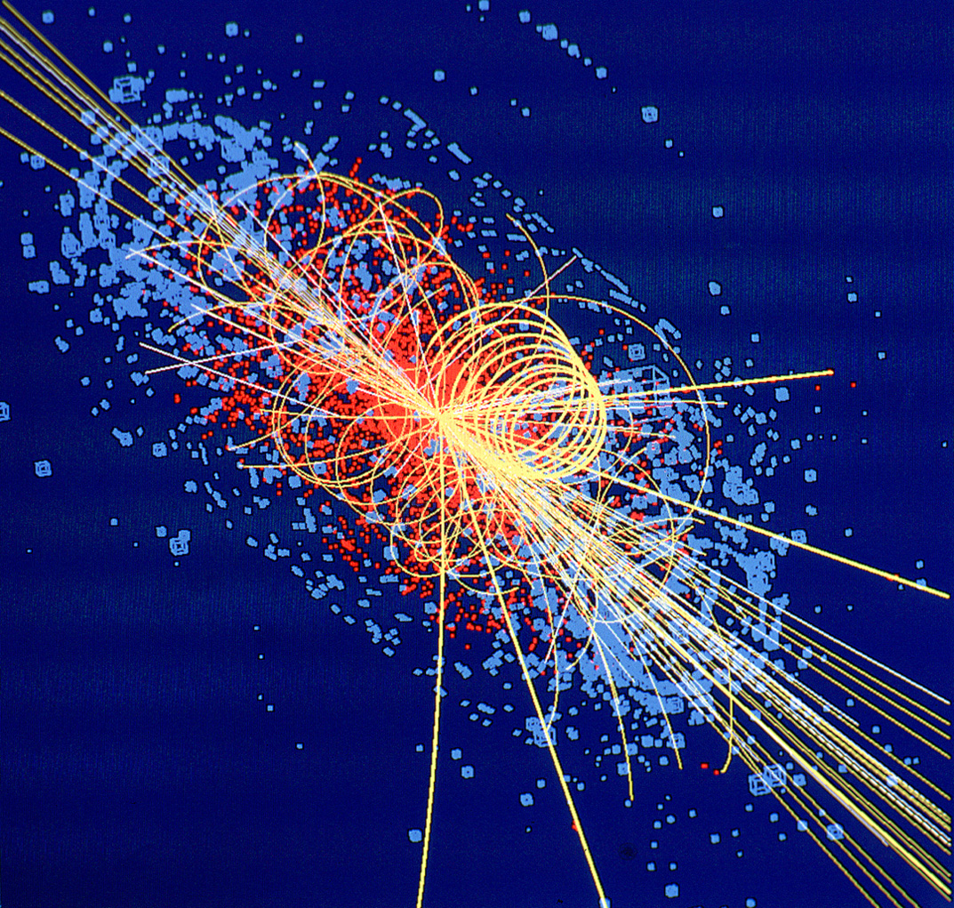
CERN: Particle Physics and Innovation
Interfacing between fundamental science and key technological developments
CERN Technologies and Innovation
Accelerating particle beams
Detecting particles
Large-scale computing (Grid)
Notes:
14

Slide 15
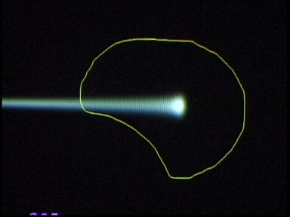
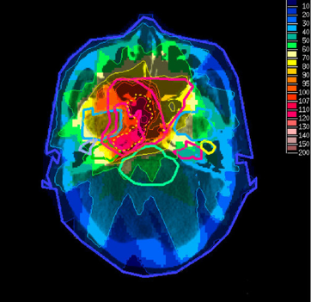
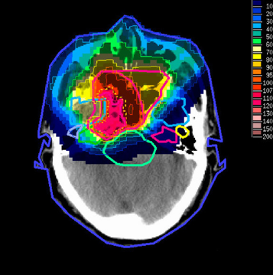
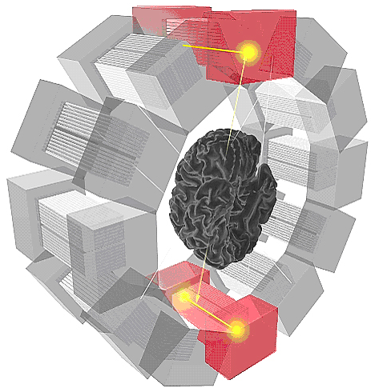
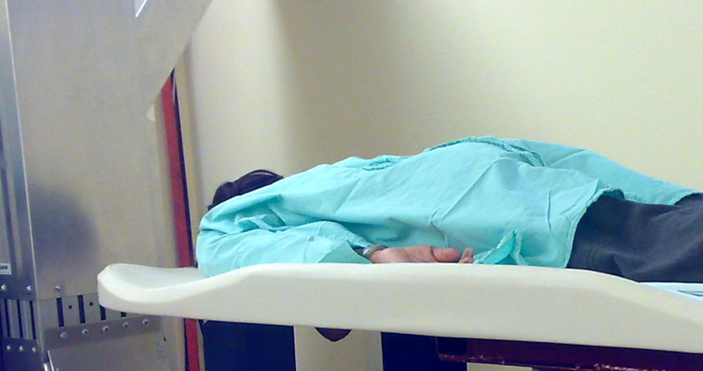
Medical Application as an Example of Particle Physics Spin-off
Combining Physics, ICT, Biology and Medicine to fight cancer
Hadron Therapy
Tumour Target
Leadership in Ion Beam Therapy now in Europe and Japan
Protons
light ions
Accelerating particle beams
~30’000 accelerators worldwide
~17’000 used for medicine
X-ray
protons
>100’000 patients treated worldwide (45 facilities)
>50’000 patients treated in Europe (14 facilities)
Imaging
PET Scanner
Clinical trial in Portugal, France and Italy for new breast imaging system (ClearPEM)
Detecting particles
Notes:
15

Slide 16
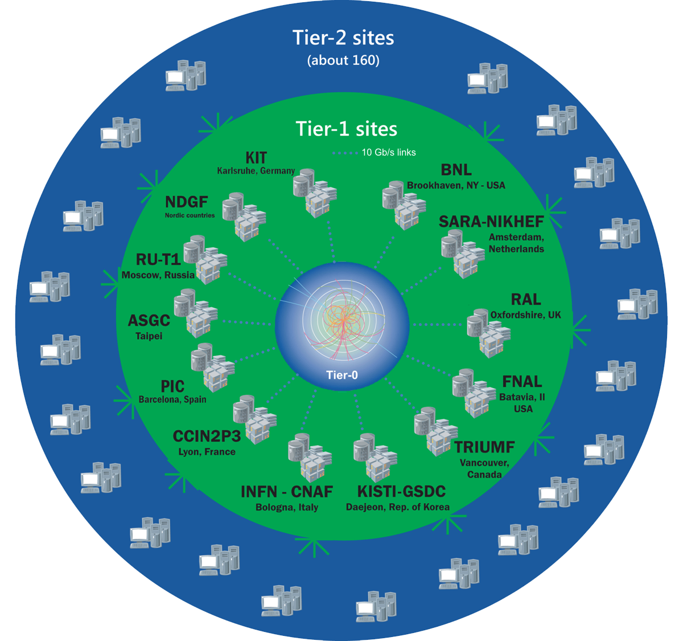
The Worldwide LHC Computing Grid
Tier-0
(CERN and Hungary):
data recording, reconstruction and distribution
>170 sites in,
42 countries
750k CPU cores
800 PB of storage
Tier-1: permanent storage, reprocessing,
analysis
> 2 million jobs/day
Tier-2: simulation,
end-user analysis
35 GB/s global transfers
WLCG:
An International collaboration to distribute and analyse LHC data
Integrates computer centres worldwide that provide computing and storage resource into a single infrastructure accessible by all LHC physicists

Slide 17
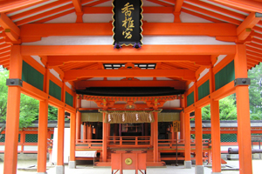
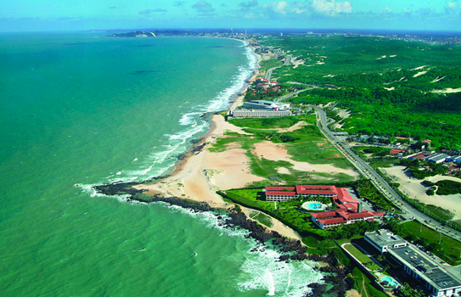
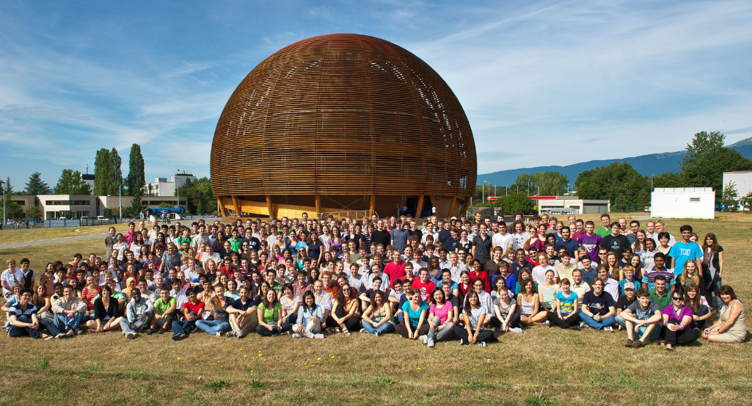
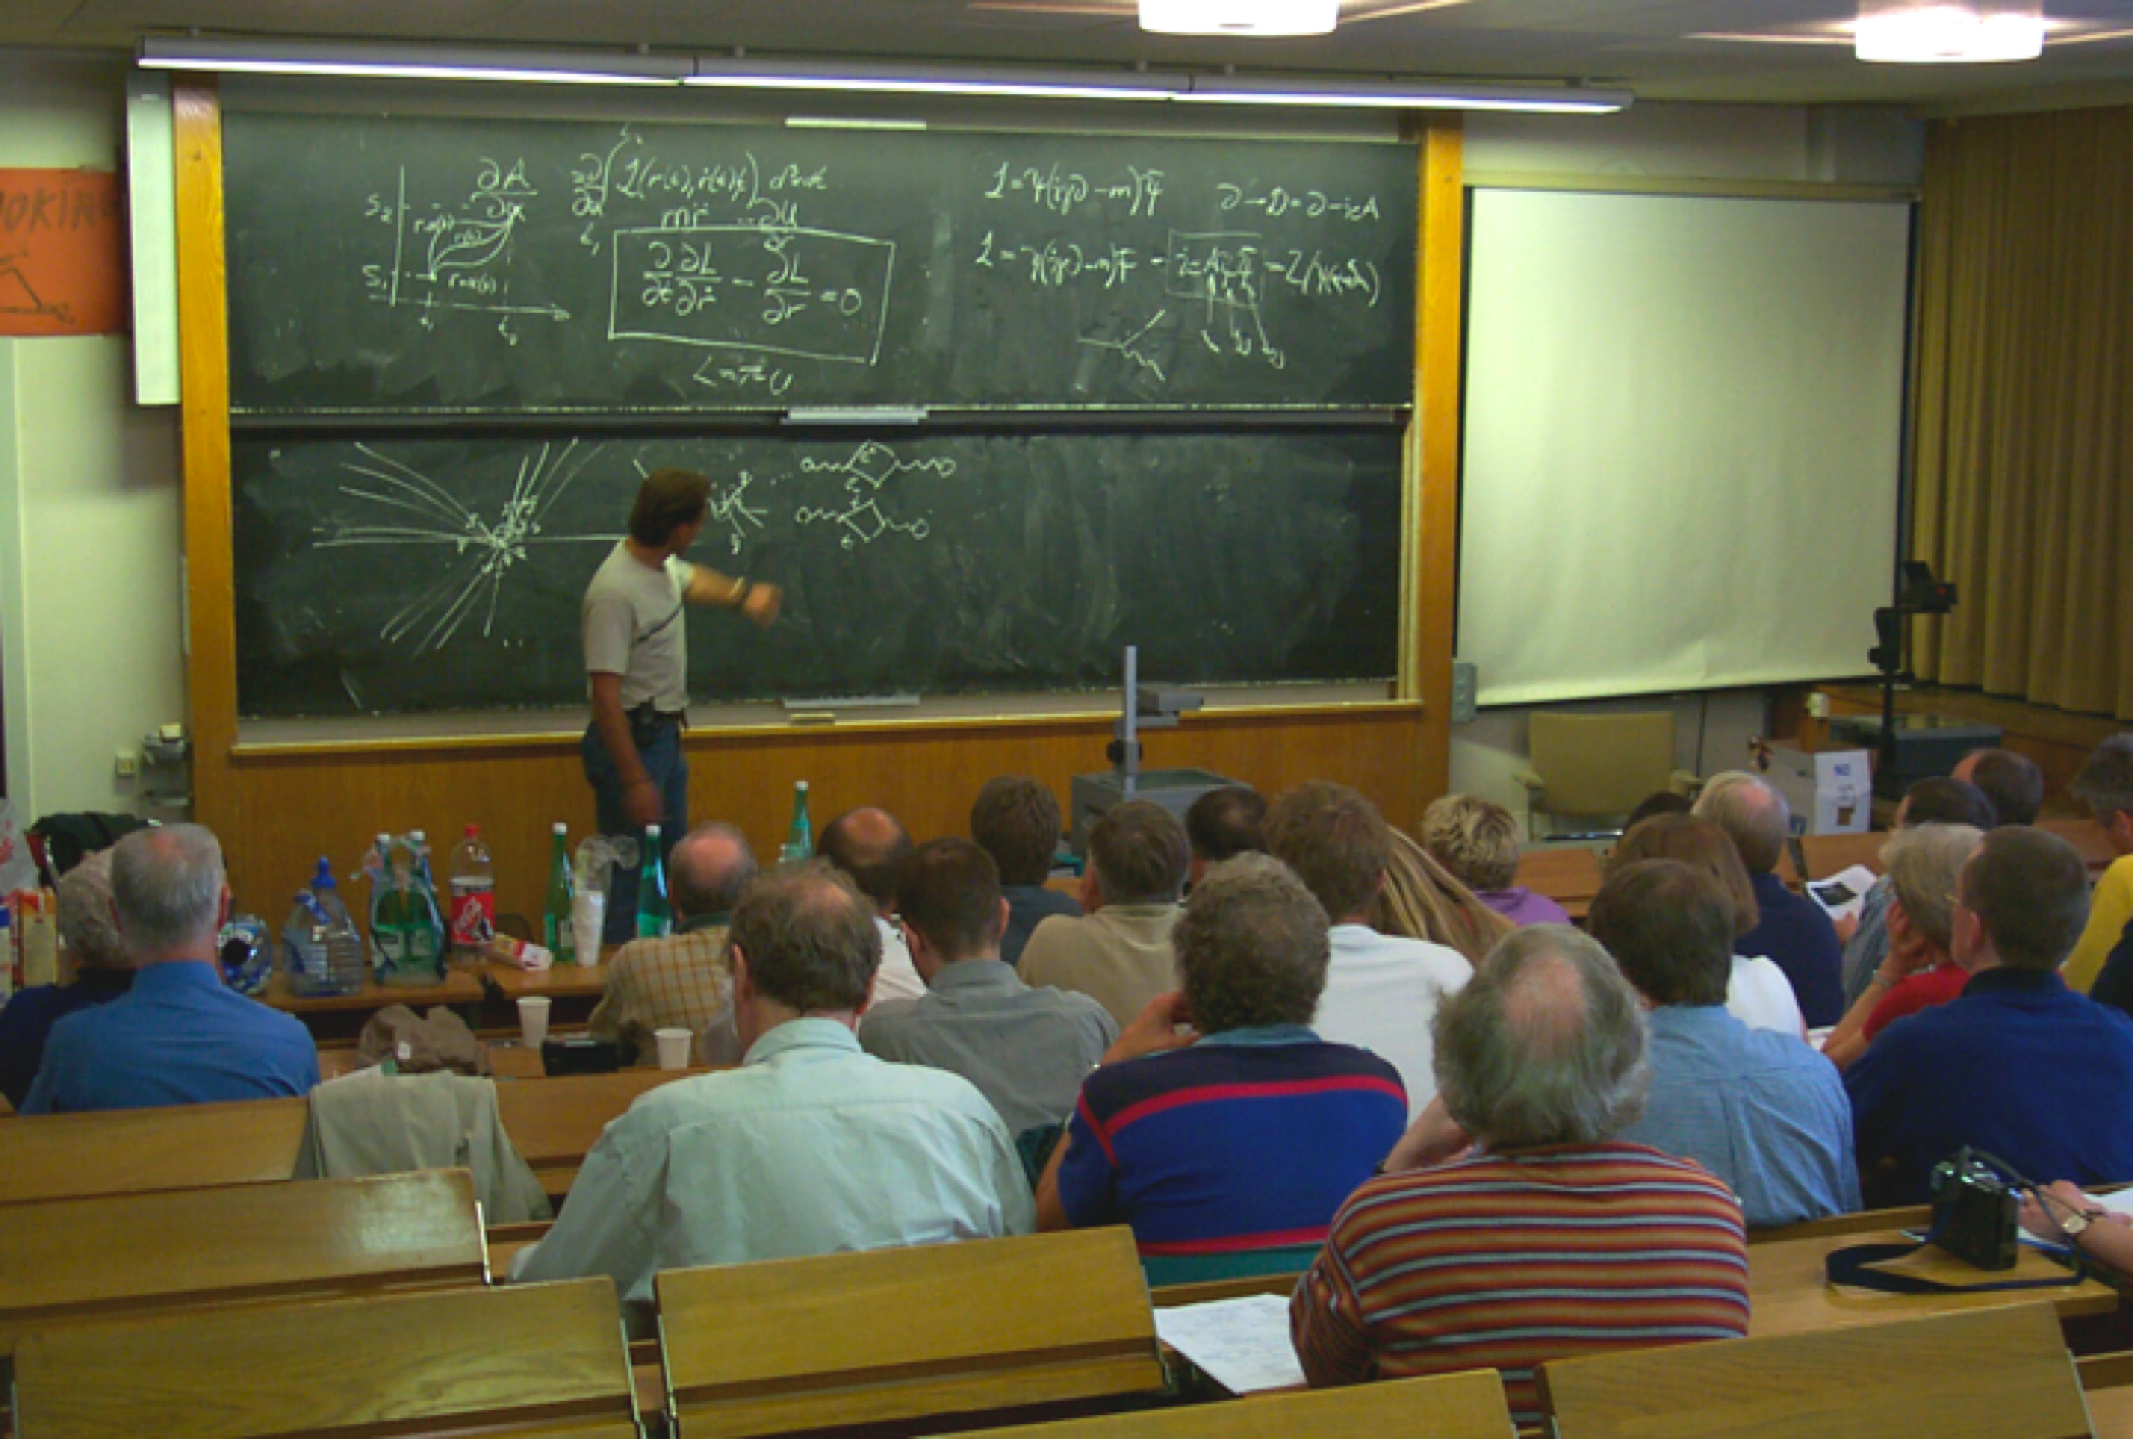
CERN Education Activities
Scientists at CERN
Academic Training Programme
Asia-Europe-Pacific School of High-Energy Physics
Fukuoka, Japan, 2012
Puri, India, 2014
2016 Beijing, China
2018 Quy Nhon, Vietnam
Latin American School of High-Energy Physics
Arequipa, Peru, 2013
Ibarra, Ecuador, 2015
San Juan del Rio, Mexico, 2017
Young Researchers
CERN School of High Energy Physics
CERN School of Computing
CERN Accelerator School
CERN
School of Physics
Italy, June-July 2018
Undergraduates
Summer Students
Programme
CERN Teacher Schools
International and National Programmes
Public visitors
135 thousand per year

Slide 18
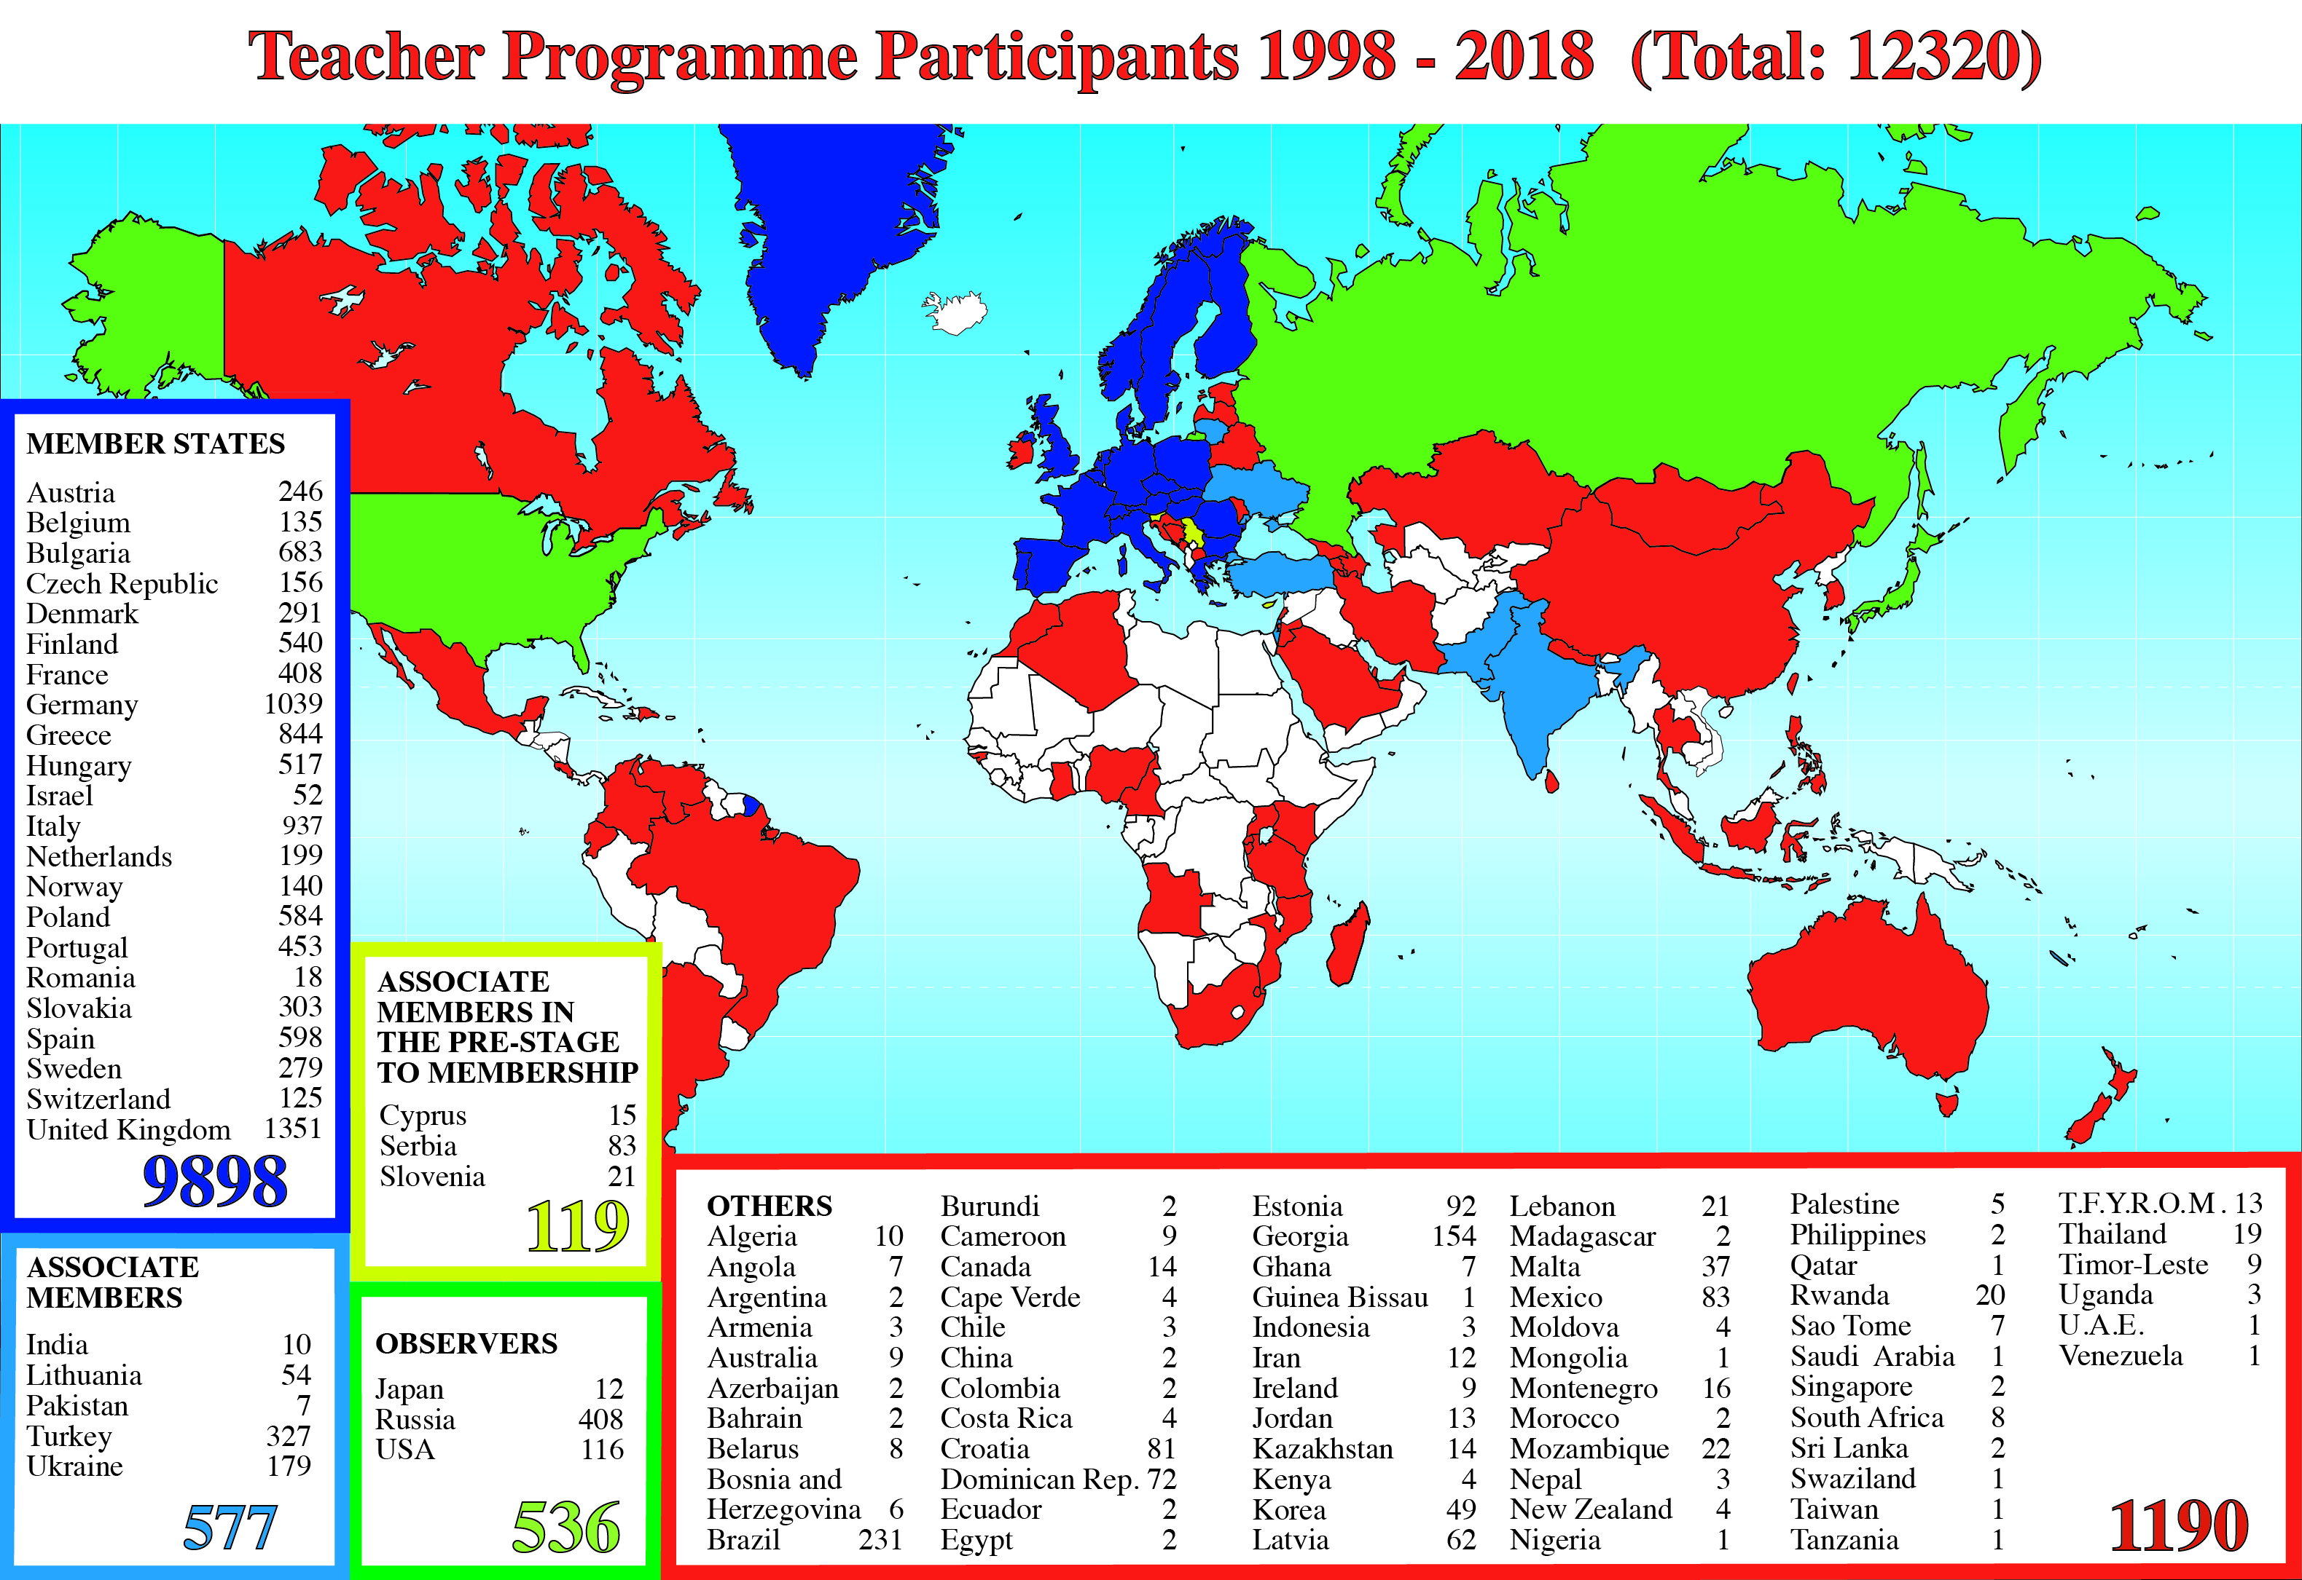
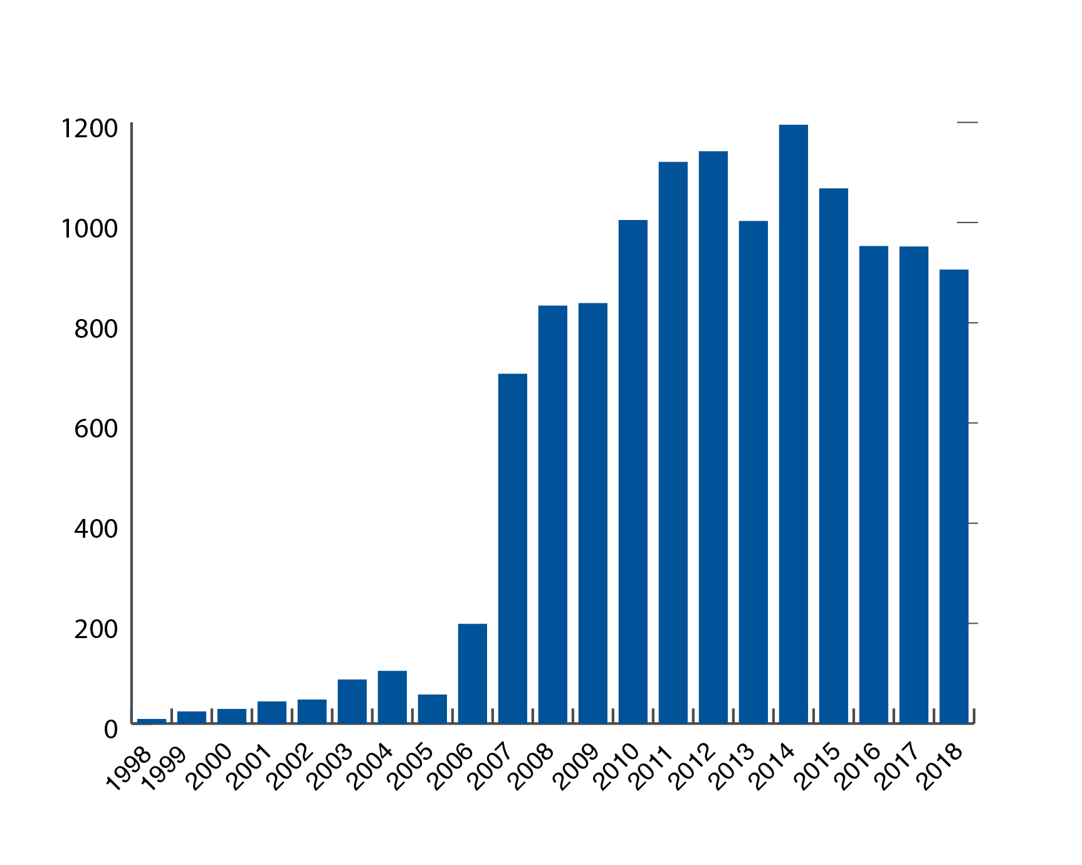
CERN Teacher

Slide 19
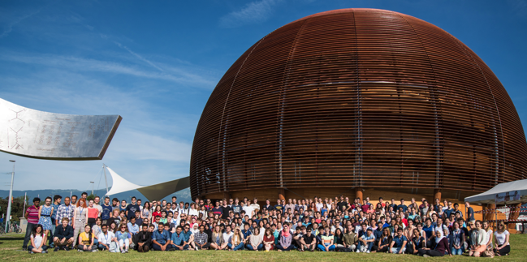
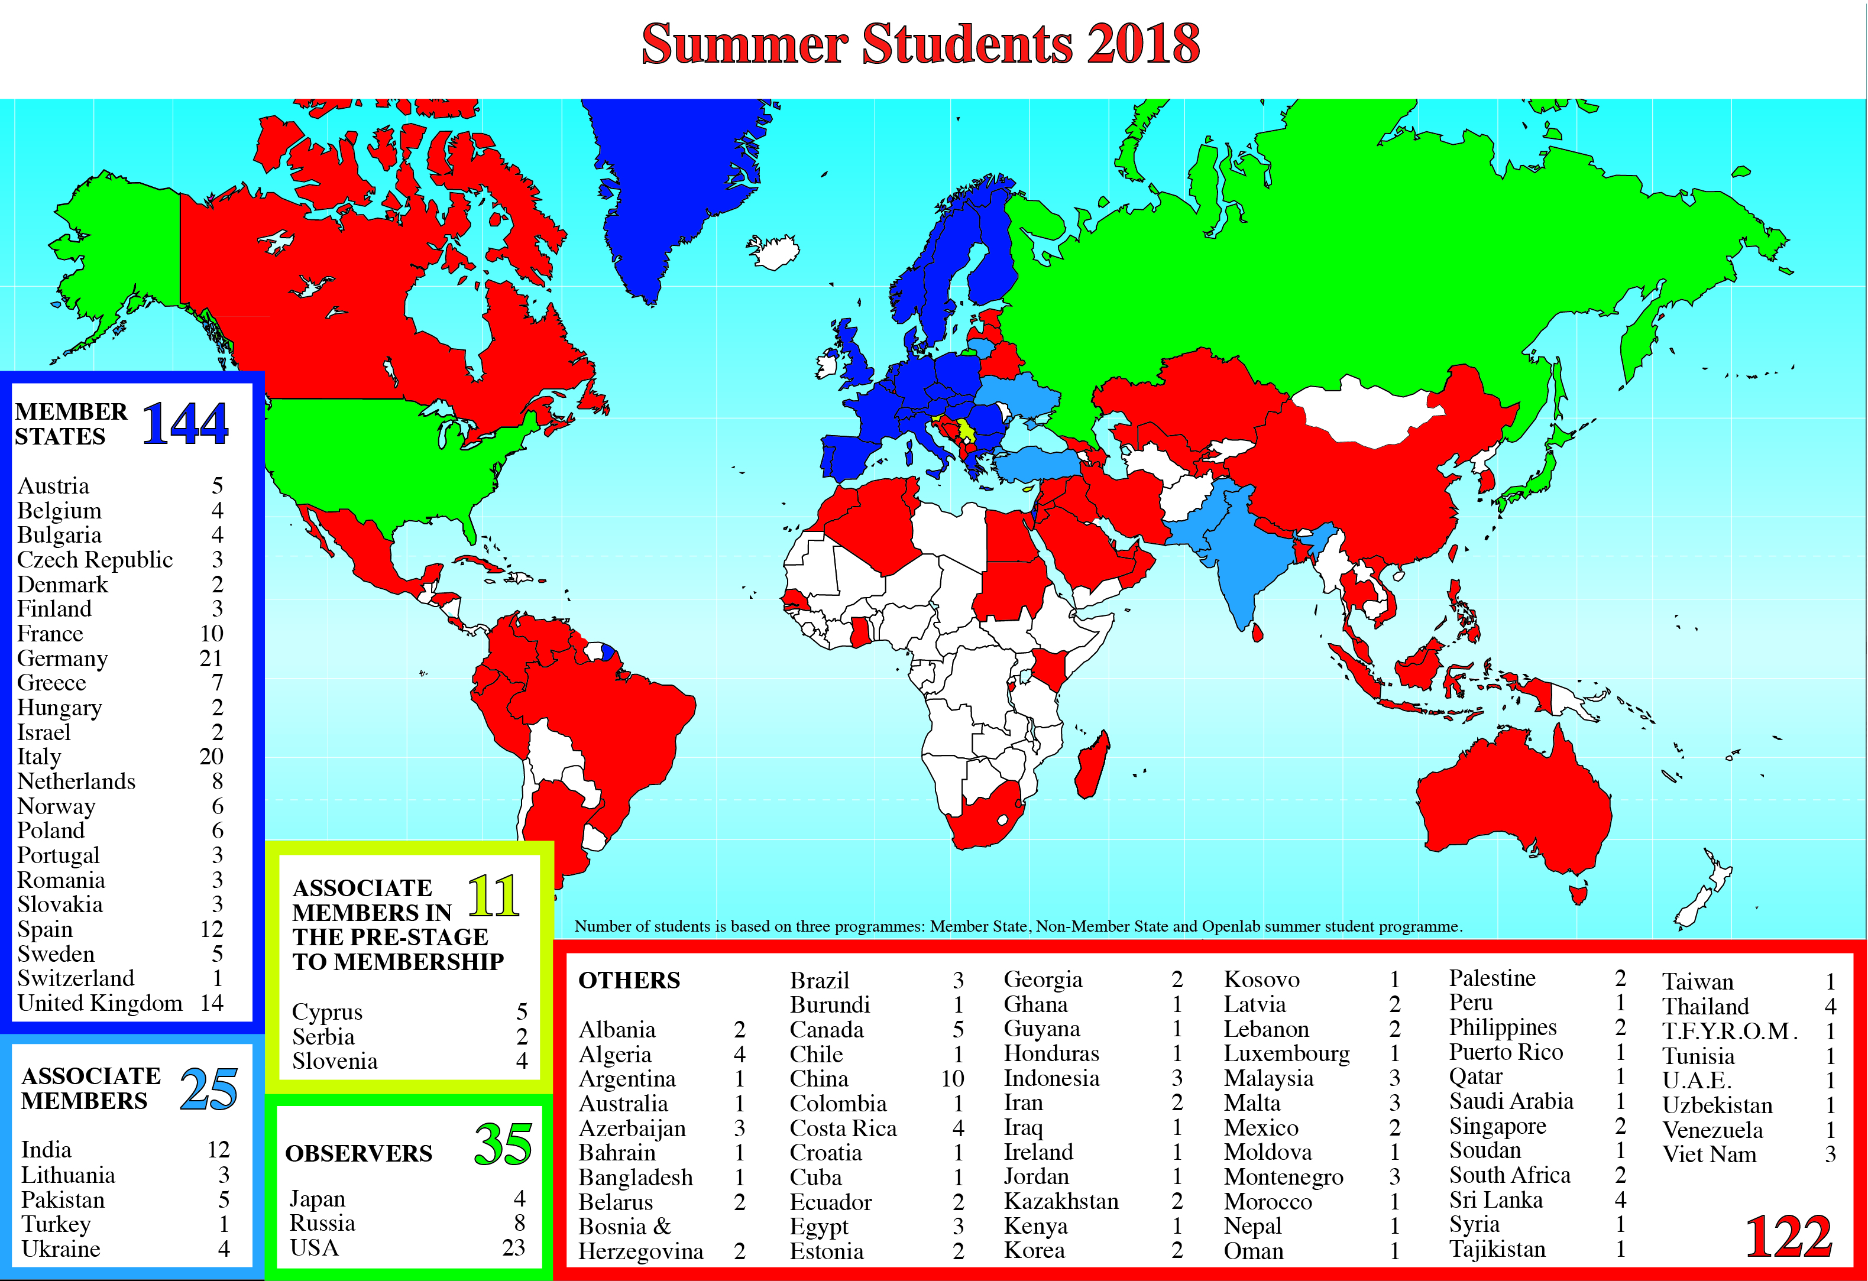
Summer Students 2018

Slide 20

Finland and CERN
Finland joined CERN as a Member State in 1991, but Finnish groups have participated in CERN experiments almost since its foundation.
Scientists from Finland participate in the
LHC experiments: ALICE, CMS, MOEDAL, TOTEM
non-LHC experiments: ISOLDE, CLIC/CTF3 & CLOUD (Cosmic rays and cloud formation)
Finnish Institutes involved:
Helsinki Institute of Physics (HIP), coordinating participation of
  University of Helsinki
  Aalto University
  Tampere University
  Finnish Meteorological Institute, Helsinki
  University of Jyväskylä
  University of Kuopio
  Lappeenranta University of Technology

Slide 21


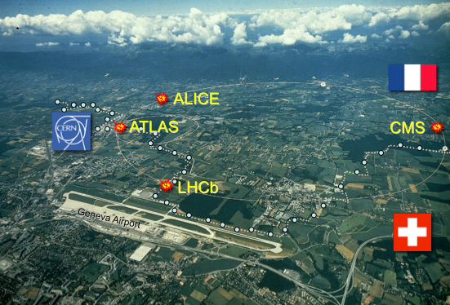

Finland and CERN
Strong involvements in the LHC experiments
CMS:
University of Helsinki
Helsinki Institute of Physics (HIP)
Lappeenranta University of Technology
ALICE:
University of Jyväskylä
Helsinki Institute of Physics (HIP)
Totem
TOTEM (next to CMS):
University of Helsinki
Helsinki Institute of Physics (HIP)
Strong contribution also to the LHC Computing Grid (WLCG)
Notes:
21

Slide 22

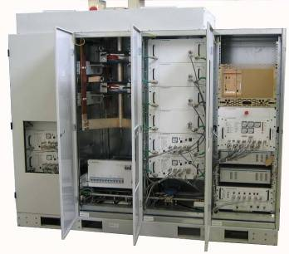
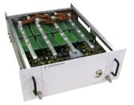
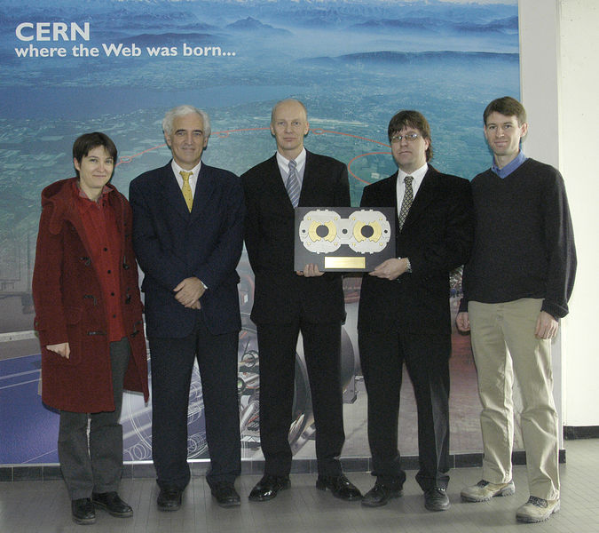

Finland and CERN
High-current
and
high-precision
LHC power converters
[2kA, 8V]

Slide 23
Kiitos! Thank You!
Accelerating Science and Innovation
Notes:
23

Slide 24

Safety Information for Visitors
Safety is our highest priority
We are confident that you have read the Safety Information provided prior
to the visit and ask that you take the time to read the document placed
in front of you once more before embarking on the site visit.
By taking part in the site visit you are deemed to have understood and accepted the Safety Information provided to you.
Please always follow the instructions given by your guide
and do not hesitate to ask if you have any questions.

