Slide 1
CERN Basketball Club
General Assembly
10th July 2019

Slide 2
2019-2020
Members
  CERN 1: 12 players (team registered, players will be communicated)
  CERN 2: 14 players (team registered, players will be communicated)
  Only trainings: ~8 people
Gyms (not yet confirmed)
  Tuesdays: Chavanne
  Wednesdays: Collège Rousseau request (+chavanne but unknown yet)
  Thursdays: Diamanterie Saint Genis
Competitions – GAB
    CERN 1 - League A /CUP
    CERN 2 - League C /CUP
https://twiki.cern.ch/twiki/bin/view/SocialActivities/BasketballClub

Slide 3
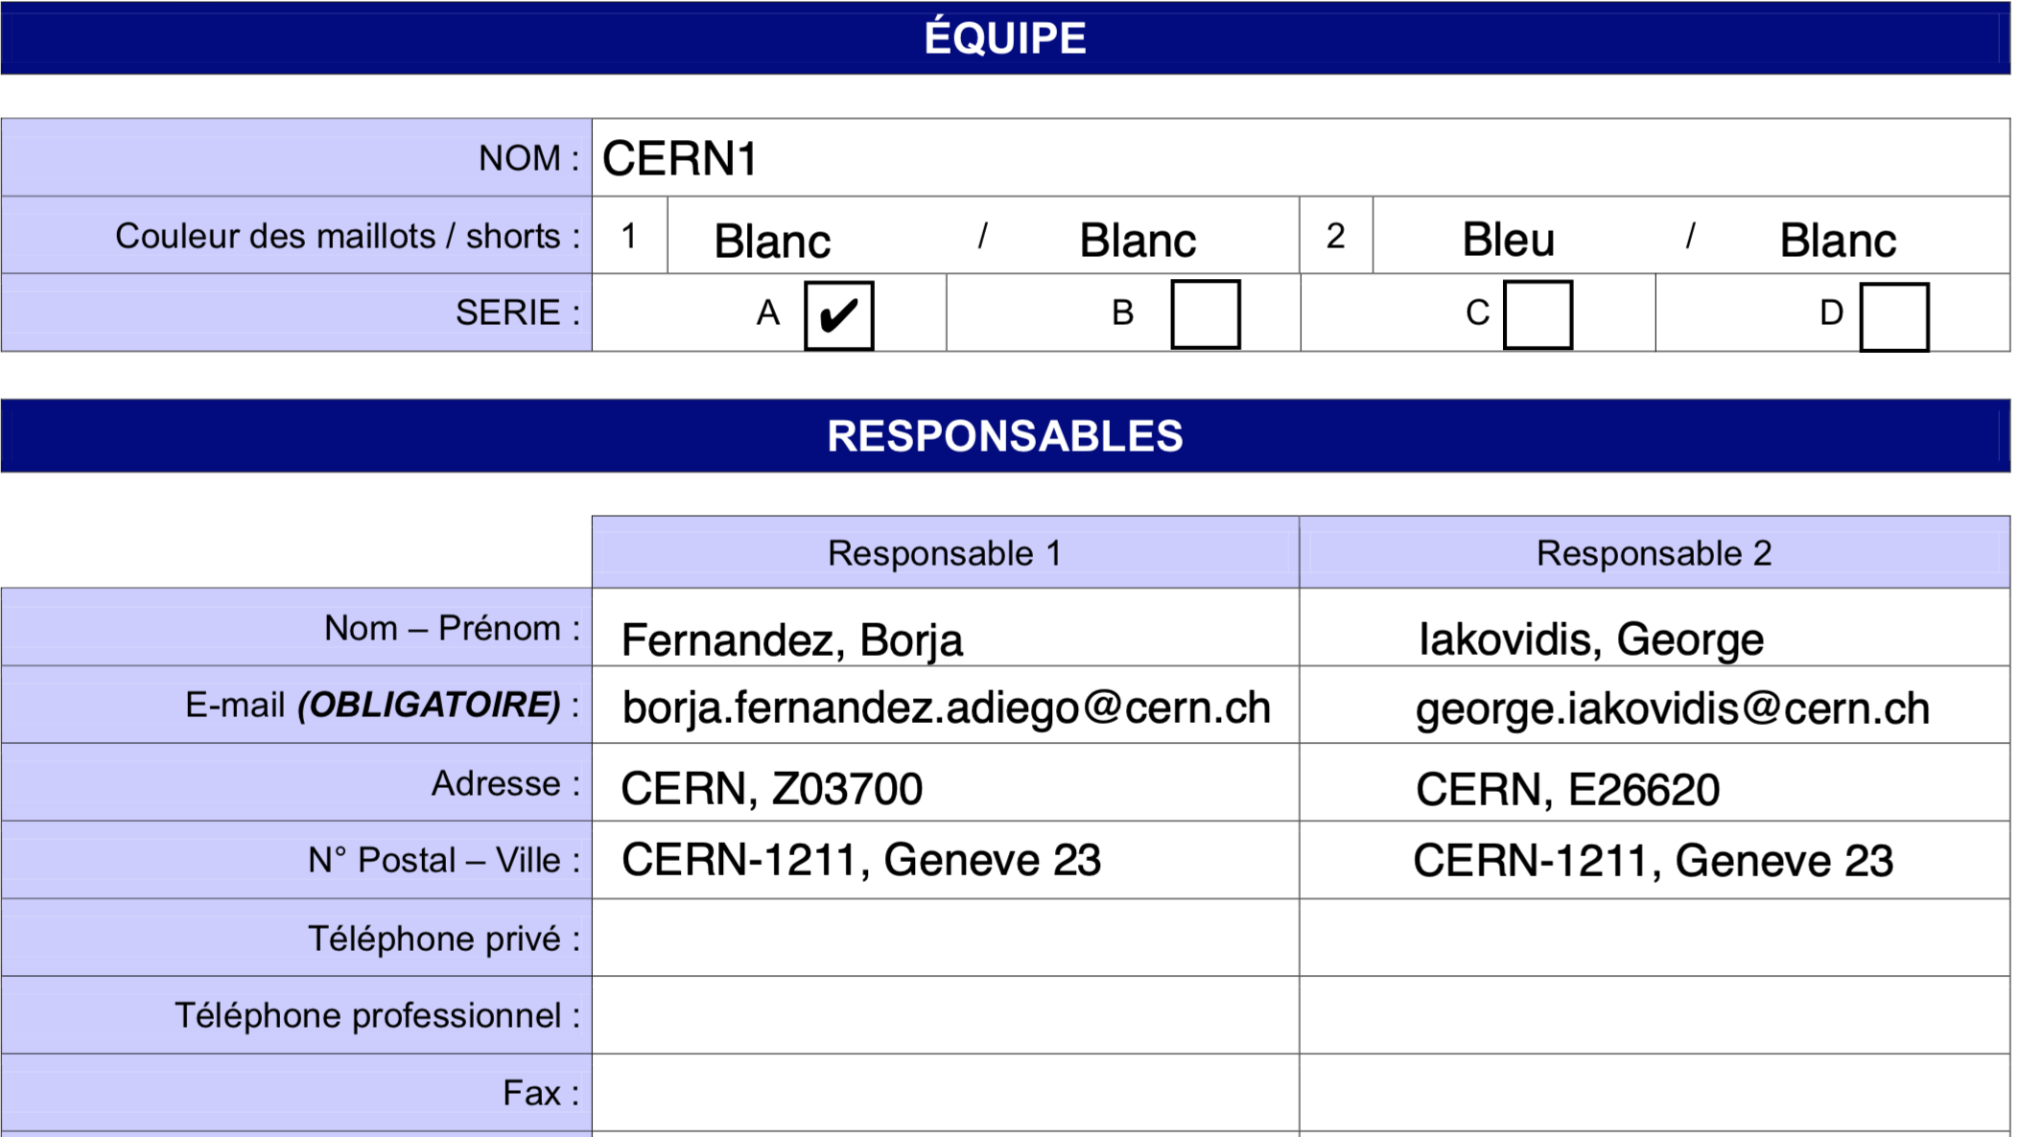
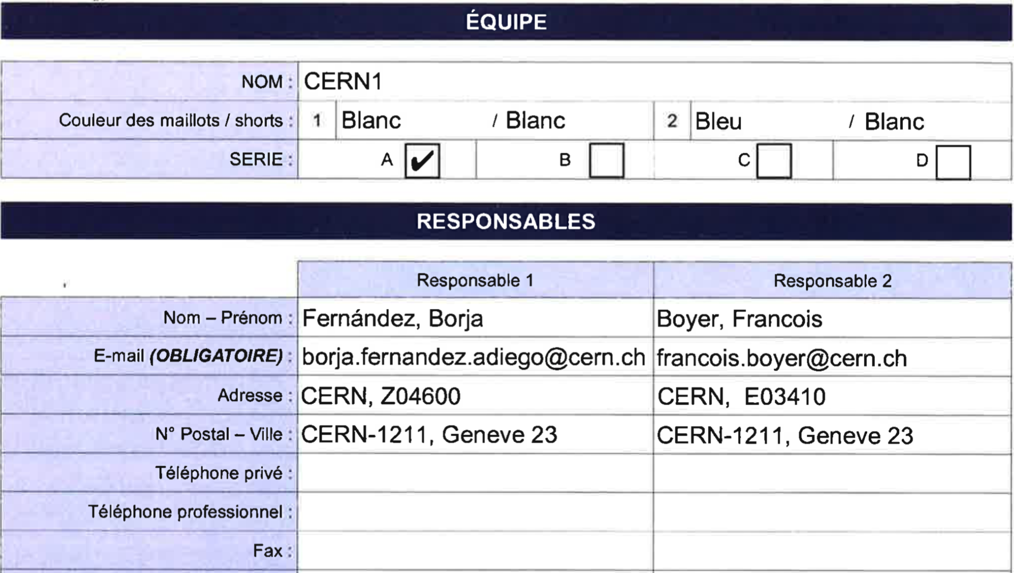
2019-2020 Change in CERN1

Slide 4
2019-2020 Committee Proposal
I have served the club as a member of the committee for 2 seasons (2013-14)
And as President for 4 seasons (2015-now)
I believe I have done my fair share to the club
But also I believe people should rotate and bring new people to the steering wheel of the club

Slide 5
2019-2020 Committee Proposal
Borja Fernandez Adiego – President/CERN1R
George Iakovidis – Vice President
Jeronimo Ortola Vidal – Treasurer/CERN2R
Manuel Gonzalez Berges – Secretary/CERN2R
Haroon Rafique – Coach / Member
Francois Boyer – Member/CERN1R

