Slide 2
Learning &
Development
@ CERN

Slide 3
Excellence
Learning & Development
@ CERN
Training
Expertise
Knowledge
Learning
Leadership
Teaching
Development
Motivation
Passion
Coaching
Competencies

Slide 4

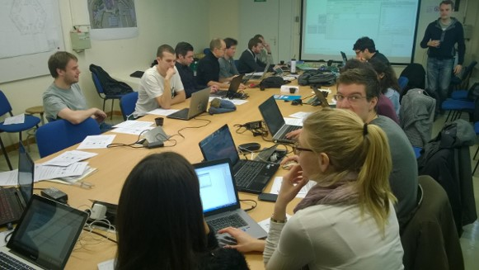
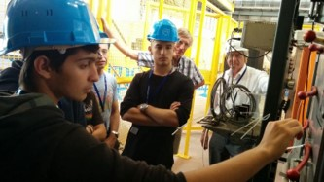
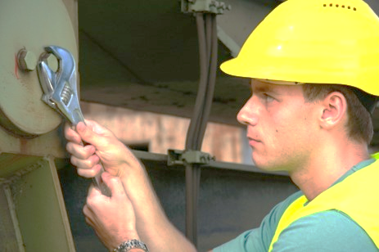
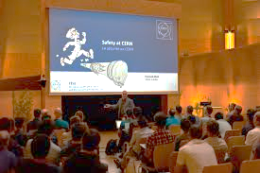
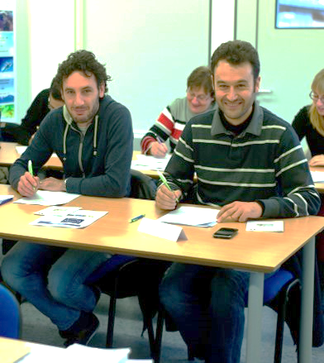

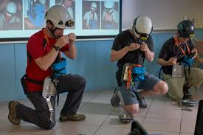
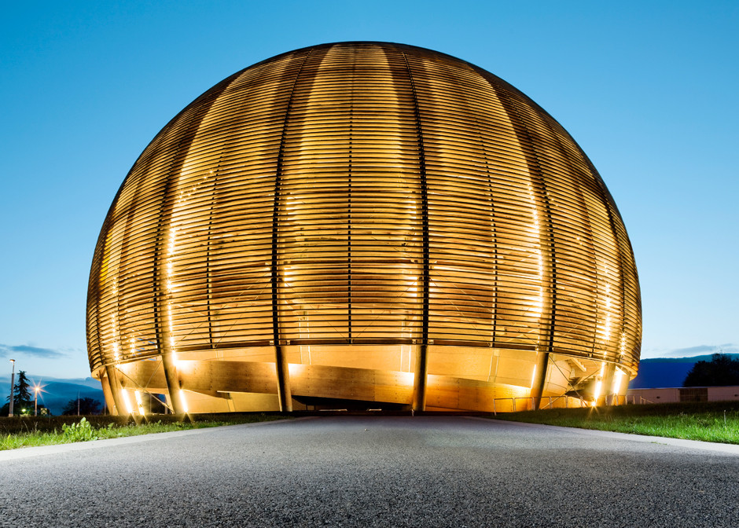
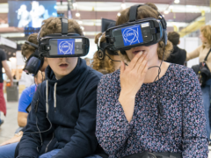
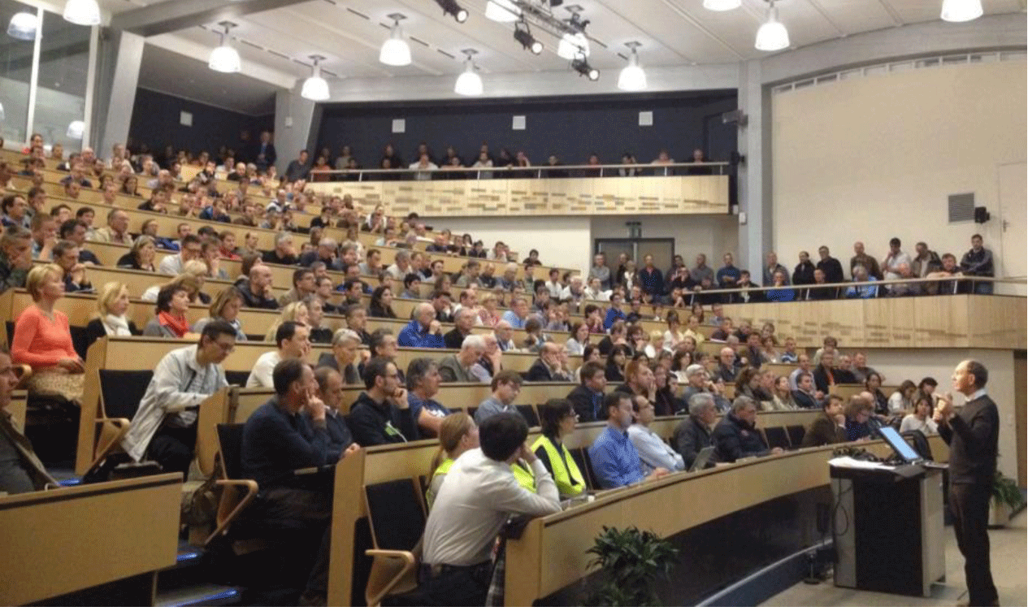
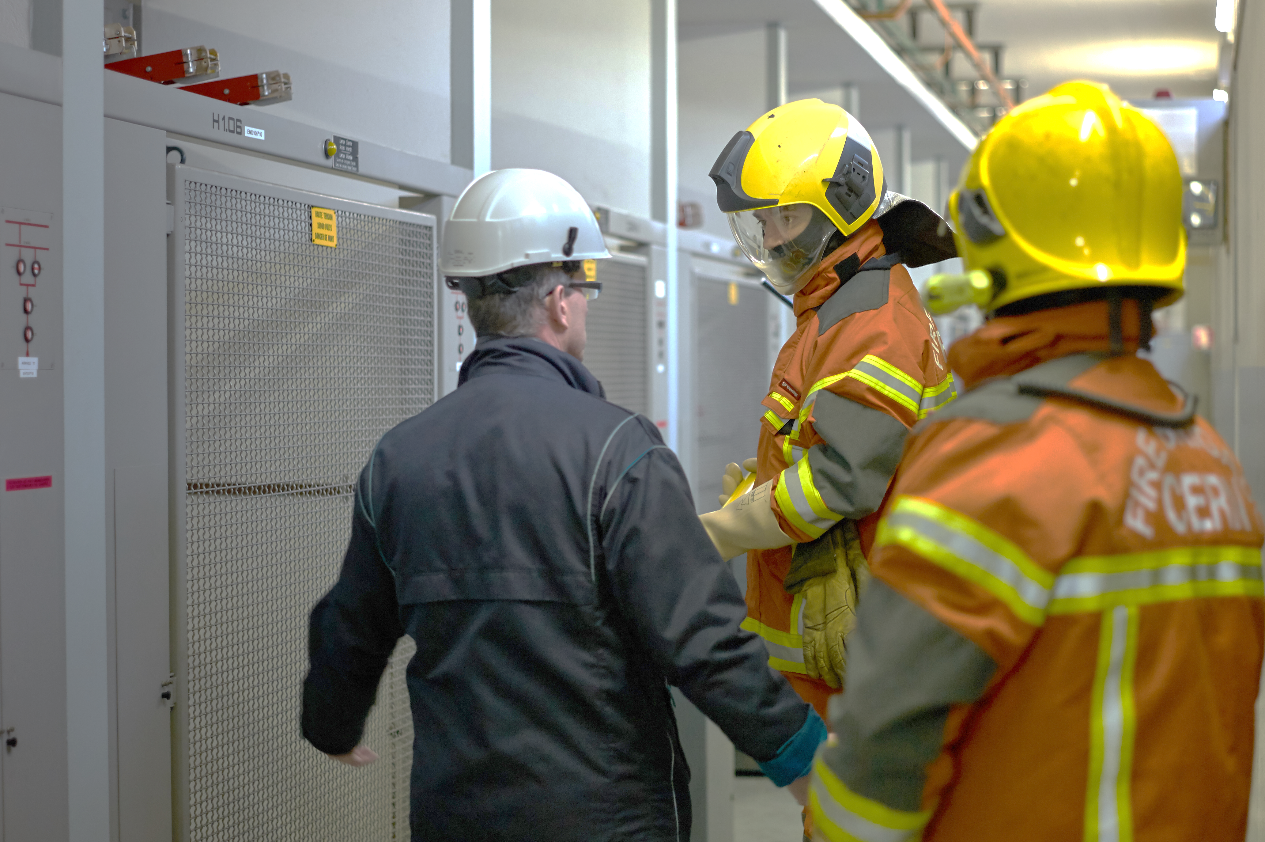
Learning & Development
@ CERN

Slide 5

RESEARCH
EDUCATION
Development
Learning
Training
TECHNOLOGY
COLLABORATION
Notes:
As already explained by other speakers today, one of the core missions of CERN is EDUCATION.
Some of you are enrolled as student in a university, and you are here at CERN to complete your education, by doing advanced research.
Others have already finished their studies, and will stay at CERN for a limited period. In that period, you will be able to learn about specific technologies and techniques, and bring this knowledge and skills to your next job. You will become experts and be able to share this knowledge with others.

Slide 6
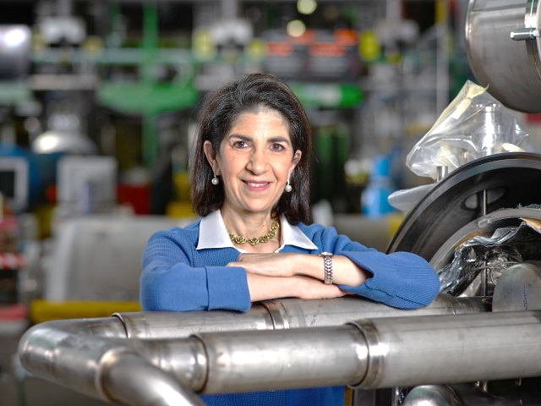
Learning & Development @ CERN
WHY
Sponsored at the highest level of CERN, learning is positioned as a strategic activity for achieving the mission of the Organization
Notes:
CERN has elaborated a Learning and Development Policy, which is sponsored by the Directorate.
They see learning as a strategic activity in order to achieve Excellence in CERN’s mission.

Slide 7
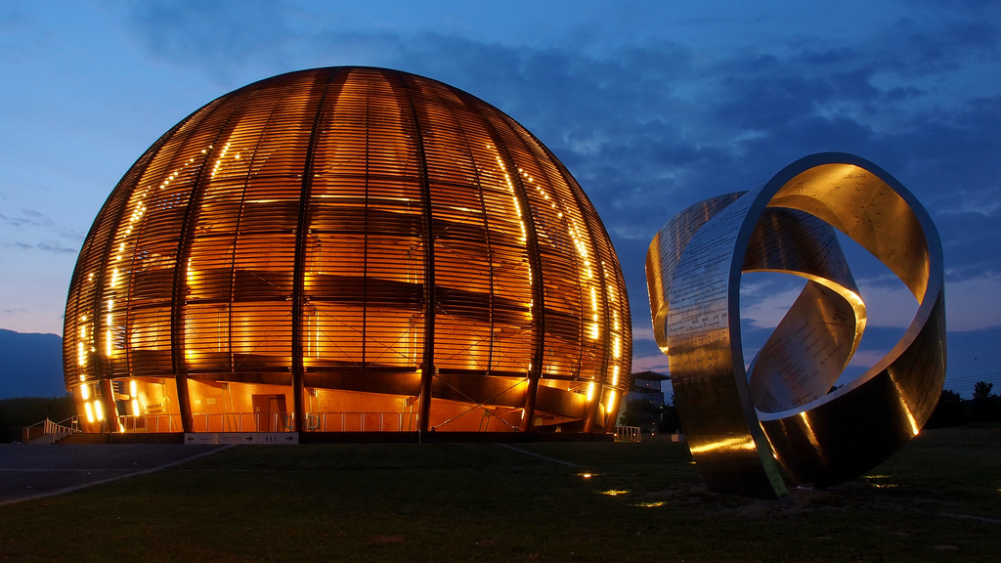
Learning & Development goals
WHY
HIGHLY QUALIFIED AND MOTIVATED WORKFORCE
CORE & LEADERSHIP COMPETENCIES
CERN
VALUES
COHERENT
APPROACH
EQUITABLE ACCESS
Notes:
The aim is to have a highly qualified and motivated workforce – without this, CERN would not be able to achieve its ambitious goals.

Slide 8
Learning & Development goals
WHY
HIGHLY QUALIFIED AND MOTIVATED WORKFORCE
TECHNICAL & BEHAVIORAL COMPETENCIES
CERN
VALUES
COHERENT
APPROACH
EQUITABLE ACCESS
Notes:
So the aim is to have a highly qualified and motivated workforce – without this, CERN would not be able to achieve its ambitious goals.
We need professional people. This means highly qualified in the technical domain, but hard skills alone are not sufficient.
CERN people need also excellent soft skills in order to promote CERN values as diversity, integrity, creativity, and commitment.
For that, there is a coherent approach to learning and it access to training is equitable over the organisation.

Slide 9
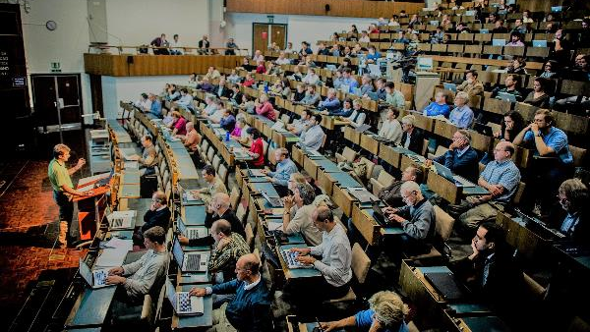
Which category of personnel can benefit from learning and development ?
WHO
All categories
everybody can register
Notes:
Everybody at CERN can register for courses which are relevant for them.
A few notes :
There are courses which have certain explicit requirements to make sure that they are relevant for those attending : this can be that you have a certain role (like for example Safety Officer) or that you have already a certain level of expertise (for example to enrol for an Advanced Java Course, or and advanced French course)
Training has a cost – and this is borne by the employer. In case of staff and fellows, your employer is CERN. For Users, it is your home institute which employs you which will normally pay for training. And for doctoral students, it is the university where they study. However, certain course are offered free of charge to anyone at CERN. This is true in particular for the mandatory safety training.
Did you know that official spouses/partners can attend the language courses at CERN ?

Slide 10
HOW
Notes:
How do you learn ?
Are any of the pictures related to learning ?
Or should I ask, are any of the pictures not related to learning ?
Some of the activities are very technological (like the virtual reality masks), others are very formal like lectures in a hall, others are more practical and hands-on.

Slide 11
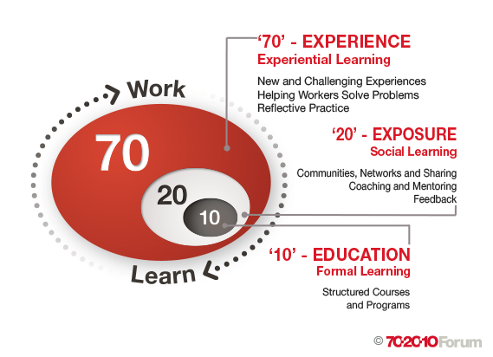
HOW
Notes:
There is a framework, which is called 70/20/10.
It indicates where learning comes from :
Formal courses account for 10% - this might look surprisingly low, and you may wonder why you have been sitting so many years at school
Social or collaborative learning, like for example feedback from others, or sharing of experience within professional networks make up 20%
But the bulk -70%- comes from learning by doing – your own experience with real new problems to solve

Slide 12
Diversity of learning opportunities
HOW
DEVELOPMENT
Systematic enhancement of competencies leading to personal /professional growth
LEARNING
Variety of formal & informal actions aimed at MPE development
Membership
Conferences
Knowledge sharing
Assignments
Distance learning
On-the-job
Academic Seminars
Self-learning
Job shadowing
Job rotation
Individual coaching
  TRAINING
  Formal programmes delivered internally and externally with specific outcome
Projects
Team actions
CERN training catalogue
External training
Under Dept responsibility
Under L&D responsibility
Under Dept responsibility with L&D guidance
Notes:
This graph is very similar and indicates different learning activities that go which each area, as well as who is responsible.
The Learning and Development Group in HR is responsible for the green areas – mainly for the organisation of the formal learning. For all the rest, your hierarchy plays an important role.
But the most important role is your self.

Slide 13
Learning priorities
HOW
What does it mean ?
Mandatory to perform a function or a role in the Organization
AND / OR
Necessary to ensure a successful integration in the Organization and/or the local area
Notes:
I mentioned already that there are learning priorities. At CERN, these are what is needed to
Perform a function
Integrate in the organisation and the local area

Slide 14
Learning priorities
HOW
What does it include?
    Onboarding programme
    safety-training and awareness programmes
    technical training improvement programmes
    CERN office software (EDH, HRT, etc)
    basic language training (English & French)
    core leadership and supervisory skills programmes
    core communication programmes
    sensitization to diversity issues in the workplace
Notes:
Here you have a list of what type of courses this includes.

Slide 15
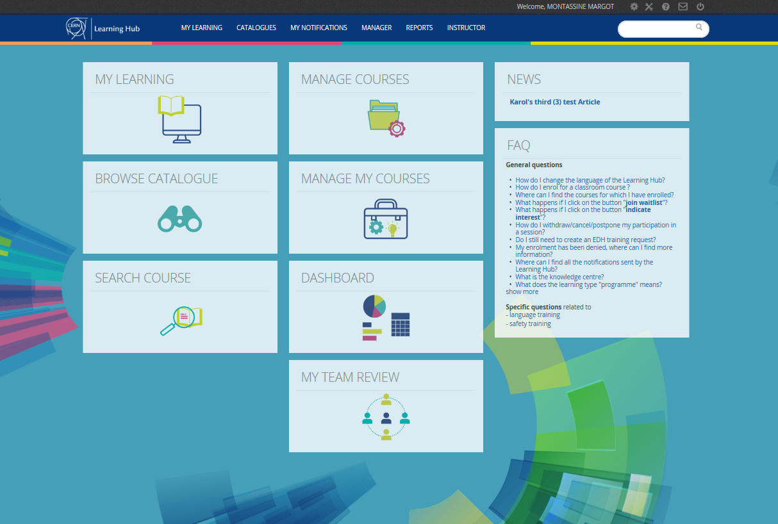
CERN Learning Hub
HOW
http://learninghub.cern.ch/
Notes:
The first option is via the HR departmental webpage

Slide 16
CERN Learning Hub
HOW
How to register to a course?
Notes:
The first option is via the HR departmental webpage

Slide 17
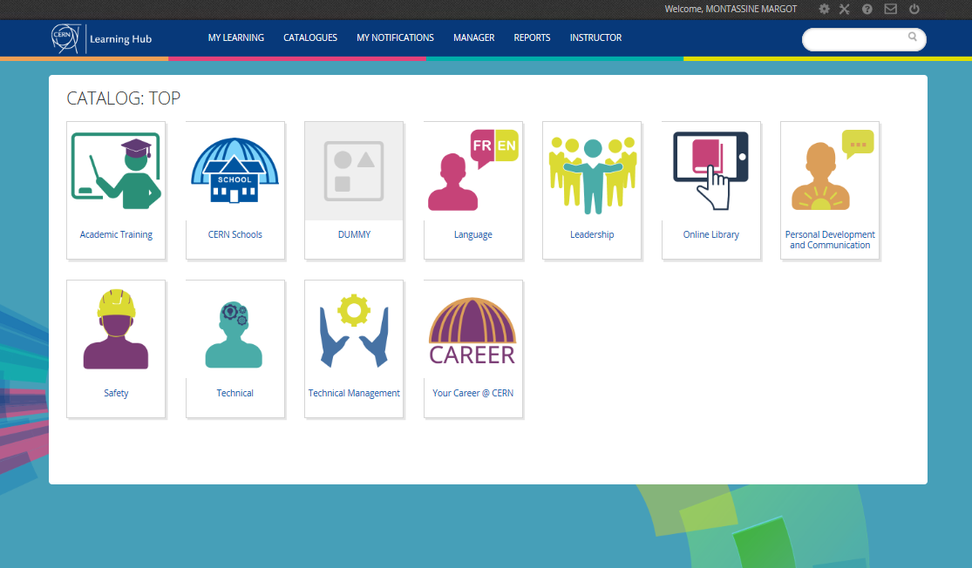
CERN Learning Hub
HOW
How to register to a course?
Notes:
The first option is via the HR departmental webpage

Slide 18
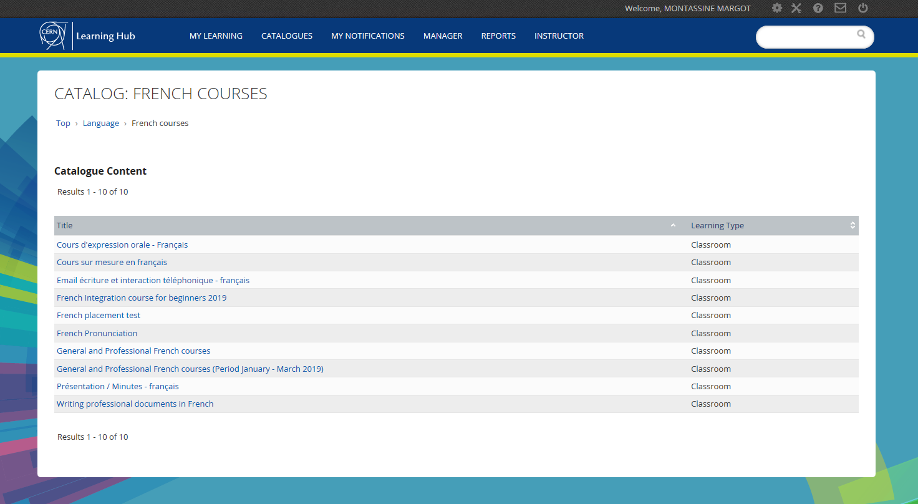
CERN Learning Hub
HOW
How to register to a course?
Notes:
The first option is via the HR departmental webpage

Slide 19
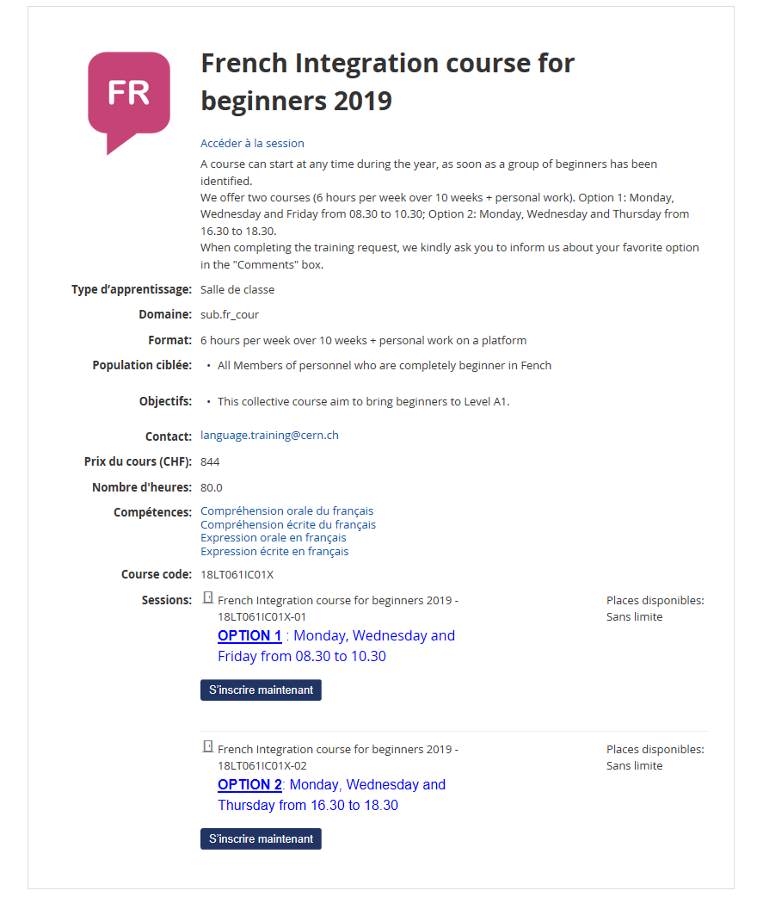
CERN Learning Hub
HOW
How to register to a course?
Notes:
The first option is via the HR departmental webpage

Slide 20






























Internal learning expertise
HOW
High level quality learning portfolios

Slide 21
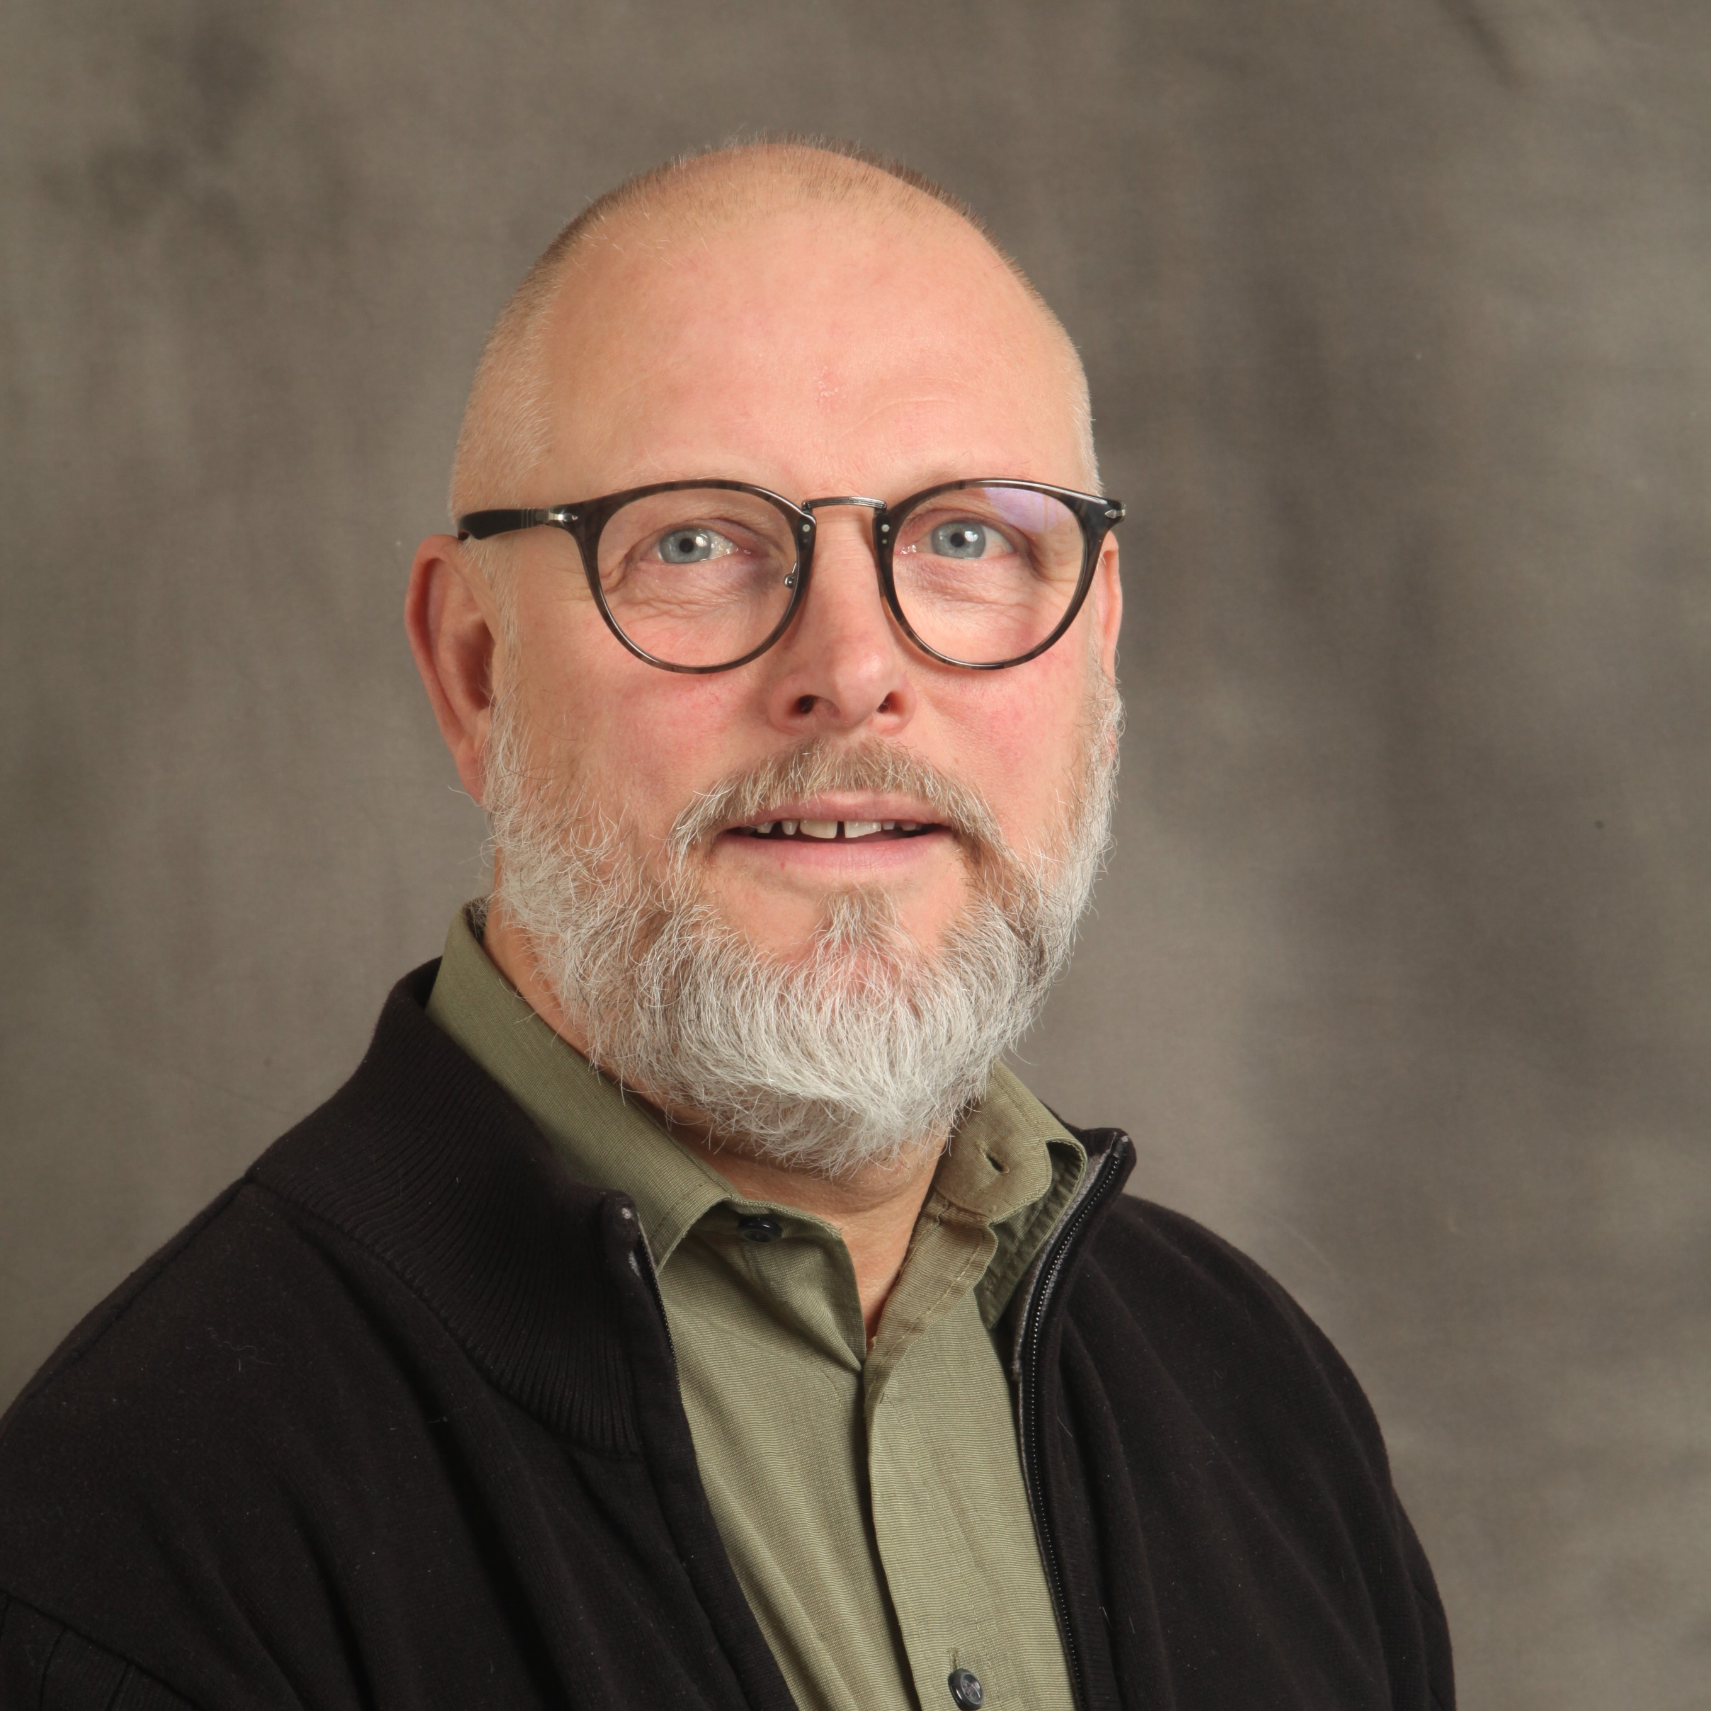





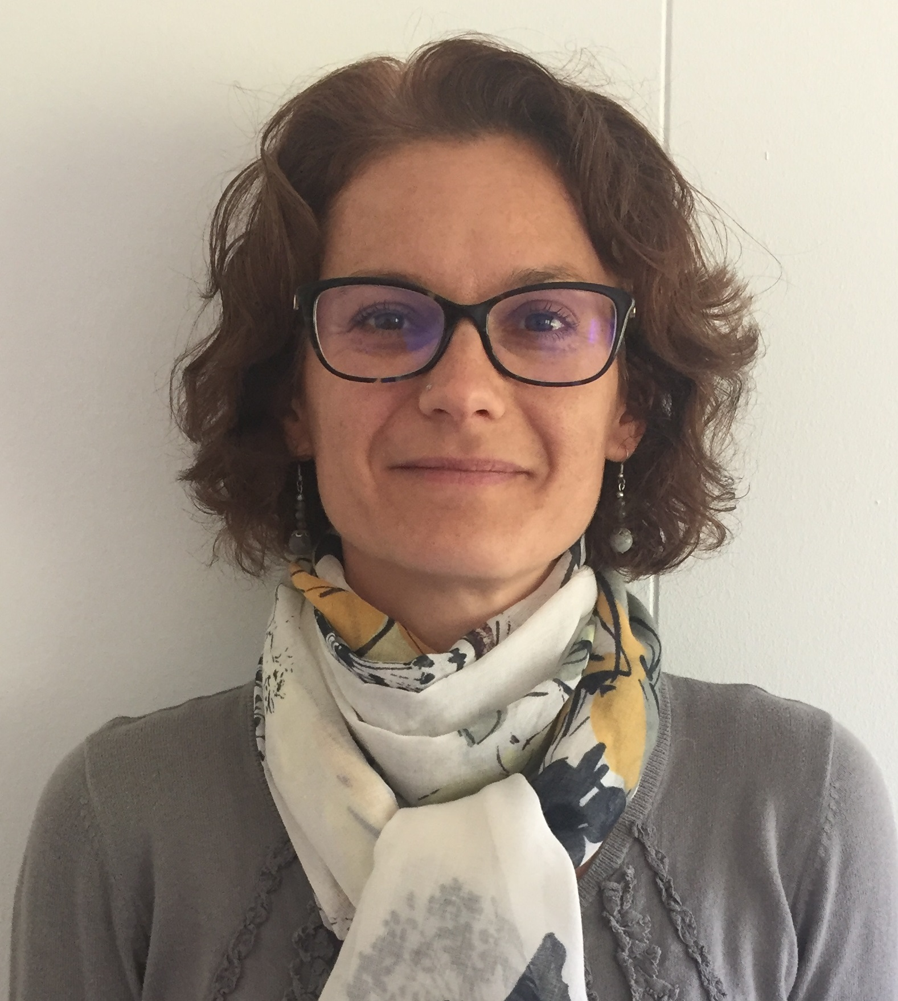


Your contacts – HR Learning Experts
WHO
Erwin
MOSSELMANS
Elizabeth
EASTWOOD-BARZDO
Marie
LAHCHIMI
Margot
MONTASSINE
Nathalie
DUMEAUX
Nathalie
PERKINS
Maria
FIASCARIS
Marie-Laure
LECOQ
Learning and Development Team
HSE
Safety Training
Pascale
GOY

Slide 22
Your DTO*
WHO
International Relations
Director General Units
Health & Safety and Environmental unit
Pension Fund
RCS
KNOORS Nathalie
DG
MEICHTRY Lynda
HSE
LEDEUL Adrien
PF
MARME Ghislaine
IR
FROMM Christina
Accelerators and Technology
Finance and Human Resources
Research & Computing
BE
MONTESINOS Eric
FAP
ROZYCKA Agata
IT
KWIATEK Michal
EN
NICQUEVERT Bertrand
HR
ALOT BARAJAS Rocio
TH
KNOORS Nathalie
TE
HOBGEN Georgina
IPT
ANGELINI Véronique
EP
KNOORS Nathalie
ATS
SMB
CARVALHO CORREIA
Paula
RCS
KNOORS Nathalie
HOBGEN Georgina
*DTO = Departmental Training Officer

Slide 23


Slide 24
WHO
YOU

Slide 25


Slide 26

Thank you for your attention
Ready to ‘accelerate’ your learning journey at CERN ?

