Slide 1
TRR base & dom penetrators
04/07/2019

Slide 2
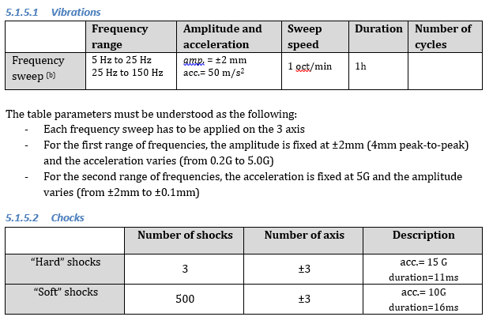
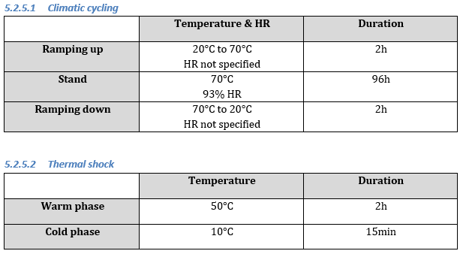
Stress Tests Procedure

Slide 3
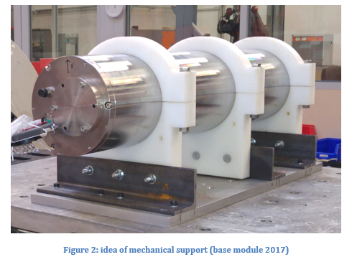
Mechanical configuration
Both base & dom penetrator mounted on the same flange
Flange mounted on an ORCA cylinder
Use the cylinder support of ORCA-DU6
Reproduce ≈ the configuration of the DU stack
Test also the MPO connector (inside the cylinder)
Internal frame design: reproduce what we can
imagine of the next design

Slide 4
Estimative Planning
01-20 July: finalization of the mechanics
01-20 July: reception of the fiber adaptor and tests ?
Remark: reception in time not sure
  Fall back solution: get the adaptor set from NIKHEF?
25-26 July: Vibrations + Shocks
8-12 August: climatic tests
19 August: thermal shock
End August: final report

Slide 5
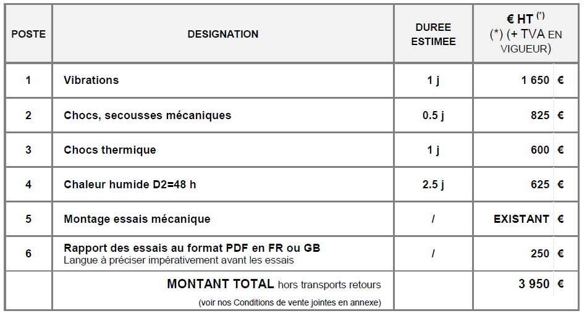
Budget
Sopavib quotation: 3950 €
Is there already a qualification budget ?
If not, the CPPM proposal is to pay it (to be quick) but
to substract the amount to the common fund contribution

