Slide 1
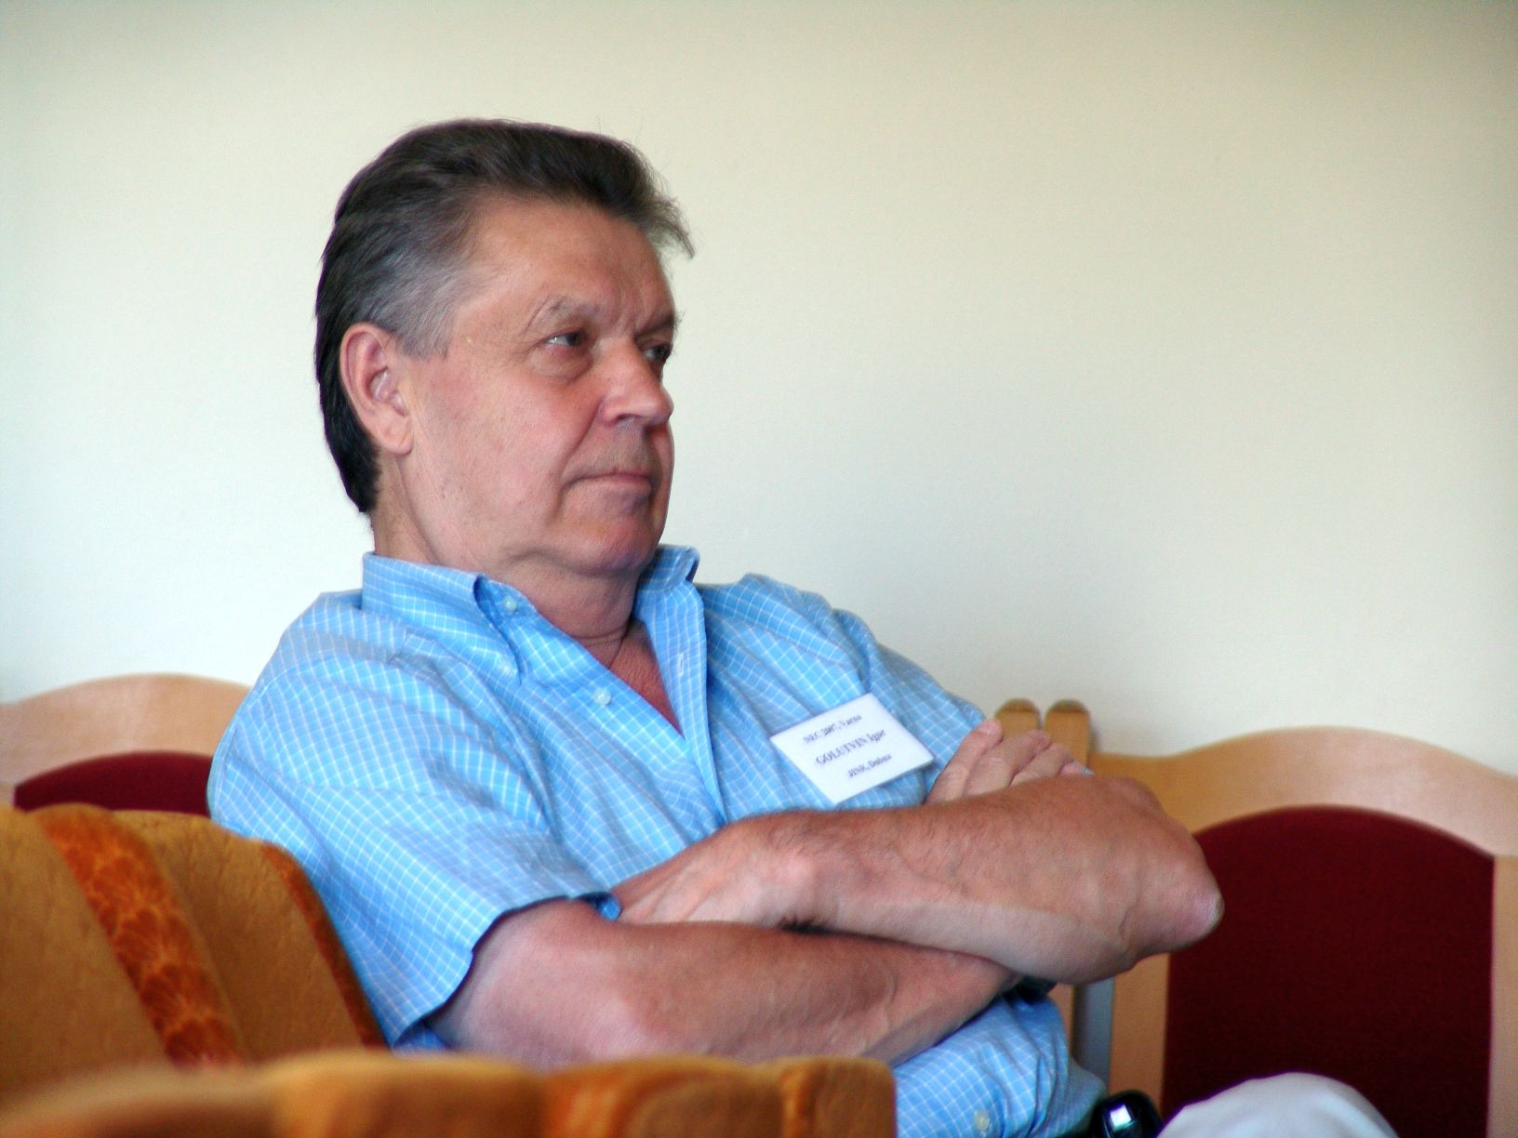

Slide 2
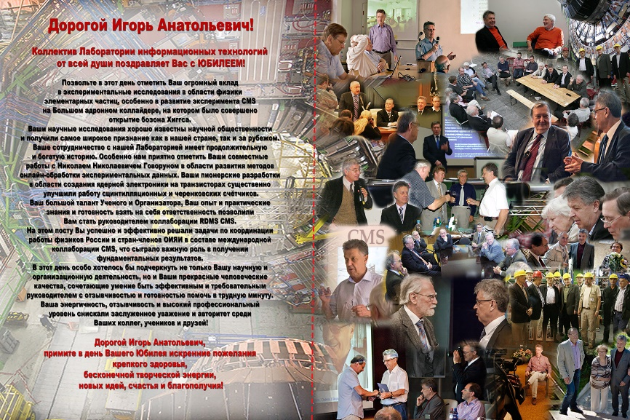

Slide 3


Slide 4
Golutvin & Computing
Первый on-line эксперимент c командой Н.Н. Говоруна
RDMS-CMS
Golutvin I., Korenkov V., Pose R., Tikhonenko E. CMS computing support at JINR// JINR D11-98-122 Dubna, 1998
WLCG, grid in JINR, RDMS-CMS Computing
Tier1 for CMS in JINR
Symposium Nuclear Electronics and Computing (NEC) in Varna and Montenegro

Slide 5
Tier1 for CMS Normalized Elapsed time (HEPSPEC06) * Number of Processors (hours), last 3 months
DE-KIT 167,572,034 9,6%
ES-PIC 73,739,783 4,2%
FR-CCIN2P3 197,855,380 11,3%
IT-INFN-CNAF 164,639,832 9,4%
RU-JINR-T1 344,721,302 19,7%
UK-T1-RAL 184,538,153 10,5%
US-FNAL-CMS 612,637,793 35,1%

Slide 6
Russia — Normalized Elapsed time (HEPSPEC06) * Number of Processors (hours) by Resource Centre and VO (LHC VOs) (last 3 months)
Resource Centre alice atlas cms lhcb Total Percent
ITEP 3,682,086 2,745,217 2,230,421 3,131,839 11,789,562 1.59%
JINR-T2 18,523,801 25,462,560 27,560,452 16,207,769 87,754,583 11.83%
JINR-T1 0 0 344,791,794 0 344,791,794 46.48%
RRC-KI-T2 3,471,341 656,349 0 2,924,484 7,052,174 0.95%
RRC-KI-T1 89,353,962 88,826,775 0 48,331,312 226,512,048 30.54%
RU-IHEP 14,517,293 16,312,437 14,291,681 6,518,482 51,639,892 6.96%
RU-SARFTI 336,402 0 0 0 336,402 0.05%
RU-SPbSU 1,212,931 0 0 133,363 1,346,293 0.18%
Ru-INR 619,102 0 4,475,454 613,558 5,708,114 0.77%
ru-PNPI 2,169,866 434,878 0 2,215,480 4,820,224 0.65%
Total 133,886,783 134,438,216 393,349,801 80,076,286 741,751,086
Percent 18.05% 18.12% 53.03% 10.80%

