Slide 1
Infrastructure Modification Compatibility for 11T
M. Gonzalez de la Aleja, P. Fessia
13/08/2019

Slide 2
Outline
Description of necessary modifications for the installation of the 11T assembly (11T dipoles+TCLD) are described in:
  WP11: 11T Dipole Full Assembly Integration Study → EDMS 1904620
  WP5: TCLD Integration Study → EDMS 1903950
The aim is to go through the list of activities foreseen, analise compatibility of services and components for both configurations:
  11T full assembly
  Standard LHC dipole
Summarize the info in 2 tables and 2 images (LHC dipole vs 11T config.) + spare slides

Slide 3
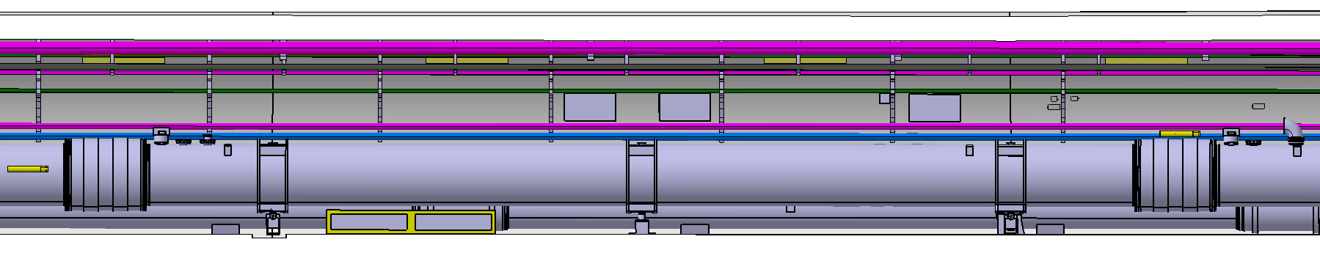
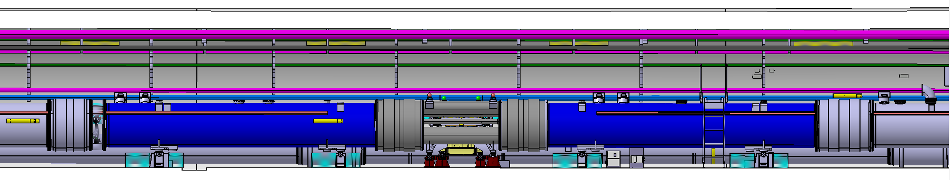
11T expected activities - Compatibility
R7
LHC C9R7
10
9
9
11
9
MB.A9R7 (LBARA.9R7)
1
DYPB
17
HL-LHC C9R7
16
14
15
12
7
17
13
2
3
4
5
In the RR77
6
6
8
17
In the TZ76

Slide 4
11T expected activities – Infrastructure modif. compatibility
n | Activities | Loc | Fully Compatible | Non Compatible | Comp. with Modification | Comments
1 | DYPB.9R7 removal Currently installed under MB.A9L7, protecting the mentioned dipole. MB.A9L7 dipole to be removed. | 9R7 | X |  |  | It can be stored and put it back. Possibility to leave cabling in place
2 | RYSA01 removal Rack installed at RR77. It will be replaced by the new RYABA01 (11T PC) | RR77 | X |  |  | RYSA01 is a rack where EPC has disconnected modules that serve as spares for the racks in that area; if there is a problem in a connected spare, they take out the module and replace by one that is in the RYSA rack.
3 | RYABA01 (11T PC) installation Plus the current leads cabling | RR77 | X |  |  | Activity to be performed at the RR, Independent from tunnel activities
4 | Water connection for 11T PC | RR77 | X |  |  | Activity to be performed at the RR, Independent from tunnel activities
5 | 2 crates for QDS and TRIM Units can be integrated between DYPG01 and DYPIB01 racks | RR77 | X |  |  | Activity to be performed at the RR, Independent from tunnel activities
6 | 2 DYPB racks for 11T installation - Under MB.A8R7 - Under MB.A10R7 | 8R7, 10R7 | X |  |  | Activity to be performed away from 11T cryostat. Cabling connected to the IFS and to the racks in the RRs can be installed anyway.
7 | 3BLMs for 11T magnets + 1BLM for TCLD | 9R7 |  | X |  | BLM to be considered as part of the 11T assembly. Present BLM to be uncabled at the last moment
8 | Paint Limited Stay Areas on the floor (at the level of the non spring loaded valve in MB.B8R7) | 8R7 | X
9 | F3/F4 Electrical Boxes displacement Installed on cable trays in front of the MB.A9L7 (LBBRB.9L7) dipole. To be displaced by 11m towards the arc. | 9R7 | X |  |  | Check the cabling length of components with connections to those boxes (EN-EL)
10 | Reduce size of L18A EC (control cable ladder) To avoid intefrerence with palfinger during TCLD installation | 9R7 | X
11 | Displace the cable tray support to the left of its actual position, and if needed, install another one to the right. | 9R7 | X
12 | Re-route nQPS and BLM cables currently installed in a TELEX along the magnets (using L18A EC and L12A EC, respectiv.) | 9R7 |  |  | ? | Presently approved configuration is not compatible between 11T and stardand dipole. To check if it can be modified to make it compatible with both configurations
13 | 3 Coffrets Prise installation 4x10A monophase, 16A triphase, 32A triphase | 9R7 |  |  | X | At the foresee location, they might interfere if we later re-install the old dipole with the current racks. In any case, they should be installed after the 11T dipoles are in place.
14 | Passerelle over the QRL installation | 9R7 | X |  |  | It can be installed and left in place
15 | LHC Bridge installation | 9R7 | X |  |  | It will be removed if 11T if the 11T is not installed
16 | Water connections to the EDA/EDR pipes Installation of flexible pipes to the TCLD | 9R7 | X |  |  | It can be done and ready for use. It doesnt matter if in the end they are not used
17 | Installation of new racks for TCLD in the LHC galleries | TZ76 | X |  |  | Independent from tunnel activities. Cabling to be connected to the TCLD can be pulled from the racks and installed along the tunnel till the area
18 | 11T+TCLD jacks installation | 9R7 |  | X |  | Standard dipole jacks and new 11T+TCLD jacks are not compatible
TCLD
TCLD
TCLD
TCLD
TCLD
TCLD
TCLD
TCLD
TCLD
TCLD
13

Slide 5
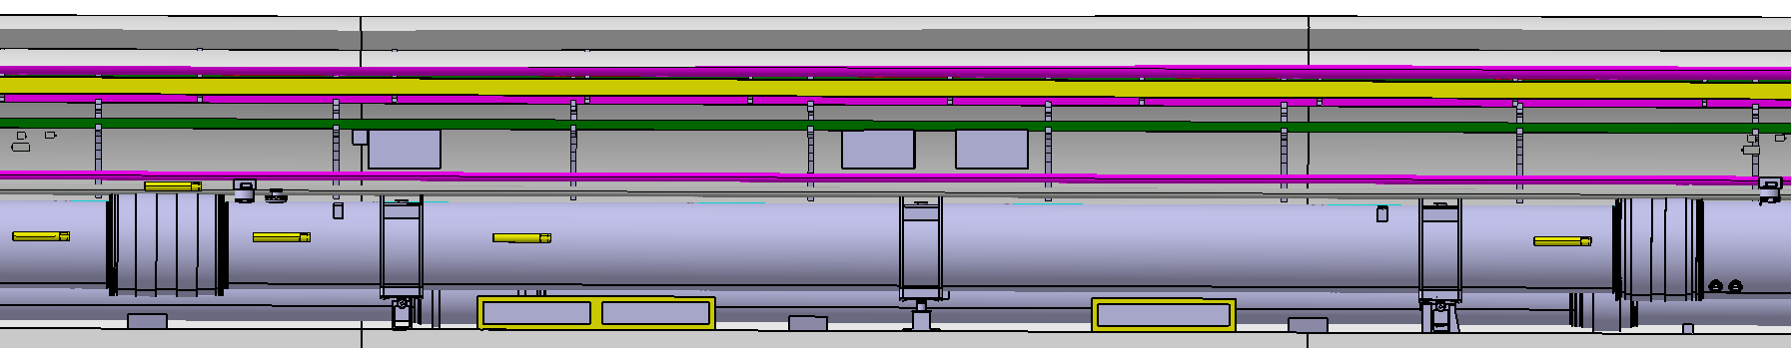
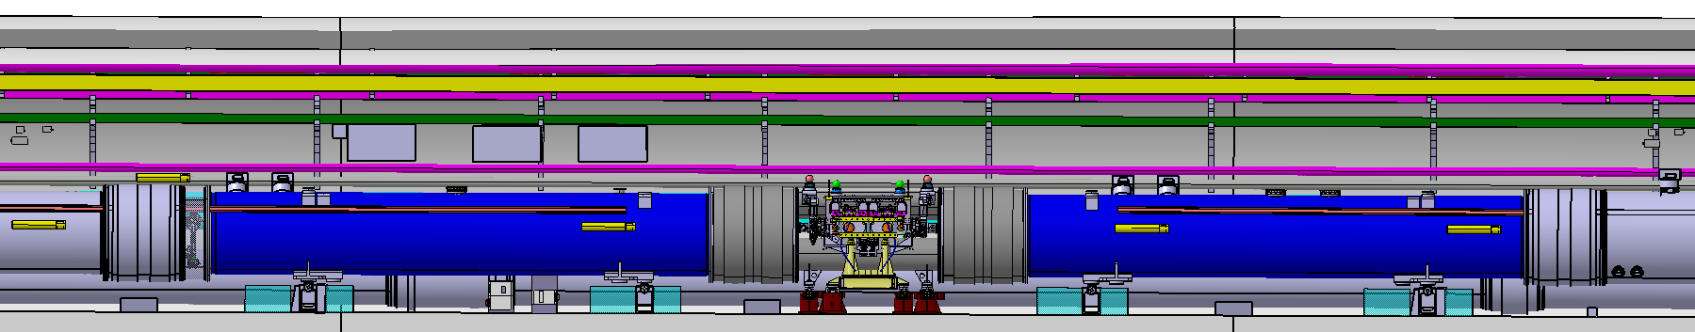
11T expected activities - Compatibility
DRAFT
L7
LHC C9L7
10
10
MB.A9L7 (LBBRB.9L7)
1
DYPB
2
DYPQ
15
HL-LHC C9L7
13
11
8
12
15
3
4
5
6
In the RR73
7
9
In the TZ76
14

Slide 6
11T expected activities – Infrastructure modif. compatibility
n | Activities | Loc | Fully Compatible | Non Compatible | Comp. with Modification | Comments
1 | DYPB.9L7 removal Currently installed under MB.A9L7. To be removed | 9L7 | X |  |  | It can be stored and put it back. Possibility to leave cabling in place
2 | DYPQ.9L7 displacement Currently installed under MB.A9L7. To be displaced under MB.B8L7 | 9L7, 8L7 | X |  |  | It can be displaced and leave it installed there
3 | RYSA01 removal Rack installed at RR73. It will be replaced by the new RYABA01 (11T PC) | RR73 | X |  |  | RYSA01 is a rack where EPC has disconnected modules that serve as spares for the racks in that area; if there is a problem in a connected spare, they take out the module and replace by one that is in the RYSA rack.
4 | RYABA01 (11T PC) installation Plus the current leads cabling | RR73 | X |  |  | Activity to be performed at the RR, Independent from tunnel activities
5 | Water connection for 11T PC | RR73 | X |  |  | Activity to be performed at the RR, Independent from tunnel activities
6 | 2 crates for QDS and TRIM Units can be integrated between DYPG01 and DYPIB01 racks | RR73 | X |  |  | Activity to be performed at the RR, Independent from tunnel activities
7 | 2 DYPB racks for 11T installation - Under MB.B9L7 - Under MB.B10L7 Plus cabling going from the racks to the magnets and to the RR. | 9L7, 10L7 | X |  |  | Activity to be performed away from 11T cryostat. Cabling connected to the IFS can be installed till the 11T area
8 | 3BLMs for 11T magnets + 1BLM for TCLD | 9L7 |  | X
9 | Paint Limited Stay Areas on the floor (at the level of the non spring loaded valve in MB.A8L7) | 8L7 | X
10 | F3/F4 Electrical Boxes displacement Installed on cable trays in front of the MB.A9L7 (LBBRB.9L7) dipole. To be displaced by 3.5m towards the arc. | 9L7 | X |  |  | Check the cabling length of components with connections to those boxes (EN-EL)
11 | Re-route nQPS and BLM cables currently installed in a TELEX along the magnets (using L18A EC and L12A EC, respectiv.) | 9L7 |  |  | ? | Presently approved configuration is not compatible between 11T and stardand dipole. To check if it can be modified to make it compatible with both configurations
12 | 3 Coffrets Prise installation 4x10A monophase, 16A triphase, 32A triphase | 9L7 |  |  | X | At the foresee location, they might interfere if we later re-install the old dipole with the current racks. In any case, they should be installed after the 11T dipoles are in place.
13 | Water connections to the EDA/EDR pipes Installation of flexible pipes to the TCLD | 9L7 | X |  |  | It can be done and ready for use. It doesnt matter if in the end they are not used
14 | New racks for TCLD in the LHC galleries | TZ76 | X |  |  | Independent from tunnel activities. Cabling to be connected to the TCLD can be pulled from the racks and installed along the tunnel till the area
15 | 11T+TCLD jacks installation | 9L7 |  | X |  | Standard dipole jacks and new 11T+TCLD jacks are not compatible
TCLD
TCLD
TCLD
TCLD
TCLD
TCLD

Slide 7
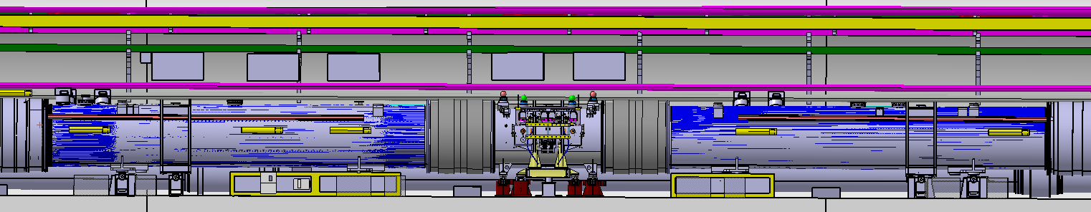
Current dipole (LBBRB.9L7) vs Full 11T configuration
Jacks no compatible
1000
500
500
500
1200
700
Overlapping the 2 images
1000
500
500
500
1200
700

Slide 8
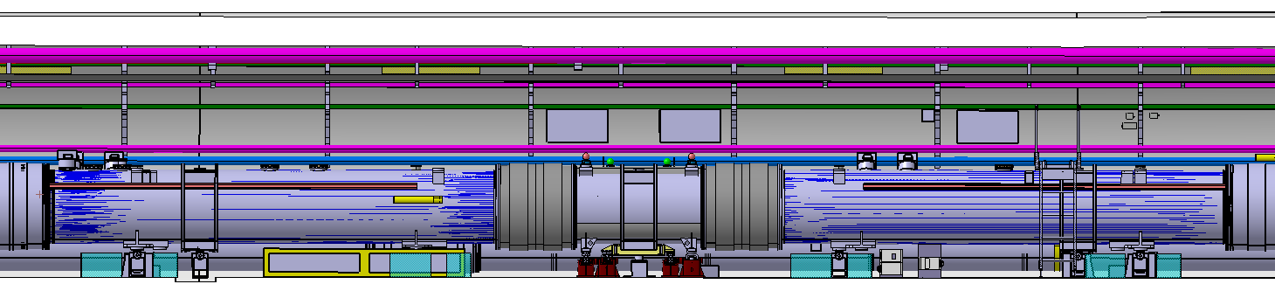
Current dipole (LBARA.9R7) vs Full 11T configuration
Jacks no compatible
1000
500
500
500
1200
1200
Overlapping the 2 images
1000
500
500
500
1200
1200

Slide 9
SPARE SLIDES

Slide 10
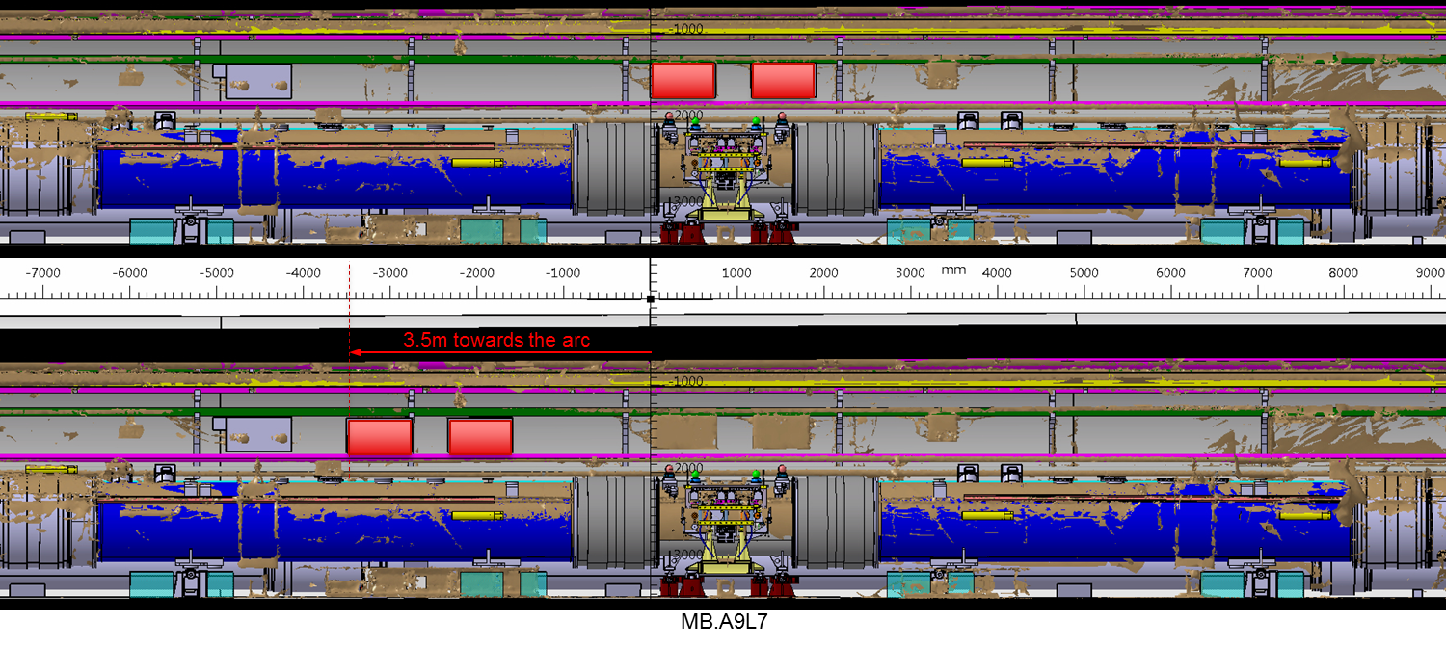
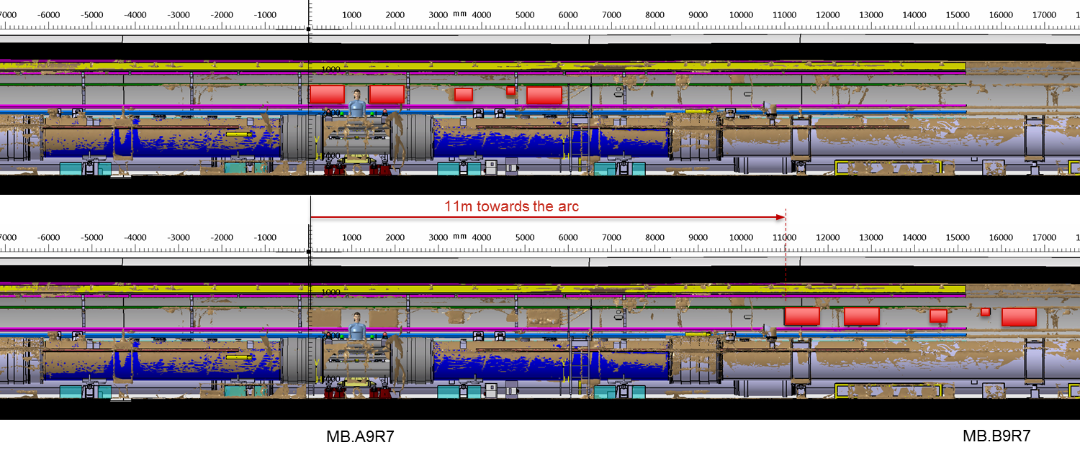
Displacement of F3 and F4 Electrical Boxes

Slide 11
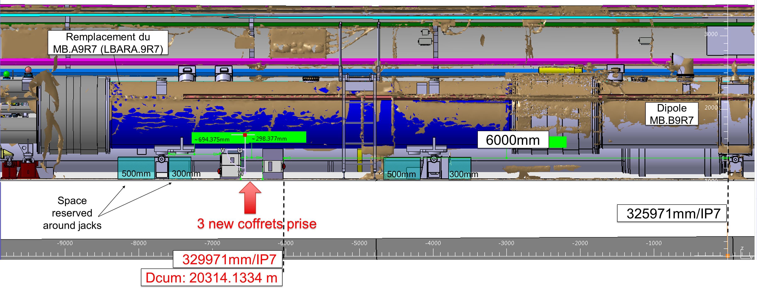
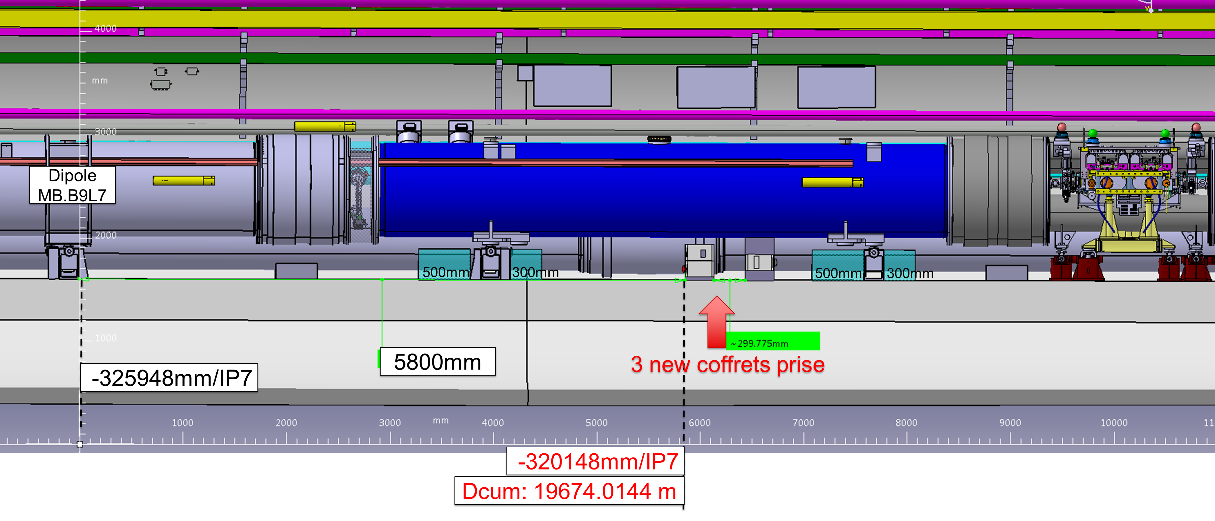
Installation of new coffets prise

Slide 12
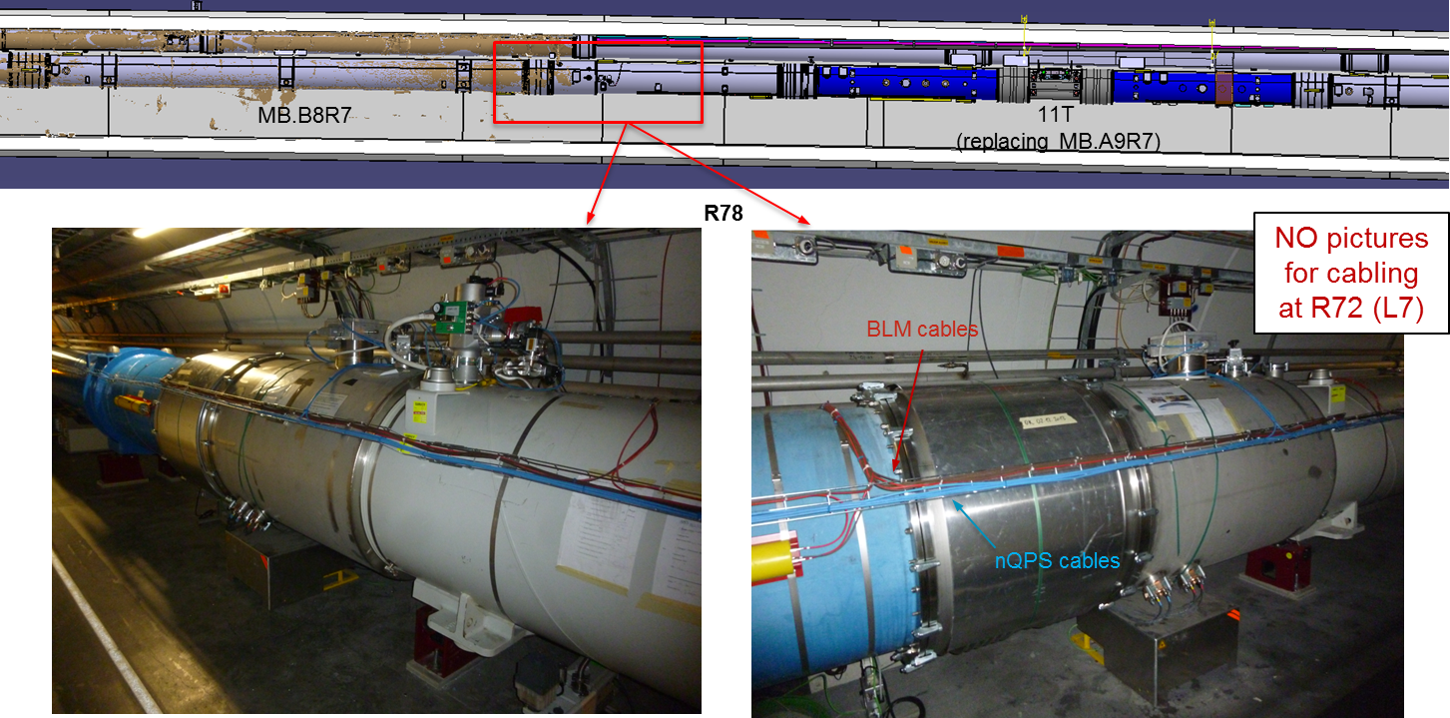
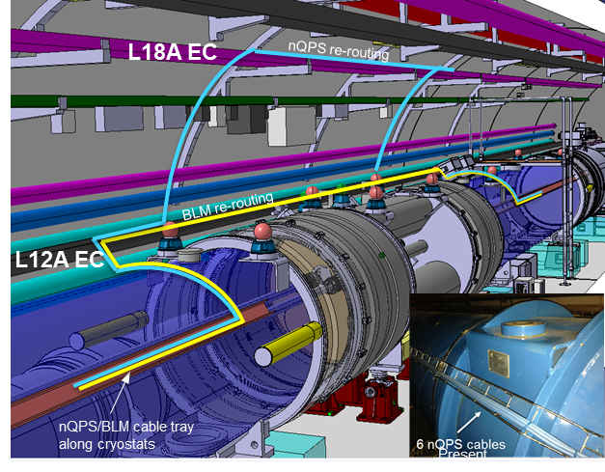
To check if the routing could be modified, to make it compatible with both 11T or dipole configurations
Re-routing of current cables: nQPS and BLM cables in the telex placed along the magnets.

Slide 13
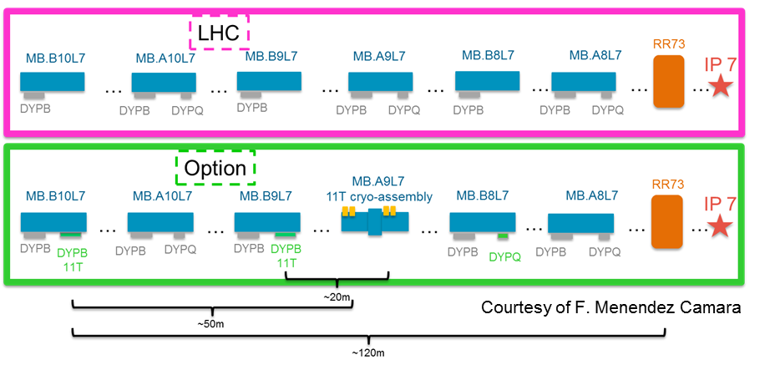
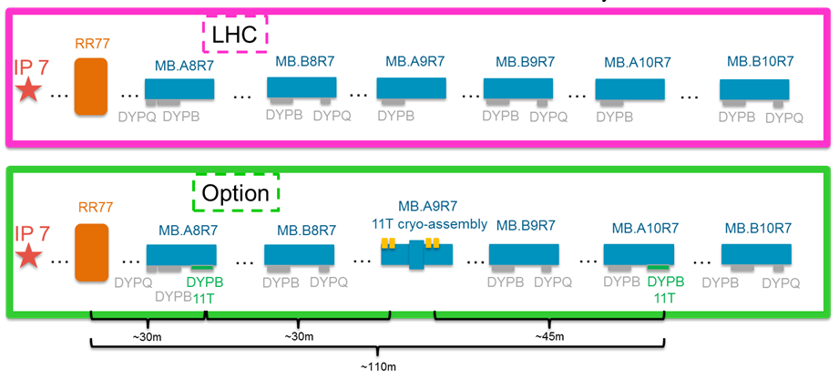

Location of new 11T DYPB racks underneath the magnets

Slide 14
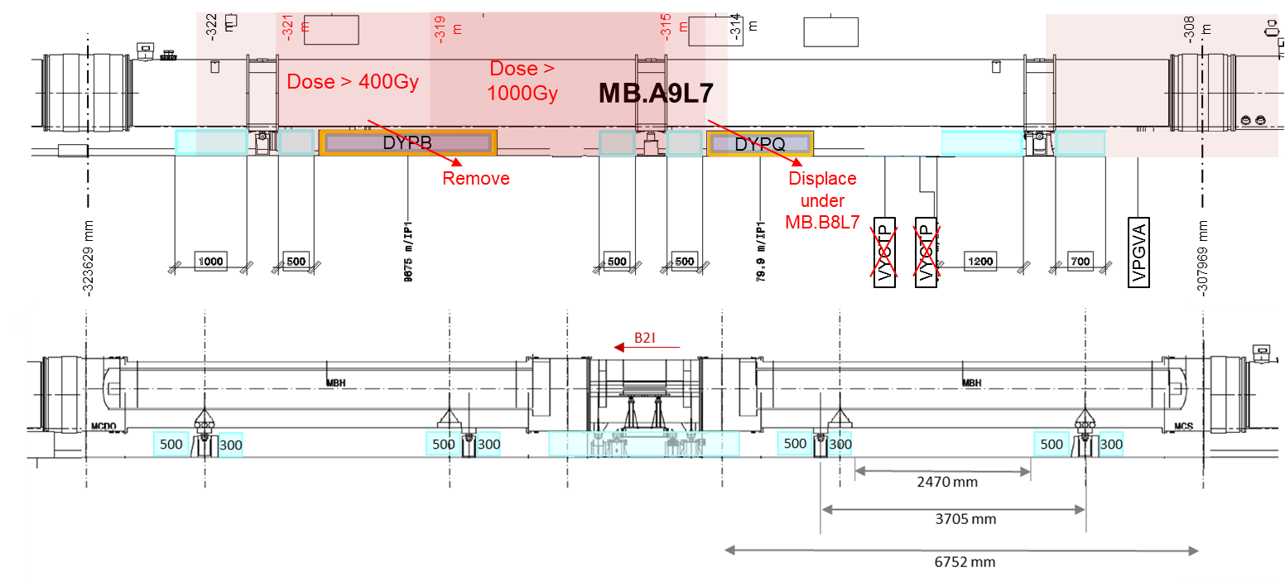
Current MB.A9L7 (LBBRB.9L7) vs Full 11T configuration
Position of jacks and racks presently installed

Slide 15
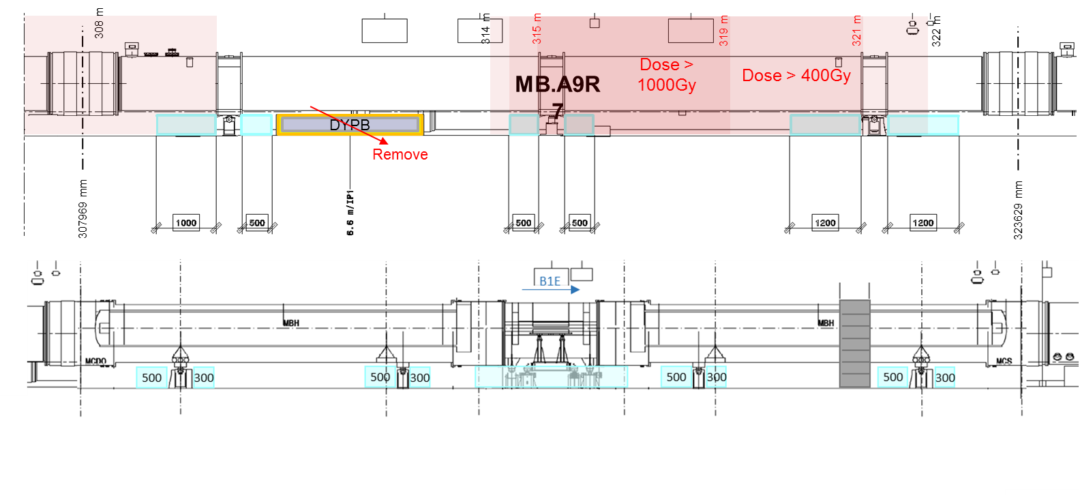
Current MB.A9R7 (LBARA.9R7) vs Full 11T configuration
Position of jacks and racks presently installed

Slide 16
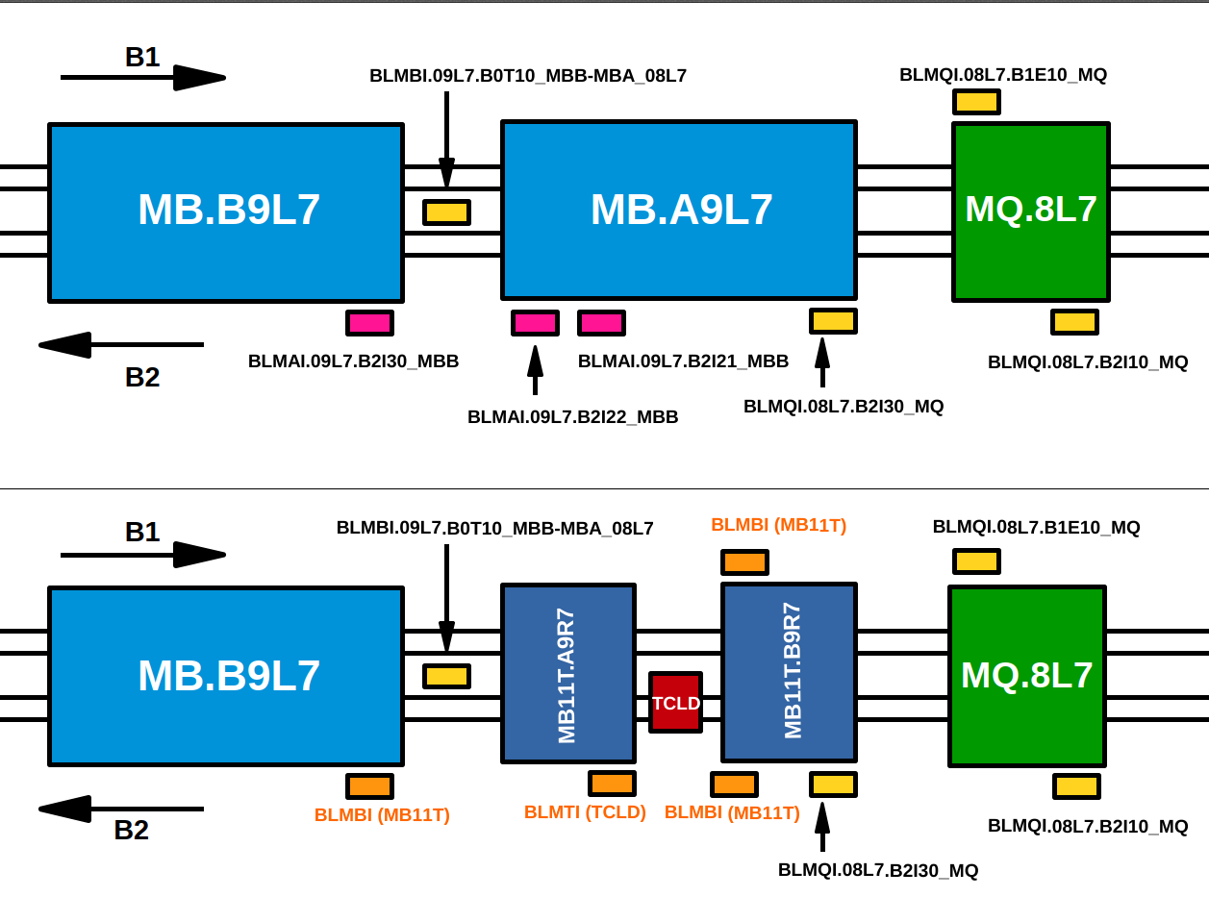
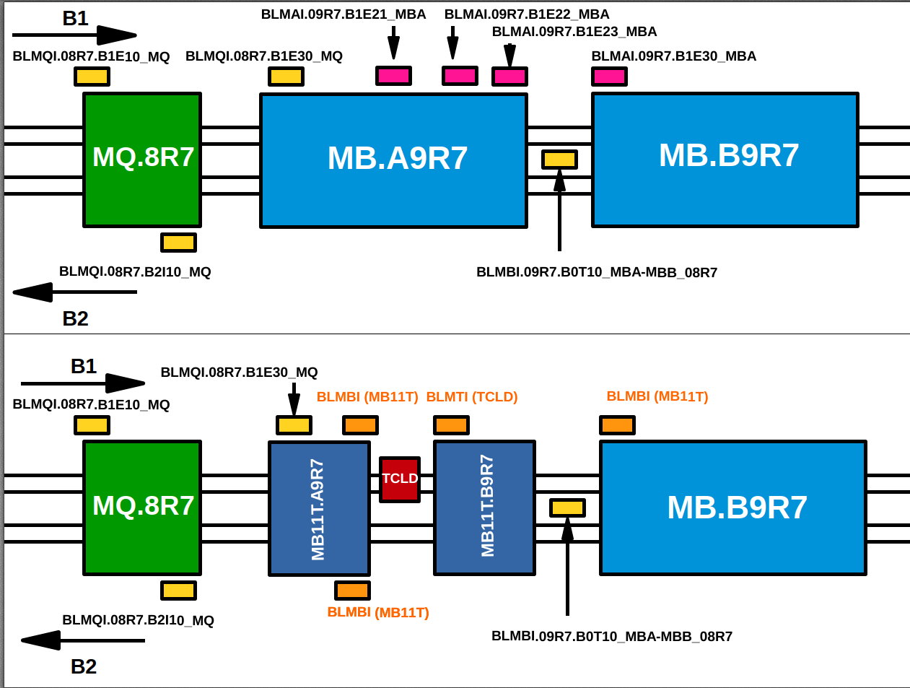
BLM layout

Slide 17
Standard LHC dipole vs 11T assembly configuration
LHC C9L7
MB.A9L7 (LBBRB.9L7)
L7
HL-LHC C9L7
LHC C9R7
MB.A9R7 (LBARA.9R7)
R7
HL-LHC C9R7

