Slide 1
SWAN for NXCALS
Piotr Sowiński, BE-CO-DS, 11.10.2019
on behalf of NXCALS Team

Slide 2
Agenda
Accelerator Logging Service
NXCALS Project
SWAN for NXCALS
User feedback
Conclusions

Slide 3
Background:
CERN Accelerator Logging Service
CALS is a CERN-wide mission-critical service in production since 2003.
Stores >2TB/day of data from >2.6 million signals of accelerator equipment and beam measurements. ~1PB of data logged so far.
Used by >1000 users from across CERN.
Currently based on Oracle DBMS.
High Level Objectives:
  Information management for accelerator performance improvement
  Make available long term statistics for management and help decision support process
  Avoid duplicate logging efforts

Slide 4
NXCALS Project
Motivation:
In general, accelerator operation has stabilised
Increasing number of complex data analysis use cases, looking at longterm data sets with a goal of tuning performance and preparing for the future (HL-LHC and beyond).
CALS system has reached its limits when it comes to data analysis functionality.
NXCALS is the successor of CALS based on Hadoop Big Data technologies using cluster computing power for data analysis.
The horizontally-scalable architecture should be capable of confronting highly increasing amount of logged data.

Slide 5
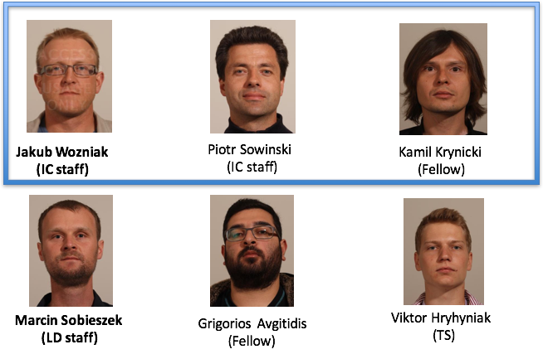

NXCALS Team

Slide 6
In Collaboration With…
                IT-DB & EP-SFT
              Hadoop BigData storage software & hardware platform
              SWAN as a Data Science platform with NXCALS
                TE-MPE
                To have a single data archive for Post-Mortem using NXCALS
                BE-ICS
On WinccOA to NXCALS datasources

Slide 7
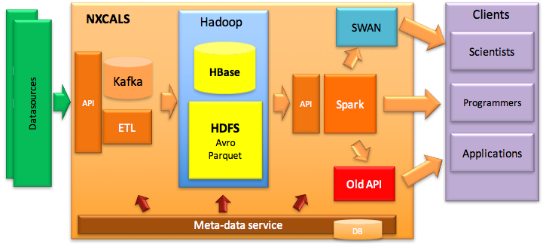
NXCALS Architecture
Notes:
Java Ingestion API to send data to Kafka (as Avro)
ETL extracts it from Kafka towards
HDFS (as Avro, into staging folders)
HBase (as Avro, for low latency)
Both destinations at the same time
Avro files are deduplicated & compacted
Into larger Parquet files (with Spark)
Hadoop-friendly process, avoids many small files
Spark Extraction API for data access (Java, Python, Scala)
Meta-data service knows location of objects in files
Avoids scanning many files
“Replacement” for missing indexes
Why Kafka ?
Redundancy & data safety (if Hadoop not available)
Low latency streaming API for extraction
Why HBase ?
Fast, low latency for online monitoring queries
Buys time for data deduplication & compaction into Parquet files
Why Parquet as final storage ?
Open, columnar, storage efficient format with good compression
Good performance for extraction
Easy to understand, access (even outside of the system), backup, etc

Slide 8
How SWAN Fits Whole Picture ?
Proposed as one of the NXCALS data access methods among Java API, NXCALS Spark bundle and others
Thanks to joint effort between BE-CO, IT and EP-SFT, NXCALS is well integrated into SWAN environment:
  New NXCALS releases are automatically deployed - on a weekly basis NXCALS libraries are collected from the dedicated EOS space.
  SWAN team ensures the software stack for NXCALS contains correct Python and Spark versions + required libraries
Python Data Access API easily accessible offering different data query builders
Plays important role especially during the CALS -> NXCALS transition period (testing, ad-hoc queries, TIMBER substitute). Being used on a daily basis.
More details can be found in NXCALS Documentation: http://nxcals-docs.web.cern.ch

Slide 9
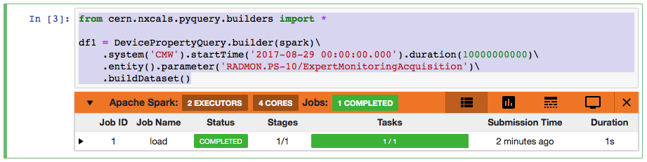
NXCALS Data After Few Clicks !
After requesting authorisation to NXCALS service it is sufficient to:
  Provide CERN credentials
  Select Environment (NXCALS Python3 software stack and BE NXCALS Spark cluster)
  Establish Spark clusters connection (with bundled NXCALS configuration)
  Import NXCALS builders and execute a code as in the example below:

Slide 10
When to use SWAN ?
  For code prototyping - building SPARK queries, checking performance, etc
  Ad-hoc queries - no additional setup / configuration required
  For the simple visualisation of results using Pandas through matplotlib for example
  Sharing code / analysis results

Slide 11
Users Feedback
NXCALS user questionnaire (11-03-2019), with a purpose to:
  Establish contact / start dialog with the NXCALS user community using SWAN
  Better understand NXCALS user needs concerning the service
  Suggest improvements and new functionalities to SWAN service as required from the NXCALS perspective
Areas covered include: Usage, Expectations, Satisfaction

Slide 12
Survey Responses - Usage
    How often is it used ?
      From “Occasional” to “On the regular basis”
      Daily / Weekly
    How is it actually used ?
      Sharing scripts or studies
      Hosting documentation in the notebooks
      Testing NXCALS (quick and easy, before proper coding)
      Plotting and charting (no NXCALS TIMBER (GUI) yet, plenty of Python libraries)
      Ad-hoc queries / scrapbook (post processing, machine development on-line analysis, prototyping code)

Slide 13
Survey Responses - Expectations
How critical the service availability is for your activities ?
  Mixed answers from “Critical” to “Non Critical” due to software instabilities (b.t.w which is much improved since then)
Does it have to be up 24/7 ?
  It is almost the case already now
  Expected to be up during working hours, but often outside working hours
What should be reaction time in case of issues ?
  Replies range from 1 hour to 1-2 days…

Slide 14
Survey Responses - Satisfaction
How easy is the service to use currently ?
  Very easy to use (strongest point of the service)
How fast is the SWAN service in providing you the required results ?
  Fast enough / Not as fast as a desktop, but totally acceptable so far for my activities in general (processing on the client side might be faster but running Spark application in Hadoop is the same)
Are you satisfied with integration of NXCALS services ?
  The limitation to only a single Spark connection per session is a severe limitation (this limitation has since been removed)
  The connection time to Hadoop/NXCALS is very slow (currently much faster)

Slide 15
Conclusions
Well integrated with NXCALS, being an easy “access point” to logging data
Always up to date thanks to automatic NXCALS libraries deployment
As reported by many users - very useful for data analysis, plotting and sharing which helps during transition period from CALS to NXCALS when new TIMBER GUI application will be developed
Excellent tool for code prototyping
Very good cross-department collaboration, resulting in end-user issues being efficiently resolved, in particular:
  Reliability has improved a lot.
  Functionality to have multiple session was introduced.

Slide 16
Thank you !

Slide 17
Main Team Focus In 2019 and Onwards
NXCALS contains all of the historical CALS data
  Migration is progressing well
    Dedicated setup deployed on 65 machines
    1PB to be moved, including tens of corner cases from CALS and CCDB (but ~95% of data already moved. That represents 25 x 10^12 of data points !)
A backward compatible Java client API is provided
  Old CALS API has 126 methods
  Progressive releases being prepared for early adopters
A new version of Timber is available in production
The data extraction performance is at least comparable with CALS
Decommission CALS by the end of LS2 once the above criteria have been satisfied

