Slide 1

AOB: A New Tool For HTCondor Submission - pyHTC
A. Poyet, G. Sterbini
Beam-Beam and Luminosity Meeting – 12th July 2019

Slide 2
Context and Motivations
To run a script a huge number of times, or needing a heavy computing time, one needs in general to send them to a cluster of nodes to run every scripts in parallel.
At CERN, the batch service is based on HTCondor (previously, it was LSF).
Some codes like SixTrack come with a submission environment that hide the submission from the user → Makes your life easier, but what’s really going on in this black box?
Useful reference to read: http://batchdocs.web.cern.ch/batchdocs/index.html
HTCONDOR TUTORIAL : http://batchdocs.web.cern.ch/batchdocs/tutorial/introduction.html
  See also ‘HTCondor training’ by F. Protopsalti : https://indico.cern.ch/event/635217/attachments/1458551/2252370/HTCondor-Presentation.pdf
Submitting a job requires the creation of a proper submit file that can be understood by HTCondor
In general, it would be useful to be able to prepare and to submit jobs from your python script/notebook → This is the aim of pyHTC ☺

Slide 3
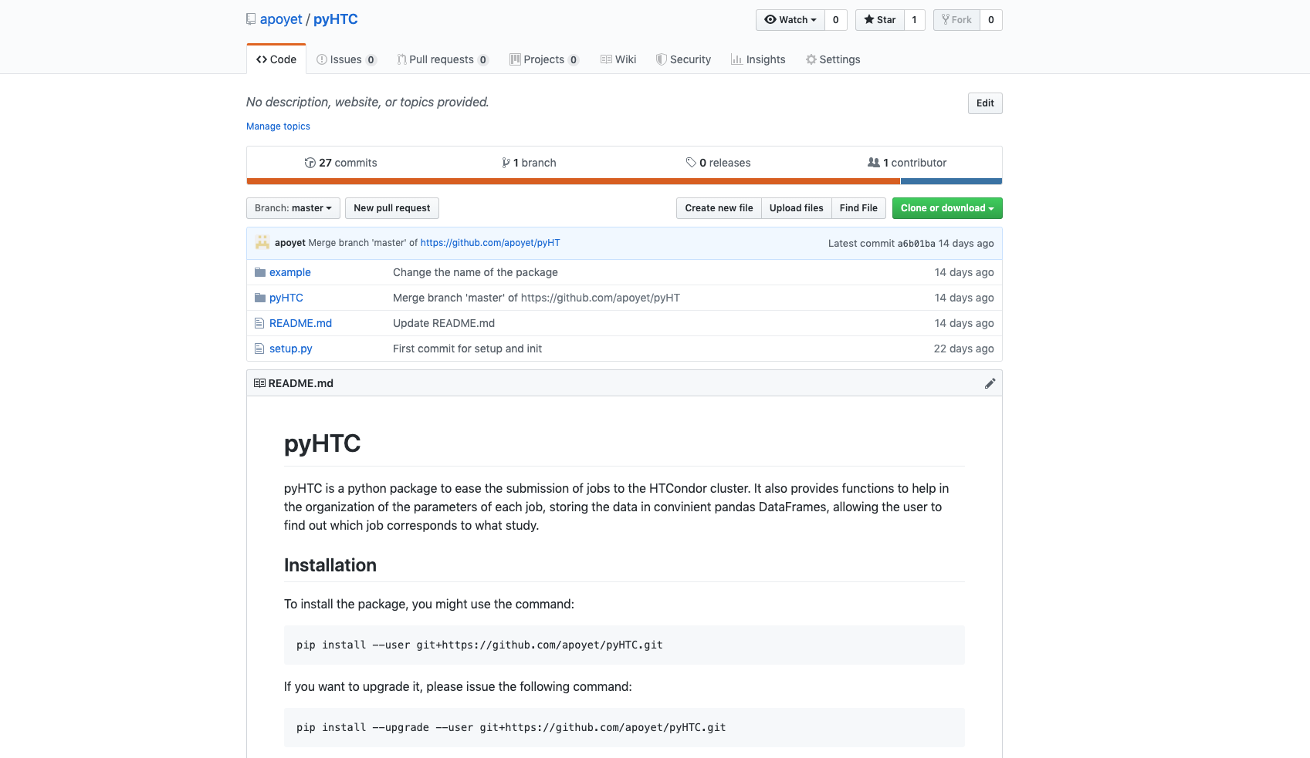
pyHTC
pyHTC is python package that helps the user to prepare and submit jobs to HTCondor
  https://github.com/apoyet/pyHTC
Very preliminary at the moment : feel free to contribute ☺
PRELIMINARY

Slide 4

Starting with pyHTC
EOS Submission is not supported by the HTCondor service (http://batchdocs.web.cern.ch/batchdocs/troubleshooting/eos_submission.html). Therefore, this example will be made assuming a notebook located in AFS.
To install the package:
Then import it in your favourite notebook/script ☺
pyHTC.Study? What’s that? Hmmm….
pip install –user git+https://github.com/apoyet/pyHTC.git
→ Better to see a real example!

Slide 5
Conclusions
This is only the beginning…. But it is already possible from a dictionary of parameters to produce the corresponding submission file and to submit through python notebooks.
Outputs files paths are then recovered in a nice Pandas Dataframe, where all the information is summarized.
The next step will be to implement the flexibility of the input, typically to allow the re-submission of a finer grid of parameters, without re-submitting the jobs already done.

Slide 6
Thanks for your attention !

