Slide 1
On Beam Screen vibration and its impact on the beam.
D. Gamba, G. Arduini, R. Corsini, C. Garion, M. Morrone
79th HL-LHC Technical Coordination Committee (TCC) - 18th July 2019

Slide 2
Request and References
  Request from 61st HL-LHC TCC meeting (15/11/2018 indico)
  “WP2, WP3 and WP12 should assess whether a beam screen vibration test on a long magnet should be performed outside the STRING.”
References:
  2019: C. Garion, Vibrations of the HL-LHC shielded beam screens. (EDMS #2031211 v2.4)
  Oct 2018: C. Garion, Status of beam screen / cold bore / interconnect / CWT design & production (indico)
  May 2018: C. Garion, Beam screen design (indico)
  Oct 2017: M. Morrone et al. Magnetic Frequency Response of HL-LHC Beam Screens (inspirehep)
  Oct 2018: D. Gamba et al. Impact of HL-LHC civil engineering work on the LHC: do we see it and what can we learn for HL-LHC (indico)
  Jan 2019: M. Morrone et al. Test of beam screen on short model (indico)
  M. Sitko. Vibration test of the 10 m long LHC beam screen (EDMS #2067643)

Slide 3
Present knowledge and assumptions
Mechanical behavior of Beam Screen studied in [1]:
  Modelled as mass on springs with:
    Coulomb damping (friction forces between mechanical components)
    Magnetic damping (eddy-current-induced forces while moving in magnetic field)
      Compatible with Magnetic Frequency response of HL-LHC BS studied in [4]
  Theoretical model + Finite Element simulations in COMSOL
First 3 vibration modes at low frequency:
  13 - 15 Hz (Q1 type) and 19 - 23 Hz (Q2 type)
High damping and power dissipation at higher frequencies
BS moves rigidly with Cold Mass (within a few % for <60 Hz)
  No enhancement of ground motion to be expected
BS “magnetically locked” inside Cold Mass
  Only strong “internal” excitations could make the BS oscillate
  Possible source (~ kHz): turbulent flow in cooling tubes

Slide 4
Conclusions
The present models and observations suggest that there is no need for beam screen vibration test on a long magnet outside of the STRING.
However: it is envisaged (and already planned by TE/VSC) a measurement (frequency and amplitude) of turbulent flow induced vibration in cooling tubes
  This can be tested without a magnet
Additionally: important to estimate the expected vibration of the cold mass due to natural ground motion and technical services:
  Planned measurement of Ground to Cold Mass transfer function at the string (EN-SMM) and on prototype outside the string (EN-MME).
Thank you for your questions and comments!
Notes:
FSI: frequency scanning interferometry

Slide 5
Appendix

Slide 6
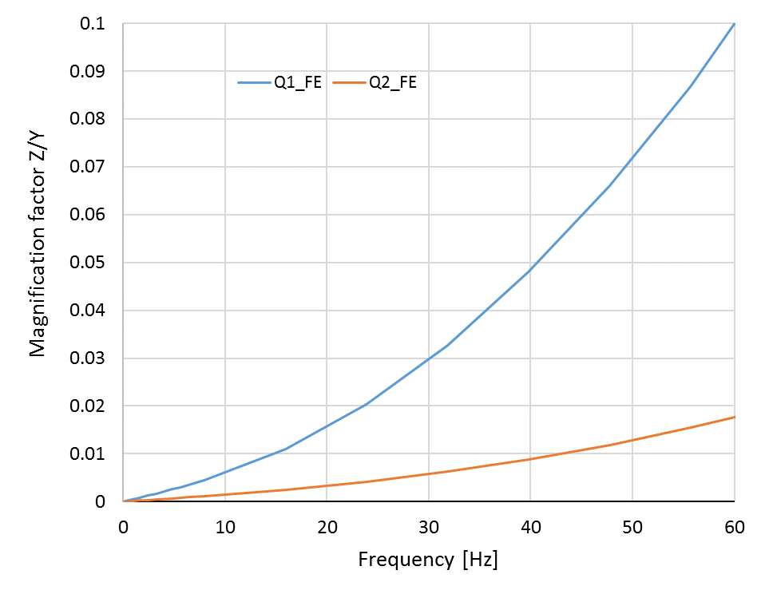
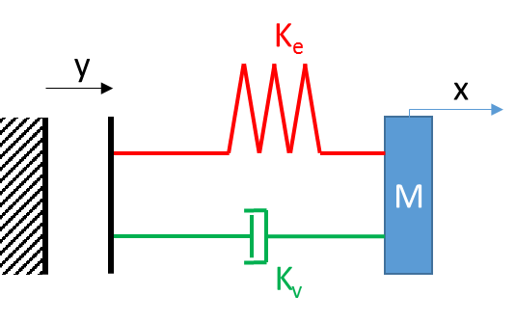

From Cold Mass to Beam Screen [1]
Is the BS assembly enhancing/damping the possible vibration of the cold mass?
$$z\left(t\right)=x\left(t\right)−y\left(t\right)$$
No: due to magnetic-induced forces, BS and Cold mass move rigidly with a few % relative variation at f < 60 Hz

Slide 7
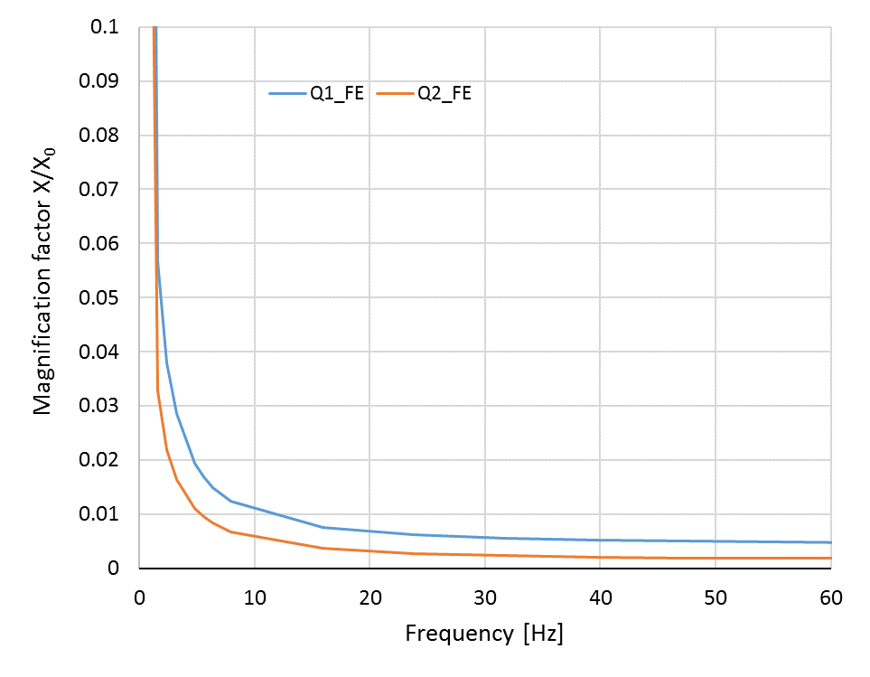
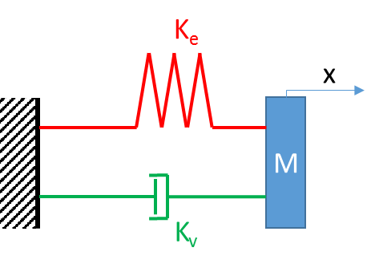
From “Internal Excitation” to Beam Screen [1]
Magnification between “internal excitation” (x₀) and actual oscillation of the BS (x) << 1

Slide 8
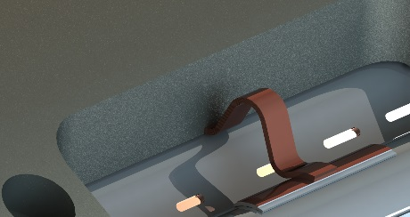
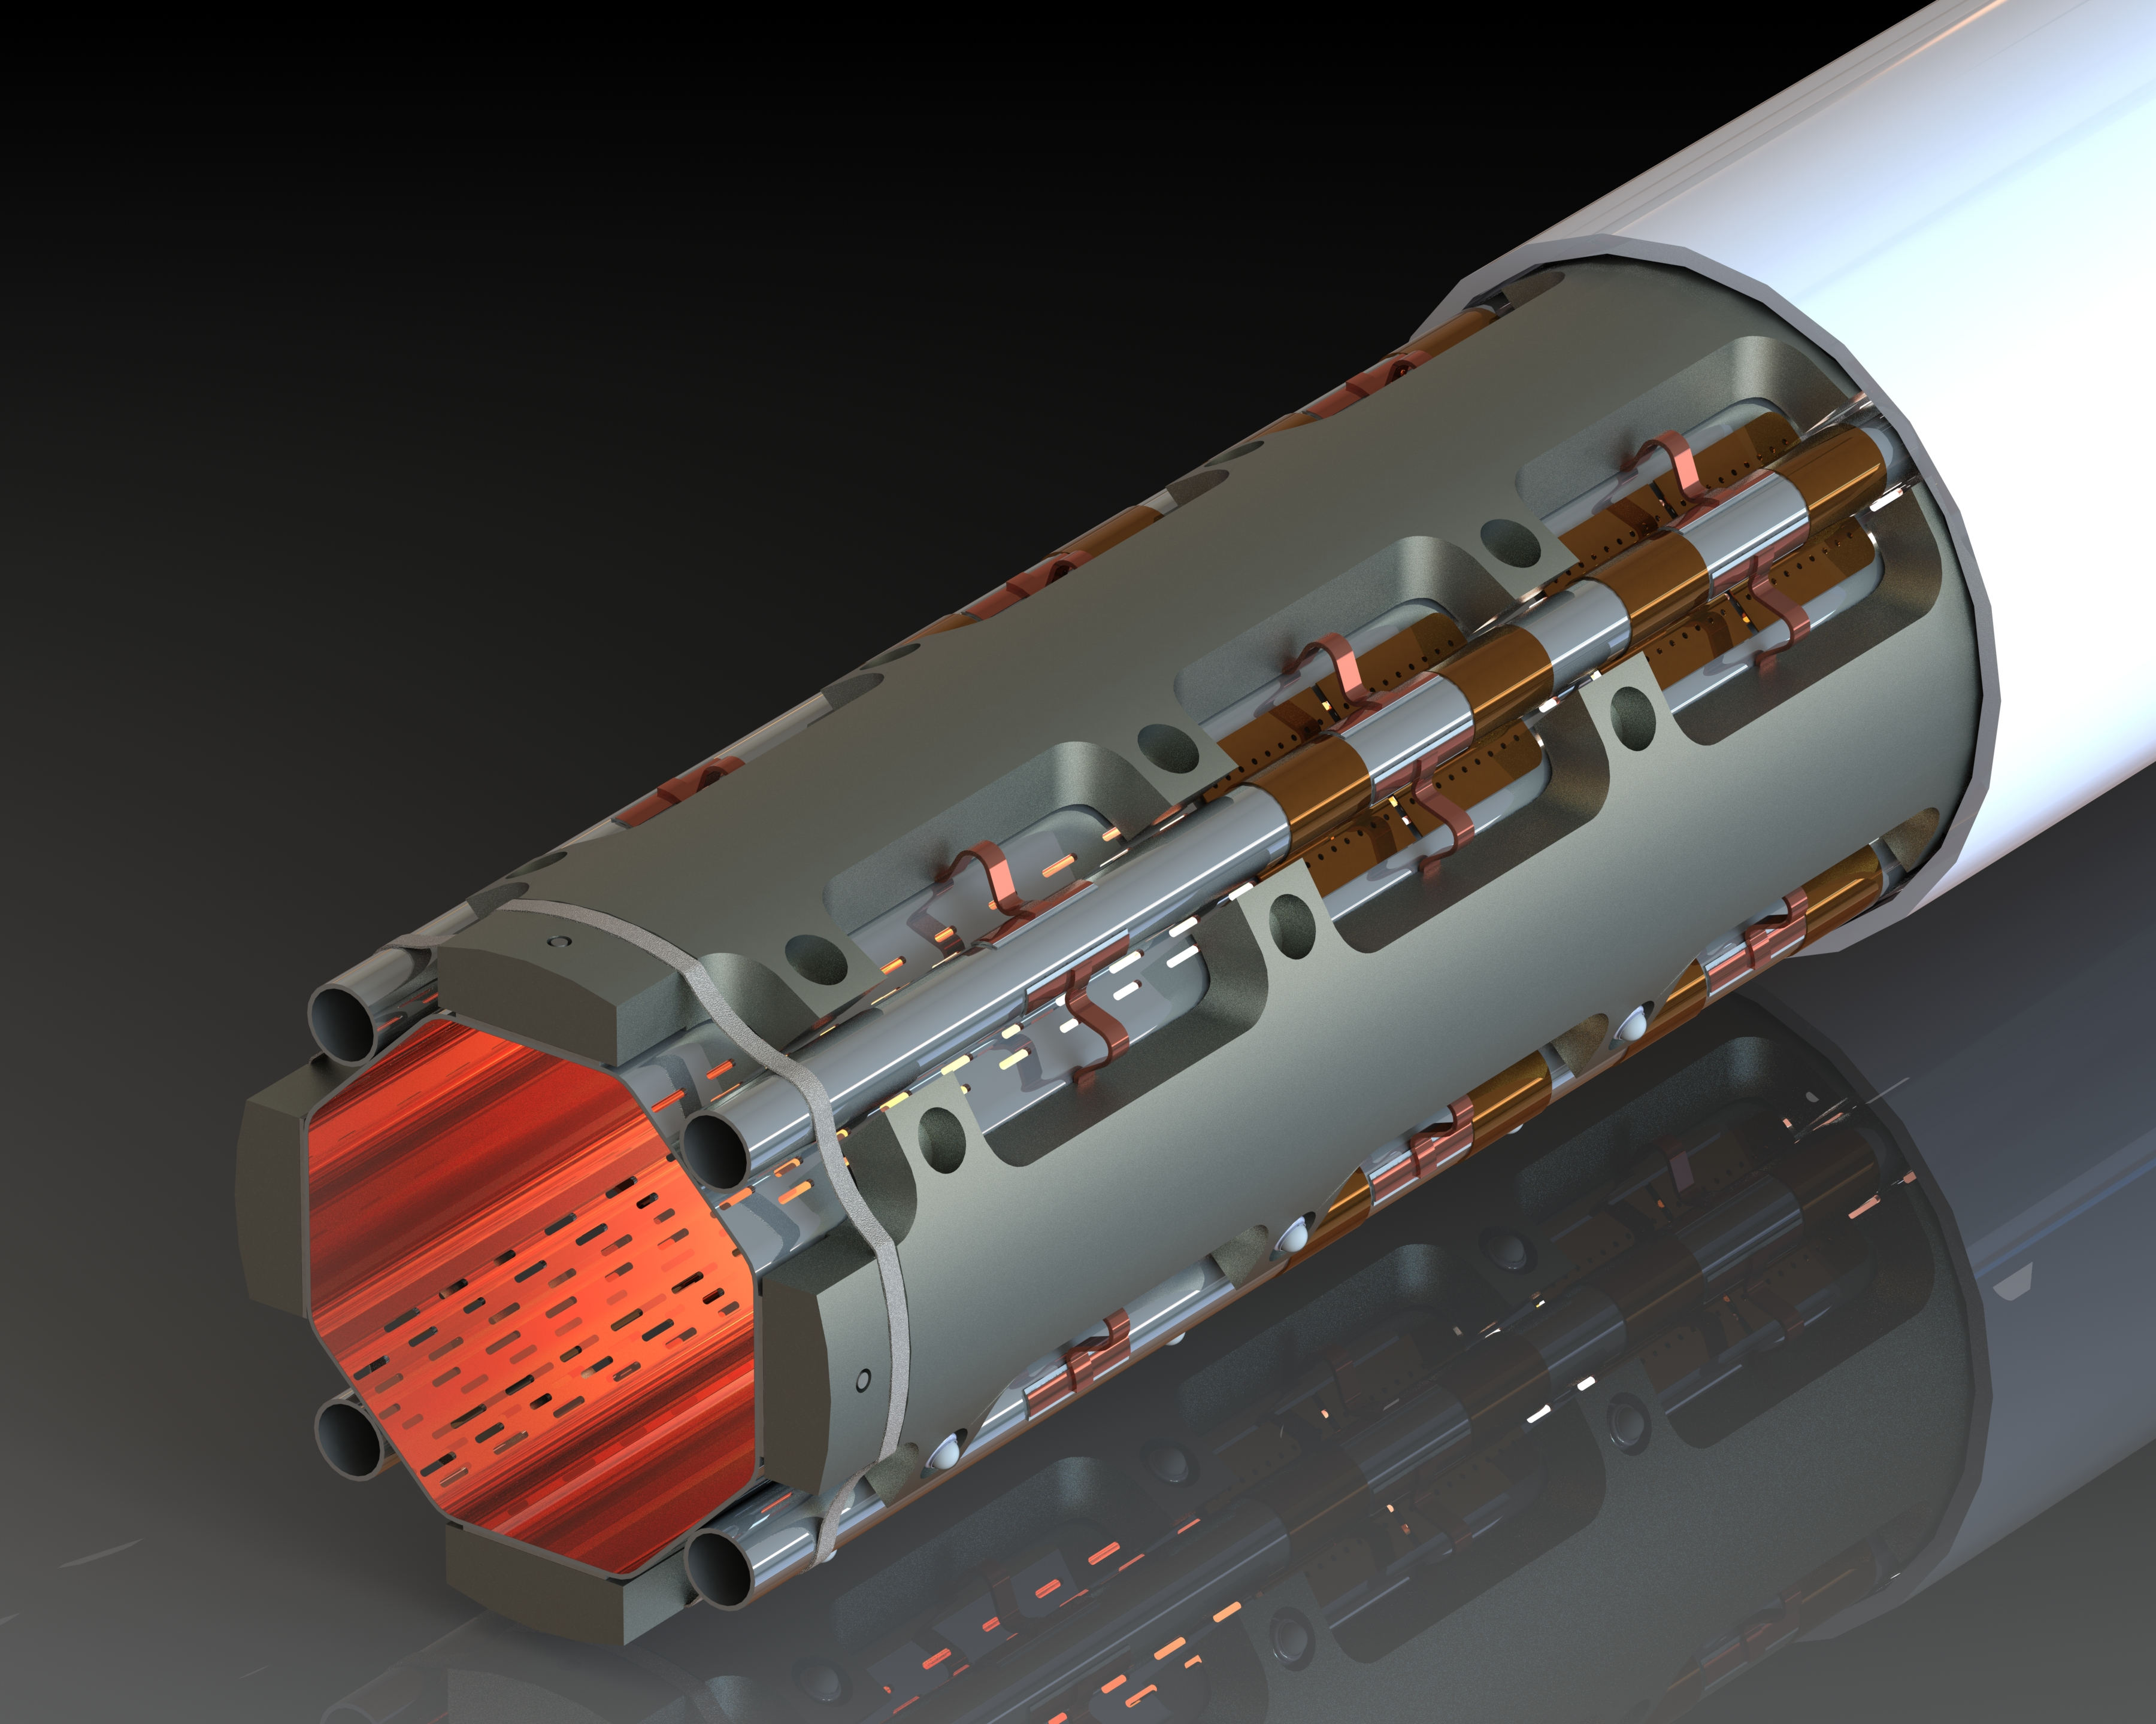
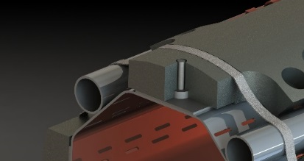
Beam Screen (BS) – Cold Bore (CB) design
Thermal links:
In copper
Connected to the absorbers and the cooling tubes or beam screen tube
Cold bore (CB) at 1.9 K:
4 mm thick tube in 316LN
Tungsten alloy blocks:
Chemical composition: 95% W, ~3.5% Ni, ~ 1.5% Cu
Mechanically connected to the beam screen tube: positioned with pins and titanium elastic rings
Heat load: 15-25 W/m
40 cm long
Pumping slot shield
Beam screen tube (BS) at 60-75 K:
Perforated tube (~2%) in High Mn High N stainless steel (1740 l/s/m (H2 at 50K))
Internal copper layer (75 μm) for impedance
a-C coating (as a baseline) for e- cloud mitigation
Laser treatments under investigation
Cooling tubes:
Outer Diameter: 10 or 16 mm
Laser welded on the beam screen tube
Elastic supporting system:
Low heat leak to the cold bore tube at 1.9K
Ceramic ball with titanium spring
From C. Garion – 8th HL-LHC Collaboration Meeting 2018 [2] - link

Slide 9
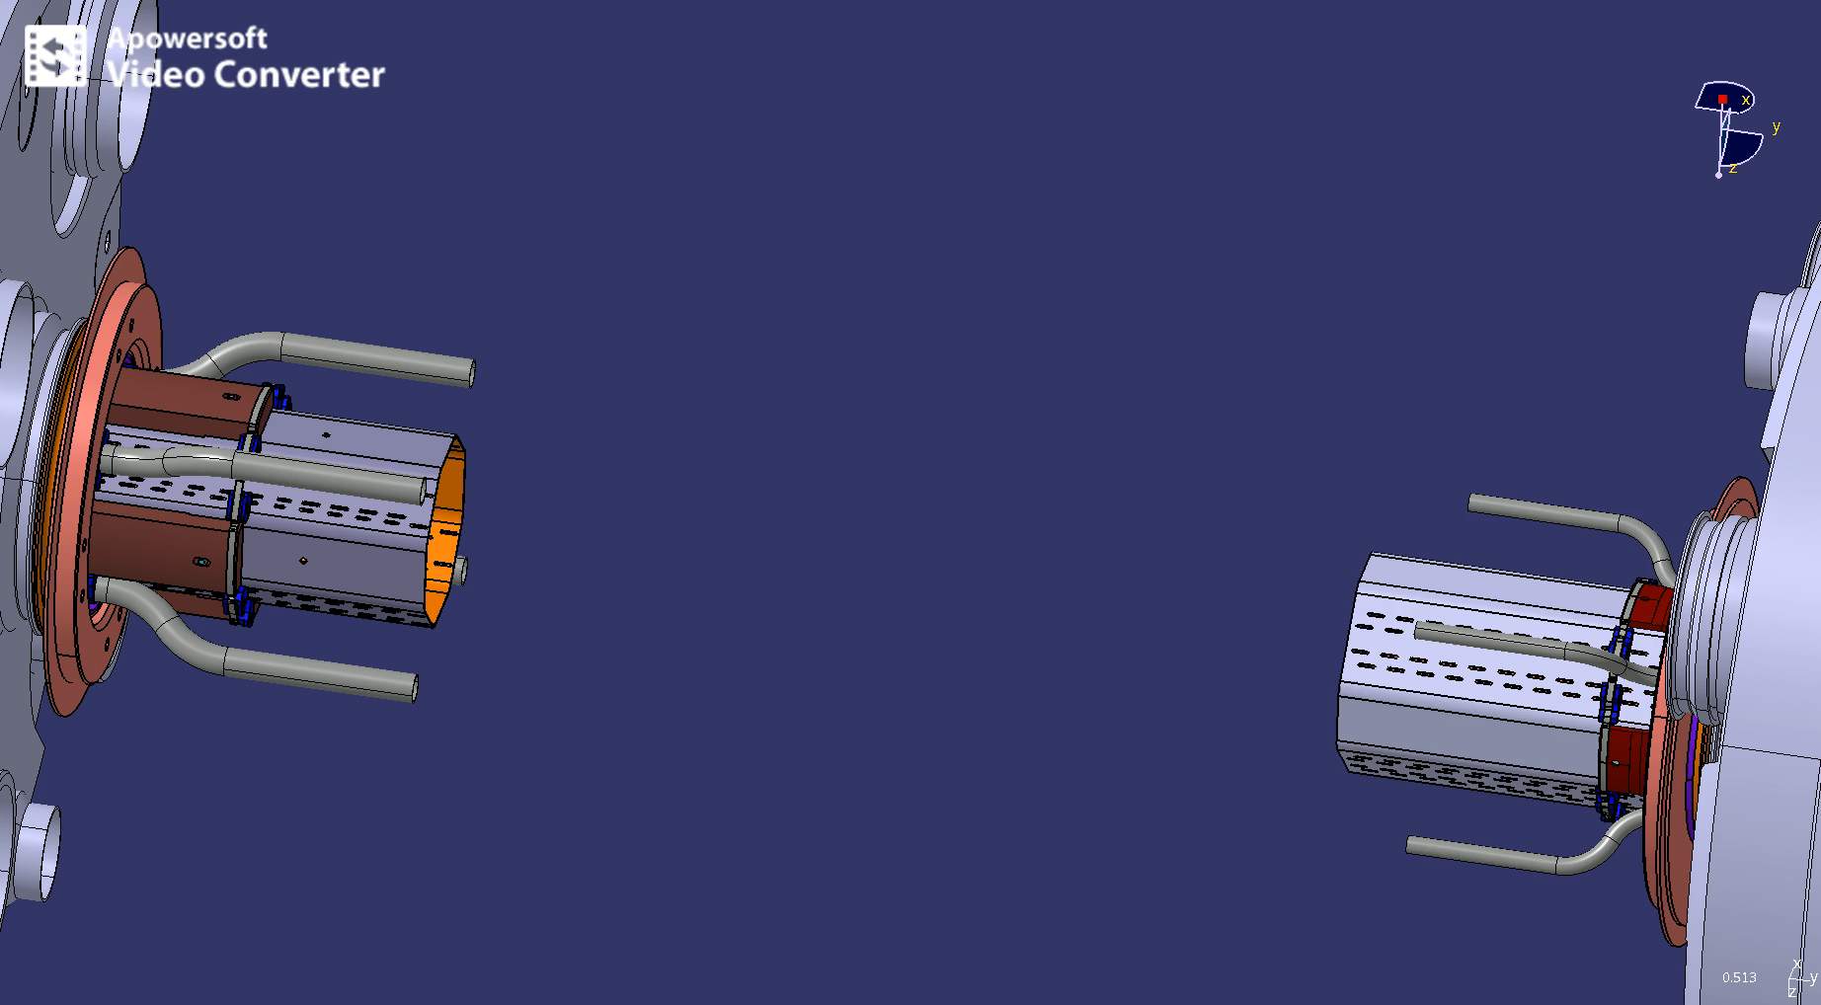
Beam screen extremities – assembly sequence
“Free” side, via bellows, but some “link” via cooling pipes
Will end-up being fixed to the Cold Bore and BPM
From C. Garion – 8th HL-LHC Collaboration Meeting 2018 [2] - link

Slide 10
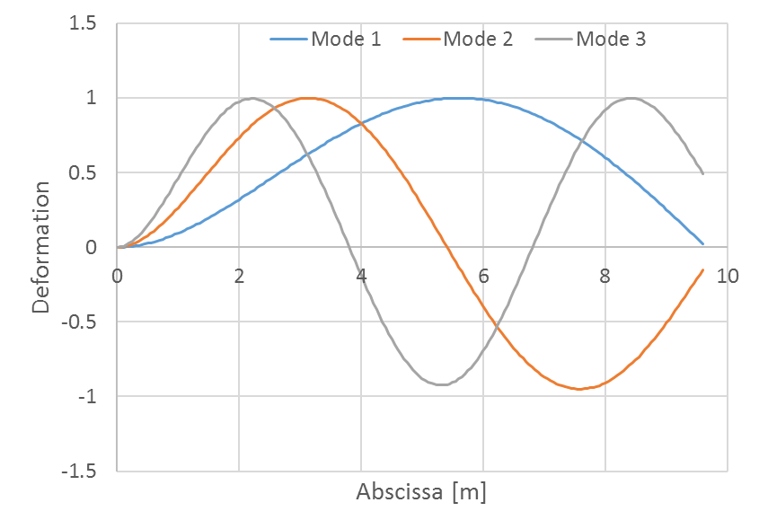
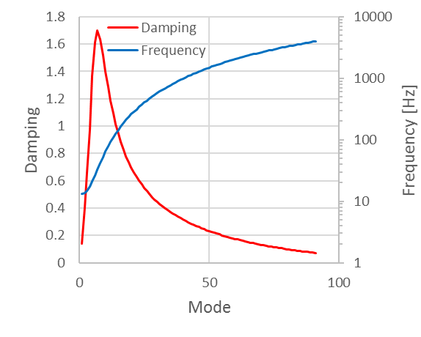
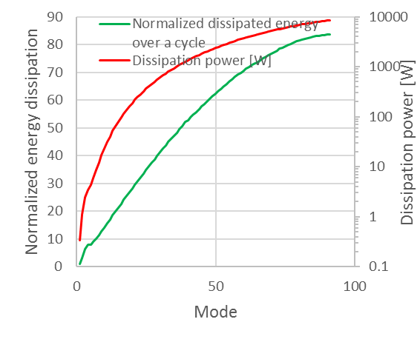
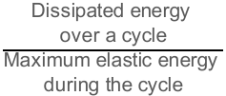
Beam Screen: natural vibration frequencies
Natural vibrations of the beam screen have been studied, based on :
beam elements
discretized elastic supports
beam screen bellows at one extremity
(EDMS 2031211)
 | Q1 type | Q2 type
1st mode | 13.2 | 19.5
2nd mode | 13.6 | 20.2
3rd mode | 14.9 | 22.5
Natural frequencies [Hz]
EDMS #2031211: “in a first approximation, the natural frequencies of first modes are close and independent of the length of the beam screens. ”
BS is fixed to the CB at one end of the magnet only
Eigen modes
High damping by Coulomb friction is expected for high order modes.
$$\frac{\begin{aligned}\text{Dissipated} \text{energy} \\ \text{over} \text{a} \text{cycle}\end{aligned}}{\begin{aligned}\text{Maximum} \text{elastic} \text{energy} \\ \text{during} \text{the} \text{cycle}\end{aligned}}$$
“unrealistic” high dissipation power due to Coulomb damping (friction forces)
First 7 modes: damping <= 1; f <= 30 Hz
Expected damping for Q1 beam screen
From C. Garion – 8th HL-LHC Collaboration Meeting 2018 [2] - link

Slide 11
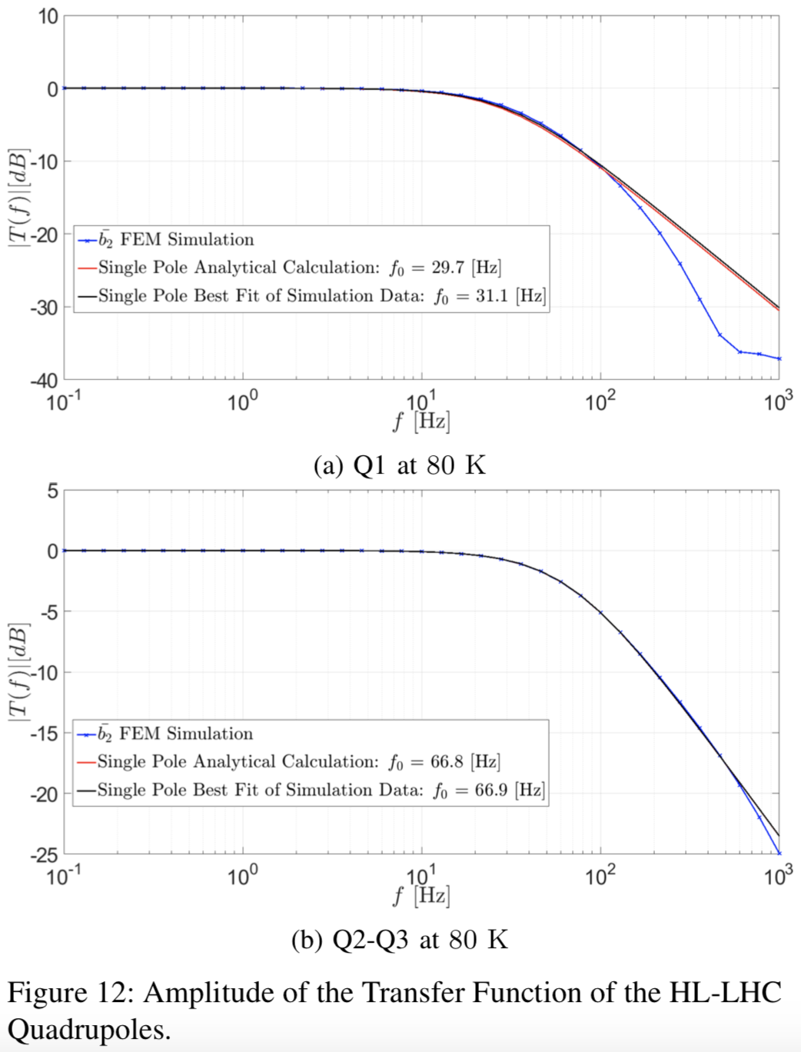
Transfer function from “magnet/coil” to axis
From M. Morrone et al. [4]
[4]: Study to assess the transfer function from current ripple to magnetic field ripple:
At ~10(Q1)/20(Q2) Hz the beam screen is damping about 1 dB of a possible field ripple from “coil” to “magnetic axis”.
Assumption here: this -1 db (≈ 10%) of the magnetic field could be “carried” by the beam screen if this oscillates at the same frequency.
A 10 μm oscillation of the BS is inducing a magnetic field oscillation of 1 μm
  Compatible with [1]
First mode(s) Beam Screen vibration frequencies

Slide 12
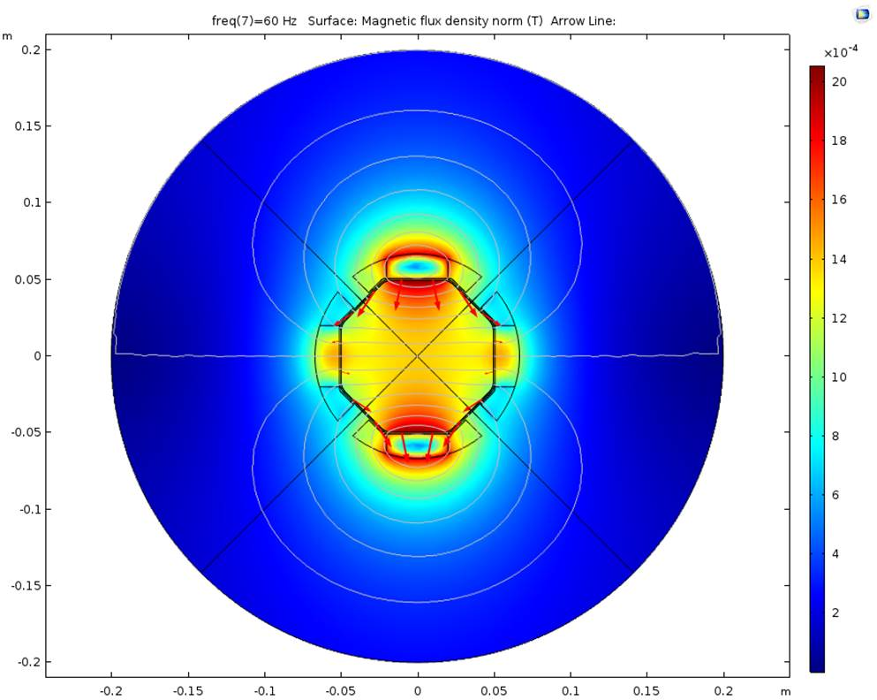
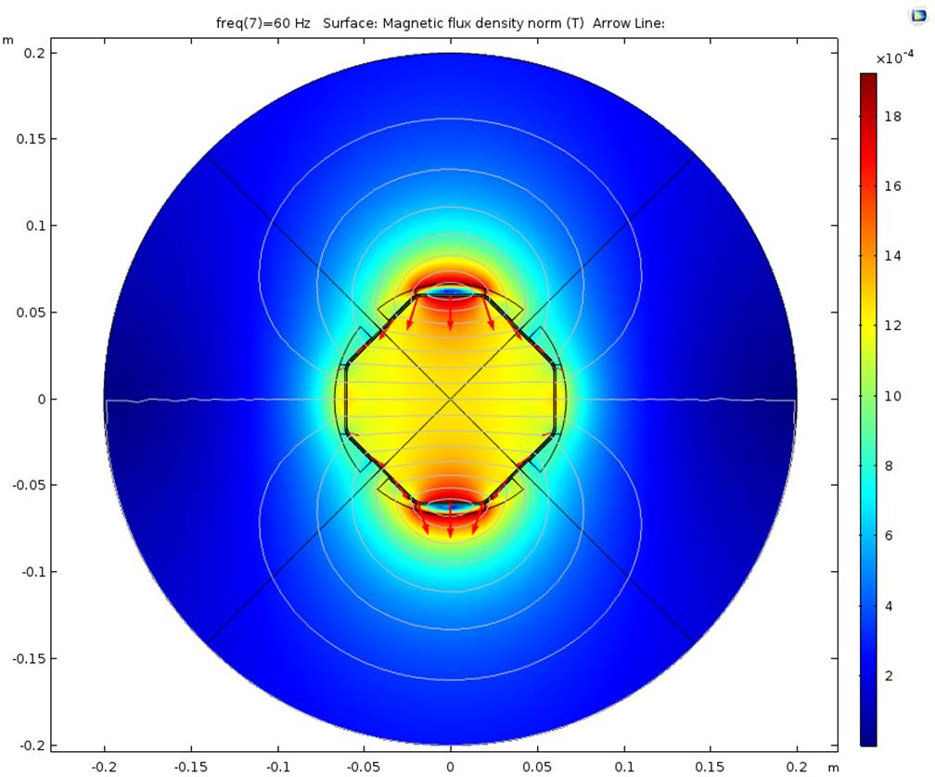
True that BS transports B field?
Imposing 10 um vertical oscillation at 60 Hz.
  Perturbation of magnetic field of ~1.3mT for a gradient of 140 T/m
@60 Hz one has damping of
  -7dB (Q1) = ~55% of field transported
  -2.5dB (Q2) = ~25% of field transported
  => I would expect 140*10^-5*0.55(or *0.25 for Q2), i.e. 0.77 mT for Q1 and 0.35 mT for Q2.
  Not too far from expectation, but about a factor 2 worst than expected.
Note: 1 mT is the field is equivalent to displace a 140 T/m quadrupole by ~7 um.
  Such an oscillation of the BS would induce about 7 beam sigma separation at IP!
Q1
Q2-Q3
1.38 mT
1.25 mT
From M. Morrone et al– email 04/03/2019

Slide 13
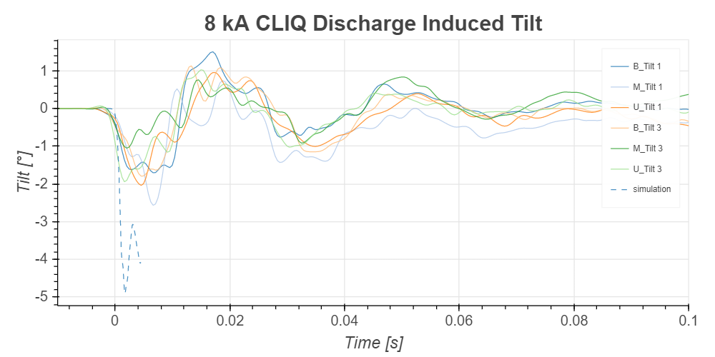
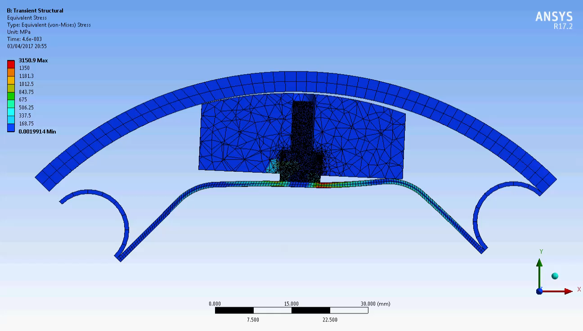
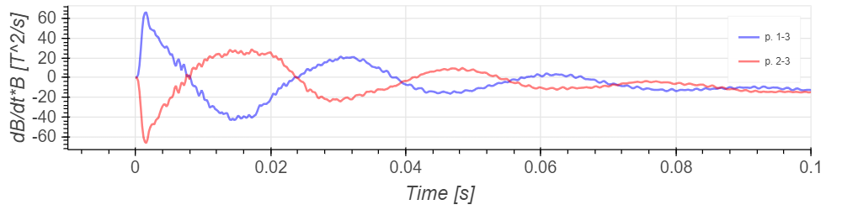
From measured Δy
B measured at r =75 mm in front of each pole.
Inside BS aperture
From M. Morrone et al– WP3 meeting [6] - link

Slide 14
Why do we care? First order effect: orbit
Impact of triplet magnetic field oscillation on beam closed orbit:
Luminosity loss [%] | 1 |  | 10 |  | ~2
 | LHC | HL-LHC | LHC | HL-LHC | HL-LHC
Orbit sep. IP1/5 [σ_{beam}] | 0.2 |  | 0.7 |  | 0.3
Necessary field. motion rms [μm] | 0.3 | 0.2 | 0.9 | 0.7 | 0.3
rms orbit @TCP* [σ_{beam}] | 0.1 | 0.1 | 0.4 | 0.4 | 0.2
rms orbit @BPM* [μm] | ~50 | ~50 | ~240 | ~240 | ~120
Numbers computed for 15cm β* optics, assuming IP1/5 triplet only source of perturbation.
  Assuming both IP triplets oscillate by the same rms amplitude in one plane only.
A reasonable threshold is 1% instantaneous luminosity loss, which correspond to about 0.3 (LHC) or 0.2 (HL-LHC) μm transverse motion of triplets’ magnetic field.
* Considering the most sensitive TCP/BPM/plane
From D. Gamba– 8th HL-LHC Collaboration Meeting 2018 [5] - link
Notes:
Exp. magnetic rms motion [μm] computed as Beam_sigma_separation/max(ampliFactorTableIP)

Slide 15
In a quadrupole, the average dipolar kick imprinted to beam depends on the mode
Integrated kick
≈ k
Integrated kick
≈ k 2/π
Integrated kick
≈ 0
Clearly, the first mode is the most “dangerous” for the beam.

