Slide 1


BNL irradiation of Mo-coated MoGR & CfC samples – plans for Post Irradiation Examination work
79th HL-LHC TCC
N. Solieri, K. Kershaw, A. Lechner, V. Vlachoudis, I. Lamas Garcia, R. Illan Fiastre, M. Calviani (EN-STI)
C. Accettura, F. Carra (EN-MME)
S. Redaelli (BE-ABP)
With invaluable contributions of many different teams within the RaDIATE International Collaboration and CERN

Slide 2
Introduction
Radiation damage effects by HE protons
RaDIATE Collaboration & sponsored BNL irradiation
Irradiation of LHC collimator materials
CERN2 BNL capsule, irradiation in early 2018
Price Enquiry for PIE in 2019-2020, description of baseline and optional activities
Conclusions

Slide 3
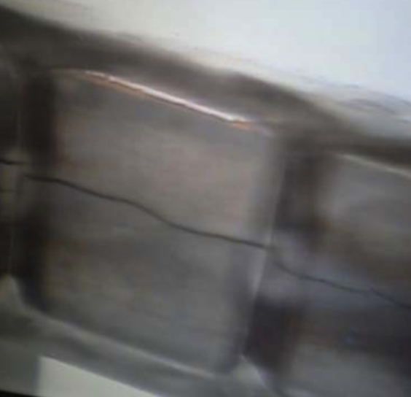
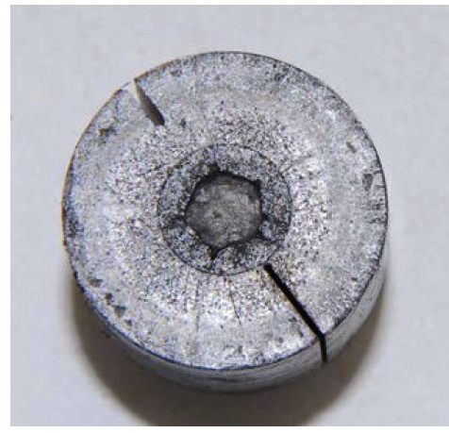
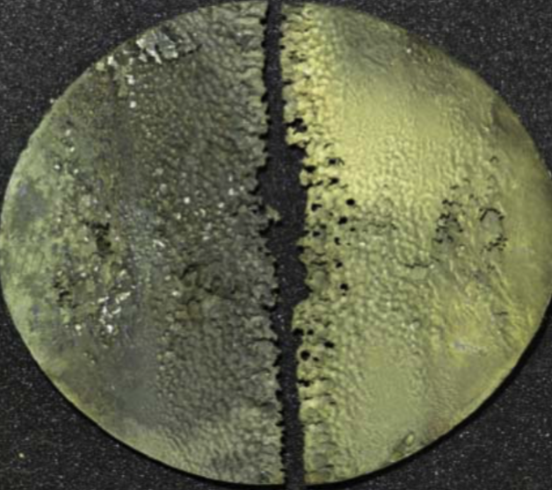
Radiation Damage studies
Recent major accelerator facilities (operational or planned) have entered an regime where BIDs survivability is at stake, limited by radiation damage on materials
  Plans for future high power, high intensity facilities will present even greater challenges
  Proton induced radiation damage is significantly different from thermal neutron damage, as encountered in the nuclear industry
To maximize the benefit of high power accelerators, these challenges must be addressed in time to provide critical input to high energy colliders as well as multi-MW beam target facilities
FNAL NuMI NT-02
CERN AD-target
ORNL Hg target

Slide 4
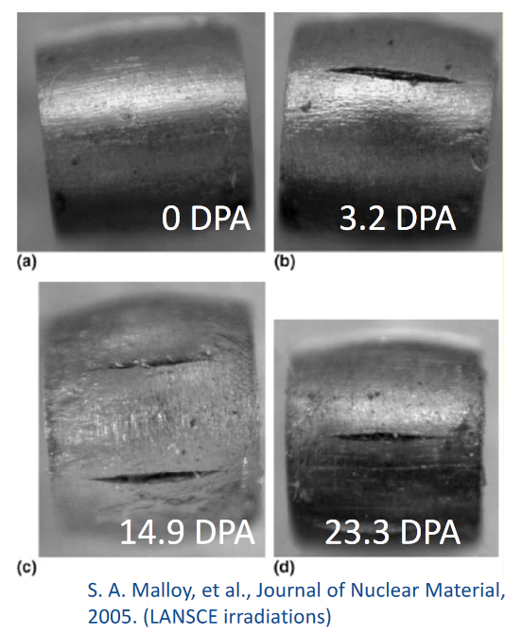
Radiation Damage Effects
Displacement in crystal lattice (expressed in Displacement per Atom – DPA)
  Embrittlement / creep / swelling
  Fracture toughness reduction
  Thermal/electrical conductivity reduction
  Coefficient of thermal expansion
  Modulus of elasticity
  Fatigue response
  Accelerated corrosion
Transmutation products
  H/He gas production can cause void formation and embrittlement (expressed as atomic parts per million per DPA, appm/DPA)

Slide 5
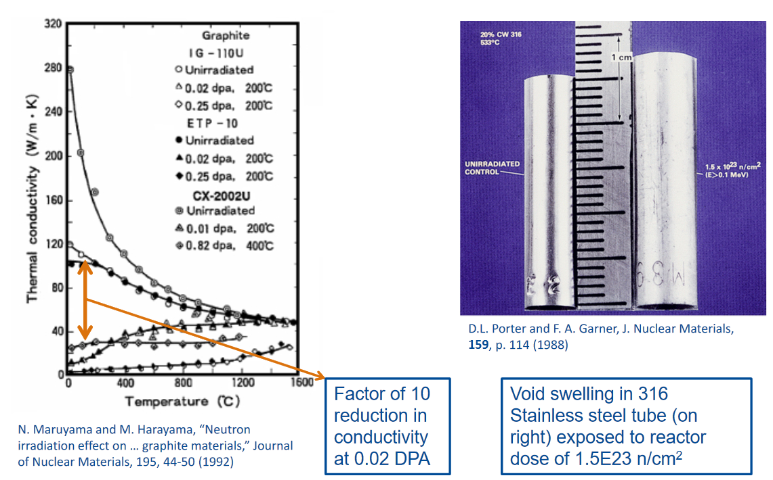
Radiation damage effects can be significant

Slide 6
Radiation Damage
Effects from low energy neutron irradiations do not equal effects from high energy proton irradiations (transmutation)
Irradiation Source | DPA rate (DPA/s) | He gas production (appm/DPA)
Mixed spectrum fission reactor | 3 x 10⁻⁷ | 0.1
Fusion reactor | 1 x 10⁻⁶ | 10
High energy proton beam | 6 x 10⁻³ | >1000
P. Hurh

Slide 7
Exploration of radiation damage effects requires high and low energy irradiation studies
High energy proton irradiations are expensive and time consuming
  Long irradiation beam times (months)
  Difficulties of Post Irradiation Examination (PIE) of highly activated samples
  Fully representative of HEP conditions
Low energy ion irradiations are inexpensive and can achieve several DPA in ~1 hour
  Low to zero activation (PIE in “normal” lab areas)
  Greatly accelerated damage rates
  BUT… they have drawbacks!
  Very shallow penetration (0.5-100 μm) → no mechanical testing possible (only hardness and micromechanics)
  Little (no) gas production (transmutation/spallation) in samples
  Dose rate effect might modify microstructure and response
Compromise would be a triple beam (simultaneous ion, H and He implantation), but still no straightforward correlation with HE irradiations

Slide 8


Slide 9
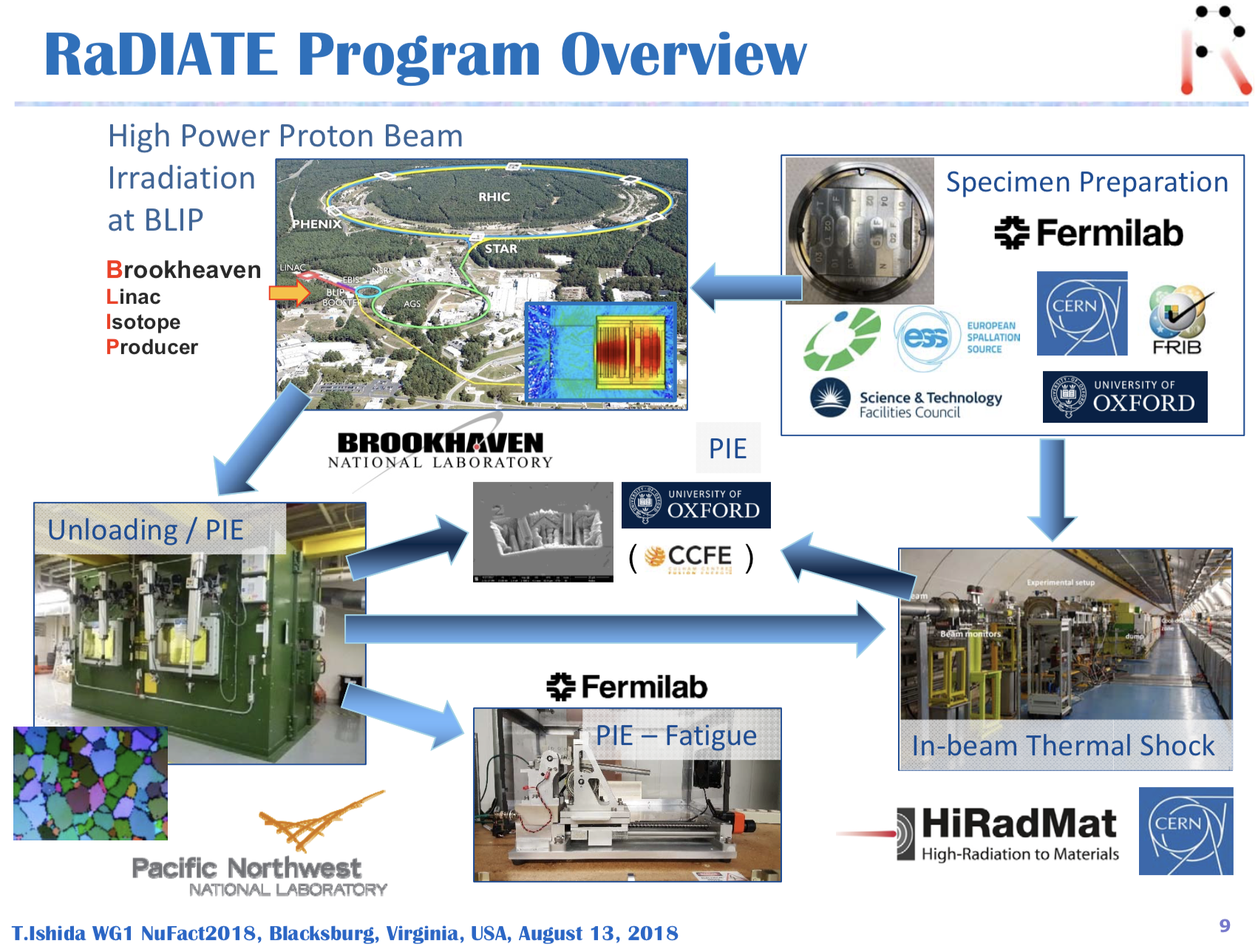
Brookhaven
Linac
Isotope
Producer

Slide 10
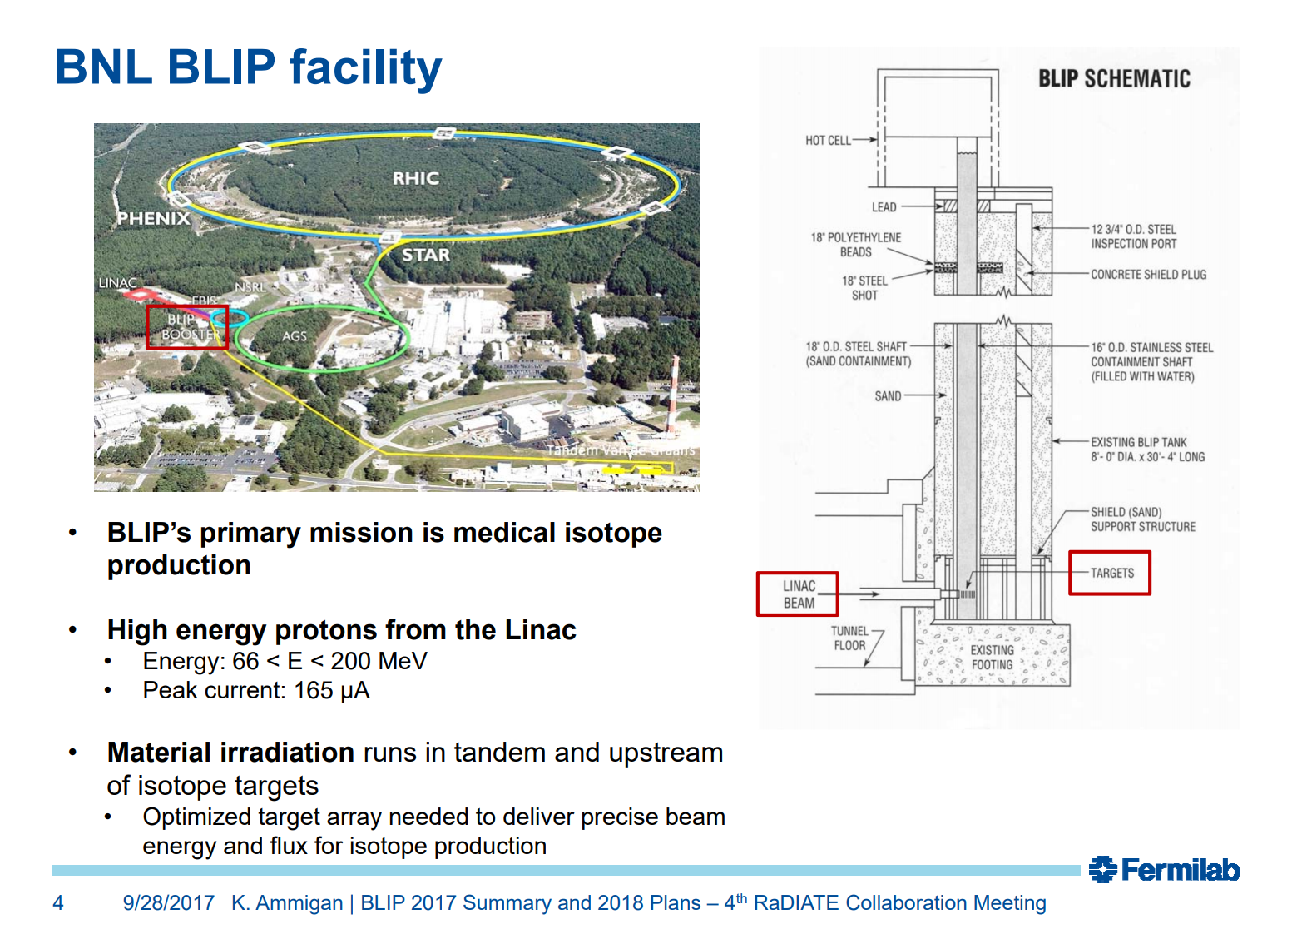

Slide 11
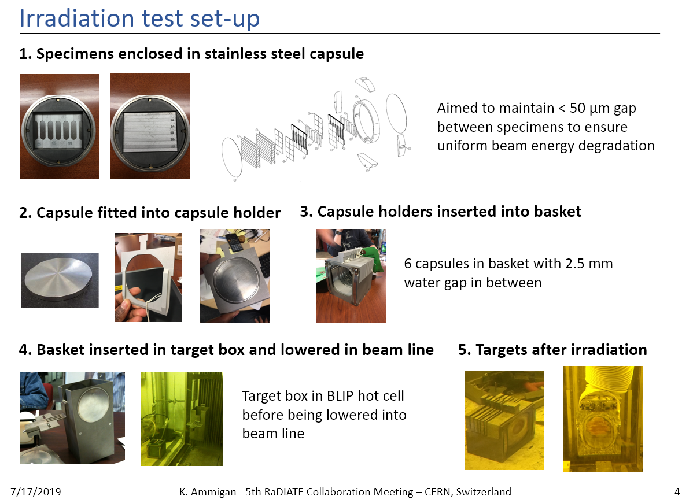

Slide 12
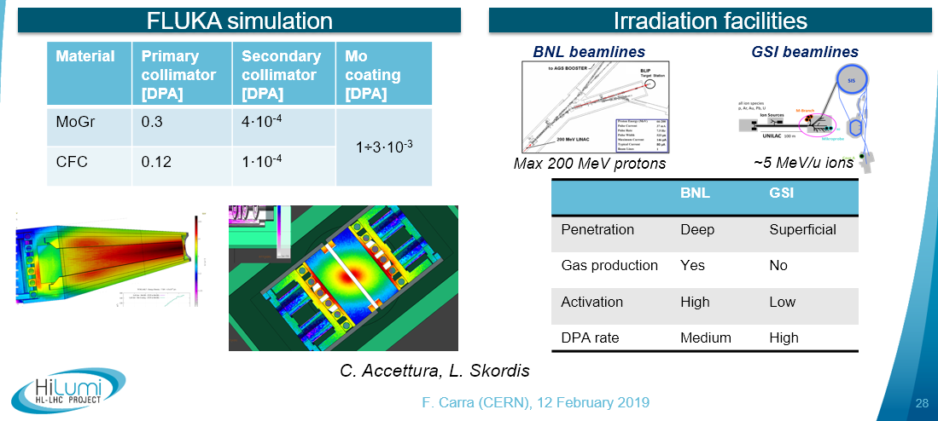

Radiation damage collimator materials
International Review of HL-LHC Collimation System, 11/12 February 2019
Gas production in HL-LHC not yet available, assuming to be in the order of magnitude of ~1000-2000 appm/DPA for graphitic materials and O(100) appm/DPA for higher-Z materials such as Mo (studies still ongoing)
Impacted area is anyhow very (very) limited

Slide 13
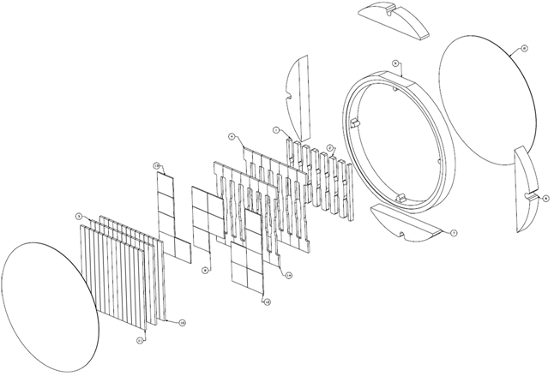
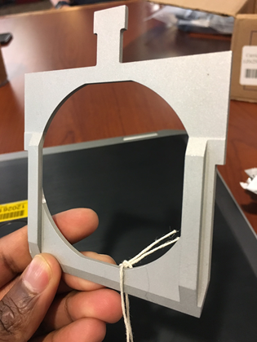
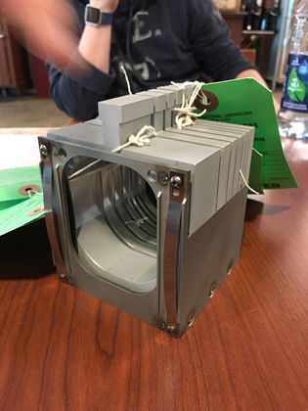
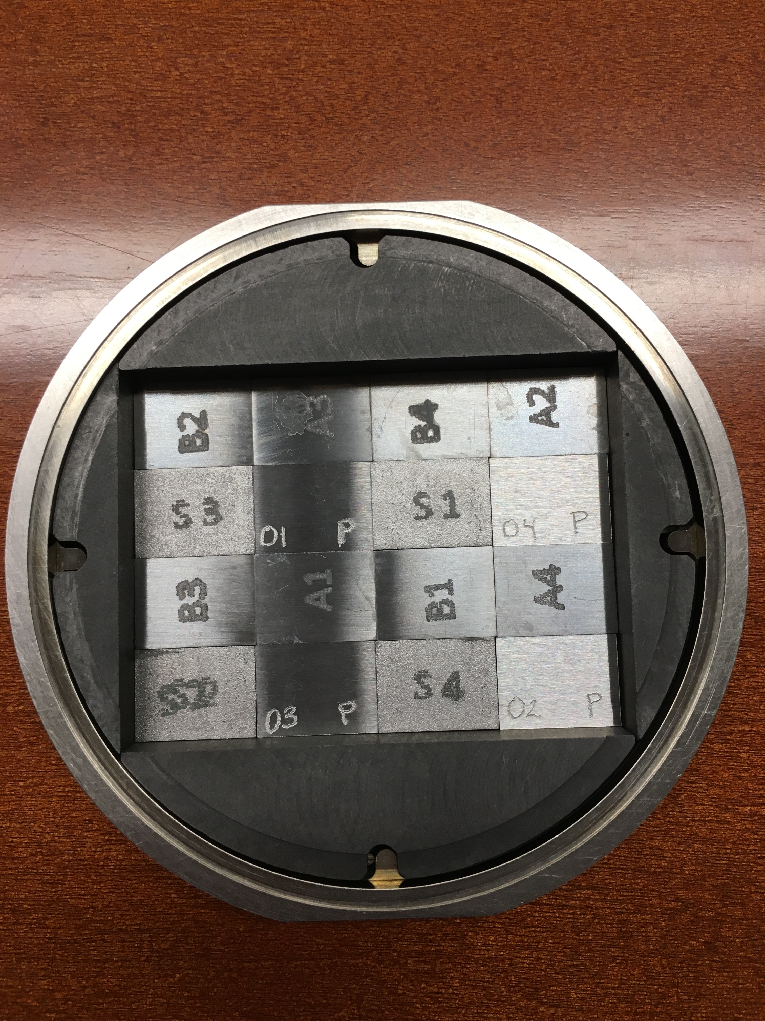
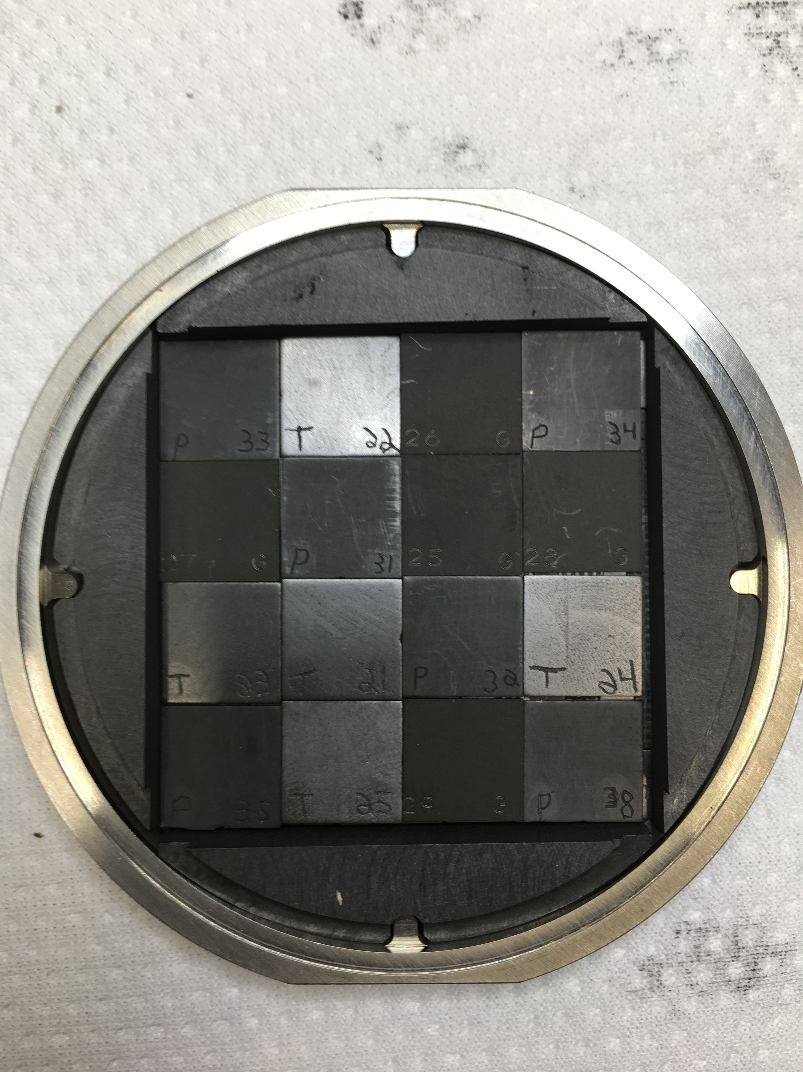
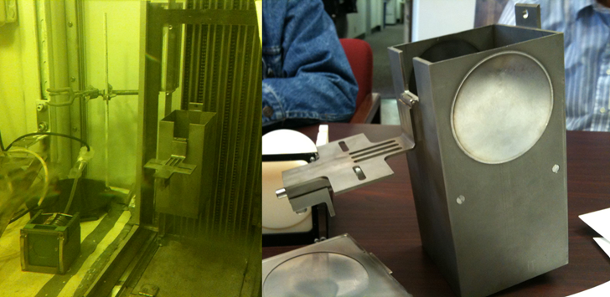
Objectives of BNL irradiation (2017-2018)
Evaluate radiation damage effects from high energy protons in various accelerator materials
  Beam windows, secondary particle production targets, collimators, beam dumps
Perform PIE activities to characterize property changes due to proton irradiation damage
Gas production (i.e. swelling) representative of running facilities
Capsule holder and basket
Specimen layers in graphite capsule
Beryllium (12 x 9 mm)
Graphite
(10.5 x 10.5 mm)
Target box and BLIP hot cell

Slide 14
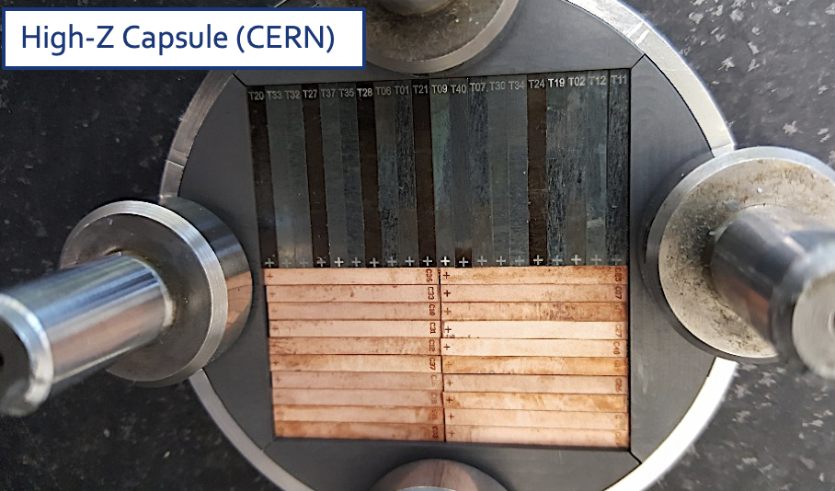
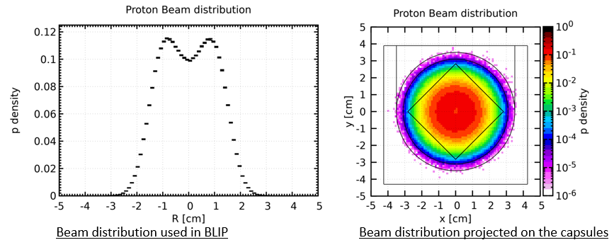
Status of RaDIATE samples and perspectives
1st phase RaDIATE-sponsored irradiation (2017)
  1.76 x 10²¹ POT in 22d @146 mA average
2nd phase RaDIATE-sponsored irradiation (January-March 2018)
  2.81 x 10²¹ POT in 33d @158 mA average
Beam time fully paid by Fermilab partner via RaDIATE
CERN capsule(s) built and financed by BDF Project

Slide 15
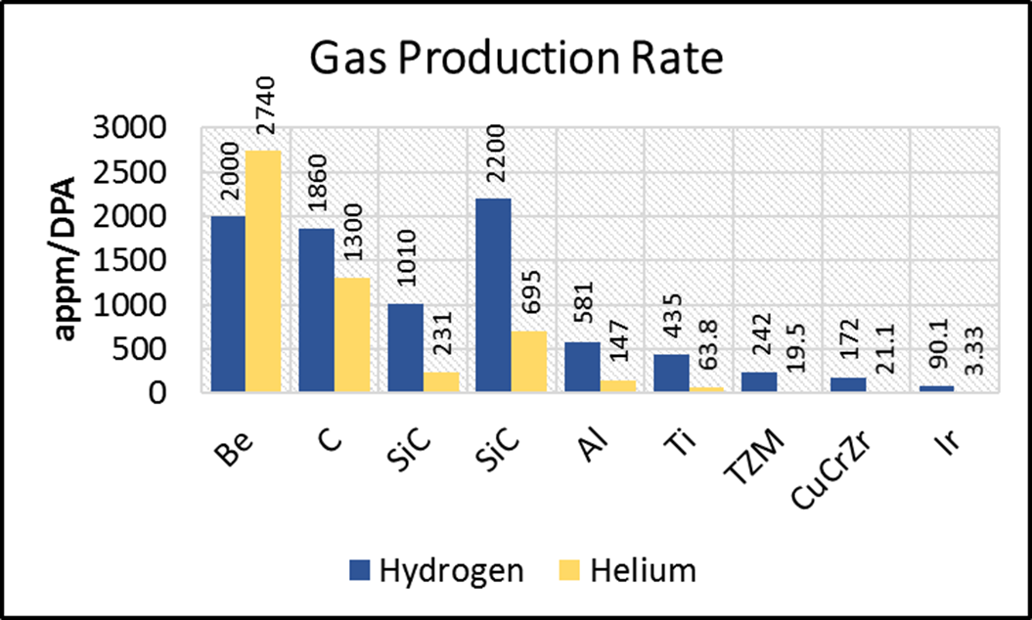
DPA received over the two BNL runs
Material | Capsule | DPA (Nordlund)
Beryllium | Be (FNAL) | 0.06
Graphite | C (FNAL) | 0.11
Aluminum | Al (ESS) | 0.71
Titanium | US Ti (KEK) | 1.53
Silicon | Si (CERN) | 0.19
SiC | Si (CERN) | 0.12
Graphite | Si (CERN) | 0.04
Exp. Graphite | Si (CERN) | 0.04
Titanium | DS Ti1 (KEK) | 0.25
TZM | High-Z (CERN) | 1.11
CuCrZr | High-Z (CERN) | 1.18
Iridium | High-Z (CERN) | 2.75
Panasonic C | High-Z (CERN) | 0.04
TaW | CERN 2 | 4.77
CfC-Mo | CERN 2 | 0.06-0.08
MoGr-Mo | CERN 2 | 0.06-0.09
Silicon | CERN 2 | 0.32
Flex C | CERN 2 | 0.08
Titanium | DS Ti2 (KEK) | 0.95
Final values pending capsule opening to confirm beam position

Slide 16
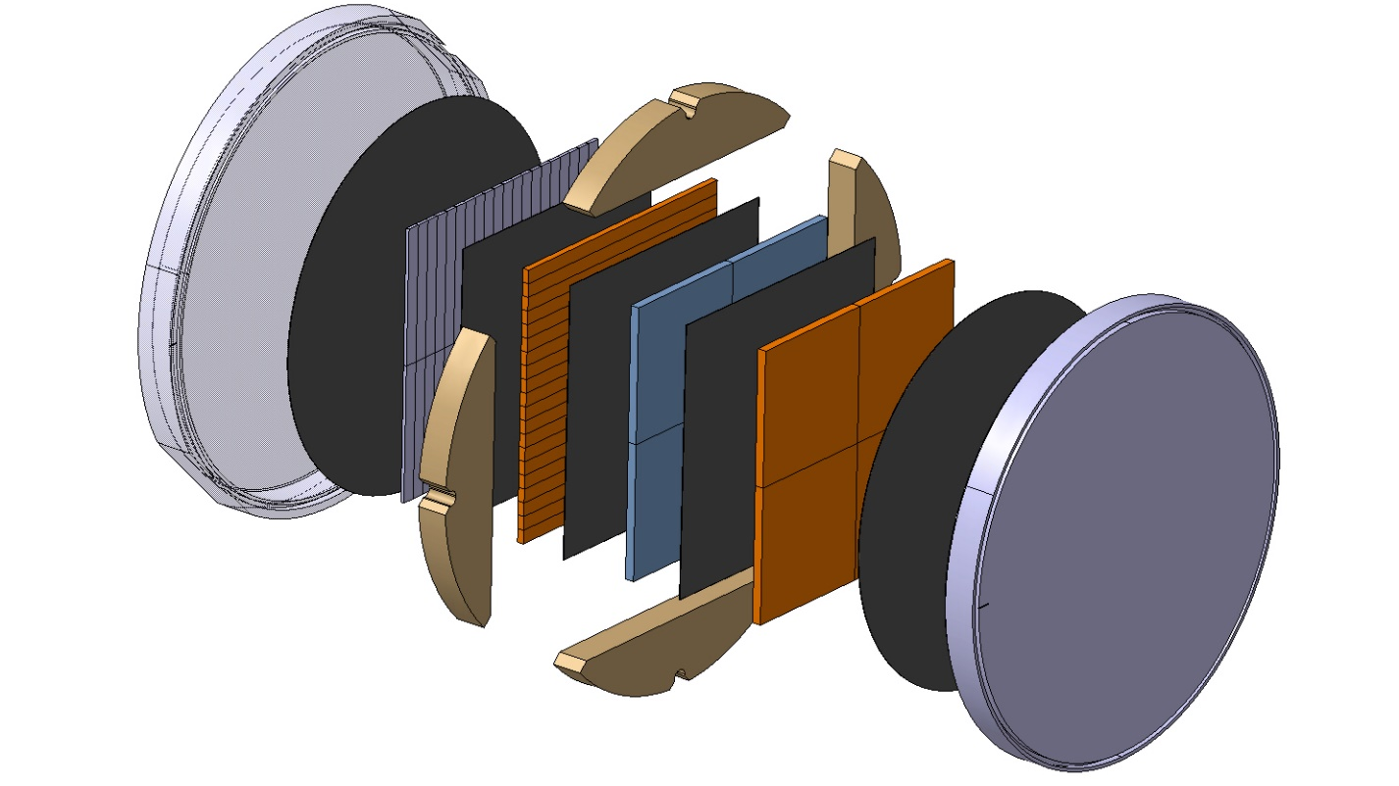
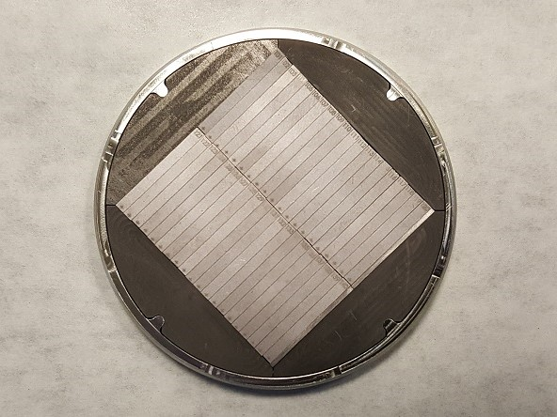
CERN BNL Run #2
Mo-coated CFC & MoGr (8 μm)
  Test: Mo adherence on CFC vs MoGr + optional tests (see later for details)
  Opportunistic material irradiation
  Irradiation temperature estimated at ~230 °C (peak)
TaW (2.5%)
  Used as cladding material for BDF target
Monocrystalline Silicon
  Used for crystal collimation
Systematic use of PGS graphite to increase thermal contact conductance (TCC)
0.5 TaW
1 Si
1.35 CfC
1.35 MoGr
4.5 C
0.1 PNG

Slide 17
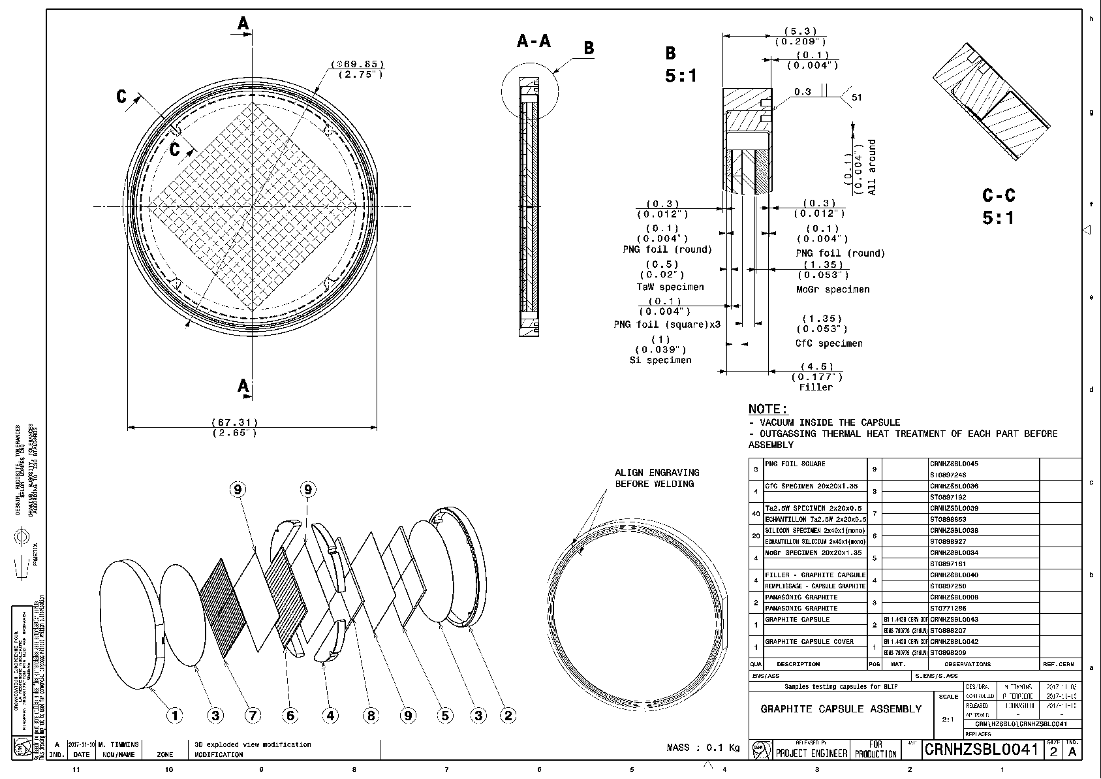
https://edms.cern.ch/document/2114690/1

Slide 18
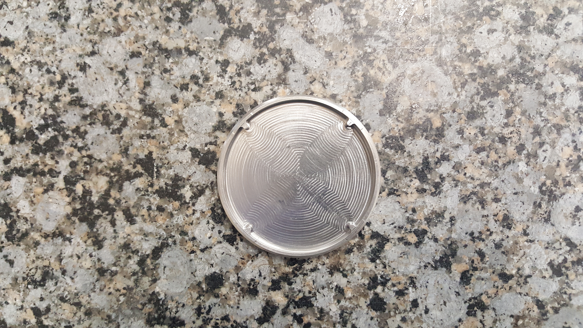
Machined bottom capsule
~7 cm

Slide 19
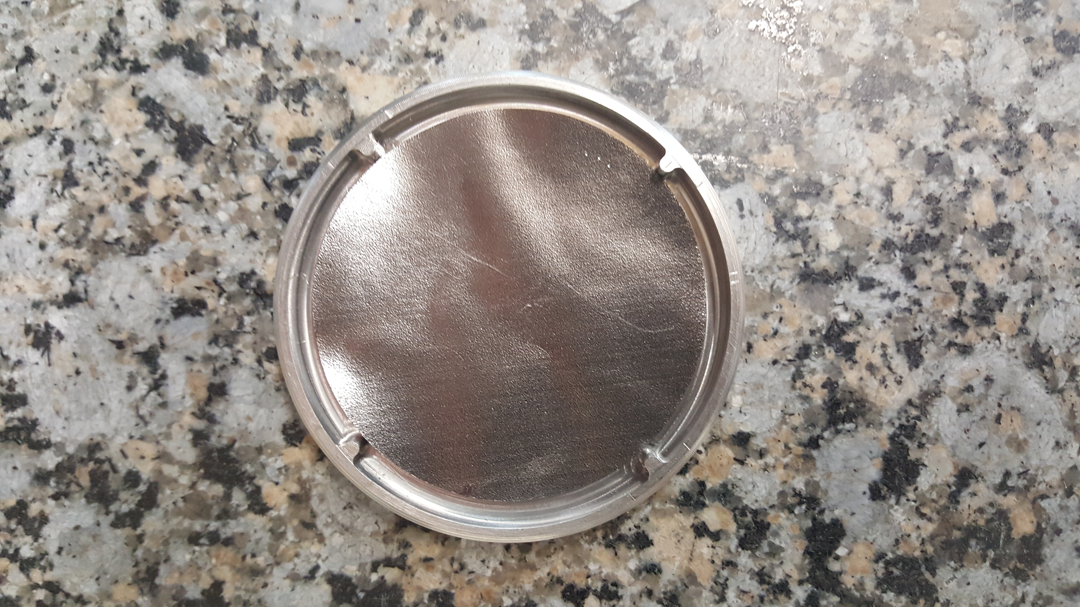
PGS foil

Slide 20
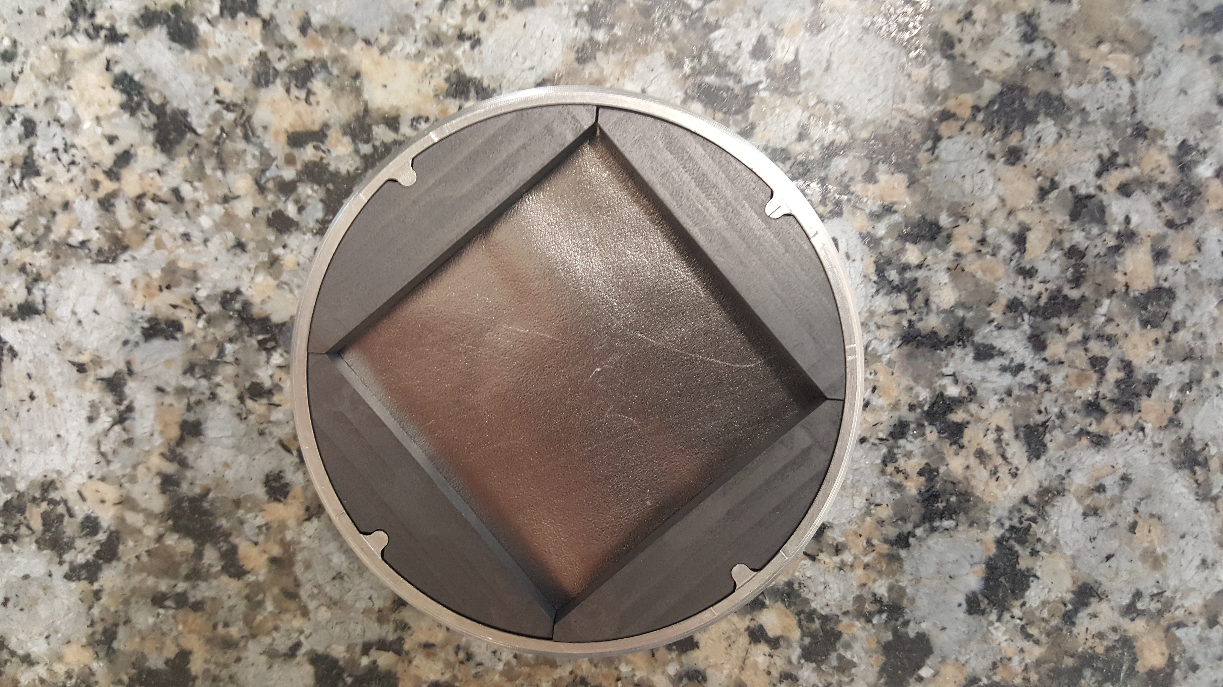
Graphite spacers

Slide 21
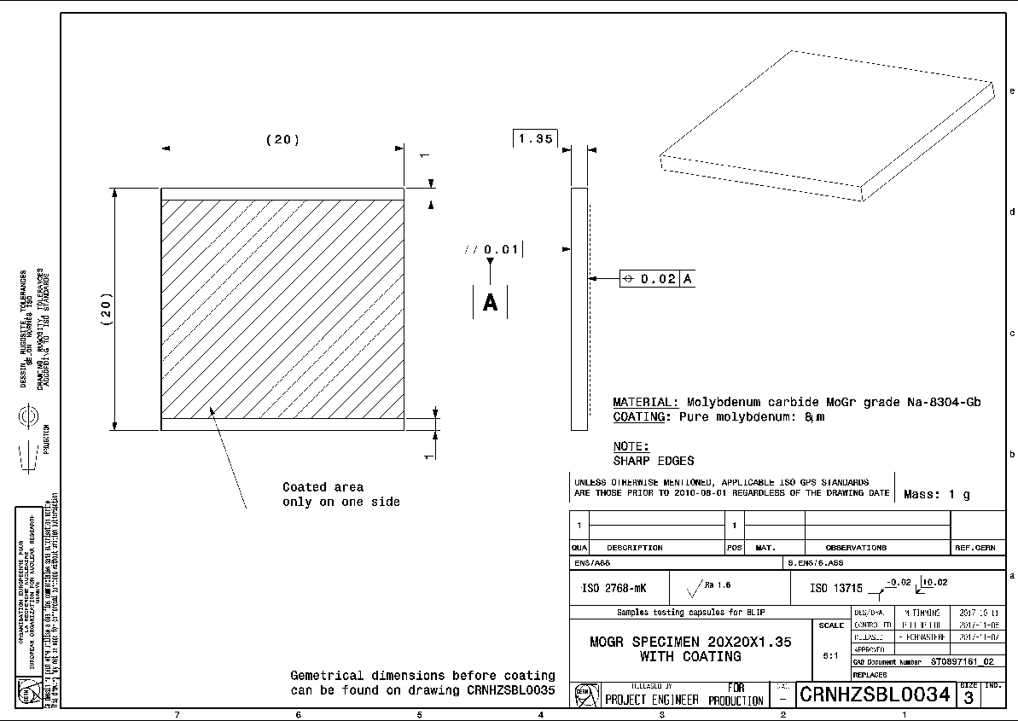
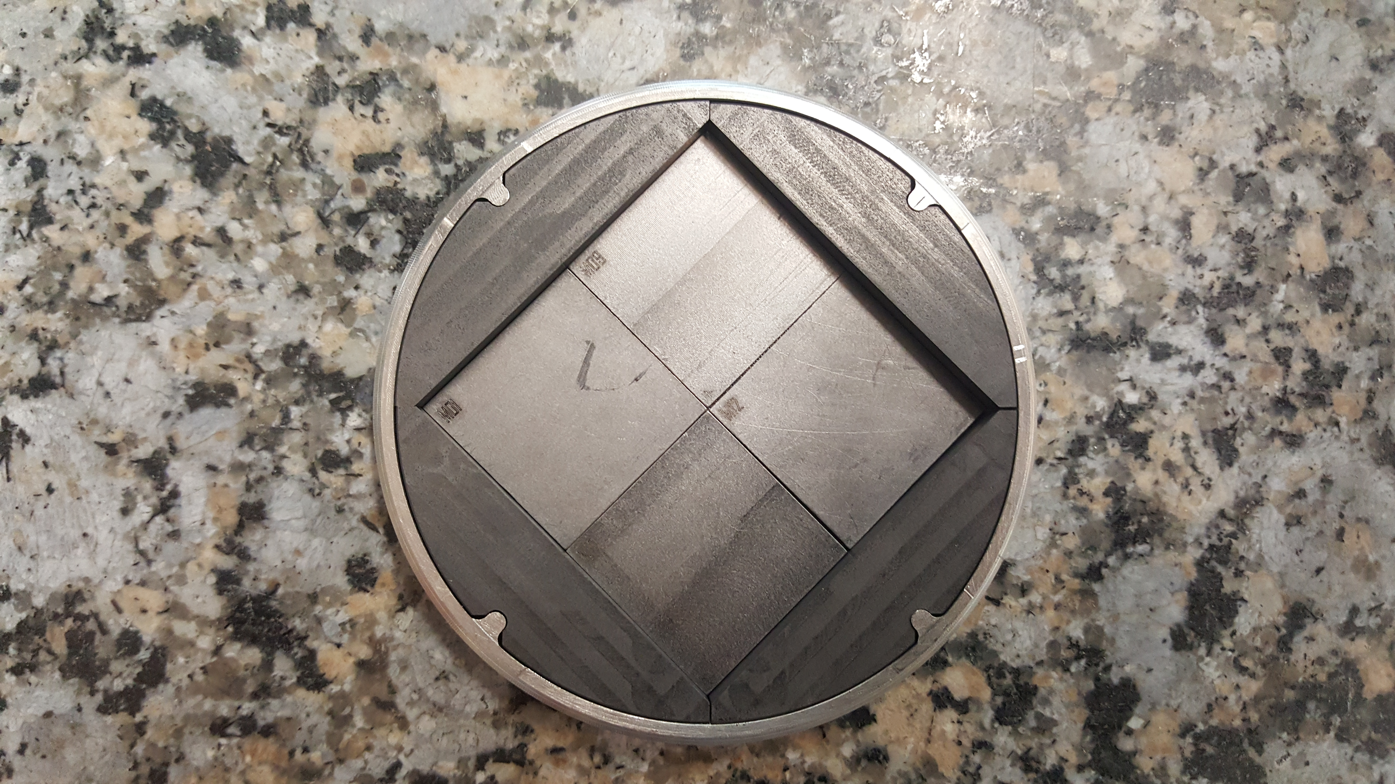
Mo coated MoGR

Slide 22
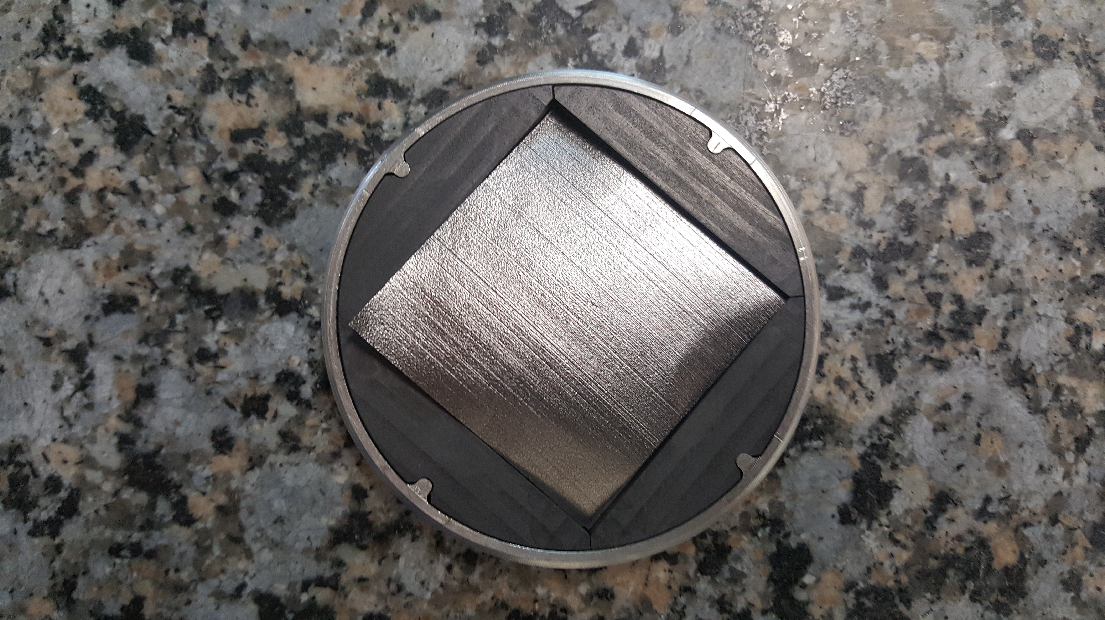
PGS foil

Slide 23
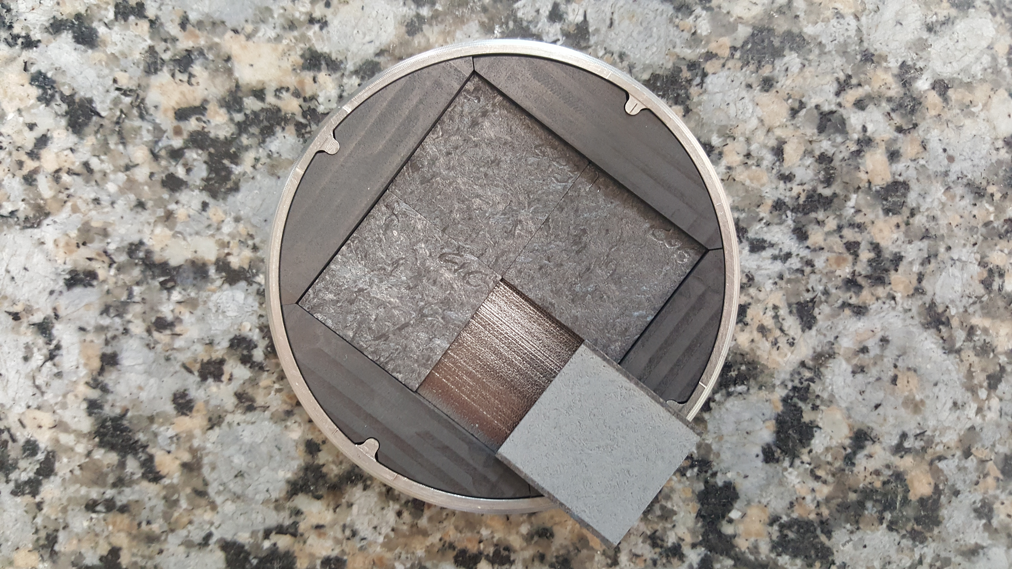
Mo coated CfC

Slide 24
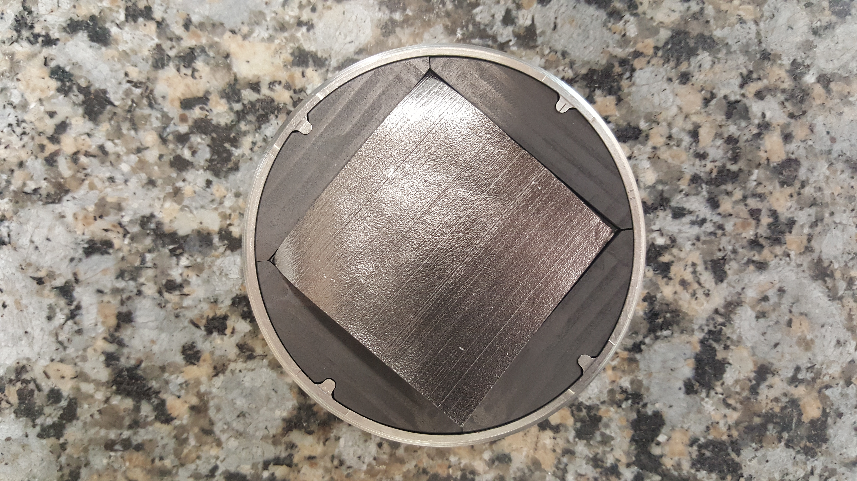
PGS foil

Slide 25
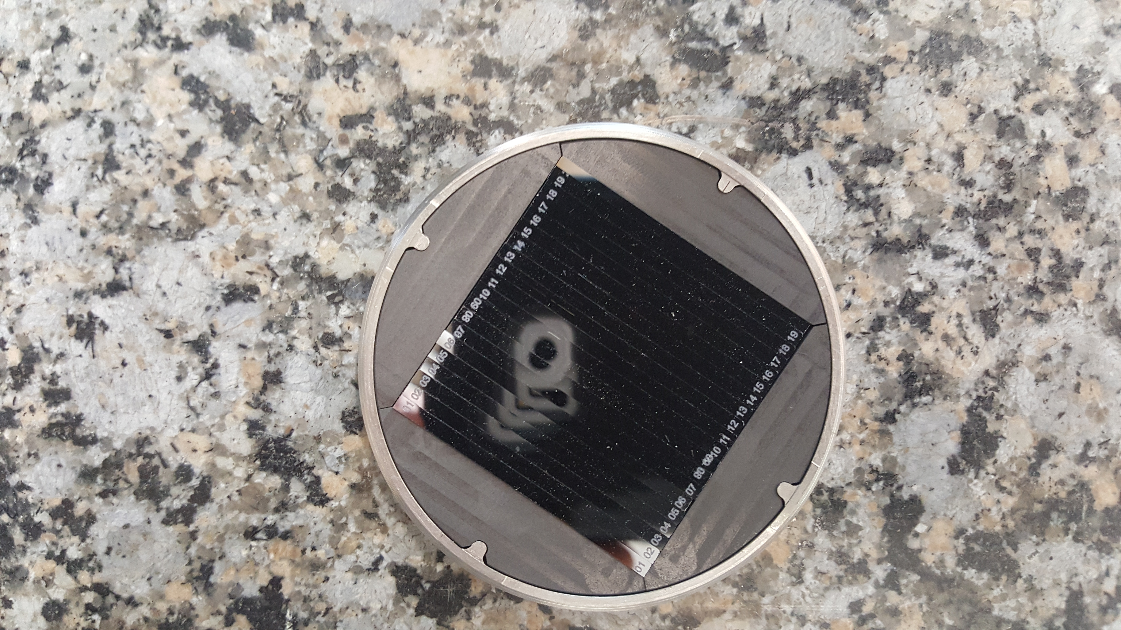
Monocrystalline Si

Slide 26
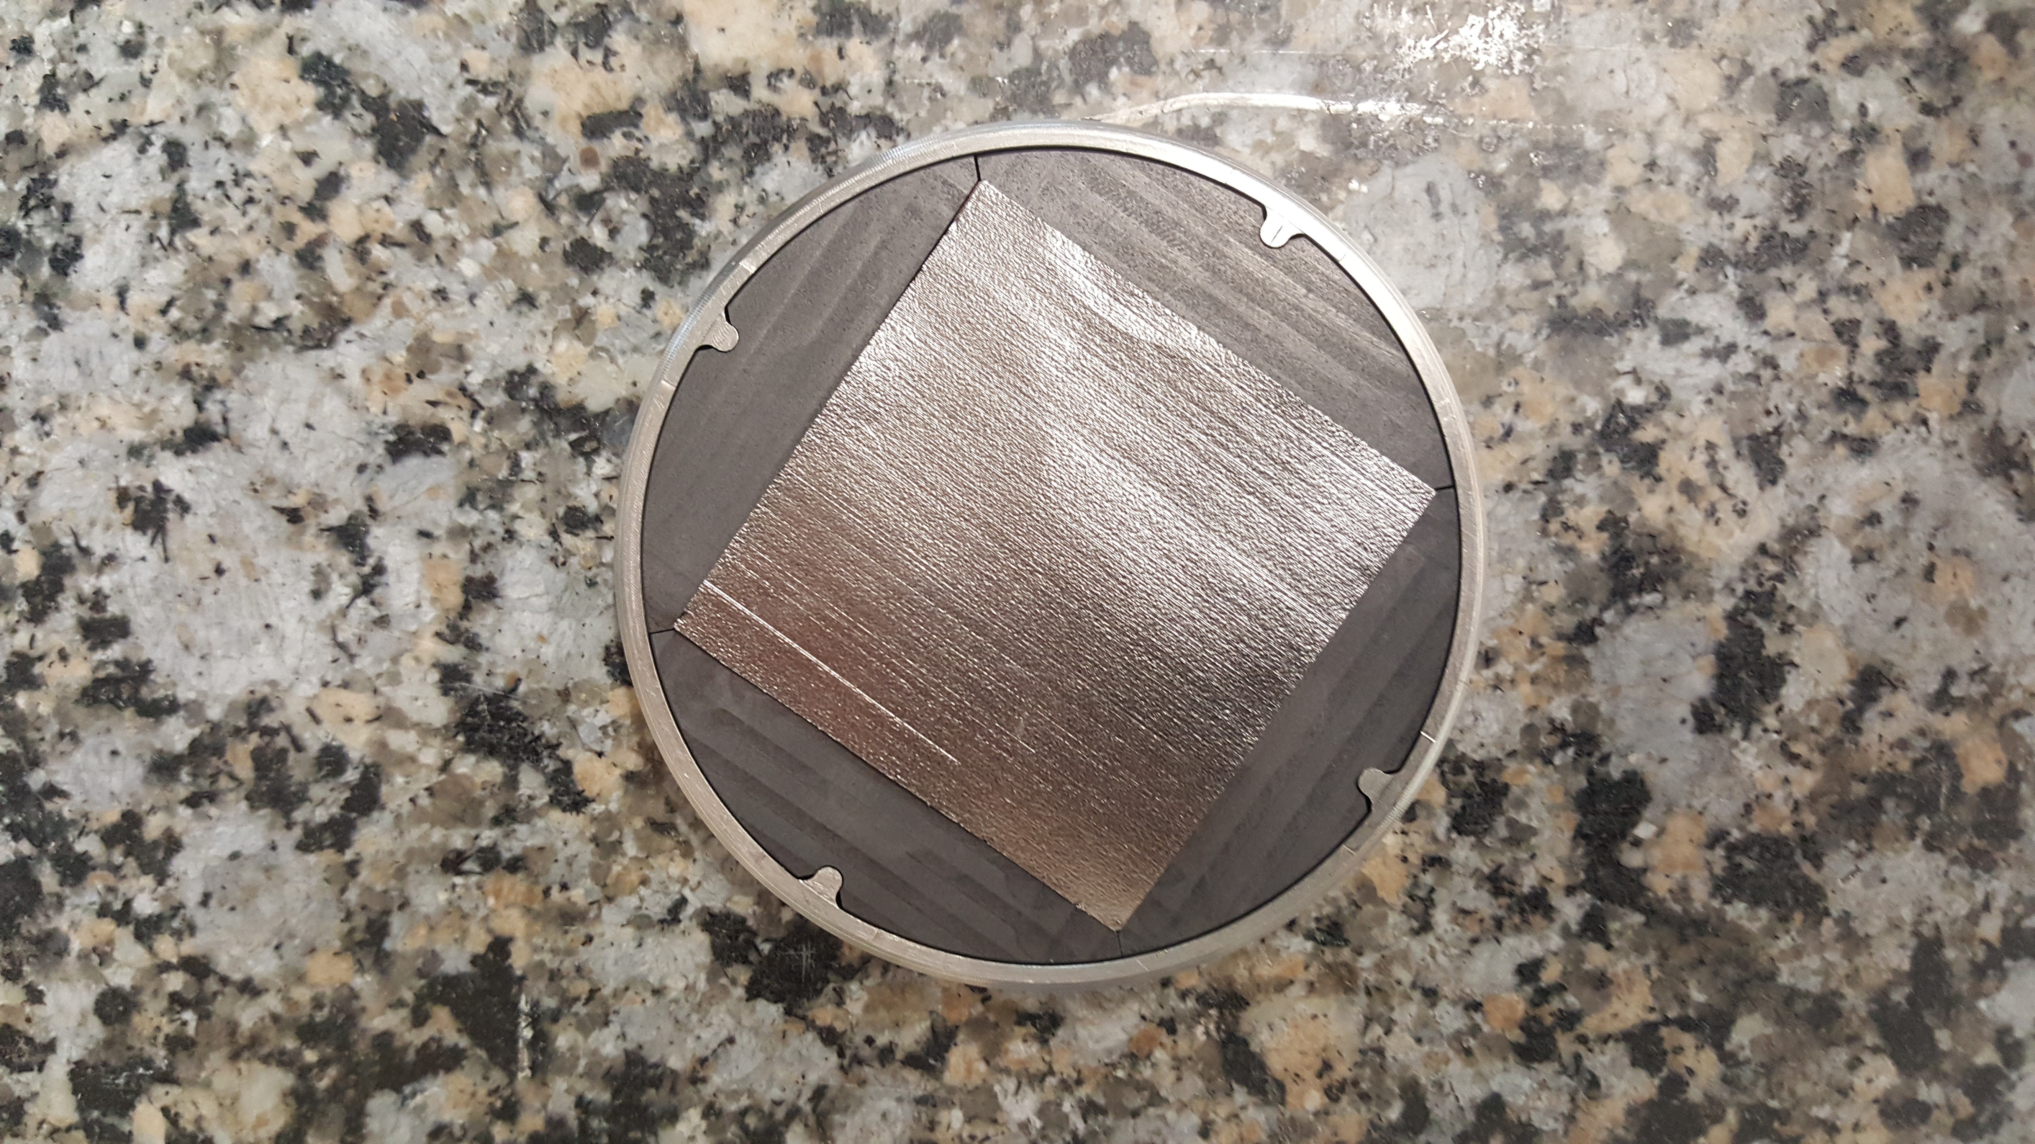
PGS foil

Slide 27
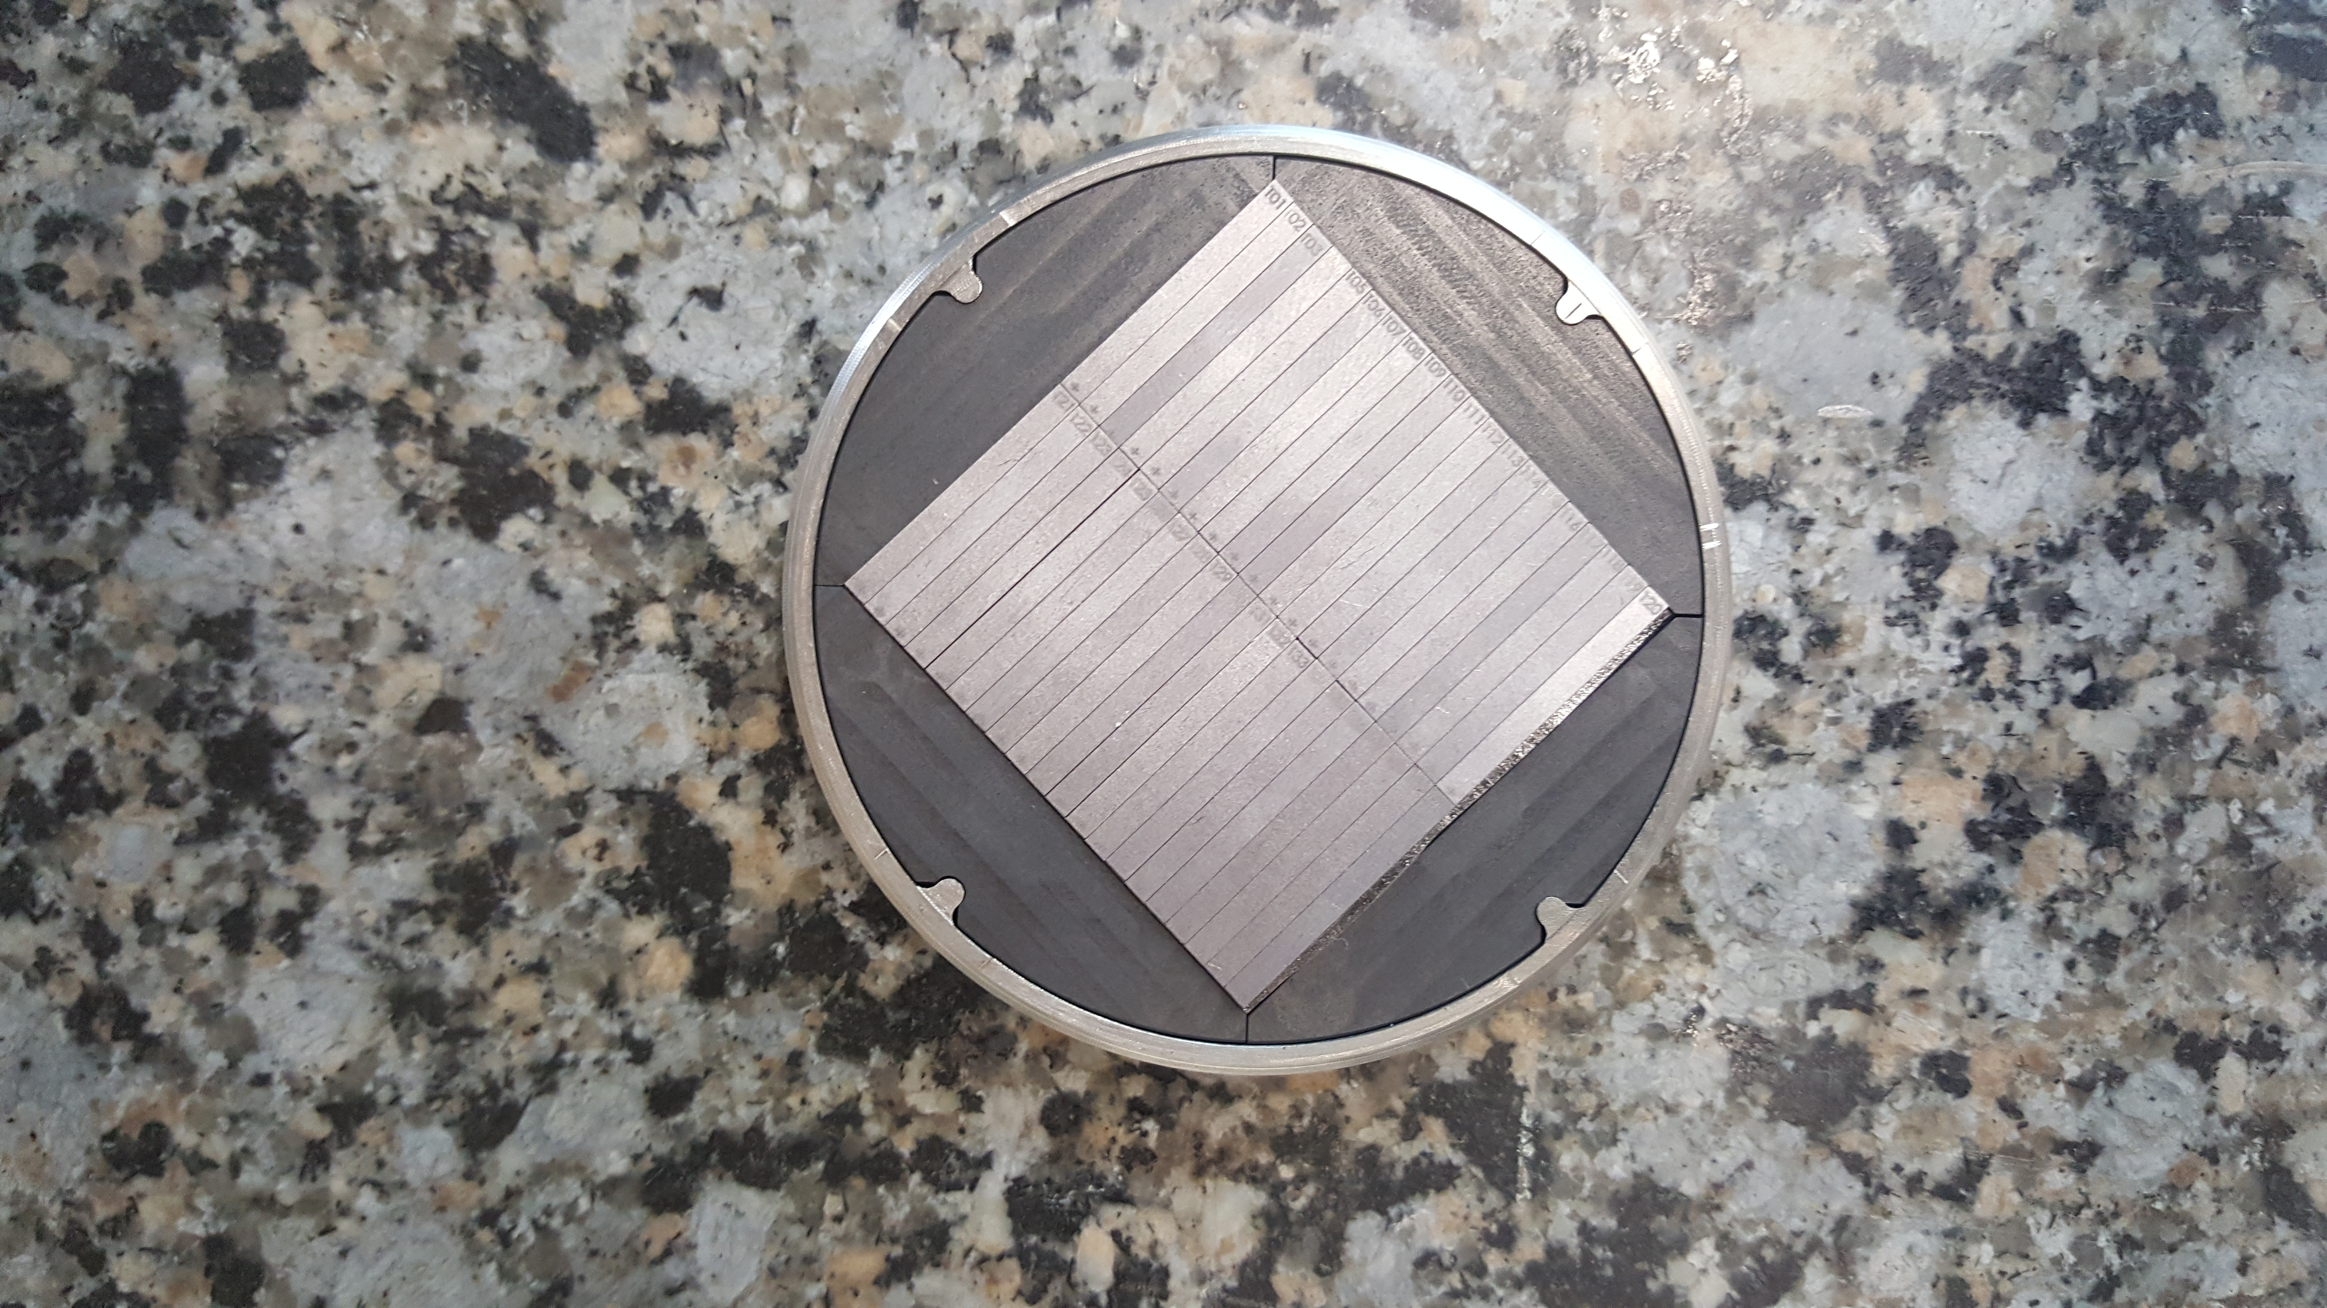
TaW

Slide 28
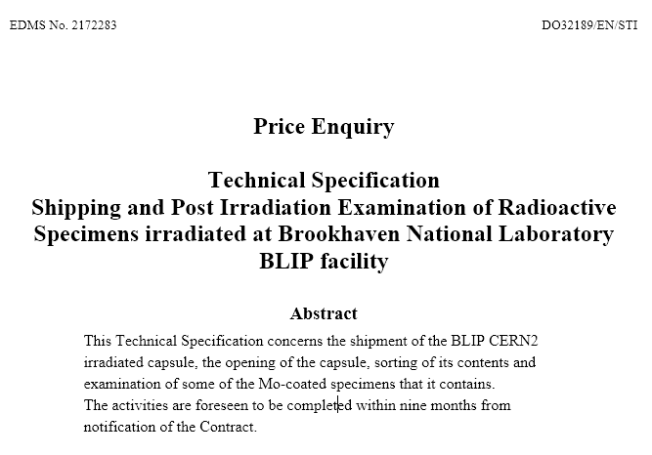
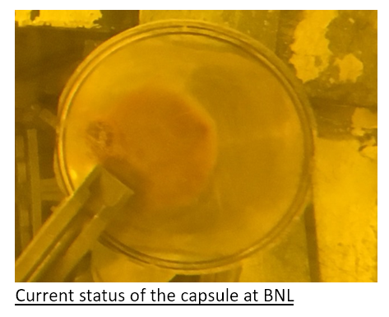
Post Irradiation Examination of Mo-coated graphite samples
HL-LHC WP5 officially approved the request for PIE of CERN2 capsule end of February 2019
Departmental request issued afterwards (DR-7711538/EN/HL-LHC) and approved in April 2019, after further definition of scope during WP5 PSM on 26.03.2019
Focus on Mo-coated MoGR + visual investigation of Mo-coated CfC

Slide 29

Scope of the contract – baseline activities
Shipment of the capsule to the contractor facility
Opening of the capsule
  Preparation of opening procedure
  Evaluation of applicability of opening procedure when CERN2 capsule is unloaded in the hot-cell
  Validation of opening procedure on spare CERN2 capsule supplied by CERN
  Extraction, sorting and storage of specimens
Examination of MoGR/CfC samples
  Visual inspection on 4 Mo-coated MoGR and 4 Mo-coated CfC specimens
    Photographic documentation of the samples to show possible macroscopic damage to the bulk and coating
  Coating adhesion test on 2 Mo-coated MoGR specimens
Transport of all specimens from contractor facilities to CERN

Slide 30
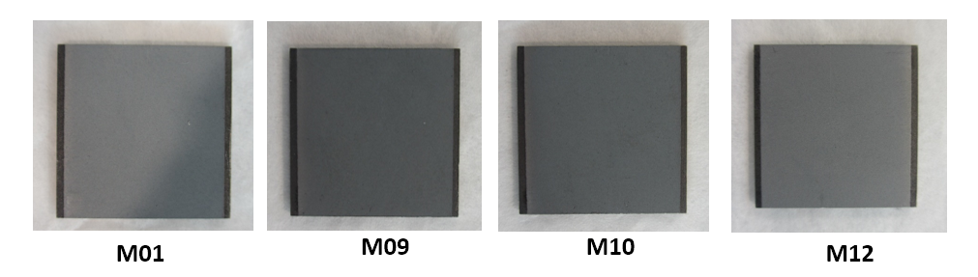
Visual inspection of MoGR and CfC specimens
Pictures of the specimens to show possible macroscopic damage of the 4 Mo-coated MoGR specimens and 4 Mo-coated CfC specimens
  Structural integrity of specimens
  Permanent deformation and geometry changes
  Presence of cracks on the coated and uncoated side
  Macroscopic loss of coating adherence
  Blistering in correspondence of the coating/uncoated surface

Slide 31
Coating adhesion test of two Mo-coated MoGR samples
Purpose → Evaluation of the adherence of the Mo coating to the substrate after irradiation and comparison with the results observed for the non-irradiated material
Subject → 2 of the 4 Mo-coated irradiated MoGR specimens
  PAT handy adhesion tester conforming to ISO 14916:2017
  Adhesion test following ASTM D3359-09, method B with perpendicular cuts
Aspect of interest:
  Value (MPa) at which the dolly detachment from the specimen occurs (if the test is performed with PAT handy)
  Location of the rupture (in the coating-bulk interface or in the bulk?)
  Pictures of the fracture surface
A spare Mo-coated MoGr specimen will be supplied by CERN

Slide 32
Scope of the contract – optional activities
Optional activities (cost driven, will NOT be part of the adjudication phase)
  Density Evaluation
  Electrical conductivity measurement of bulk and coating (ND)
  Thermal diffusivity measurement of bulk material at room temperature (ND)
  Microstructural investigation of bulk and coating with X-ray diffraction (ND)
  Microstructural investigation of bulk with Raman spectroscopy (ND)
  Microstructural investigation of bulk/coating interface (S/D)
  Elastic modulus measurements of the coating by indentation (D)
  Elastic modulus measurements of the bulk (D)

Slide 33
Proposed PIE contract schedule
Project green light end of February 2019, DR approved in April 2019
Price enquiry → out by end of July 2019
Contract establishment foreseen ~middle September 2019
Visual inspection to be carried out by early 2020 (challenging, mainly due to transport of the (highly) radioactive package!!!)
Adhesion test → To be completed by summer 2020
Optional tests to follow if requested (less pressure, less costs)
Timeline requested by WP5 is (very) tight

Slide 34
Possibility for future HE irradiation at BNL
WP5 asked to investigate the possibility to execute another campaign with Mo-coated and Cu-coated isostatic graphite (7550 from SGL)
  Employed in all other BIDs (TDIS, TIDVG, etc.) and potential candidate for LS3
2020 RaDIATE test run at BNL (low DPA)
  Likely required to contribute also to a fraction of the beam time cost (something not done for BLIP1 and BLIP2 RaDIATE irradiation)
  Dedicated run & capsule, to be optimized for HL-LHC WP5 needs and requirements (temperature, materials, thicknesses, geometry, etc.)
  Great opportunity to establish a good link between HE and ion irradiation (hardness, micromechanics, etc.)
  Decision to be taken in the coming weeks in order to be ready
If successful, longer run to be foreseen during 2021-2022
Further discussions at the 2019 RaDIATE Collaboration Meeting
Next steps to be decided rapidly if we don’t want to miss the slot

Slide 35
Conclusions
Post Irradiation Examination of Mo-coated CfC & MoGR samples currently being launched with an external contractor
Critical point is the shipment from BNL to contractor premises – type A transport always time consuming, but we remain confident
Results of the visual inspection (on Mo-coated CfC+MoGR) foreseen for early 2020
Coating adhesion tests (Mo-coated MoGR only following WP5 request) will follow towards summer 2020
Variety of optional tests could be activated depending on costs and WP5 requirements

Slide 36
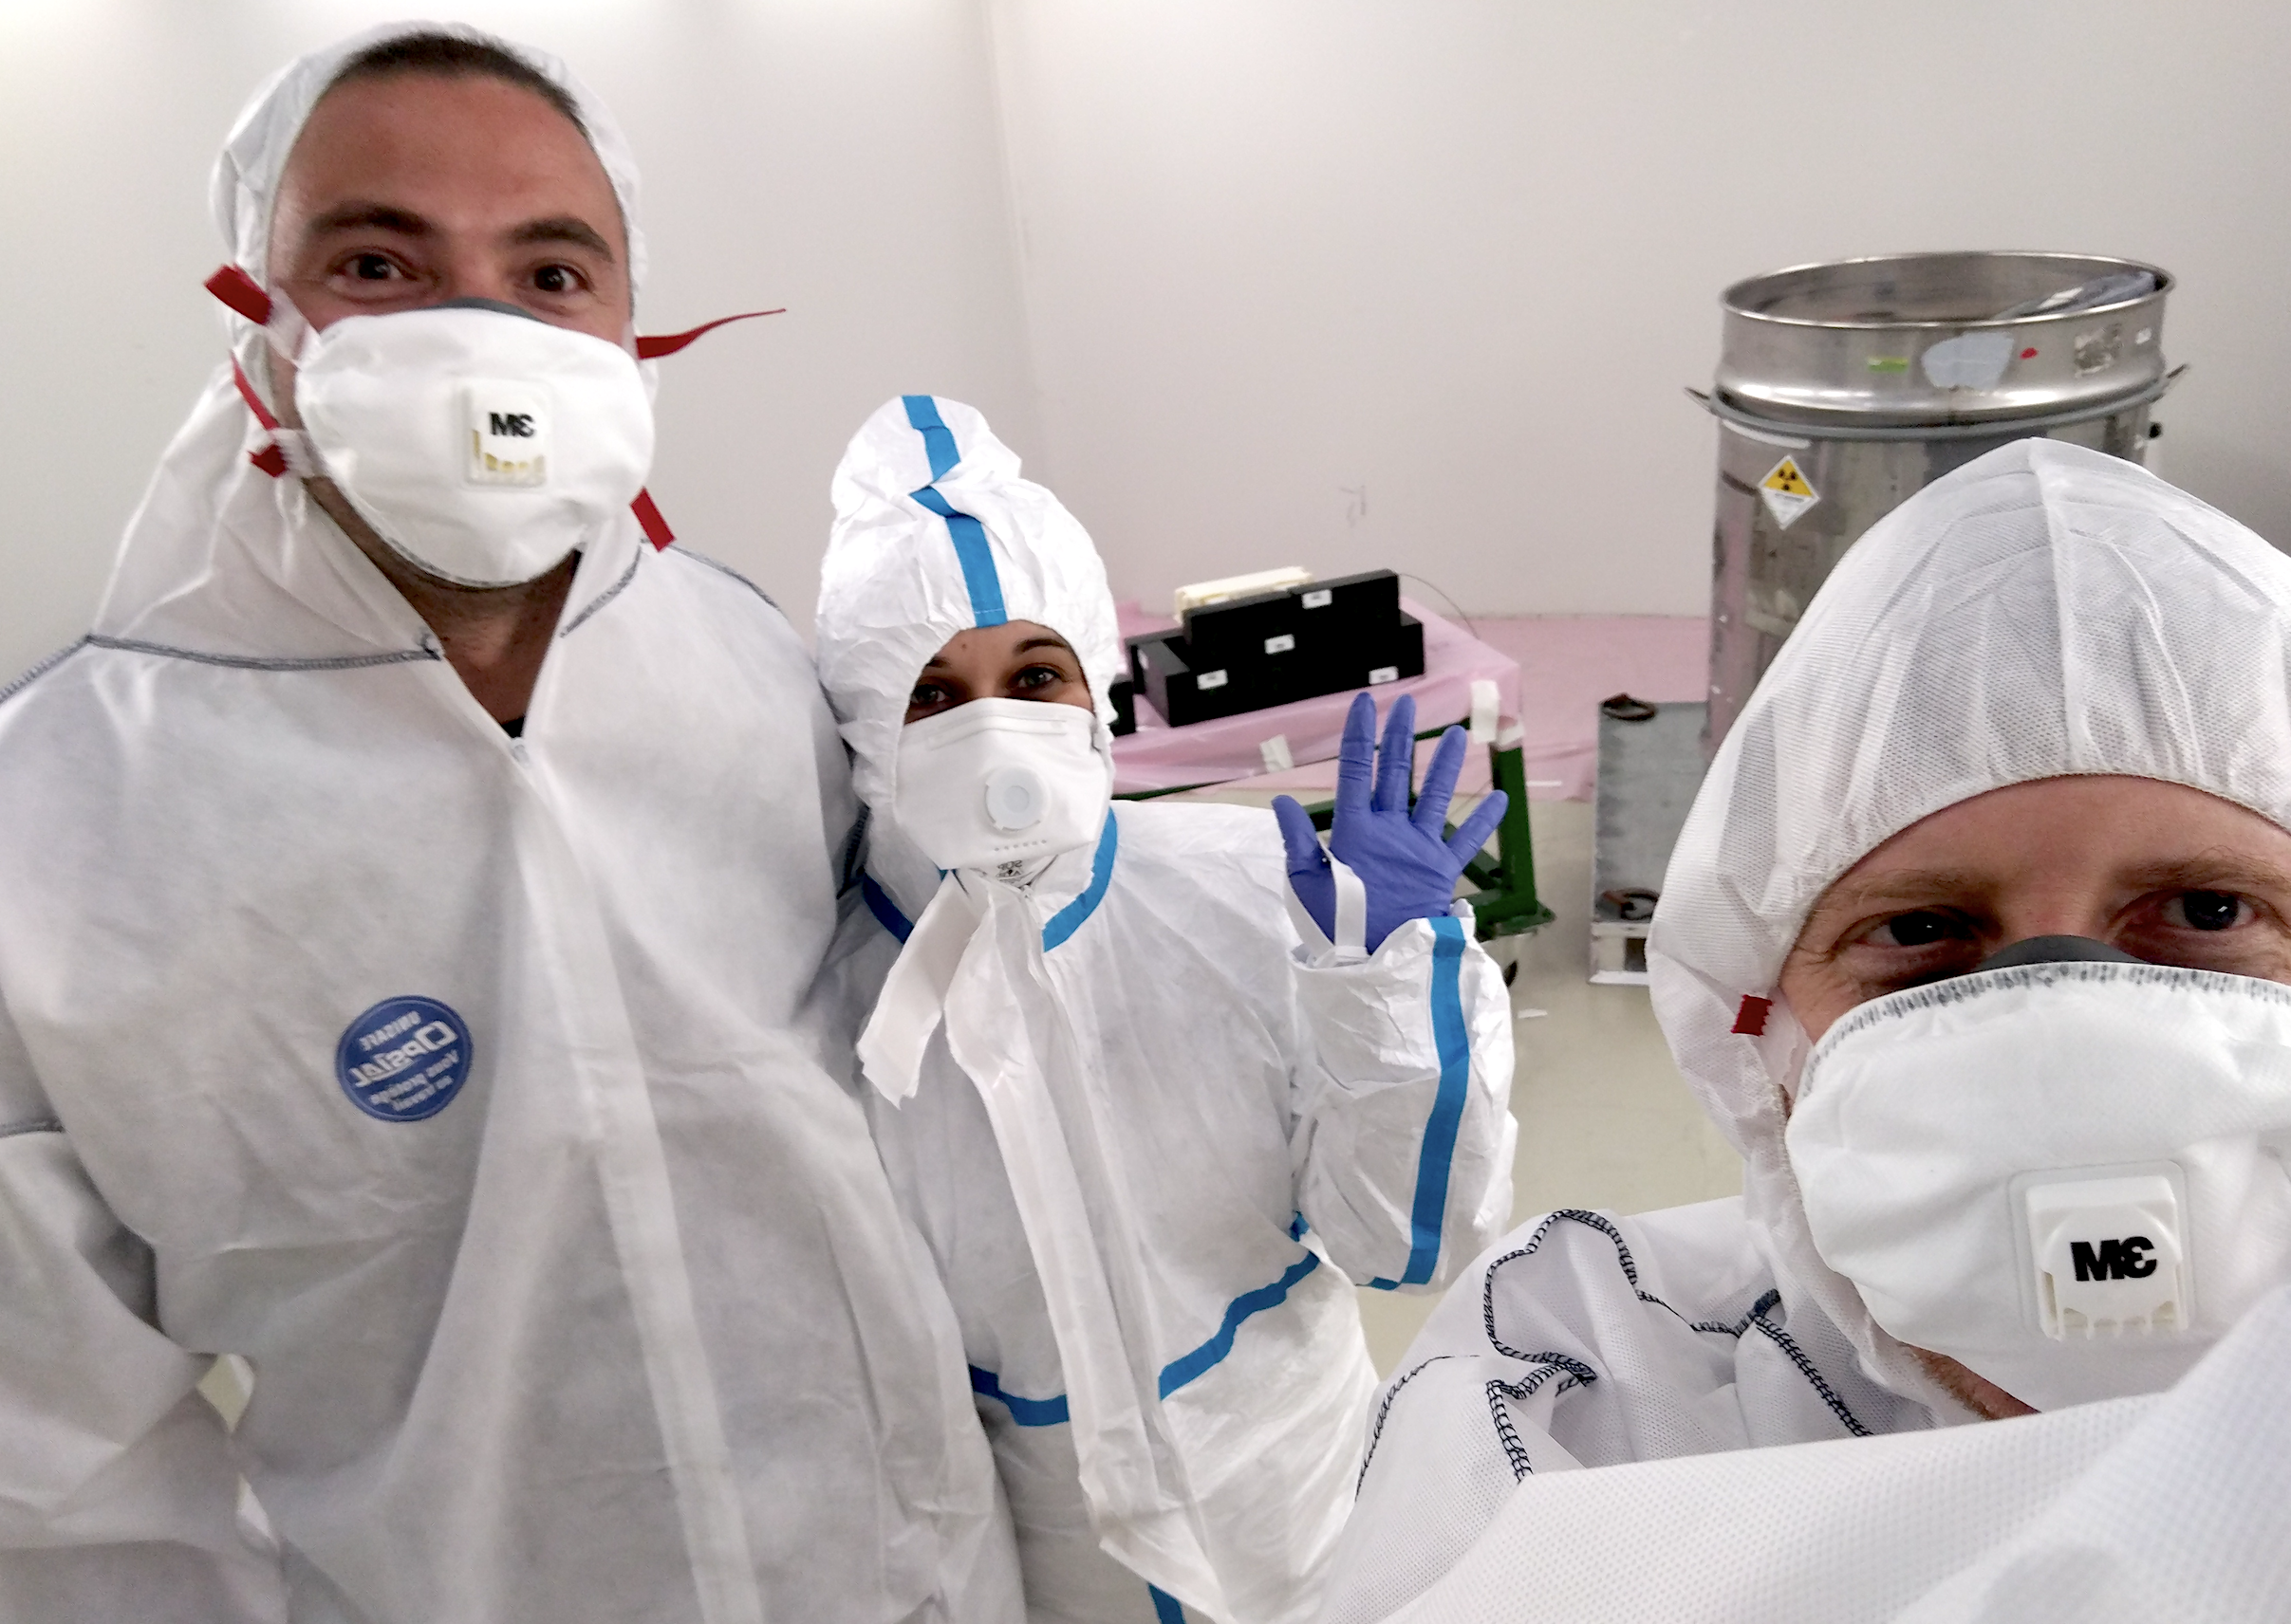
Thanks!

Slide 37
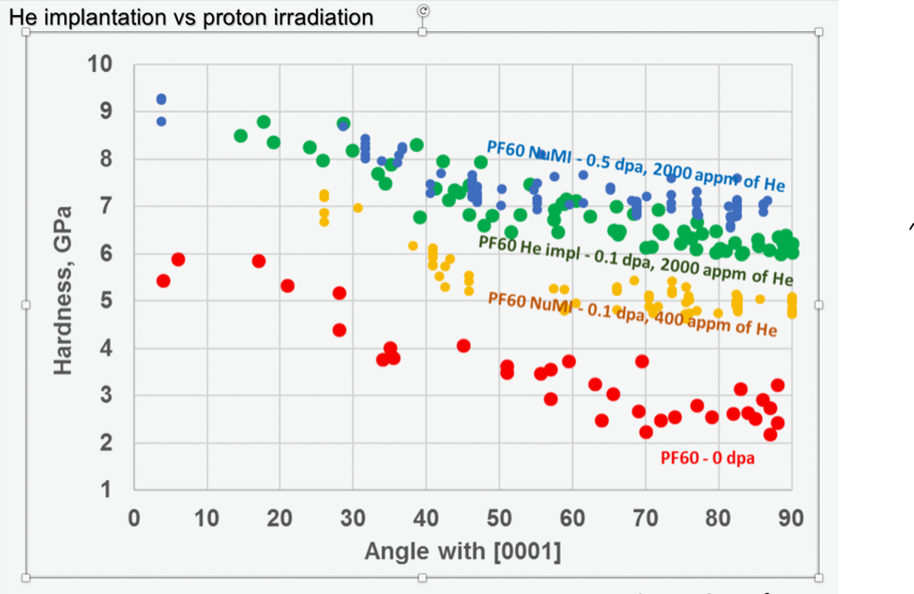
p⁺ vs. ion vs. He implantation on Be
Nano-indentation data comparing a beryllium window from NuMI beamline at Fermilab
Comparison of proton irradiation and He implantation data indicates dominating He content on the material hardness
Why He is a problem? It has low solubility in the crystal lattice, hence accumulating at defects, dislocations and at grain boundaries, leading to swelling or embrittlement

Slide 38
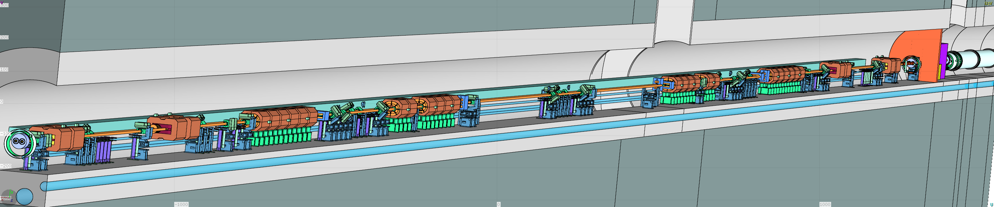
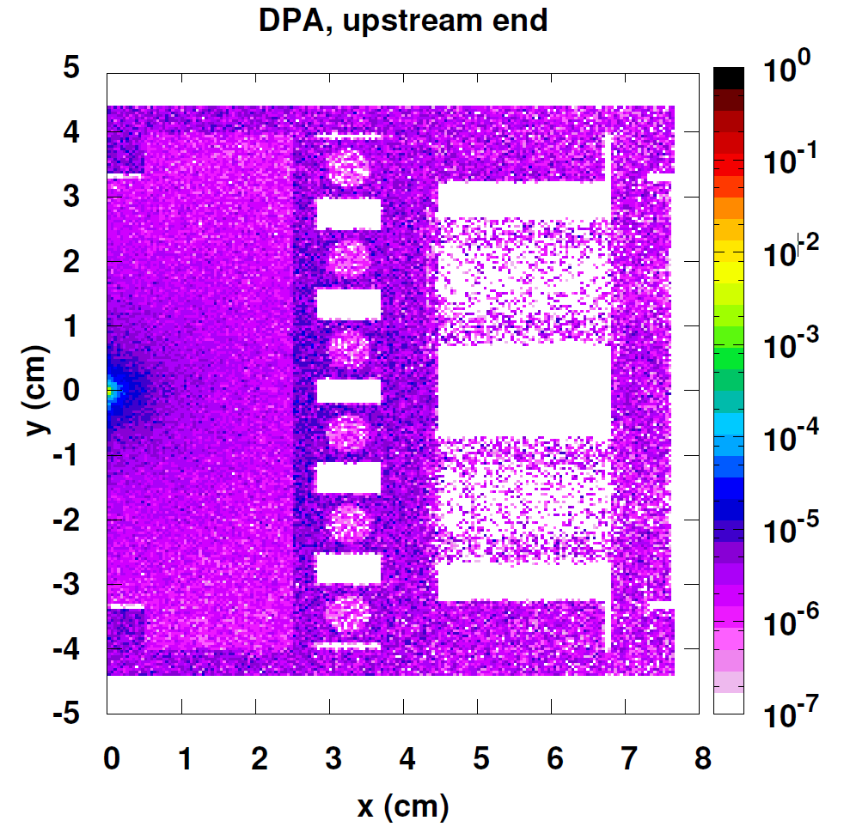
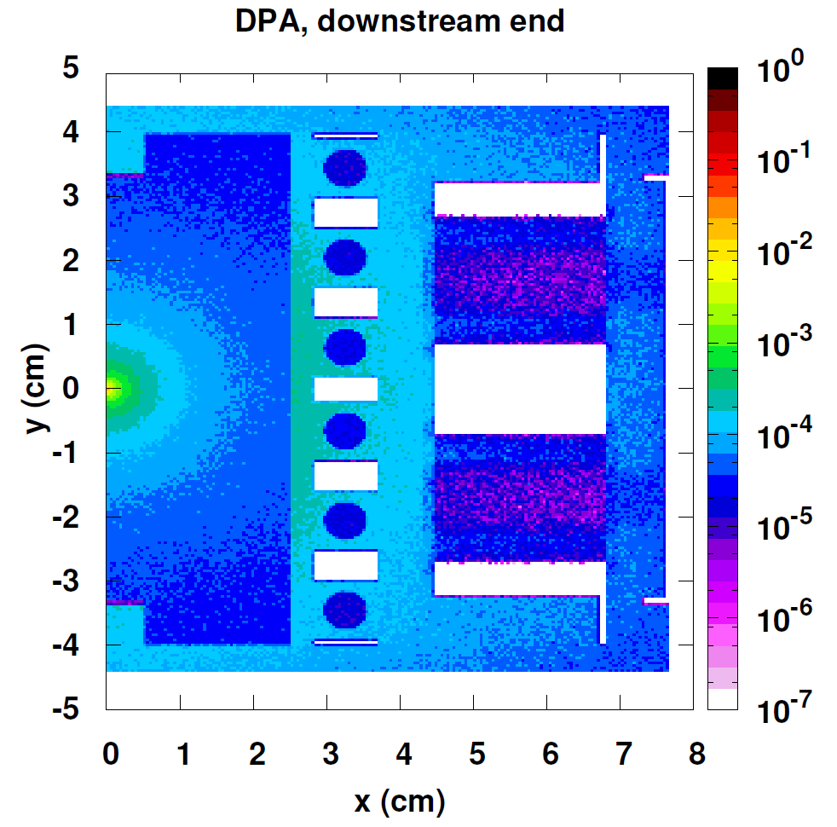
DPA in primary collimators
Displacement Per Atom (DPA) in primary HL-LHC
collimator assuming 1x10¹⁷ protons lost in the
betatron collimation system

Slide 39
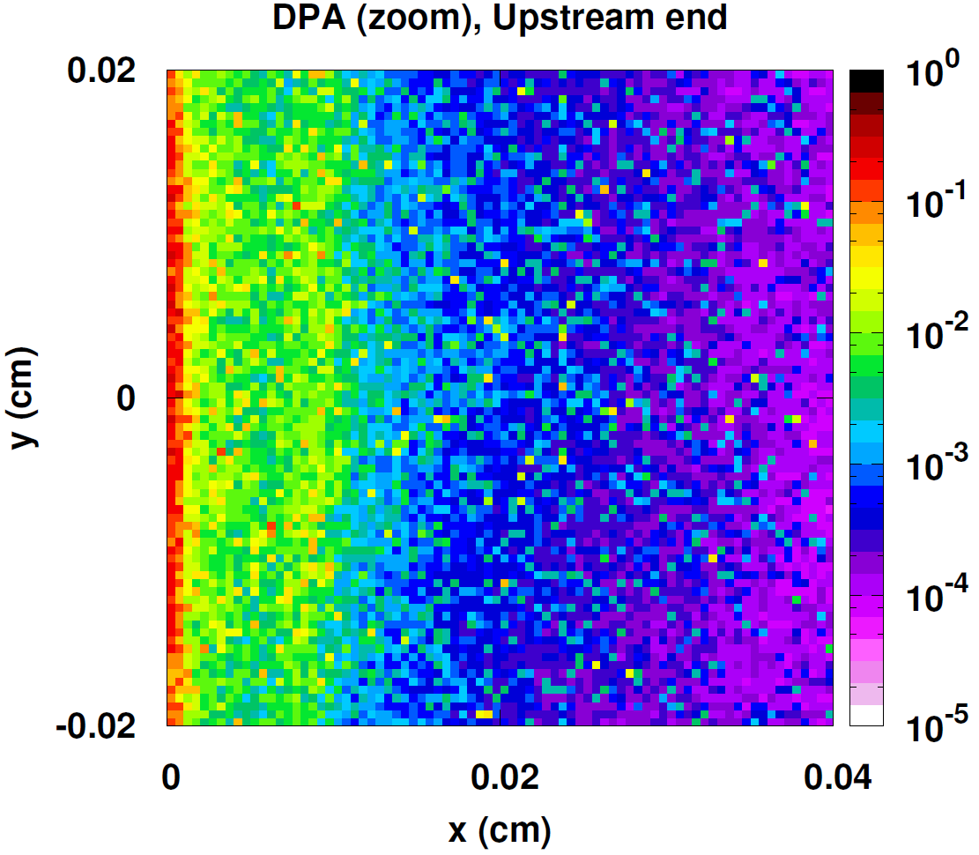
DPA in primary collimators
Displacement Per Atom (DPA) in primary HL-LHC
collimator assuming 1x10¹⁷ protons lost in the
betatron collimation system
ZOOM
Max. value of 0.3 DPA concentrated in surface area

Slide 40
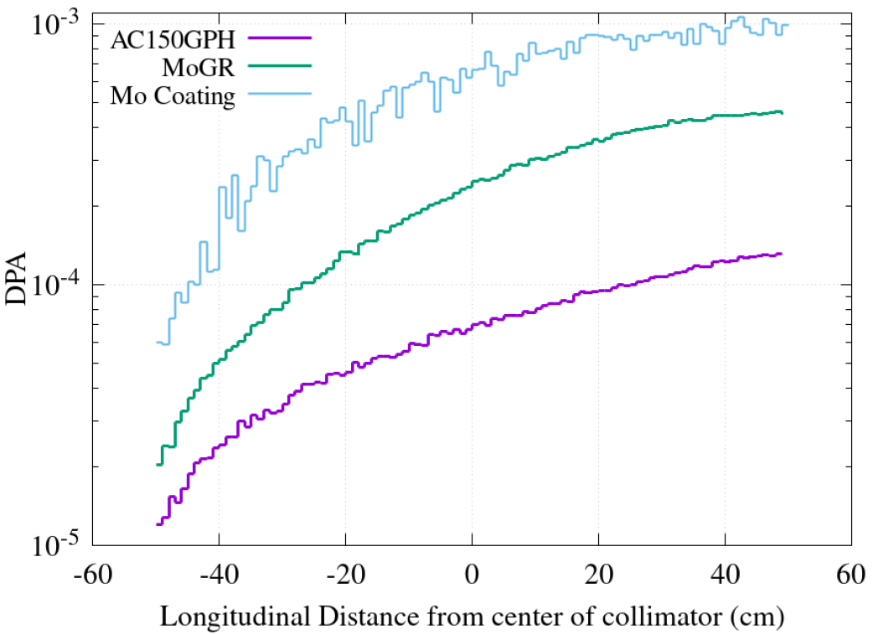
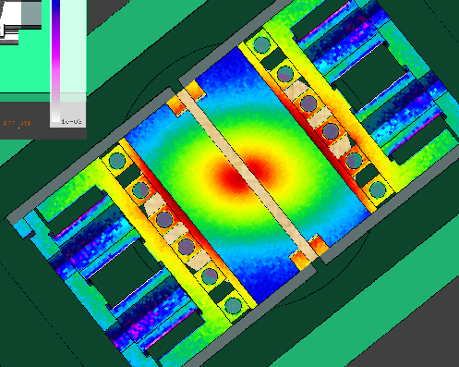
DPA in secondary collimators
Displacement Per Atom (DPA) in primary HL-LHC
collimator assuming 1x10¹⁷ protons lost in the
betatron collimation system
 | DPA
Mo coating | 1·10⁻³
MoGr secondary | 4-5·10⁻⁴
CfC secondary | 1-2·10⁻⁴
MoGR
Molybdenum coating
CfC (AC150K)

