Slide 1
Recent ion irradiation at GSI on collimator jaw materials
F. Carra
C. Accettura, A. Bertarelli, A. Fontenla, A. Lechner, O. Sacristan, K. Filippidou, P. Pastuszak, A.Weats (CERN)
M. Tomut, A. Prosvetov, P. Simon, P. Bolz (GSI)
79th HL-LHC TCC
CERN, Geneva
July 18th, 2019

Slide 2
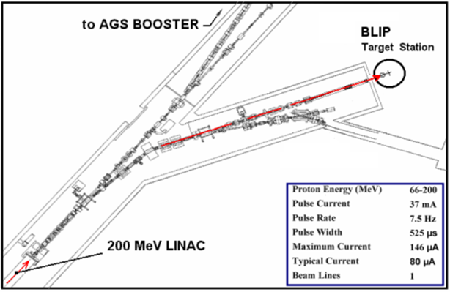
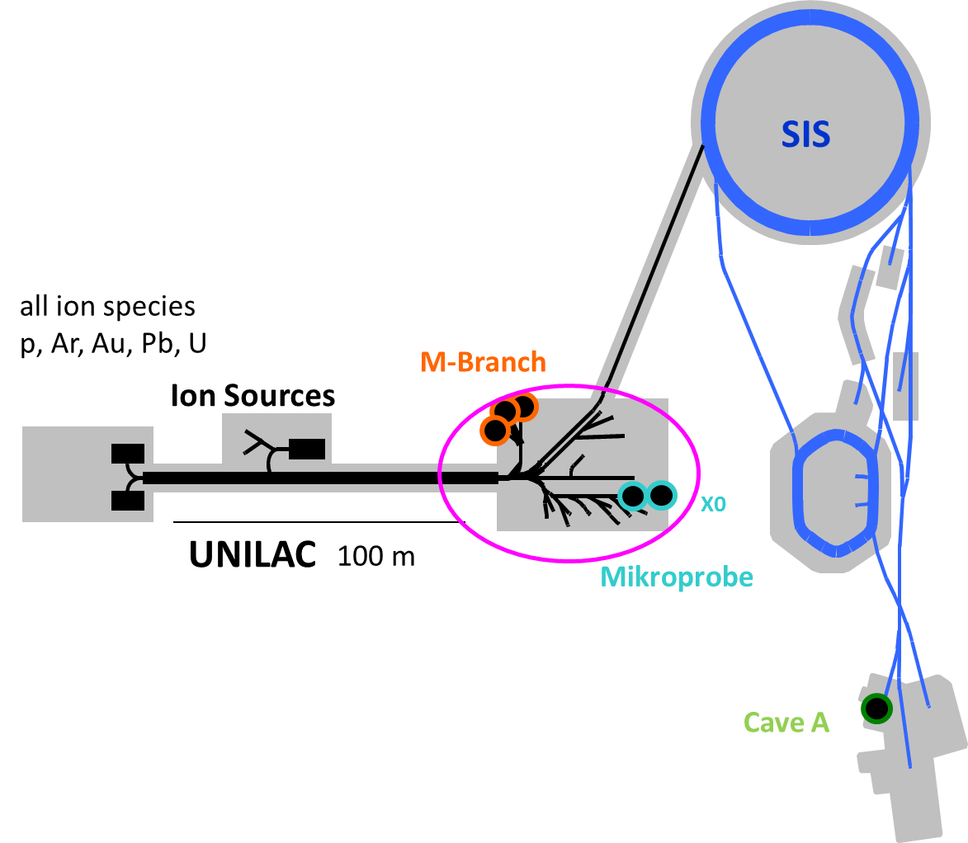
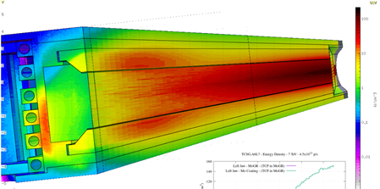
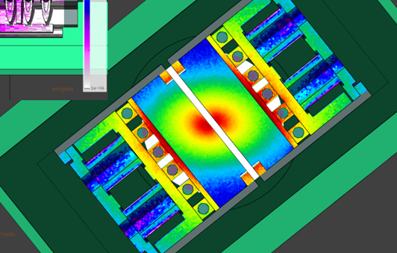
Irradiation campaigns on materials
Motivation: study of long-term irradiation-induced property degradation caused by atom displacement and gas production
FLUKA simulations estimated the expected DPA levels in HL-LHC collimators during their lifetime → experimental irradiation campaigns must reach at least the same DPA levels
With FLUKA, the same equivalence will be done in terms of gas production
FLUKA simulation
Irradiation facilities
Material | Primary collimator [DPA] | Secondary collimator [DPA] | Mo coating [DPA]
MoGr | 0.3 | 4·10⁻⁴ | 1÷3·10⁻³
CFC | 0.12 | 1·10⁻⁴
BNL beamlines
GSI beamlines
Max 200 MeV protons
~5 MeV/u ions
 | BNL | GSI
Penetration | Deep | Superficial
Gas production | Yes | No
Activation | High | Low
DPA rate | Medium | High
C. Accettura, L. Skordis

Slide 3
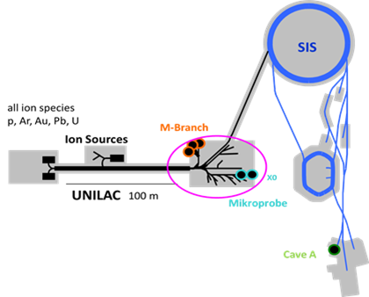
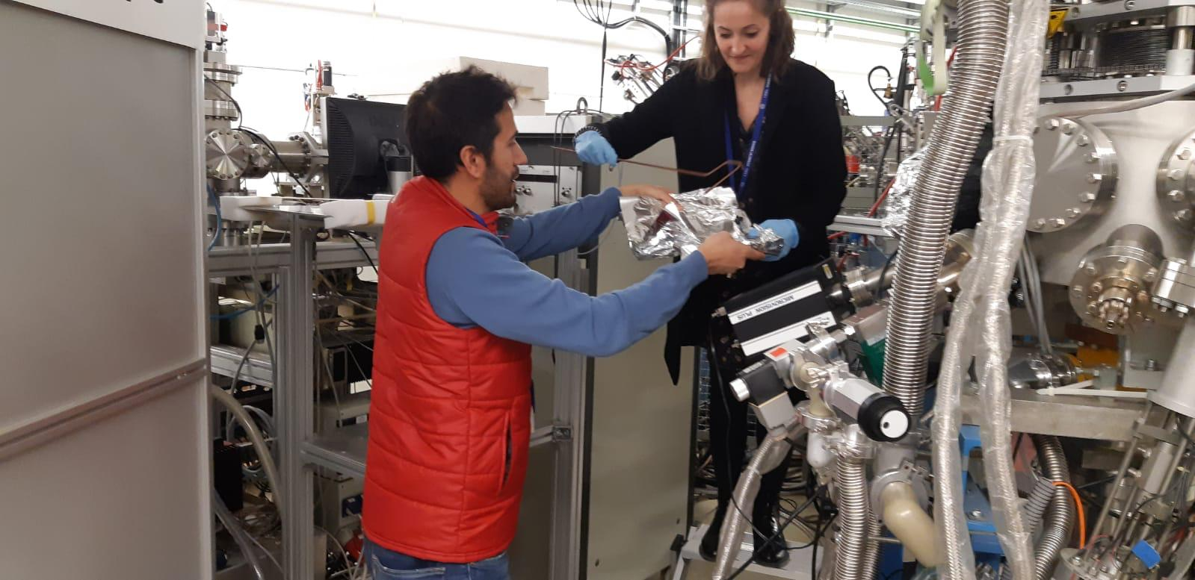

Irradiation tests at GSI
GSI (Darmstadt): M-Branch facility allows testing materials with several different ion species
Most recent tests performed in the M3 line of the M-Branch facility
Preliminary results also presented at the last ColUSM (link)
Possible thanks to the ARIES project (within Horizon 2020)
Workpackages WP17 (PowerMat), WP14 (Promoting Innovation), Transnational Access

Slide 4
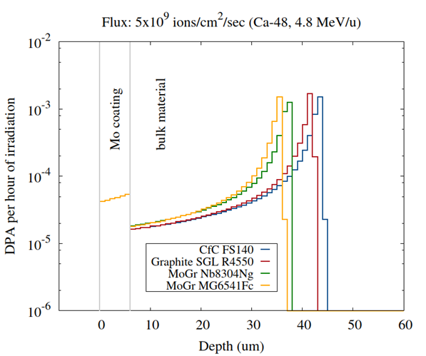
Irradiation tests at GSI
27 March – 1 April 2019: Ca ion (4.8 MeV/u) irradiation on MoGr, graphite and CFC, uncoated and coated with Mo and Cu (tests were planned already in 2018, but there was a major failure in the accelerator complex at GSI)
  Ion penetration (50 μm) higher than layer thickness (5 μm)
  Aim: produce a peak DPA in the coating equal to the one simulated for HL-LHC lifetime. Matching the peak in the coating implies surpassing the DPA in the bulk material of secondaries, and getting close to the peak levels reached in the primaries
  Total of 113h irradiation time granted
  Low activation: PIE could take place soon after the test
A. Lechner
Parameter
Species | Ca48
Charge state | +10
Energy | 4.8 MeV/u
Flux | 5÷8.5 ion/cm²·s
Time pulse | 1.8÷5.2 ms
Frequency | 5 Hz
Beam size | 2.5x2.5cm² or 2.7x2.7cm²

Slide 5
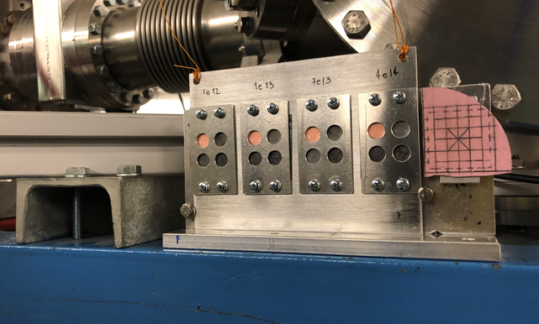
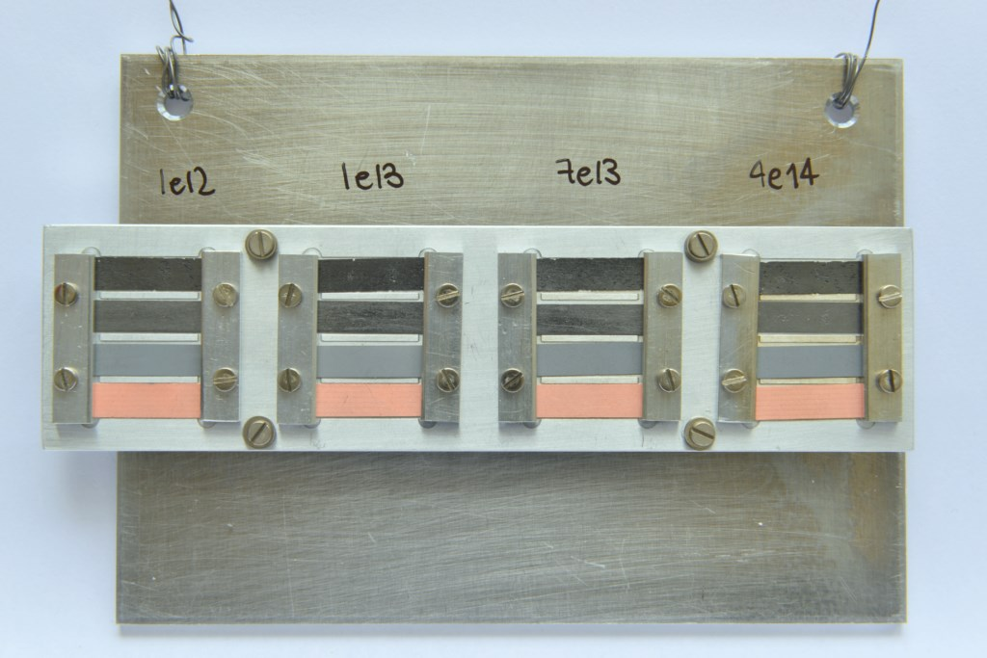
Irradiation conditions
4 target stations, to investigate 4 different fluences (up to 4e14 ions/cm², which produces 1e-3 DPA on the coating)
4 materials for each target station
2 different geometries (discs for microstructural tests and micromechanics, thin plates for electrical and thermal tests)
Sample holder for thermal measurements
Test at GSI
Fluences [ions/cm²] | Irradiation time | Peak DPA coating | Peak DPA bulk
1·10¹² | 2 min | ~2.8·10⁻⁶ | ~1.1·10⁻⁴
1·10¹³ | 20 min | ~2.8·10⁻⁵ | ~1.1·10⁻³
7·10¹³ | 2.8 h | ~1.9·10⁻⁴ | ~7.8·10⁻³
4·10¹⁴ | 15 h | ~1.1·10⁻³ | ~4.4·10⁻²
Sample holder for electrical measurements
HL-LHC
Material | Primary collimator [DPA] | Secondary collimator [DPA] | Mo coating [DPA]
MoGr | 0.3 | 4·10⁻⁴ | 1÷3·10⁻³
CFC | 0.12 | 1·10⁻⁴

Slide 6
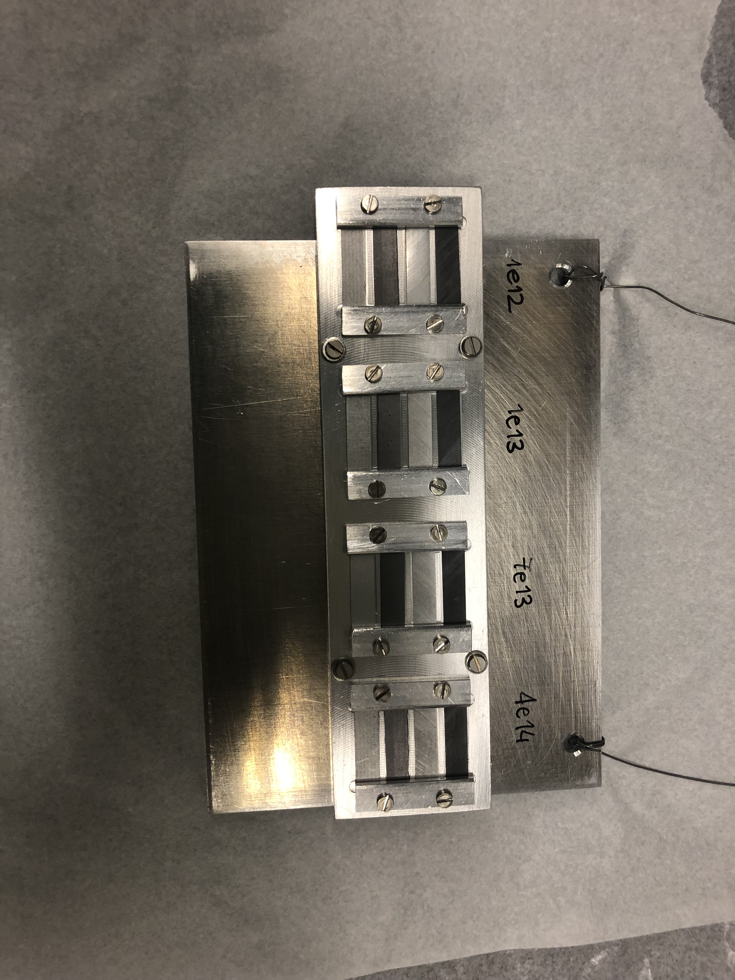
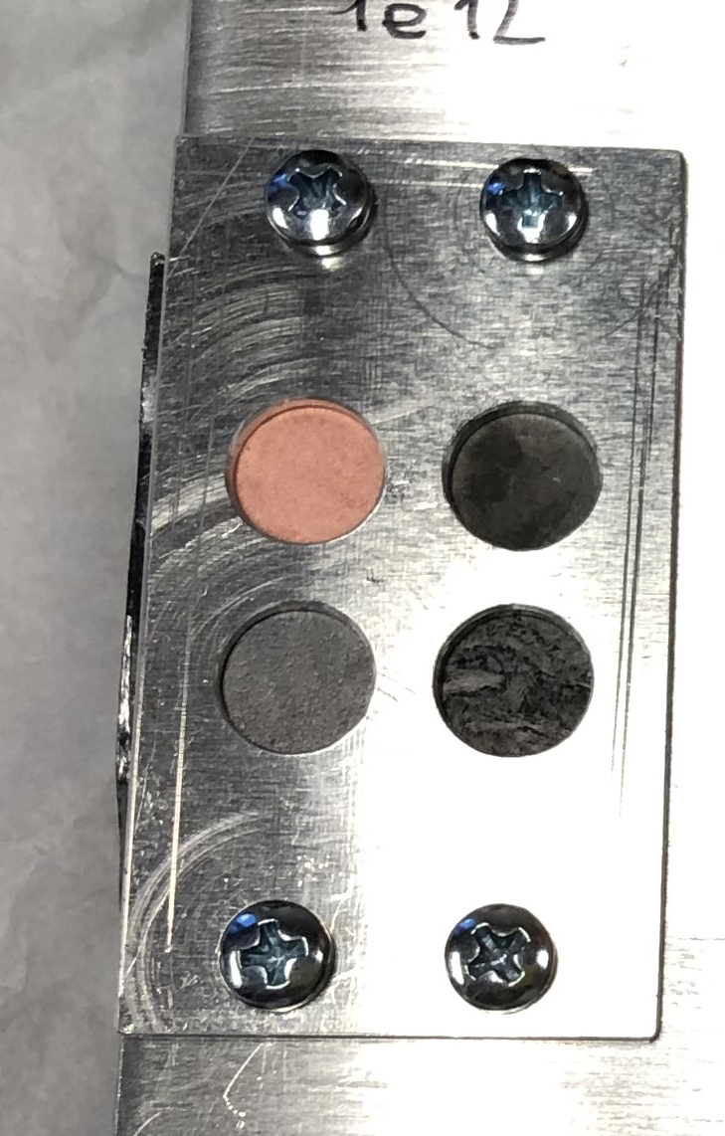
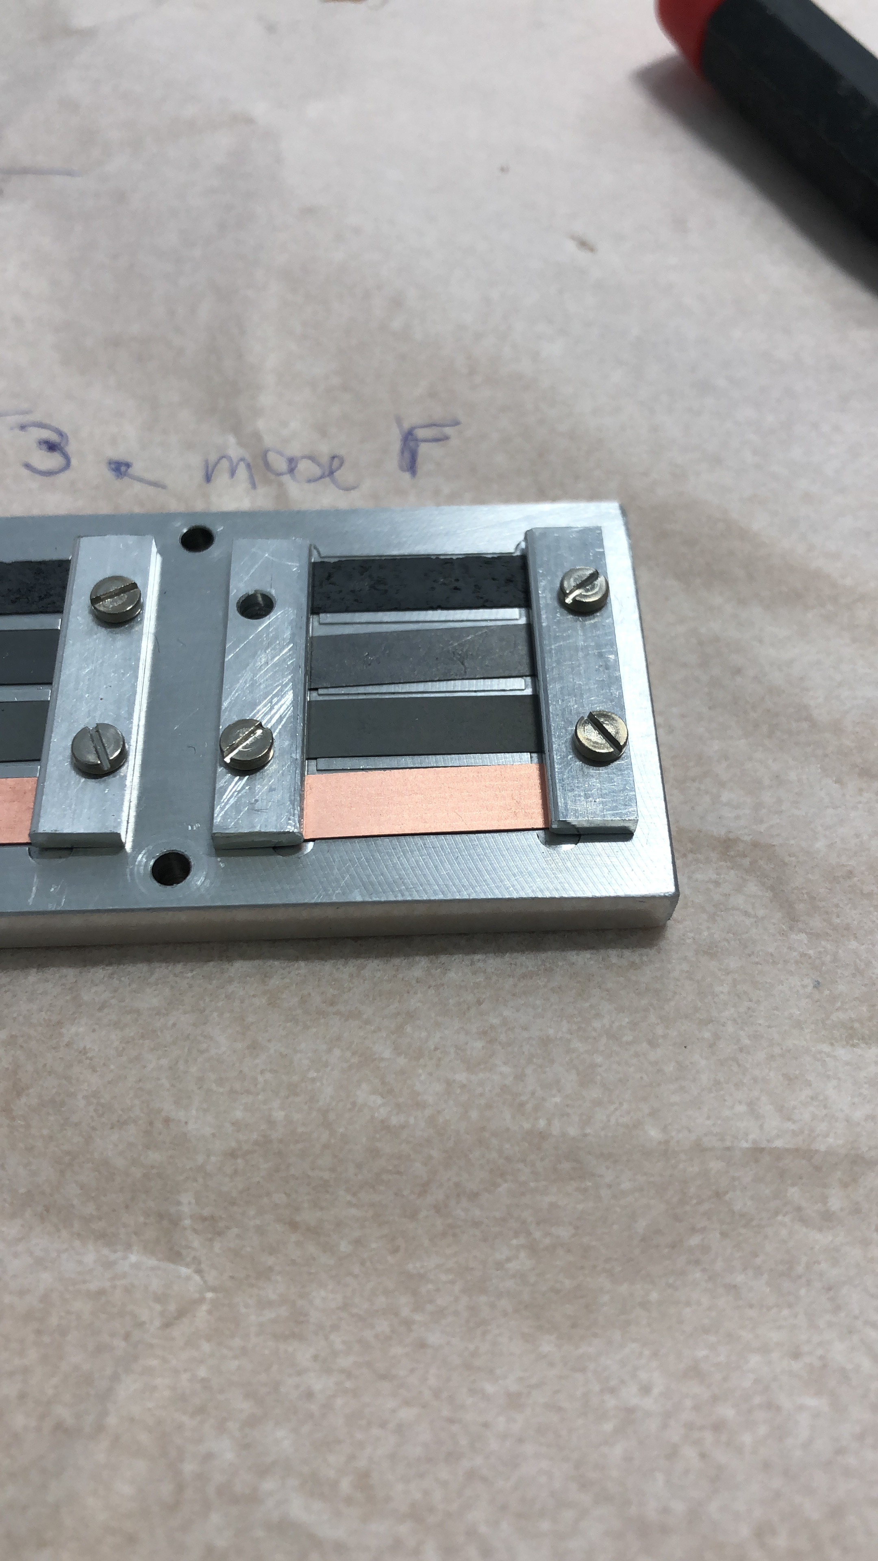
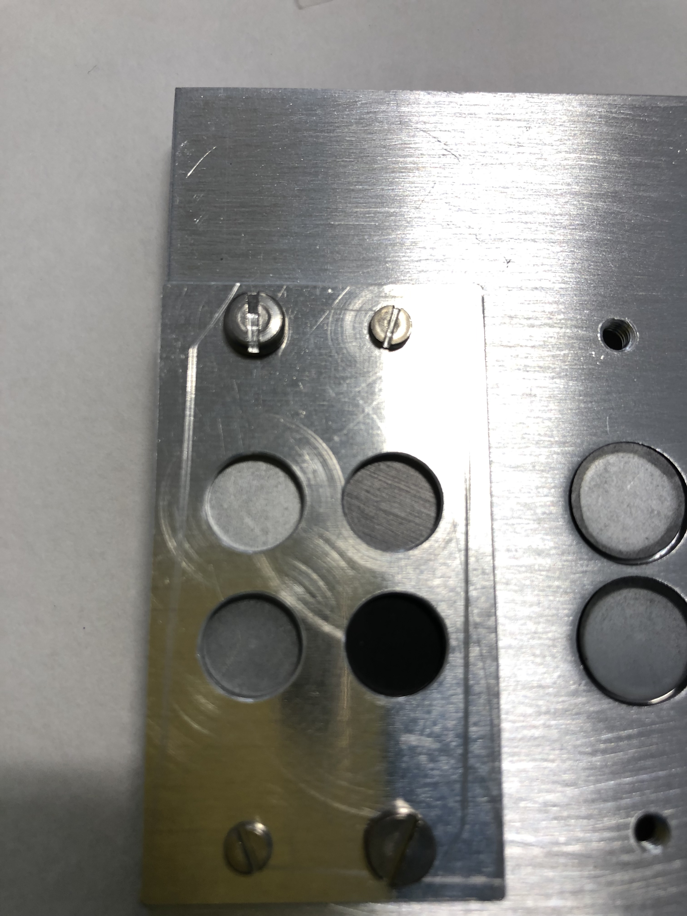
Materials tested
Sample holders n. 1 and 2
Sample holders n. 3 and 4
B
A
H
C
E
G
G
D
F
A
E
D
C
B
F
H
MoGr (Nanoker) uncoated
MoGr (Nanoker) coated with Mo
Graphite (R4550) uncoated
Graphite (R4550) coated with Mo
MoGr (Nanoker) coated with Cu
MoGr (Brevetti) uncoated
MoGr (Brevetti) coated with Mo
CFC (FS140) uncoated
plus a 5th sample holder irradiated with some additional spare time allocated → investigated 2 more fluences for the A-D materials

Slide 7
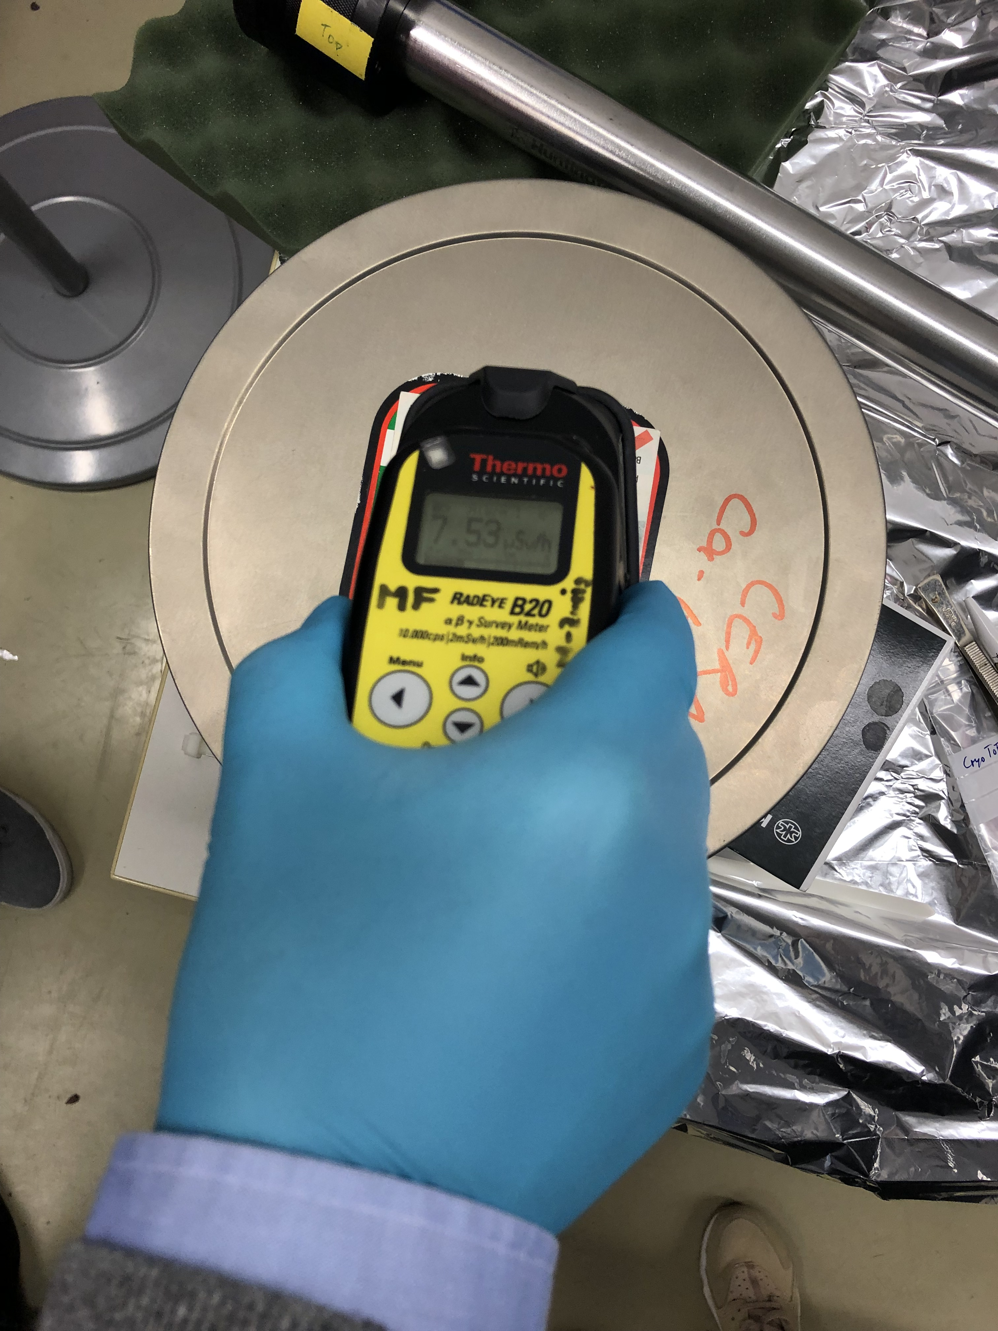
Sample activation
Right after the irradiation, at 20 cm:
  200 µSv/h before inserting them in the box
  31 µSv/h after placing them in the box
After 1 day, at 20 cm from the box: 8 µSv/h
Immediate visual inspection
~2 months
Samples shipped to CERN on June 11th (<0.1 µSv/h)
Measurements ongoing in the mechanical lab (376-R-003) classified as a controlled area since the 25th of June

Slide 8
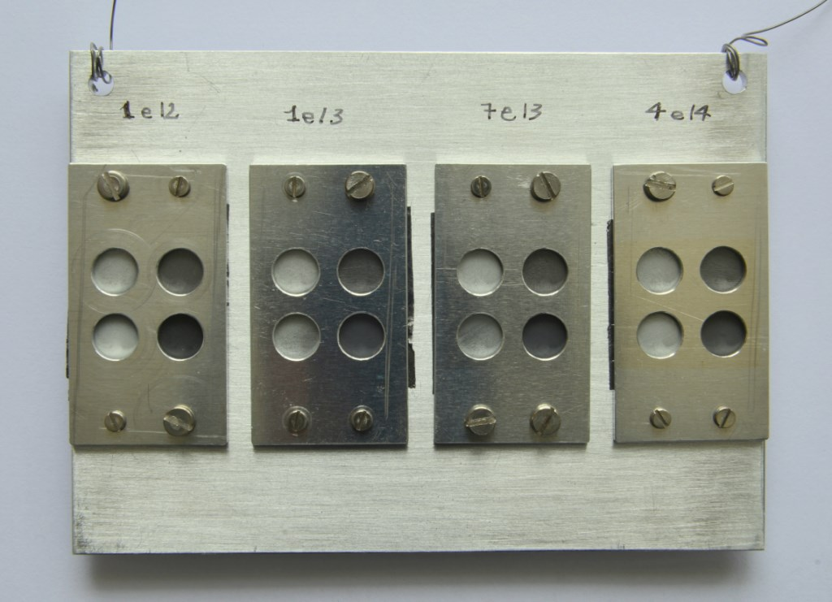
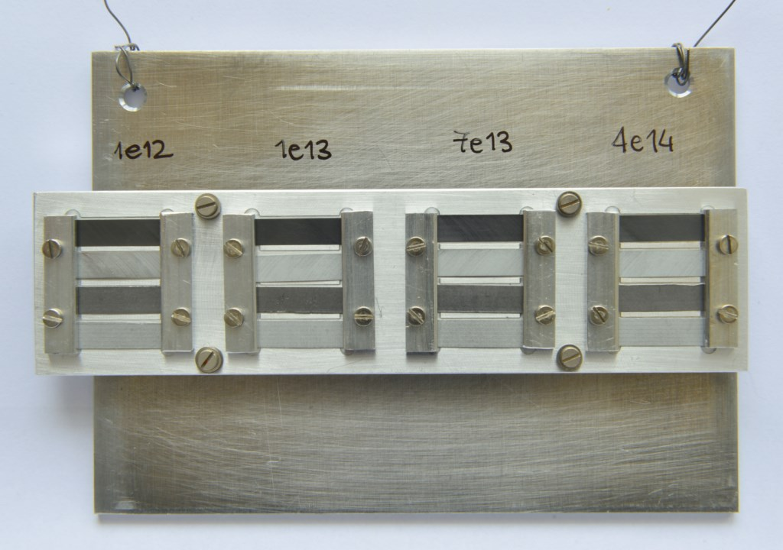
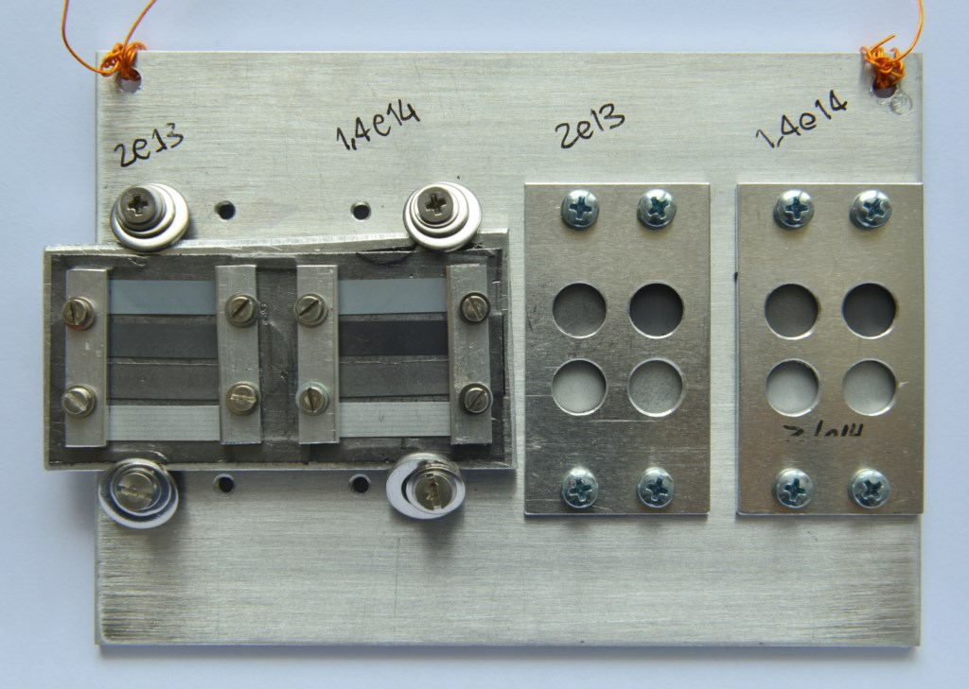
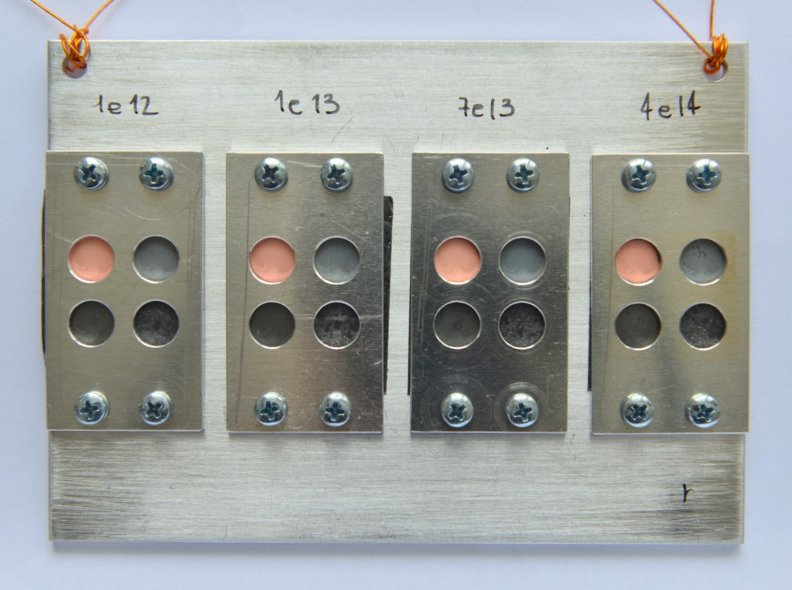
Results: visual inspection
Possible right after the irradiation (April 1st) thanks to low activation
Sample holder n. 1
Sample holder n. 2
Sample holder n. 5
Sample holder n. 3
Sample holder n. 4
No visual signs of degradation of coating/bulk

Slide 9
Results: visual inspection
Sample holder n. 1

Slide 10
Results: visual inspection
Sample holder n. 2

Slide 11
Results: visual inspection
Sample holder n. 5

Slide 12
Results: visual inspection
Sample holder n. 3

Slide 13
Results: visual inspection
Sample holder n. 4

Slide 14
Results: adherence, Mo on MoGr
Very clean and continuous coating-bulk interface, no trace of peel-off
Coating completely integer, no signs of cracks
FIB: Most irradiated MoGr with Mo specimen

Slide 15
Results: adherence, Mo on graphite
Very clean and continuous coating-bulk interface, no trace of peel-off
Coating completely integer, no signs of cracks
Mo diffusion to the bulk through the porosities
FIB: Most irradiated graphite with Mo specimen

Slide 16
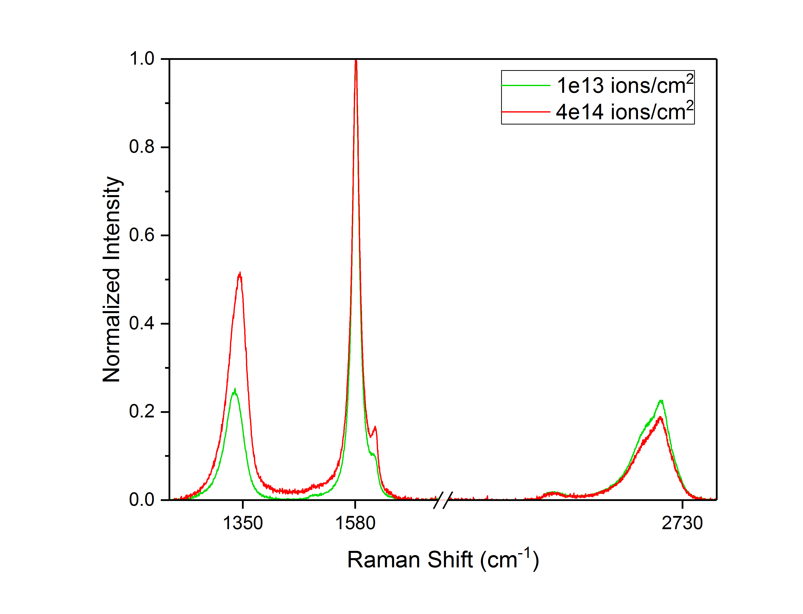
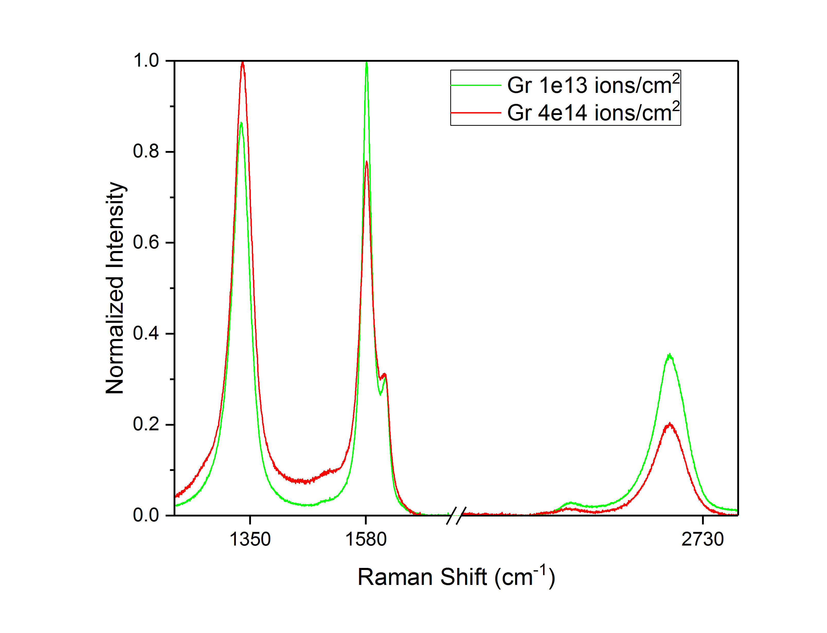
Results: Raman spectroscopy on bulk MoGr and graphite
Raman spectroscopy performed at GSI
Results in line with literature data: more ordered structure for MoGr, bigger grains (higher conductivity), disorder increases with fluence
MoGr
Graphite
G
D
G
D
2D
2D
Fluence [ions/cm²] | Grain size before [nm] | Grain size after [nm] | Normalized grain reduction
1.00E+12
1.00E+13 | 140 | 150 | -7.14%
7.00E+13 | 410 | 150 | 63.41%
4.00E+14 | 350 | 72 | 79.43%
Fluence [ions/cm²] | Grain size before [nm] | Grain size after [nm] | Normalized grain reduction
1.00E+12
1.00E+13 | 49 | 43 | 11.62%
7.00E+13 | 57 | 43 | 24.13%
4.00E+14 | 60 | 28 | 52.25%

Slide 17
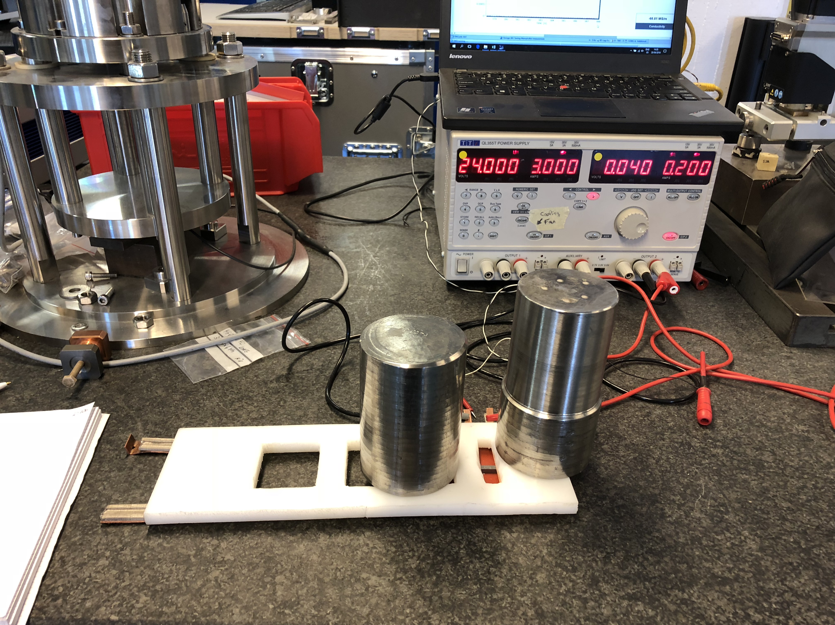
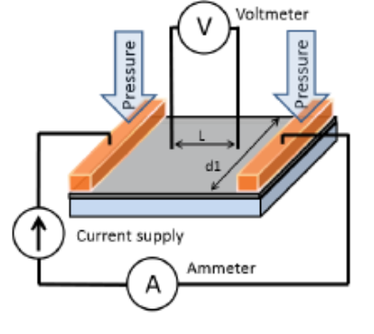
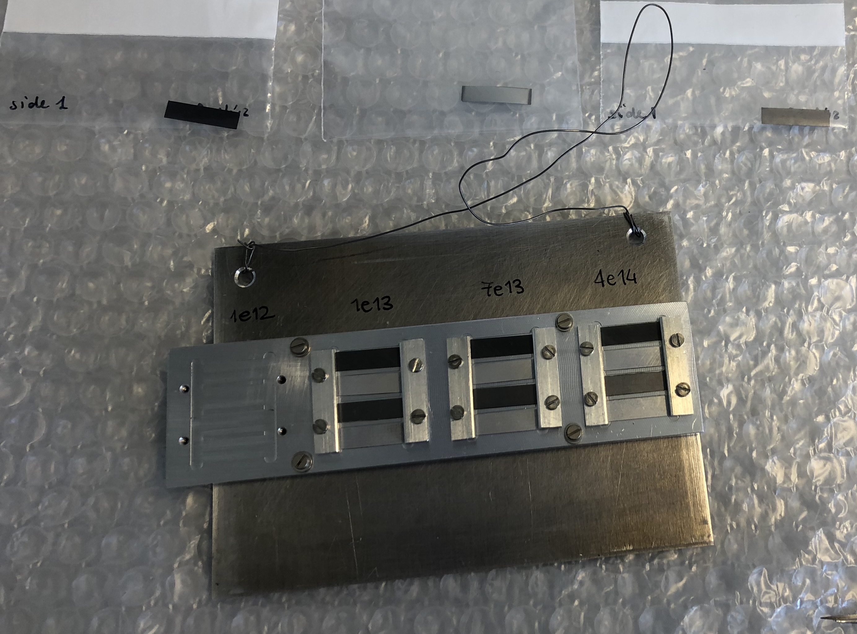





Electrical conductivity
Each individual testing sample measured in DC before irradiation (4-probes method)
It requires high statistics (20 measurements per sample at a given current, 3 different currents → 60 measurements per sample)
A total of 5.000 measurements (before+after irradiation) → mostly completed!
Data must now be implemented in the different models of irradiated materials, to derive electrical conductivity after irradiation
Preliminary results presented at the ColUSM for the most simplified model, we could update on this in a few weeks
$$R_{irradiated}= ?$$
$$R_{coating}= ?$$
Collaboration with WP2 to develop a method for measuring small samples in AC
Investigation of the mismatch between AC and DC measurements (coherent results for Mo-coated MoGr – 18 MS/m, factor 2 higher resistivity for Mo-coated graphite in AC)
$$R_{bulk}=ρ_{pristine}\frac{L}{d_{1}∗t_{bulk}}$$
$$R_{bulk}=\frac{R_{bulk_pristine}{∙R}_{bulk_{irrad}.}}{R_{bulk_pristine}+R_{bulk_{irrad}.}}$$
40-50µm
150µm

Slide 18
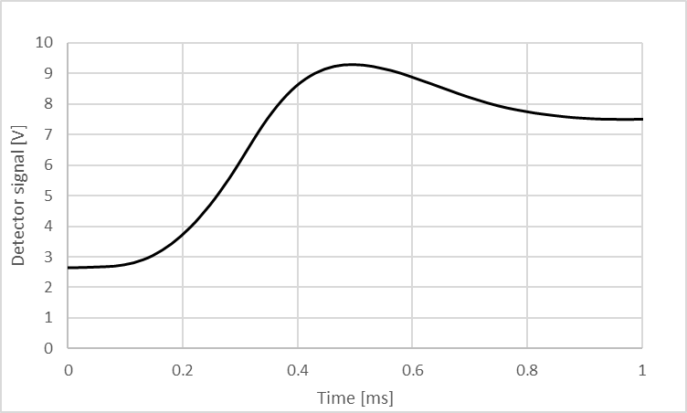
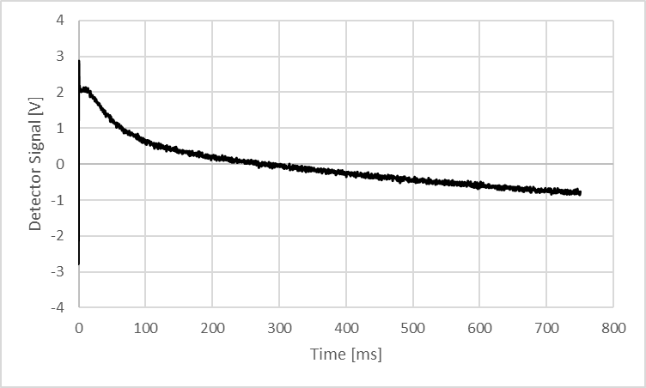
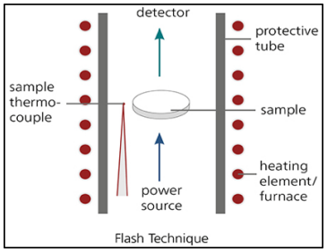
What’s next: thermal conductivity
~100 measurements → laser flash technique
2-layers model+ reverse engineering
Short and long measurement to study heating up and cooling down (along plane and through plane conductivity studies)
    + XRD, indentation, annealing, SEY (~2 months)
    Longer term: gas implantation, but first need of simulating gas produced in HL-LHC collimators (ongoing)
Very thin sample→ lateral conduction

Slide 19
Conclusions
Ion irradiation: important complementary technique to proton irradiation, to study irradiation-induced damage on materials
Last irradiation campaign (27 March – 1 April) performed at GSI on uncoated and coated collimator material samples
DPA peaks on the coating equivalent to those simulated for HL-LHC secondaries were achieved during the irradiation
Fast PIE allowed by low material activation, several tests already completed showed good structural integrity of bulks and coatings, good adhesion!
A significant number of measurements (thousands) for electrical and thermal conductivity also performed, data now to be implemented in irradiation models to derive the change of property
Few more tests planned for the next two months (XRD, indentation, annealing, SEY)
Longer term: infer the damage related to gas production via ion gas implantation (e.g. MIAMI2 – UK?), however: important to simulate the gas production expected for HL-LHC! (ongoing in EN-STI)
CERN, GSI, PoliMi involved in the material PIE through ARIES project

Slide 20

Thanks for your attention!

Slide 21
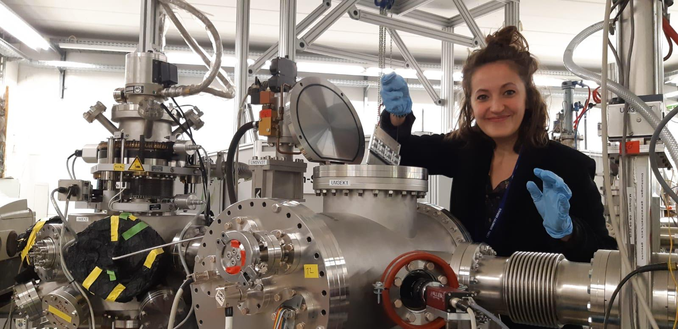

Slide 22
Backup slides

Slide 23
Status and planning
Complete thermal conductivity of Gr e MoGr
Electrical and thermal conductivity of other materials (CFC, MoGr with fibers, copper coating)
Test of different method to benchmark electrical conductivity
Microstructural characterization
Test | week 1 | week 2 | week 3 | week 4 | week 5 | week 6 | week 7 | week 8 | week 9 | week 10 | week 11 | week 12
Electrical conductivity
Density
Thermal conductivity
XRD
Raman
FIB
Indentation
Adhesion

Slide 24
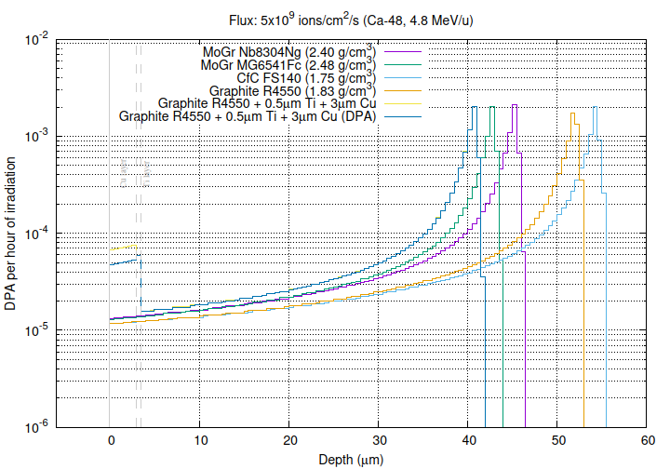
DPA

Slide 25
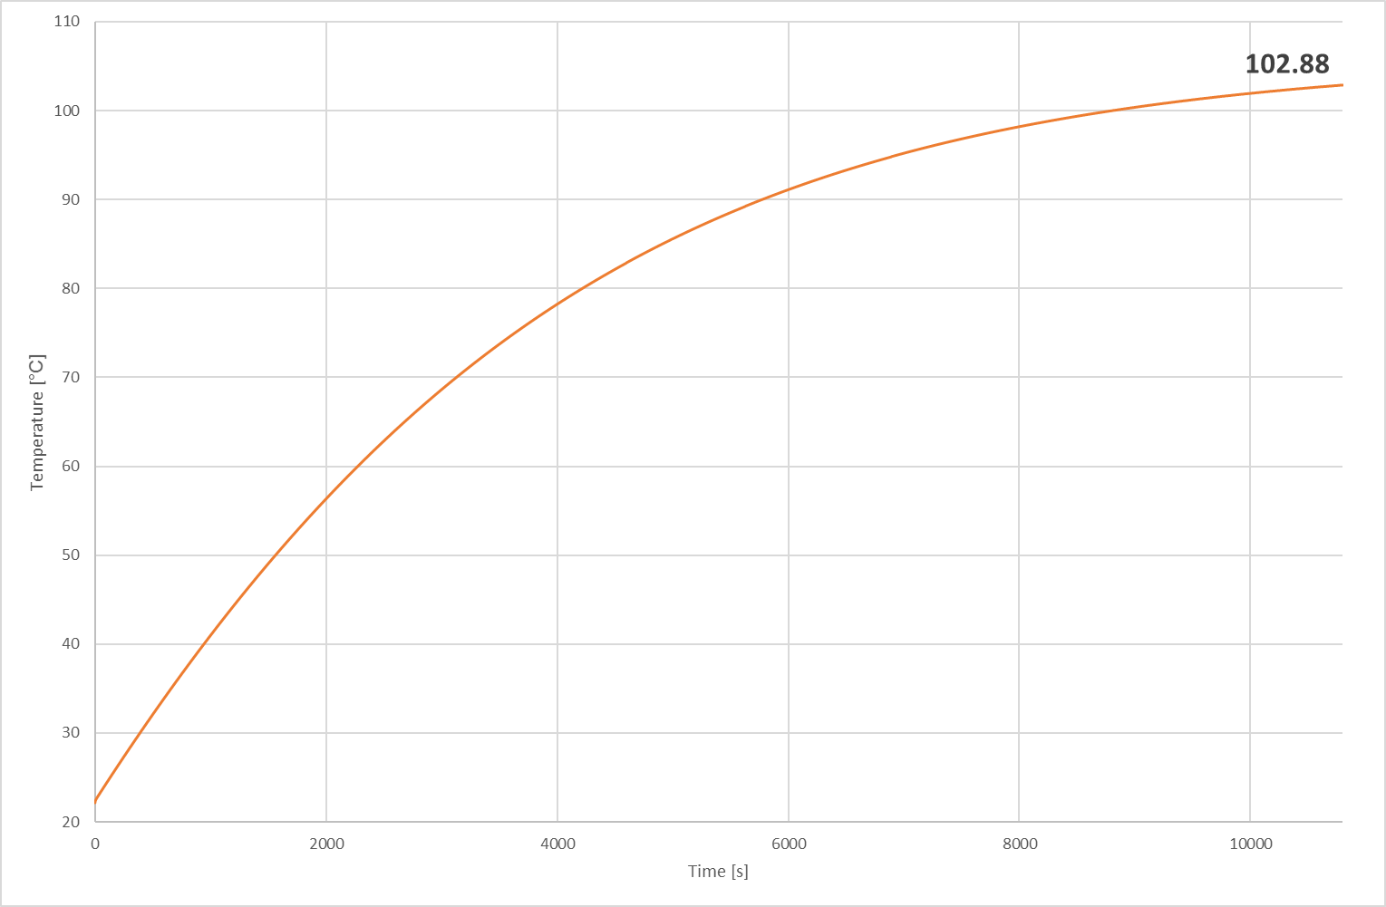
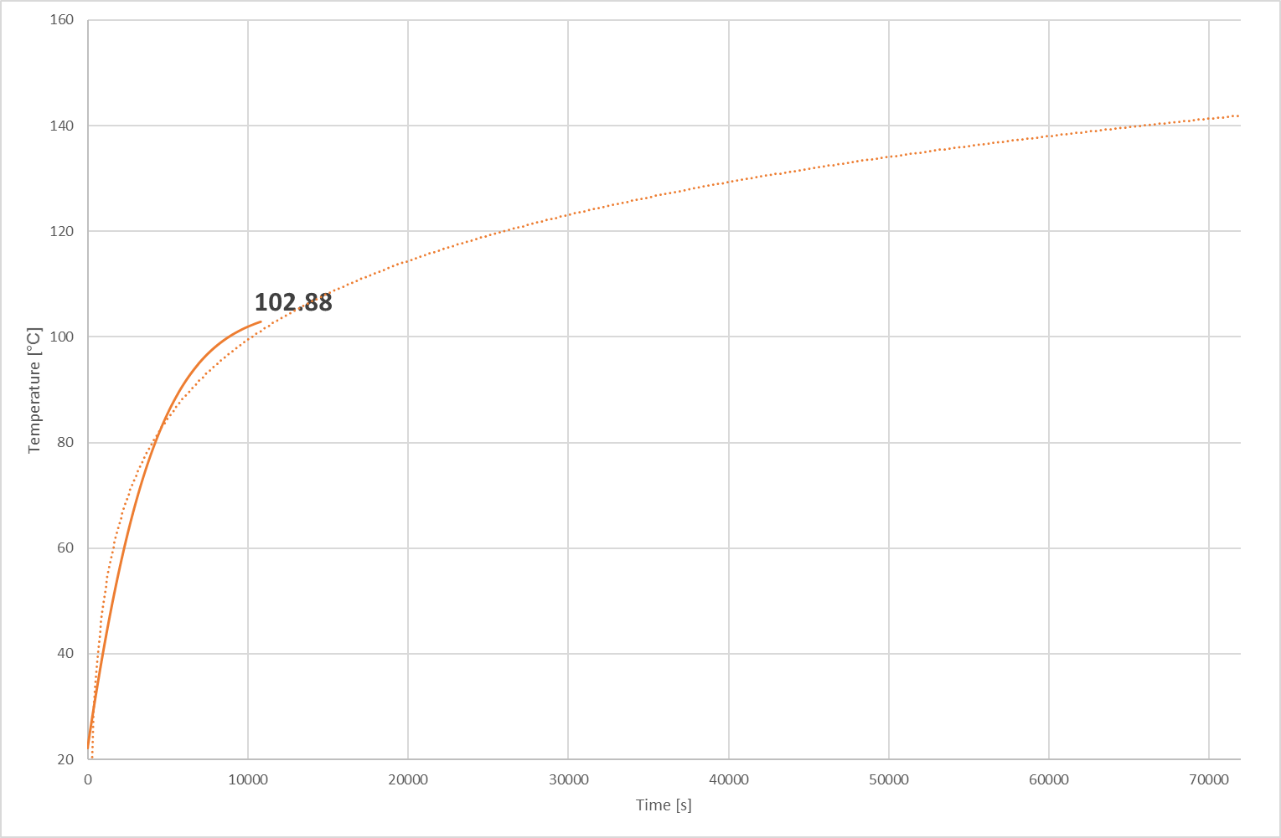
Temperature profile
2D geometry
1 imp/s
Wout= 2.16 W, Win=3W
→Close to equilibrium
! Repeat the analysis for electrical conductivity sample
! Repeat with right power/imp and frequency

Slide 26
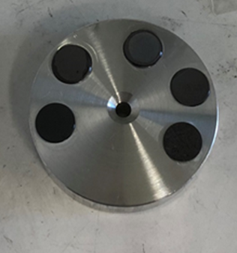
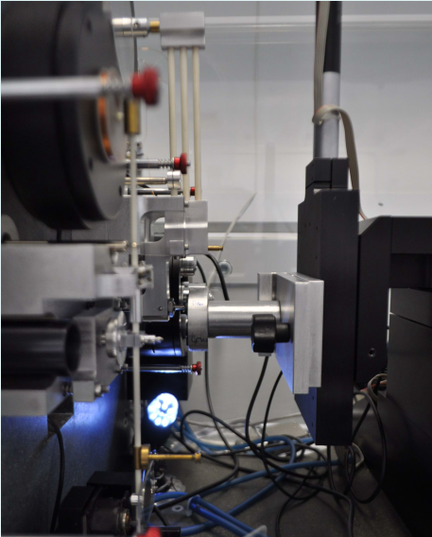
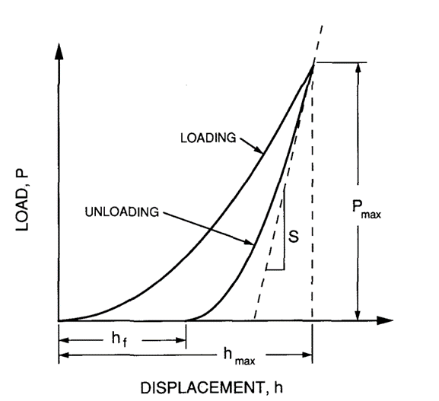
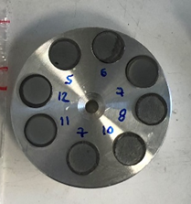
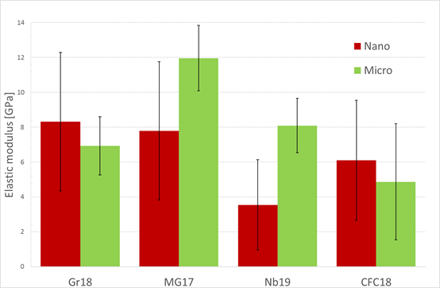
Indentation−Bulk
Each sample indented in 25 points with penetration-controlled (nano) and load controlled (micro)
Microindentation allows a reduction of the standard deviation→ useful to observe radiation-induced hardening and increase of the elastic modulus
Nano-Micro indentation set-up (GSI)
Material | Average E [GPa] | Standard deviation [GPa] | IET [GPa]
Graphite R4550 | 6.9 | 1.7 | 11
MG6541Fc | 12 | 1.9 | 5
Nb8304Ng | 8.1 | 1.6 | 4
CFC FS 140 | 4.9 | 3.3 | 3
 | Max load [mN] | Max depth [nm]
Nanoindentation | 2 | 500
Microindentation | 400 | 8000
Differences with respect other method (e.g. IET) related to factors such as anisotropy and non-linearity.

Slide 27
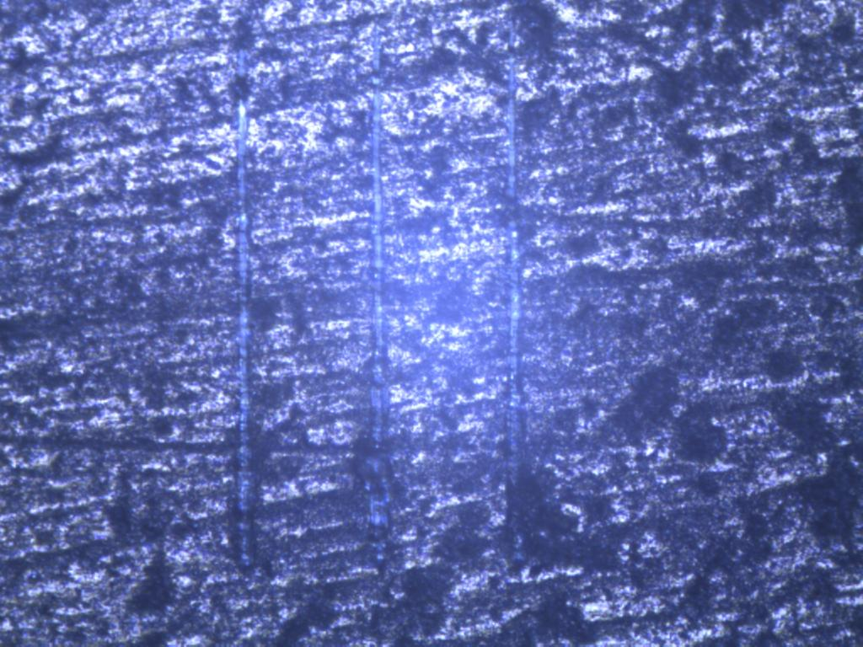
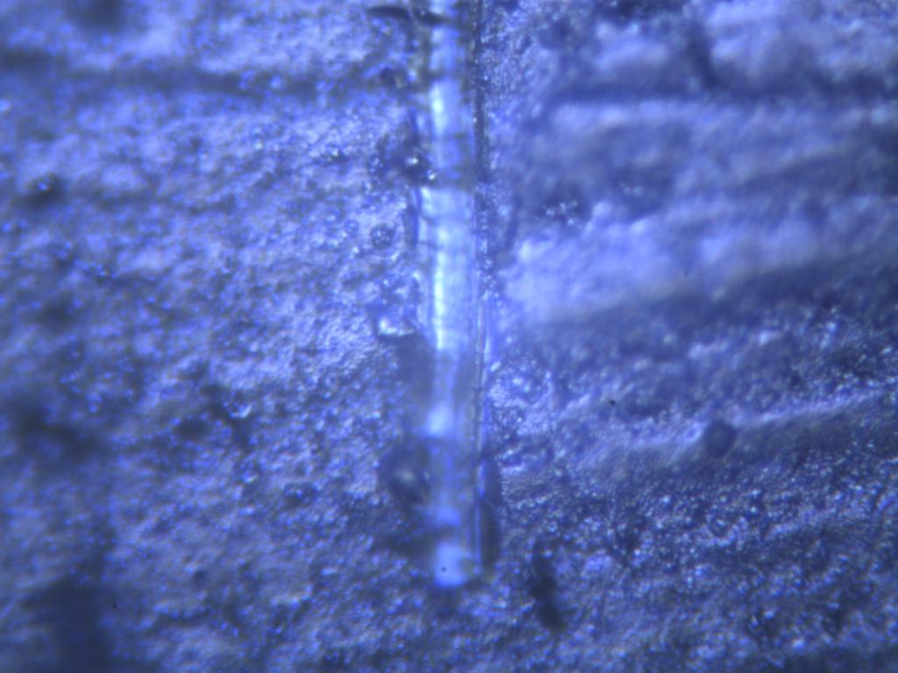
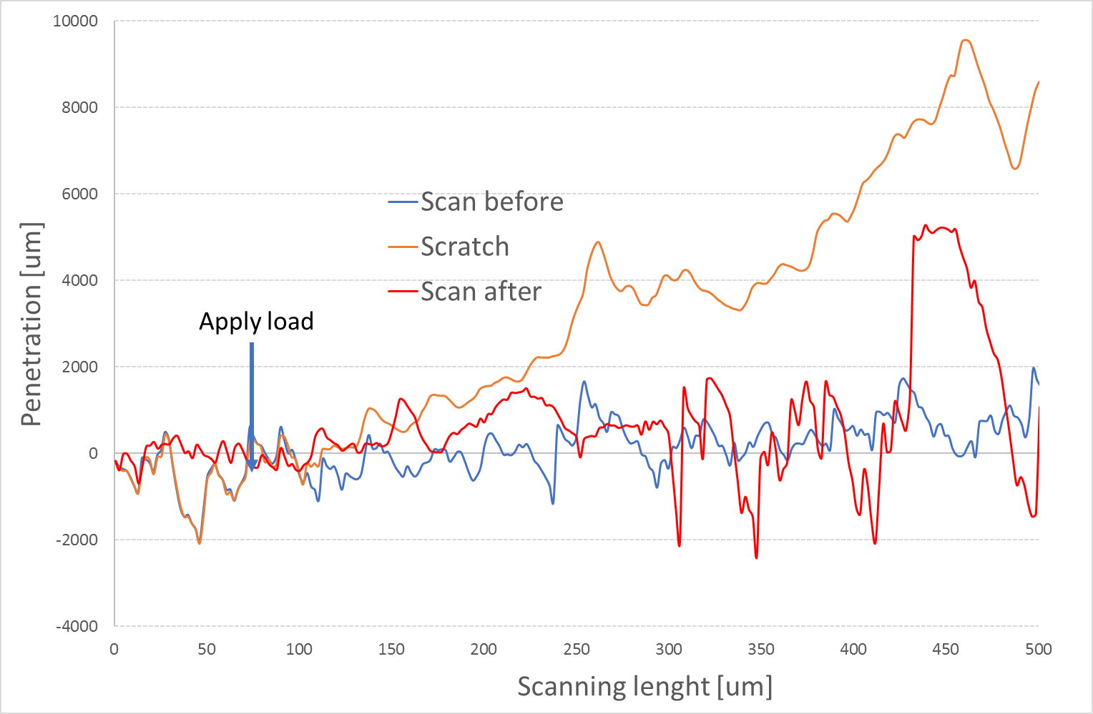
Coating adhesion-Scratch test
An increasing load is applied by the nanoindenter, possible coating failure can be detected with:
  Optical microscopy images→ difficult for material roughness and coating/bulk colours
  Abrupt variation in the load curve→ irregularities due to roughness already present
  Acoustic emission→ not available in the used set-up
C. Accettura - 8th HL-LHC Collaboration Meeting

Slide 28
SEM Mo on MoGr
Mo on MoGr irradiated at 4e14 ions/cm2→ Max DPA in the coating corresponding to the peak DPA in the coating at the end of the HL-LHC lifetime
Before irradiation
After irradiation
We are comparing different samples but same bulk, surface preparation and coating process
Irradiated sample: possible indication of grain size reduction→ to be checked with XRD

Slide 29
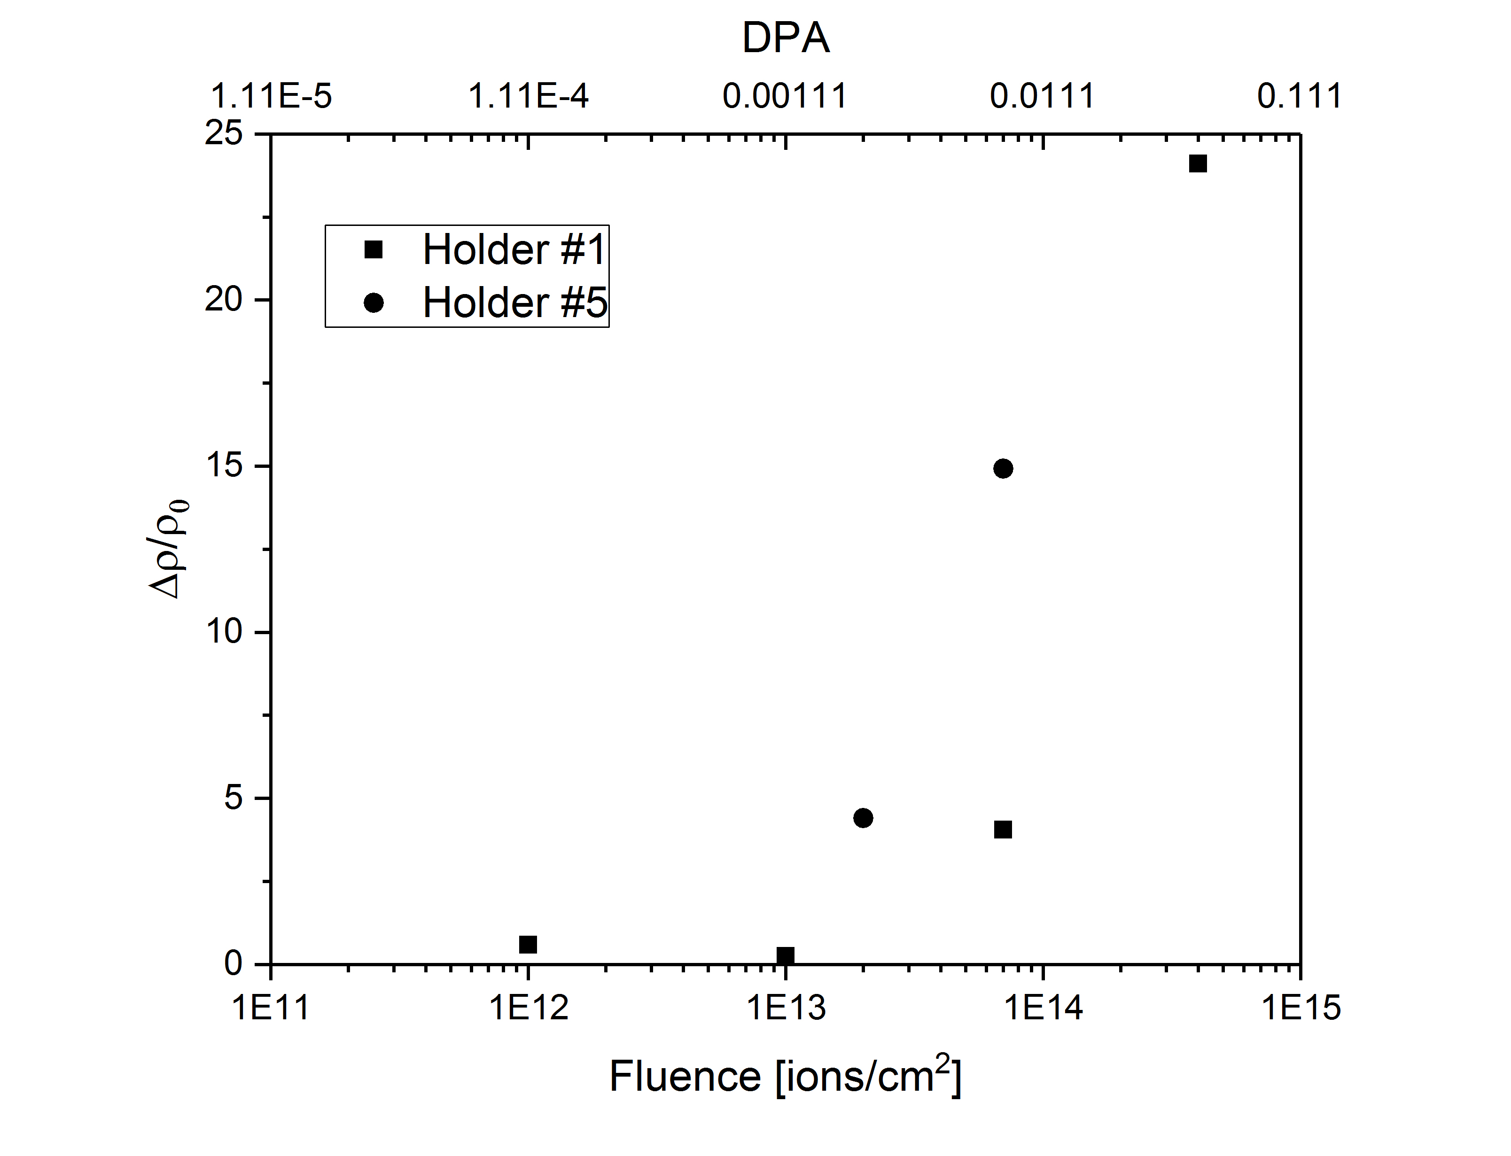
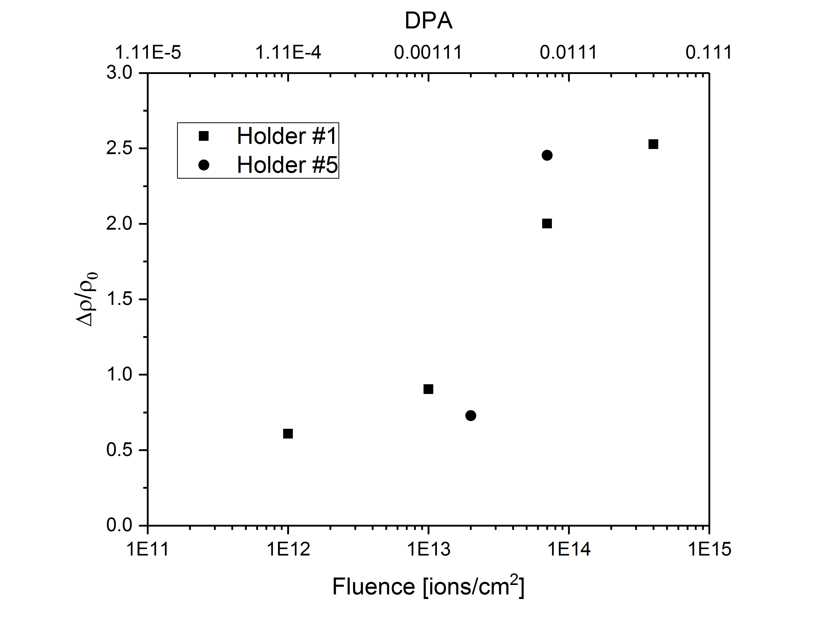
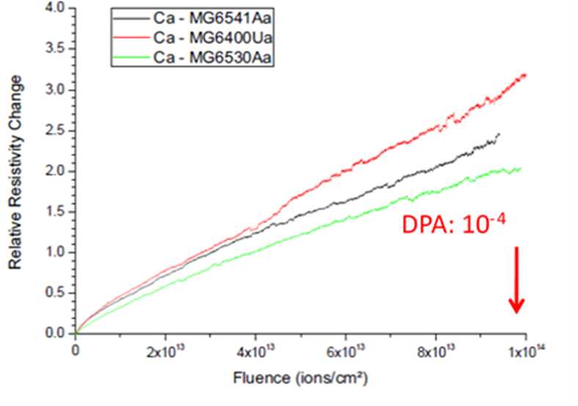
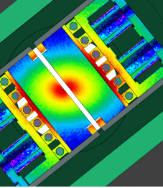
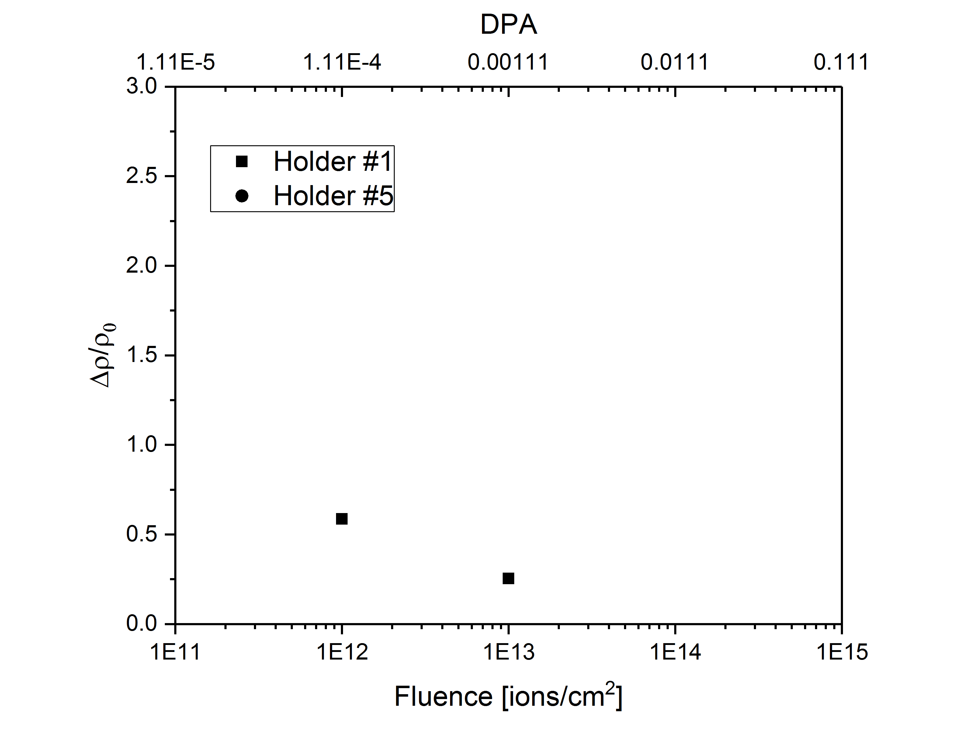
Electrical resistivity measurements
Bulk resistivity changes in function of fluences (DPA)
Graphite starts from a much more disordered state→ reach saturation before MoGr
Electrical conductivity in MoGr systematically higher than Gr in spite of stronger DPA effect
Values coherent with literature and previous tests
Results depend on model adopted → still under investigation
HOLDER #1
MOLIBDENUM-GRAPHITE
GRAPHITE
HOLDER #5
Threshold effect at 1e-3 DPA (10 times higher than TCSPM bulk DPA)
Irradiation test at GSI 2015-2016

Slide 30


Electrical resistivity measurements
Coating after irradiation ~6-13 MS/m
Additional analysis ongoing, it depends on the model adopted
Important to study grain size to understand if the trend is reasonable (XRD)
Potential annealing at high fluence (T~100-150°C, to be checked)
$$R_{coating}= ?$$
$$R_{bulk}=\frac{R_{bulk_pristine}{∙R}_{bulk_{irrad}.}}{R_{bulk_pristine}+R_{bulk_{irrad}.}}$$

Slide 31
Holder | Fluence | DPA peak | Material | σlayer_irradiated
1 | 1.00E+12 | 1.11E-04 | graphite | 0.053
1 | 1.00E+13 | 1.11E-03 |  | 0.047
5 | 2.00E+13 | 2.22E-03 |  | 0.054
1 | 7.00E+13 | 7.77E-03 |  | 0.031
5 | 1.40E+14 | 1.55E-02 |  | 0.026
1 | 4.00E+14 | 4.44E-02 |  | 0.025
1 | 1E+12 | 1.11E-04 | MoGr | 0.575
1 | 1E+13 | 1.11E-03 |  | 0.558
5 | 2.00E+13 | 2.22E-03 |  | 0.126
1 | 7E+13 | 7.77E-03 |  | 0.185
5 | 1.40E+14 | 1.55E-02 |  | 0.047
1 | 4E+14 | 4.44E-02 |  | 0.033

Slide 32
Simulation of gas production
The ion irradiation is characterized by
  High dose rate→ conservative with respect p+
  No gas production→ important to investigate!
Simulate gas production with H/He implantation
  Where?→ MIAMI (University of Huddersfield): 10keV, ~100nm
    Possible to regulate the beam to have certain appm/DPA
    Online TEM monitoring
    Thermophysical characterization would not be possible in such a small layer, but a threshold for blistering can be established
  How much?
    FLUKA simulation (appm/DPA production)
    Measurement of diffusion coefficient with TDS
  With the ion irradiated samples (at different DPA) we could investigate the influence of the DPA on the gas effects

