Slide 1

79th HL-LHC TCC
WP17: Technical Update
Laurent Tavian
On behalf of the SWP leaders
18 July 2019

Slide 2
Table of contents
WP17 and its sub-workpackages
Work progress update
  Civil engineering
  LS2 preparation work (UPR, connection to existing buildings)
  EL and CV user needs
  SM18 test infrastructure upgrade
Open points under discussion

Slide 3
WP17: Infrastructure, Logistics & Civil Engineering
WP17 sub-workpackages |  | Main contributions
WP17.1 | Civil engineering | SMB-DO, SMB-SE
WP17.2 | Electrical Distribution | EN-EL, TE-EPC, SMB-SE
WP17.3 | Cooling and ventilation | EN-CV
WP17.4 | Access and alarm system | BE-ICS
WP17.5 | Technical monitoring | BE-ICS, (BE-CO)
WP17.7 | Transport | EN-HE
WP17.8 | Upgrade/consolidation of test facilities | TE-CRG, TE-MPE
WP17.9 | Logistics and storage | SMB-SC
WP17.10 | Operational safety | EN-ACE
9 sub-workpackages
14 Groups

Slide 4
Work progress
WP17 sub-workpackages |  | Progress | Activity
WP17.1 | Civil engineering | 25 % | Design & construction
WP17.2 | Electrical Distribution | 3 % | Design & tendering
WP17.3 | Cooling and ventilation | 2 % | Design & tendering
WP17.4 | Access and alarm system | 1 % | Design & tendering
WP17.5 | Technical monitoring | 0 % | Design
WP17.7 | Transport | 5 % | Design & tendering
WP17.8 | Upgrade/consolidation of test facilities | 84 % | Installation
WP17.9 | Logistics and storage | 12 % | Support
WP17.10 | Operational safety | 2 % | Design

Slide 5
Work progress: Civil engineering (WP17.1)
Detailed design in progress
  Huge effort between WP17, WP15, future building users and the CE consultants.
  Completed for underground structures
  In progress for the surface buildings:
    Still some pending issues (Alarm & access racks)
  Design completion by end 2019.

Slide 6
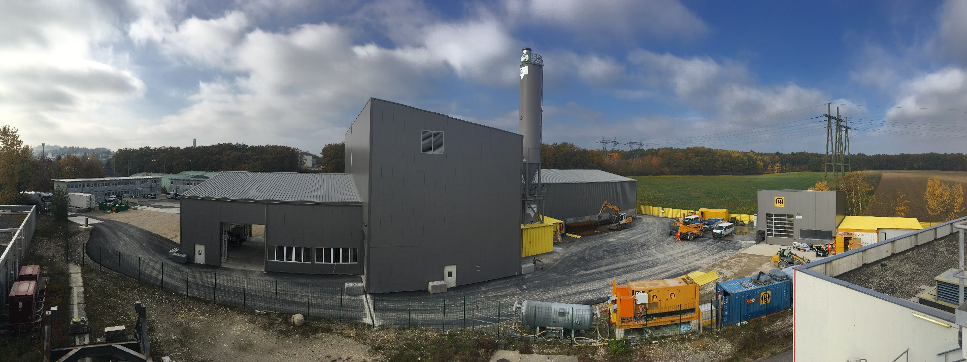
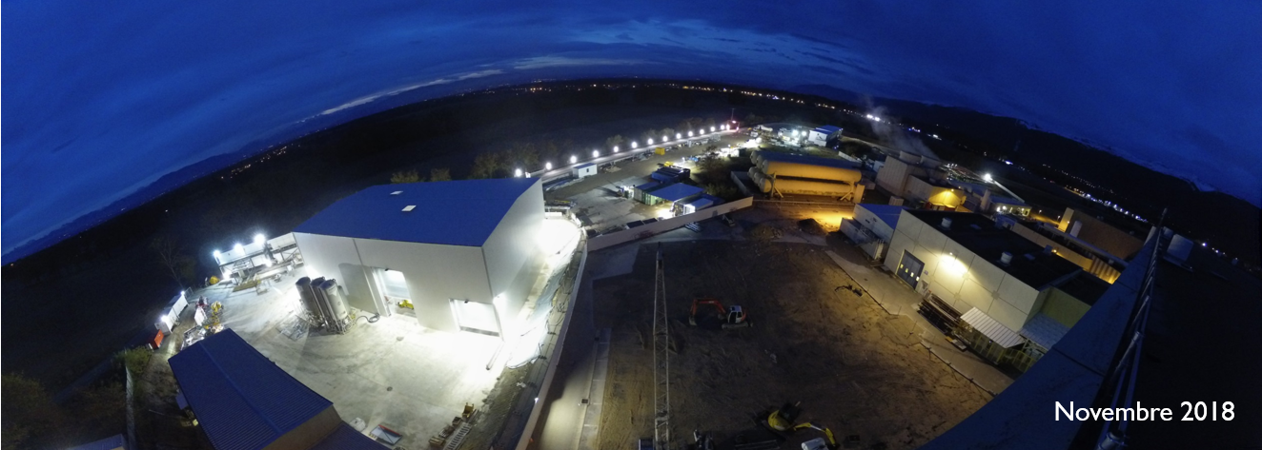
Work progress: Civil engineering (WP17.1)
Site mobilization completed
Point 1
Point 5
(by night)

Slide 7
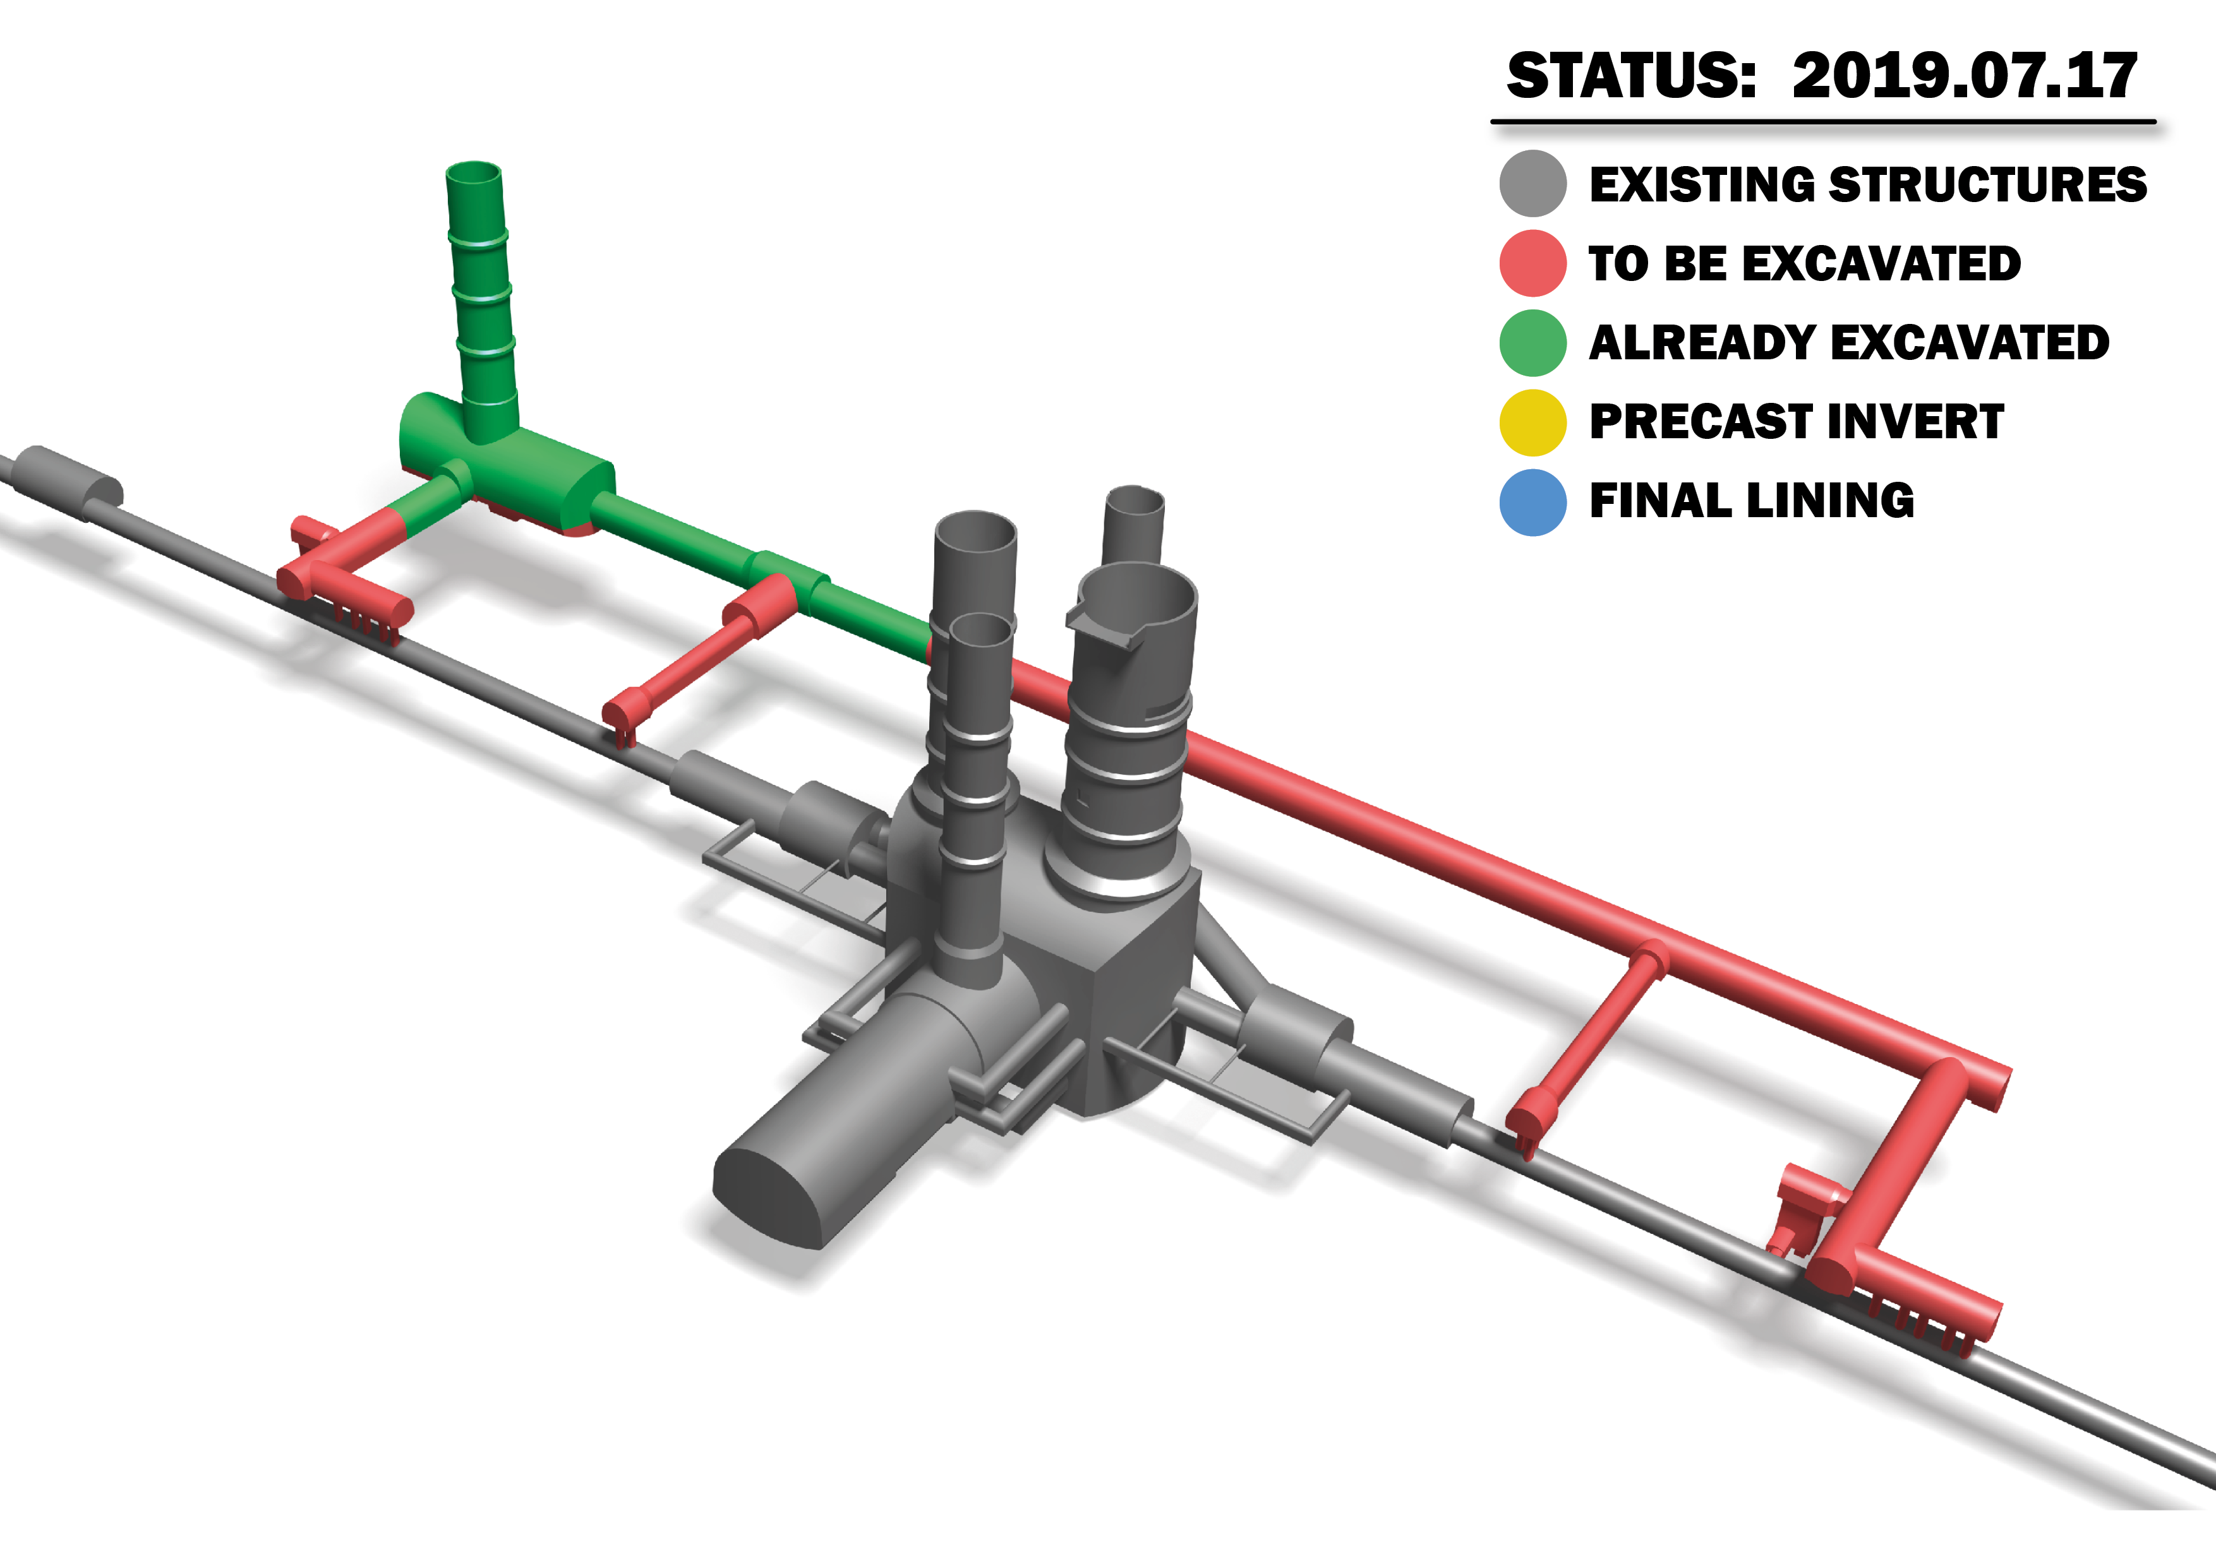
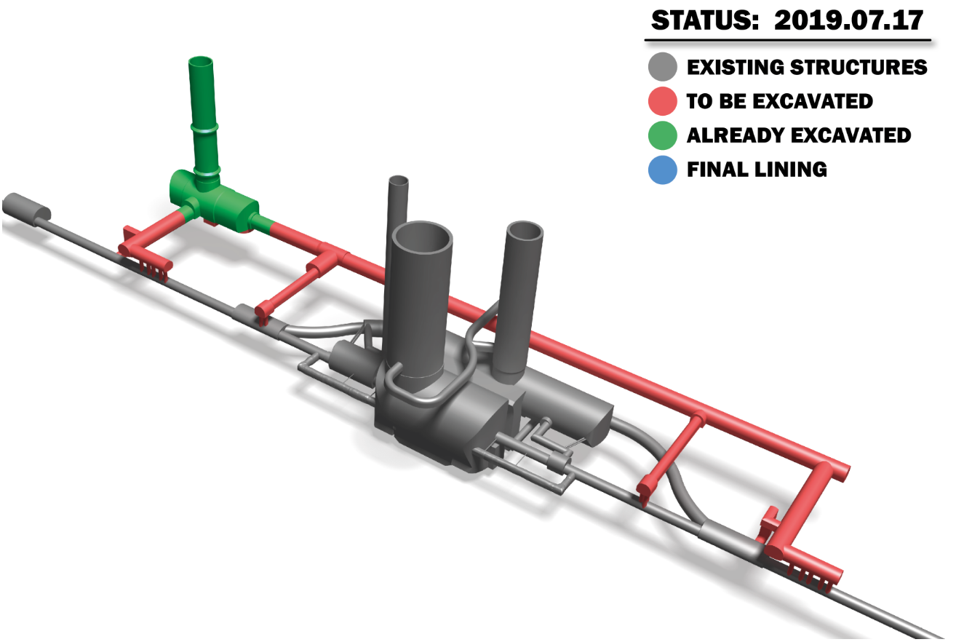
Work progress: Civil engineering (WP17.1)
Point 1
Point 5

Slide 8
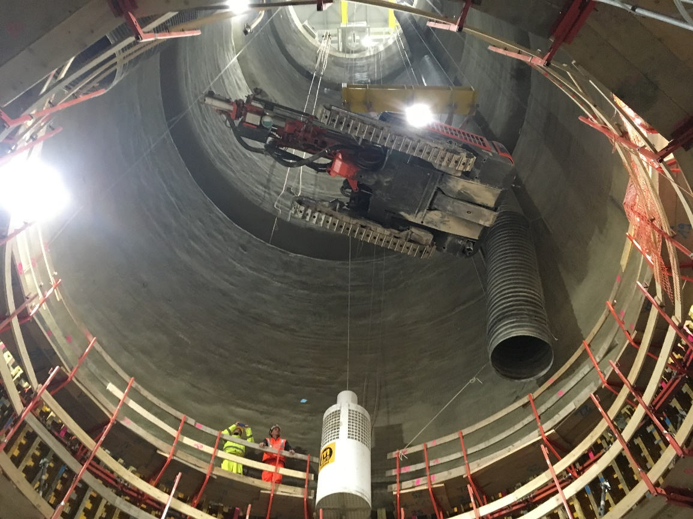
Work progress: Civil engineering (WP17.1)
Shaft excavation completed
Point 1
Point 5

Slide 9
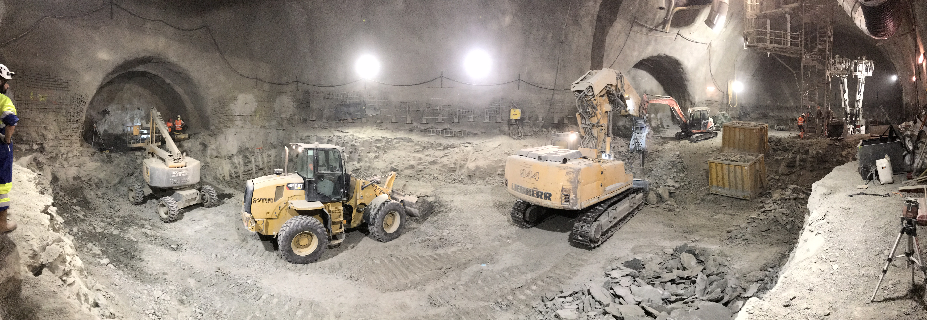
Work progress: Civil engineering (WP17.1)
Cavern excavation about completed (remaining part not on the critical path)
US/UW17 cavern (90% complete, on-hold)
9
US/UW57 cavern 85 % complete

Slide 10
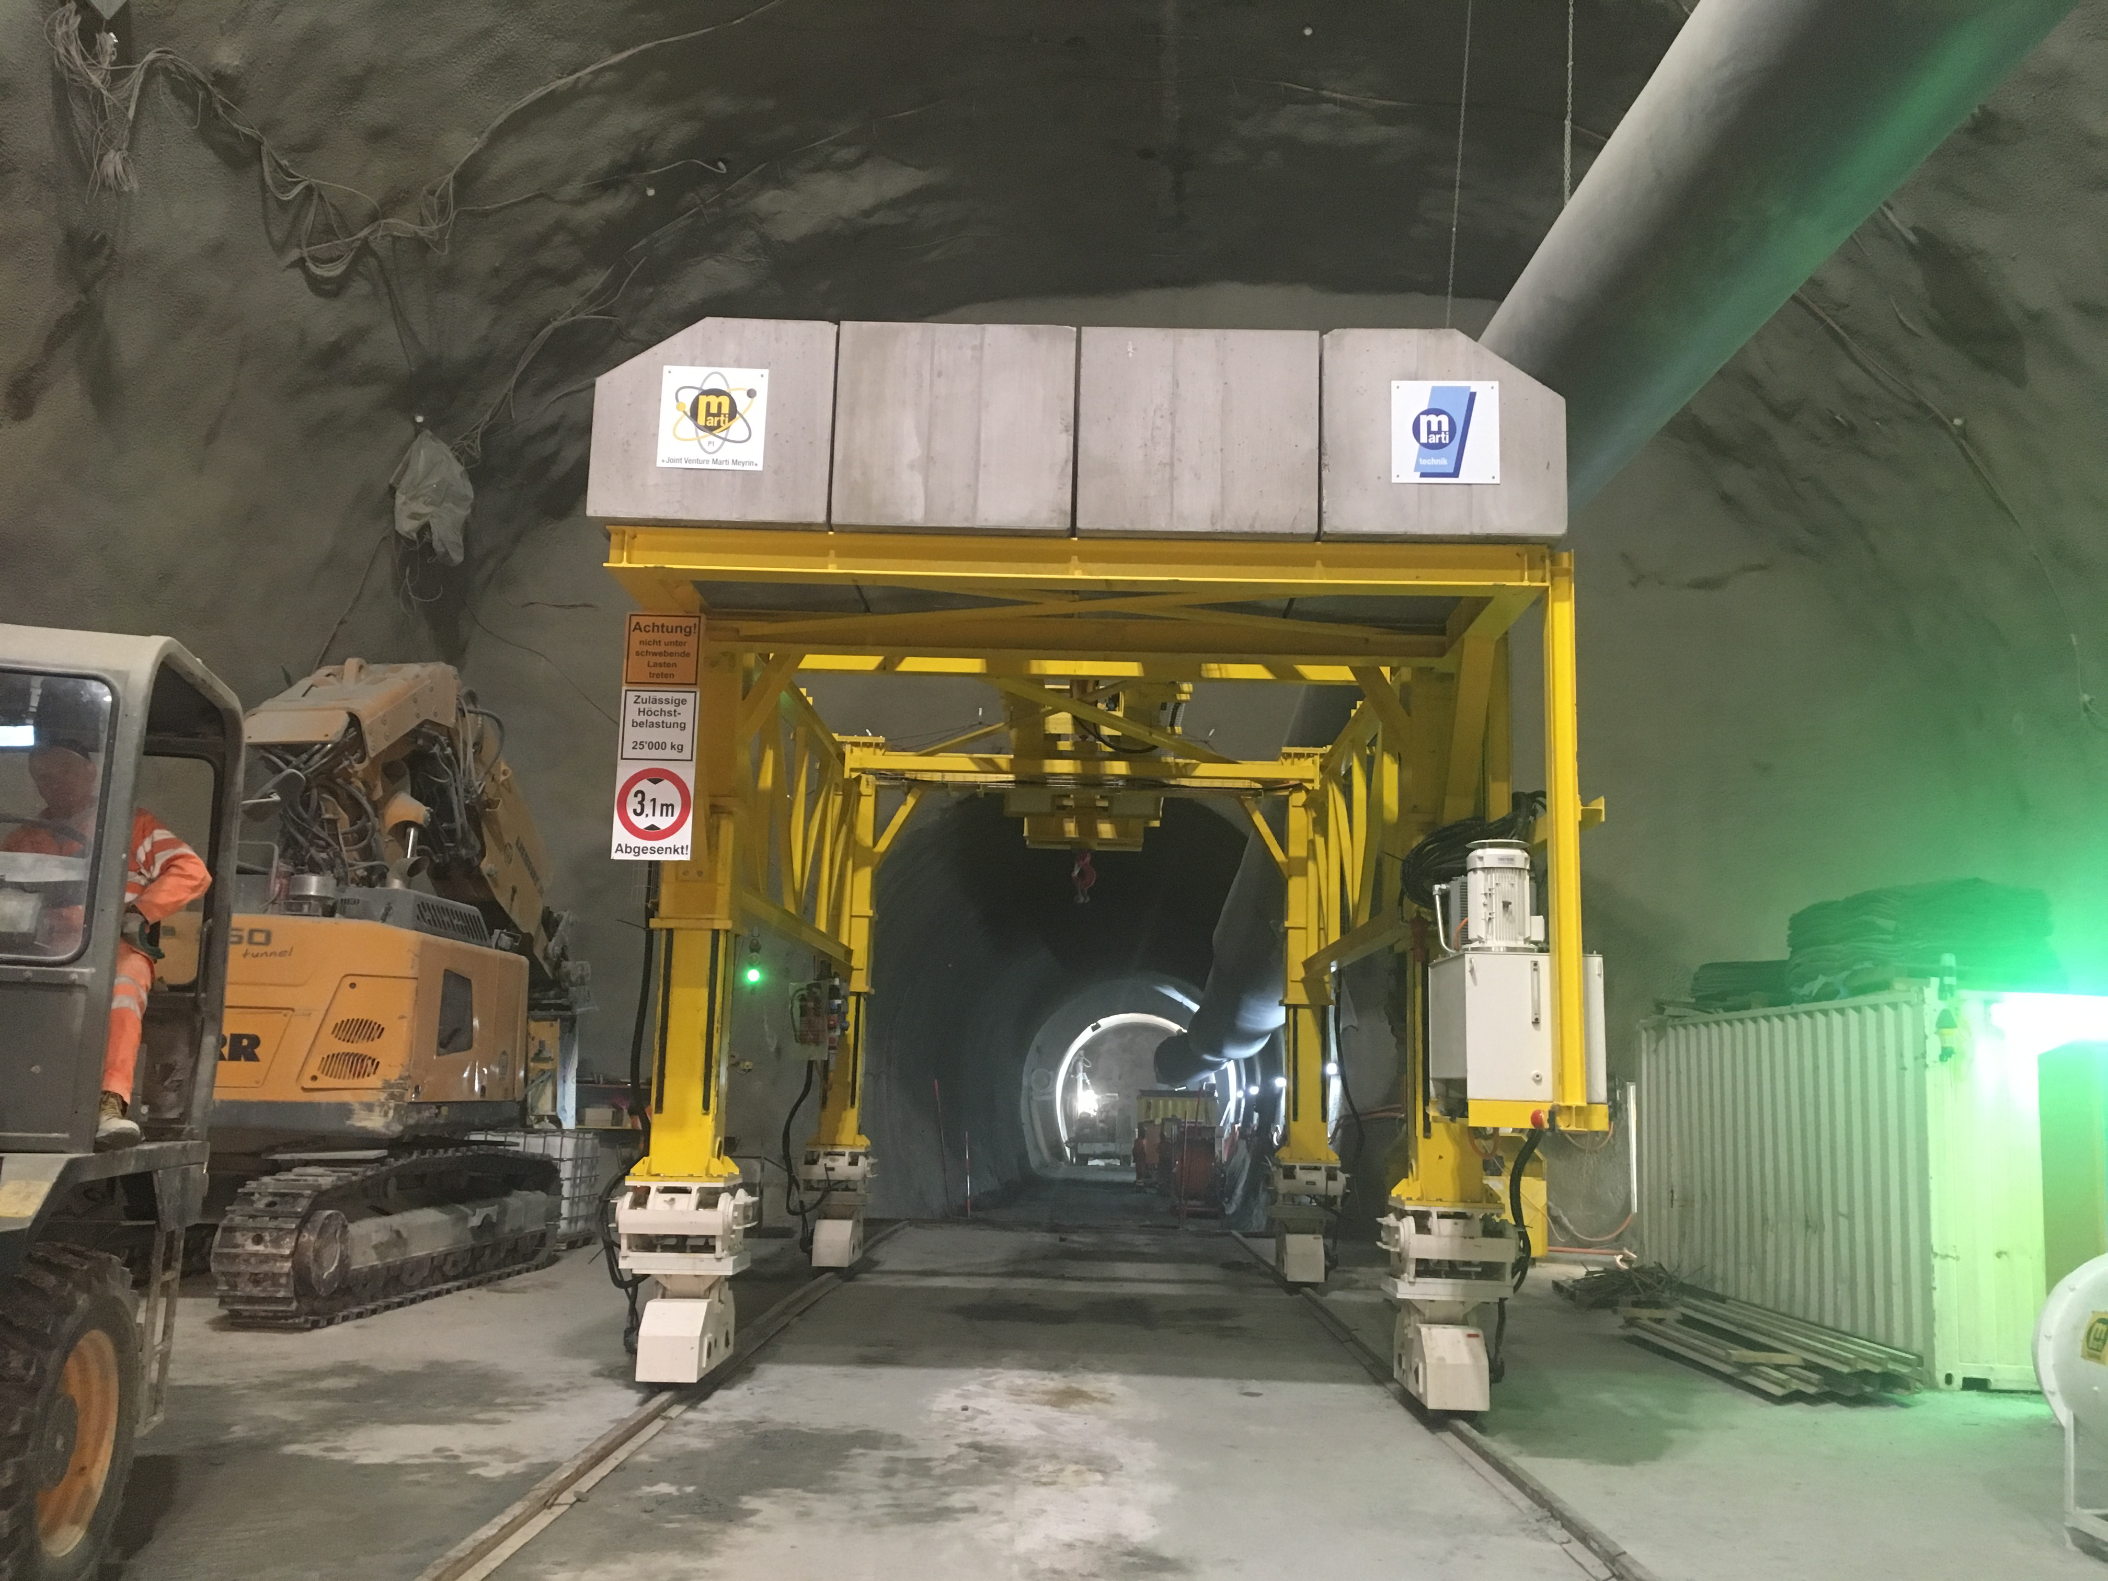
Work progress: Civil engineering (WP17.1)
Technical galleries in progress
View into UR15 through gantry crane to install UR15 precast invert elements

Slide 11
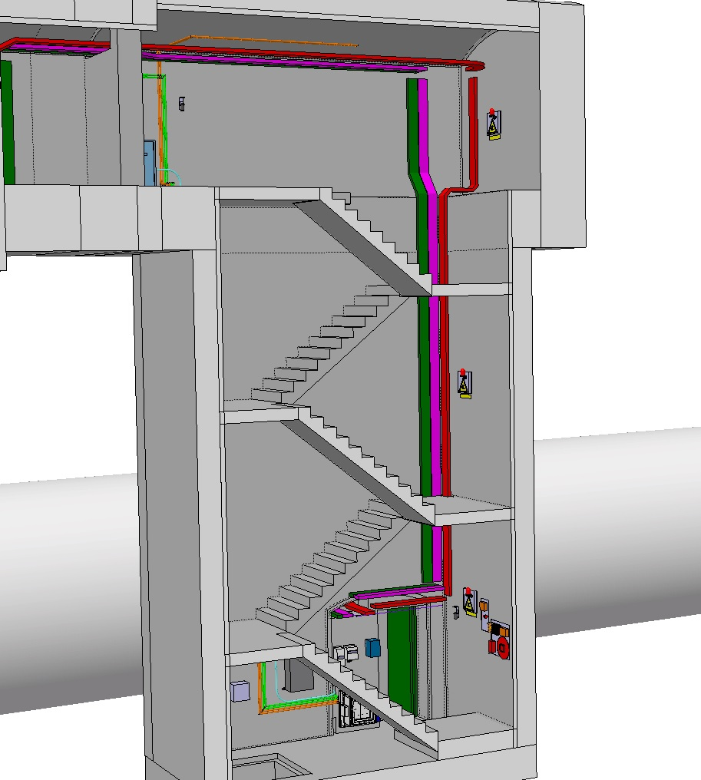
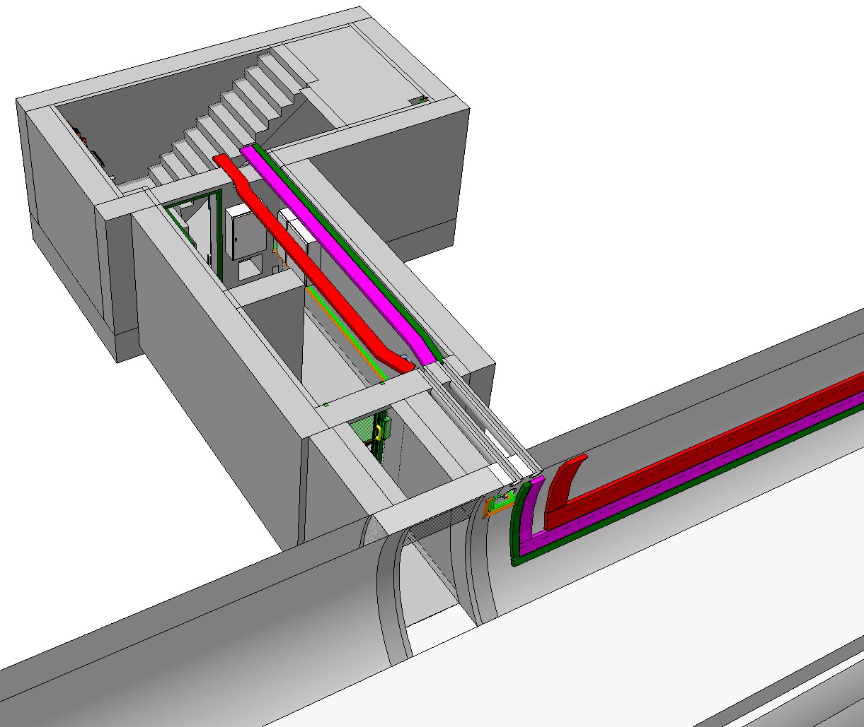
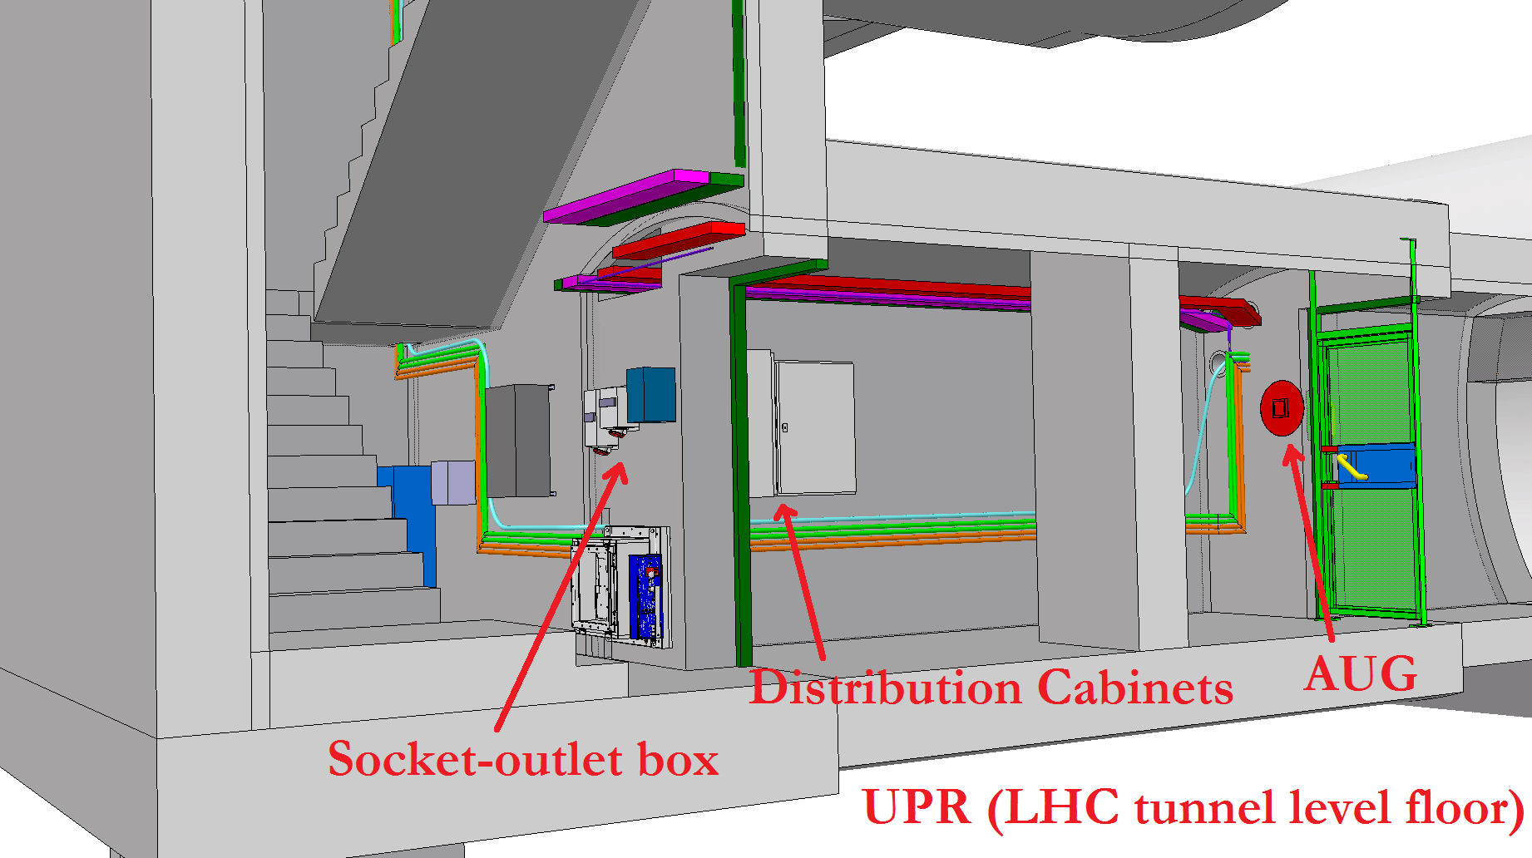
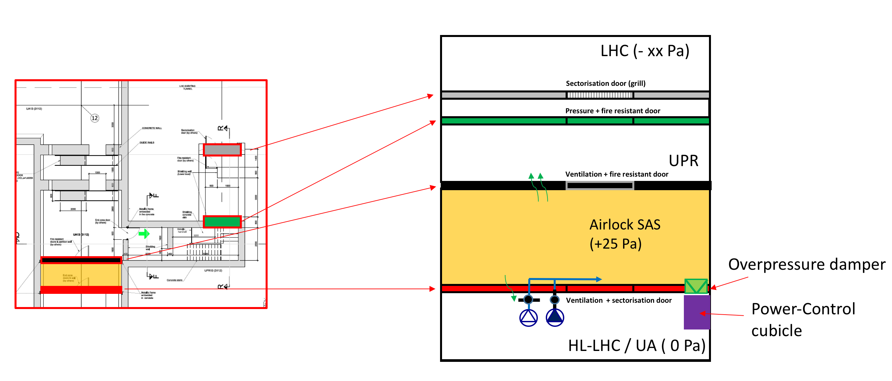
UPR LS2 work preparation: the UPR
Contributions:
WP17.1
WP17.2
WP17.3
WP17.4
WP17.5
WP17.7
WP17.10

Slide 12
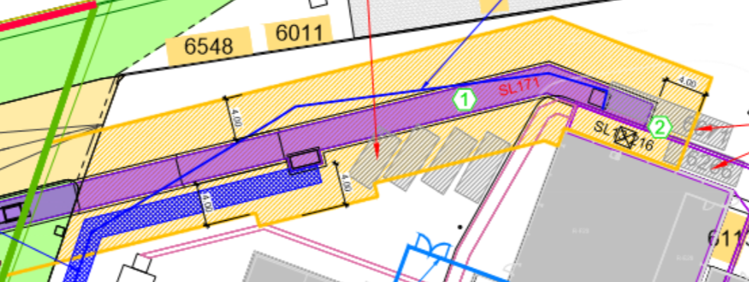
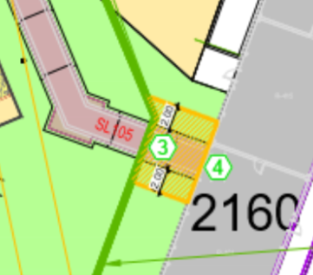
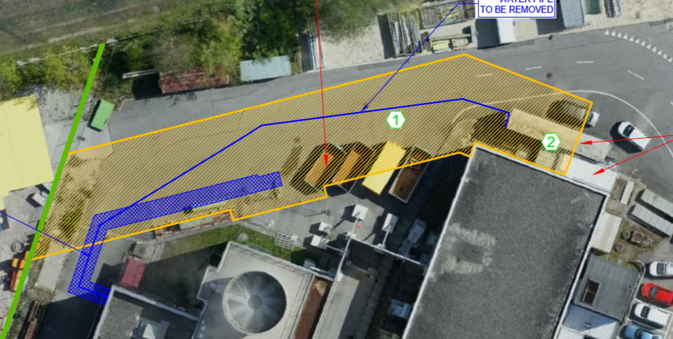
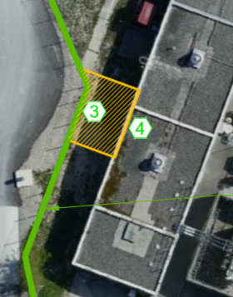
UPR LS2 work preparation: Connection to existing buildings at P1

Slide 13
UPR LS2 work preparation: Connection to existing buildings at P5

Slide 14
Work progress: Electrical distribution (WP17.2)
Review of the users needs
Loads forecast table - version of 07.05.10 |  |  | Point 1 | Point 5
User | WP | Location | [kW] | [kW]
Cryogenic system | WP5 | SHM | 5320 | 5320
Ventilation | WP17.3 | SE | 36 | 36
Ventilation | WP17.3 | SU | 44 | 44
Ventilation | WP17.3 | SF | 51 | 221
Ventilation | WP17.3 | UW | 20 | 20
Ventilation | WP17.3 | SHM | 32 | 62
Ventilation | WP17.3 | UR | 32 | 32
Ventilation | WP17.3 | UA | 6 | 6
Ventilation | WP17.3 | US | 6 | 6
Cooling | WP17.3 | SU | 566 | 566
Cooling | WP17.3 | SF | 520 | 520
Cooling | WP17.3 | UW | 138 | 138
Radiofrequency | WP4 | UR | 0 | 0
Radiofrequency | WP4 | US | 0 | 0
Radiofrequency | WP4 | UA | 888 | 888
Radiofrequency (low level) | WP4 | UR+US | 12 | 12
Collimation | WP5 | - | - | -
Power converters | WP6b | UR | 1014 | 1014
Cold Powering WP6a | WP6a | UR15 | 19 | 19
Machine Protection | WP7 | UR15 | 24 | 24
11T Dipole | WP11 | - | - | -
Vacuum Systems | WP12 | - | - | -
Beam Instrumentation | WP13 | ?? | 6 | 6
Beam Transfert & Kickers | WP14 | HL-LHC | 0 | 0
Survey | WP15.4 | HL-LHC | 65 | 65
EN-EL Fibers Optics | WP17.2 | HL-LHC | 0 | 0
EN-EL Network and Controls | WP17.2 | HL-LHC | 2 | 2
RP Monitors | WP17.4 | HL-LHC | 1 | 1
Transport | WP17.7 | HL-LHC | 316 | 316
General Services | WP17.2 | Surf. & Und. | 320 | 320
 |  | Total | 9,438 | 9,638
Change w/r to the Baseline 2016 |  |  | -577 | -875
Reduced consumption of cryogenics not implemented yet

Slide 15
Work progress: Cooling and ventilation (WP17.2)
Review of the users needs
(-0.2 MW)
(-0.4 MW)
Reduced consumption of cryogenics not yet implemented (-0.8 MW ?)
No impact on the cooling towers (already ordered)
Some cost reductions expected for the other systems

Slide 16
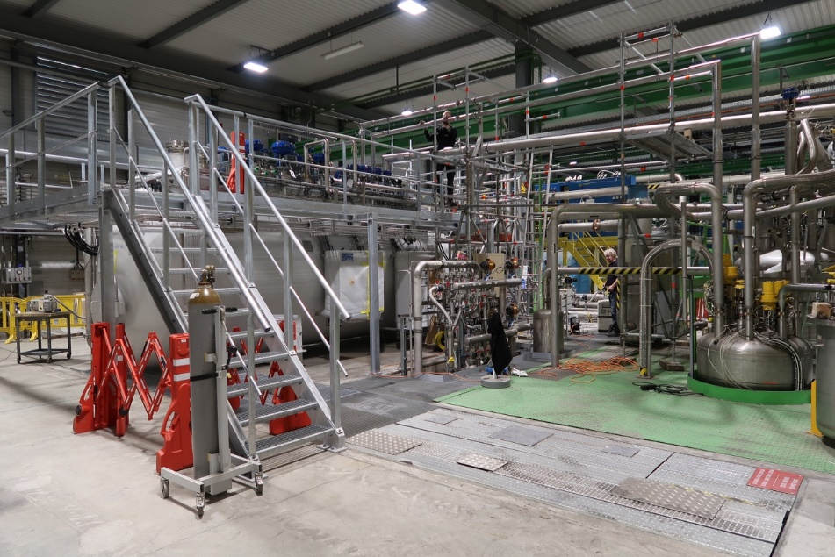
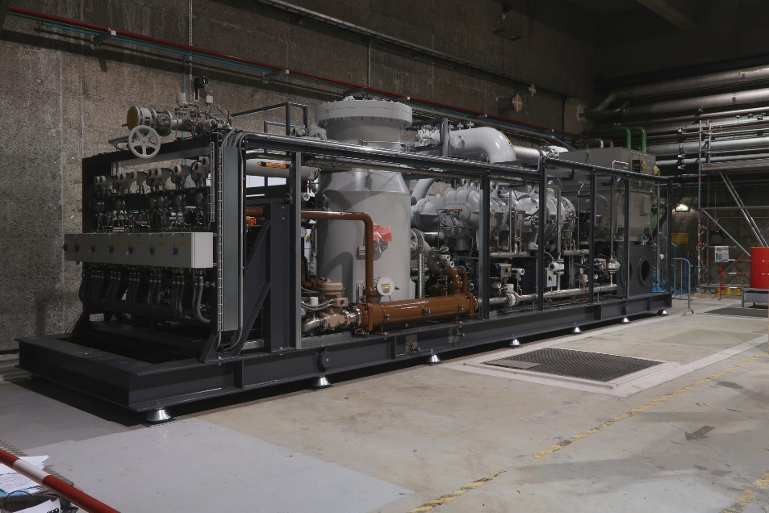
Work progress: Upgrade/consolidation of test facilities (WP17.8)
The new SM18 helium liquefier
Warm compressor station
He liquefier (~1000 l/h)
Commissioning by end 2019!

Slide 17
Open points on WP17 scope
Possible additional Scope
  Location change of the electrical sub-station at P5
  Additional common BE-CO infrastructure in WP17.5 (technical monitoring). Waiting for BE-CO inputs (meeting CW34)
  Special buildings for alarm & access racks
Possible Scope reduction
  Simplification of the smoke extraction system
    Automatic-opening fire-resistant doors vs fire-resistant dampers
    Suppression of the UL smoke extraction system
    ECR in preparation

Slide 18
Location of the electrical sub-station @ P5: the baseline
M. Manfredi

Slide 19
Location of the electrical sub-station @ P5: the alternative
M. Manfredi

Slide 20
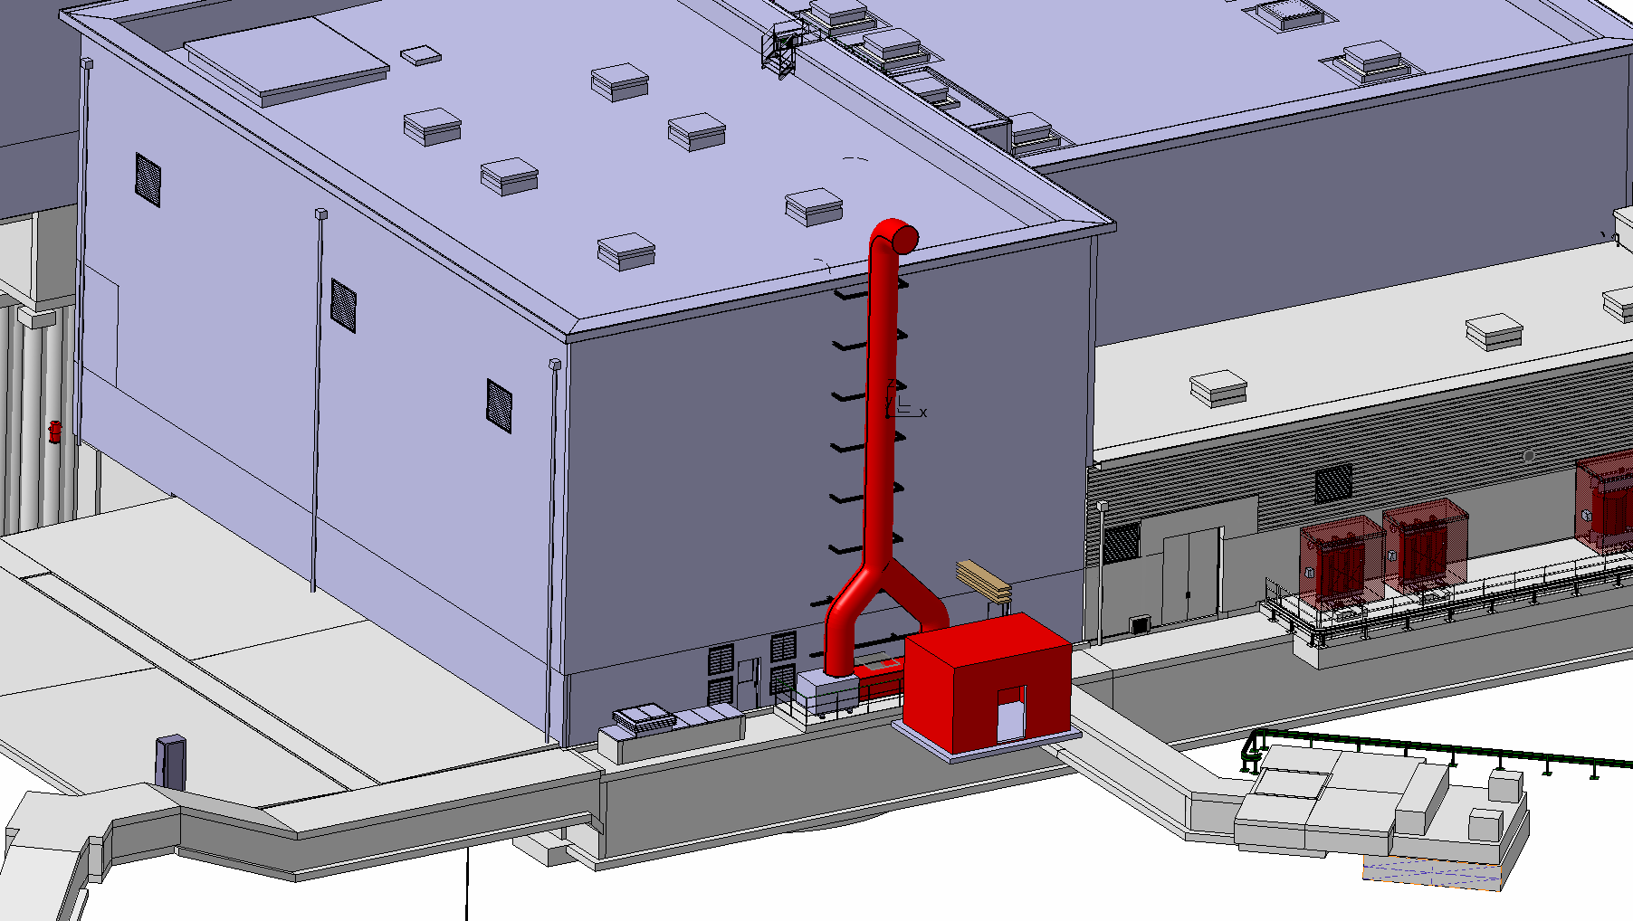
Special building for alarm & access racks @ P1
(Preliminary)
New platform and room for alarm and access racks
S. Maridor

Slide 21
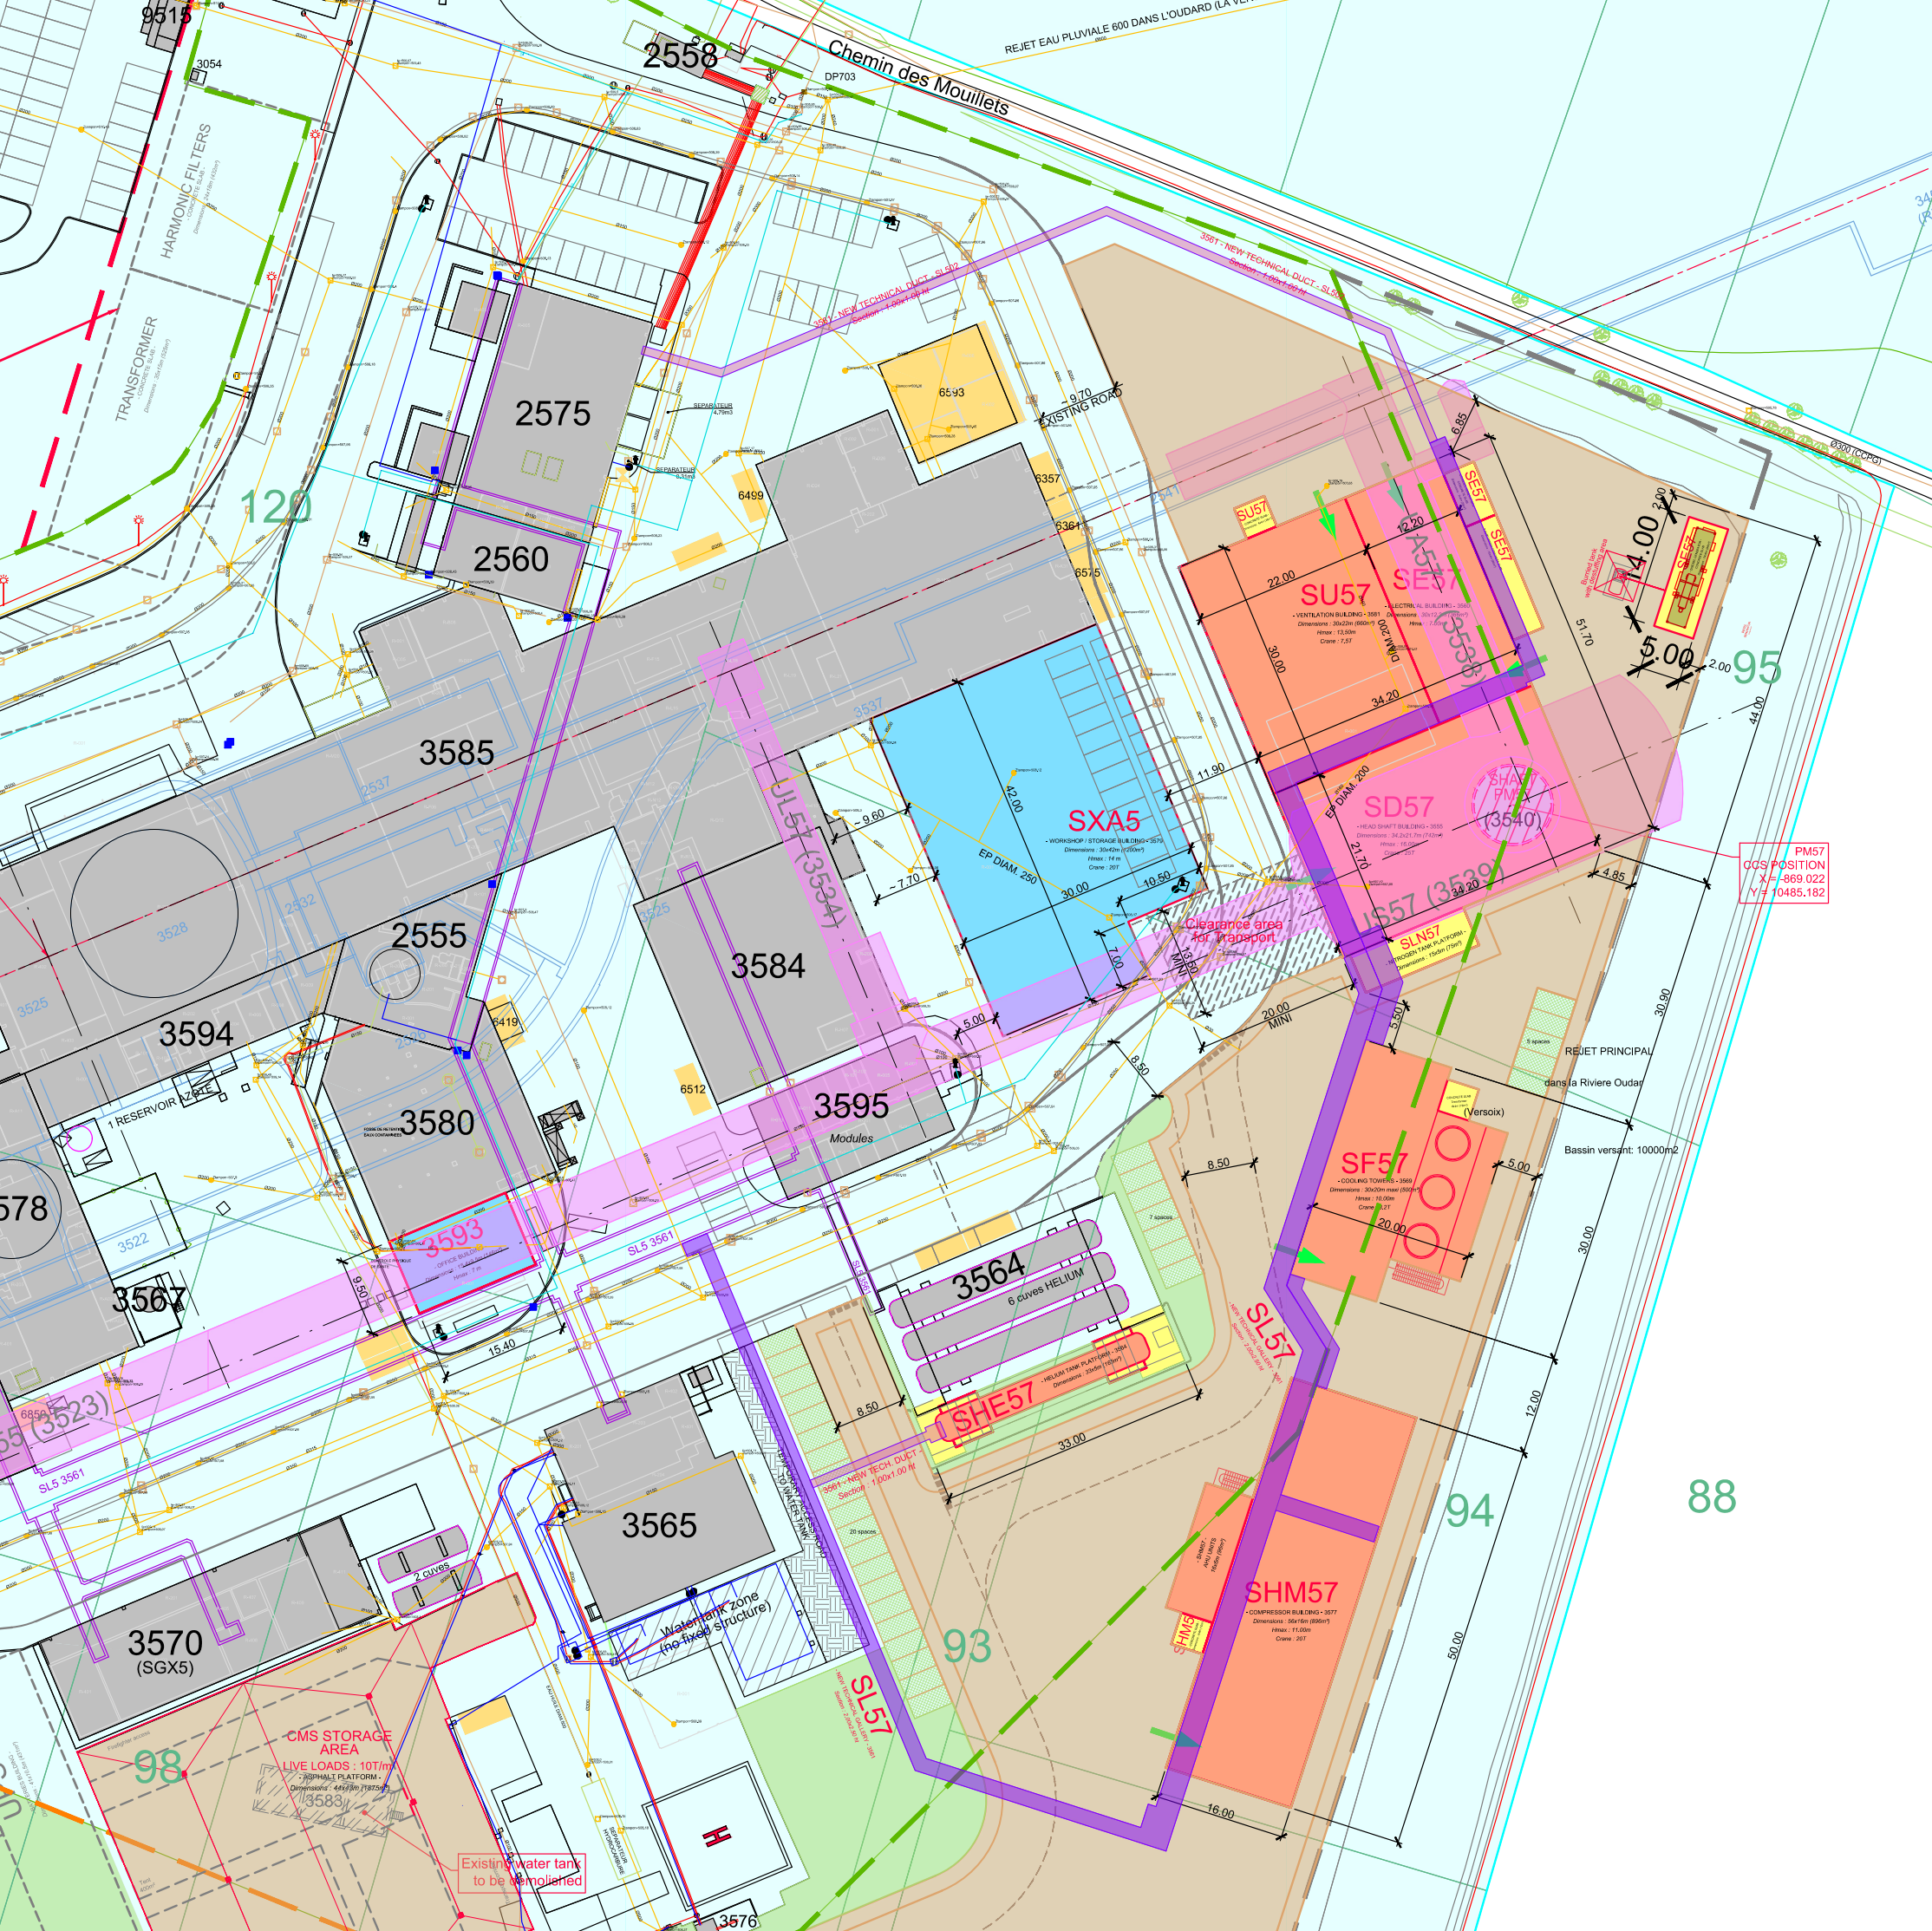
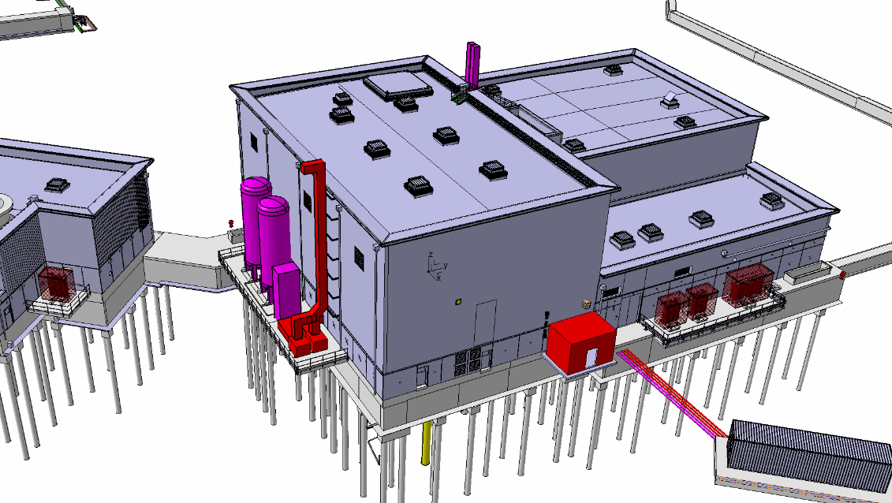
Special building for alarm & access racks @ P5
(Preliminary)
New platform and room for alarm and access racks
S. Maridor

Slide 22
Thank you !

