Slide 1
The High Luminosity
LHC Project at CERN
How to cooperate in CERN R&D activities and create innovative solutions
Beniamino Di Girolamo – CERN
On behalf of the HL-LHC Project
Slovenian Day – CERN – 9 October 2019

Slide 2
Outline
The High Luminosity LHC Project
The mechanism of Collaboration Agreements
Two personal examples of R&D and innovation
Conclusions

Slide 3
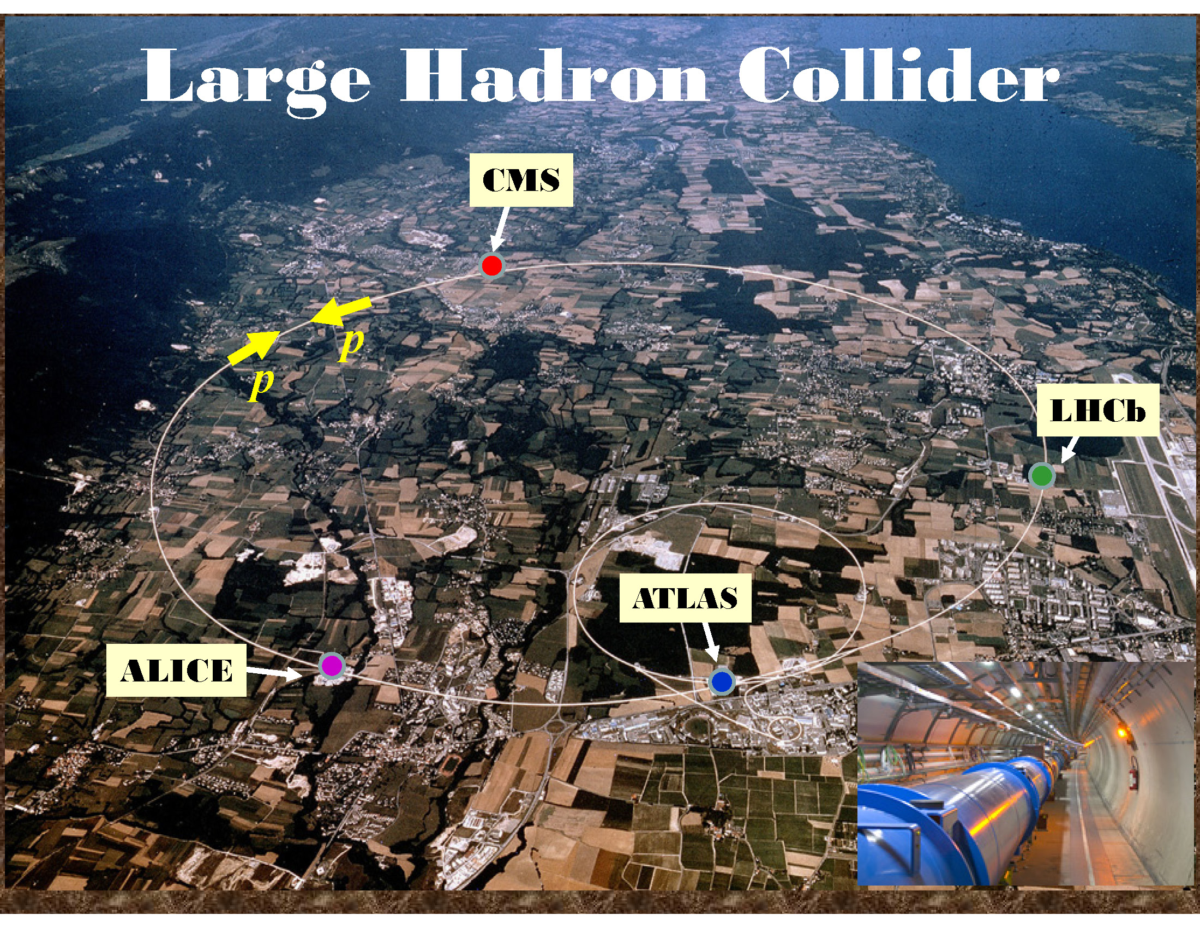

Slide 4

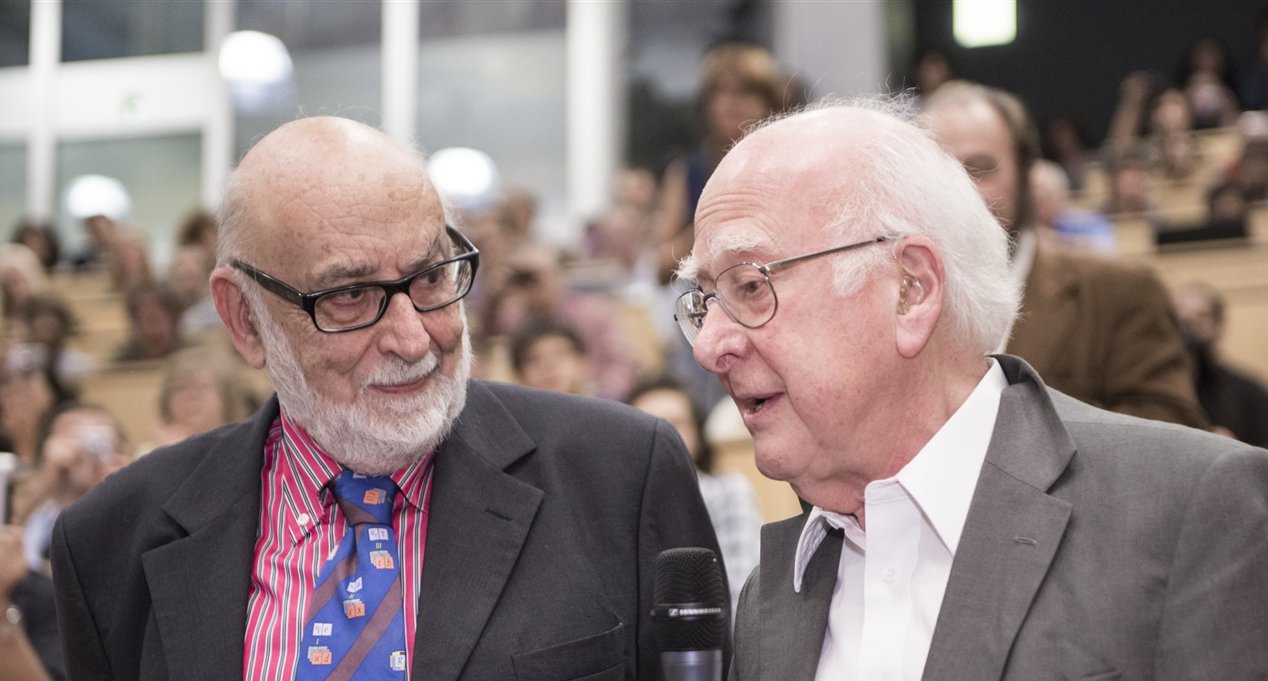
Discovery 2012, Nobel Prize in Physics 2013
The Nobel Prize in Physics 2013 was awarded jointly to François Englert and Peter W. Higgs "for the theoretical discovery of a mechanism that contributes to our understanding of the origin of mass of subatomic particles, and which recently was confirmed through the discovery of the predicted fundamental particle, by the ATLAS and CMS experiments at CERN's Large Hadron Collider”.

Slide 5
But…
No evidence of New Physics so far…
If New Physics at TeV scale its spectrum is heavy: need of high luminosity (3000 fb⁻¹) and a lot of energy
Puzzles:
  Why Higgs boson is so light? (naturalness or fine tuning?)
  What is the origin of matter-antimatter asymmetry?
  Why is Gravity so weak?
  The 96% Dark Universe?
  Other unknowns?
LAST BUT NOT LEAST: LHC is ageing as well as the detectors
Let me summarize as: we need to improve how we produce the phenomena that we want to study and how we look at them.
Find the hidden details.

Slide 6
Goal of HL-LHC as fixed in 2010
From FP7 HiLumi LHC Design Study application
The main objective of HiLumi LHC Design Study is to determine a hardware configuration and a set of beam parameters that will allow the LHC to reach the following targets:
A peak luminosity of L_{peak} = 5×10³⁴ cm⁻²s⁻¹ with levelling, allowing:
An integrated luminosity of 250 fb⁻¹ per year, enabling the goal of L_{int} = 3000 fb⁻¹ twelve years after the upgrade.
This luminosity is more than ten times the luminosity reach of the first 10 years of the LHC lifetime.
Ultimate performance established 2015-2016: with same hardware
and same beam parameters: use of engineering margins:
L_{peak ult} ≅ 7.5 10³⁴ cm⁻²s⁻¹ and Ultimate Integrated L_{int ult} ∼ 4000 fb⁻¹
LHC should not be the limit, would Physics require more…
Project approved by CERN Council in June 2016

Slide 7
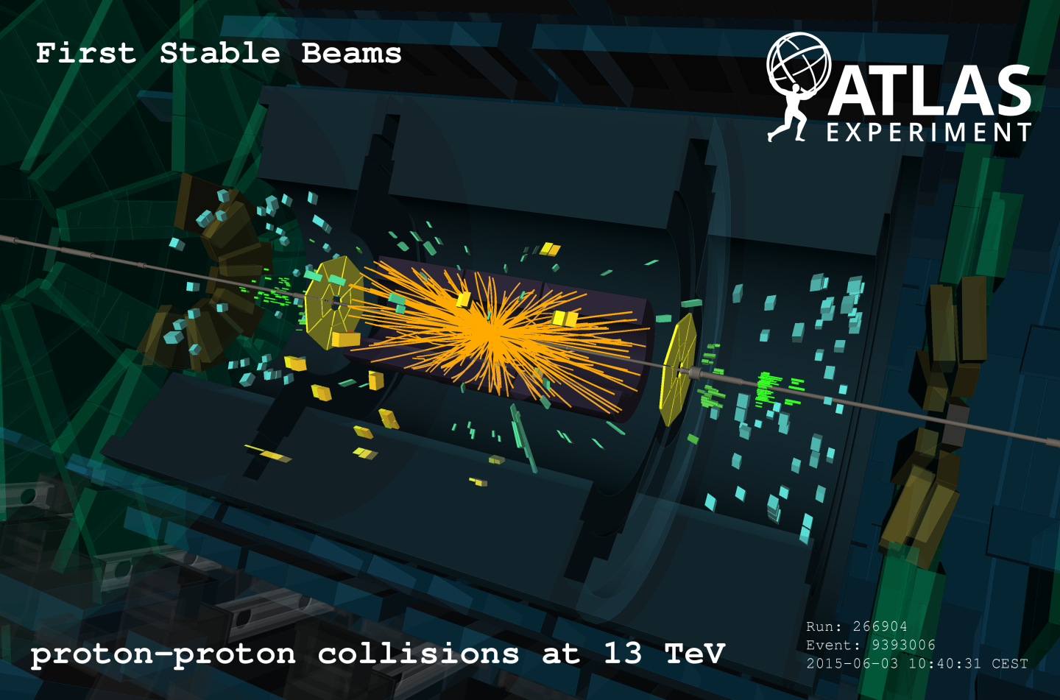
Collecting as many pictures as possible of phenomena

Slide 8
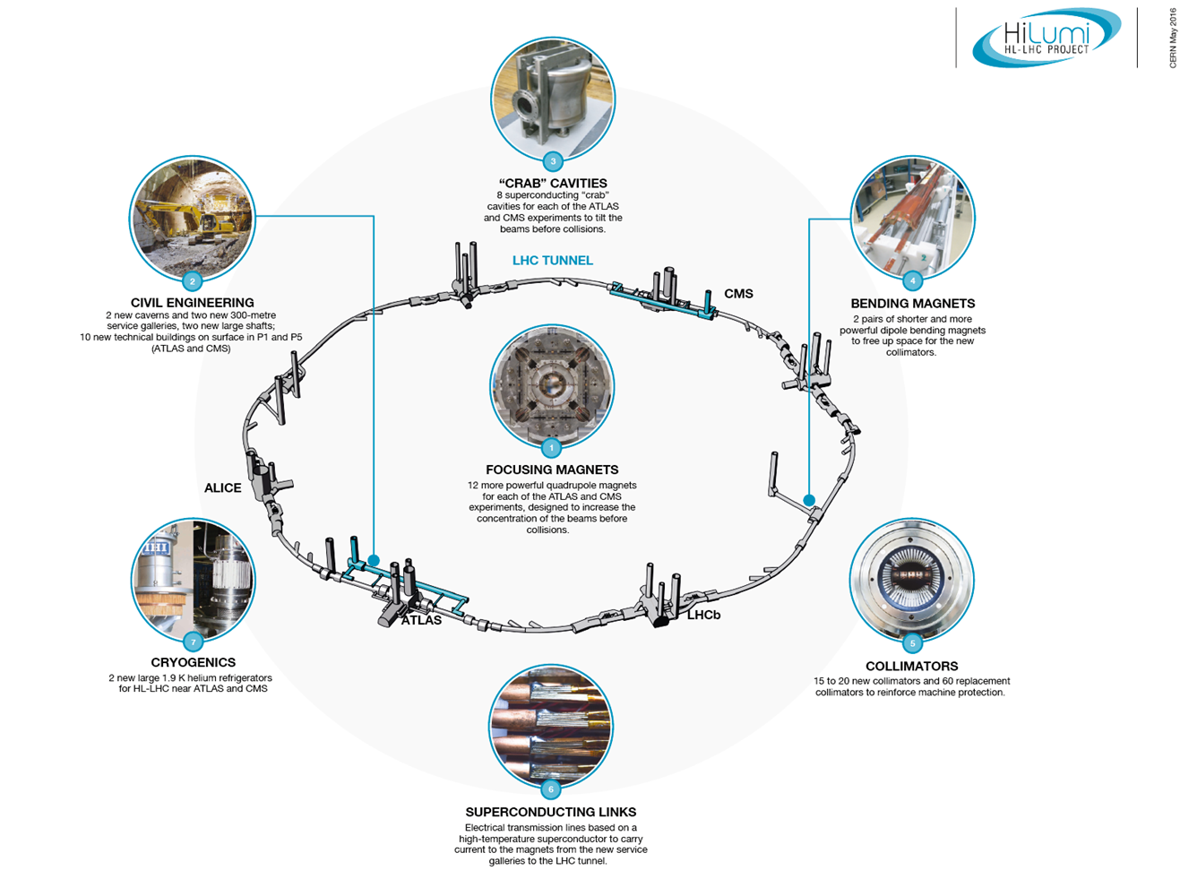
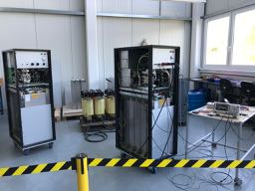
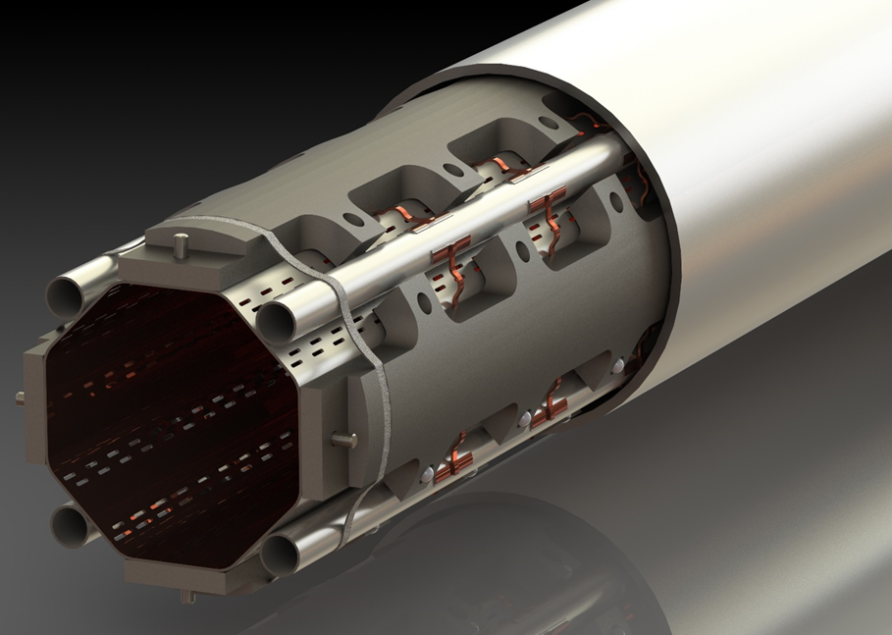
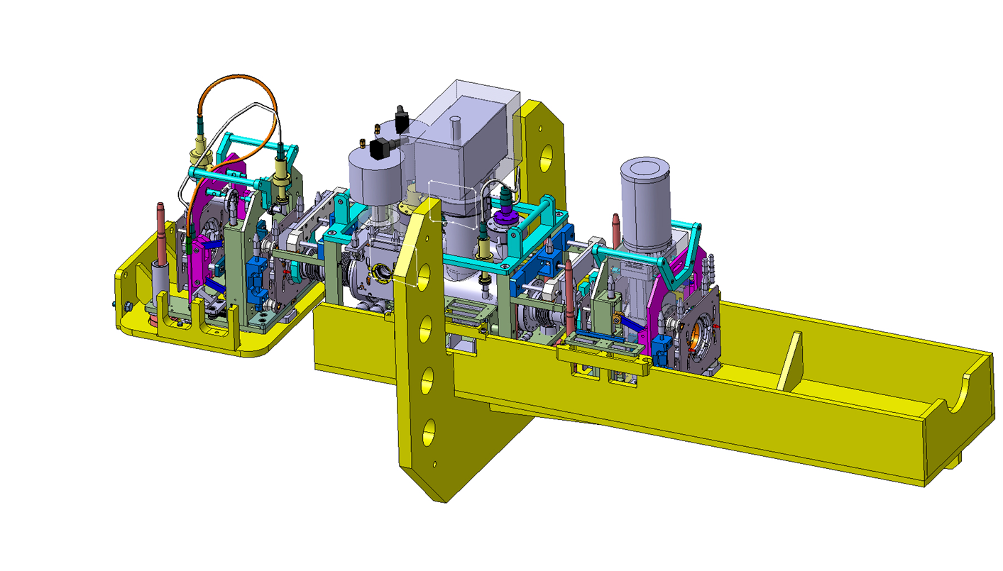
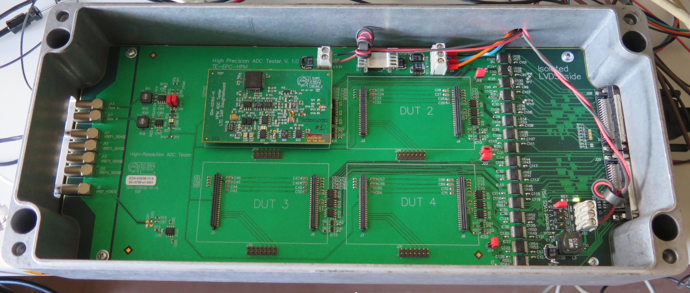
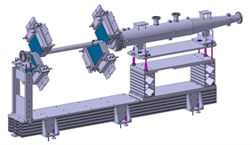
Technology landmarks

Slide 9
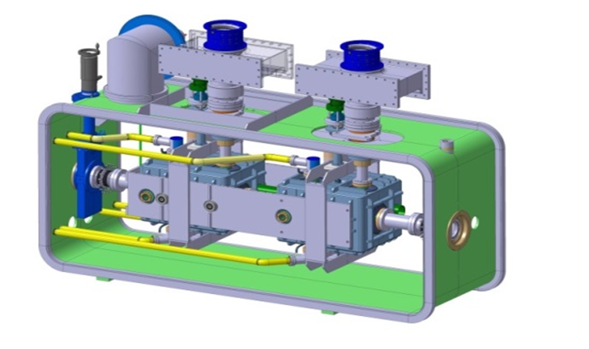
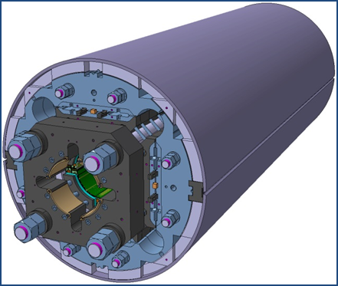
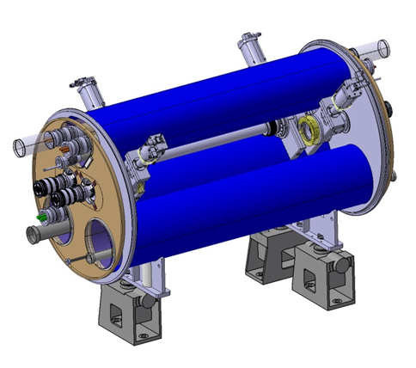
The largest HEP accelerator in construction
ATLAS
CMS
Dispersion Suppressor (DS) in P7
Matching Section (MS)
Interaction Region (ITR)
Modifications
In IP2: new DS collim. in C.Cryost.
In IP7 new DS collimation with 11 T
Change/new lay-out
TAXN
D2
CC
Q4
Correctors
Q5
Q5@1.9K in P6
New collimators
Complete change and new lay-out
TAXS
Q1-Q2a-Q2b-Q3
D1
All correctors
Heavy shielding (W)
Cryogenics, Protection, Interface, Vacuum, Diagnostics, Inj/Extr… extension of infrastr.
> 1.2 km of LHC !!
Notes:
Put IR1 and IR% ovberr the grey Martching Section and ITR

Slide 10
Participation with collaboration agreements
CERN procures via tenders and procurement rules as explained
In addition there is a mechanism for countries to provide in-kind contributions
  A collaborating institute from a given country establishes a collaboration agreement with CERN
  The institute provides part of the funding (generally 50% for member states)
  The institutes takes on liability and procurement strategy

Slide 11
In-Kind contributions – Considerations
In-kind contributions are necessary for:
  Reducing the CERN financial cost.
  Having NMS that are members of LHC experiments, to participate also to the accelerator construction cost.
In-kinds are agreed with Collaborating Laboratories or Institutes, via Collaboration Agreements
The in-kind contributions generate work for industry
  Contributions are typically hardware deliverables built in institutes and industries (via tenders by the institutes)

Slide 12
In-kind contributions – Not only money!
In-kind contributions are necessary for HL-LHC also because:
  CERN has not enough personnel for design and follow up: with no external collaborator we would delay the project or we would need to stop other key R&D.
  That’s why is critical that an Institute has its own competent personnel to make engineering and/or the construction follow up.

Slide 13
K-contracts for collaboration agreement
CERN Procurement treats it as a contract awarded to a Research Institute/University
If the payment is > 200 kCHF the Finance Committee authorization is required since it is a direct contract without formal tender.
Industry are involved by the Collaborating Institute according to its own rule. CERN needs to qualify and approve the main «subcontract».
The trend of the in-Kind contribution is monitored by the HL-LHC management via special «Steering committees» and by the HL-LHC Collaboration Board
The 50% is not a hard threshold but we need to show to the FC that the gain for CERN is solid (w.r.t. to a tender).

Slide 14
A list of contributions
 | COUNTRY | Institute | Title
R&D | France | CEA | Thermal Design of Superconducting High Field Magnets at CERN
 | UK | Manchester | Beam instrumentation
 | UK | Manchester | Cold powering: DFBX for String
 | UK | ASTeC+Dundee | Laser treatment prototype (LESS)
Prototypes and BASELINE | Italy | INFN | High-order corrector magnets + prototypes
 | Spain | CIEMAT | Nested orbit correctors + prototypes
 | China | IHEP | D2 Correctors
 | Sweden | Uppsala Univ. | Cold testing of corrector magnets and crab cavities
 | Japan | KEK | D1 magnet model and cold mass
 | Italy | INFN | D2 model + prototype+ Magnet
 | USA | Several | Crab Cavities
 | USA | Several | Triplet magnets
 | Canada | TRIUMF | RFD Crab-cavities cryomodules
 | Sweden | Uppsala Univ. | DFHM and DFHX 8+2 units
 | UK | SOTO | DFM and DFX 8+2 units
 | UK | ASTeC+Lancaster | DQW Crab-cavities cryomodules
 | Serbia | Ministry | Magnets and CC jacks
 | Russia | BINP | TAXS and TAXN
 | Russia | BINP | Current leads matching section and inner triplets
 | Russia | BINP | Low impedance collimators (12 units) + IR collimators (28 units)
 | Russia | BINP | Solid State RF powering (replacing IOT)
 | Russia | BINP | BPM Mechnics (20+28 units)
 | Russia | Protvino | Ionisation chambers for SPS and LHC systems for HL-LHC beams (1000 units)
 | Russia | MEPhI + JINR | HF-HOM and HOM Couplers and Filed Antennas
OPTIONS | UK | LIV+RHUL | Beam instrumentation EO-BPM
 | UK | Liverpool | Beam Instr. For HEL
 | UK | Dundee | Laser treatment final (LESS)
 | Russia | BINP | LHC Dump System
 | Russia | BINP | OPTION: Hollow e-lens
 | Russia | PNPI/Protvino | OPTION: ​Crystal collimation for ions

Slide 15

Collaborating Institutes on HL-LHC WEB
“the sun never sets”
http://hilumilhc.web.cern.ch/about/collaboration-institutes

Slide 16
Other considerations
An in-kind contribution makes sense only in case of a long term interest by an Institute
Never a good idea to use it simply to maximize the short term return.
However, it can turn out a very good long term investment!
But must be supported by a genuine scientific and technological interest by a competent home team! Without a competent home team is NOT possible to assign an in-kind contribution!
The interest of CERN is a networking model where the CERN resources are matched by local national resources and where the entire community align to the CERN scope providing also an invaluable intellectual contribution, beside increasing the validated industrial partners.
So collaborations and in-kinds are necessary for HL-LHC and also in this respect HL-LHC is a necessary «prototype» for FCC!

Slide 17
Before concluding: two very personal examples of R&D activities and innovative solutions

Slide 18
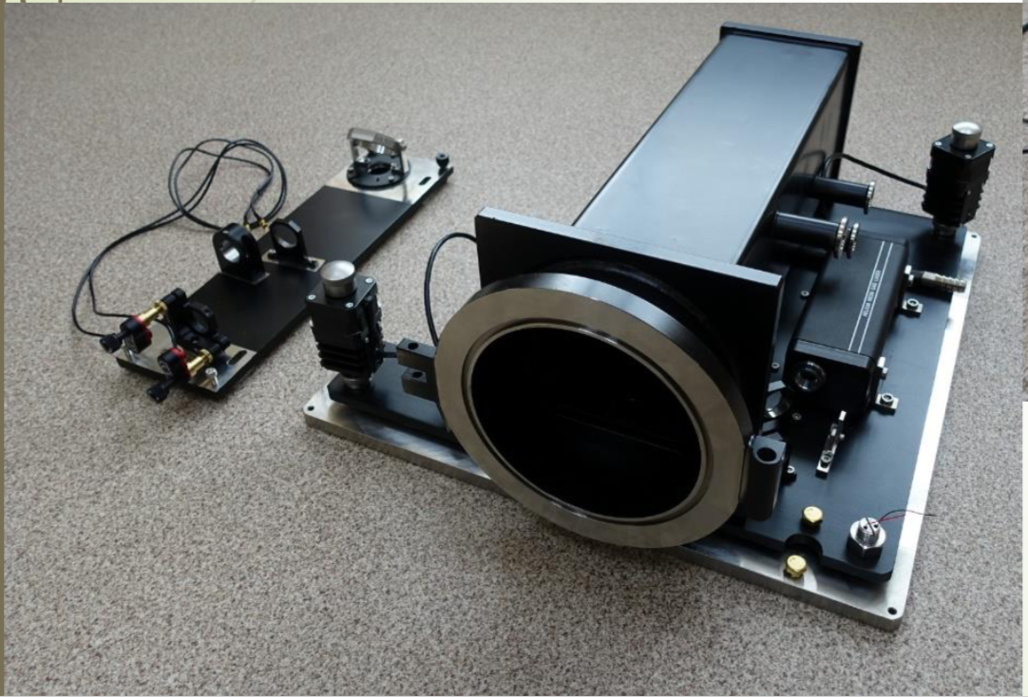
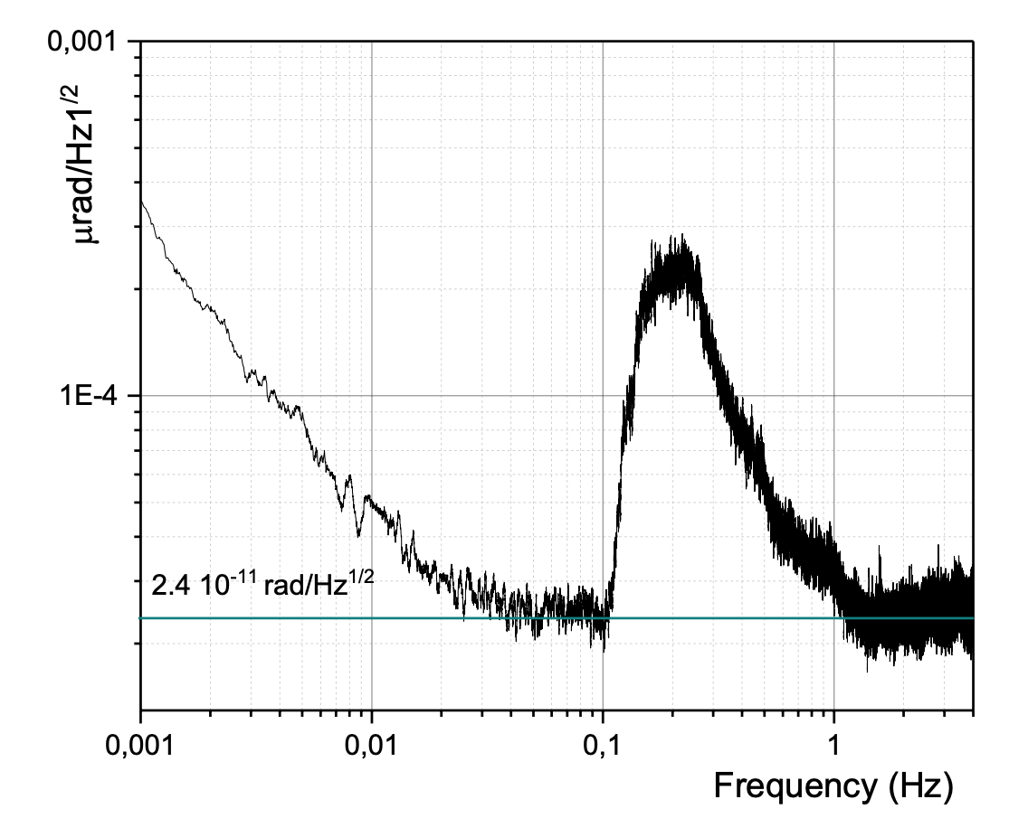
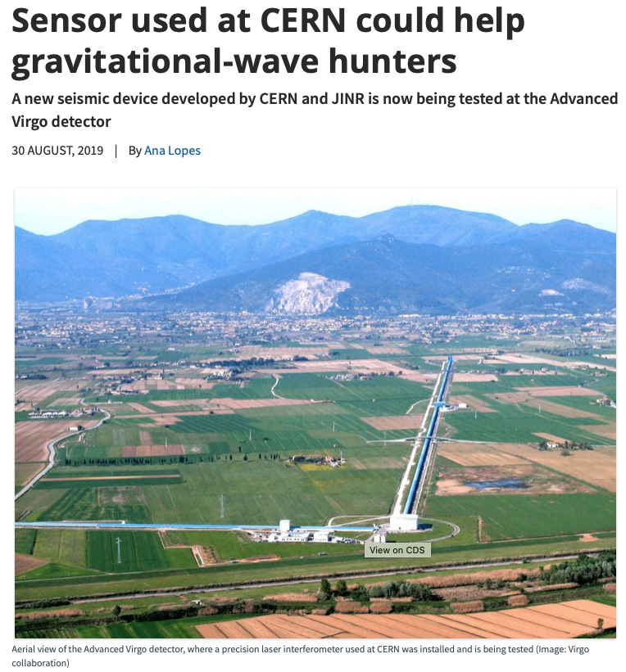
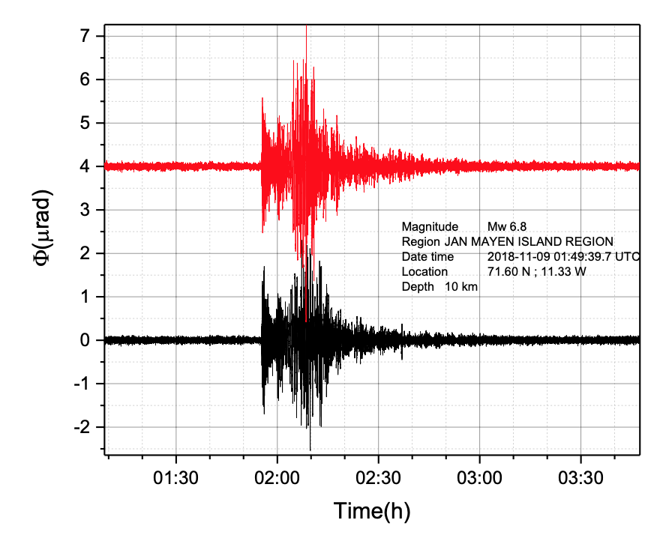
Development of high precision angular measurements
  A precision of 2.4.10⁻¹¹ rad/Hz^{1/2} in the frequency range [10⁻³,12.4] Hz
CERN-JINR collaboration
Now installed also at Virgo - a gravitational wave experiment

Slide 19
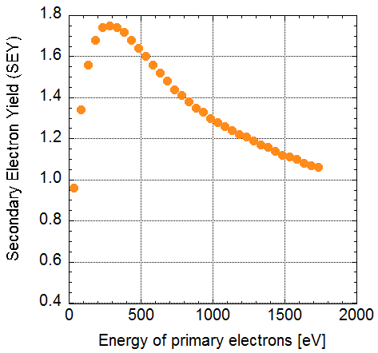
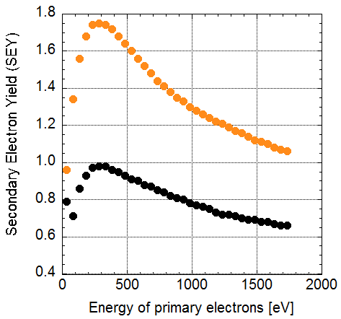
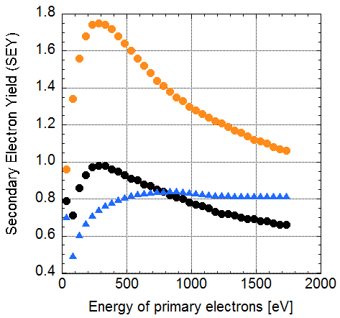
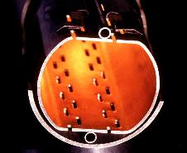
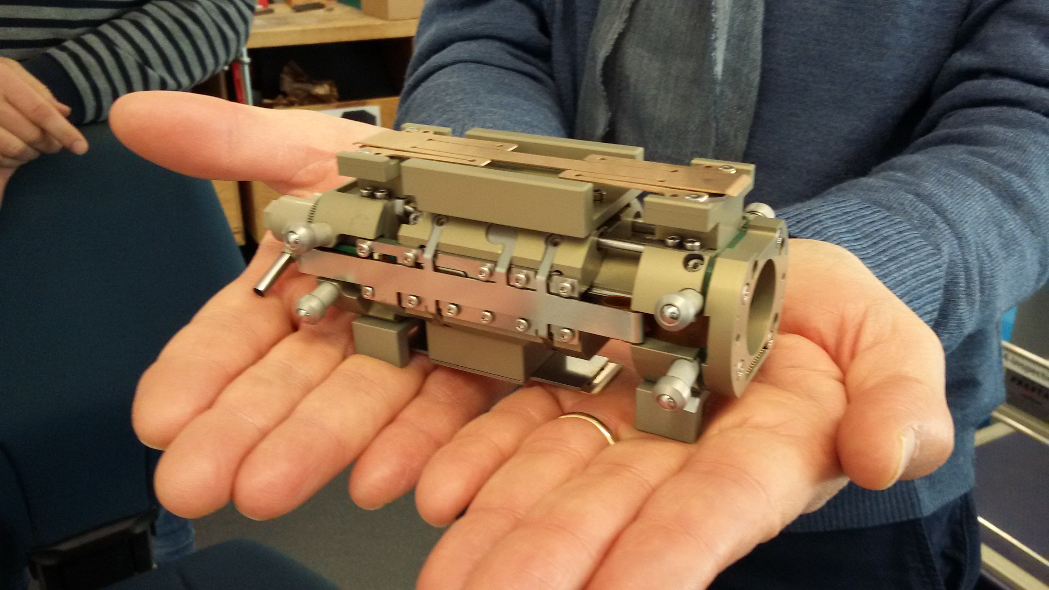
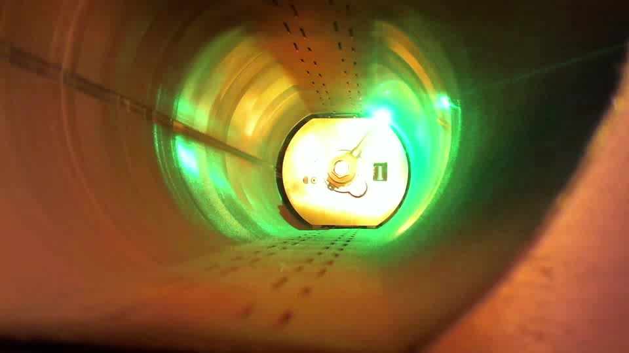
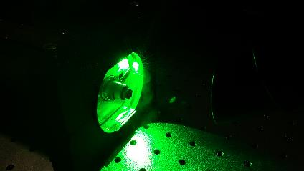
Very high precision positioning system to bring laser light in a tiny pipe
δ_{max}
10 μm
Fighting e-cloud effects that induce higher need of cryogenic power
Cu
Laser treated
a-C
LESS
Lower SEY is a
morphological effect
LHC beam screen
7 μm precision in translation
CERN-Dundee Univ.-STFC and GE-IR

Slide 20
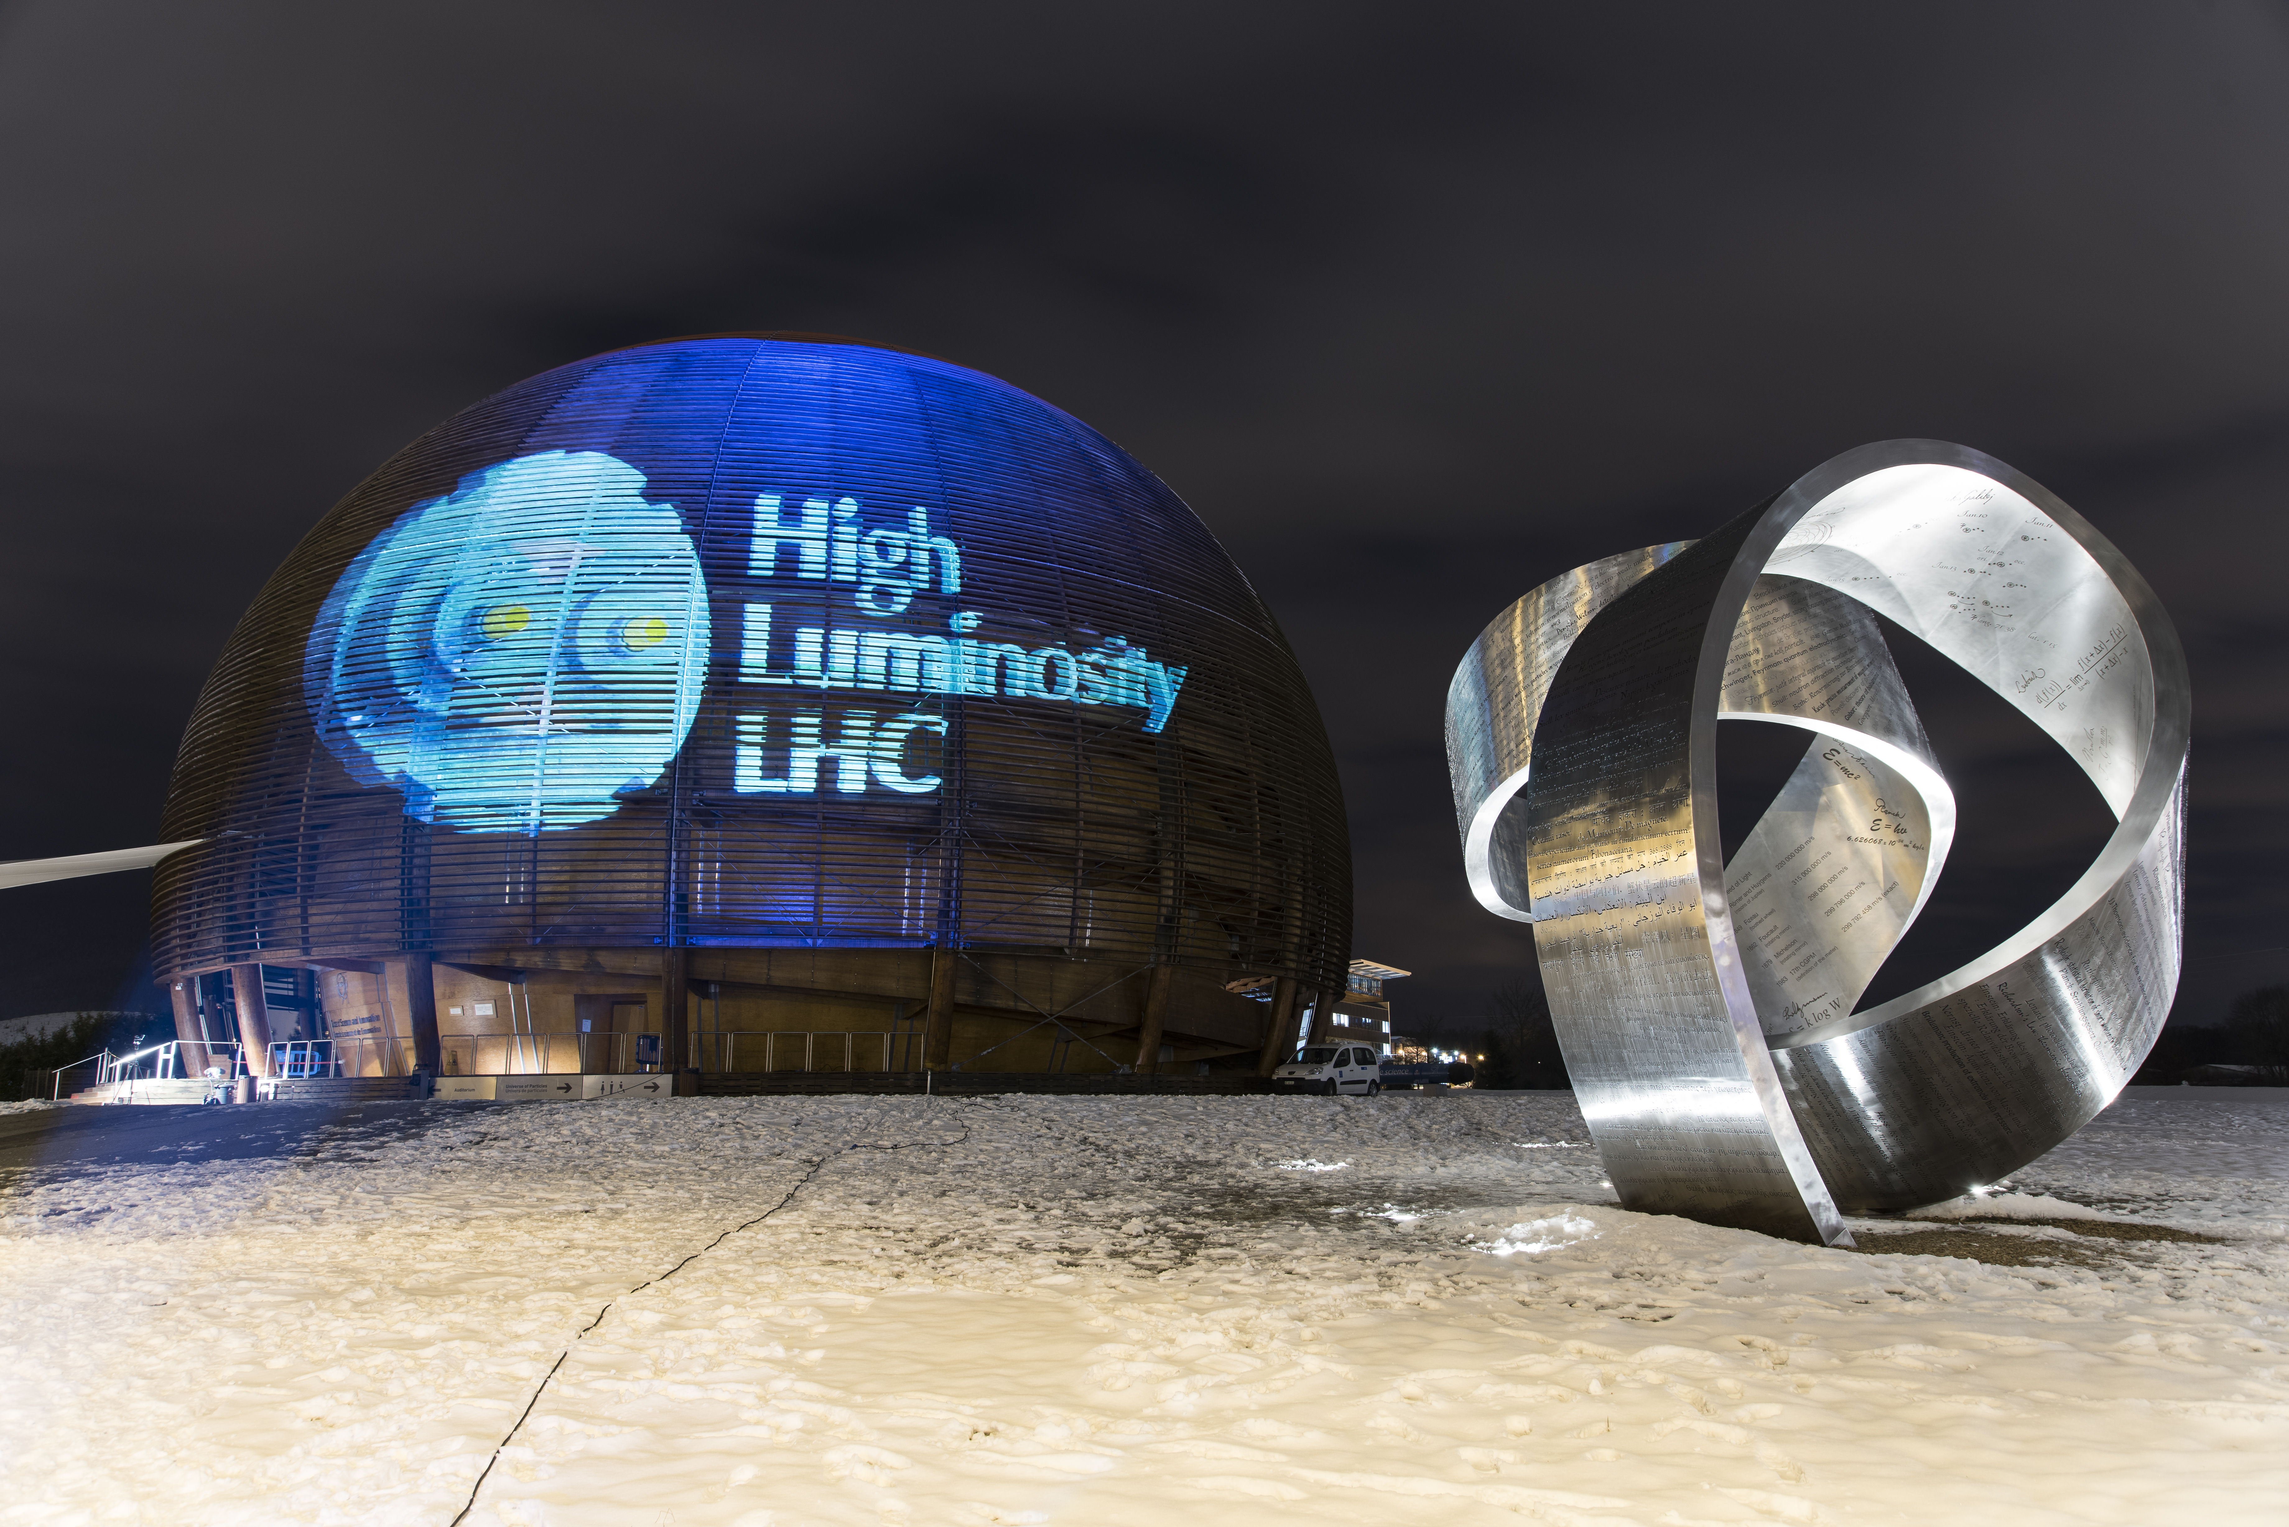
Thanks!
Questions?

