Slide 1
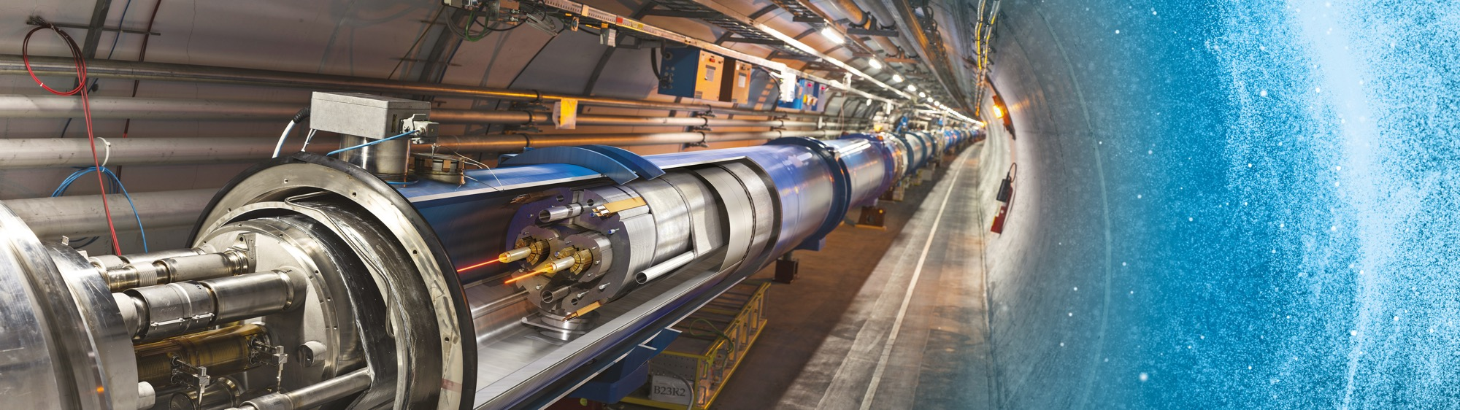
Business opportunities at CERN
Slovenia @ CERN - 09 October 2019
Jérôme Pierlot

Slide 2
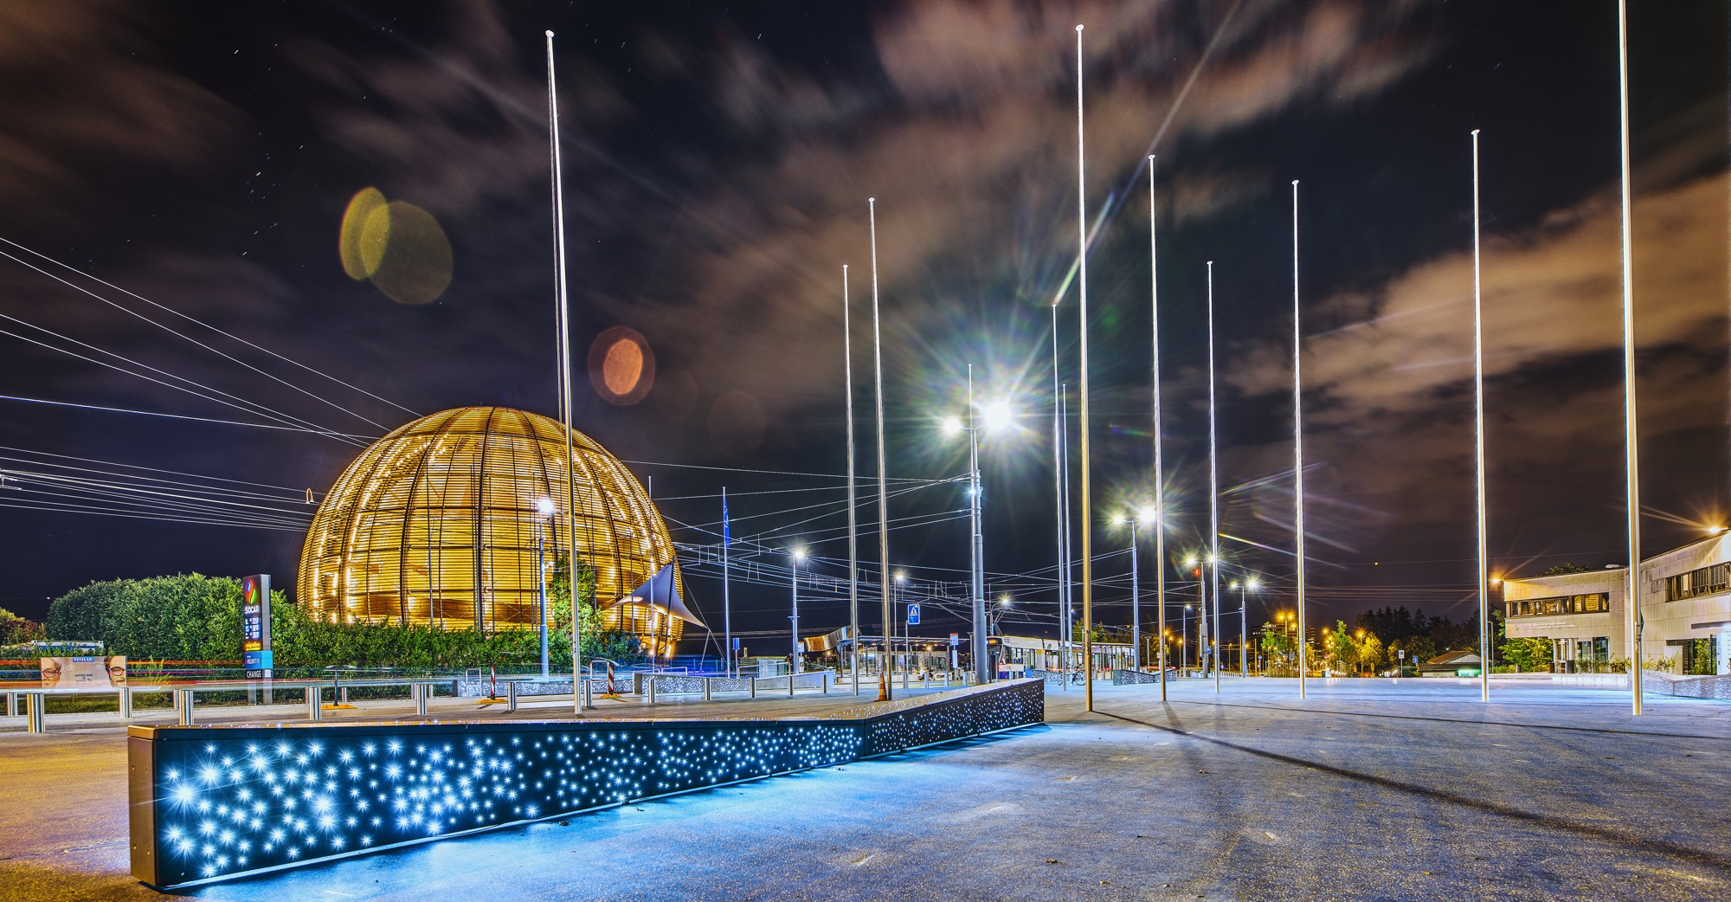

AGENDA
Business Opportunities @ CERN
    What we buy
    Shopping List
    HL-LHC
Upcoming Tenders
Successful Bidders from Sl

Slide 3

Business Opportunities @ CERN

Slide 4
Suppliers Database Registration
Please register in CERN Database (only 38 Firms…)
Please accept the GCCC:
General Conditions of CERN Contracts
  GCCC are standards, and light compared to many private companies
  Dedicated section in the Tender form for remarks, in case of major divergence with GCCC leading to a deal-breaker situation
  … but CERN has the right to accept or not !

Slide 5
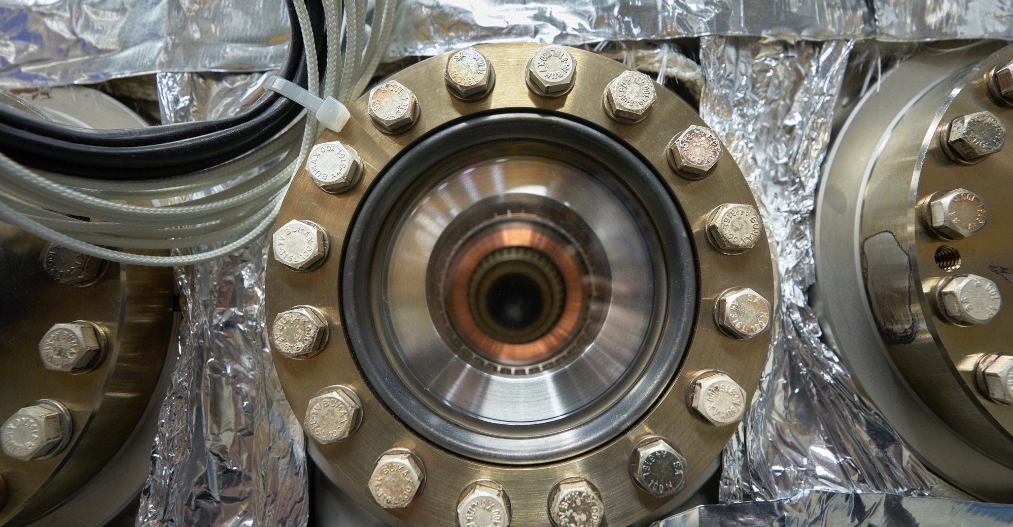
What we buy
Recurrent supplies & services
Accelerator technologies required for consolidation projects and new developments

Slide 6
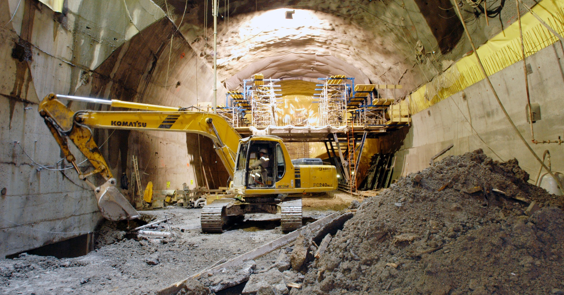
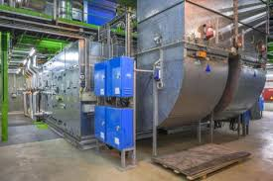
What we buy
Civil engineering:
  New constructions & renovation of existing buildings
  Roads, earthworks and sewage systems
  Metallic structures
Cooling and ventilation equipment
  New systems & renovation of existing buildings
  Air handling units
  Pumps

Slide 7
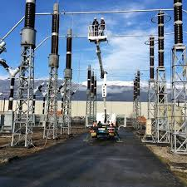
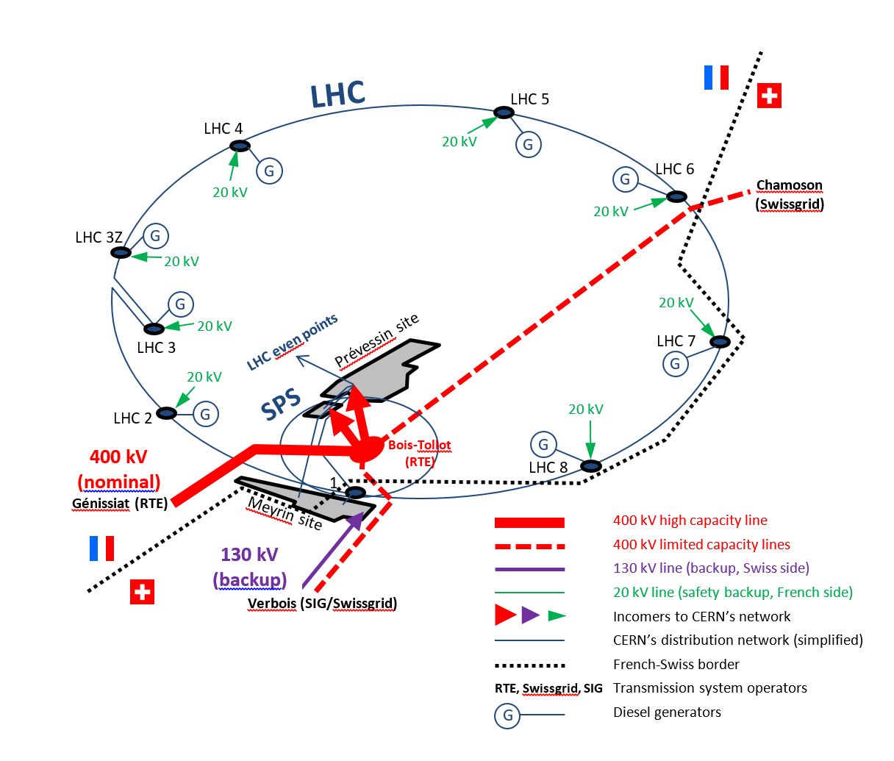
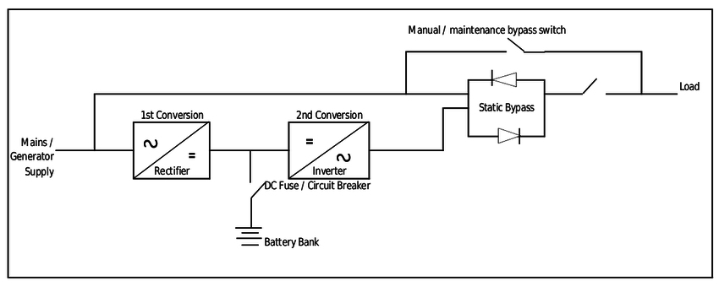
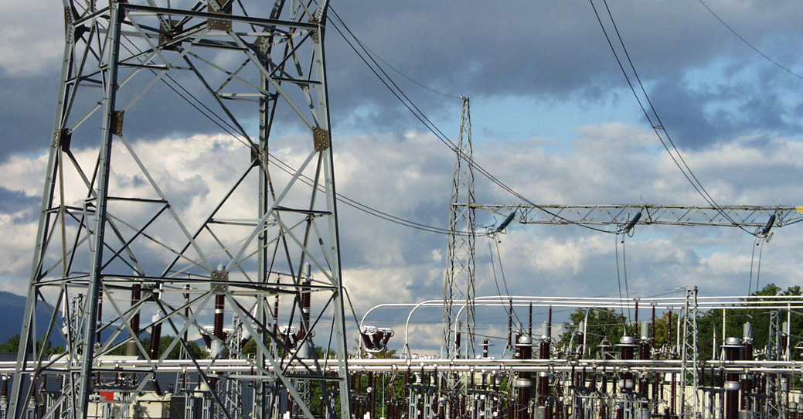
What we buy
Electrical engineering
    Biggest private Network in EU
    200 MW of installed Power
    300 + HV Cubicles
    350 + Transformers
    2000 + LV Switchboards
    300 + UPS Systems
        100 + 48 V DC systems
        25 000 + Circuit Breakers

Slide 8
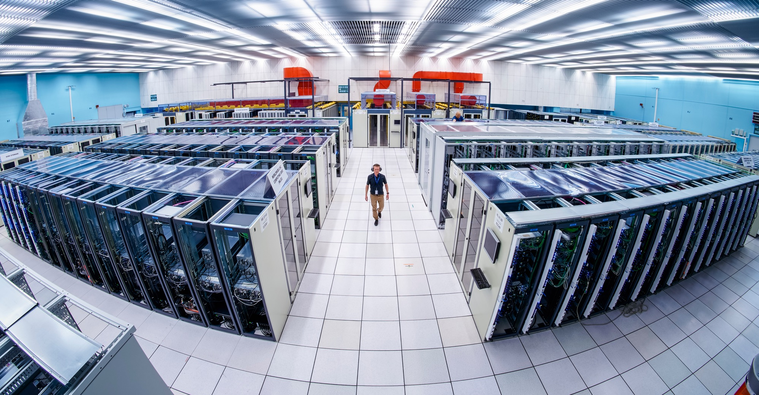
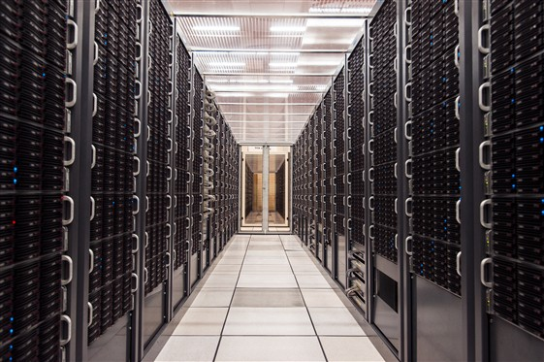
What we buy
Information & Technology:
  Computing systems
  Servers
  Software
  Network equipment
  Personal computer equipment

Slide 9
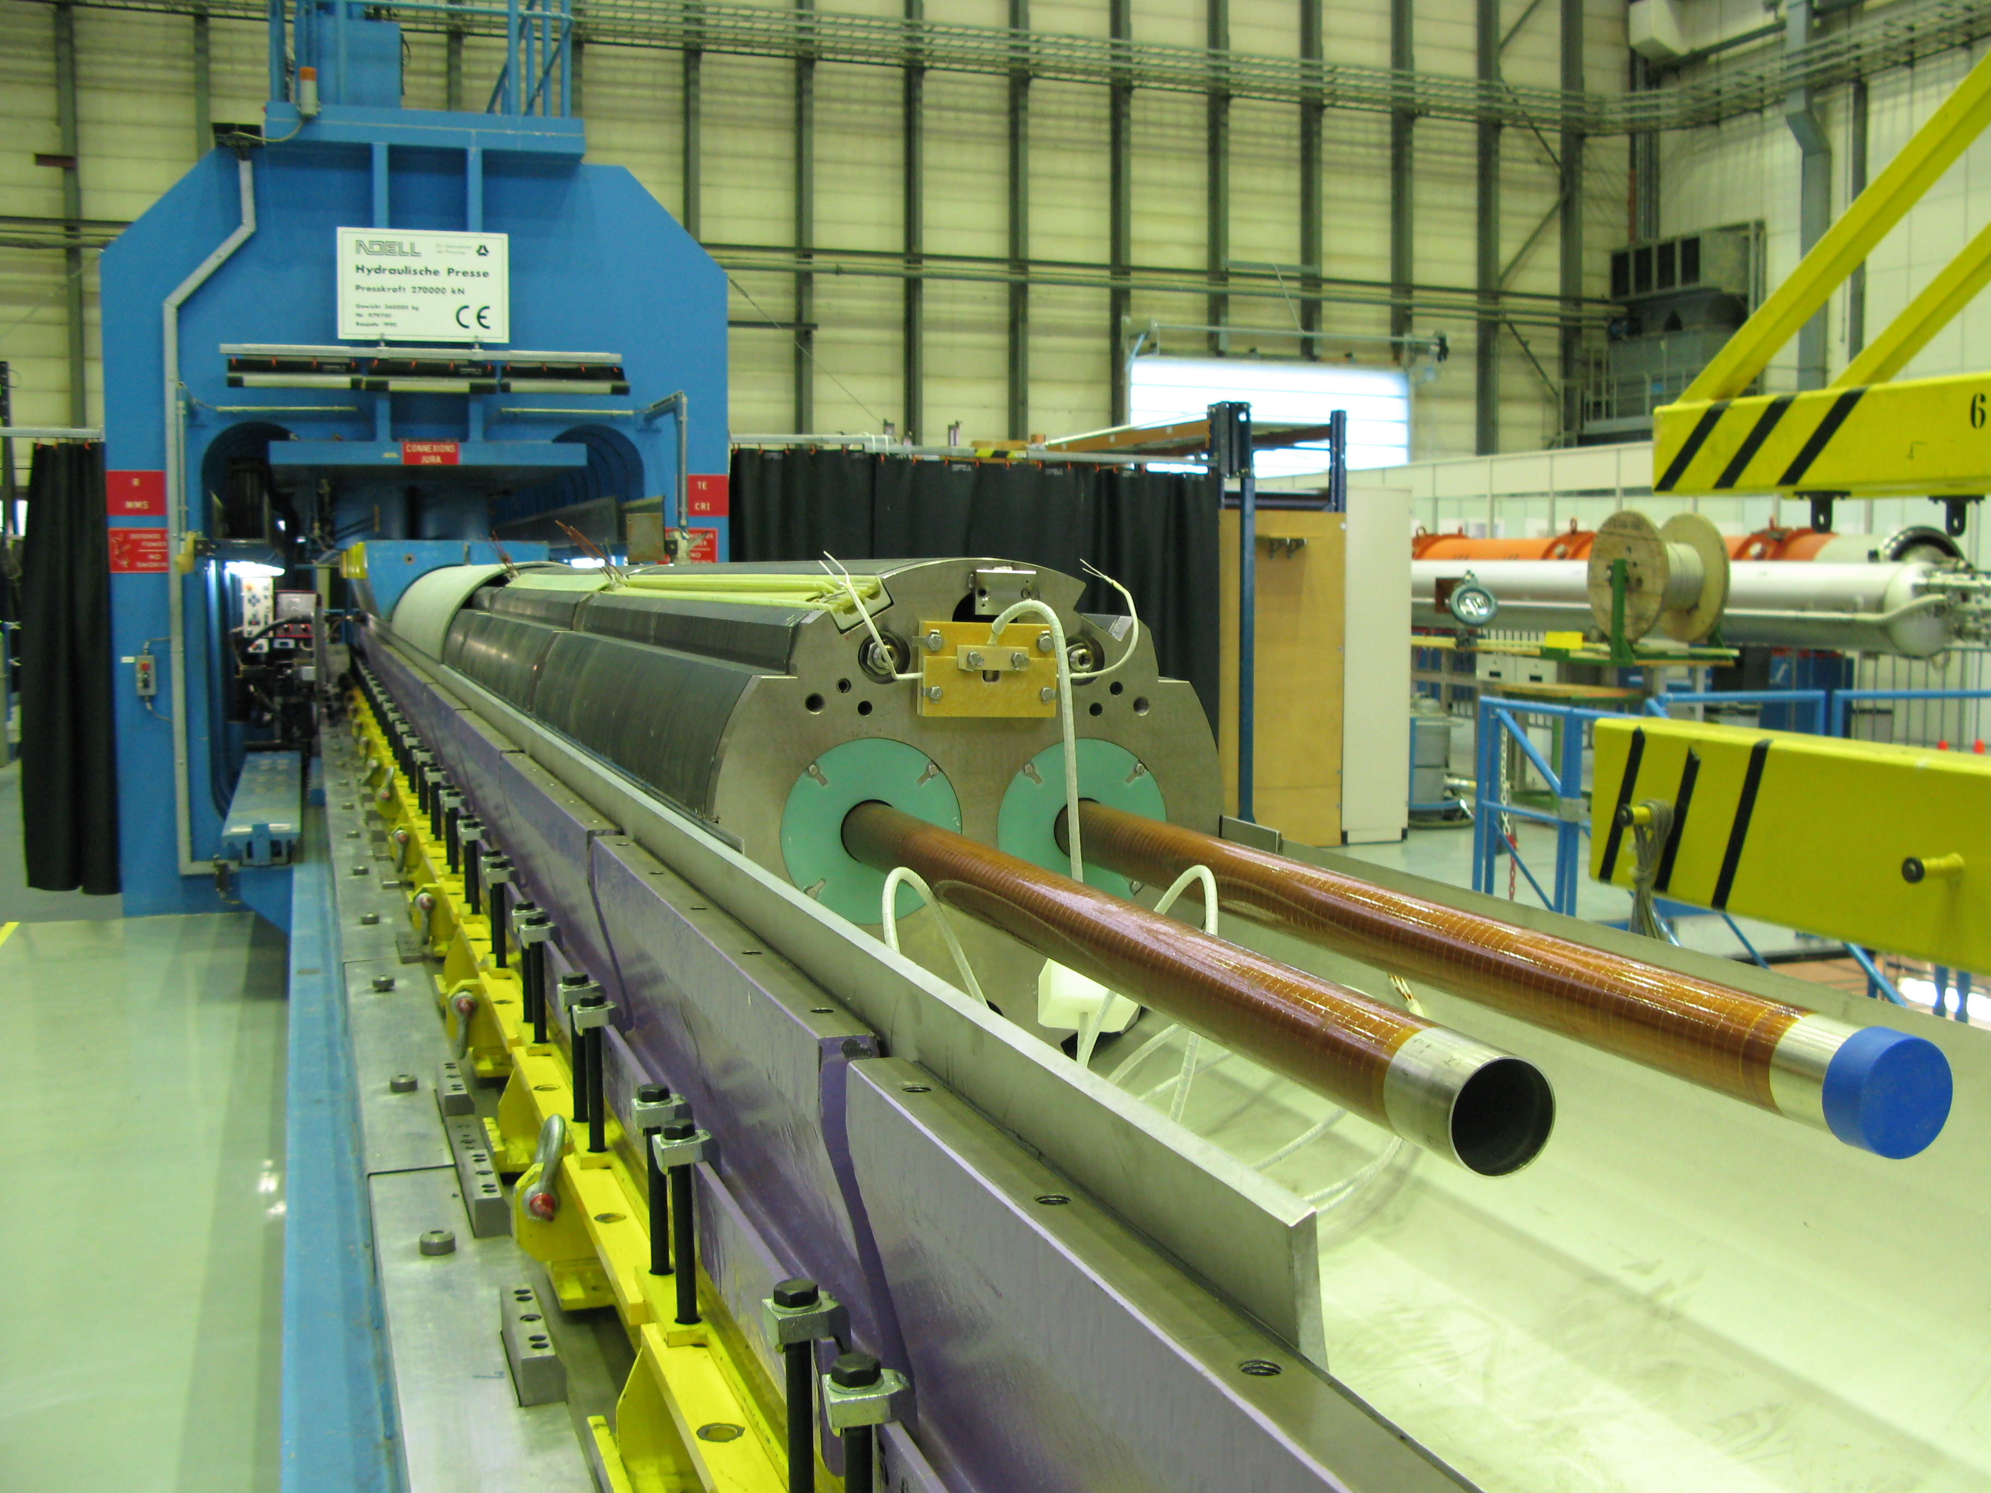
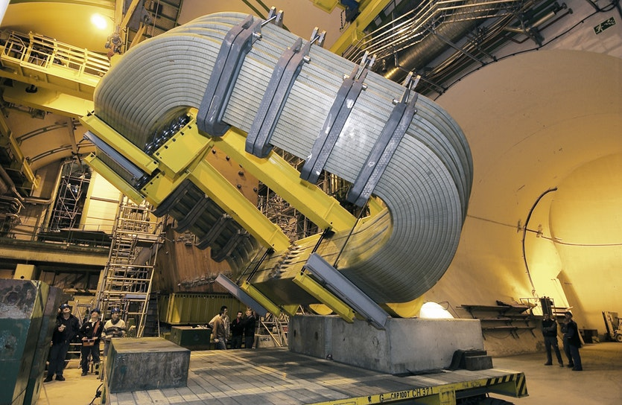
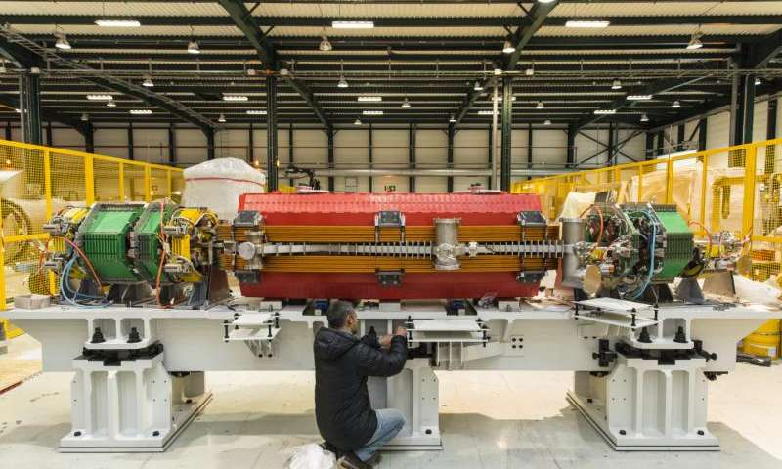
What we buy
Magnets
  Electro Magnets
  Permanent Magnets

Slide 10
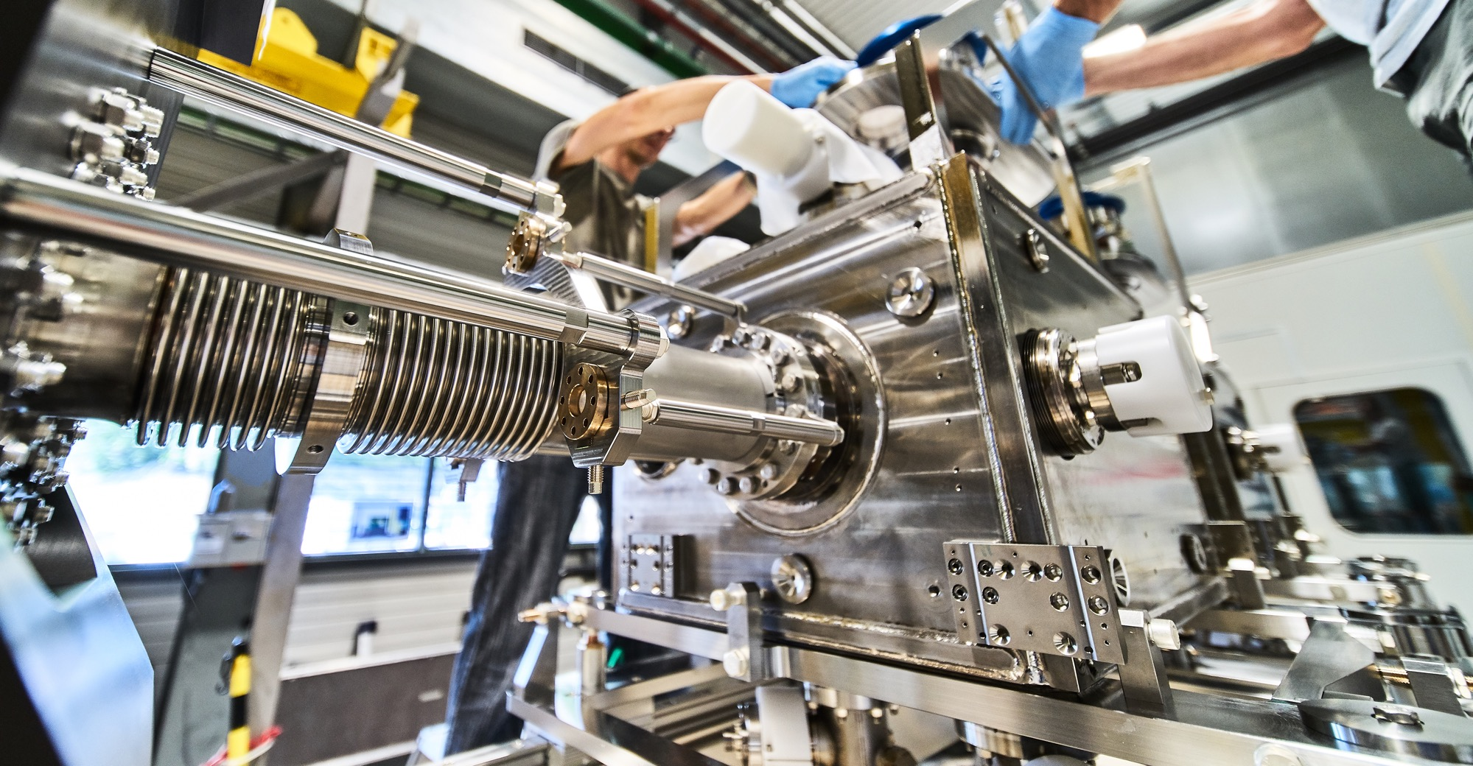
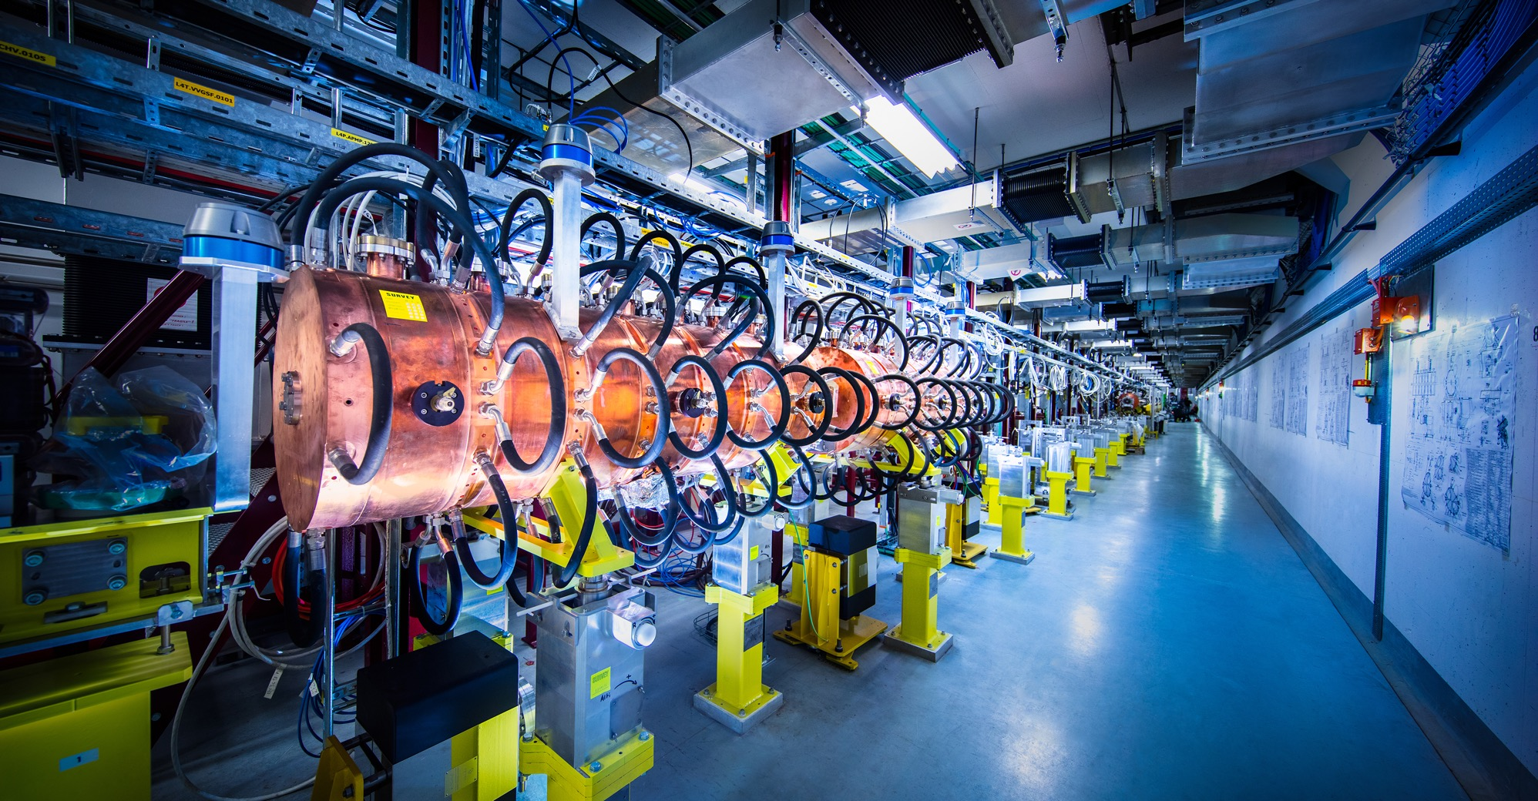
What we buy
Mechanical Engineering
  Machining & Sheet metal work and arc welding
  Raw materials, finished and semi-finished products (plates, pipes, etc.)
  Offsite engineering and testing
  Electronics & RF Equipment
  Electronic components (active, passive)
  PCBs and assembled boards
  LV and HV power supplies
  Radiofrequency equipments
  Amplifiers

Slide 11
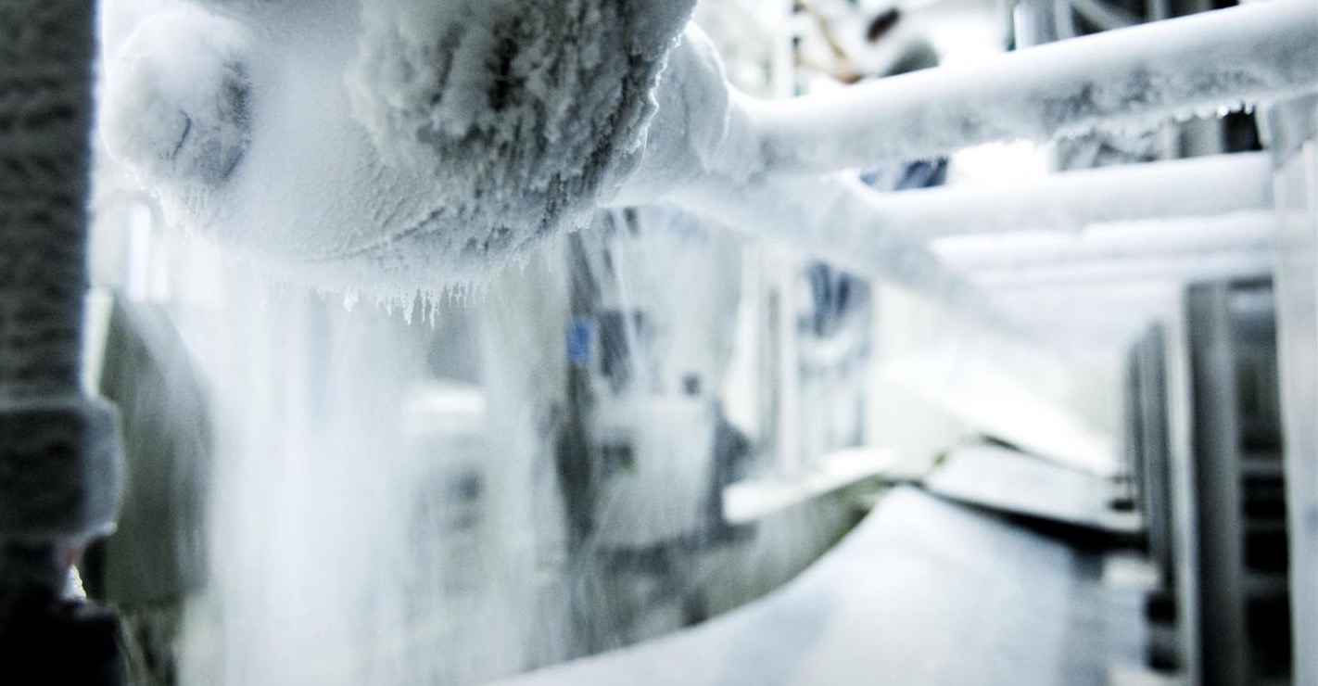
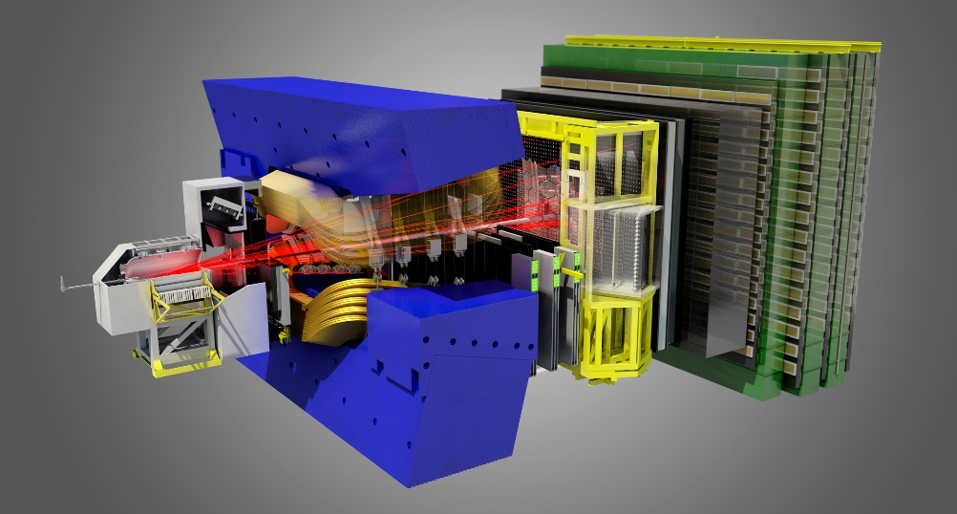
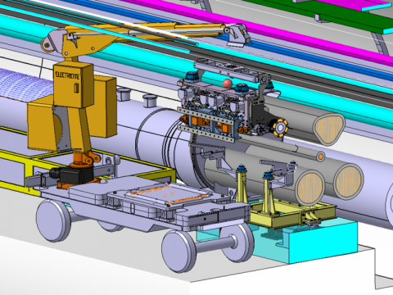
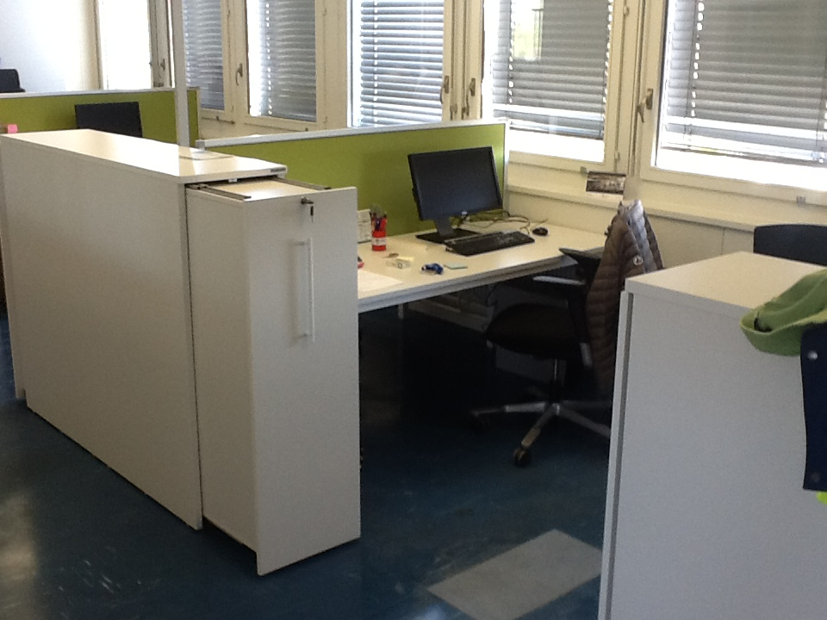
What we buy
As well as various different Supplies:
  Cryogenic and vacuum equipment
  Particle detectors
  Health and safety equipment
  Transport and handling equipment
  Office supply, furniture, etc…

Slide 12
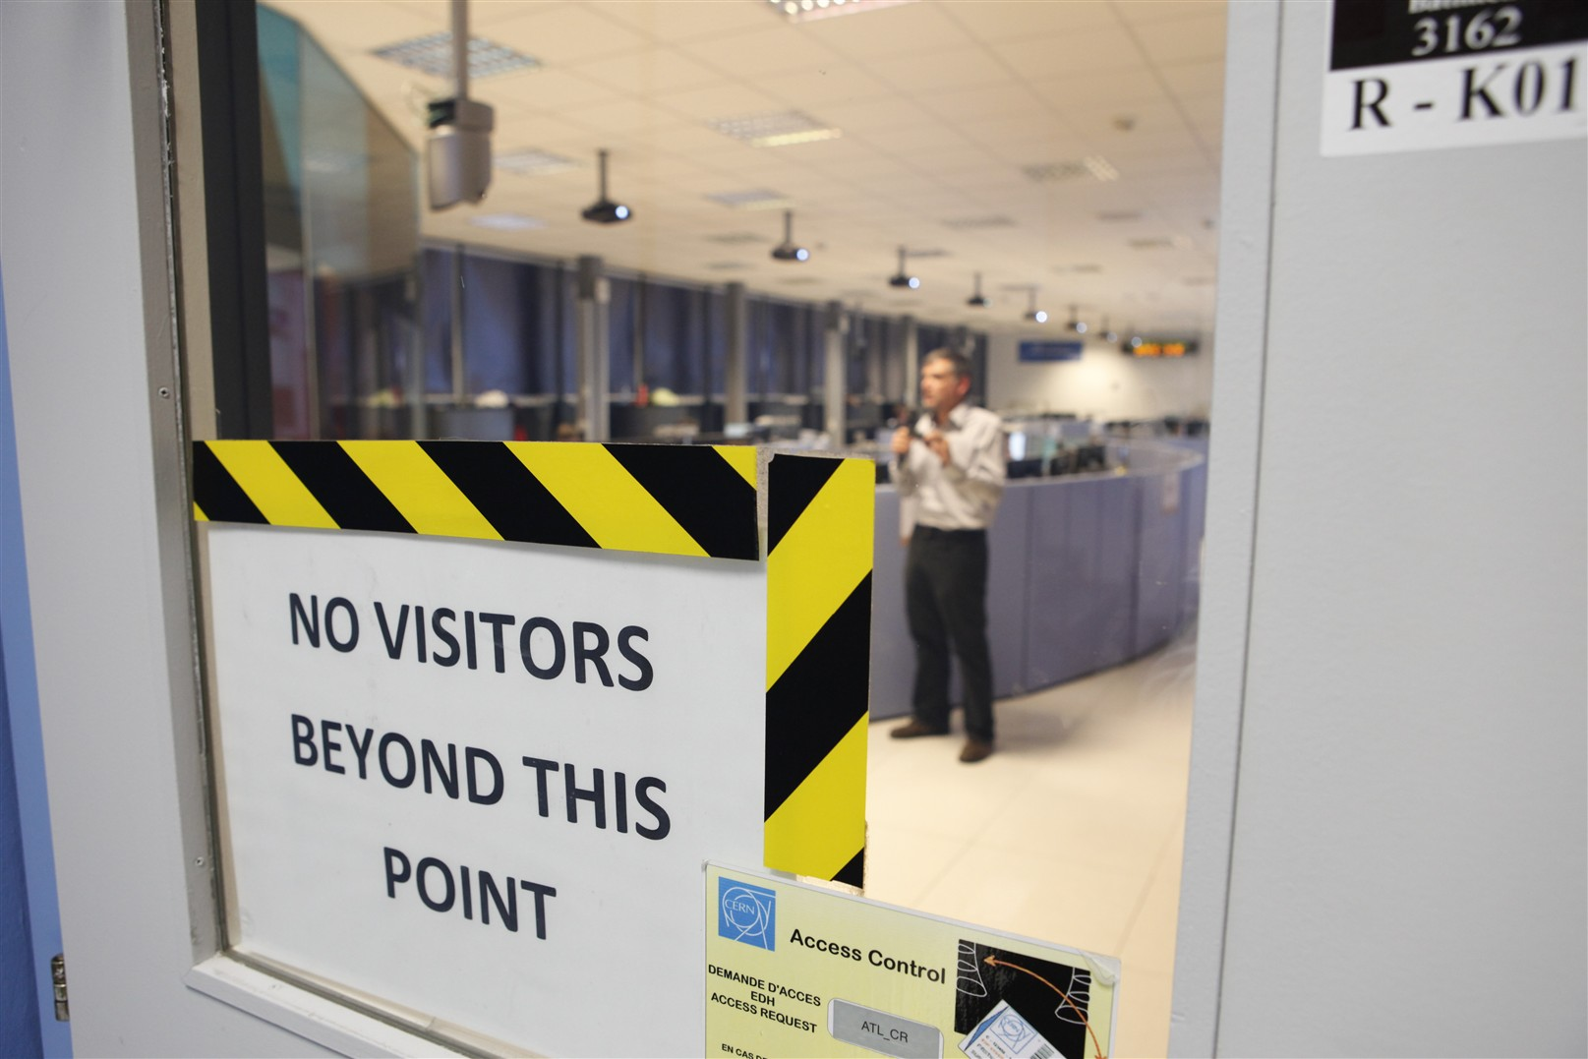
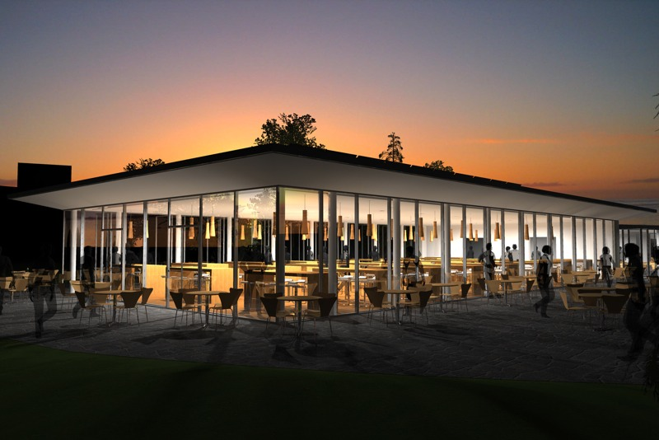

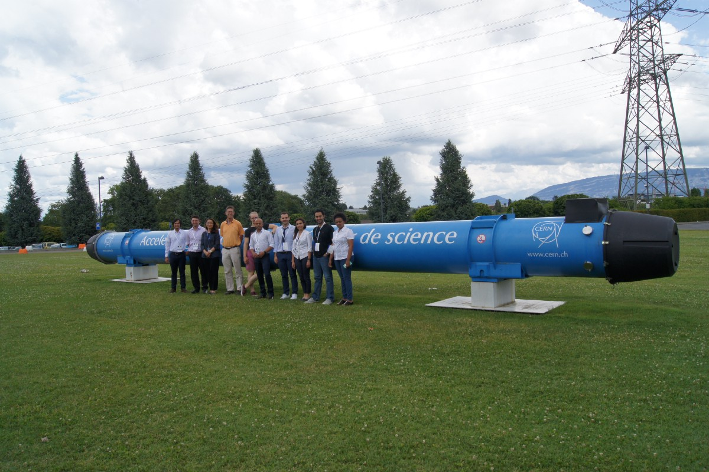
But also many onsite Service Contracts:
  Access ontrol
  Internal mail distribution
  Food & catering
  Office cleaning
  Park and gardens maintenance
  Electrical maintenance
  Cranes maintenance
  Snowplow
  … and many more !

Slide 13
What we buy
CERN buy everything that is needed to run the
Organization and its accelerators !
Supplies ⬄ Services
from Office Supplies ⬄ to Particles Detectors
Simple Supplies ⬄ Highly Technological Supplies

Slide 14

3 Types of Enquiries
“Price Enquiry” (DO) :
  Enquiries < 10’000 CHF
  10’000 CHF ≤ Enquiries < 200’000 CHF
“Invitation-to-Tender” (IT) :
  3. Enquiries ≥ 200’000 CHF

Slide 15

Procurement Website
  https://home.cern/

Slide 16
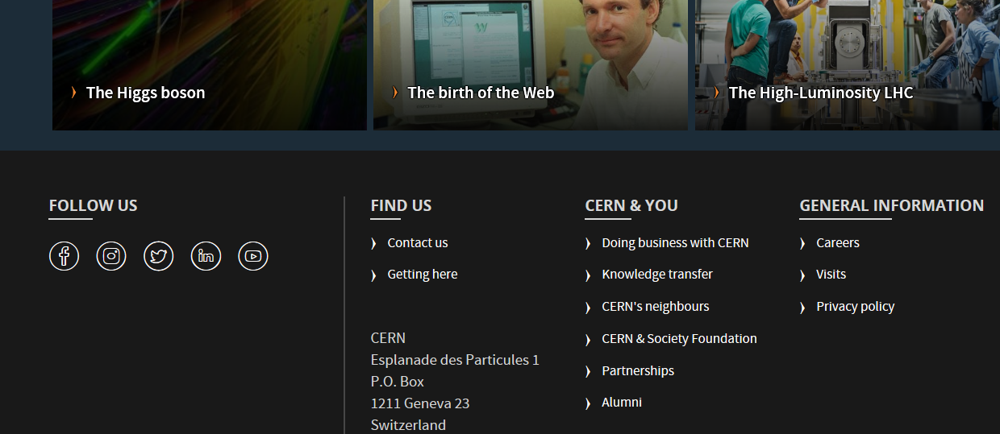
Procurement Website

Slide 17

Procurement Website

Slide 18

Procurement Website

Slide 19
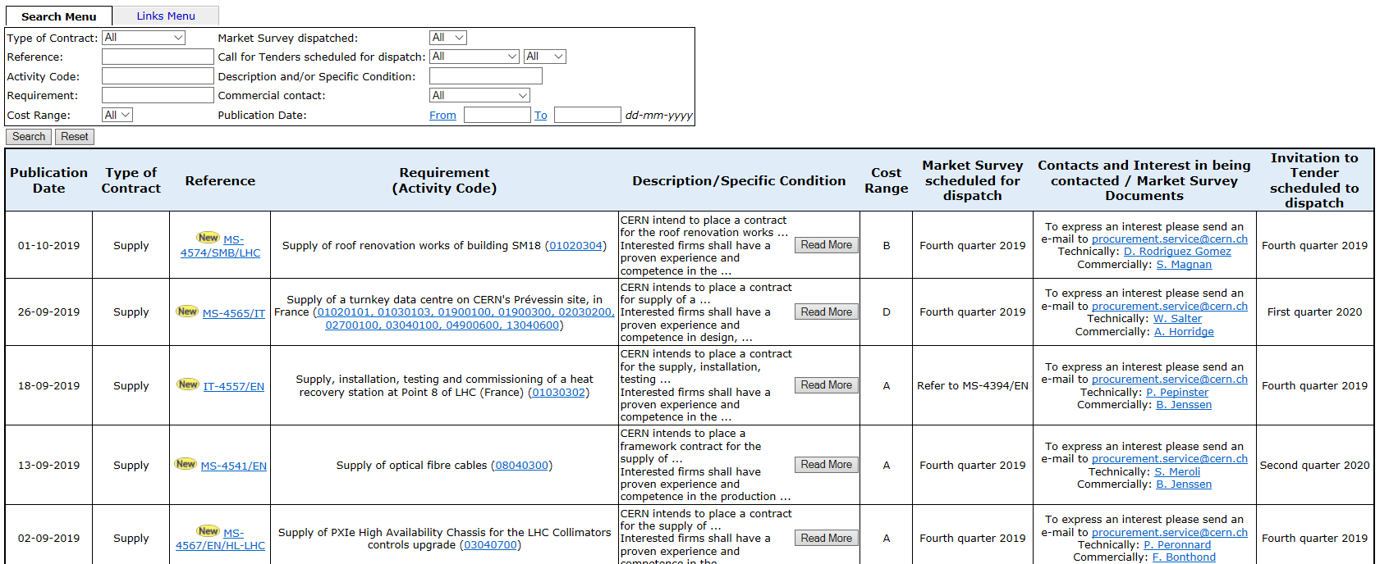
Procurement Website

Slide 20
Procurement Website

Slide 21
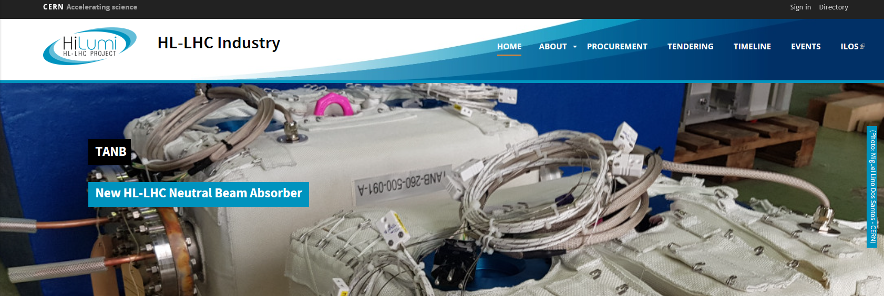
Procurement Website

Slide 22
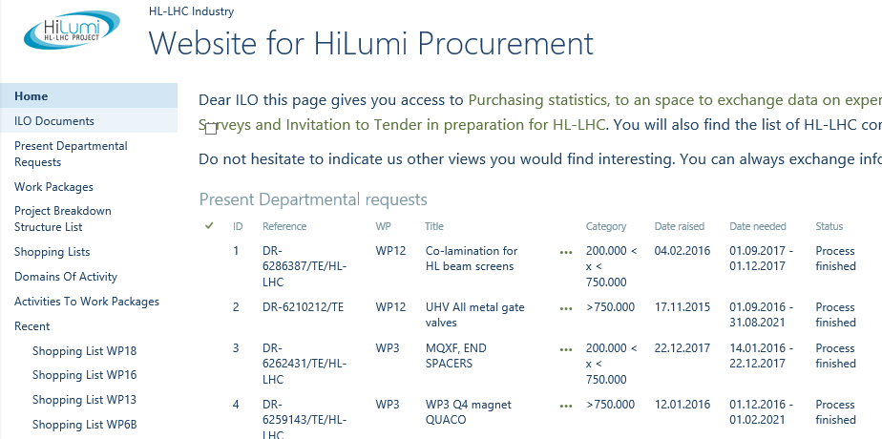
Procurement Website

Slide 23
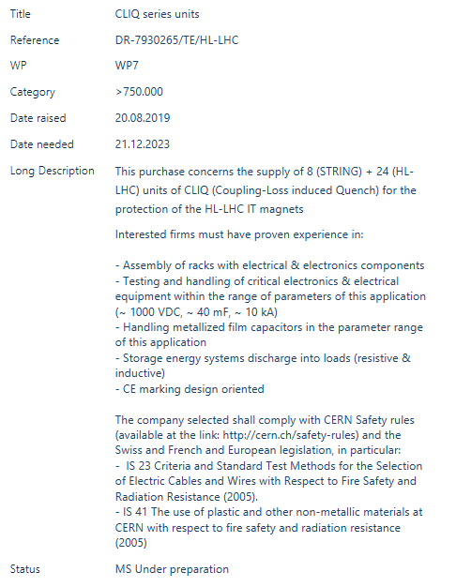
Procurement Website

Slide 24


Upcoming Tenders

Slide 25
MS-4565/IT
Supply of a turnkey data center on Prevessin site
Requirement:
Supply of a turnkey data centre on CERN's Prévessin site, in France (01020101, 01030103, 01900100, 01900300, 02030200, 02700100, 03040100, 04900600, 13040600)
Description and/or Specific Condition:
CERN intends to place a contract for the supply of a turnkey data centre on CERN's Prévessin site, in France, including the design, construction, operation and maintenance. The data centre shall provide an initial capacity of 4 MW and be capable of staged upgrades to at least 12 MW. It shall include all technical infrastructure systems as well as racks, excluding IT and networking equipment. The contract is foreseen to be awarded in January 2021.
Interested firms shall have a proven experience and competence in design, construction, operation and maintenance of data centres. The proposed data centre should be based on an existing design which is already operational.

Slide 26
MS-4513/TE/HL-LHC
Design and supply of 76 units of 2kA Direct Current Current Transducers (DCCTs)
Requirement :
Design and supply of 76 units of 2kA DCCTs for the High-Luminosity Project (02100900)
Description and Specific Condition:
CERN intends to place a contract for the design and manufacture of 76 bipolar voltage output DCCTs with a nominal current rating of 2 kA and a 12 hour stability of less than 1 part in 10^6 (ppm)
Interested firms shall have testing and calibration facilities to less than 10-ppm absolute accuracy, and be experienced in supplying high precision DCCT systems.

Slide 27
MS-4541/EN
Supply of Optical fiber cables
Requirement :
Supply of optical fibre cables (08040300)
Description and Specific Condition:
CERN intends to place a framework contract for the supply of optical fibre cables (both single mode and multimode optical fibre cables, and totally approximately 300 km) meant to be pulled or air-blown in a dedicated optical fibre infrastructure.
Interested firms shall have proven experience and competence in the production of optical fibre cables.

Slide 28
MS-4561/SMB
Supply of construction works
Requirement :
Supply of the construction works for a new building for the heat recovery station at point 8 on the French part of CERN. (01010300, 01020200, 01020300, 01020400)
Description and Specific Condition:
CERN intends to place a contract for the construction works for a new building (15 x 6 ml) for the heat recovery station at point 8 on the French part of CERN, including reinforced concrete (100m3), road works, steel construction, cladding (250m2), roofing and waterproofing (90m2), external door, and metal floor (90m2).
Interested firms shall have a proven experience and competence in the field of civil engineering works and construction of industrial buildings.

Slide 29
MS-4558/SMB
Supply of Personal Protective Equipment
Requirement :
Supply of personal protective equipment (10080100, 10080200, 10080300, 10080400, 10080500, 10080600)
Description and Specific Condition:
CERN intends to place a three-years contract for the supply of personal protective equipment on the CERN site including work and protective clothing, head, eye, ear, hand, foot and body protections.
Interested firms shall be able to prove experience and competence in the supply of personal protective equipment, including on stock, follow-up service for repairs and replacements.

Slide 30
MS-4541/EN
Supply of centrifugal water pumps
Requirement :
Supply of centrifugal water pumps (01030303)
Description and Specific Condition:
CERN intends to place a five-year blanket purchase contract for the supply of centrifugal water pumps in the flow range between 1 and 1000 m3/h and a manometric height between 20 and 200 m. The quantity of pumps needed per year is estimated to be around 15 with an average flow of 150 m3/h and a manometric height of 60 m. The above estimated quantities are given for information only, and do not constitute any commitment from CERN.
Interested firms shall have proven competence and experience of at least ten years in the field of designing, manufacturing and testing centrifugal water pumps in the flow range between 1 and 1000 m3/h and a Manometric height between 20 and 200 m.

Slide 31
MS-4561/SMB
Supply of technical services for exhibitions, events and educational laboratories
Requirement :
Supply of technical services for exhibitions, events and educational laboratories on the CERN site, and outside CERN for travelling exhibition deployment (12070300, 12070400).
Description and Specific Condition:
CERN intends to place a contract for the provision of technical services for exhibitions, events and educational laboratories on the CERN site and as well for occasional travelling exhibitions outside CERN. The services include maintenance of 500 pieces of audio-visual and IT equipment on two permanent exhibitions and ten visit points at the CERN sites in Switzerland and France, as well as events held at CERN and technical support for travelling exhibitions. The contract is foreseen for an initial period of three years, renewable by CERN.
Interested firms shall have proven experience and competence in the domains of exhibition services, IT services and/or facility management services.

Slide 32
HL-LHC Procurement Challenges ahead

Slide 33
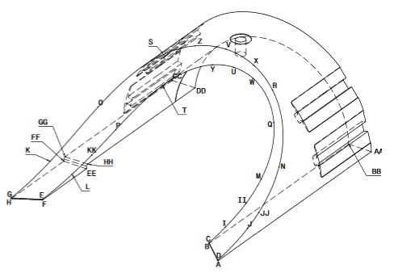
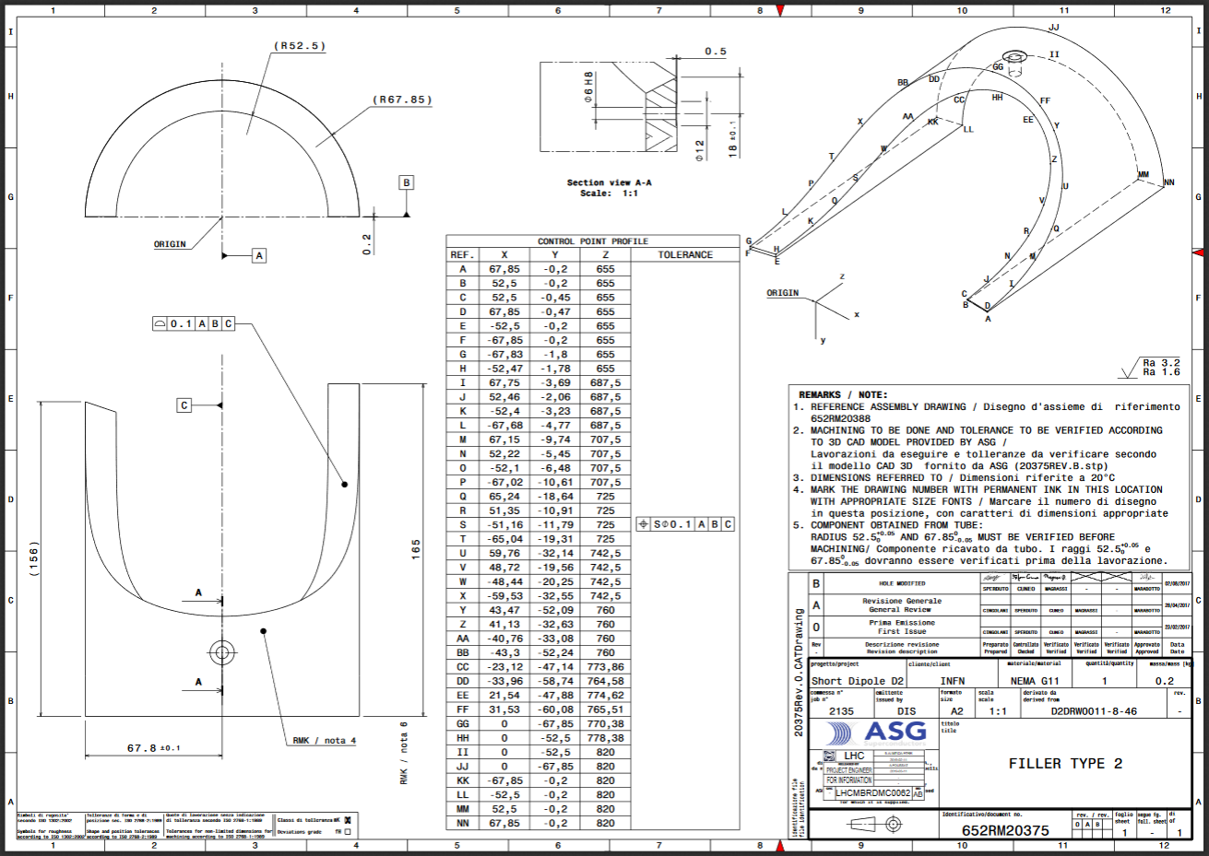
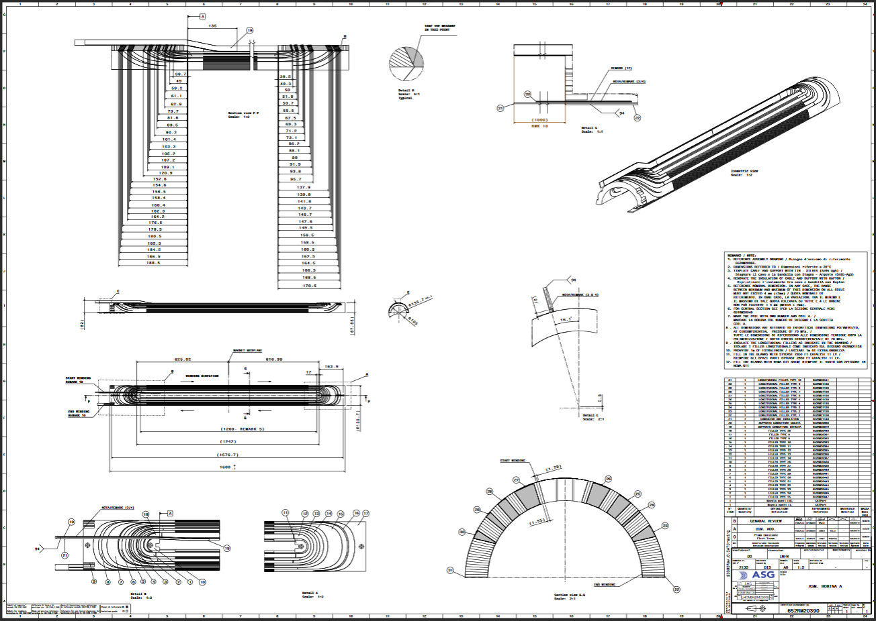
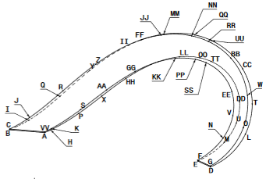
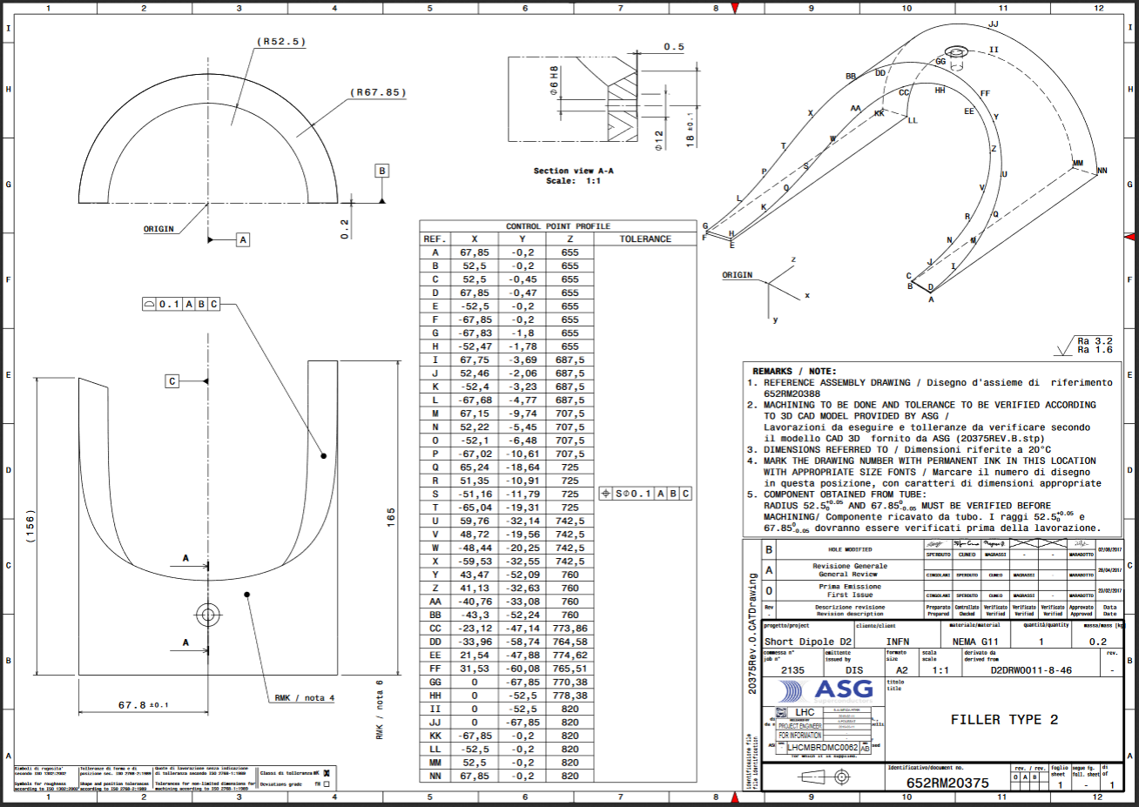
End Spacers manufactured in G11 NEMA material for D2
Requirement : Tendering foreseen by 2020
High precision machining
Complex shapes
Material to be acquired by the manufacturer

Slide 34
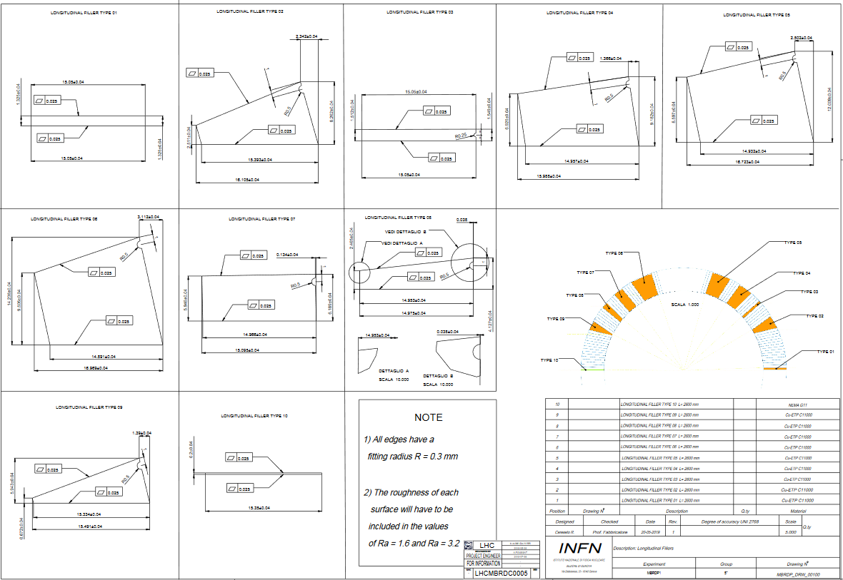
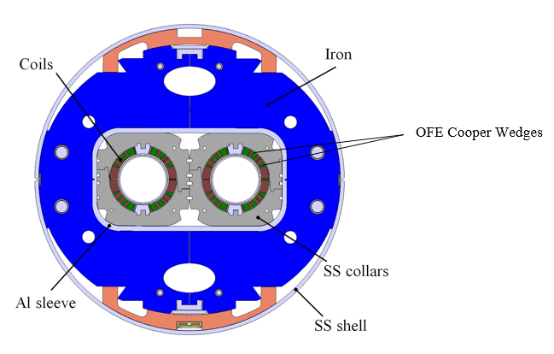
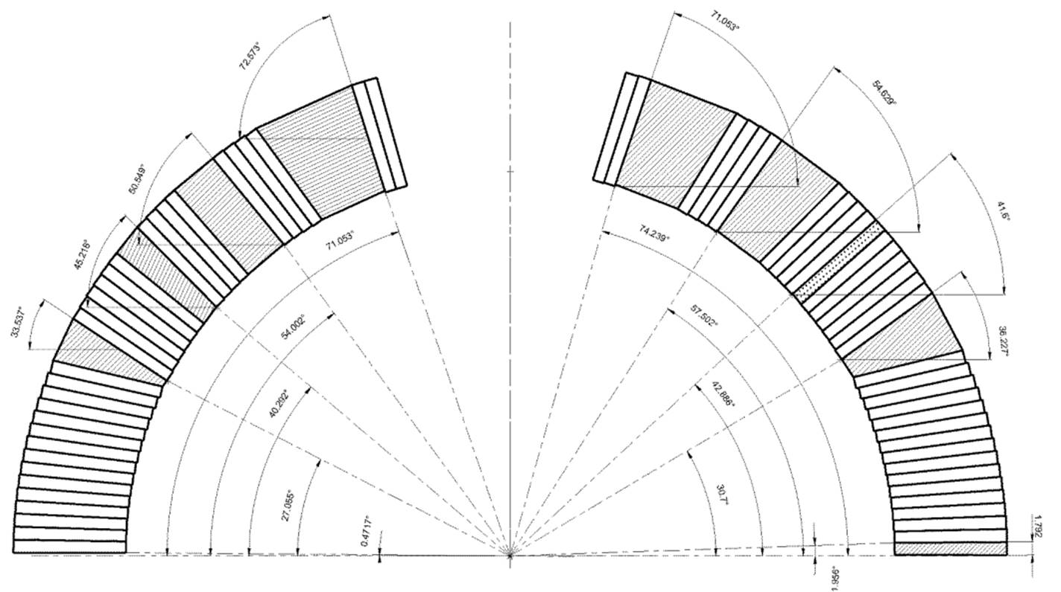
Wedges for D2
Requirement : Tendering foreseen by 2020
High precision manufacturing
Tight tolerances
Made of OFE Copper extruded and cold drawn

Slide 35
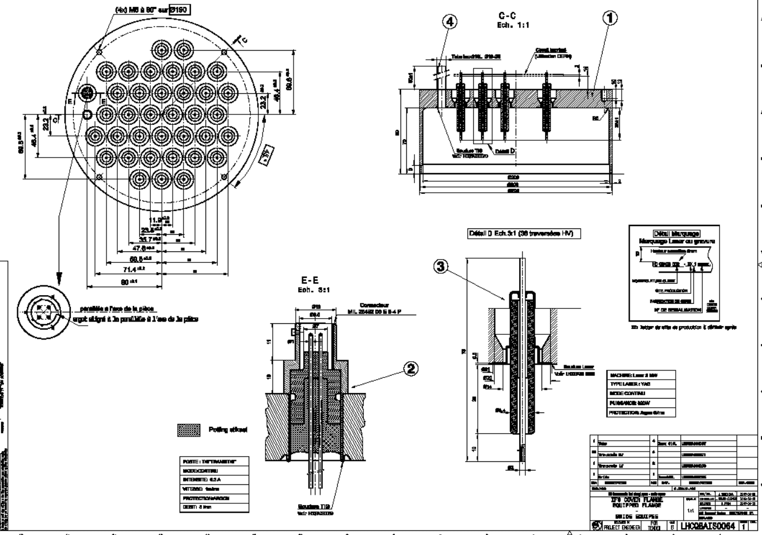
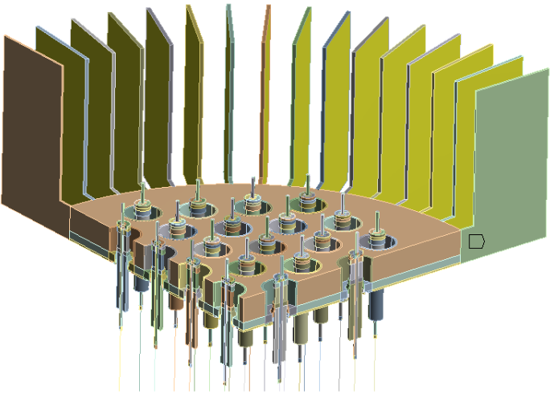
Instrumentation feedthrough system
Requirement :
Electrical cover instrumentation flange with insulated high voltage pins welded for the D2 recombination dipole
New design of OD 258 mm- variants with 46-52 pins
Laser Welding of the pins to the flange

Slide 36
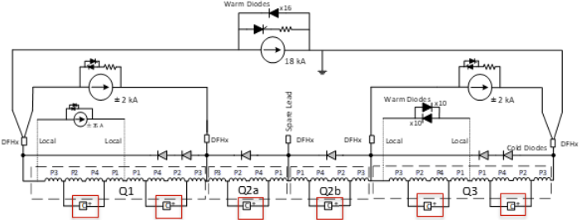
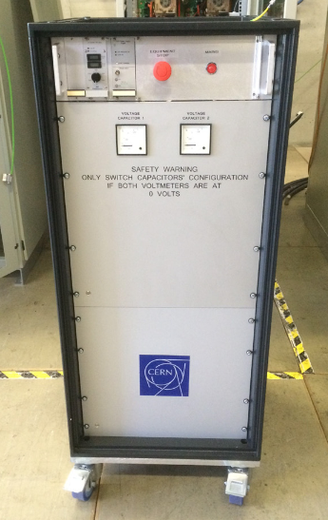
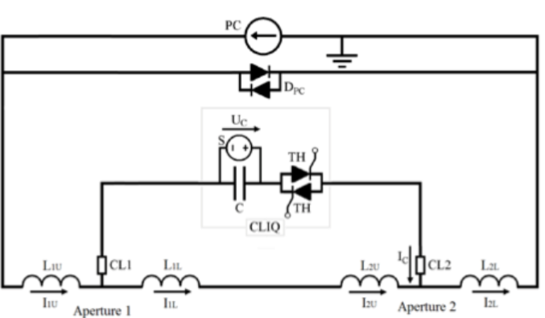
Coupling-Loss Induced Quench (CLIQ)
Requirement :
Protection of superconducting magnets after a quench
Assembly of racks with electrical & electronics components
Integration and testing of critical electronics & electrical equipment (~ 1000 VDC, ~ 40 mF, ~ 10 kA)
Handling metallized film capacitors in the parameter range of this application
Storage energy systems discharge into loads (resistive & inductive)

Slide 37
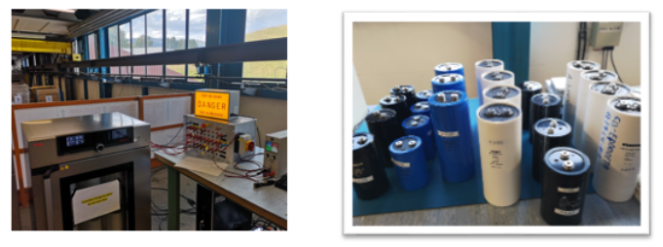
Capacitors for CLIQ for superconducting magnet protection
Requirement :
Long life ( >20 years at 25 C), Energy will be stored and released a maximum of 5 times per day and 200 times per year, usually into an inductive load of ~ 4 mH with a peak current of ~ 3 kA
Capacitance of ~ 40 mF
Withstand a surge current up to 100 kA

Slide 38
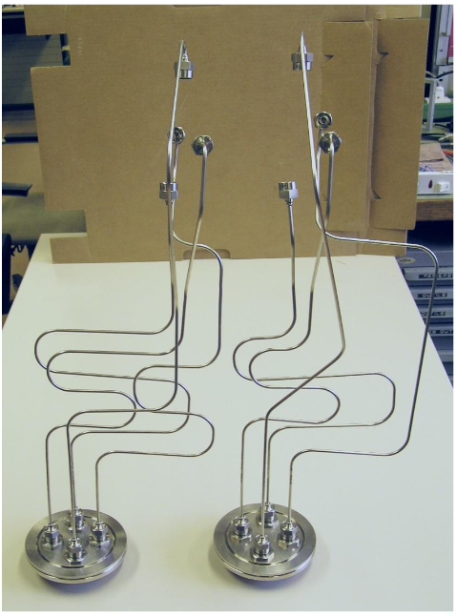
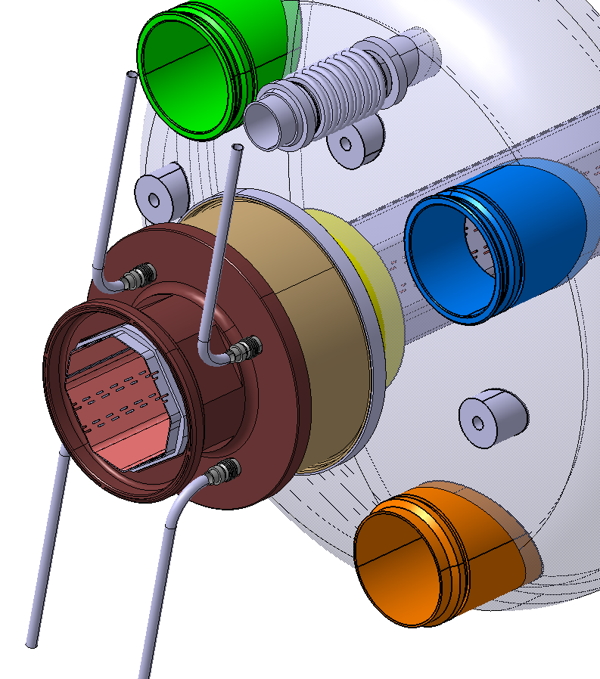
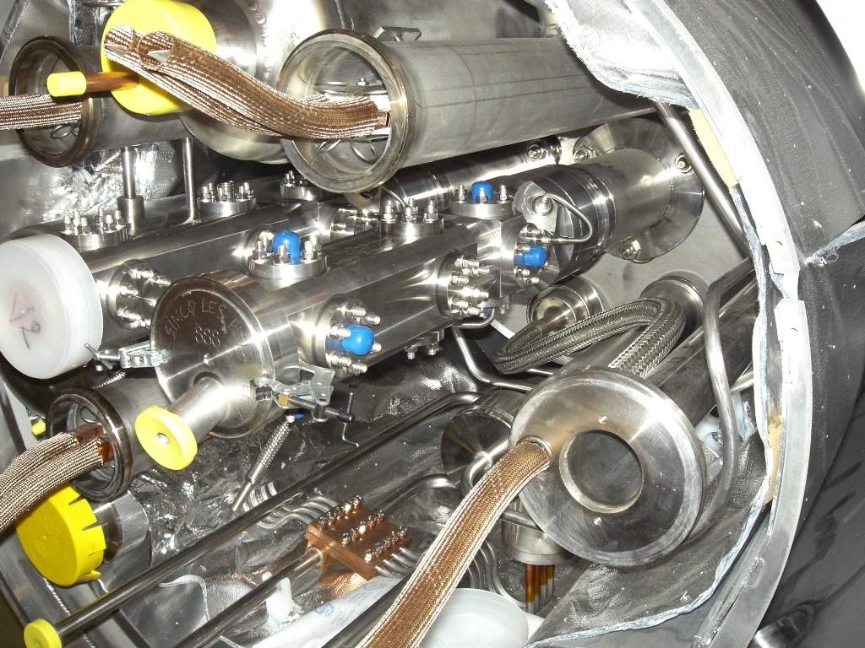
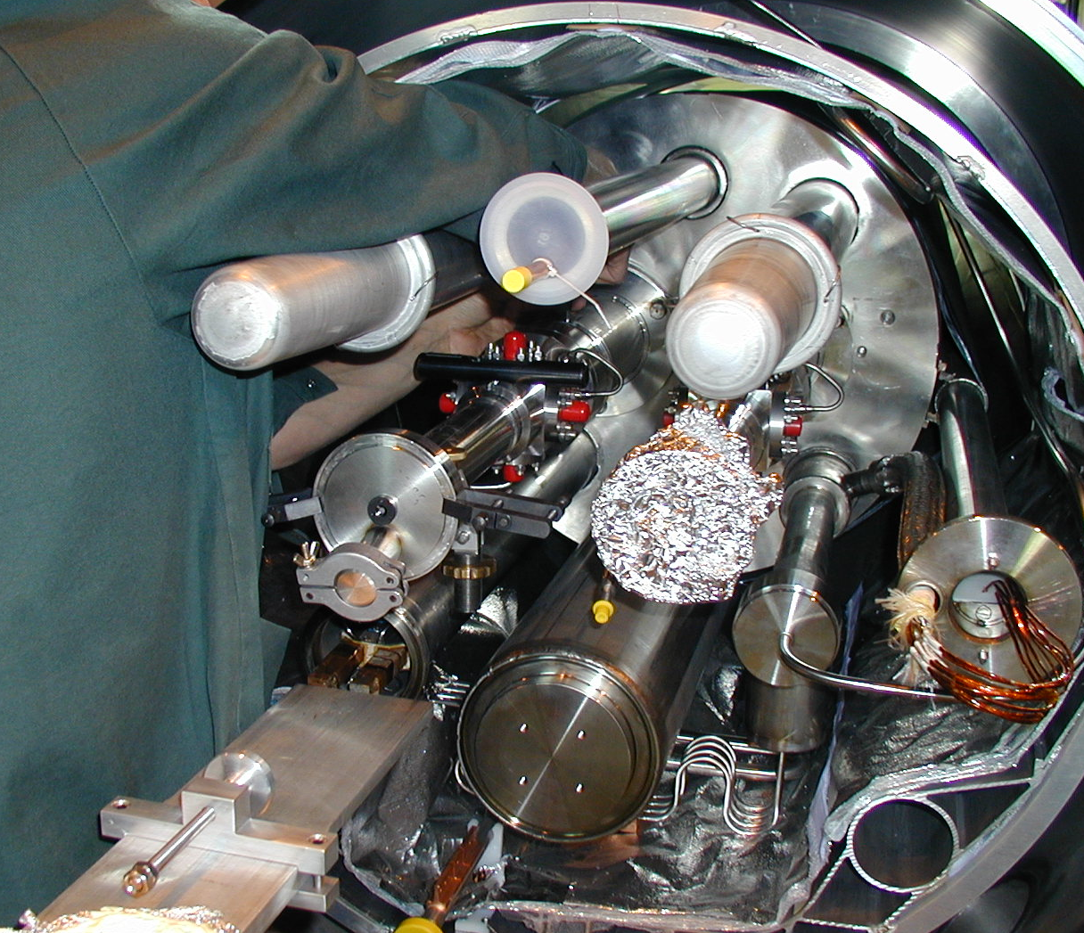
Cryogenic Cables for Beam Position Monitors
Requirement :
~ 300 cables needed (proto, series, spares)
Cables to withstand cryogenic temperatures (~ 5K)
SiO2 Coaxial RF Cables

Slide 39
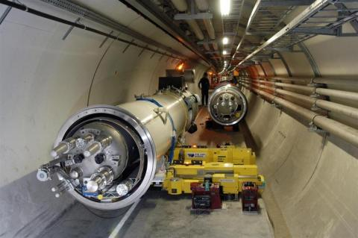
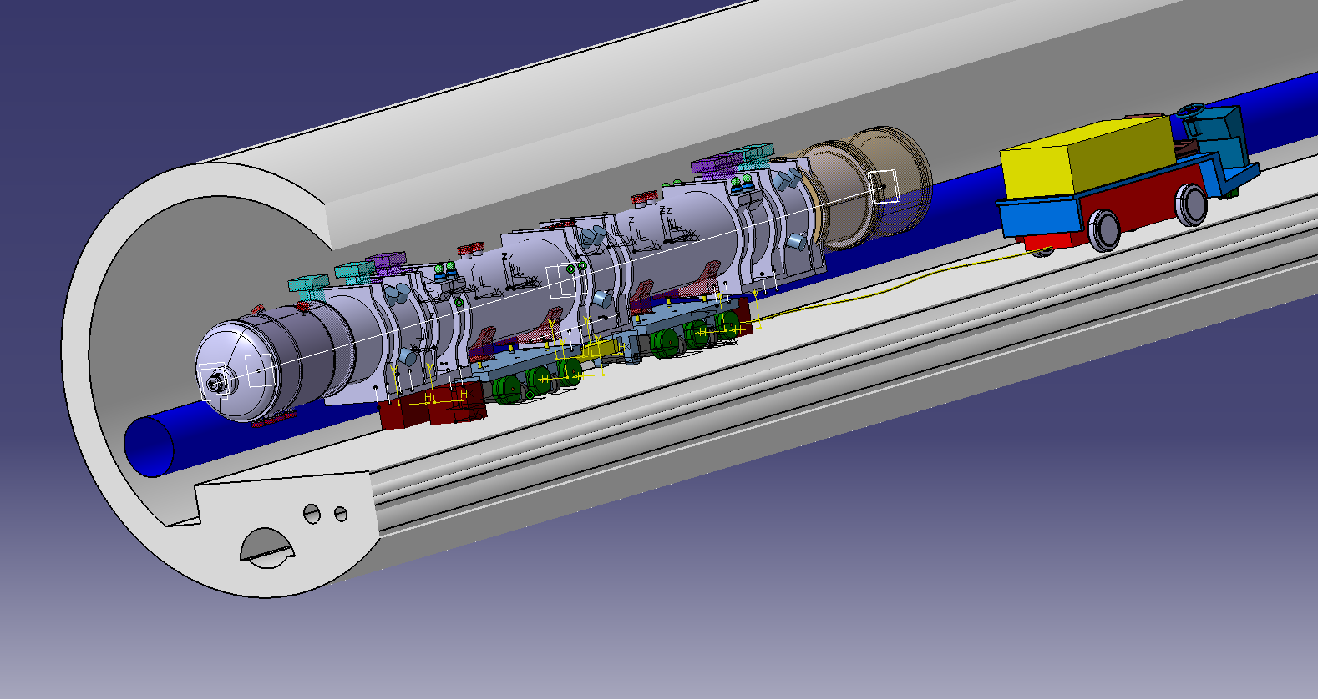
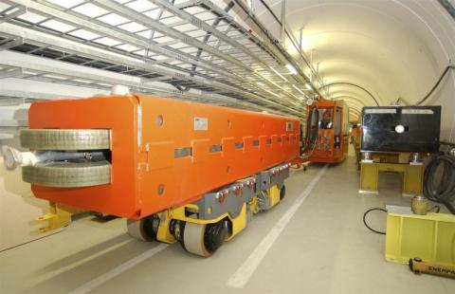
Transport equipment
Requirement :
Customized vehicles for installation of the magnets in the LHC
Customized forklift for FeedBoxes
Trailer and transfer system for Absorber (TAXN)

Slide 40
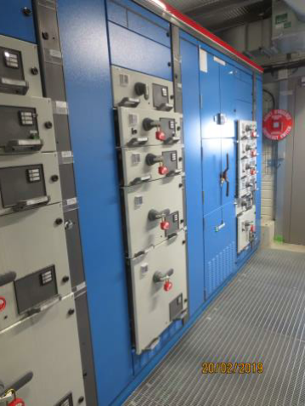





Equipment for the new HL-LHC Electrical Buildings
Requirement :
Power Transformers
MV Cubicles
Power Cables (fire and radiation resistance)
LV Switchboards and electrical protections

Slide 41




Electrical Substation LHC P5 (CMS)
Requirement :
66 / 18 kV substation
38 MVA transformer
Modification of LHC P6 electrical

Slide 42



Cooling and ventilation for HL-LHC Project
Requirement :
Design, supply, installation, testing and commissioning of surface and underground ventilation systems

Slide 43



Cooling and ventilation for HL-LHC Project
Requirement :
Design, supply, installation, testing and commissioning of:
  chilled and mixed cooling water production systems
  compressed air and heating circuit
  primary cooling water systems
  secondary demineralised
  raw water cooling circuits for the HL-LHC Project

Slide 44

Successful Bidders & Contractors

Slide 45
Successful Bidders & Contractors
100 % of the successful bidders …………
  Were registered in CERN Database
  Made an offer
Often small – medium sized and flexible firms
Full understanding of specifications
  Exceeding specifications will be too expensive
  Take into consideration test and documentation costs
Best offer directly
Agreed on the General Conditions of CERN Contracts
  GCCC are standards, and light compared to many private companies

Slide 46
Three notable examples of successful bidders offering goods originating from Slovenia
            ELGOLINE LTD
            CONTAINER DOO
            ZUSTAL
            PARTICULARS

Slide 47
ELGOLINE LTD
Podskrajnik 34,
Sl-1380 CERKNICA

Slide 48
End-Cap Bus Tapes / ATLAS
Bus tapes – flexible circuits
  Joint Development Project between Elgoline Ltd. & Jožef Stefan Institute
  Route to the End cap Petal: power (HV and LV), Data, Ground, Clock, and control to silicon strip modules on a end cap petal
  Cu/Kapton©, double-sided, dimensions 65x35 cm2
  The circuit has to be radiation hard up to 660 kGy

Slide 49
CONTAINER D.O.O.
Bezigrajska cesta 6,
Sl-3000 CELJE

Slide 50






Special containers for transport of nuclear materials
Container certified «Type A»
Container certified «IP2»
Special container certified «IP2»

Slide 51
ZustAl
Raceva 14,
Sl-4226 ZIRI

Slide 52


Mechanical parts for automatized trolleys in radioactive environment
Manufacturing of a total quantity of 34 mechanical parts for automatized trolleys to be used in radioactive environment
Parts in stainless steel 304L and brass

Slide 53
PARTICULARS
Dragomelj 154,
SI-1230 DOMZALE

Slide 54



Sensor characterization with Laser
Characterizations of Pixel detector prototypes
Edge-TCT (Transient Current Technique) employs a LASER supplied by Particulars to induce e-h pairs in the silicon
  3 axis beam focusing (beam spot 5 um) and positioning system (precision 1 um)
  Infrastructure for testing irradiated samples in place (chiller, cold chuck, dry air, small volume)
Measurements of charge collection efficiency as a function of position, depletion depth and charge sharing across neighboring pixels
y [µm]
x [µm]
MM112, 40 µm pixel, 3x3 µm elec

Slide 55
So, why not you ?

Slide 56
Thank you

