Slide 1



Slide 2
ENERGY
EFFICIENCY
Techno-economic energy optimization in real time

Slide 3
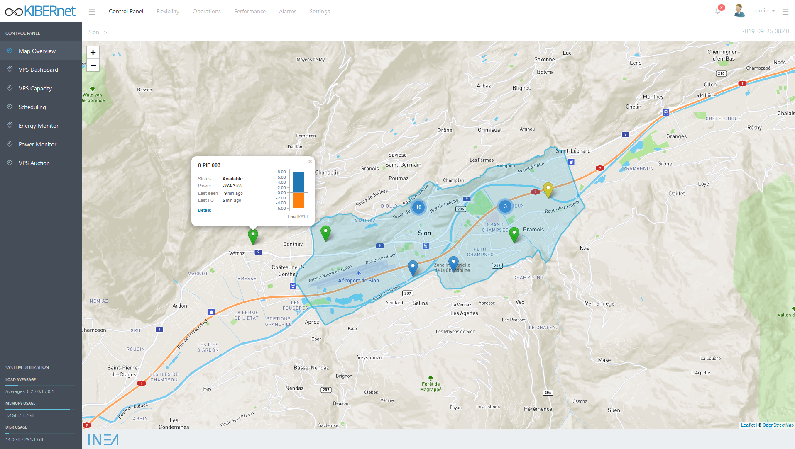
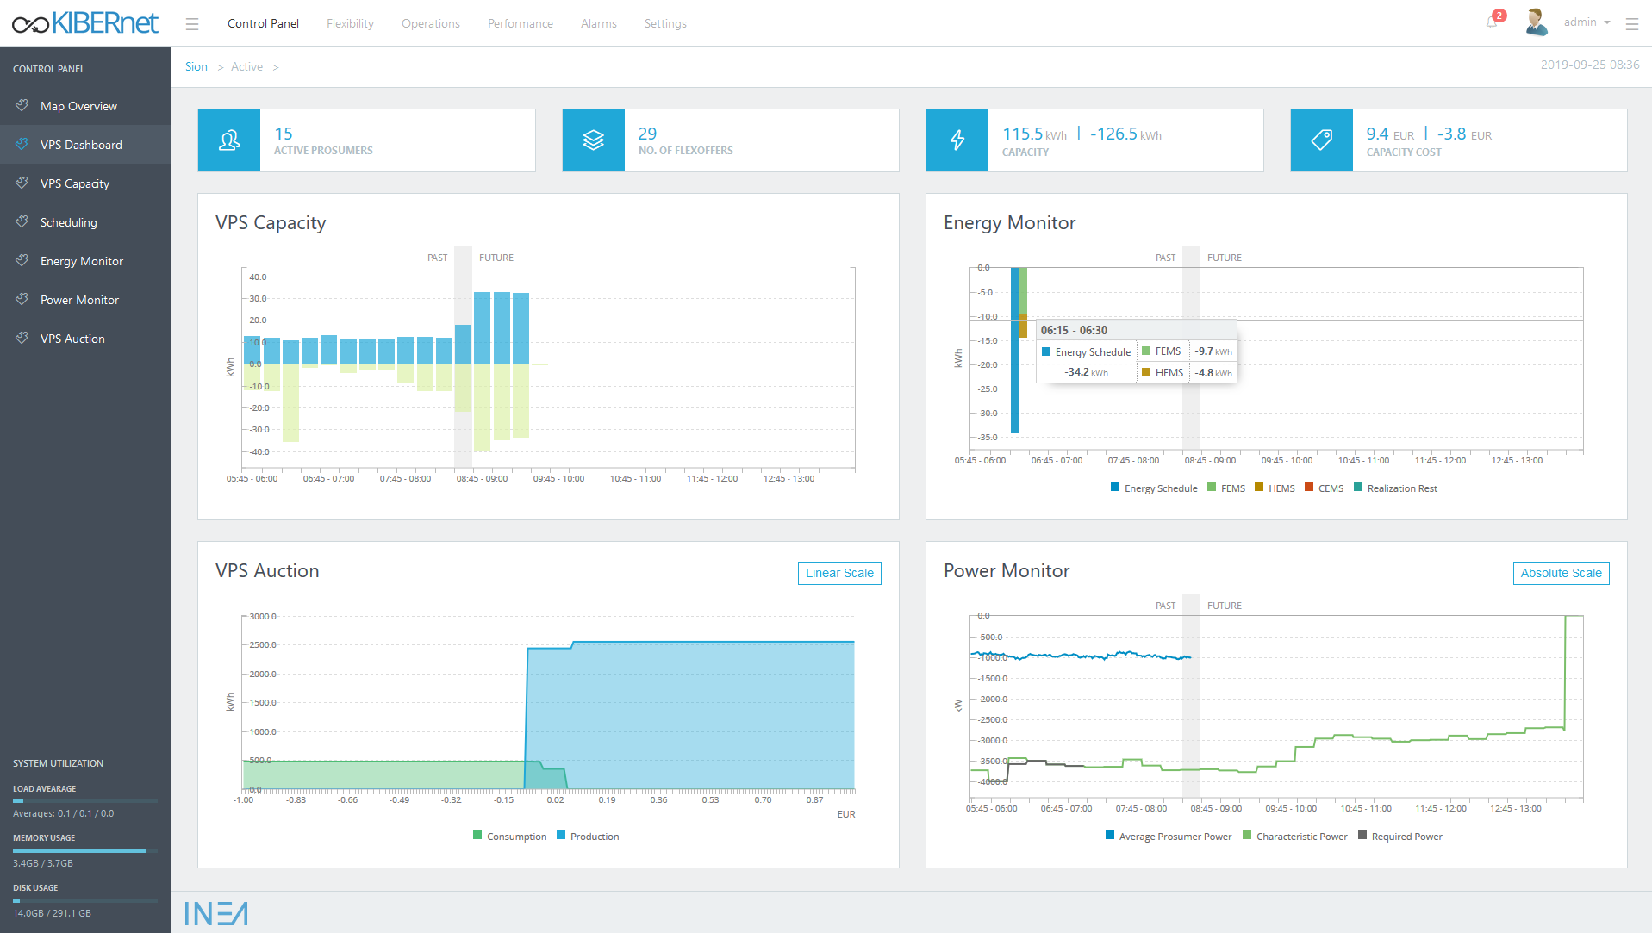
Energy Savings
by combining traditional energy sources
with renewable
Virtual Energy Storage
Holistic virtual power system
Storage abstraction
Sector coupling
Techno-economic energy optimization in real time

Slide 4
We strive towards a brighter, greener future.
EFFICIENT. SUSTAINABLE. GREEN.

