Slide 1

INTRA LIGHTING
Bojan Jurina

Slide 3
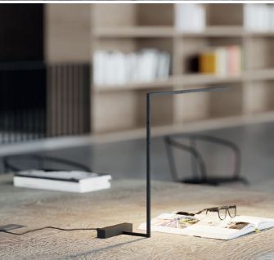
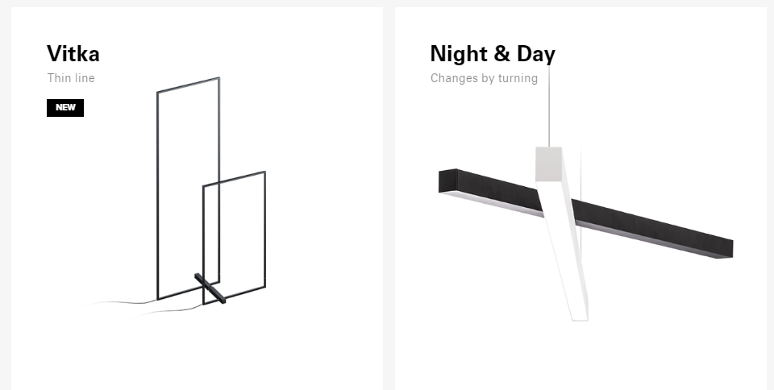
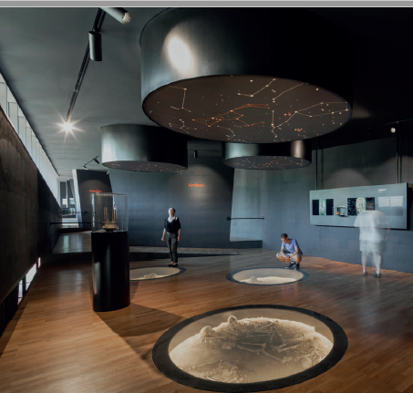
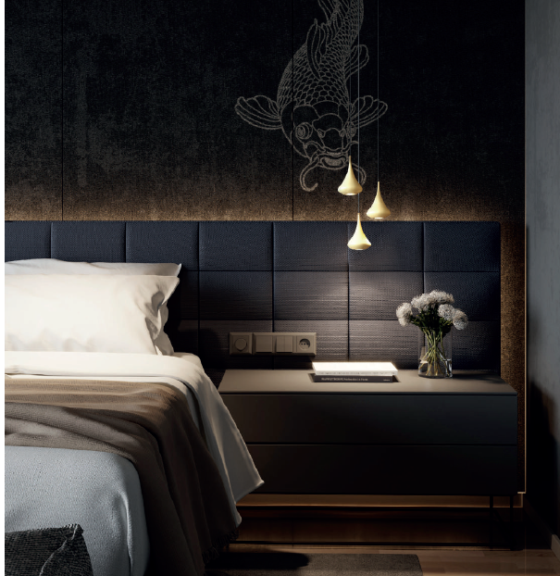
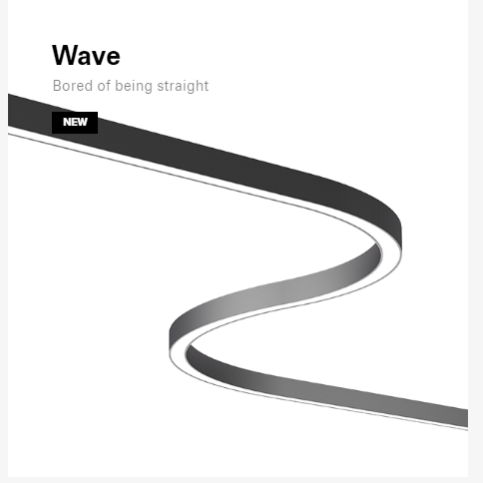
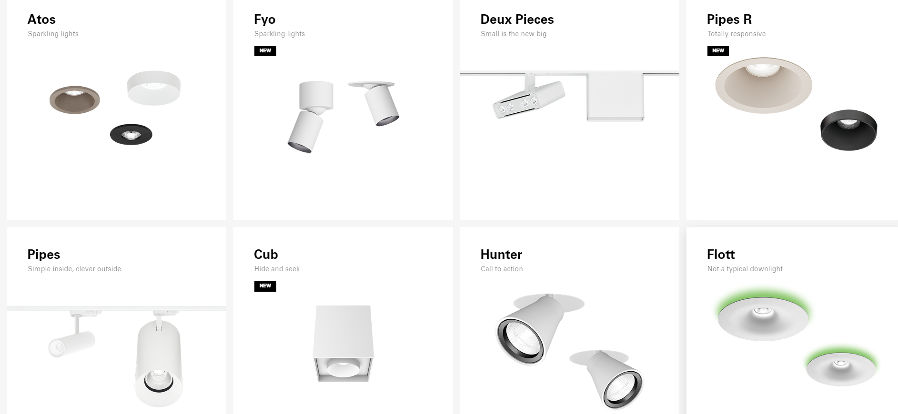
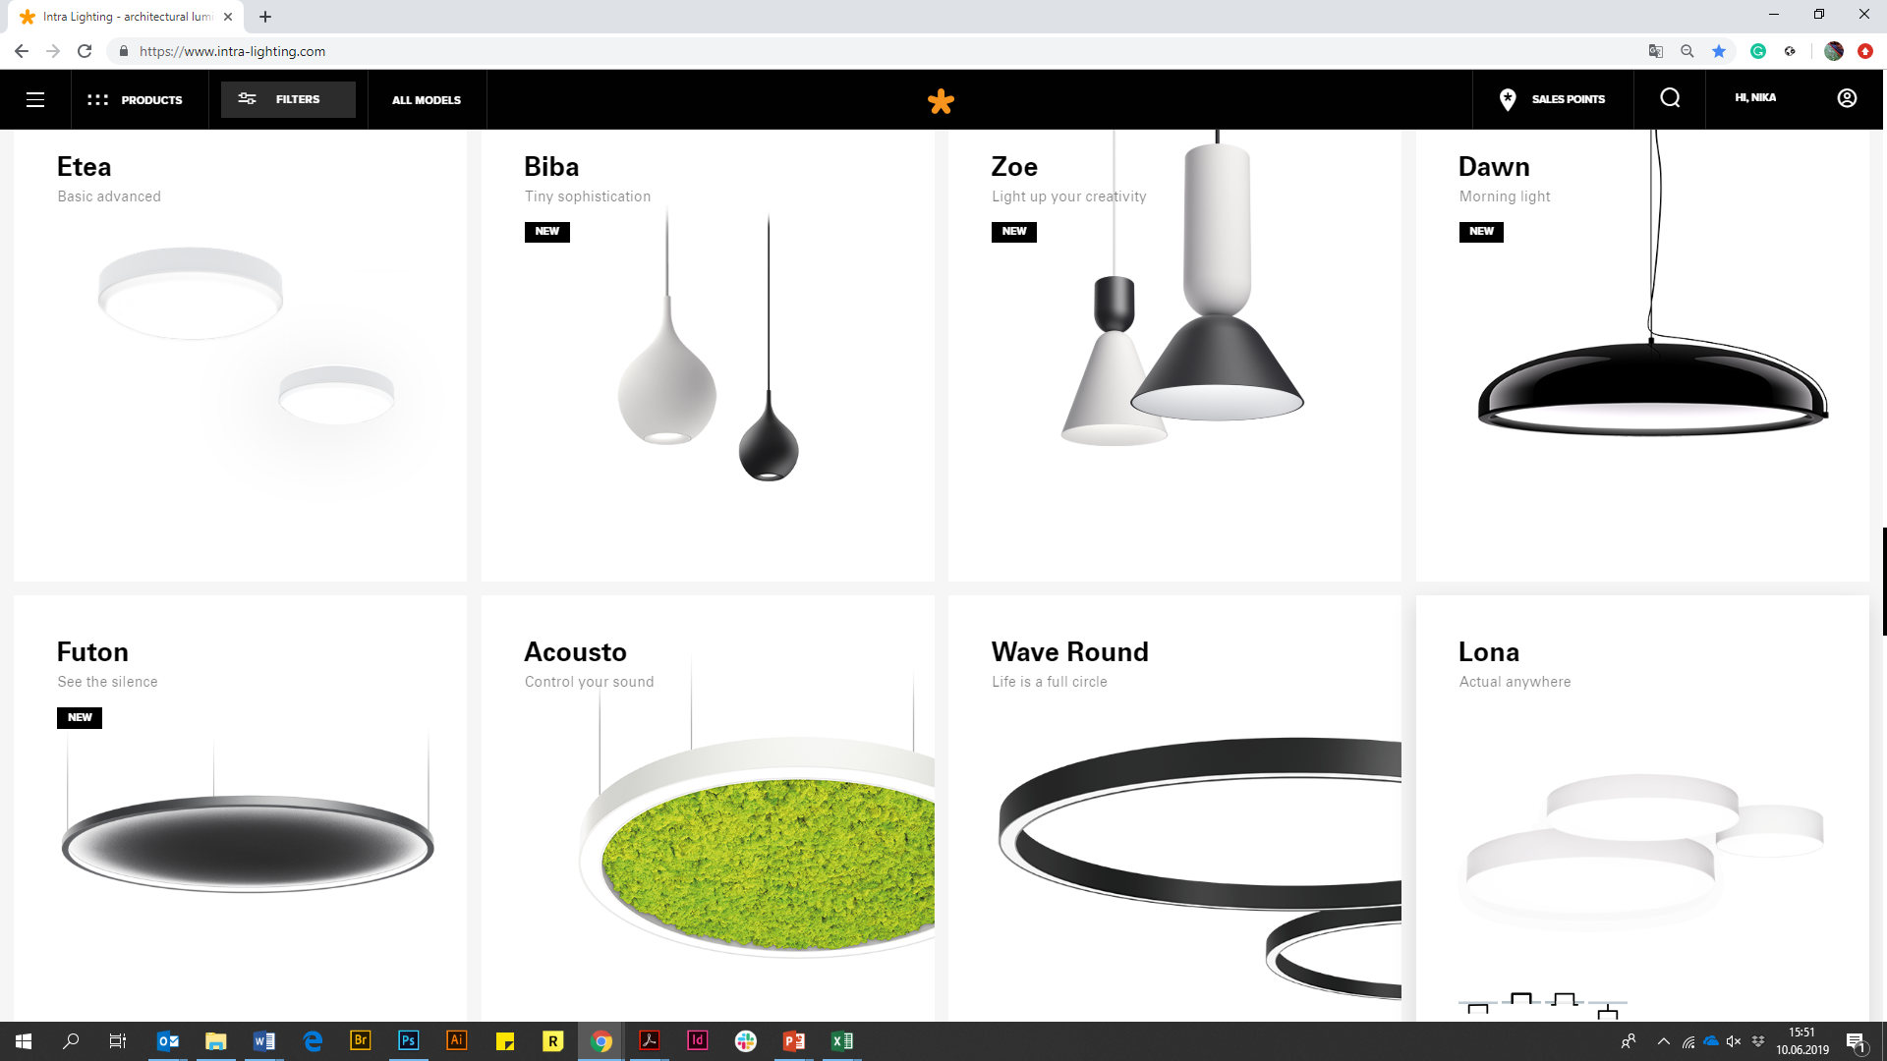
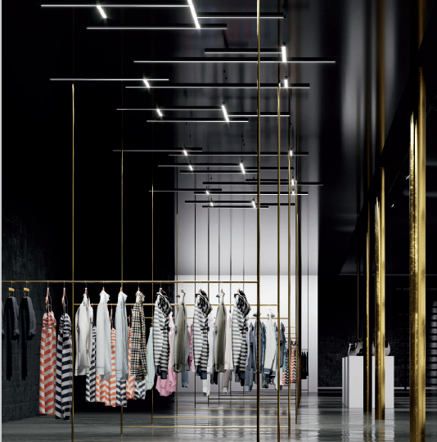

Slide 4

Light where it is needed,
when it is needed and
as much as needed

Slide 5
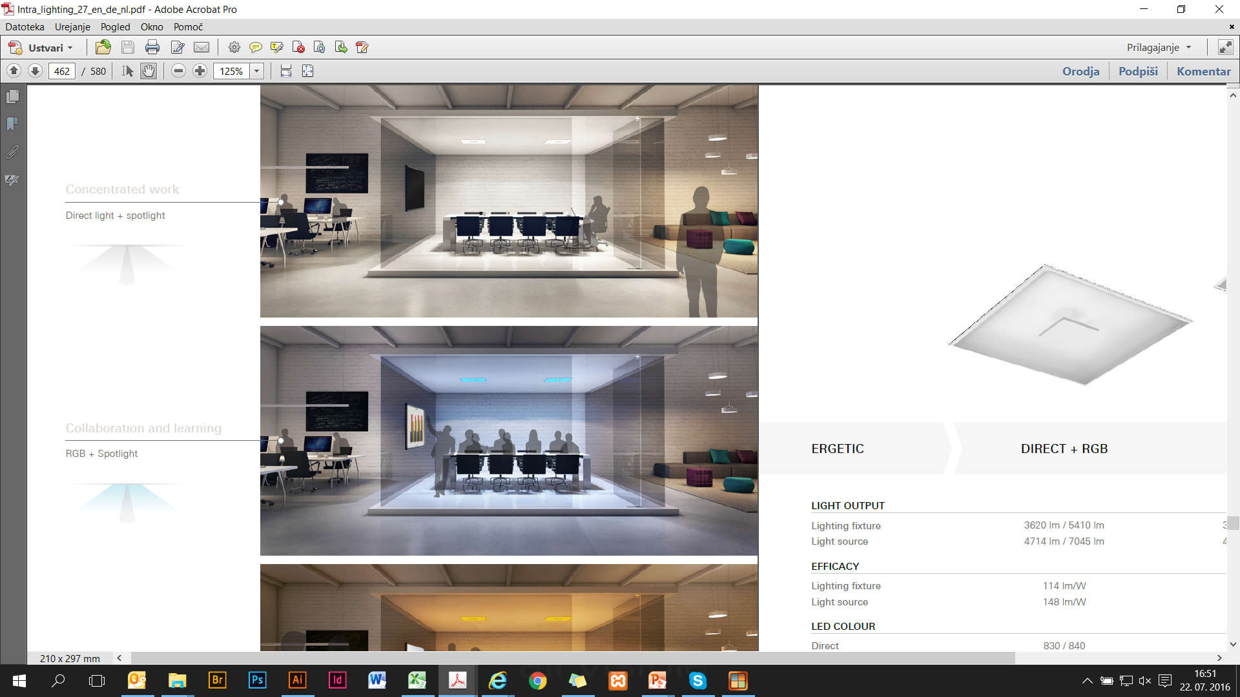
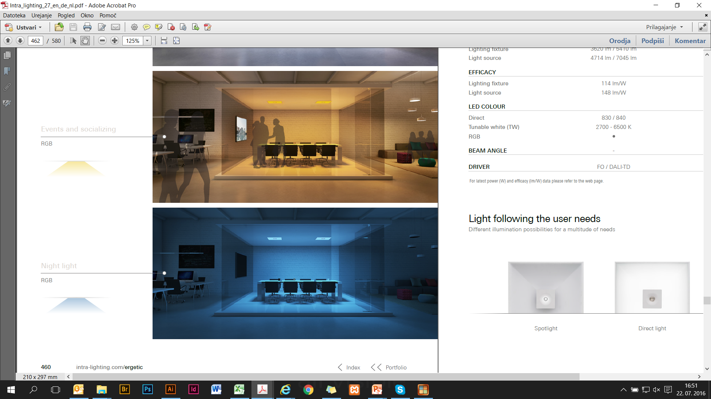

The right light for the right situation
www.intra-lighting.com
5

Slide 6
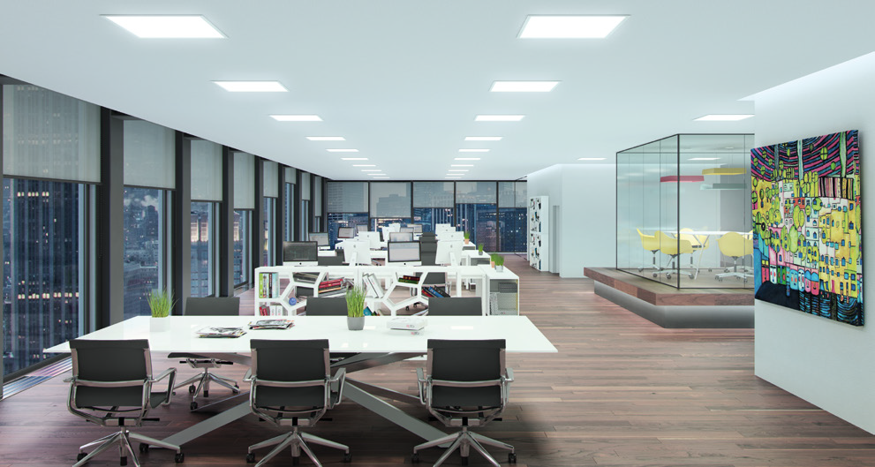
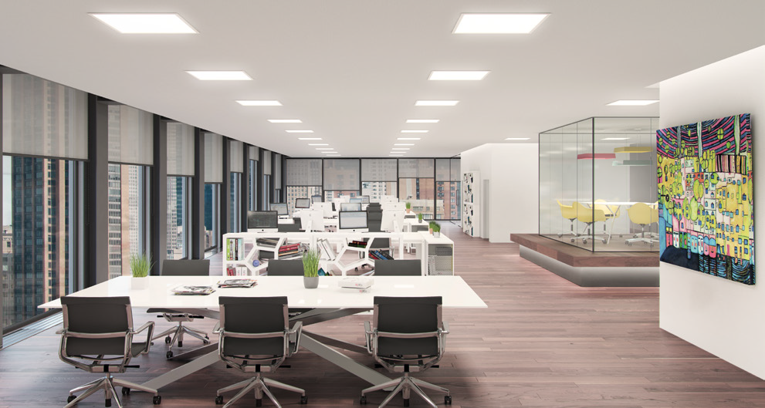
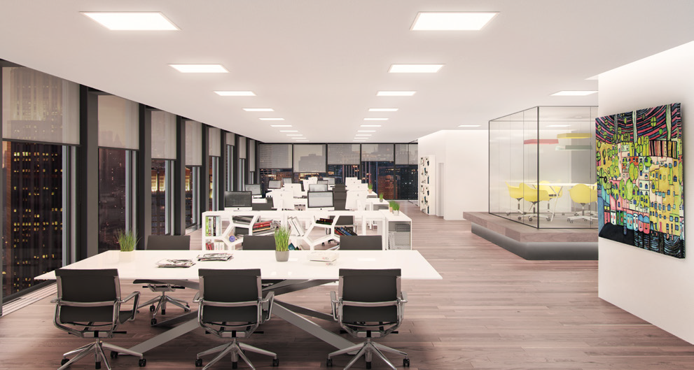
Supporting well-being
www.intra-lighting.com
6

Slide 7
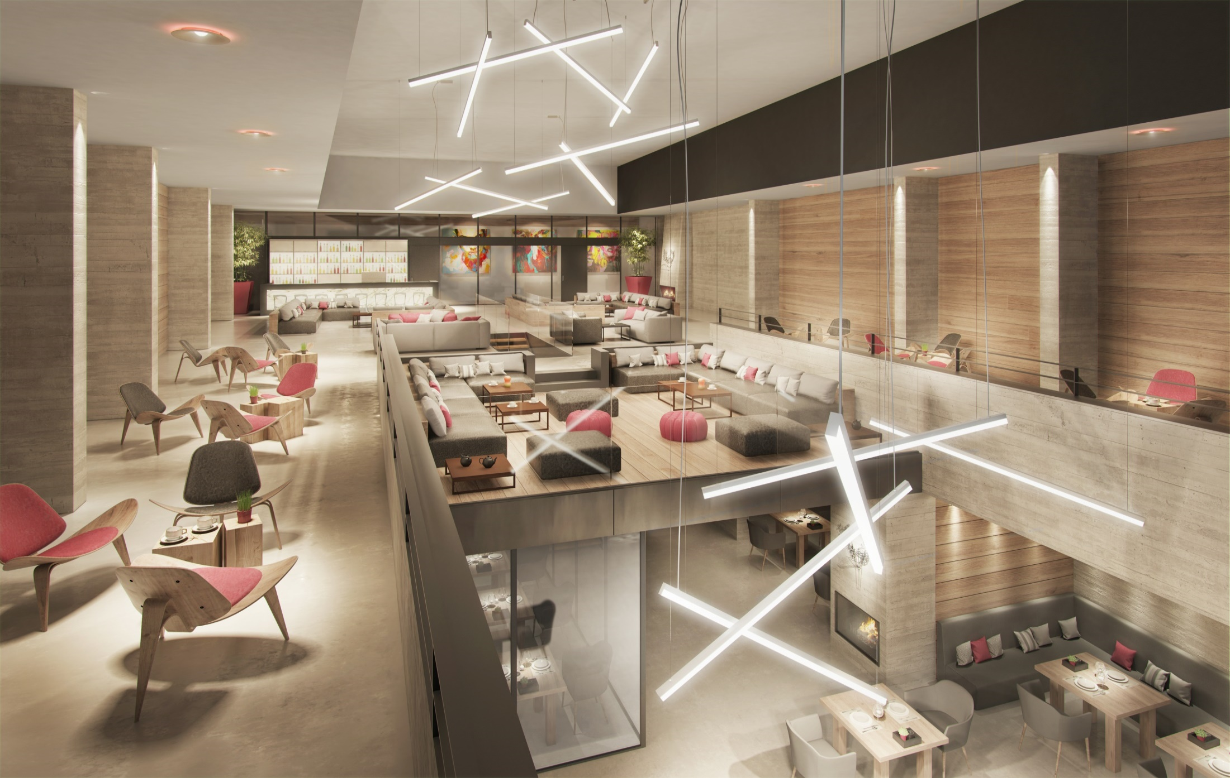
Architectural graphics

Slide 8
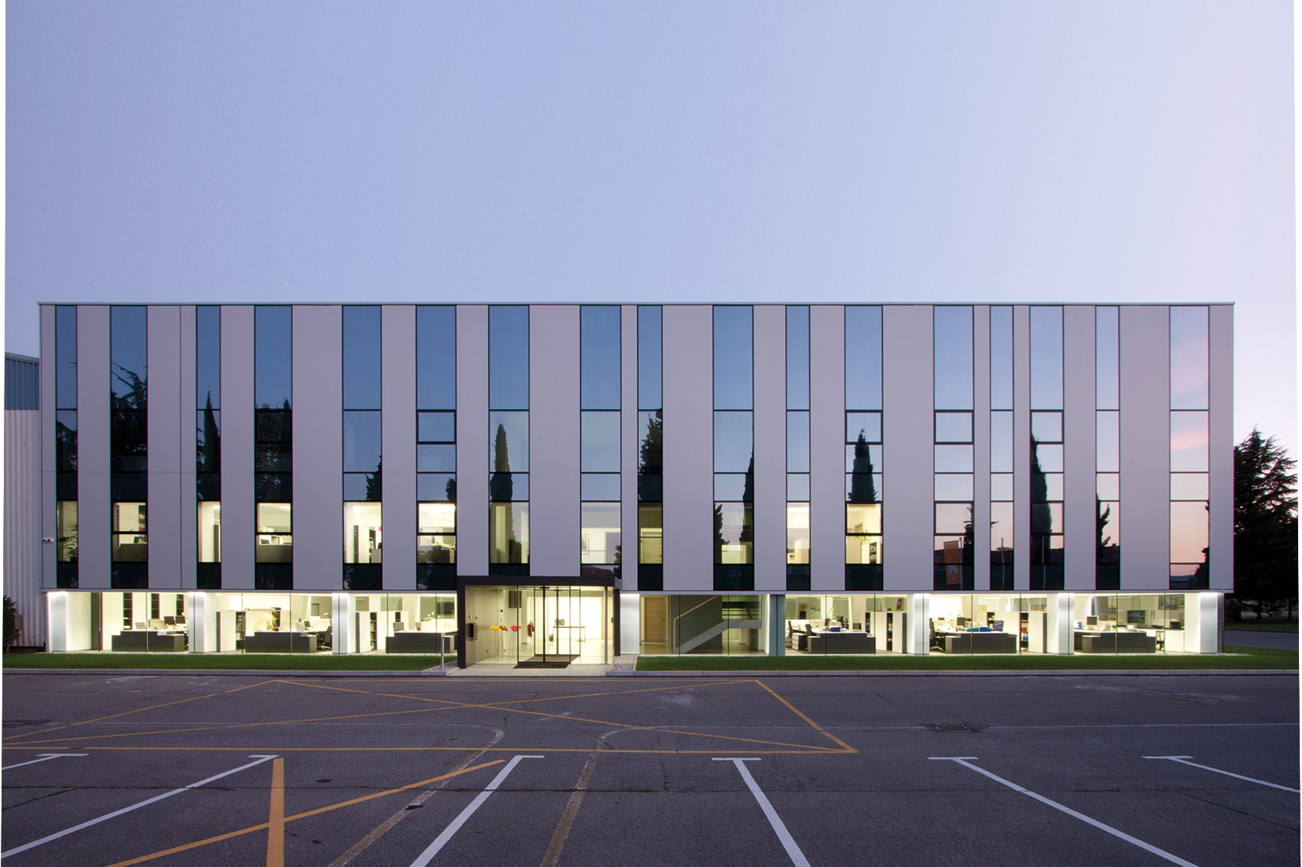
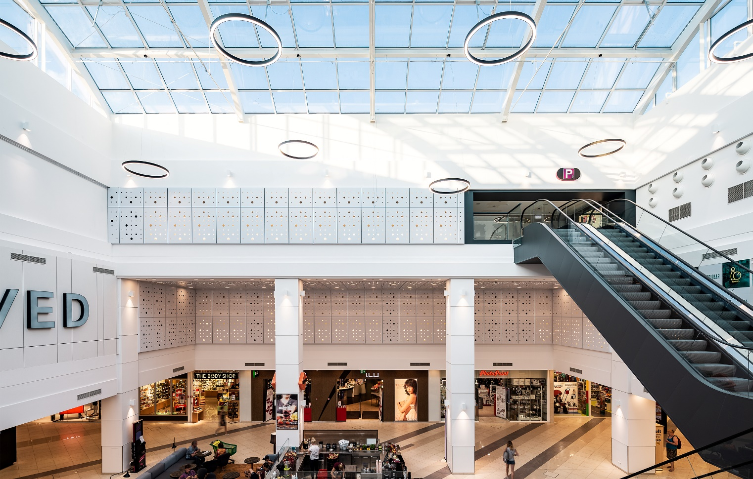
Intra lighting
Established in
1989
Intra Lighting headquarters
Šempeter pri Gorici, Slovenia

Slide 9
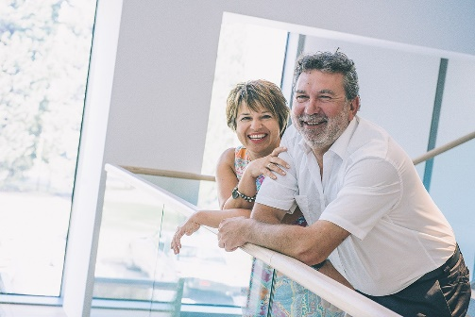
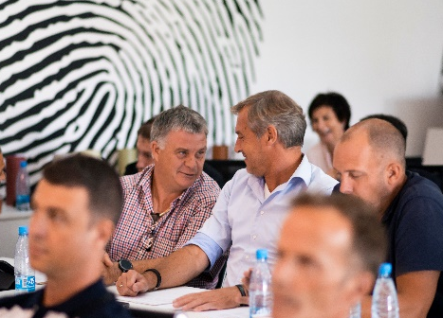
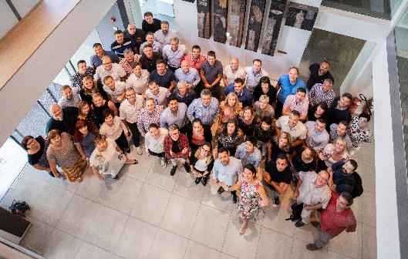
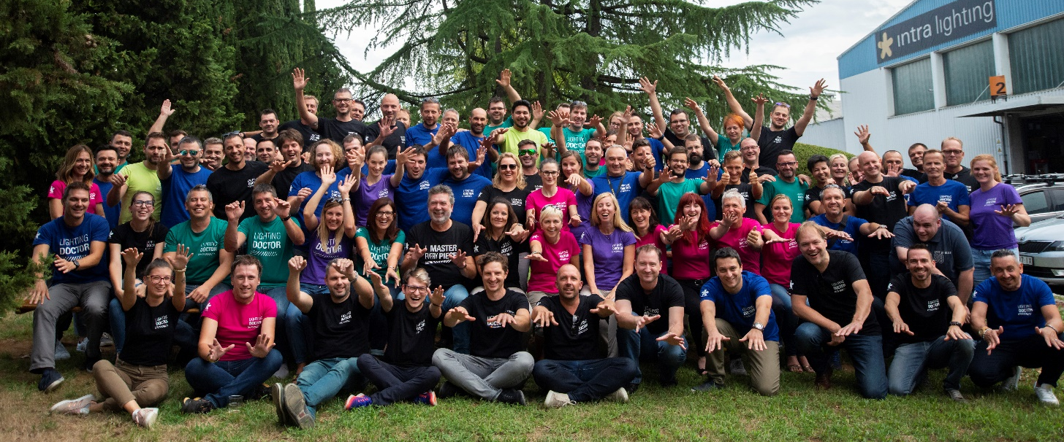
The team behind the brand
Knowledge
Creativity
Experience
Passion

Slide 10
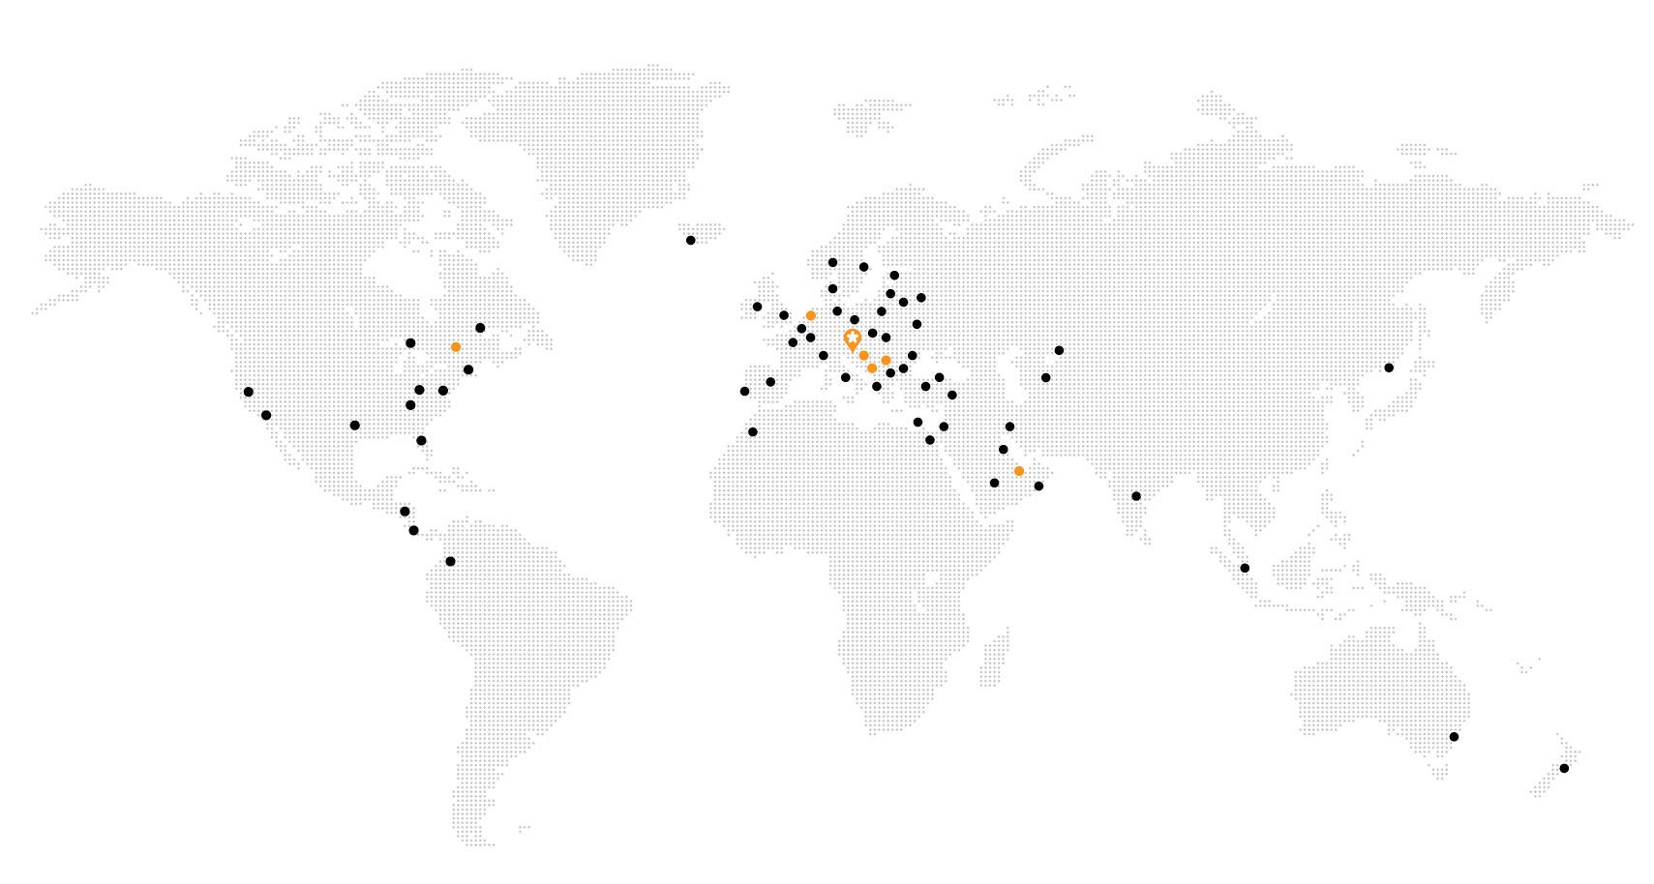
Passion for local, worldwide.
350
Employees
68
Countries
30
Years of experience
34,4
mio EUR turnover

Slide 11
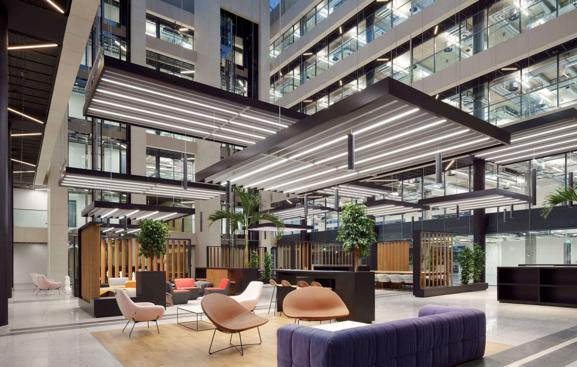
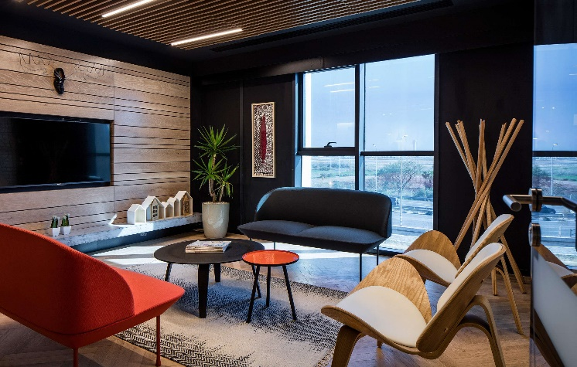
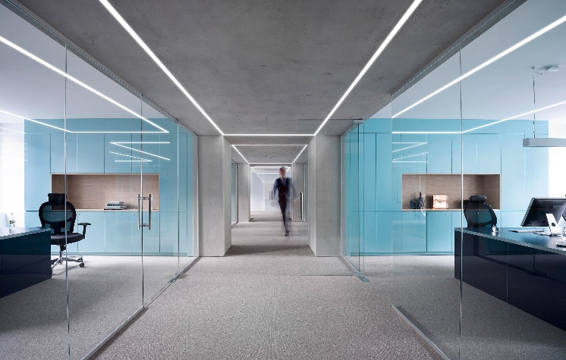
Offices
Facebook, Dublin, Ireland Architect: AARPUS Design Studio
ISS Architecture: Dorit Weinbren and Tamar Puzis
Ljubljana Stock Exchange Architecture: Kosi in partnerji, d.o.o., Arhitektura 2211

Slide 12
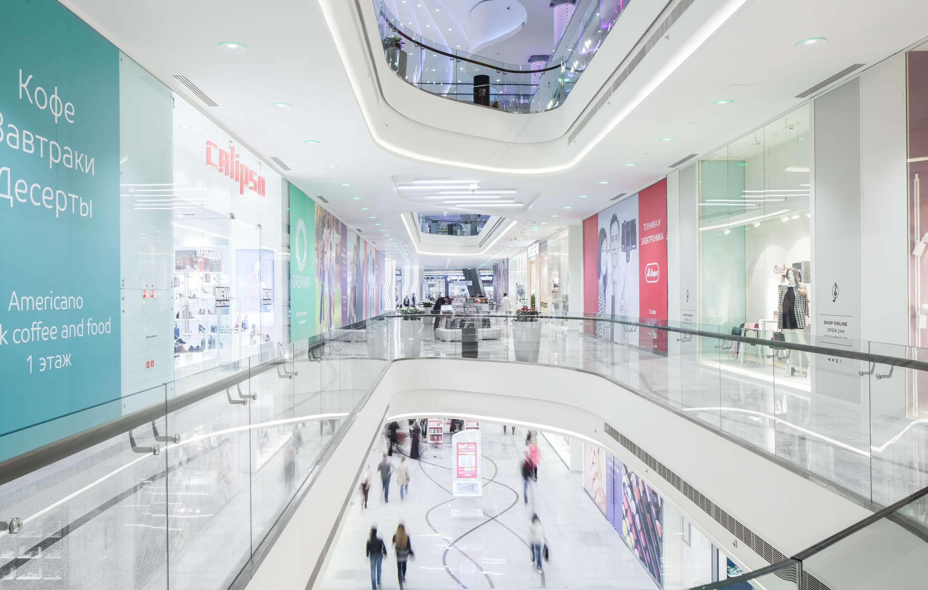
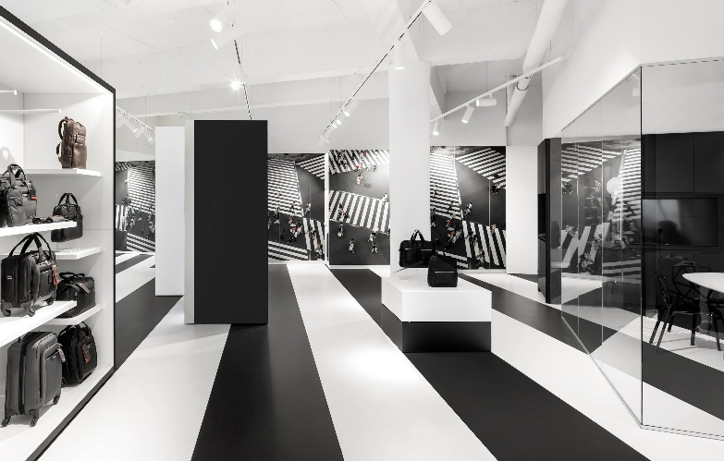
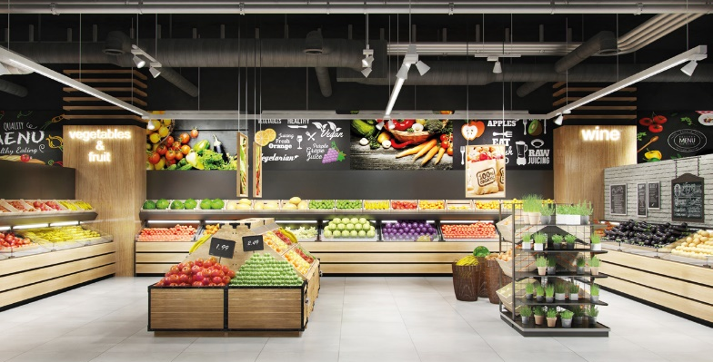
Retail
Oceania Mall, Moscow, Russia
Samsonite, Amsterdam, The Netherlands
Architecture: i29 Interior Architects

Slide 13
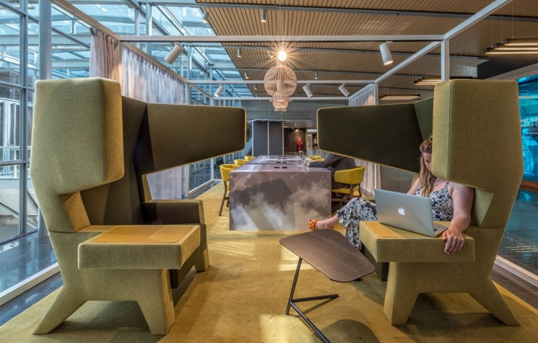
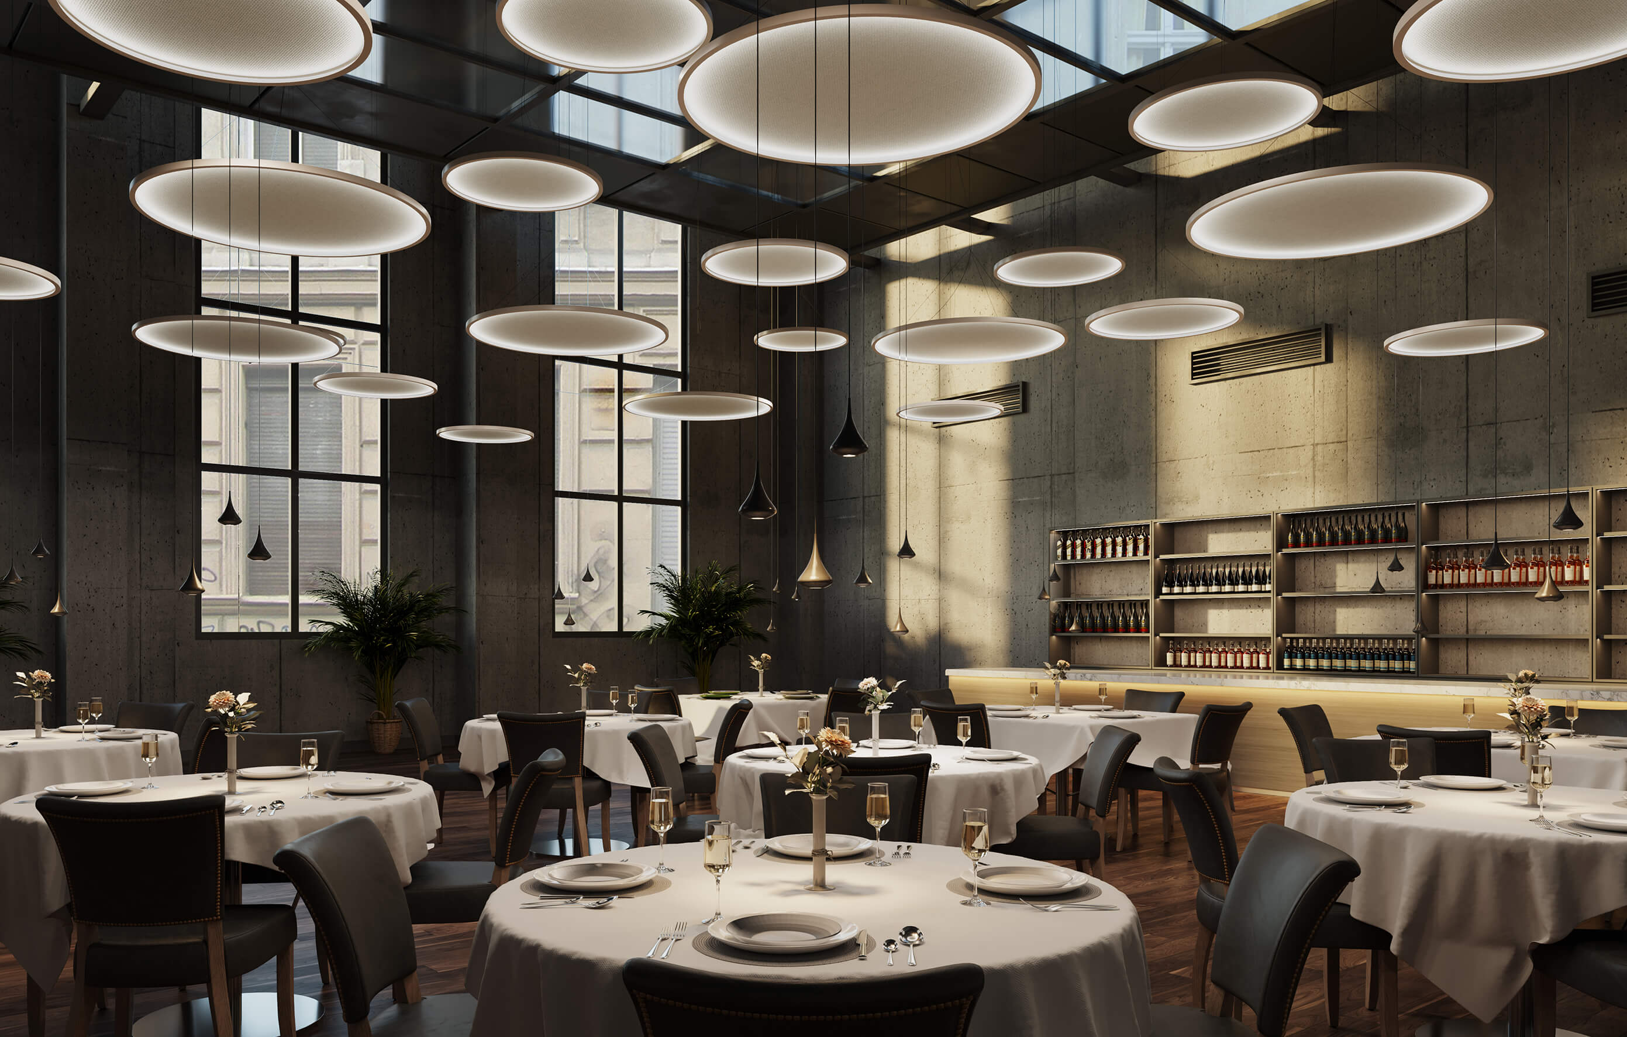
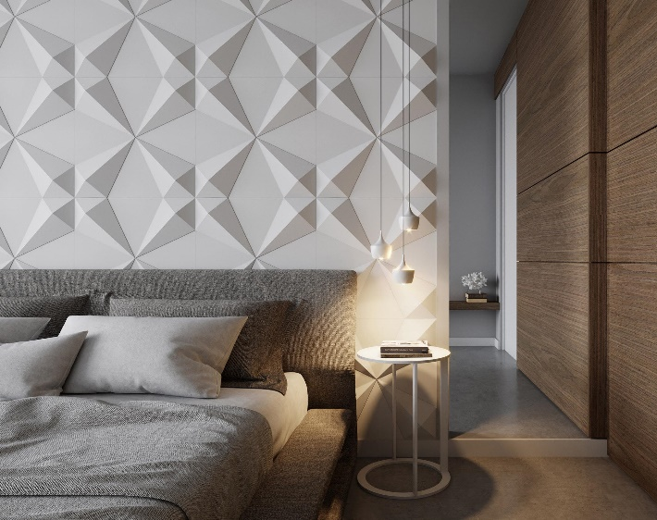
Hospitality
WTC Shiphol, Amsterdam, The Netherlands Architect: D/Dock

Slide 14
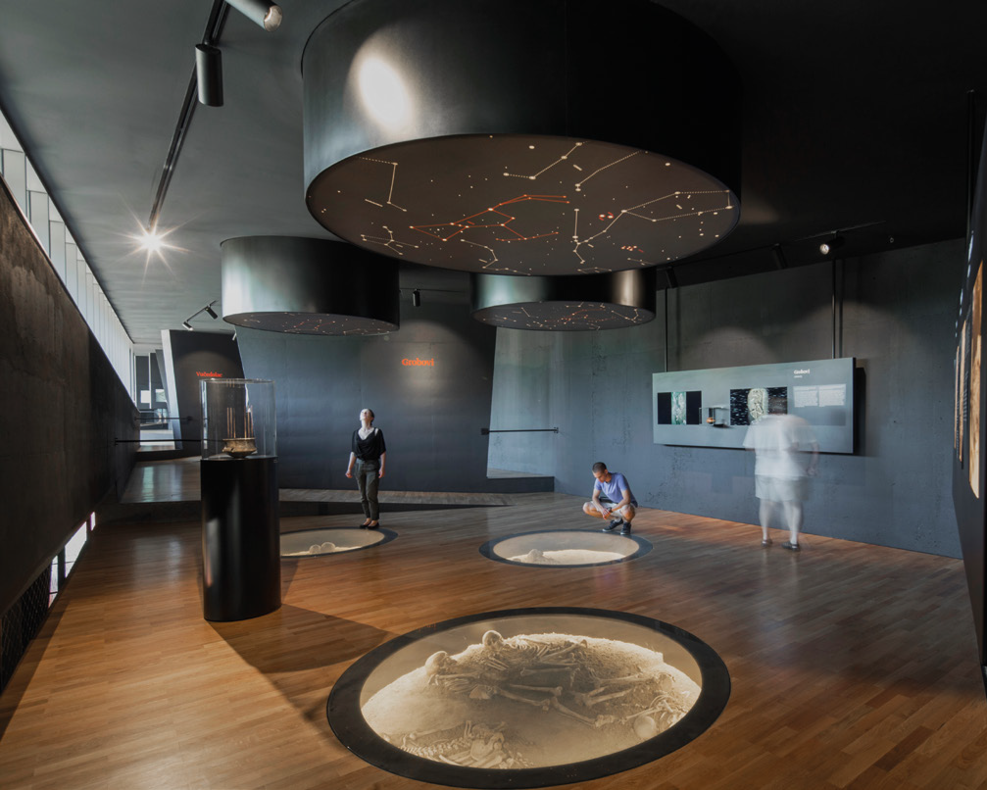
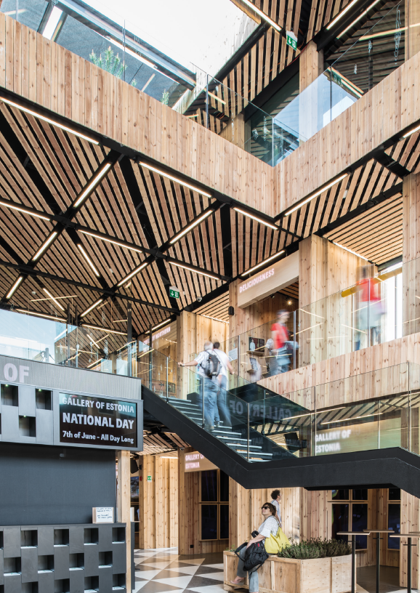
Exhibitions
Muzej vučedolske kulture, Vukovar, Croatia Architecture: Radionica arhitekture + Vanja Ilić
Estonia pavilion, Expo Milano, Italy Architecture: Kadarik Tüür Arhitektid

Slide 15
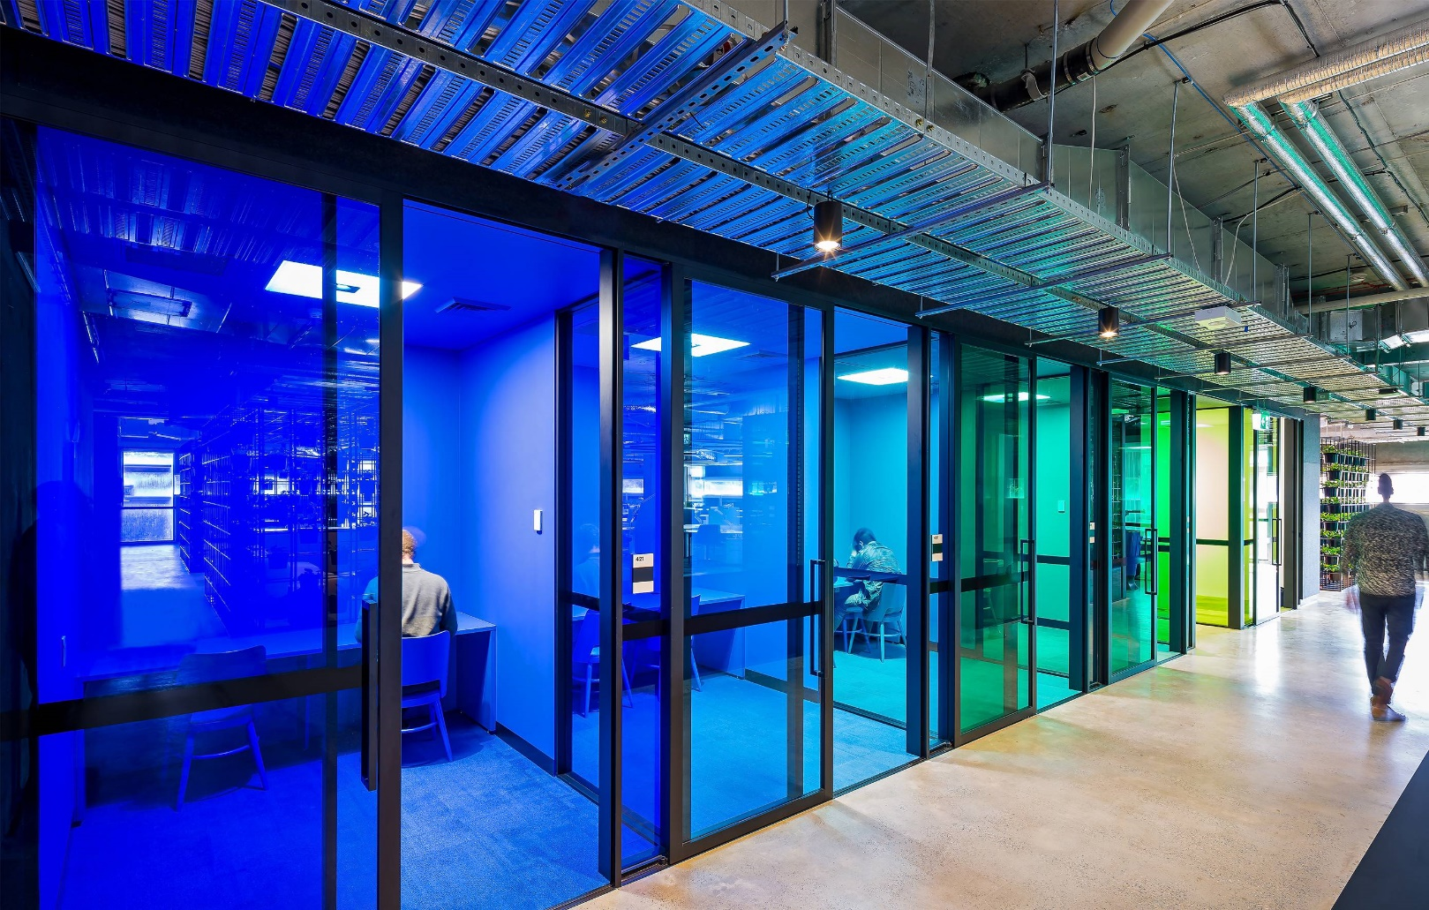
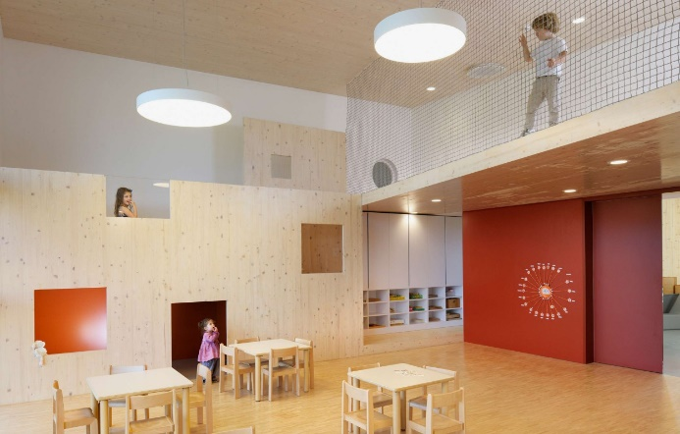
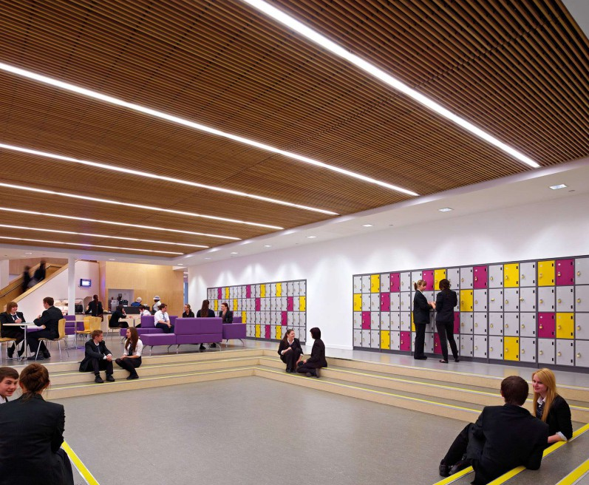
Education
Kindergarten Poljčane, Poljčane, Slovenia
Architecture: MODULAR arhitekti
Park Mains, Erskine, United Kingdom Architecture: Holmes Miller
Macquaries university Sydney, Australia Architecture: Architectus

Slide 16
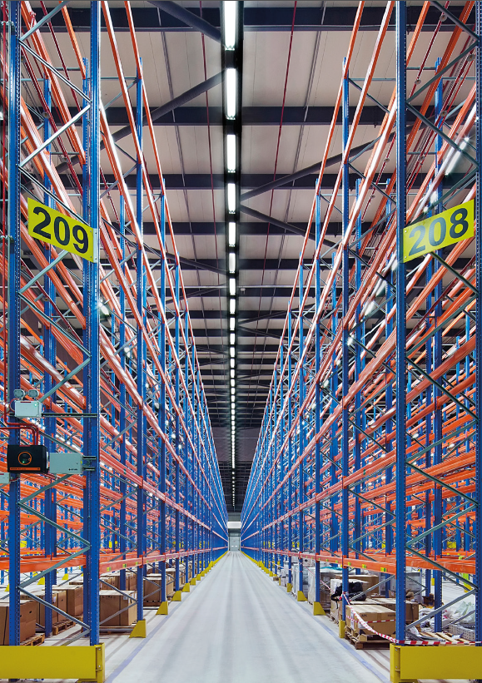
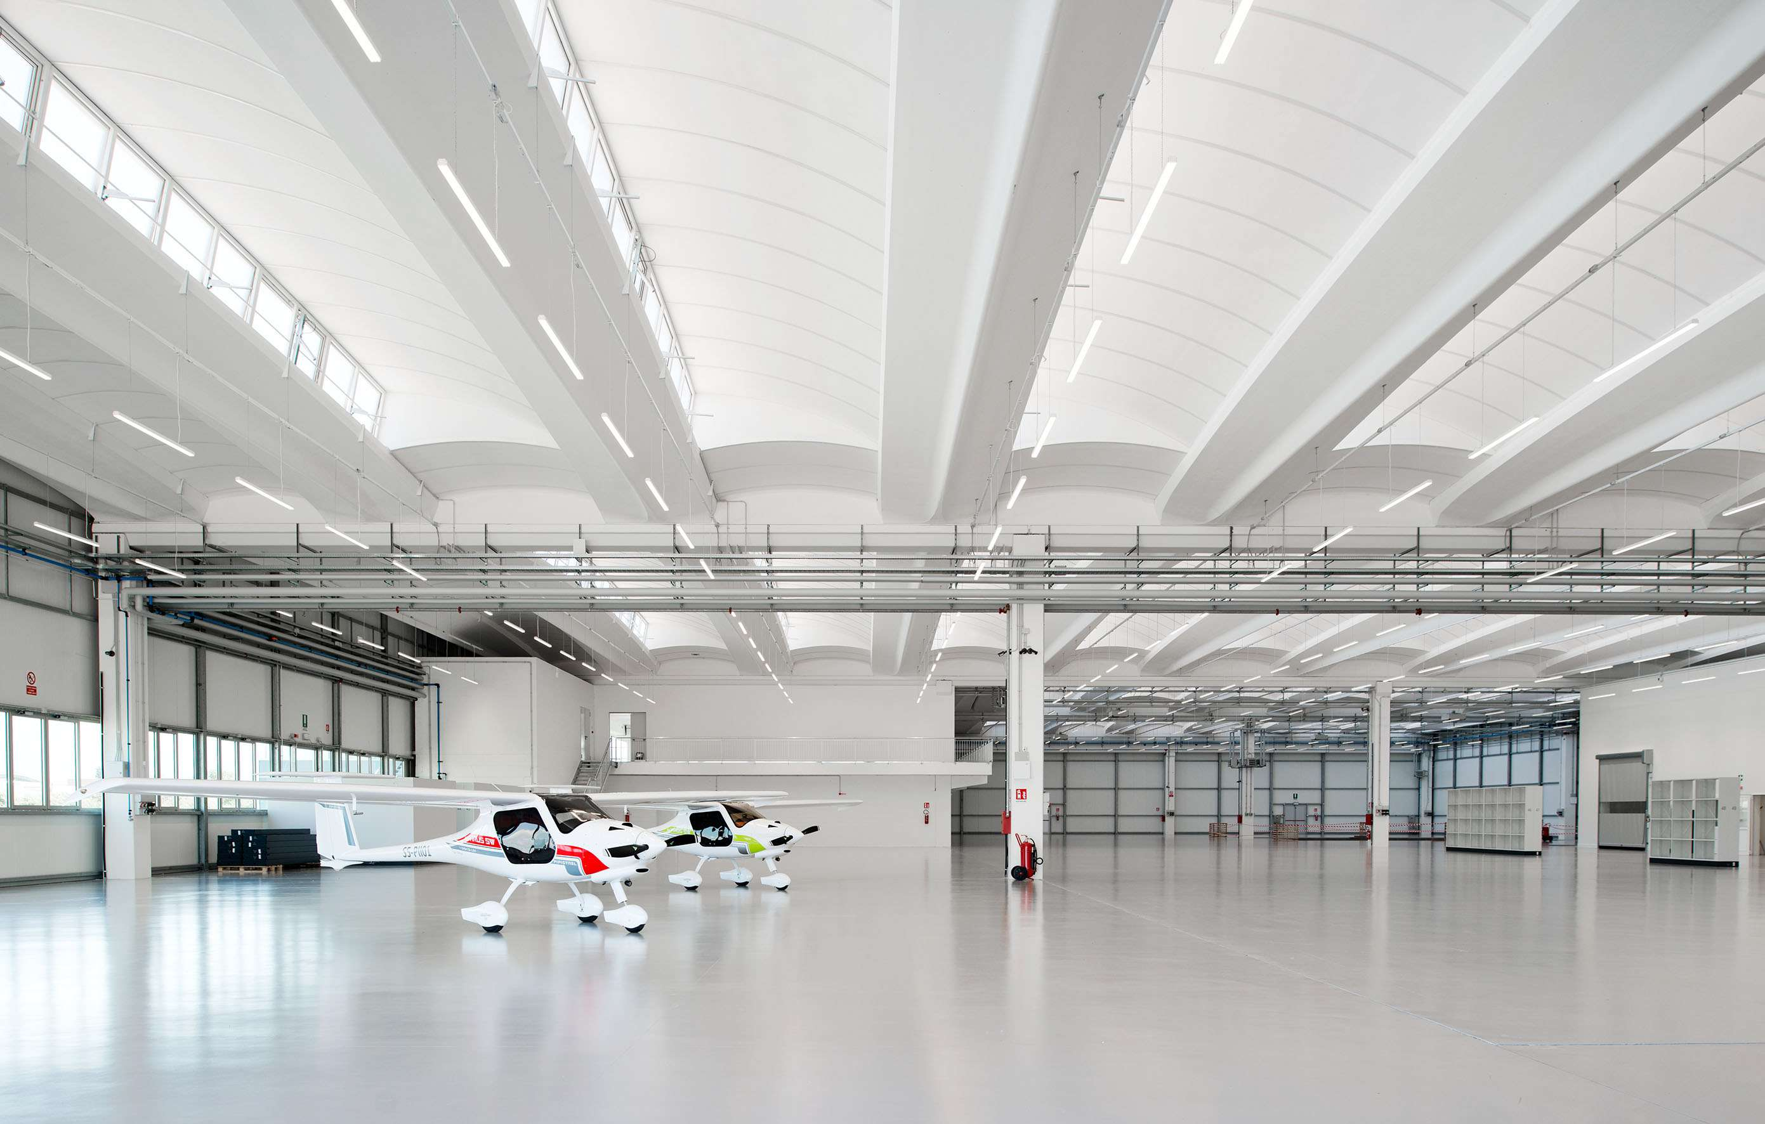
Warehouses and Industrial halls
KEA, Dubai, UAE Developer: GRDI, Consultant: Kelly Taylor Associates, Lighting design: Reynard Lighting
Pipistrel, Slovenia Architecture:Studio DeGressi Gorizia

Slide 17
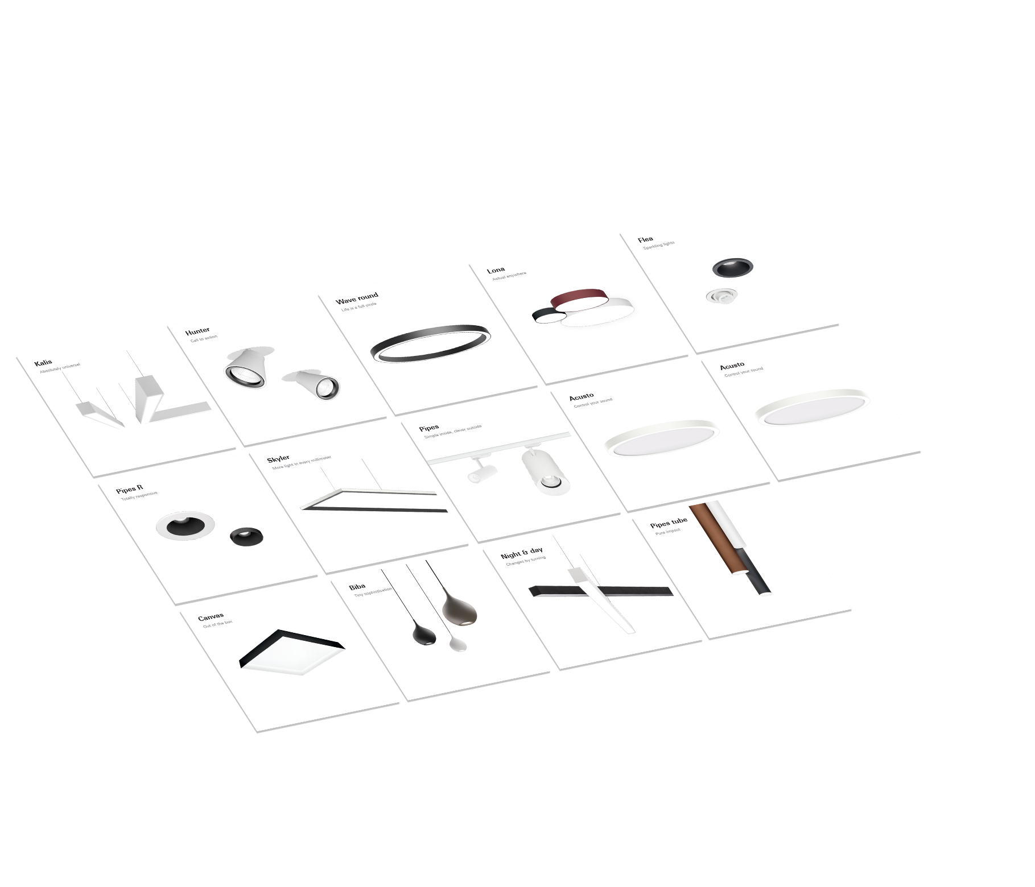

Wide product portfolio
4 -10
New product families
every year

Slide 18
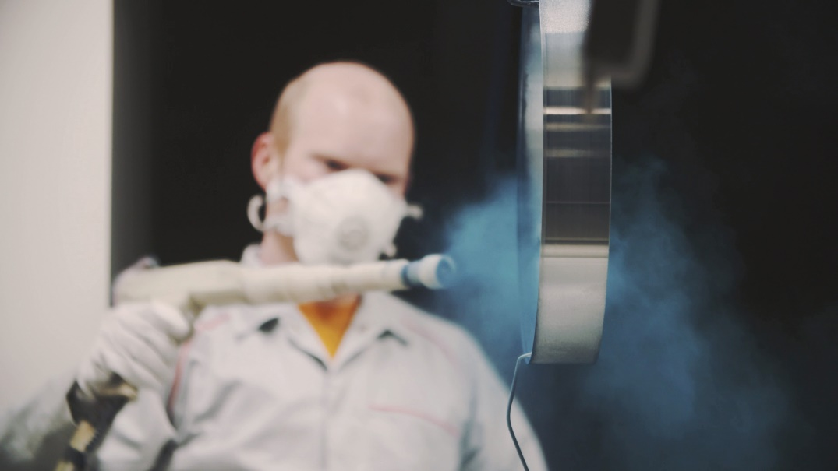
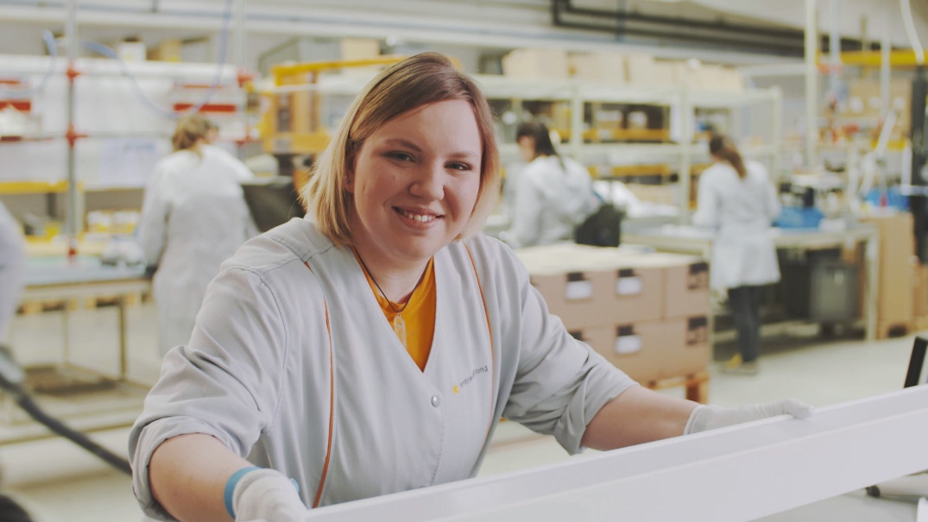
Made in Europe
100%
Tested products
ISO
Certified
26
Thousand m2

Slide 19
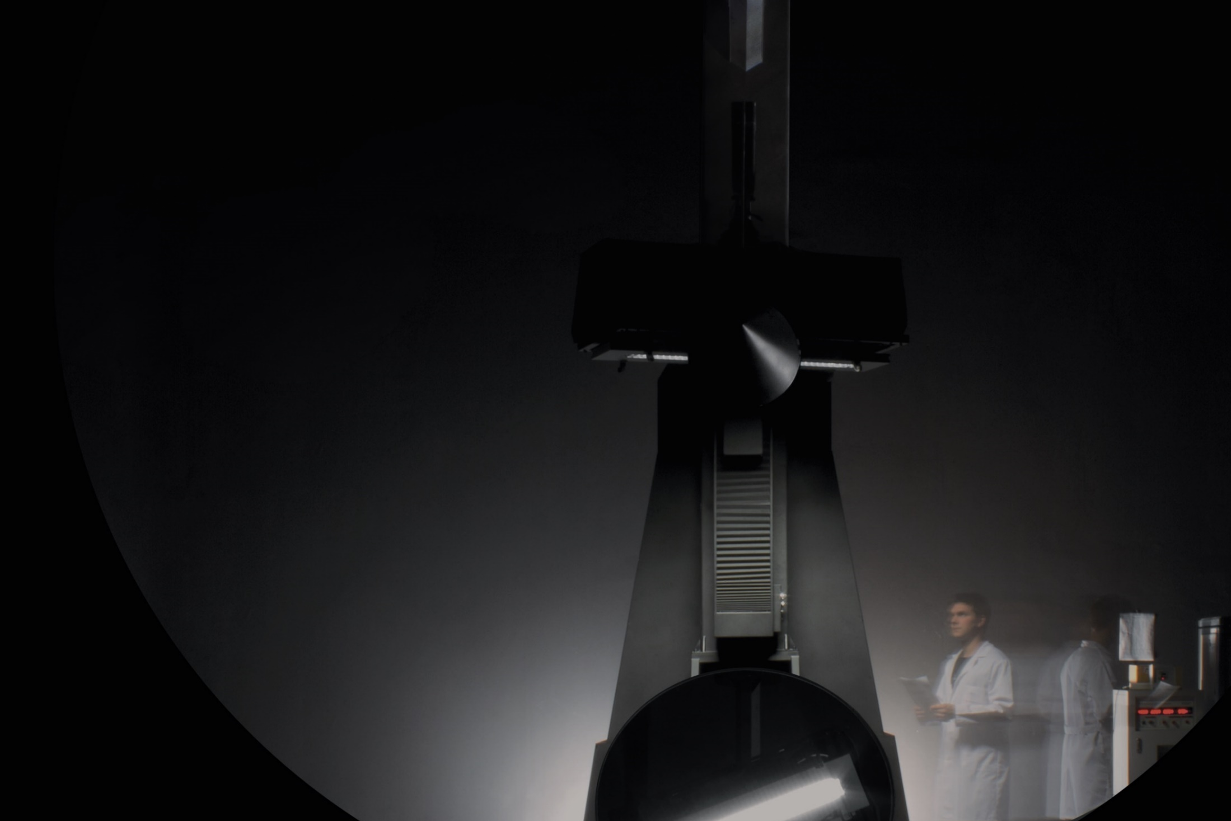

Laboratories
Among the biggest in Europe
Exact measurements

Slide 20

Quality in every detail
100 % tested products
High internal quality standards
Verified & certified suppliers
7- year warranty

Slide 21

Focusing green
93%
Recycable products
60 %
Renewable energy

Slide 22
User focused
support

Slide 23
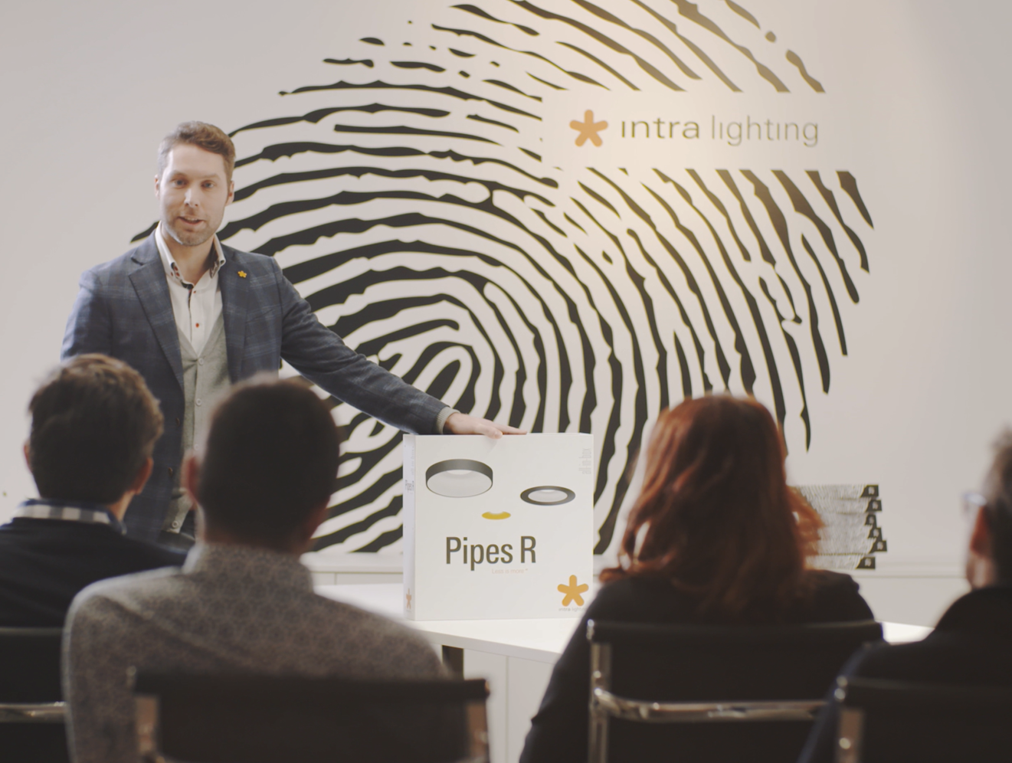
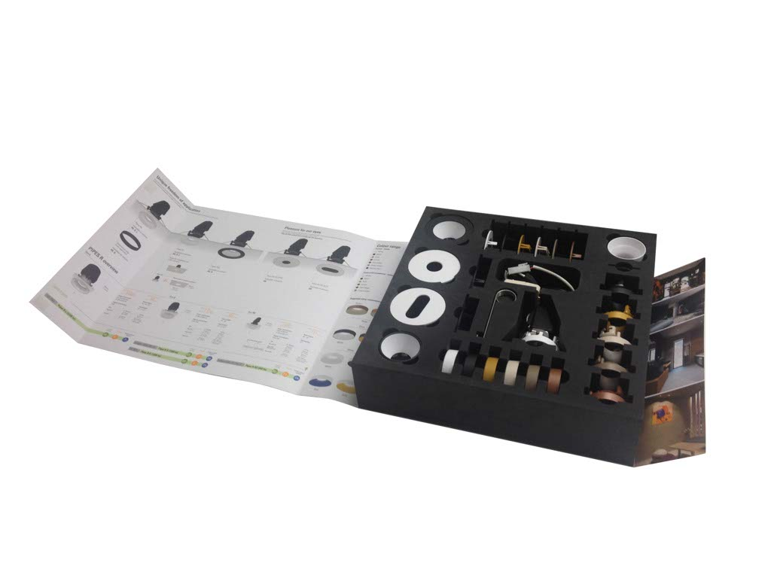
Product presentations

Slide 24
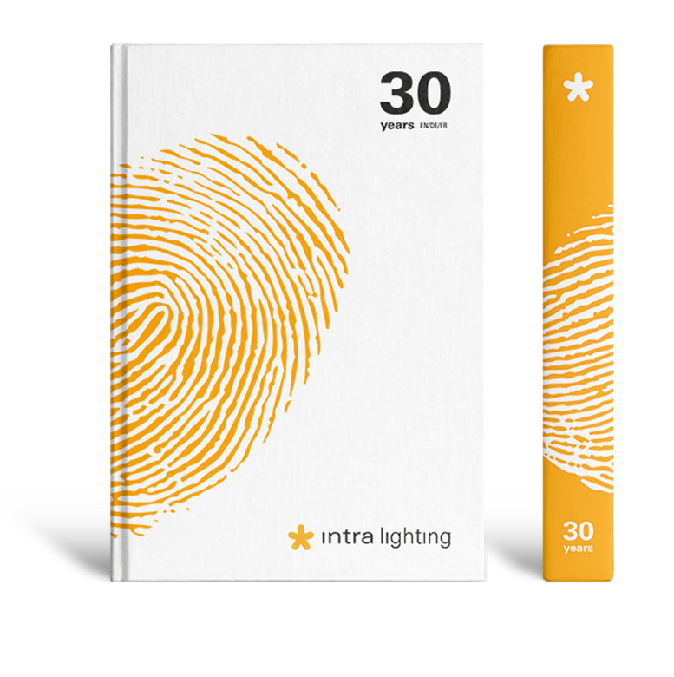
New catalogue
20 new product families
18 languages
EN / DE / NL / FR / SI / CR / IT / ES / RU / RS
NO / SE / DK / FI / CZ / PL / SK / HU
New technical content

Slide 25
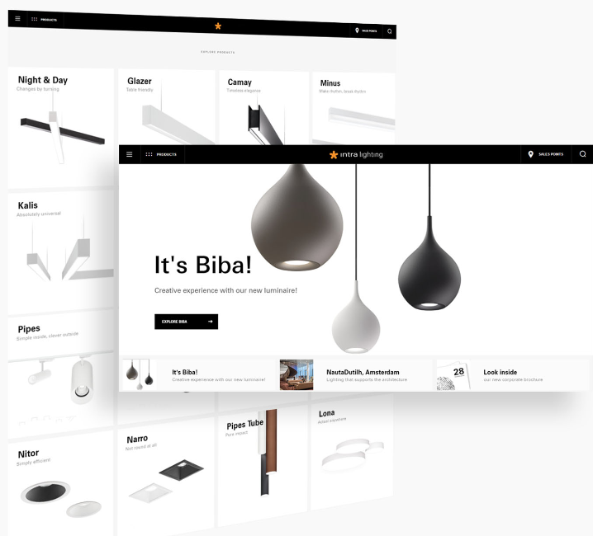
Web page
User focused
All that you need in one place
Easy to use / easy to find

Slide 26
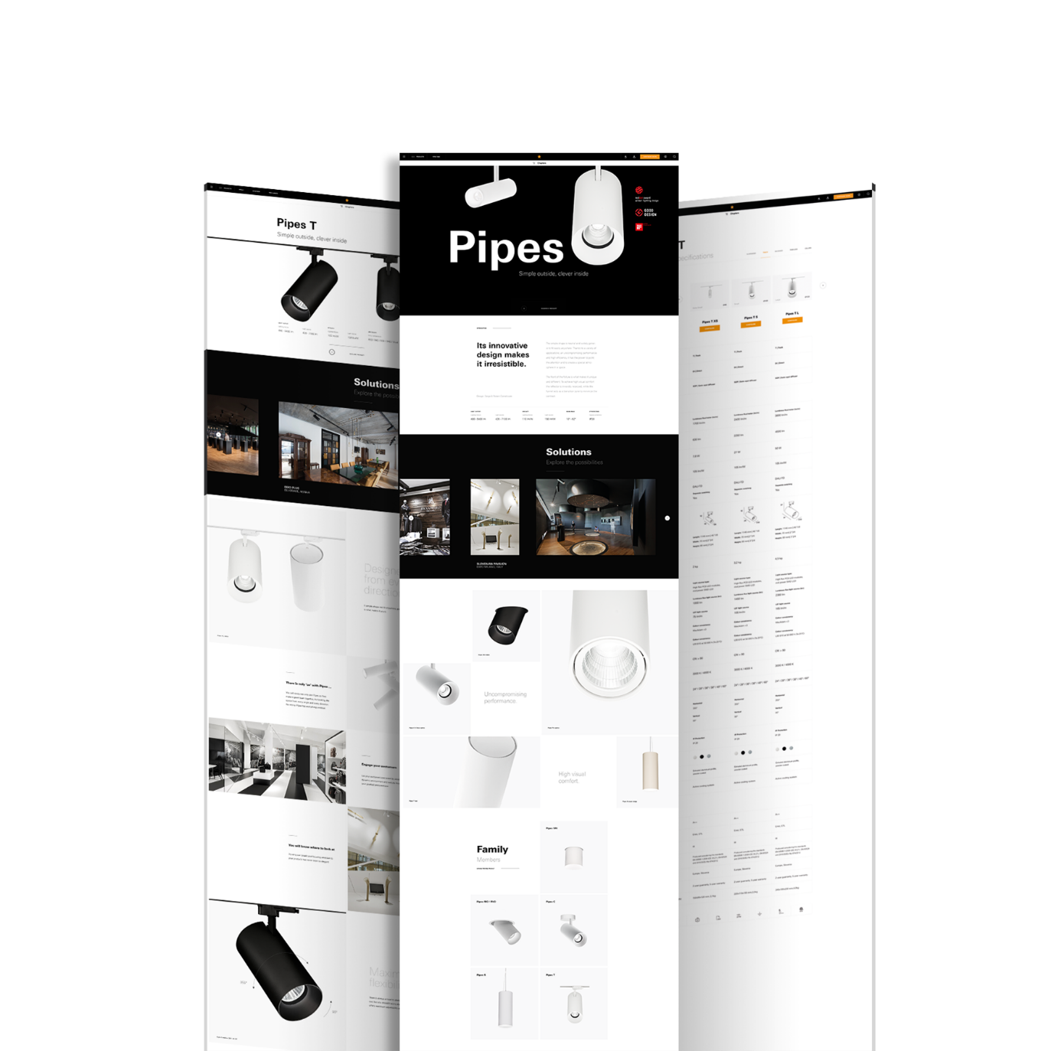
3 ways to discover a product
Image
Visual
Technical

Slide 27
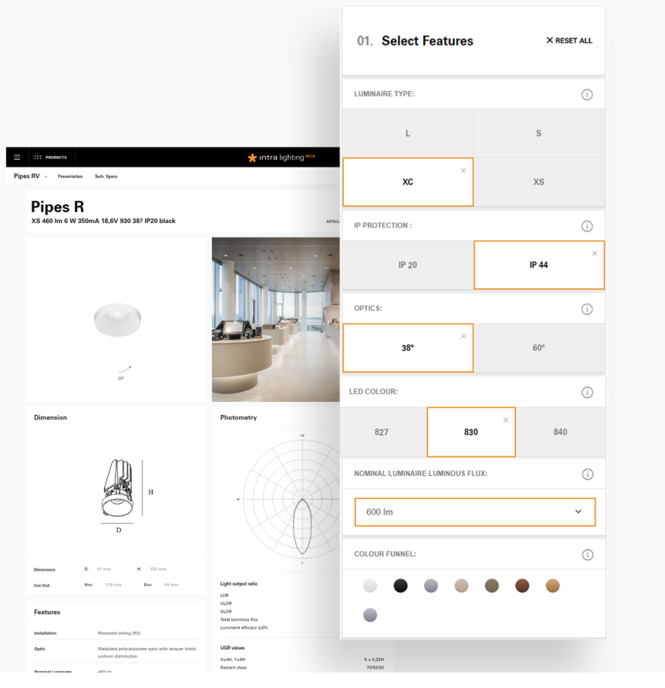
10 seconds to the product code
54 product families
250.000 codes
One database
Complete documentation

Slide 28
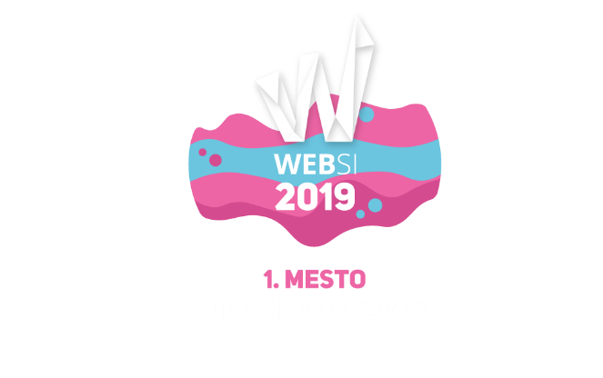
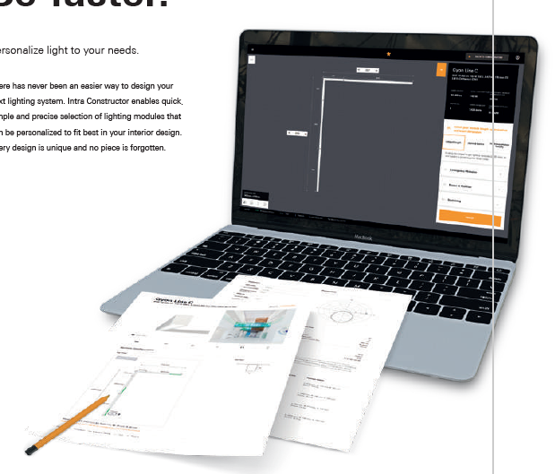
Intra Constructor
Personalize the system to your needs
Less than 60s to build
No mistakes, no forgotten parts
All documentation prepared

Slide 29
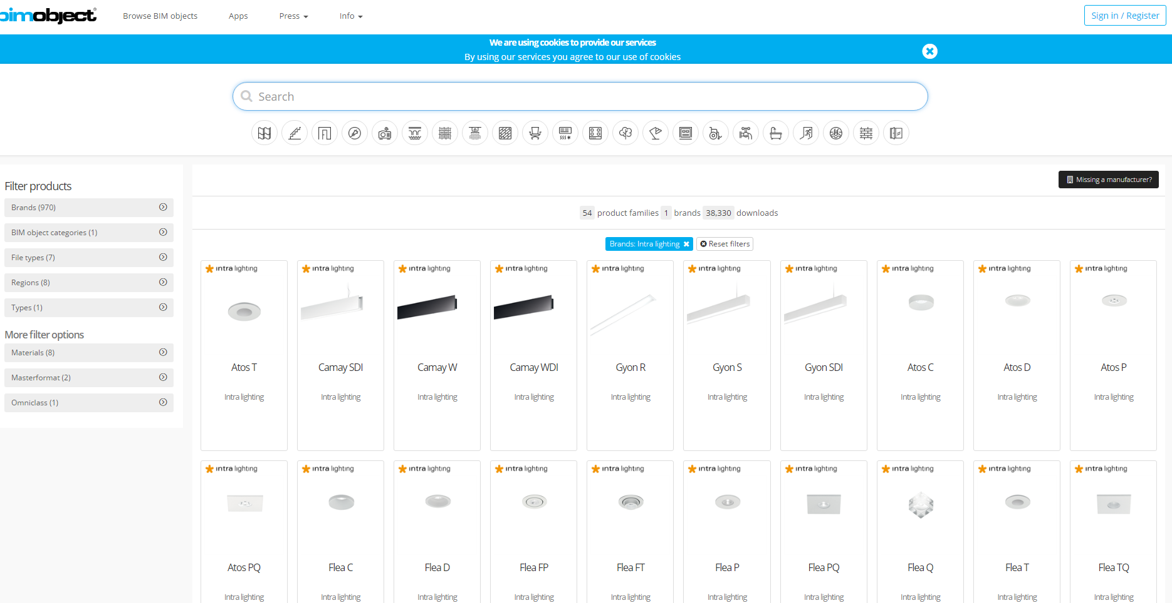
3D BIM
Video on how to place BIM Objects or Acess to BIM Library

Slide 30




Enhance presentation

Slide 31
Solving lighting
challenges of
our clients

Slide 32












Brands that trust us

Slide 33



Microsoft
One Microsoft Place, Dublin, Ireland

Slide 34


NautaDutilh
Amsterdam, The Netherlands

Slide 35


International
House Sydney
Sydney, Australia

Slide 36


Kalverpassage
Amsterdam, The Netherlands

Slide 37

Expo 2020
Dubai, United Arab Emirates

Slide 38


Facebook
Nova Atria South, Dublin, Ireland

Slide 39


Ferrari
Maranello, Italy

Slide 40
Achievements &
Future plans

Slide 41



Product awards

Slide 42




Product awards

Slide 43

Product awards

Slide 44

Silver Gazela
Silver Slovenian Gazela: Award for the fastest growing companies in Slovenia

Slide 45

Marketing Excellence
Among 3 Top Companies in B2B Category

Slide 46

Best digital tool: Intra Constructor
Websi – 1st Place
for Intra Constructor in a Digital Tool Category

Slide 47

Business Stars Award
Among 10 finalists for Delo's Business Stars Award

Slide 48


Entering the US and German market

Slide 49
New factory & Experience centre

