Slide 1


Slide 2

NANOCUT d.o.o.

Slide 3
GAMMA / NEUTRON FLUX HARDENED PRODUCT

Slide 4
LED lighting,
analog electronic circuits.

Slide 5

COMPANY PROFILE
NANOCUT d.o.o. was established in year 2014. It is private own small company with exstensive knowledge in physics, electronics and mechanical CAD CAM engineering.
In first two years we developed a few models of high efficiency LED lights for industry use, shops and offices.
With own mechanical and electronical workshop we can reaserch, develope and produce medium quantity Led lights in very short time.
We also develope and manufacture all LED drivers ourselves.

Slide 6
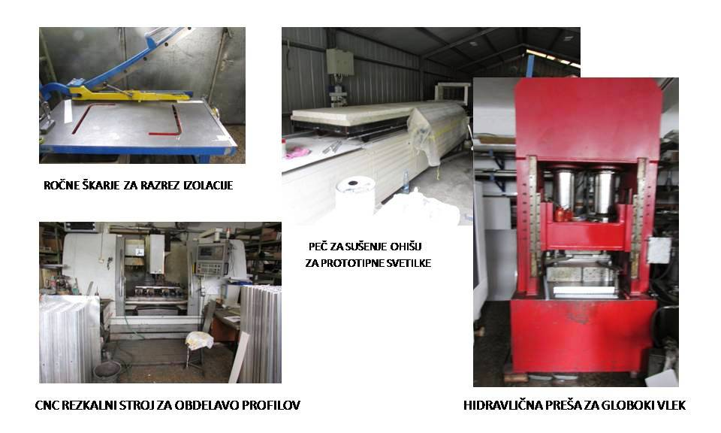
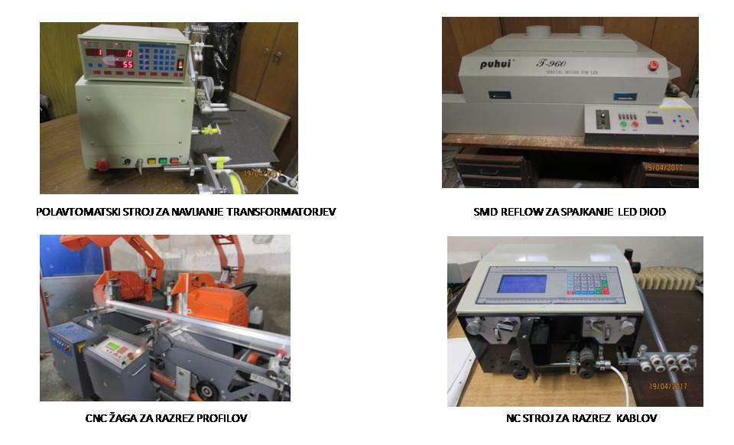
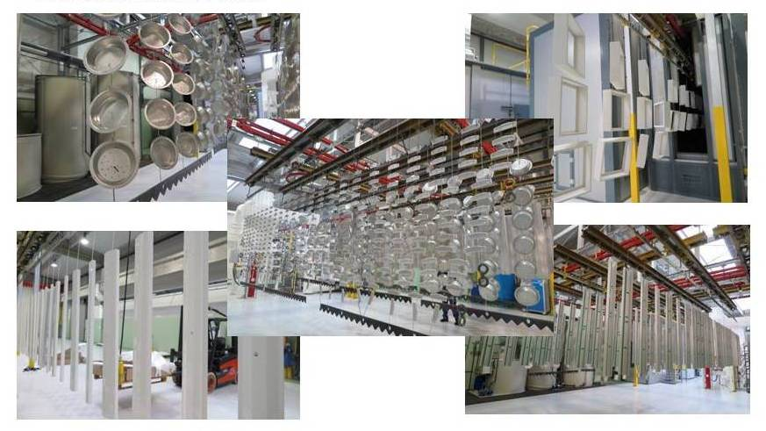
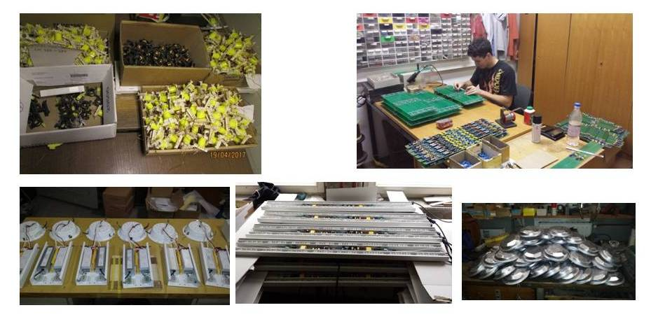
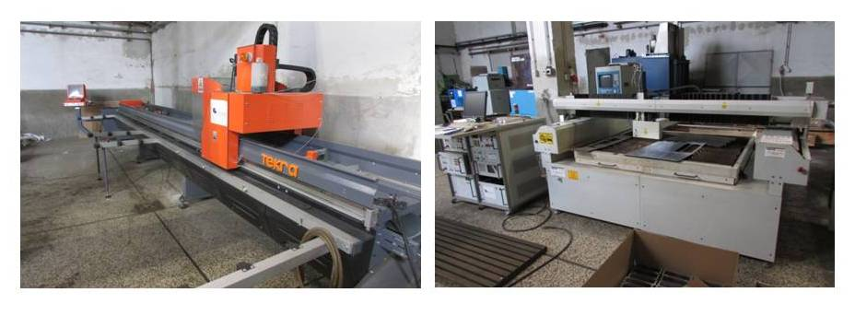
OWN PRODUCTION FACILITITY
MECHANICAL EQUIPMENT
EQUIPMENT FOR ELECTRONIC
OUTSOUCING POWDER PAINTING
ASSEMBLING
METAL CUTTING EQUIPMENT

Slide 7
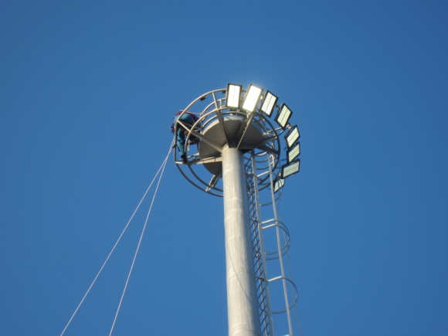
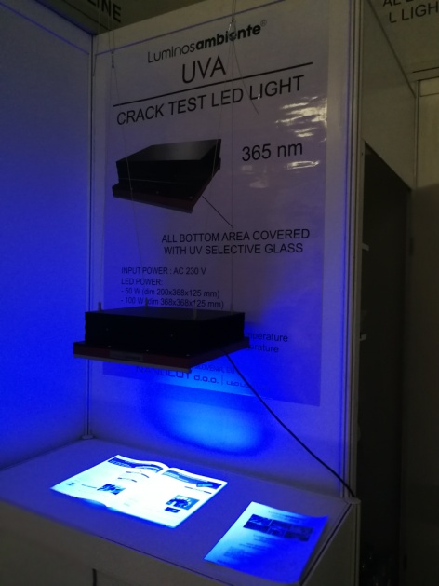
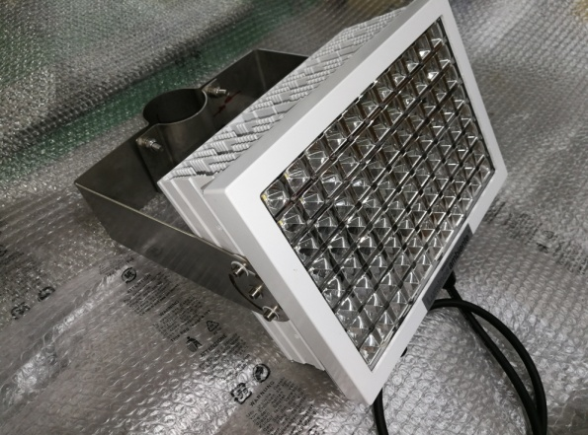
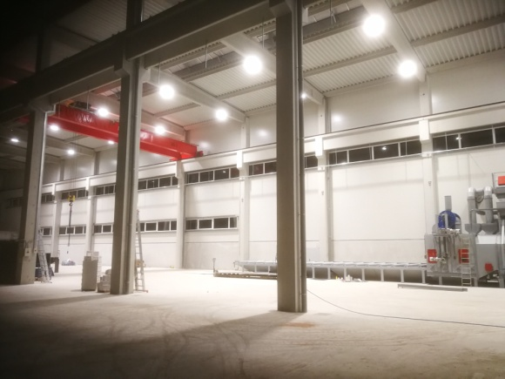
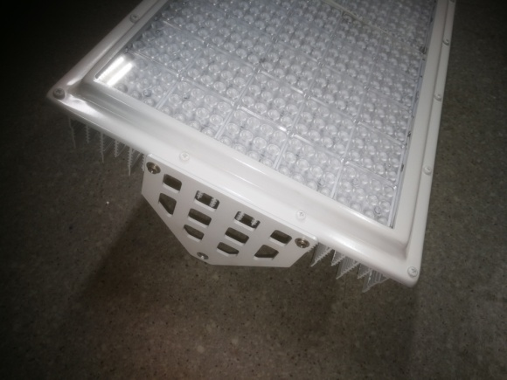
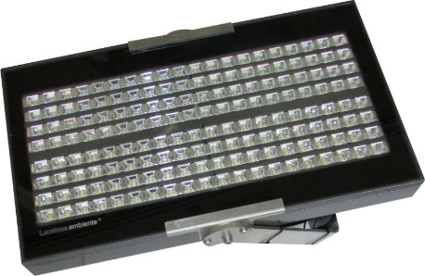
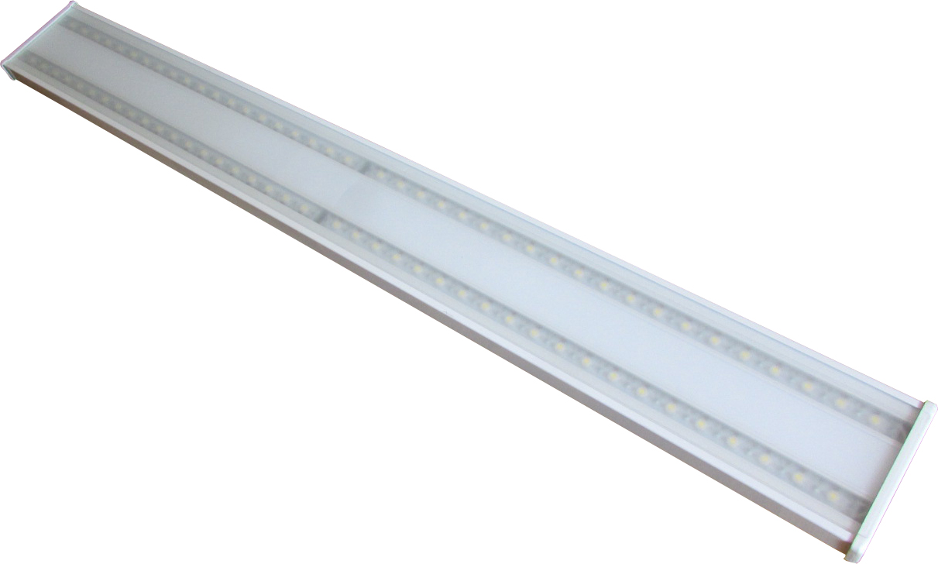
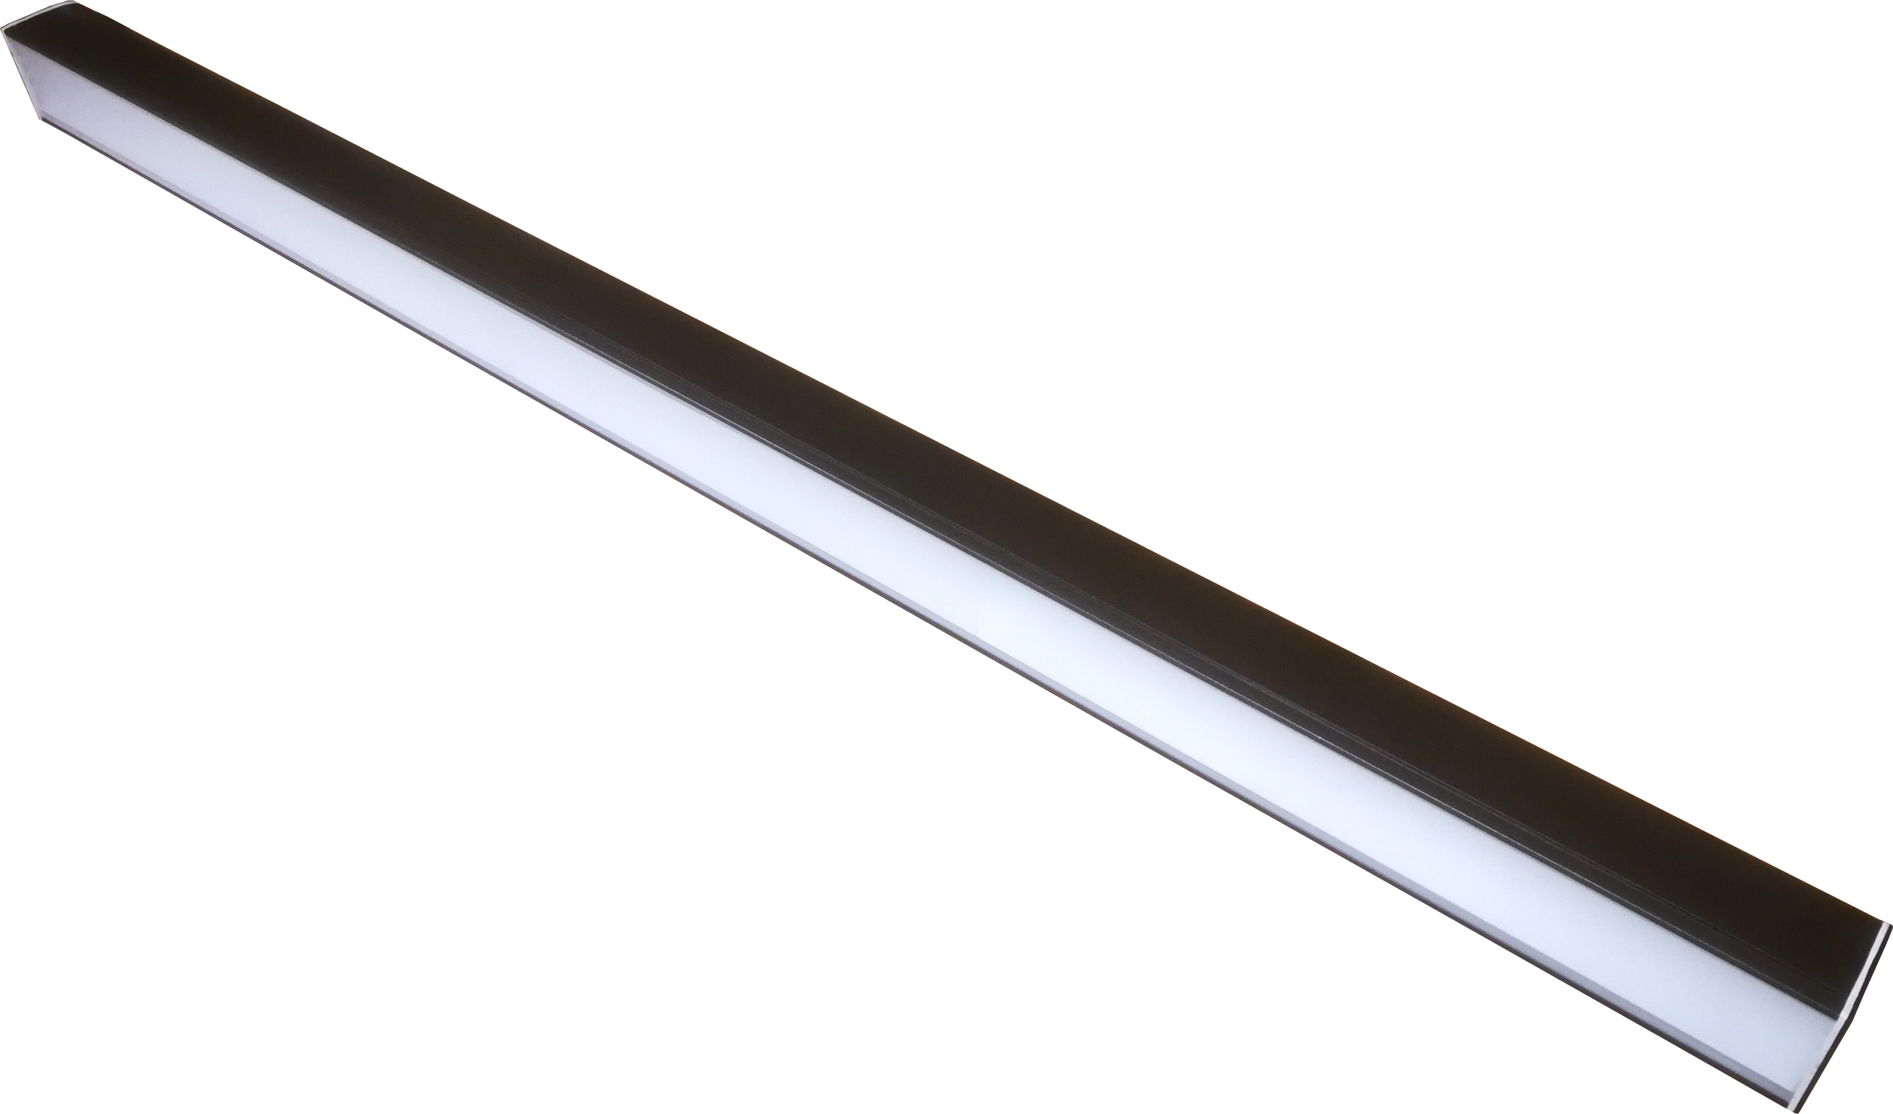
OUR STANDARD LED LIGHT MODELS
FOCUS/GAMMA REFLECTOR
CRACK TEST UV-365nm
STR ULTRA/GAMMA
FLAT LINE/GAMMA
STADION REFLECTOR/GAMMA
LINEAR/GAMMA

Slide 8
CAN LED LIGHT WORK INSIDE RADIATION AREA
First we signed agreement with Jozef Stefan Insitute, who owned 250 KW TRIGA reaserch nuclear reactor.
In this reactor all components can be tested on GAMMA radiation and Neutron flux to very high level.
As we saw potential customers in Nuclear industry we started to test standard LED drivers. Results were very bad. They survive Gamma dose 50 – 200 Gy.
We started tested, inside reactor, all components used in LED light.
.

Slide 9
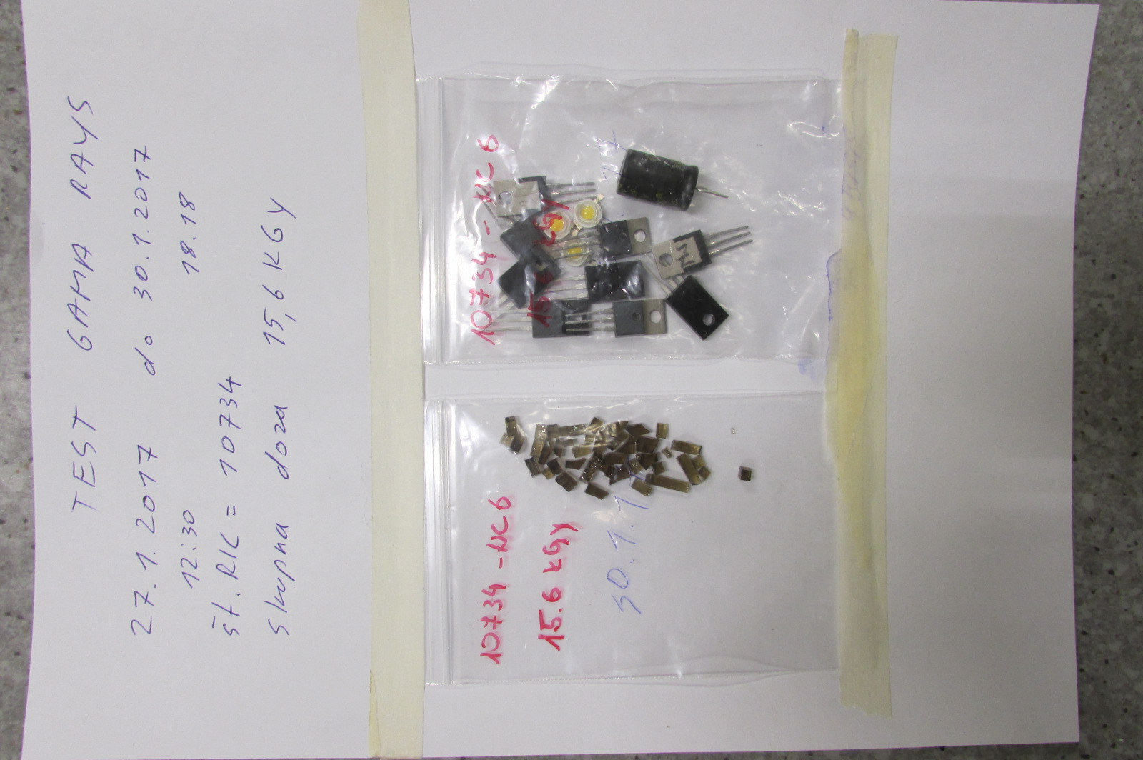
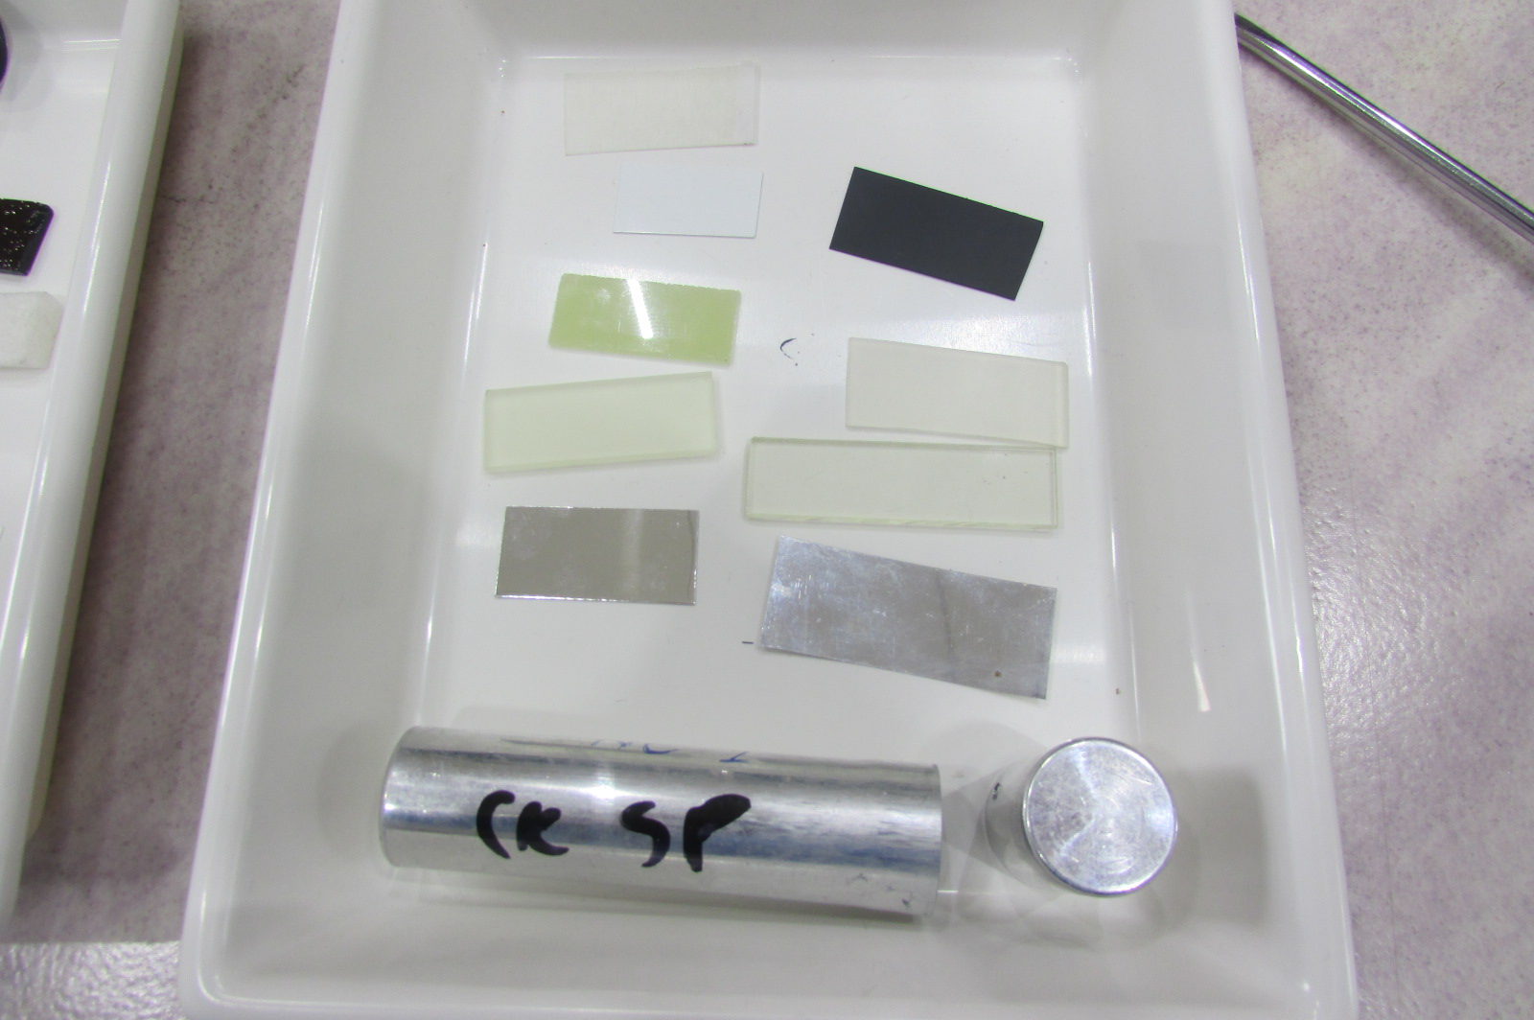
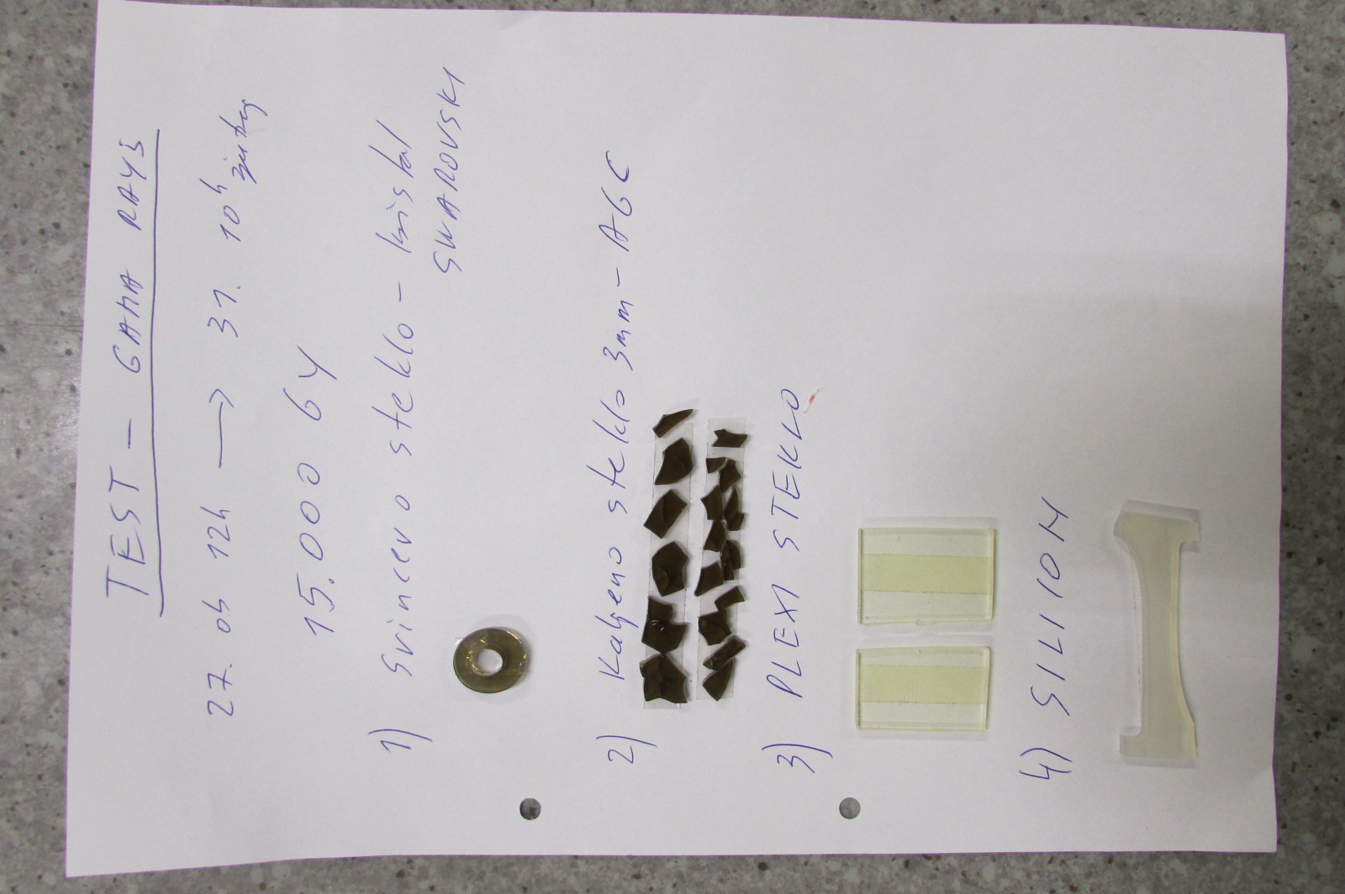
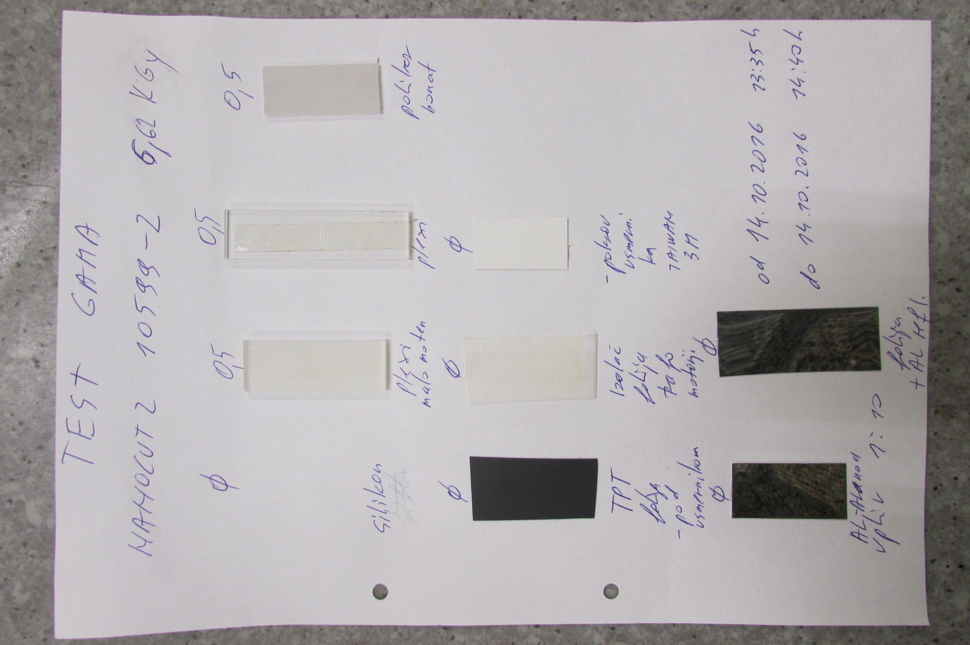
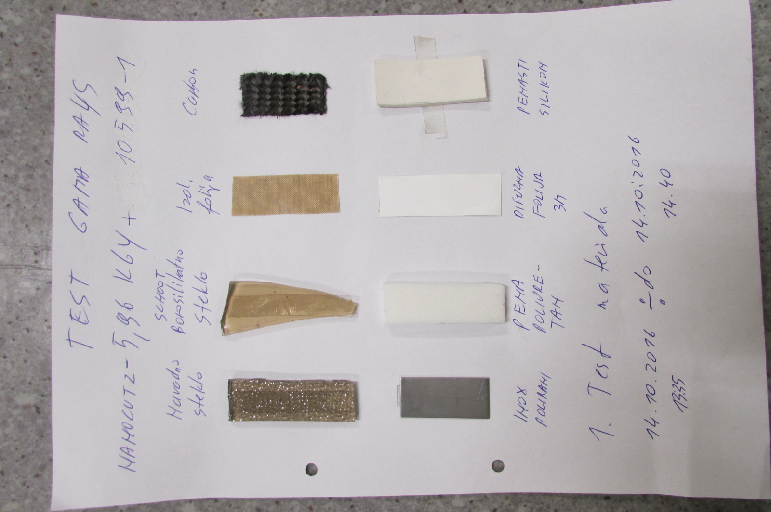
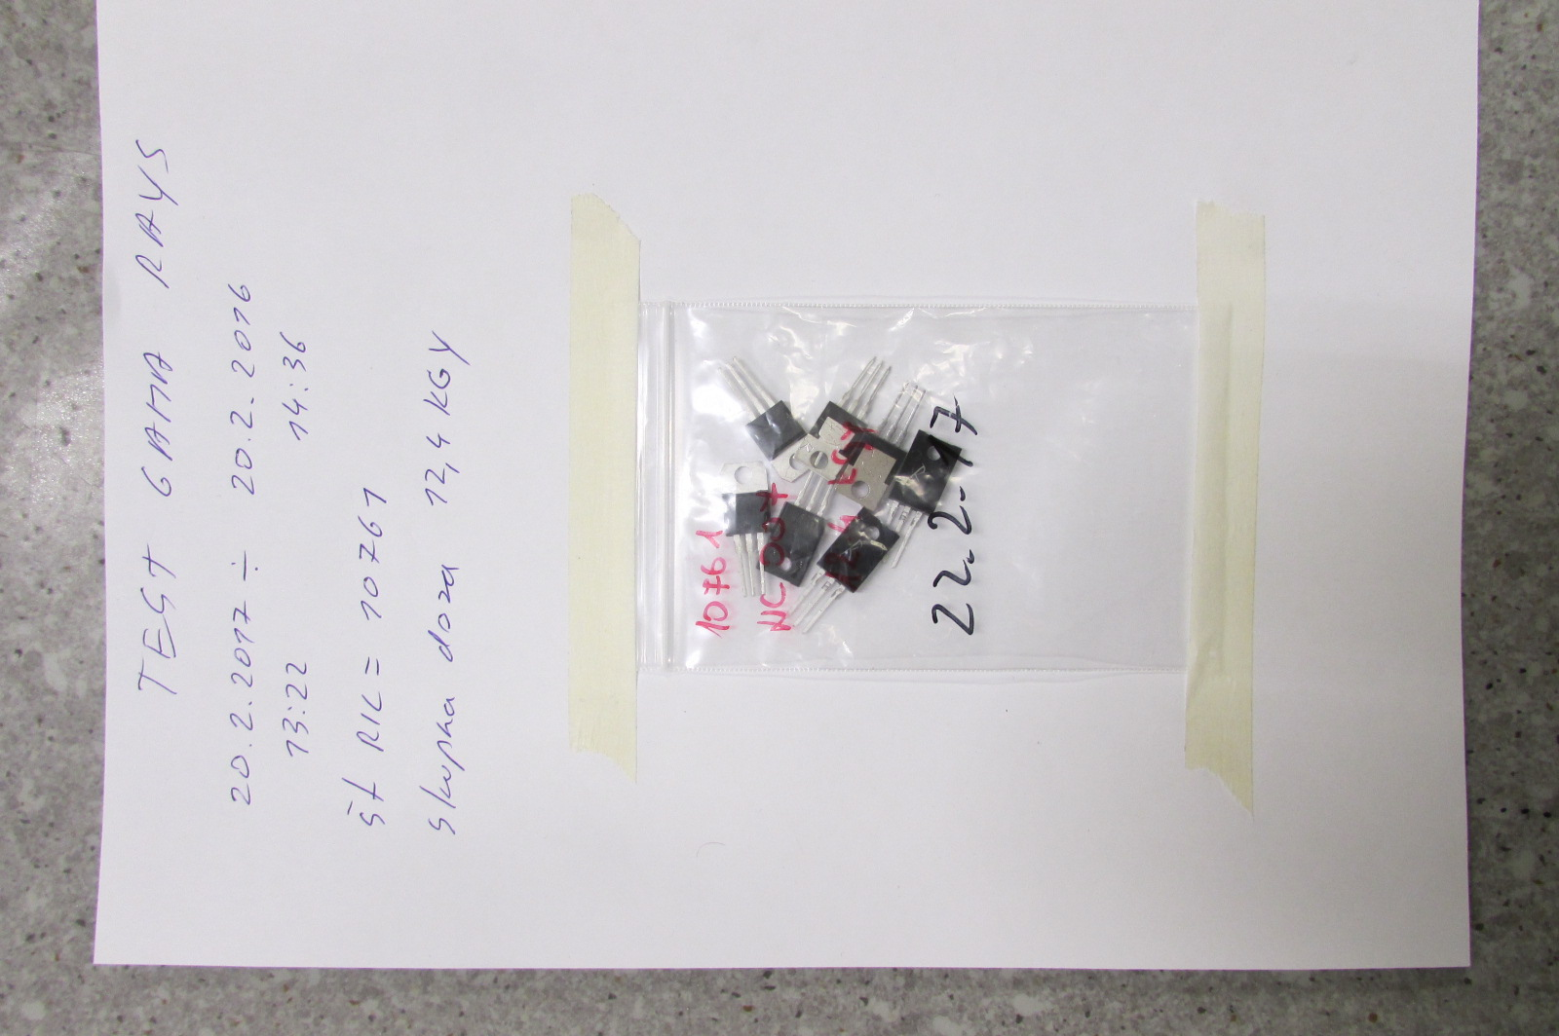
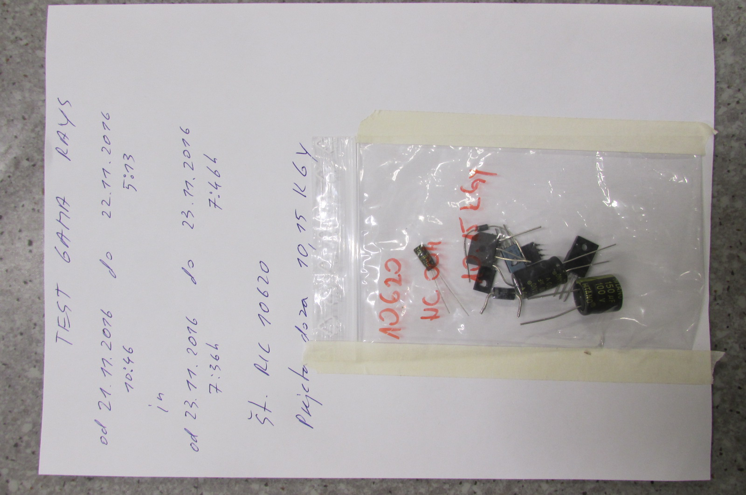
Component Testing inside TRIGA reaserch reactor
.

Slide 10
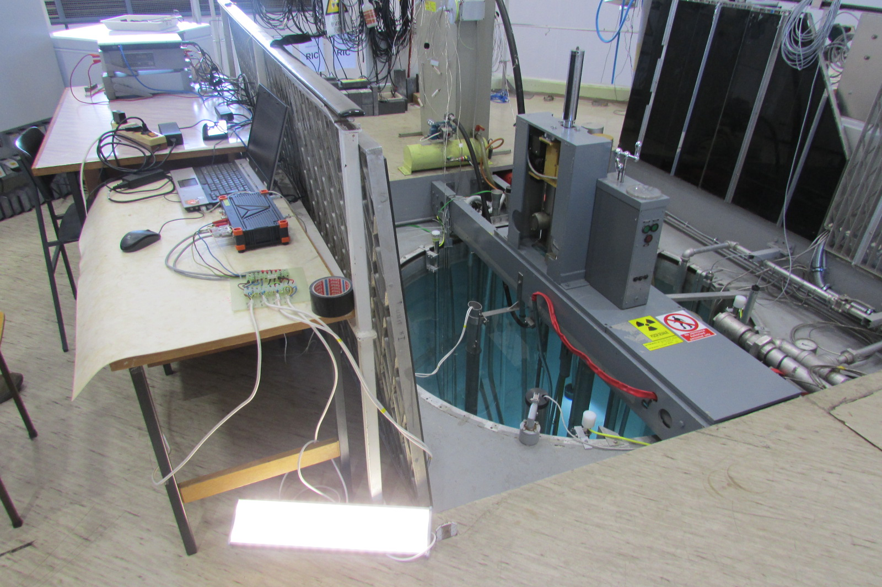
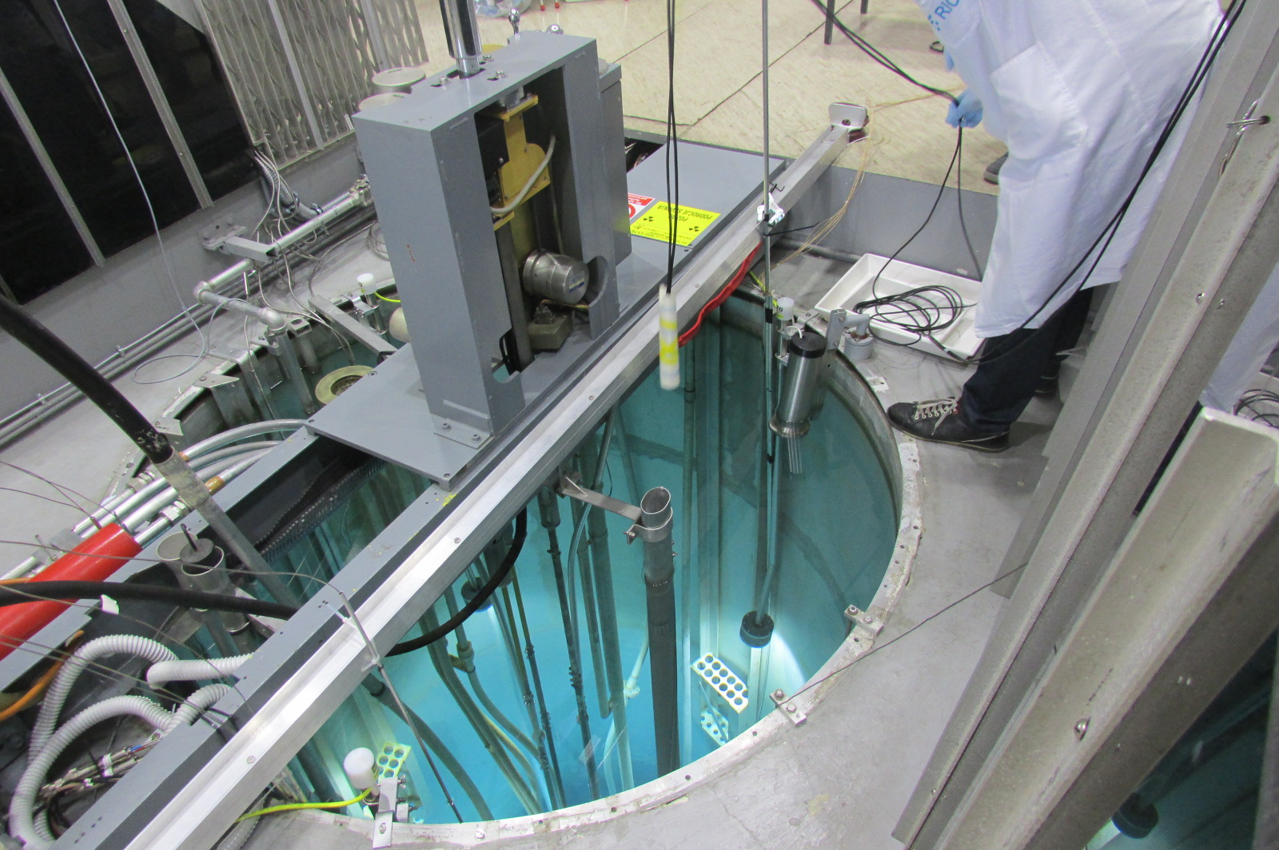
LED driver testing inside TRIGA reaserch reactor
All technical parameters for LED driver, was controling all the running time with
DEWESOFT measurement instruments.
LED driver was lowered inside triangle tube, down to the middle of radioactive core.

Slide 11
RESULTS AFTER ONE YEAR TESTING
After all components testing, we saw that mechanical components have no big change
on GAMMA dose up to 100 Kgy. The main problems are LED driver components and GLASS.
We need almost two years to develope final circuits with right components for LED driver
(PFC stage, constant current generator and other neccessary protection function).
We tested LED driver up to 17 KGy. In year 2020 our testing will go further up to 100 KGy and more.
It is very interesting that final LED driver works in very wide voltage range.
Starting from AC 20 V (DC 24V) up to AC 360 V (DC 510V).
PFC correction go up to 0.9, and efficiency up to 90%. Output power up to 60 W.

Slide 12
POTENTIAL FOR GAMMA HARDENED LED DRIVER
As we design GAMMA hardened LED driver in same dimension as our standard LED driver,
we can use it in all our existing LED lights.
In past two years we already sold around 300 different GAMMA resistant LED lights ,which
can be installed in:
Nuclear power plants, (containment building and other high radiation area),
SFDS (spend fuel dry storage area),
LLILRW ( low and intermediate level radioactive waste building),
WMB (waste management building),
FUSION reactors, Neutron and Proton accelerator,
Industrial radiography detection area, pharmaceutical industry , medical facilities,
Nuclear testing facilities.
.

Slide 13
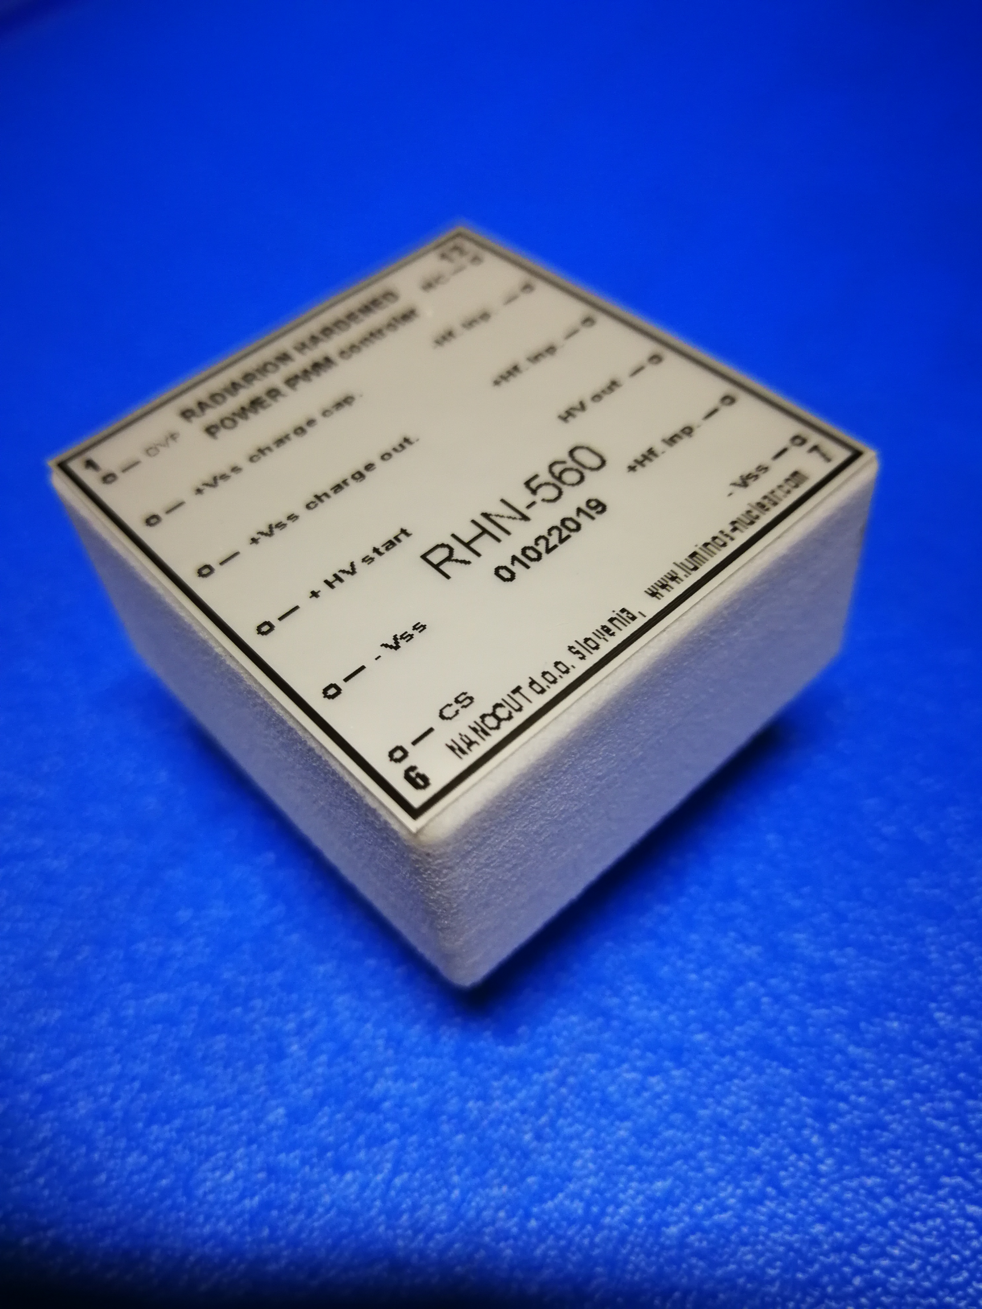
OTHER GAMMA and NEUUTRON FLUX RESISTANT ELECTRONIC COMPONENTS
We are working on finalizing operational amplifier which can work in
radiation area with GAMMA dose speed up to 100 Gy and GAMMA dose
up to 100 KGy.
We expected that we can sell product up to the end of year 2020.
Thank you !
NANOCUT d.o.o.
director: Tadej Hrovatic Internet: www.luminos-nuclear.com
R&D: Igor Hrovatič e-mail: info@luminos-nuclear.com
RADIATION HERDENED
POWER PWM CONTROLER

