Slide 1

ISKRATEL
Gabrijel Katava

Slide 2

Comprehensive digital solutions
for a safe and smart future
Over 70 years of experience
30 locations worldwide
900 employees
Global footprint in 50+ countries
100 million satisfied users
EU-based R&D and manufacturing
The leading European ICT provider for the digital transformation of the telecommunications, transport, public safety, energy industries and EMS (Electronics Manufacturing Services).

Slide 3
Global Footprint in 50+ Countries
Slovenia | Iskratel RC IKT
Russia | Iskrauraltel Yekaterinburg IUT Moscow IUT St Petersburg IUT Krasnodar IUT Novosibirsk Iskratel Moscow
North Macedonia | ITS Skopje ITS Software Centre
Azerbaijan | Iskratel Baku
Bosnia and Herzegovina | Iskratel Sarajevo
Kazakhstan | Iskracom Iskratel Almaty
Moldova | Iskratel Kishinev
Serbia | Iskratel Prointer
Taiwan | Iskratel Taiwan
Turkey | Iskratel Turkey
Ukraine | Iskratel Kiev
Uzbekistan | Iskratel Tashkent
Partner/indirect sales
Direct sales
EMS

Slide 4







Strategic Portfolio
Telecom operators
Medical, Renewable energy, Waste mgmt.
Digitalisation and IoT, Safe & smart city
5G voice, Mobile data, MVNO
Virtualisation of CO, SD-PON
Critical, emergency & operational c.
Industrial, Home Appliances, Consumer el.
NG-PON OLT & ONTs, Mesh Wi-Fi
Virtual IMS, Universal comm.
Smart home
Communications
Core
Broadband
Networks
Industry
Verticals
Virtualisation
EMS
Enterprises
Today's
megatrends
Harmonised
ecosystems
Government
Digitalisation
Transport
Utilities, Oil and gas
Safe and smart cities

Slide 5
Performance Figures
Sales by Solutions
Of which 65% equipment and 35% services
39%
33%
Category | 2017 | 2018
Sales revenue | 88.6 m€ | 104.0 m€
R&D investments | 13.6 m€ | 13.4 m€
Net profit | 3.3 m€ | 4.0 m€
Industry
verticals
Broadband
networks
11%
17%
EMS
Communications
core

Slide 6
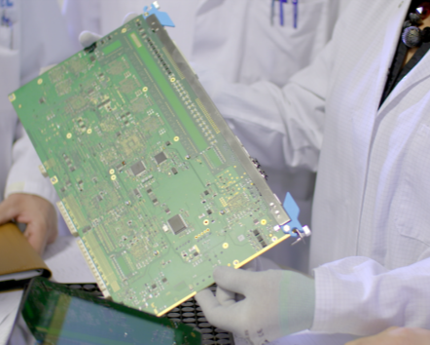
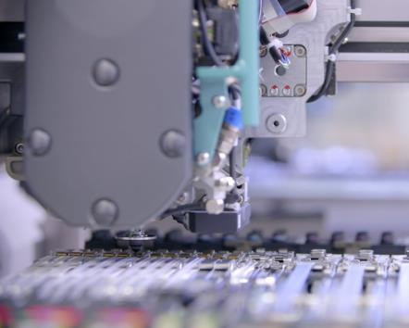


Iskratel Electronics Manufacturing Services
Excellence in meeting your expectations.
Engineering
Manufacturing
Logistics
After-sales support
Enhancing your design for optimal manufacturing with DFC, DFM and DFT.
Electronic assembly including SMT, THT, coating, testing and programming.
We deliver the product to location of your choice or handle part of your global supply chain.
Helping you deal with warranty and other customer-related issues that need quick, precise and cost-effective solutions.

Slide 7
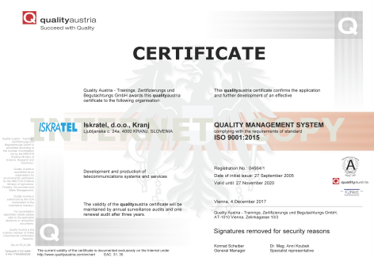
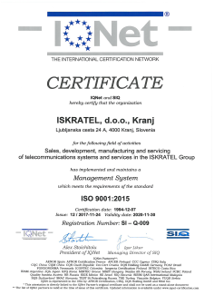
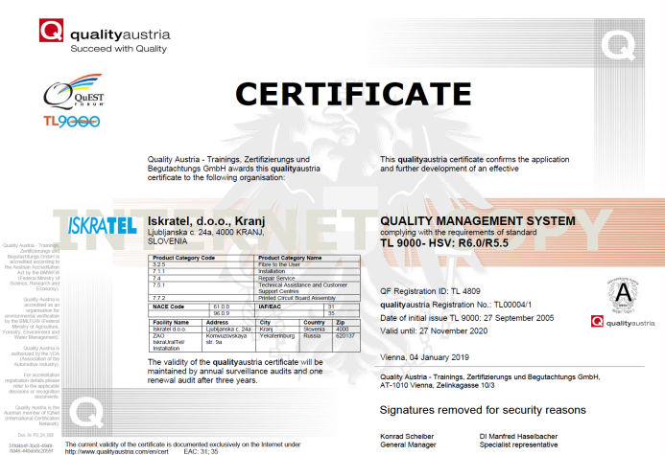
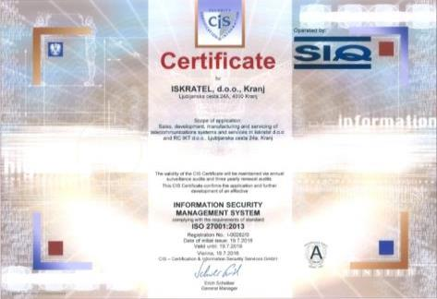
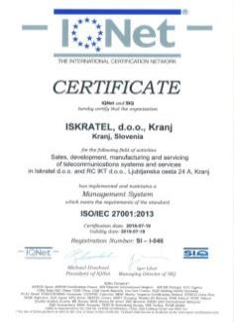
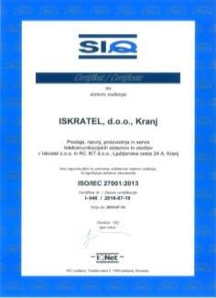
Quality Assurance
Our operations and equipment are fully compliant with the industry's most renowned standards.
Certificates
ISO 9001 (from 1994)
TL9000 (2005)
ISO 14001 (2013)
ISO 27001 (2016)
Cooperation with certification bodies
SIQ – Slovenia
Quality – Austria
Quest Forum
Interekoms – Russia
CE compliance
LVL, EMC, RTTE, ROHS2 and WEEE directives
In accordance with
ETSI, ITU, ANSI, ACME, IEC

Slide 8
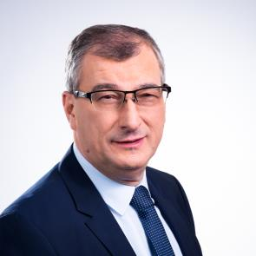
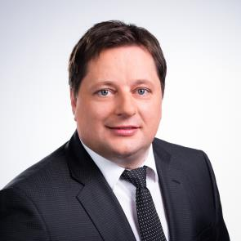
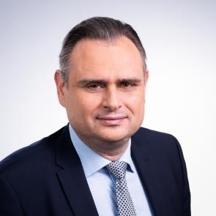
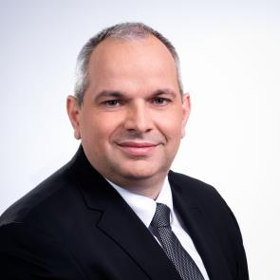
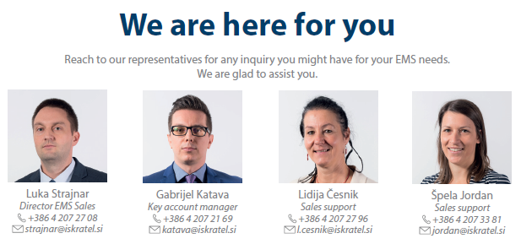
Company Management
Encouraged by tradition of success and innovative solutions we are your link to the digital future.
Željko Puljić
CEO
Robert Kuzmič
CSO
Andrej Svetina
CFO
Sašo Šimec
COO and Director of
Business Unit EMS

Slide 9
